Slide 1
CAPE HATTERAS ECOLOGICAL CONSERVATION
Delineating Shoreline and Mapping Change Along the Cape Hatteras National Seashore for Coastline Management and Transportation Corridor Adaptation Strategies
Ella Haugen
Alyson Bergamini
Julian Alcantara
Virginia – Langley| Spring 2024
Notes:
The Cape Hatteras Ecological Conservation DEVELOP team consists of our project lead, Ella Haugen, as well as Alyson Bergamini and Julian "Al" Alcantara. This project focused on delineating shoreline and mapping change along the Cape Hatteras National Seashore for coastline management and transportation corridor adaptation strategies.

Slide 2
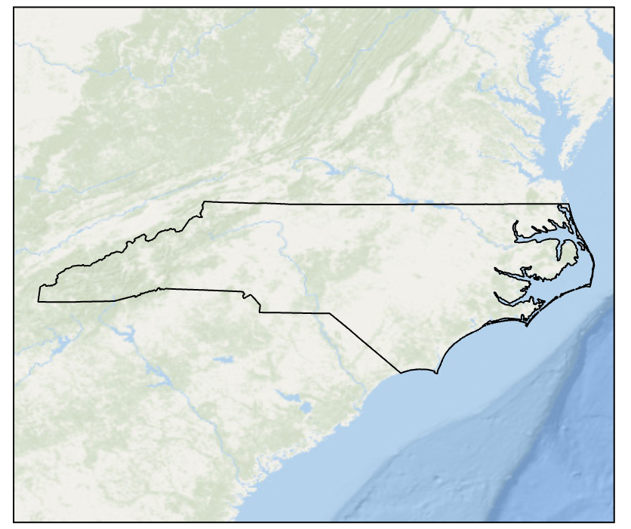
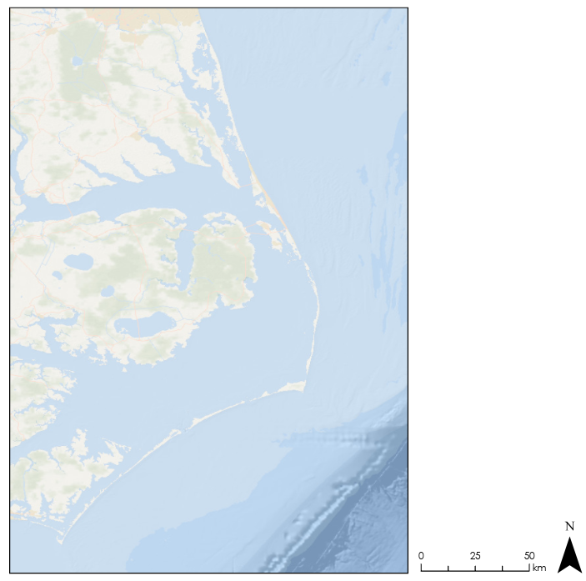
STUDY AREA
Cape Hatteras National Seashore
North Carolina
Rodanthe
Avon
South Beach
Buxton
Basemap credits: ESRI, GEBCO, Garmin, NaturalVue
Ocracoke
Study Area
Area of Interest
N
0
25
50
km
Rodanthe
Rodanthe
Notes:
The project study area is the Cape Hatteras National Seashore, located in North Carolina. Cape Hatteras National Seashore accounts for roughly 110 kilometers of the 200-kilometer stretch of barrier islands that make up the Outer Banks and is separated from the North Carolina mainland by the Pamlico Sound. Established in 1937, Cape Hatteras receives over 2 million visitors annually. The seashore is a combination of natural and cultural resources and provides a wide variety of recreational opportunities. Visitors and residents alike rely heavily on NC 12 which stretches along this section of barrier islands.
--------------------Image Information Below--------------------
Map credit: Ella Haugen
Base map credits: ESRI, GEBCO, Garmin, NaturalVue

Slide 3
PROJECT PARTNERS
Cape Hatteras National Seashore
Oversee the preservation of the seashore's resources
Monitor coastal hazards such as erosion, inundation, and sea level rise
Provide educational information services for visitors
Image Credit: NPS
Notes:
The Cape Hatteras National Seashore is managed by the National Park Service. The NPS oversees the preservation of the seashore's resources, monitors coastal hazards such as erosion, inundation, and sea level rise, and provides educational information services for visitors. The NPS also supports transportation infrastructure management recommendations and communication with the Department of Transportation.
--------------------Image Information Below--------------------
Image Credit: The National Park Service
Image Source: https://www.nps.gov/index.htm

Slide 4
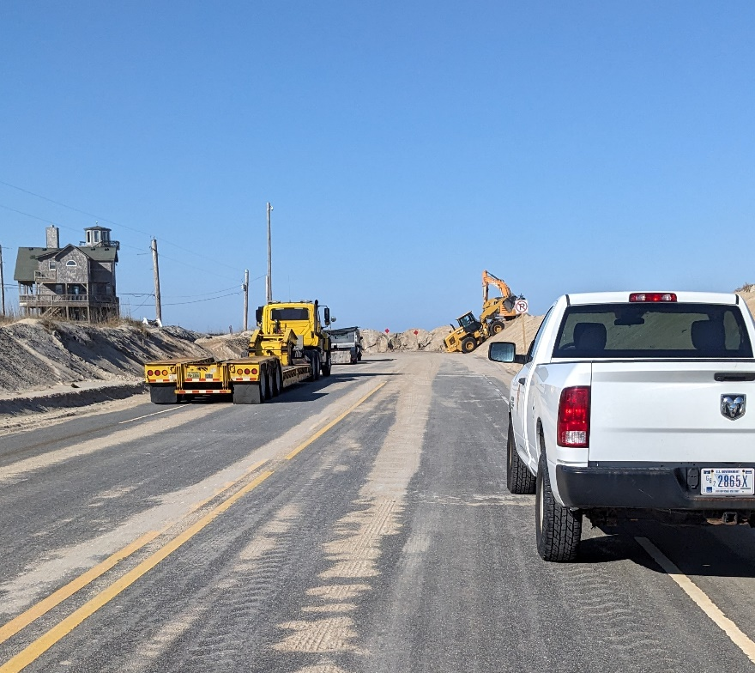
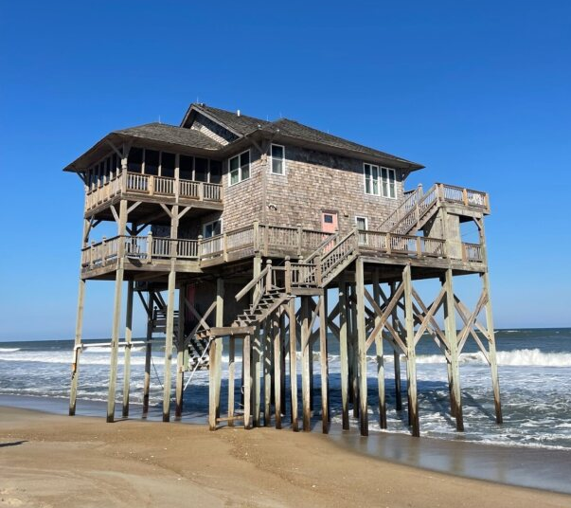
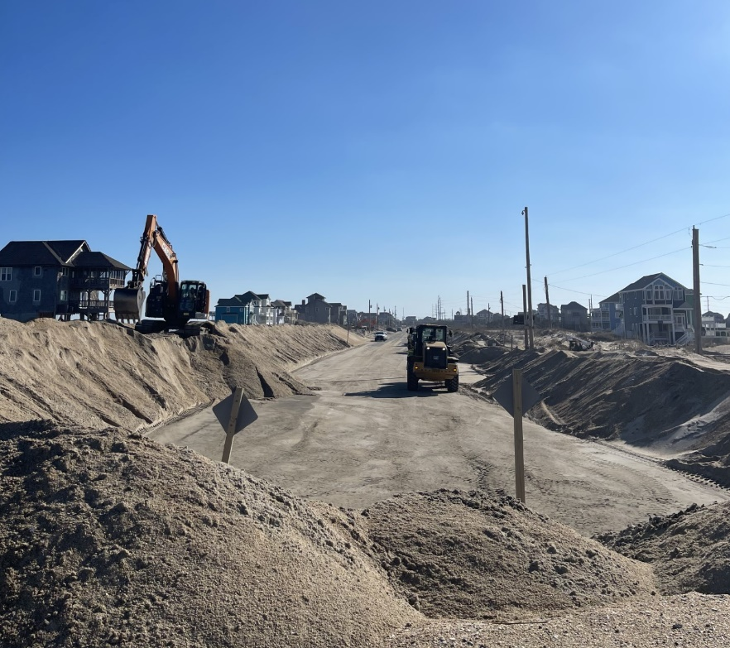
COMMUNITY CONCERNS
Frequent storms that erode the susceptible oceanfront
Damage to transportation infrastructure due to flooding and shoreline loss
Image Credits: Ella Haugen, Alyson Bergamini
Notes:
Shoreline loss and flooding due to frequent storms has created a constant state of recovery. Methods to minimize damage to existing transportation infrastructure and to construct new infrastructure are constantly being implemented and reevaluated. However, road closures due to over wash are common, which poses a threat to residents and visitors alike. This is a particular issue along NC12, which connects the barrier islands and runs through areas that are extremely vulnerable to erosion.
--------------------Image Information Below--------------------
Left Image
Image Credit: Alyson Bergamini
Image Source: DEVELOP Team
Center Image
Image Credit: Ella Haugen
Image Source: DEVELOP Team
Right Image
Image Credit: Ella Haugen
Image Source: DEVELOP Team

Slide 5
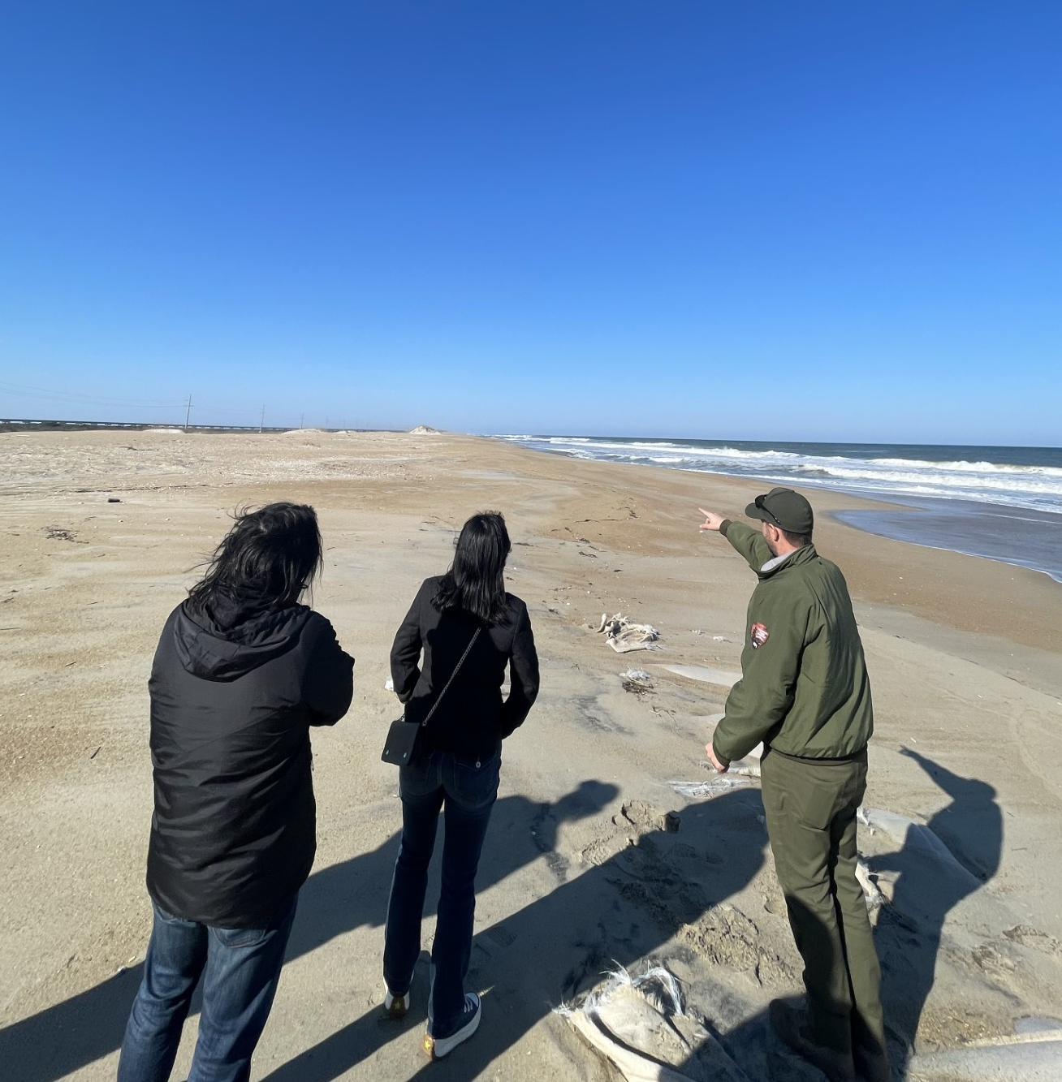
PROJECT OBJECTIVES
DEVELOP an efficient method for analyzing shoreline changes
IDENTIFY the regions and infrastructure vulnerable to coastal erosion
AID the National Park Service shoreline conservation efforts through the creation of shoreline change and infrastructure maps.
Image Credits: Ella Haugen, Alyson Bergamini
Notes:
The objectives of this project included: developing an efficient method for analyzing shoreline changes, identifying the regions and infrastructure vulnerable to coastal erosion, aiding the NPS shoreline conservation efforts through the creation of risk maps. The project identified critical areas of concern based on the 10-year study period of 2014 to 2024.

Slide 6
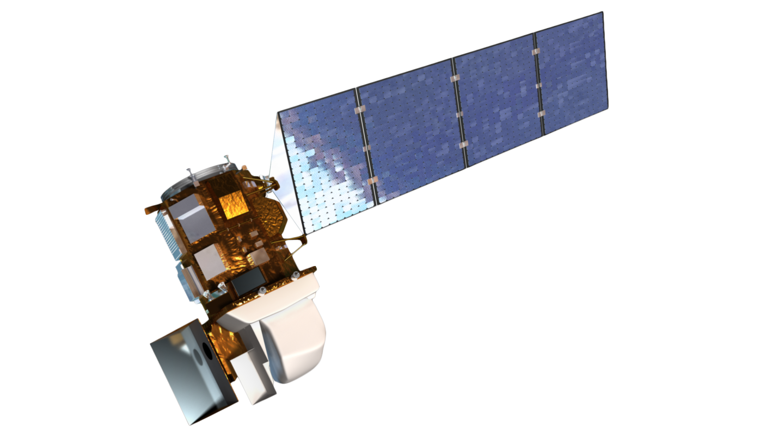
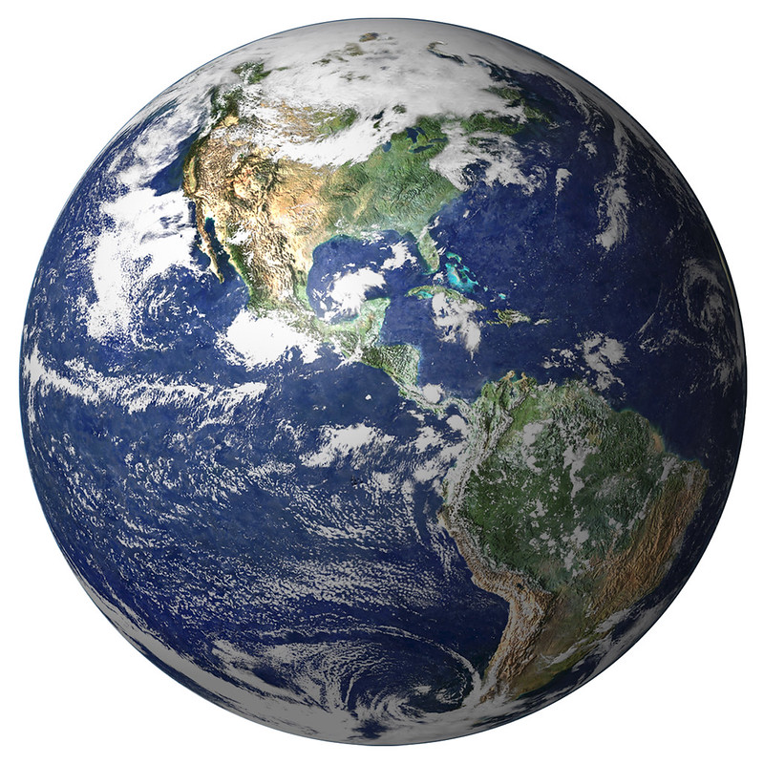
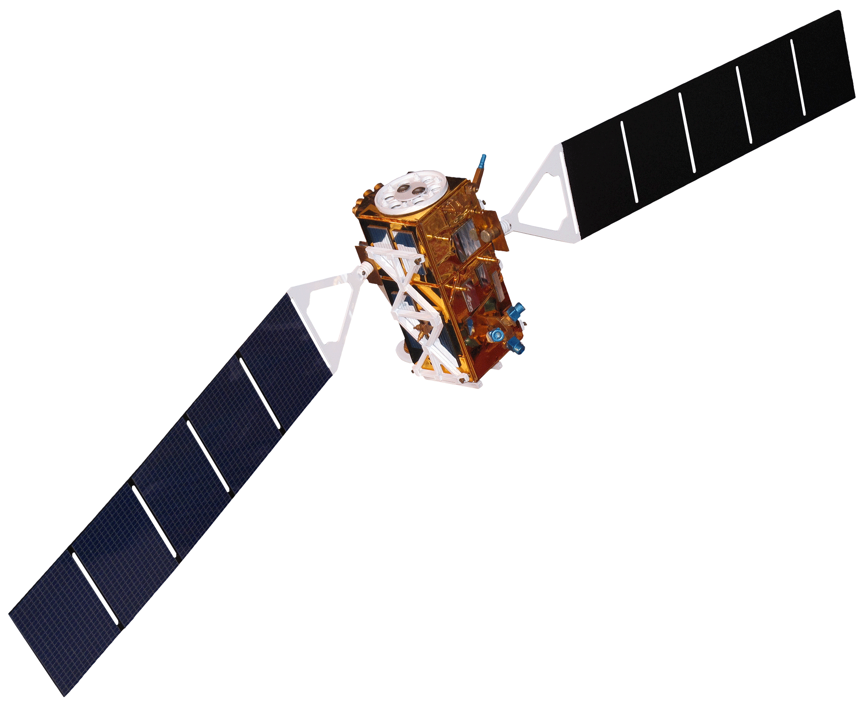
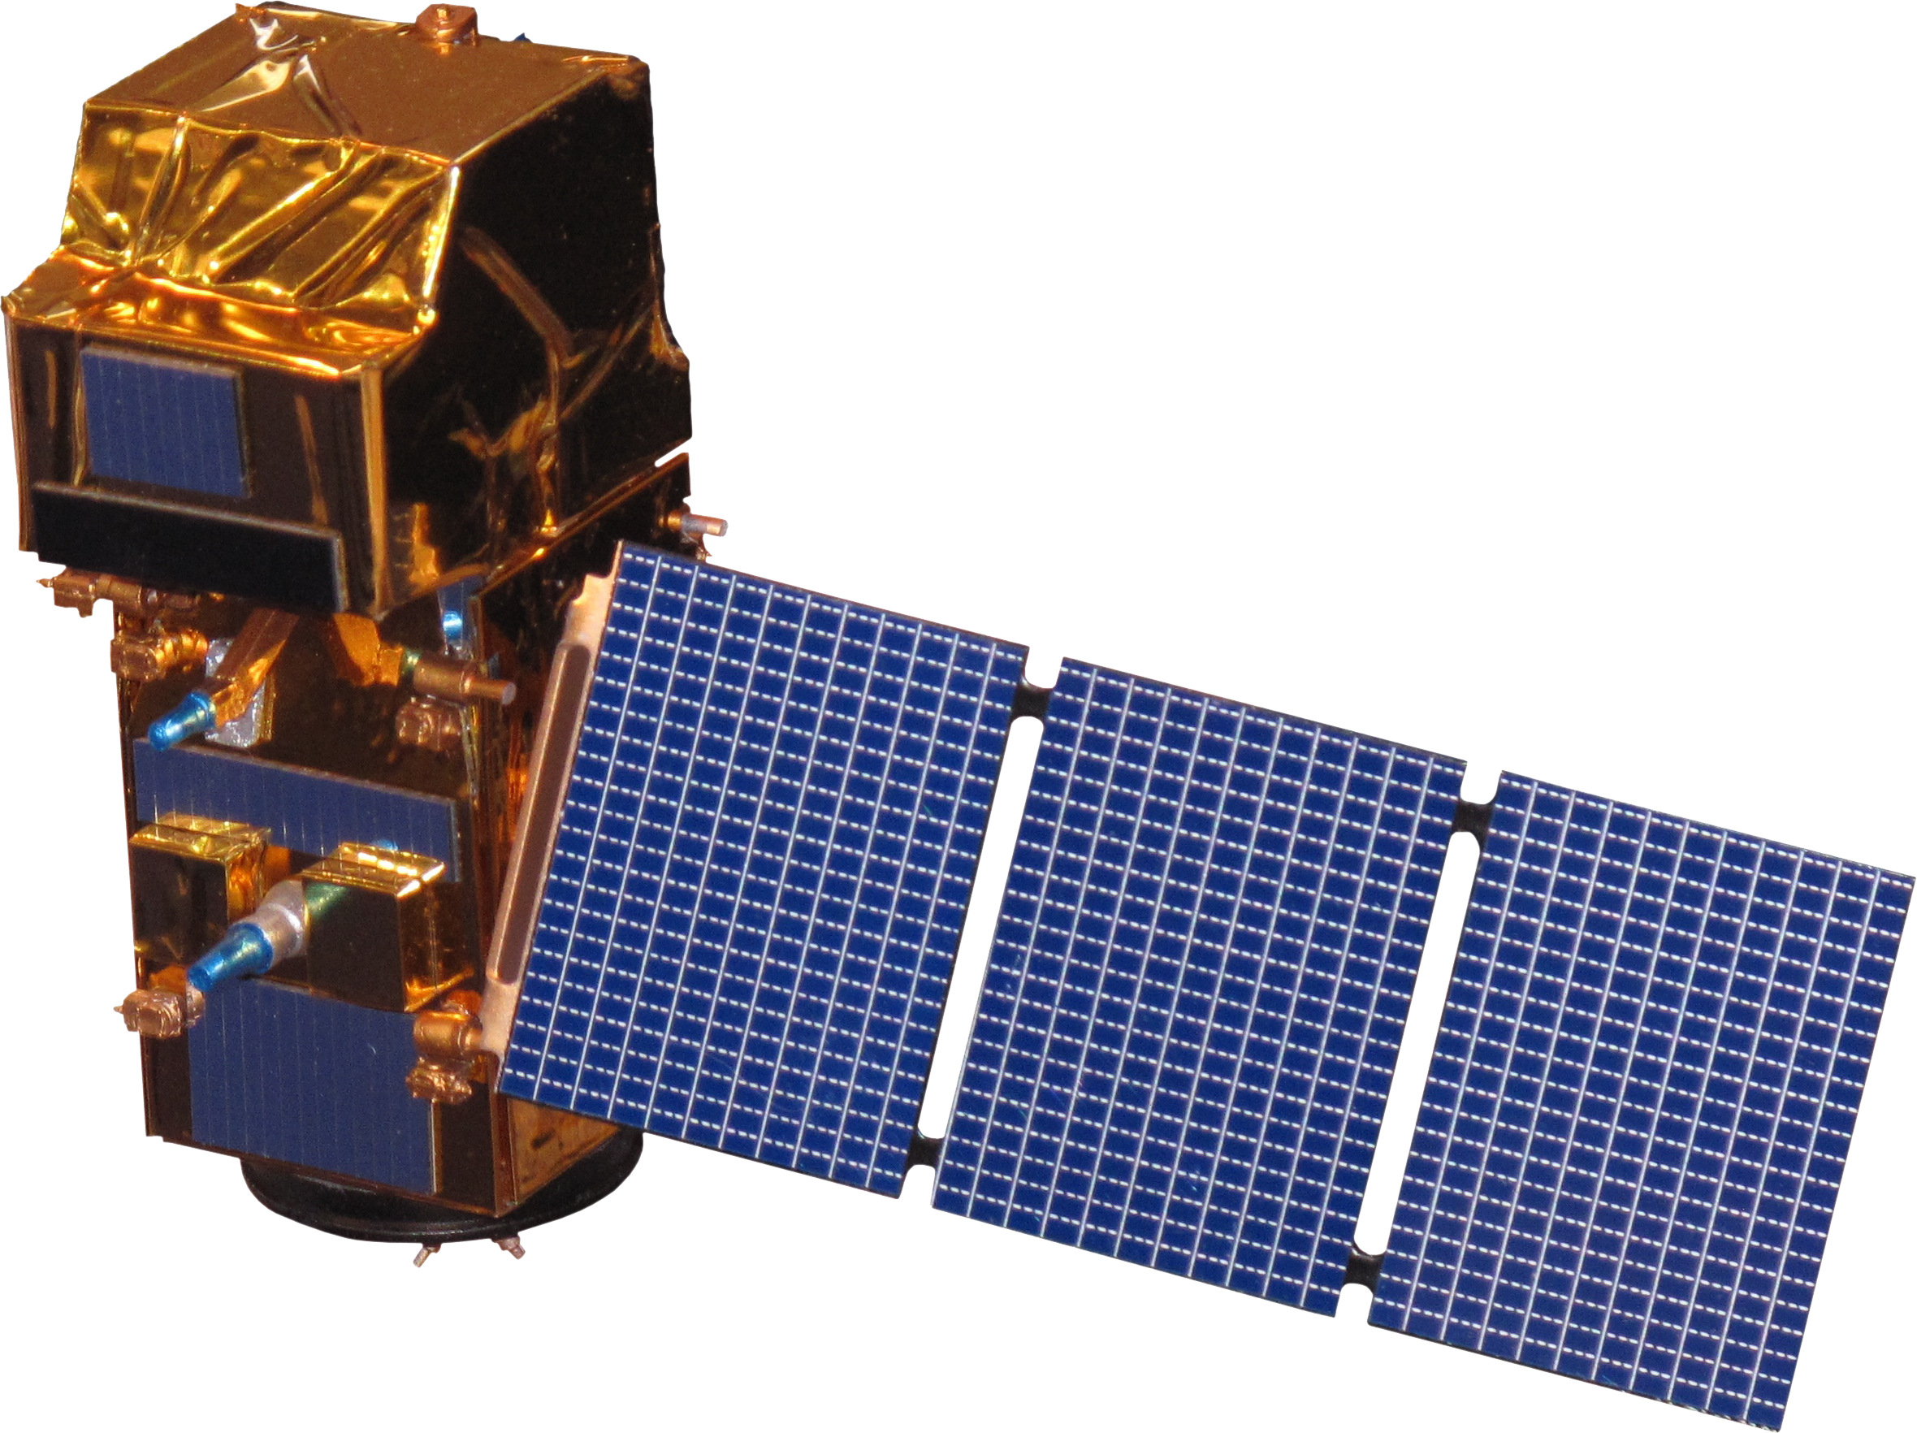
NASA EARTH OBSERVATIONS
Landsat 8 OLI
Landsat 9 OLI-2
Sentinel-2 MSI
Sentinel-1 C-SAR
Study Period: April 2014 – February 2024
Image Credit: NASA, Rama, DonkeyHotey
Notes:
To complete the project objectives, our team analyzed raster images from four satellites: Landsat 8 OLI, Landsat 9 OLI-2, Sentinel 1 C-SAR, and Sentinel 2 MSI. Most of our data came from the Landsat 8 and Sentinel 2 datasets, and our findings were supplemented with data from the other two satellites. We focused primarily on optical data but did some preliminary research validating our findings using synthetic aperture radar data.
--------------------Image Information Below--------------------
Image citations
NASA Earth Image:
Image Credit: DonkeyHotey
Image Source: https://www.flickr.com/photos/donkeyhotey/5679642883/in/photostream/ (CC BY 2.0 DEED)
Landsat 8 Image:
Image Credit: NASA
Image Source: https://science.nasa.gov/multimedia-galleries/spacecraft-icons/
Image Credit: NASA
Image Source: https://science.nasa.gov/multimedia-galleries/spacecraft-icons/
Sentinel-1 and Sentinel-2
Image Credit: Rama
Image Source Sentinel-1: File:Sentinel 1-IMG 5874-white.jpg - Wikimedia Commons (CC BY-SA 2.0 FR)
Image Source Sentinel-2: https://commons.wikimedia.org/wiki/File:Sentinel_2-IMG_5873-white_(crop).jpg CC BY-SA 2.0 FR

Slide 7
METHODOLOGY
Data Acquisition
Landsat 8 OLI
2014–2024
Landsat 9
OLI-2
2021–2024
Sentinel-1
C-SAR
2014–2024
Sentinel-2 MSI
2015–2024
Data Processing
Processed imagery with Google Earth Engine using JavaScript
Computed NDWI and MNDWI, set water threshold equal to zero
Annual and seasonal coastline
averages for the 10-year period
Data
Analysis
Shoreline Delineation Maps,
Hurricane Dorian Case Study,
Study Area Time Series Maps
Notes:
We used Google Earth Engine to acquire and process the data from the four aforementioned satellites. In order to calculate NDWI and MNDWI we set our threshold to zero, and then we used those calculations to distinguish areas that were land and not land (water) for every image as a binary. One represents water and 0 represents land. Then we created a composite map of each of those binary maps that represented the mean shoreline for the given time period. We did this to assess 10-year shoreline change over the entire study period, and also seasonal shoreline oscillation (winter vs summer) for each year. We then used ArcGIS Pro to analyze these composite maps.

Slide 8
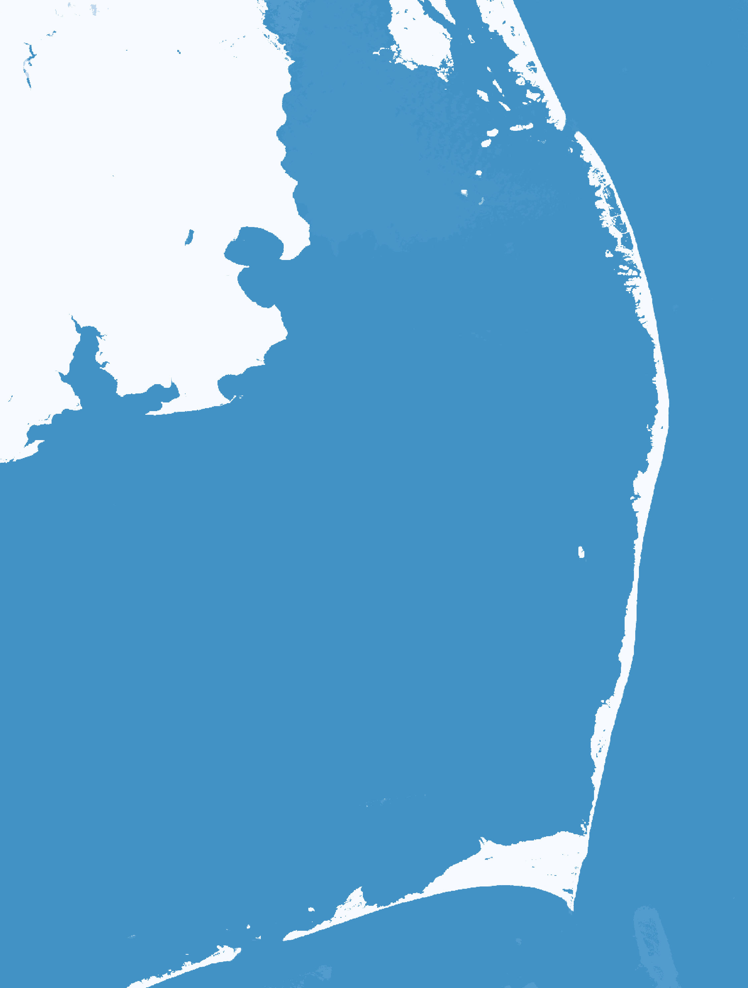
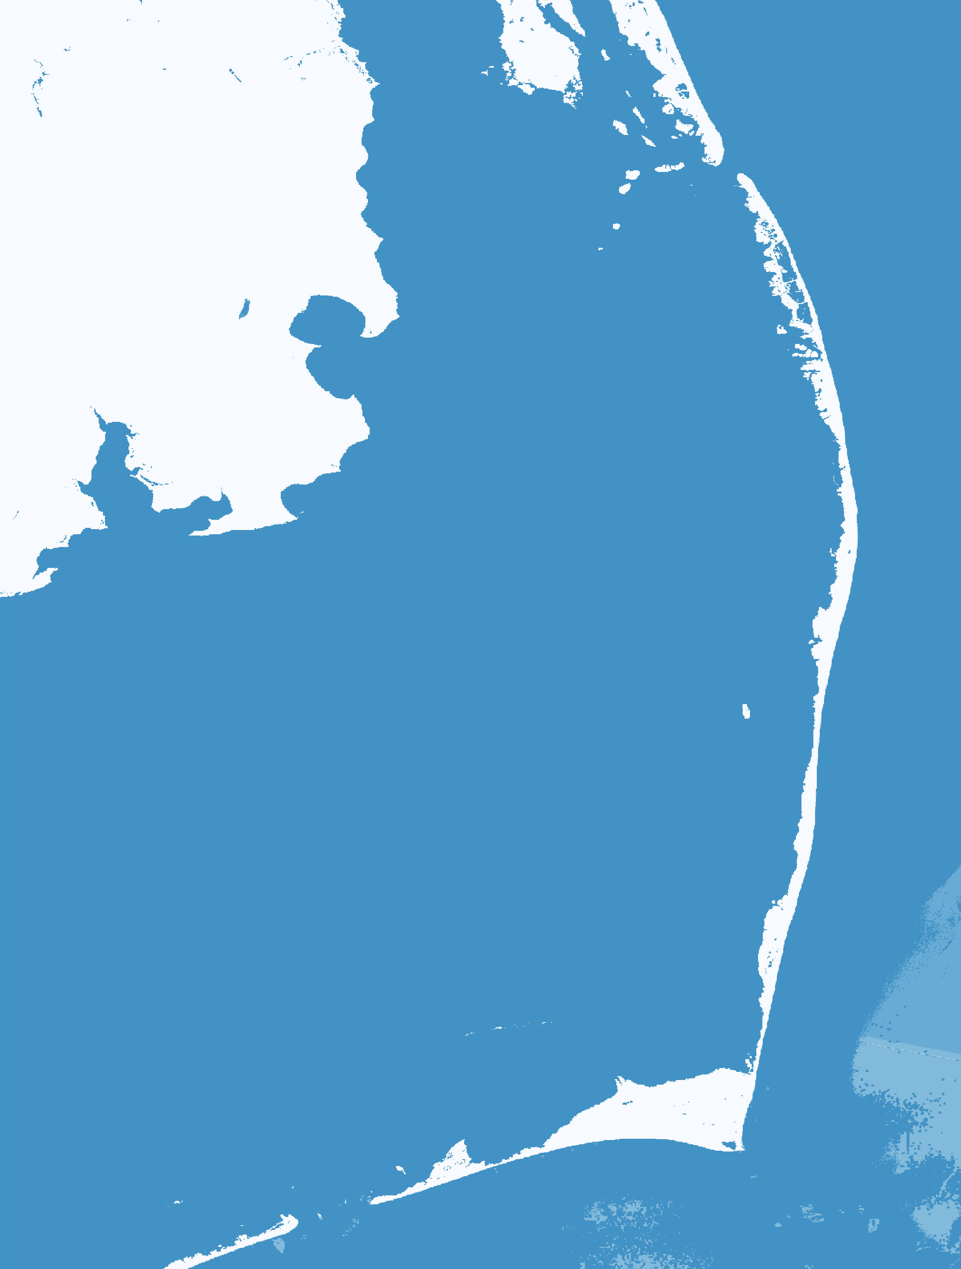
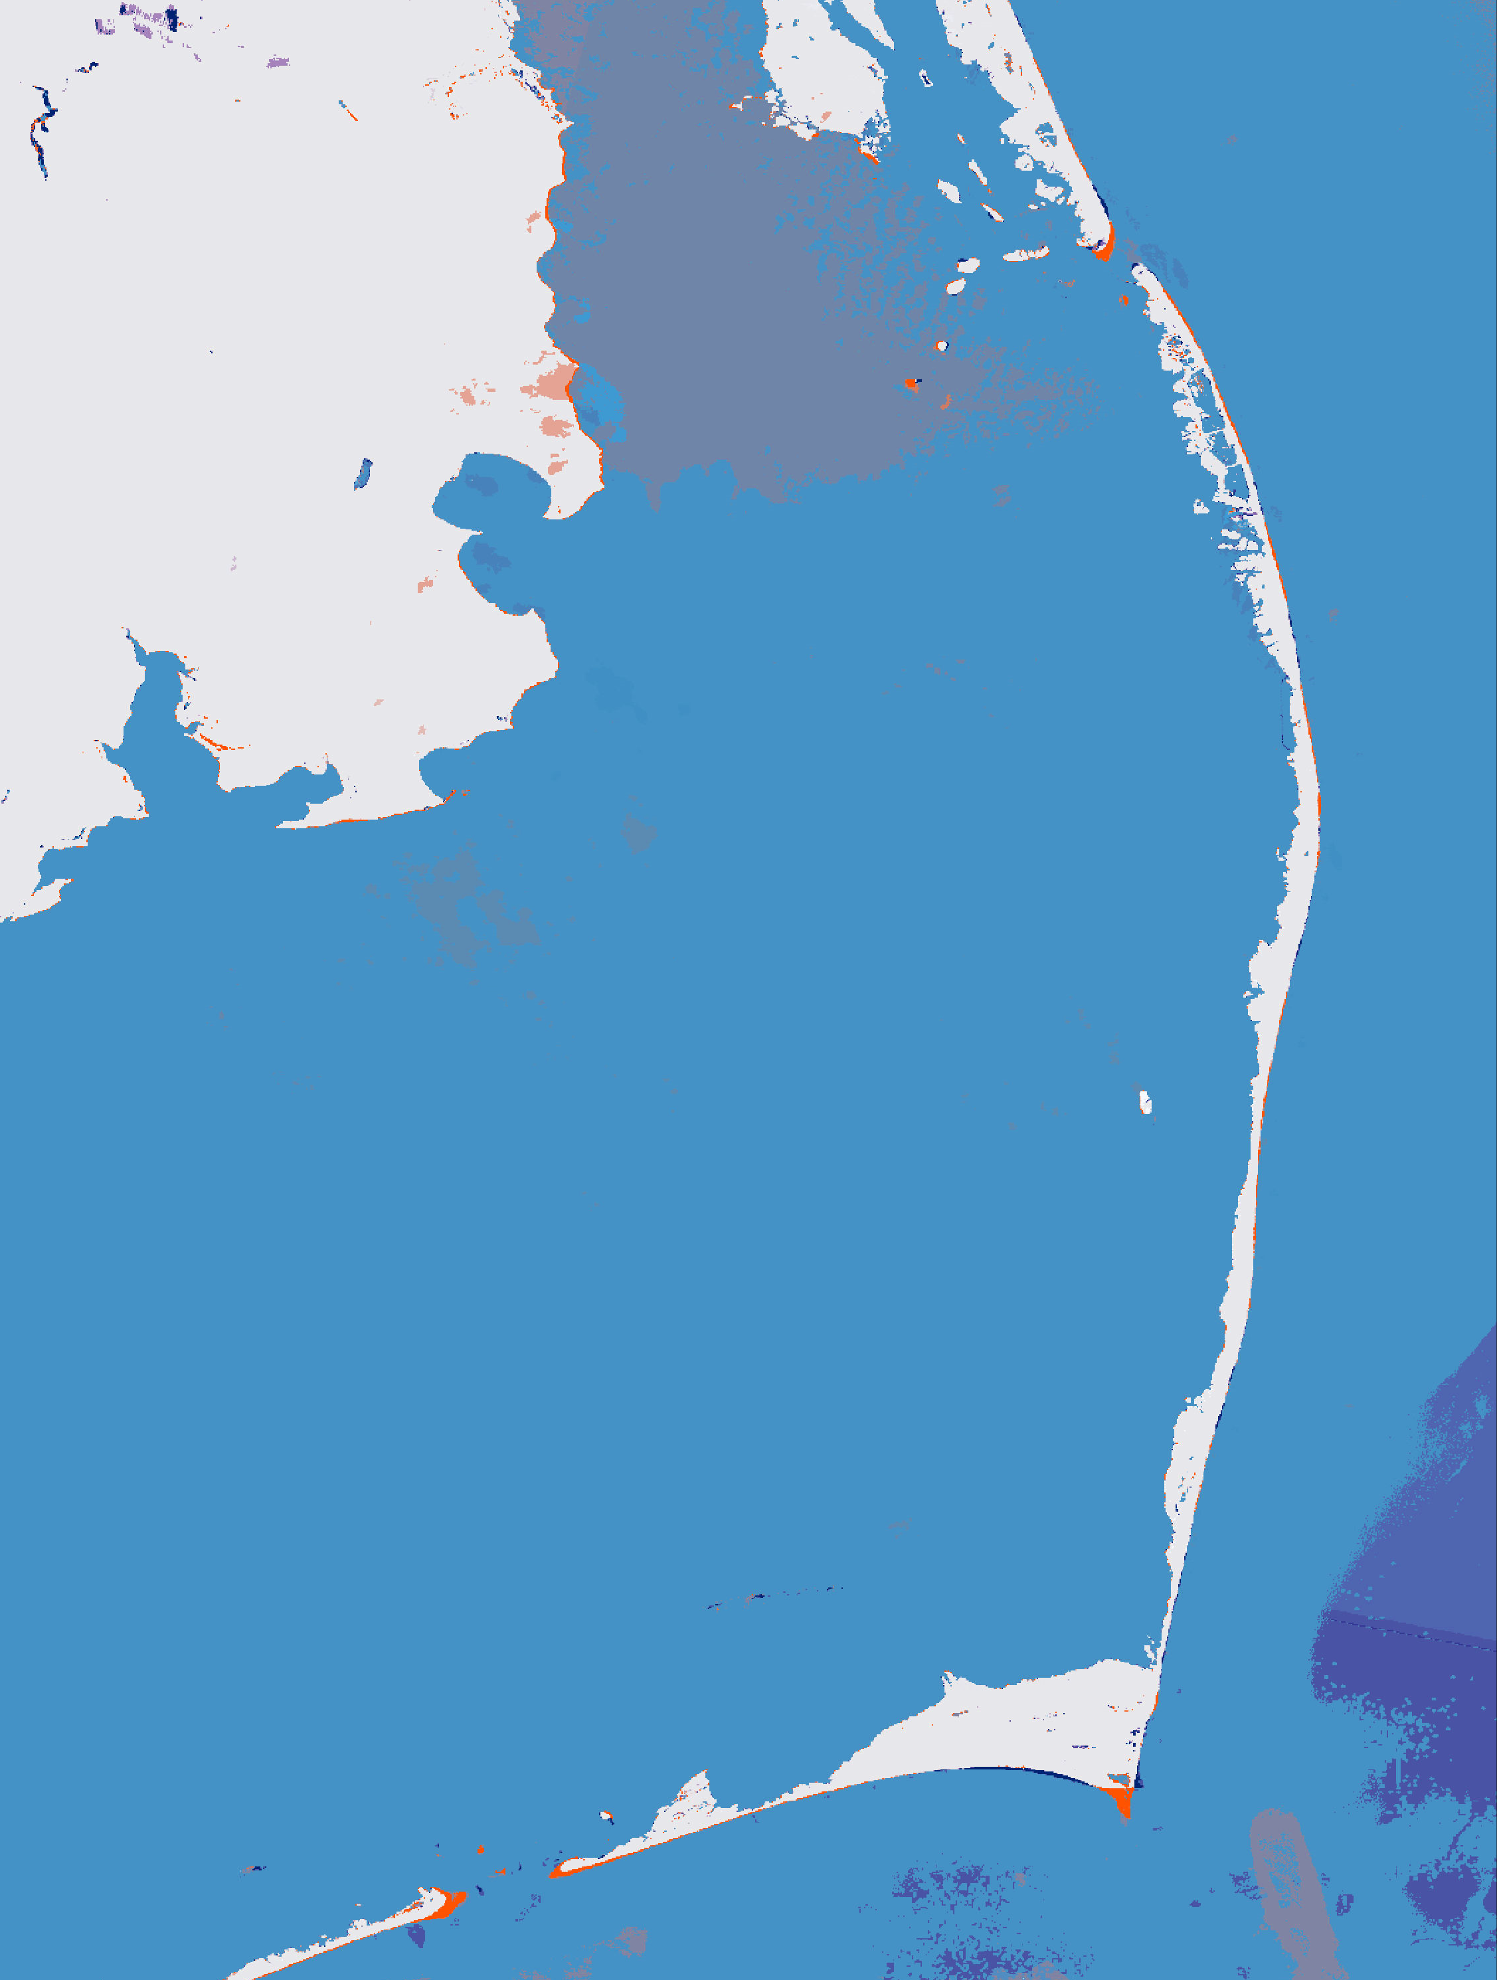
RESULTS – 10-YEAR SHORELINE CHANGE
N
N
N
0
5
10
20
0
5
10
20
0
5
10
20
Km
Km
Km
1
1
-1
0
0
-1
Base map credit: Google
Coastline Composite Image (Apr 2014 – Apr 2015)
Coastline Composite Image (Feb 2023 – Feb 2024)
10-Year Shoreline Change Image
Notes:
We created composite images for the entire study area, one for the first year of our study period (the map on the left), and one for the last year of our study period (the middle map). The maps on the left and in the middle represent the average shoreline for that entire year. Blue represents water and while represents land. The map on the right represents the difference between the other two maps (left and middle maps), or the change in shoreline from the first year to the last. Dark blue represents shoreline gain and red represents shoreline loss.
--------------------Map Information Below--------------------
Map credits: Ella Haugen
Base map credits: Google

Slide 9
RESULTS – SEASONAL OSCILLATION
Cape Hatteras National Seashore
Effective Water Length (m)
Effective Water Length (m)
Rodanthe
Avon
South Beach
Buxton
1 km
Base map credit: Google
N
As shoreline increases, effective water length decreases
0
25
50
km
Base map credits: ESRI, GEBCO, Garmin, NaturalVue
Notes:
We identified four areas of interest based on vulnerability to erosion and proximity to NC-12 that we applied that same classification to in order to quantify land gains and losses seasonally over the 10-year period. We created a series of polygons in each of the study areas that contained a certain amount of land and water pixels. The location of the western edge of the polygon varied based on the study area, and all polygons extended 1 km into the water. We were able to get the area in square meters of the water in the polygon based on the sum of the water pixels, and then divide that by the width of the polygon to obtain the effective water length in meters.
--------------------Image Information Below--------------------
Image Credits: Ella Haugen
Base map credits (right): ESRI, GEBCO, Garmin, NaturalVue, Google
Base map credit (left): Google

Slide 10
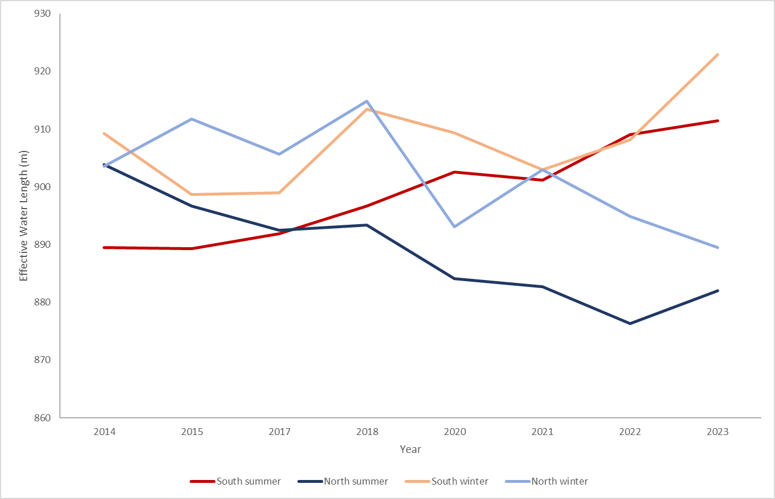
RESULTS – RODANTHE SEASONAL OSCILLATION
0
1.5
3
N
930
km
920
910
900
Effective Water Length (m)
890
880
870
860
Base map credit: Google
2014
2015
2017
2018
2020
2021
2022
2023
Year
South Summer
North Summer
South Winter
North Winter
Notes:
The study area of Avon was split based on the location of the north end of the bridge. In the north region, effective water length has generally decreased over the past 10 years in the summer and winter meaning land gain is occurring, and in the south region, effective water length is increasing meaning that land loss is occurring (aka the shoreline is receding over time). Effective water length is consistently lower in the summer than the winter in both regions, which suggests seasonal shoreline oscillation (more land in the summer than the winter).
Note that some years are missing on this figure due to extensive cloud cover within the scene during that year.
--------------------Map Information Below--------------------
Map credits: Ella Haugen
Base map credits: Google

Slide 11
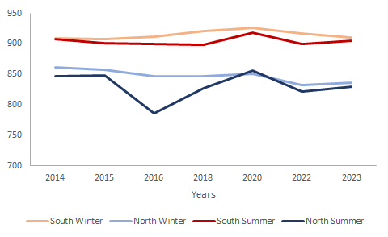
RESULTS – AVON SEASONAL OSCILLATION
0
1.75
3.5
950
Km
900
900
850
850
Effective Water Length (m)
800
Effective Water Length (m)
800
750
750
700
700
2014
2015
2016
2018
2020
2022
2023
2014
2015
2016
2018
2020
2022
2023
N
Year
South Winter
North Winter
South Summer
North Summer
Base map credit: Google
Notes:
The study area of Avon was split between North and South Avon based on Effective Water Length averages. While the Effective Water Length is higher in South Avon, as shown by the graph, there is only a slight change between the winter and summer seasons, as well as a slight change of shoreline loss over the ten year period. In fact, in North Avon, there has been land gained (deposition) rather than erosion in that area.
Note that some years are missing on this figure due to extensive cloud cover within the scene during that year.
--------------------Map Information Below--------------------
Map credits: Alyson Bergamini
Base map credits: Google

Slide 12
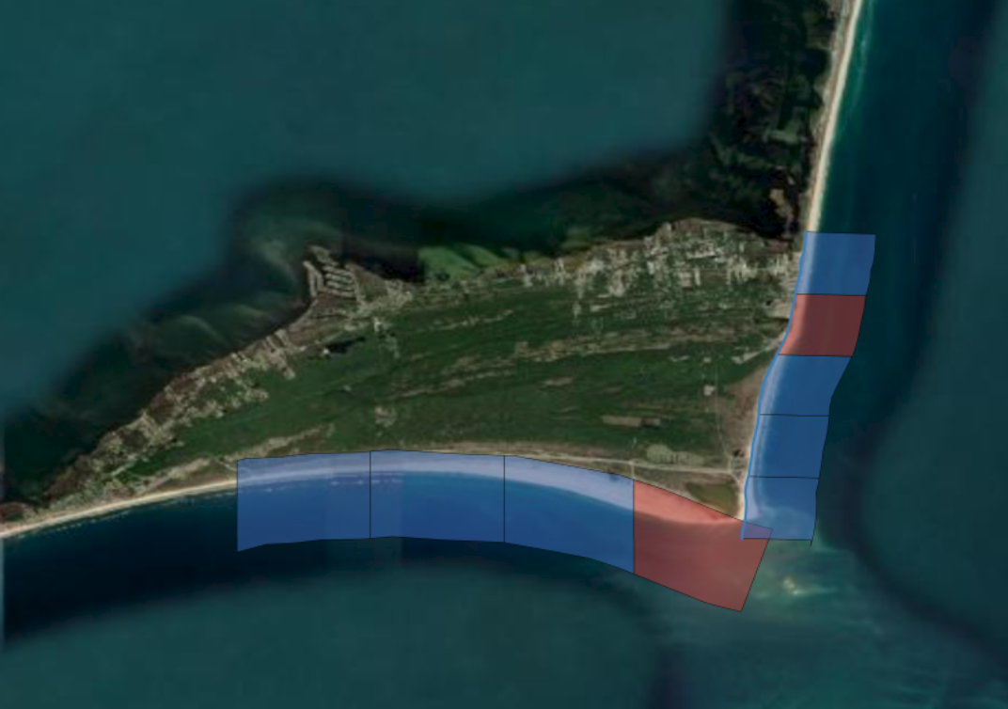
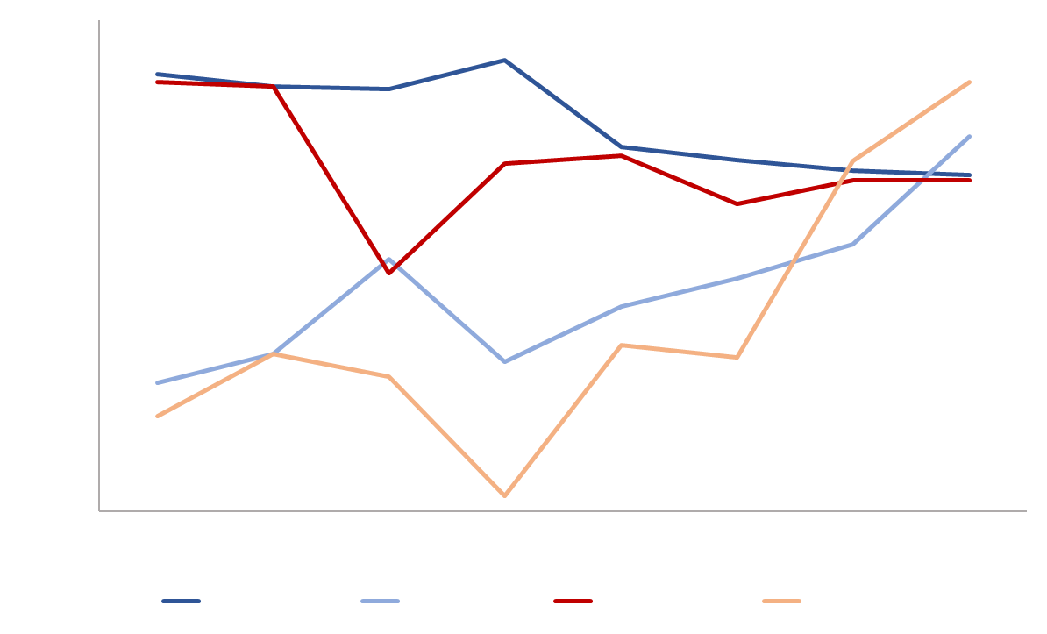
RESULTS – BUXTON SEASONAL OSCILLATION
South Beach
0
2.5
5
N
1200
Km
1100
0
2.5
5
Km
1000
Effective Water Length (m)
900
800
2014
2015
2016
2018
2020
2021
2022
2023
Base map credit: Google
West Summer
East Summer
West Winter
East Winter
Notes:
Due to the differences in shoreline behavior on either side of the cape's point, this study area was split between the eastern and southern shores. Looking at South Beach first, the shoreline has displayed two distinct trends. The western portion of South Beach, covered by blue polygons, has accreted about 80 m since 2014. The darker blue line and red line represent the effective water length for this area during winters and summers, respectively. They both agree with the ~80 m gain, as well as illustrate a seasonal oscillation similar to the other study areas. The eastern portion, covered by the red polygon, has lost approximately 238 m since 2014. This is due largely in part to the increasing severity of hurricanes and other seasonal storms. Waves during hurricane seasons have been growing in frequency and height; this change in tidal behavior is especially noticeable around cuspate Cape's like this. Waves pull sediment from the southern side and deposit the sediment on the eastern side, yielding a more asymmetrical shoreline.
Note that some years are missing on this figure due to extensive cloud cover within the scene during that year.
--------------------Map Information Below--------------------
Map credits: Julian Alcantara
Base map credits: Google

Slide 13
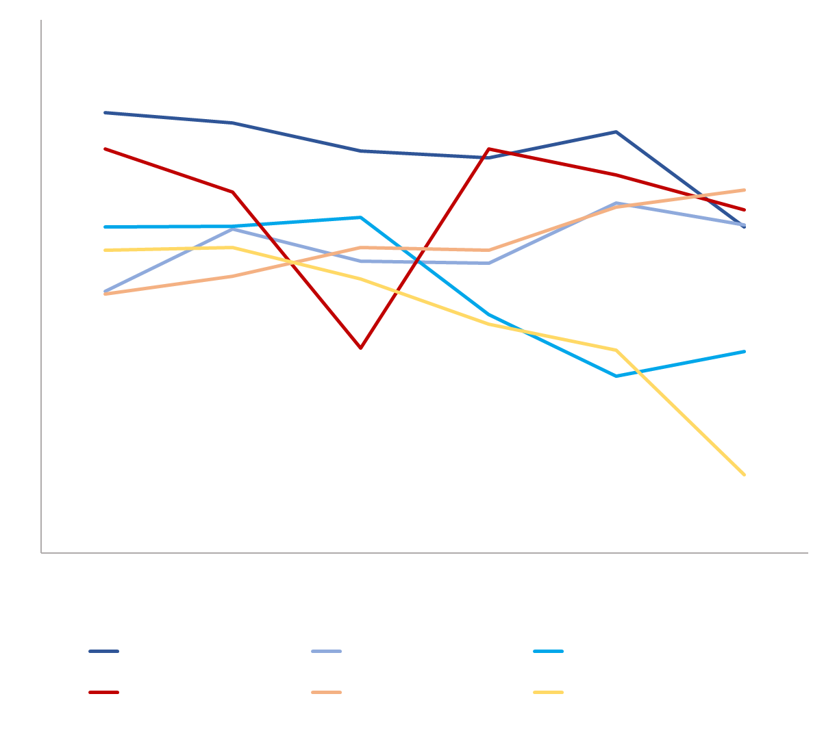
RESULTS – BUXTON SEASONAL OSCILLATION
East Beach
0
2.5
5
N
930
Km
920
0
2.5
5
910
Km
900
Effective Water Length (m)
890
880
870
Base map credit: Google
860
2015
2016
2017
2020
2022
2023
Year
North Winter
Middle Winter
South Winter
North Summer
Middle Summer
South Summer
Notes:
The east coast has been separated into three study areas. The northern-most polygon, which encompasses most of the city of Buxton, has experienced some shoreline gain, but not nearly as much as the southern portion. The red polygon indicates shoreline loss.
Note that some years are missing on this figure due to extensive cloud cover within the scene during that year.
--------------------Map Information Below--------------------
Map credits: Julian Alcantara
Base map credits: Google

Slide 14
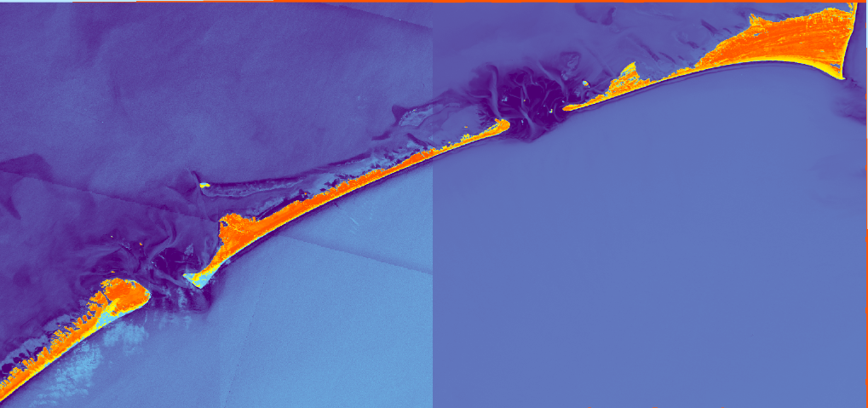
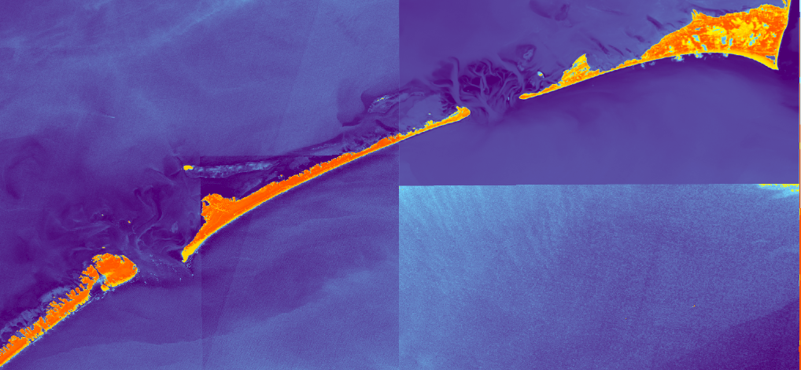
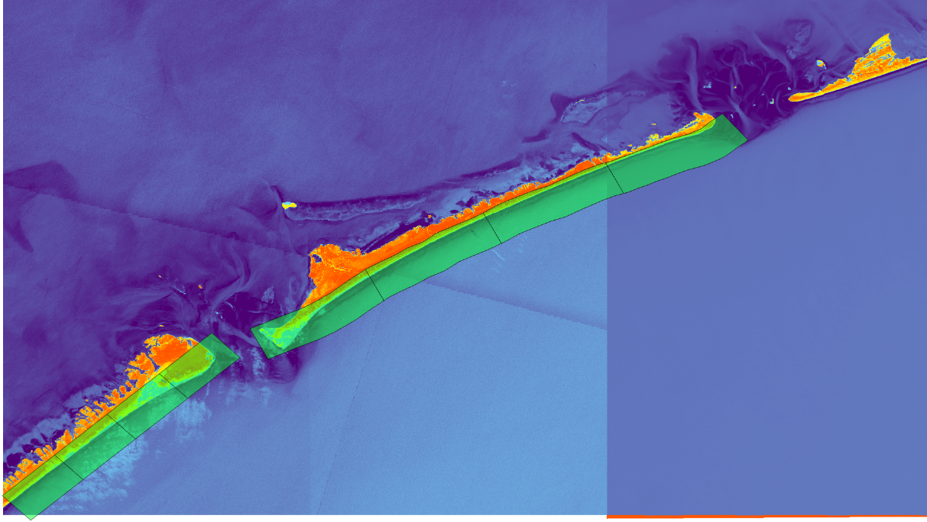
RESULTS – HURRICANE DORIAN
After
Before
Sentinel-2 MSI
Landsat 8 OLI
10/3/2019
8/30/2019
8/29/2019
9/22/2019
NDWI
0.9
0.2
-0.8
-0.6
Sentinel-2
Landsat 8
Ocracoke Inlet
Hatteras Inlet
N
0
5
10
km
Notes:
Hurricane Dorian touched down in the Outer Banks on 6 September, 2019. These images of Ocracoke and Hatteras inlets have been processed through NDWI to delineate shoreline. High values of NDWI indicate water and low values of NDWI indicate land. Like most of the OBX, these locations suffered high winds and flooding conditions.
Due to severe weather conditions around the time of the storm, the earliest cloud-free image we collected was from 3 October, 2019. Despite the gap in time, the images still show a large difference from the coast prior to Dorian's passing. A similar process as before was applied to this case study to quantify amount of shoreline loss from the storm.
Portsmouth Island North Point
1 -57.1105
2 -145.107
3 -372.093
4 -72.5537
Average -161.716
Ocracoke Island
-54.8494
-30.9234
-30.6253
-29.0482
Ave loss -36.3616
--------------------Map Information Below--------------------
Map credits: Julian Alcantara
Base map credits: Google

Slide 15
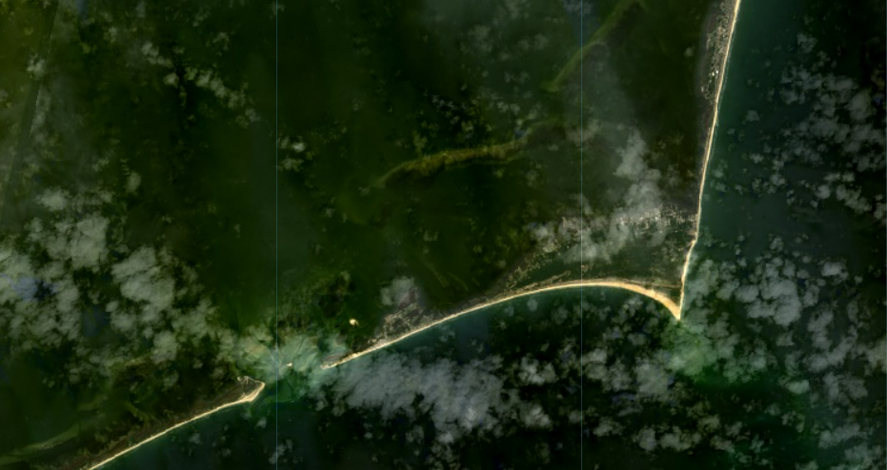
ERRORS AND UNCERTAINTIES
Spatial resolution
Dataset availability
Study area variability
Image Credit: Google
Notes:
A few limitations to our study include: 30m spatial resolution is coarse, especially concerning the smaller study areas; datasets are limited to certain time periods and cloud cover and wave interference limit quantity of high quality images and accuracy of classification; study areas see variability due to potential user errors when creating polygons on ArcPro.
--------------------Map Information Below--------------------
Base Map Credits: Google

Slide 16
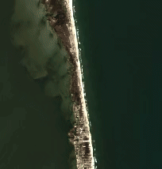
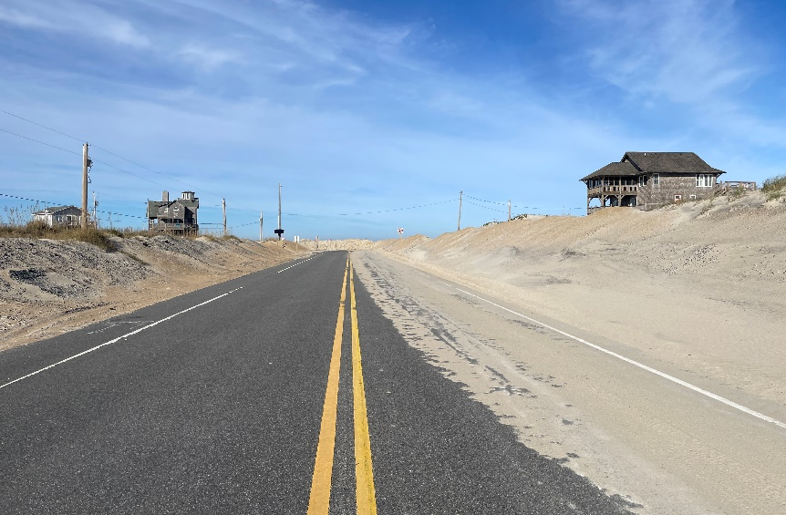
CONCLUSIONS
The creation of shoreline change maps allowed for the identification of NC-12 as vulnerable to coastal erosion.
Southern Rodanthe saw shoreline loss, which highlighted the importance of the Rodanthe Bridge.
This method of analyzing shoreline change will allow the NPS to continue analyzing seasonal oscillation, impact of storm events, and impact of infrastructure relocation on the shoreline.
Basemap credit: Google
Image Credit: Michael Flynn
Notes:
The creation of shoreline change maps allowed for the identification of NC-12 as vulnerable to coastal erosion. Southern Rodanthe was particularly vulnerable to shoreline loss. This method of analyzing shoreline change will allow the NPS to continue analyzing seasonal oscillation, impact of storm events, and impact of infrastructure relocation on the shoreline going forward. Our research focused on the Atlantic side of the island. Future research could use this method to analyze the sound side of the island, which has also experienced shoreline change during the past 10 years.
--------------------Image Information Below--------------------
Top Image
Basemap credit: Google
Bottom Image
Image Credit: Michael Flynn, NPS (Used with Permission)

Slide 17
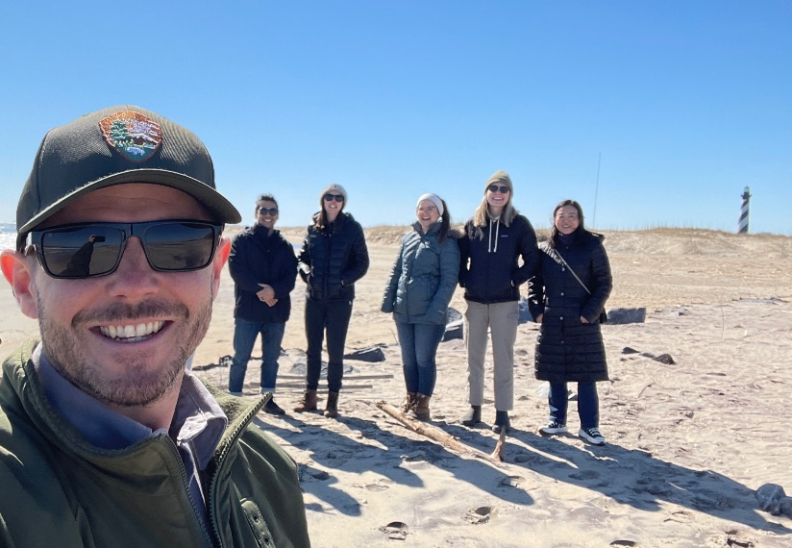
National Park Service
Michael Flynn | NPS Physical Scientist
NASA DEVELOP
Image Credit: Michael Flynn, Julian Alcantara
Olivia Landry | NASA DEVELOP Lead, Virginia - Langley​
Dr. Kenton Ross | NASA DEVELOP Program Manager​
Dr. Xia Cai| NASA DEVELOP Lead Science Advisor
This material contains modified Copernicus Sentinel data (2022), processed by ESA.
Notes:
We would like to acknowledge and thank our project partner, Michael Flynn of the National Park Service as well as our DEVELOP Lead, Olivia, and our Science Advisors, Dr. Ross and Dr. Cai.
--------------------Image Information Below--------------------
Image Credit: Michael Flynn, Julian Alcantara (Used with Permission)
Image Source: NPS, DEVELOP Team

