Slide 1
Eastern Washington Disasters
Integrating NASA Earth Observations to Analyze Spatiotemporal Distributions of Lightning-Caused Wildfires in Eastern Washington
Ani Matevosian, Amelia Zaino,
Amy Kennedy, & Evan Bradish
California – Ames
Notes:
Hello! We are the Eastern Washington Disasters team and we are excited to share our 10 week-long research project where we use NASA Earth Observations to look at lightning-ignited wildfires in Eastern Washington.
(Short Introductions)
I am Ani Matevosian...
I am Amelia Zaino...
I am Amy Kennedy...
I am Evan Bradish...

Slide 2
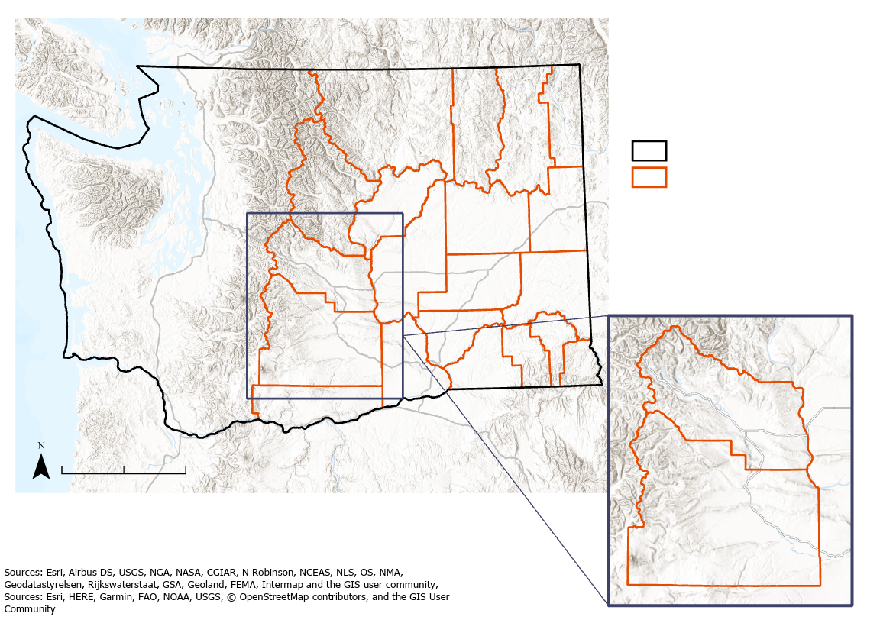
Eastern Washington
Higher elevations have pine forests. Lower elevations feature a dry shrub-steppe landscape.
Fires burn naturally in this region. Native Americans used prescribed burns to manage the landscape.
The region is mainly rural, with plenty of wildlands for resources and recreation.
Washington State
Eastern Washington
Seattle
Spokane
Kittitas County
Cle Elum
0 80
Distance (miles)
Yakima
County
Notes:
Our study area is east of the Cascade range in Washington State. We call this Eastern Washington. We decided to focus on case studies on Kittitas County and Yakima County in particular. Cle Elum is highlighted because the Nature Conservancy –Washington has its office located in the town. For context, Cle Elum is approximately 90 minutes by car from Seattle.
**edit text/bullets*
-------- References ------------
Directions source: Google. (n.d.) [Google Maps directions for driving from Seattle, Washington to Cle Elum, Washington]. Retrieved March 3, 2010, from https://goo.gl/maps/SsqEd4mPY7G6fcgm6.
Background map sources: ESRI, Airbus DS, USGS, NGA, NASA, CGIAR, N Robinson, NCEAS, NLS, OS, NMA, Geodatastyrelsen, Rijkswaterstaat, GSA, Geoland, FEMA, Intermap and the GIS user community
Text Information Sources:
Western Regional Climate Center. (2002, January 16). Climate of Washington. https://wrcc.dri.edu/narratives/WASHINGTON.htm
Busby, Sebastian Upton, "Forest Structure, Composition, and Regeneration after High-Severity and Rapidly Repeated Wildfires in the Central Cascade Range" (2019). Dissertations and Theses. Paper 5127. 10.15760/etd.7006
LandScope Washington. (2020, March 5). East Cascades Vegetation. Land Scope America. http://www.landscope.org/washington/natural_geography/ecoregions/east_cascades/vegetation/

Slide 3
Study Design
Study Area
  Eastern Washington
Study Period
  2001 to 2019
Case Studies
  In lightning, fires, and vegetation using NASA Earth observations
  Emphasis on Kittitas and Yakima Counties
Image Credit: An283/Pixabay
Notes:
As mentioned, our study area is Eastern Washington. Our Study Period is 2001-2019, because we wanted to look at overall trends in the 21st century, and due to the availability of lightning data, fire data, and vegetation moisture data. Also, this period includes large lightning-caused wildfires, especially in 2017 and 2018. Major fires include 2017’s Jolly Mountain and 2018’s Crescent Mountain. Jolly Mountain forced the evacuation of 150 homes in Cle Elum and raised concerns about air quality in the region. The 2018 Crescent Mountain fire burned 33% of the Twisp River watershed and also forced evacuations. (idk if this has a place here!!)
Our study used NASA Earth observations to look at lightning, fire, and vegetation moisture data over the study area, emphasizing the areas of Kittitas and Yakima counties which our partner expressed interest in.
*minimize repetition from previous slide*
-------References -------------
Cle Elum statistic: Clarridge, Christine. (2017, August 31). Jolly Mountain Fire sparks emergency evacuations near Cle Elum. Seattle Times. https://www.seattletimes.com/seattle-news/environment/jolly-mountain-fire-sparks-emergency-evacuations-near-cle-elum/
Image credit: John Marshall, https://tncwashington.tandemvault.com/assets/87698454
Oliver, Miles Jay. (2017, September 2). Jolly Mountain Fire threatens 3,800 homes, unhealthy levels of smoke hit Yakima. Yakima Herald.
https://www.yakimaherald.com/news/local/jolly-mountain-fire-threatens-homes-unhealthy-levels-of-smoke-hit/article_18b774b2-8ff9-11e7-b9a3-37d1ebacbc8d.html
U.S. Bureau of Land Management & USDA Forest Service - Region 6. (2019). 2018 Pacific Northwest Wildland Fire Season. https://www.fs.usda.gov/Internet/FSE_DOCUMENTS/fseprd611322.pdf
------- Image Credit Below --------
Image Credit: Pixabay
Image Source: https://pixabay.com/photos/storm-lightning-night-sky-thunder-3508531/

Slide 4
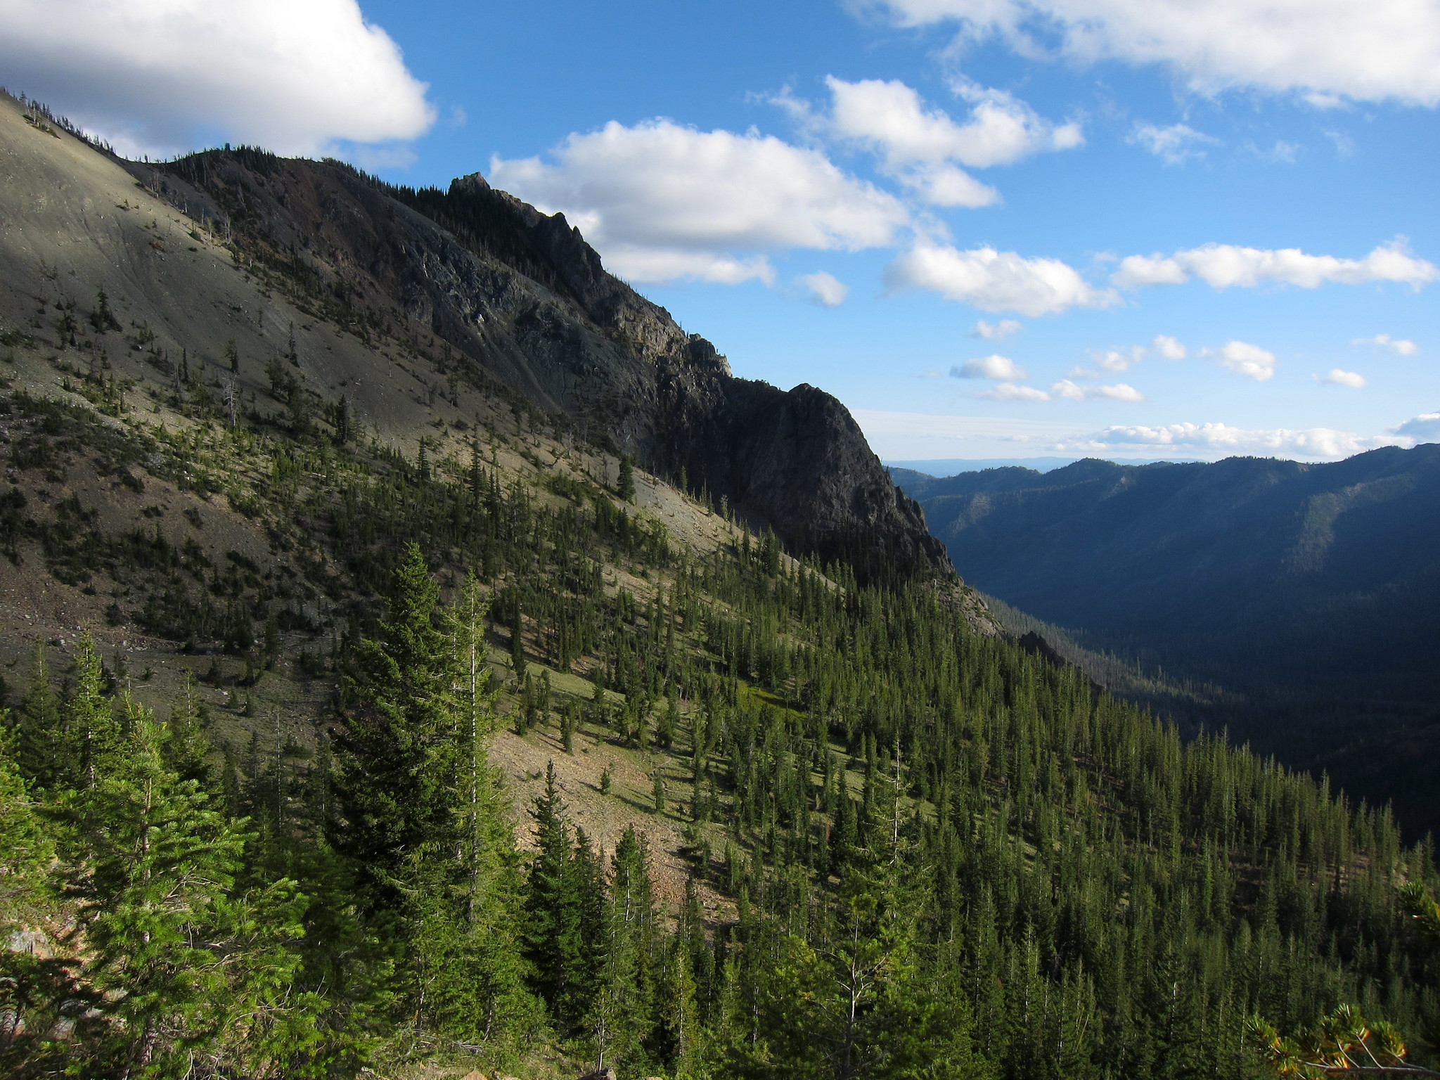
Community Concerns
Drier conditions, built up fuel, and changing land use could lead to uncharacteristically large and severe fires
Lightning-caused fires typically result in more acres burned than human-caused in the Pacific Northwest
Fires threaten homes, air quality, and local economy
Image Credit: Sean Munson
Image Credit: Pxfuel
Notes:
Eastern Washington is downwind of the Cascade Range in Washington State. Warm, damp air from the Pacific Ocean loses its moisture as it travels over the mountain peaks, resulting in relatively drier conditions on the eastern side of the range (Western Regional Climate Center, 2002), creating an environment more conducive to wildfire ignitions.
Eastern Washington’s economy in the past century has been closely tied to its landscape. Forests on the slopes of the Cascade Mountains provided timber for saw mills across Kittitas and surrounding counties. However, in the early 1990s, environmental regulations to protect forest habitat and the endangered Spotted Owl forced the timber industry into a decline (Prengaman, 2016). These regulations, combined with fire suppression initiatives such as reducing prescribed burns, led to dense underbrush growth that acted as fuel for wildfires (Washington State Department of Natural Resources, 2018). As the economy changed, development patterns changed as well. Between 1976 and 2006, population increased by 66 percent in Eastern Washington as wildlands became increasingly urbanized and residential structures were built on forested land. Though urban development in this area is not particularly dense, the fragmentation of wildlands can make it difficult and costly to fight wildfires (Gray et al., 2013).
There is also literature that shows that lightning-ignited wildfires typically burn more area than human-ignited (maybe give one of the stats below). This could be for several reasons. Often, human-ignited fires are close to populations and have access to suppression tools and high priority for safety. Lightning-ignited fires that occur in more isolated regions often aren’t detected as early or are not as high priority, giving fires time to grow and burn more area before containment (Kasischke et al., 2010; Narayanaraj & Wimberly, 2012). With more people moving to Eastern Washington and tourists travelling to this area to partake in the many outdoor activities available, compromised air quality from wildfires becomes a growing concern, along with other ripple effects (like mudslides from lack of trees).
With these factors in mind, we partnered with the Nature Conservancy in Washington to address some of their local concerns.
-------------------------Large Fire Stats in Washington State-------------------------
135 of 683 large fires in Wash from 1973 to 2019 were non-lightning caused fires (I.e. human-caused), burning 863,600 acres
194 of 683 large fires in Wash " " were lightning-caused and burned 1,858,836 acres
Since 2010, lightning-ignited fires have accounted for 36% of acres burned in large fires in Washington
(Washington Department of Natural Resources)
-------------------------Image Information Below-------------------------
Image Credit: Sean Munson via Flickr
Image Source: https://www.flickr.com/photos/logicalrealist/•988759•37/in/photolist-8AQGnK-JVDVzE-7•BeDU-MGmhtA-NwoYMB-JVDR7G-8AQGHa-MGMYfM-MGm8jy-aytuYo-8ATMfE-MGmn3L-NtRSBL-NAZHnu-SFkRFp-MQ9eWP-HdcMVD-2gLJ5qZ-MGbefF-Zn8tVC-8ATHJJ-LQtj3c-LCLmHo-MGmjGo-8za7cR-MGmfqh-Nwp•WV-MGmevw-ayqPmn-MGmow7-8ATMQ1-LSEvpY-MGm9UN-KPcjQ9-8AQEMa-owWXLA-NtRQUh-2gLHh6D-ME56Q3-Mo6GRs-Nwp8uM-K2UAzw-NtRUGN-SCCUHb-K5Rizt-NAZP9E-NAZTey-LyKMpD-fc2SVP-J98Qdv/
-------------------------References-------------------------
Gray, A., Azuma, D., Lettman, G., Thompson, J., & McKay, N. (2013). Changes in Land Use and Housing on Resource Lands in Washington State, 1976-2006. United States Department of Agriculture - Forest Service. https://www.fs.fed.us/pnw/pubs/pnw_gtr881.pdf
Prengaman, Kate. (2016, November 16). Future full of doubt for Central Washington timber industry. Yakima Herald. https://www.yakimaherald.com/news/local/future-full-of-doubt-for-central-washington-timber-industry/article_28f7•f22-ac93-11e6-a2ee-67aef0626395.html
Washington Department of Natural Resources. “Washington Large Fires 1973-2018” [MapData set]. Scale of 1:1,906,1••. “Washington Geospatial Open Data Portal.” 1973-2019. Accessed on February 10, 2020, from http://geo.wa.gov/datasets/wadnr::washington-large-fires-1973-2018.
Washington State Department of Natural Resources. (2018). 20-Year Forest Health Strategic Plan - Eastern Washington. https://www.dnr.wa.gov/ForestHealthPlan
Western Regional Climate Center. (2002, January 16). Climate of Washington. https://wrcc.dri.edu/narratives/WASHINGTON.htm

Slide 5

Project Partner
Managing Community Forests
The Nature Conservancy, Washington Chapter
Educating the Public on Fire Preparedness
Advocating for forest health
Notes:
Our partner is The Nature Conservancy (TNC) , Washington Chapter. The TNC Washington Chapter manages millions of acres of land across the state. The organization works with several stakeholders including public, private, non-profit, and tribal groups to care for the collective landscape and actively restore forests. Restoration practices include prescribed burning and forest thinning that remove dense and dry underbrush. They provide education on fire adaptation to landowners across the region. They employ geospatial methods to monitor land and use LiDAR to measure forest health and track the progress of blight.
------- Image Credit Below --------
Leaf Vector: Authorized for commercial use with modification, Google Images Public Domain Vectors

Slide 6
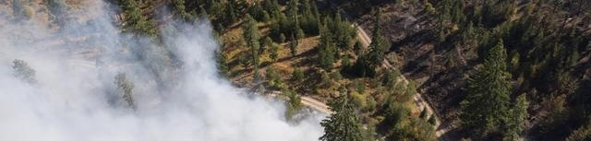
Project Objectives
Identify spatiotemporal patterns of lightning-ignited wildfires
Analyze the frequency and severity of lightning-ignited wildfires
Assess the risk of wildfire ignition in Kittitas County, Washington, and the surrounding region
Provide our partner with resources to visualize, interpret, and share data about Eastern Washington’s fire regime
Image Credit: TNC Washington
Image Source: John Marshall
Notes:
Our project aimed to identify spatiotemporal patterns of lightning-ignited wildfires,
analyze the frequency and severity of lightning ignited wildfires,
assess the risk of wildfire ignition in Kittitas and Yakima County, Washington and the surrounding region (eastern Washington).
With the community concerns in mind, our team wanted to provide our partner at the TNC with resources to visualize the data, results, and share them to his community and the public.
Lastly, it’s worth mentioning that this project set out to use and apply an under-utilized sensor, the LIS on the ISS.
-------------------------Image Information Below-------------------------
Image Credit: John Marshall
Image Source: https://tncwashington.tandemvault.com/assets/39571865 With written permission from Brian Straniti and Nikolaj Lasbo of the TNC to use.

Slide 7
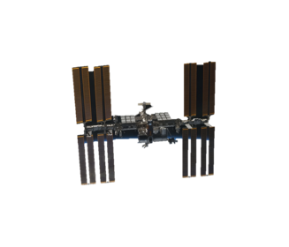
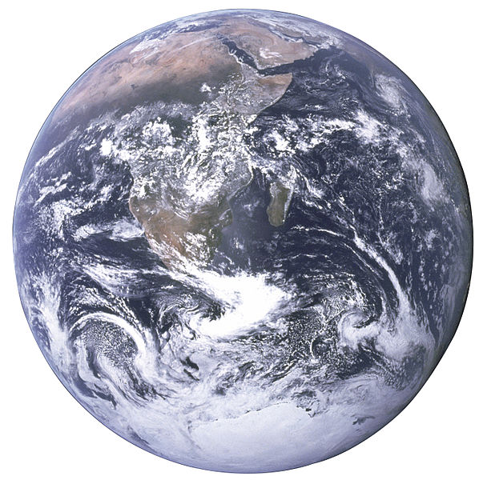
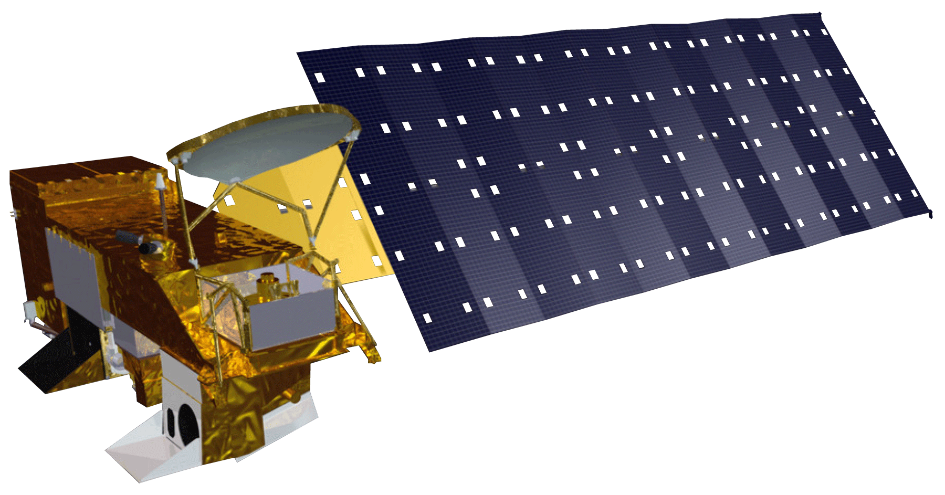
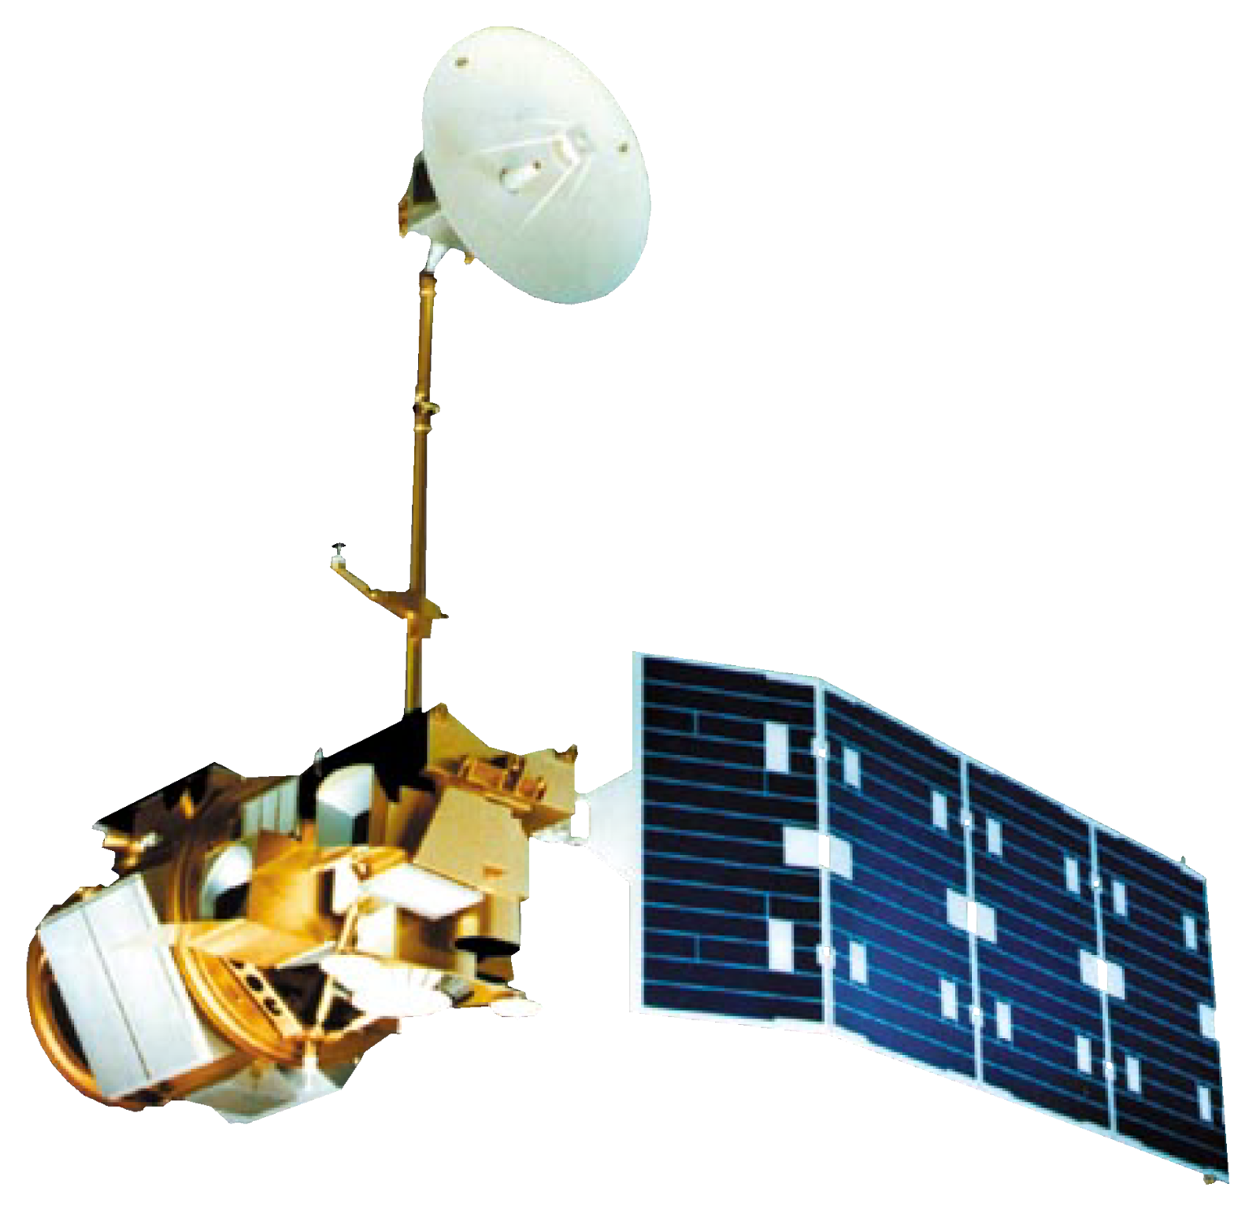
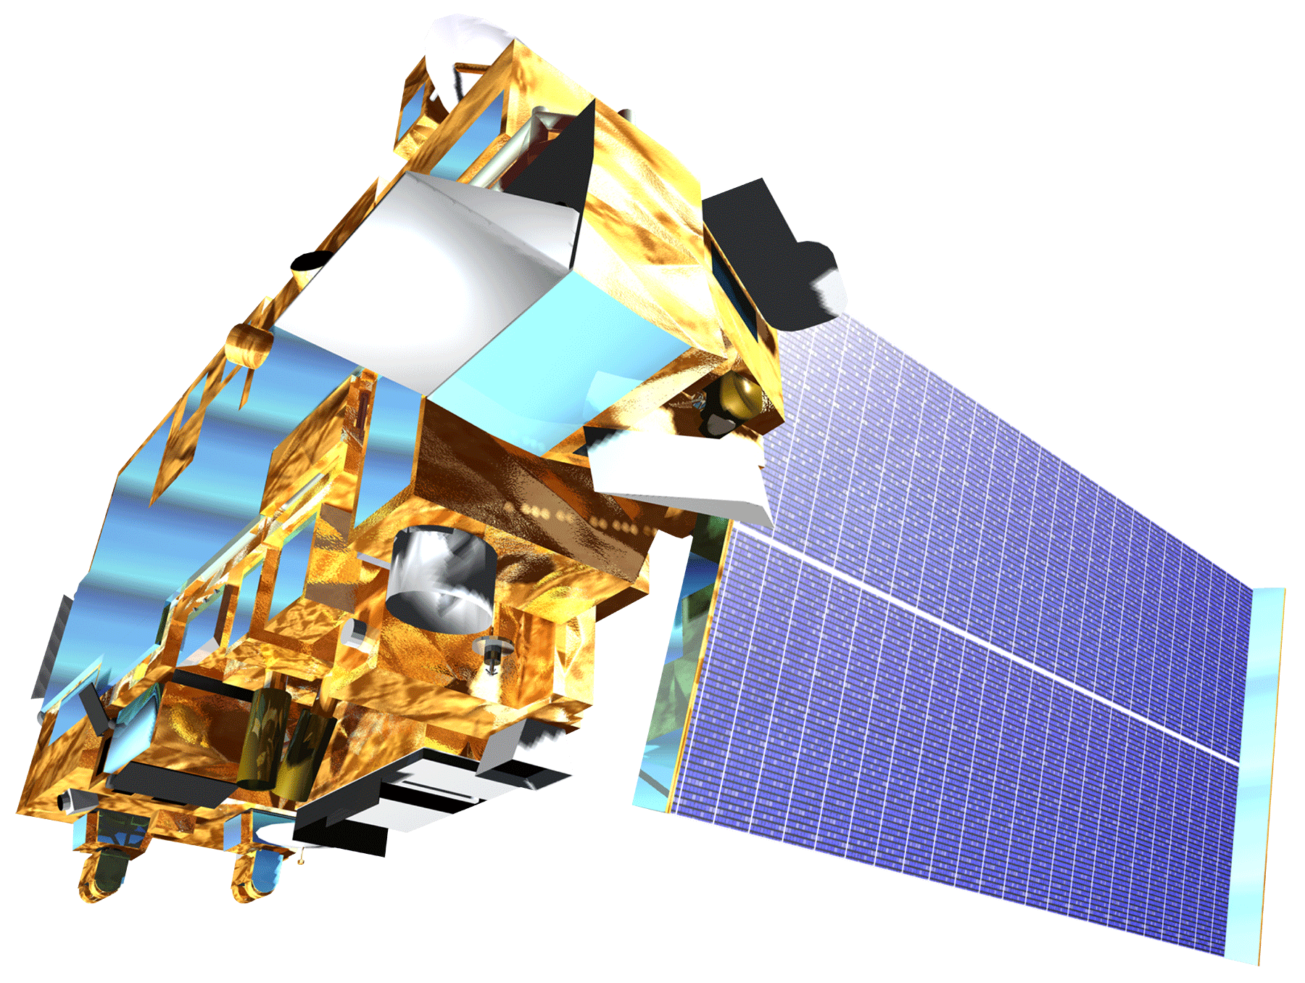
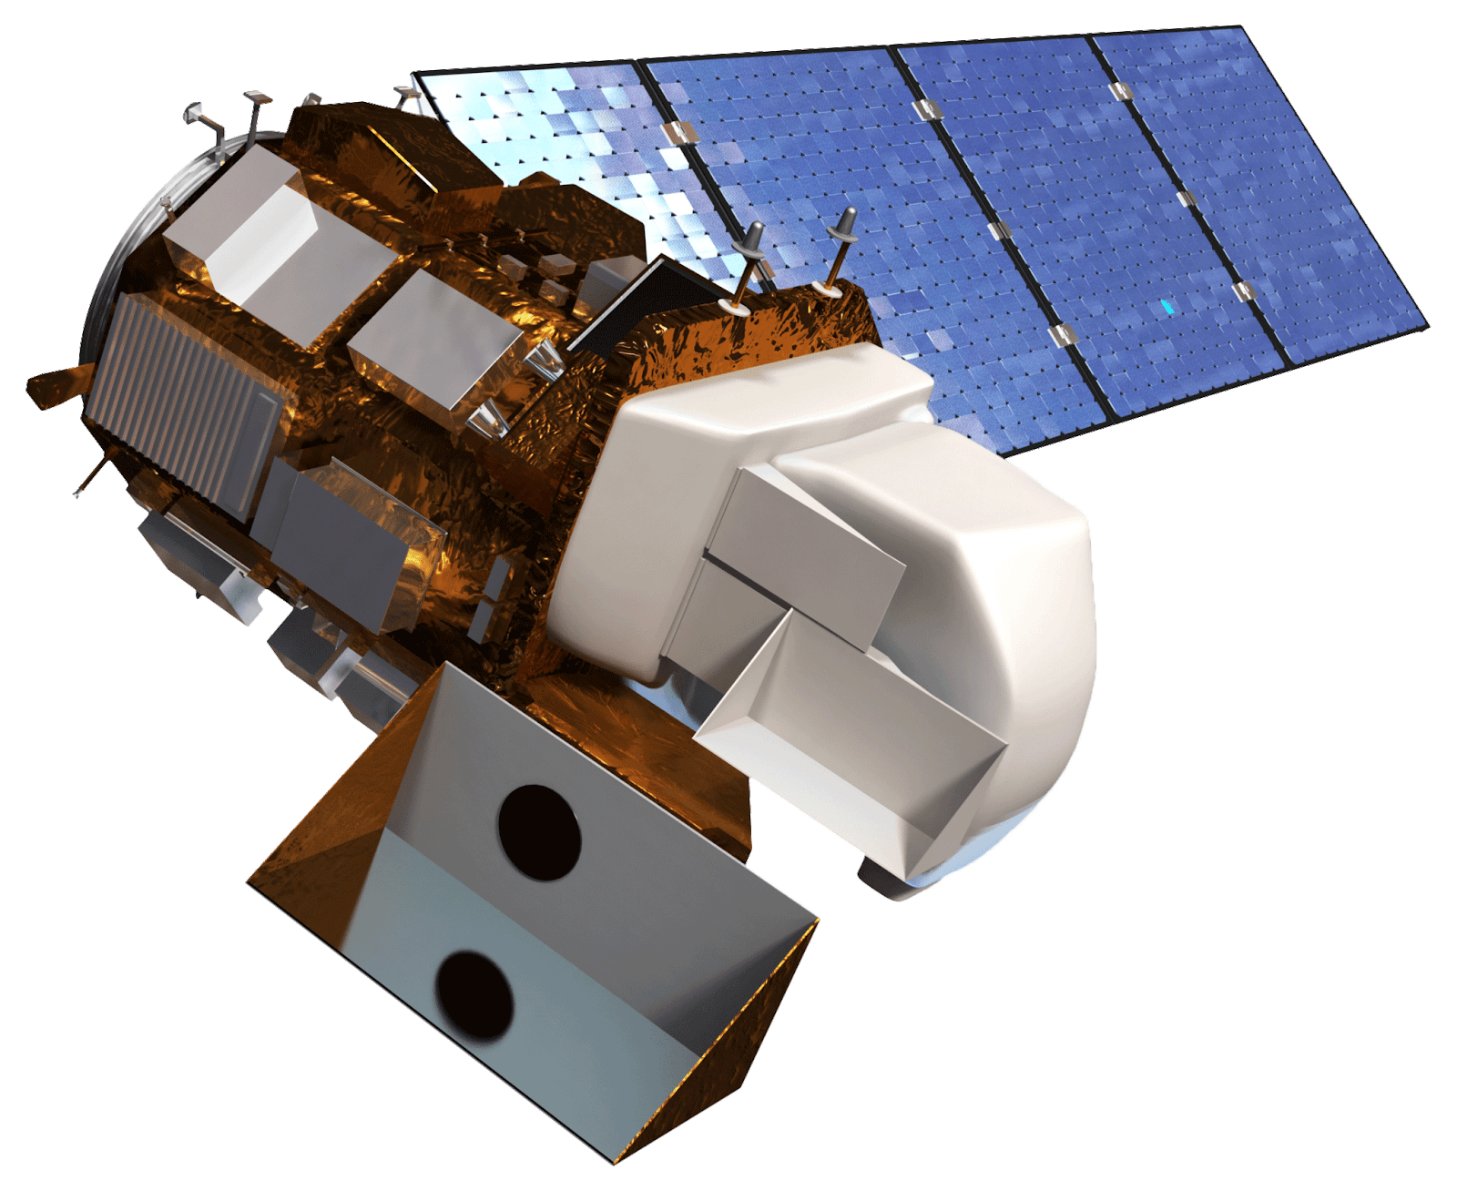
Satellites and Sensors
International Space Station
Lightning Imaging Sensor (ISS LIS)
Terra - Moderate Resolution Imaging Spectroradiometer (MODIS)
Landsat 5 Thematic Mapper
Aqua – MODIS
Landsat 8 Operational Land Imager
Notes:
We utilized the following Satellites and Sensors to gather data for the study period of 2001-2019:
MODIS on Aqua and Terra (for the burned area fire product), the International Space Station Lightning Imaging Sensor, and Landsat 5 Thematic Mapper and Landsat 8 Operational Land Imager to calculate vegetation moisture via NDMI.
Photo credits: NASA

Slide 8
Methodology Overview
Data Acquisition
Data Processing
Data Analysis
End Products
Fire Burn Record
Lightning Points
Vegetation Moisture
Calculate Respective Parameters
Fishnet Methodology
Climatology for 2001 to 2019
ArcGIS Online StoryMap
Notes:
Our methodology is as follows:
We acquired data for a fire burn record, lightning location points, and vegetation moisture data.
To process the data we intersected the layers with a fishnet template (cell sized 25 square km), and calculated parameters that we’ll go into more detail in the following slides. Then we analyzed the data of each cell by dividing it into percentiles in Excel. We reimported the attribute table for each respective data layer and changed symbology in ArcPro to display the percentiles to create the climatology maps. This process resulted in our end products: the climatology maps for 2001-2019. Then we generated an ArcGIS StoryMap as a creative platform to communicate these results and tailored it to our partner’s needs as a community outreach coordinator.
*column of circles* → text boxes feeding into fishnet

Slide 9
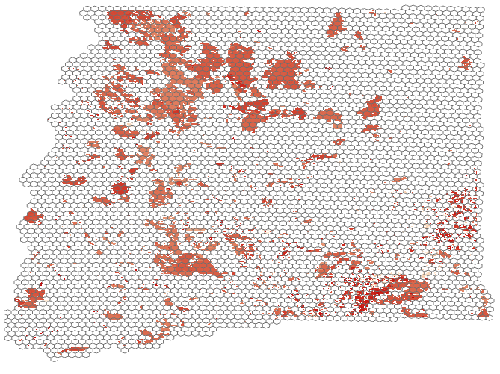
The Fishnet Methodology
Input Layers
Fire Burn Area
Vegetation Moisture
Lightning Flash Locations
Intersect with Fishnet
& Calculate
Natural Breaks
Composite Vulnerability Climatology
Percent Area Burned
Moisture Level
Rank 0-3 Risk Level
Lightning Count
Change Symbology
Notes:
We utilized a fishnet to analyze the various factors (burn area, lightning points, and vegetation moisture). First, we created an empty fishnet template. The fishnet “hexagonal” grid was composed of cells sized at 25 square km in area. This area was chosen to allow enough data to be captured in each cell, while still maintaining a sufficient amount of detail. Then we intersected the individual data layer with fishnet template. A parameter is calculated, such as for fire data – percent burn of each cell. For lightning, it was count per cell. For vegetation moisture, it was the moisture level of each cell (*potential placeholder for this parameter*). Next, the percentile is calculated in Excel, re-imported back into ArcPro, so each cell belongs to a percentile (which is calculated based on the standard deviation of the data). Lastly, the symbology is changed to visualize the percentiles to show varying degrees in percentile. Essentially, this fishnet is the method by which we’ll analyze all these data layers to produce a climatology showing patterns in overlapping fire/lightning/moisture.
-------------------------Image Information Below-------------------------
Image Credit: Evan Bradish, DEVELOPer
*This is a placeholder image with just one day of data. We may change it later

Slide 10
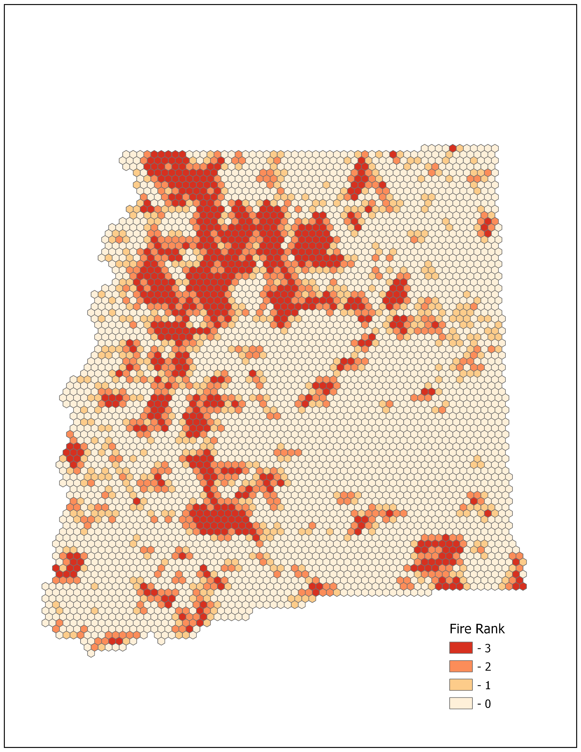
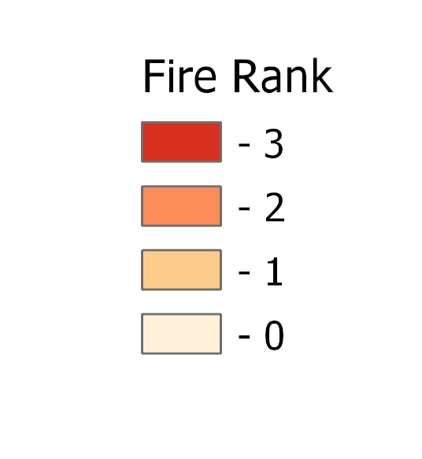
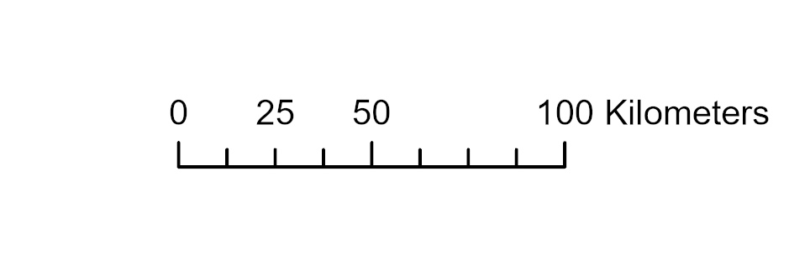
Input 1: Fire Burn Area
Data Acquisition
Download Washington Large Fires shapefile 1973 to 2018 from Washington Department of Natural Resources
Validated with MODIS
Processing
Calculate percent burned for each cell in fishnet
Classify values from 0-3 using natural jenks
Fire Rank
Notes:
We downloaded a historical “Large fire” (fires over 100 acres) record from the Washington Department of Natural Resources Geospatial Open Data Portal. Validated the data with Terra and Aqua MODIS Burned Area Product (?). Once we brought this data into ArcPro and intersected it with our fishnet, we had a new layer showing where the large fires overlapped with the fishnet grid. We created a new field within that layer's attribute table and calculated the area of each cell, naming it "BurnedArea". We then joined this back to the original fishnet, in which we had created a field that displayed the original fishnet cell area (25 sq km), which we named "CellArea". Once joined with the intersect layer, the attribute table contained both the BurnedArea and CellArea fields. We added a new field titled "Percent Burned" and used calculate geometry to divide the BurnedArea by the CellArea. This new field showed the percentage of area within each fishnet cell that has been burned between 1985 and 2018.
-------------------------Image Information Below-------------------------
Image Credit: Evan Bradish, DEVELOPer
*This is a placeholder image with just one day of data. We may change it later

Slide 11
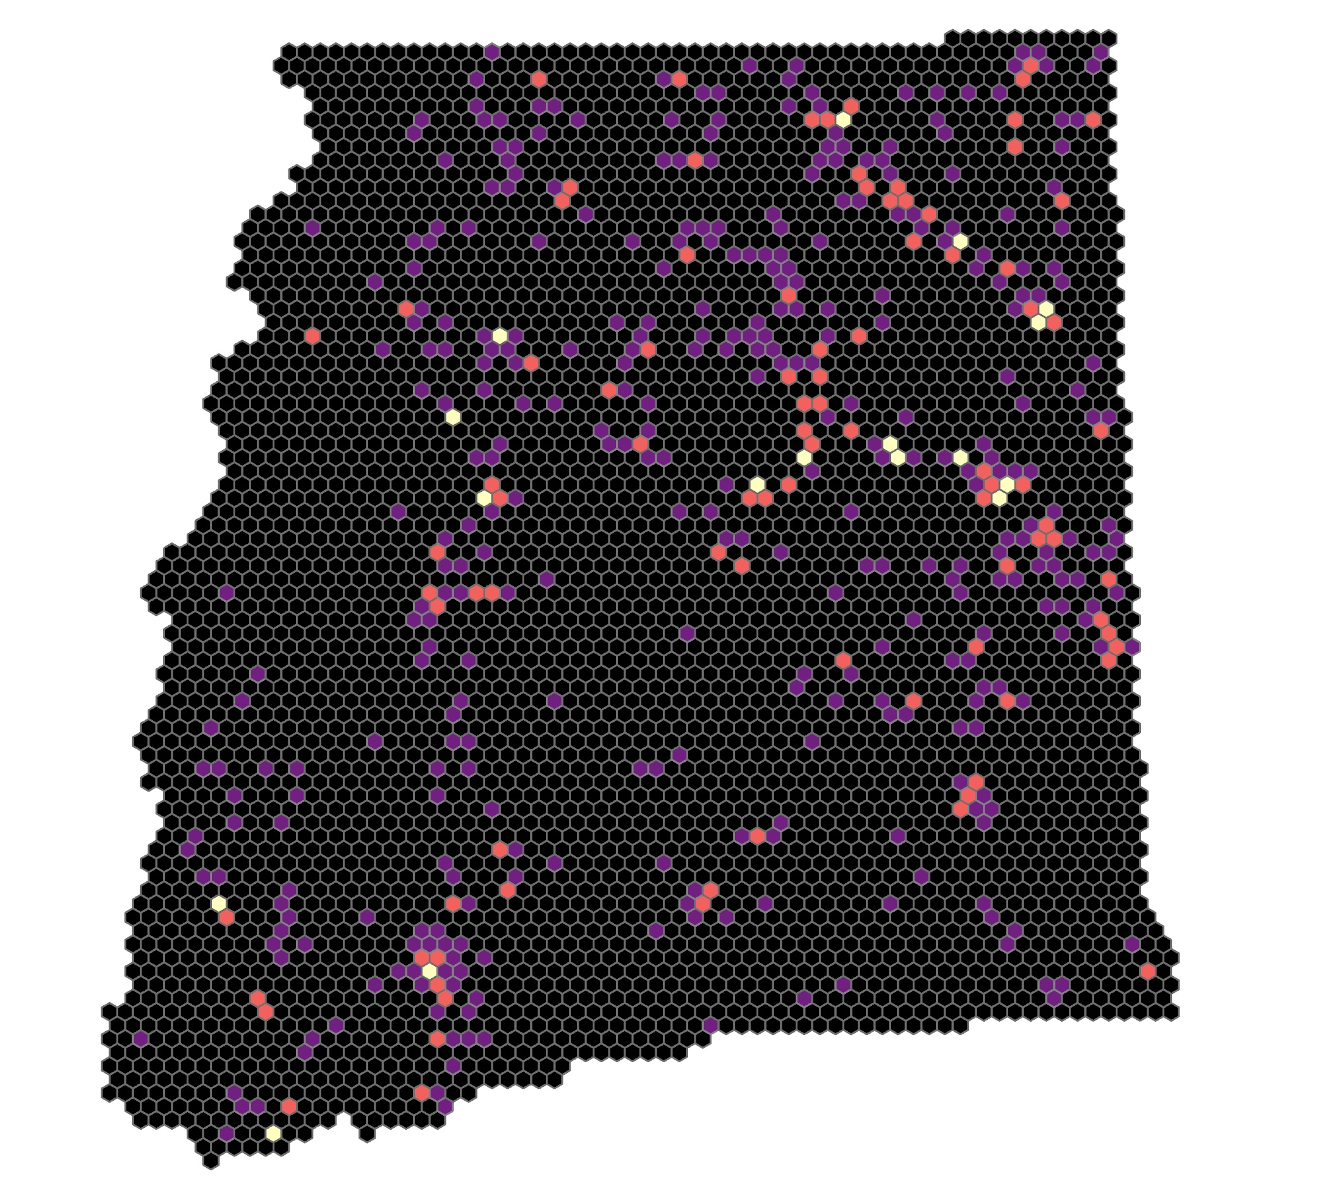
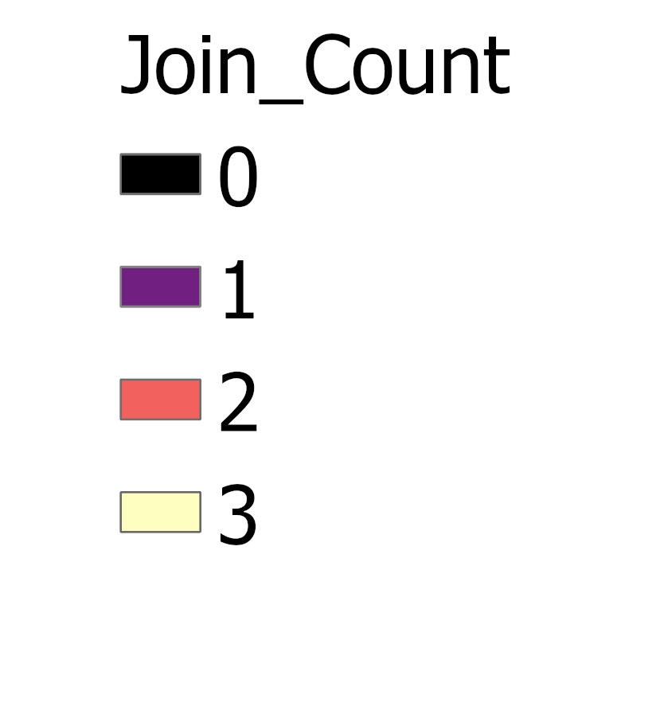
Input 2: Lightning Data
Data Acquisition
Bulk download ISS LIS files for 2017 to 2019
Convert to CSV with Python
Processing
Intersect with fishnet in ArcPro
Calculate count of lightning
points per cell
Classify data by natural jenks, rank lightning count exposure on 0-4 scale
Lightning Count Rank
Notes:
Bulk download LIS data from the Global Hydrology Resource Center (GHRC) Distributed Active Archive Center (DAAC). We utilized Python to convert these netcdf files into CSV format. We followed the same fishnet methodology as described for the Fire Data Layer. So, we imported and projected the lightning points by their coordinate locations in ArcPro and intersected the lightning data layer with the fishnet. We calculated the sum of the count of lightning points in each fishnet cell, then divided the data by their percentiles using Excel. The attribute table was imported back into ArcPro and symbology was changed to display percentiles.
-------------------------Image Information Below-------------------------
Image Credit: Amy Kennedy, DEVELOPer
*This is a placeholder image with just one day of data. We may change it later

Slide 12
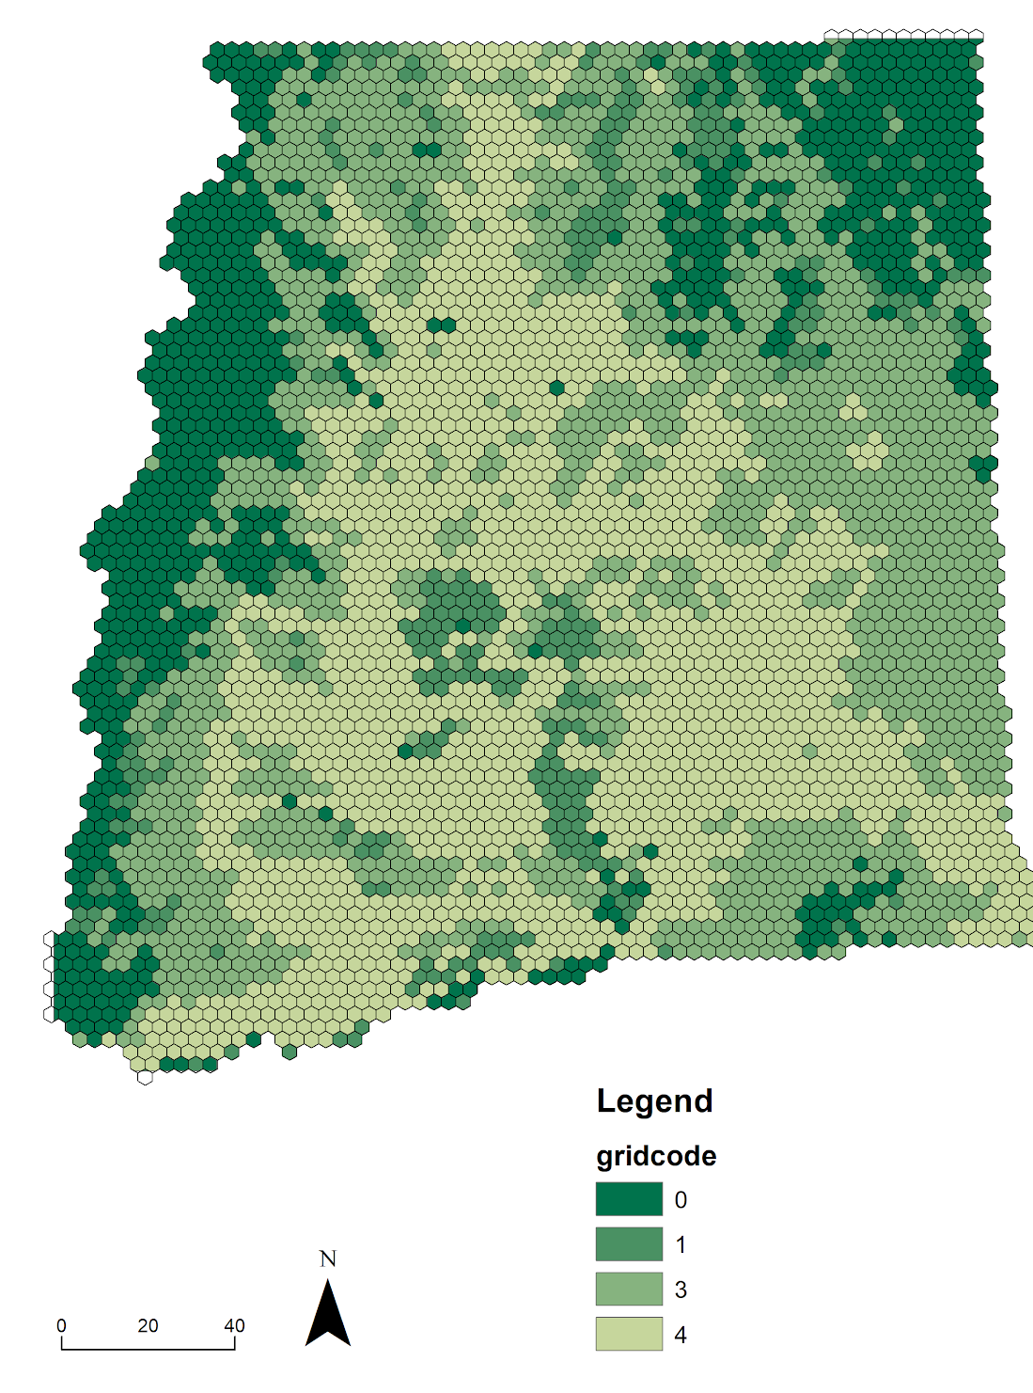
Input 3: Vegetation Water Content
Data Acquisition
Processed Landsat 5 and Landsat 8 images in Google Earth Engine with Normalized Difference Moisture Index for 2017-2019
Processing
Classify index from 0-3, with 0 the wettest vegetation and 3 the driest
Determine cells in the fishnet grid with the wettest vegetation and the driest
Vegetation Water Content
Notes:
Averaged vegetation water content for fire season (May-October) of 2017, 2018, and 2019 each. SMAP/Sentinel soil moisture data was added to a mosaic dataset in ArcGIS pro to create coverage of Eastern Washington during fire seasons (May-October) of 2017, 2018, and 2019. Soil moisture content and vegetation water content were measured against our fishnet grid.
NOTE: the methodology is going to change – we will be using Normalized Difference Moisture Index from Landsats 5, 7 and 8 for vegetation moisture.
-------------------------Image Information Below-------------------------
Image Credit: Amelia Zaino, DEVELOPer

Slide 13
Individual Climatologies
Fire Rank
Lightning Count Rank
Vegetation Water Content
Fire Burn Climatology
2001-2019
Lightning Exposure Climatology
2017-2019
Vegetation Moisture Climatology
2018-2019
Notes:
Fire Burn Climatology: 0-3 where 3 is highest fire exposure/burn history, aka “greatest risk”
Lightning Exposure Climatology:
Moisture Climatology:

Slide 14
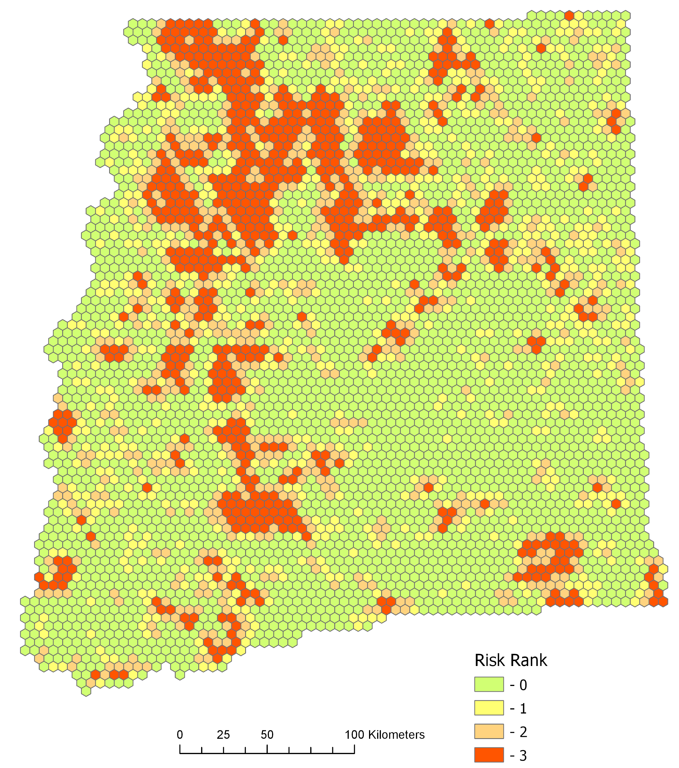
Composite Vulnerability Index
Fire Burn + Lightning Exposure Climatologies
2001 to 2019
Notes:
(We plan to put a map containing yearly composites of DNR, SMAP, and LIS fishnets for 2001-2019)
Shown here is the Final Composite Climatology Map for the years of 2001-2019. This will show areas of relative increased risk of lightning-ignited wildfires given drier soil conditions, high lightning exposure/count, and an established history of being burned.

Slide 15
Composite Vulnerability Index
Fire Burn + Lightning Exposure Climatologies compared with vegetation moisture climatology for a qualitative visual analysis
2001 to 201
Notes:
(We plan to put a map containing yearly composites of DNR, SMAP, and LIS fishnets for 2001-2019)
Shown here is the Final Composite Climatology Map for the years of 2001-2019. This will show areas of relative increased risk of lightning-ignited wildfires given drier soil conditions, high lightning exposure/count, and an established history of being burned.

Slide 16
Analysis
Calculated 679 cells in highest vulnerability category (between rank 2-6) out of 4587 cells
Total of 16,975 km at most vulnerable level
Notes:
*to be filled in*
Here we test for a statistical correlation between lightning and wildfires.

Slide 17
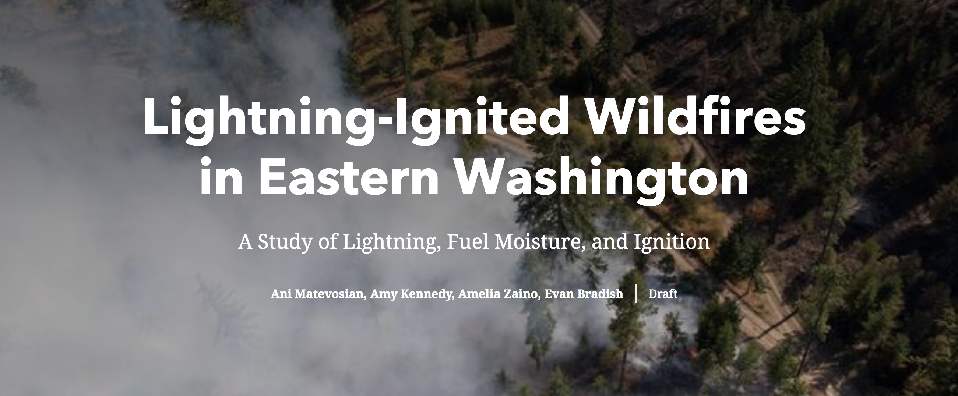
Story Map
An ArcGIS Story Map communicates the background narrative and our findings for the partner and broader community
Notes:
We created an ArcGIS story map to communicate the results and present the background narrative of Eastern Washington. This was a result of collaboration with our partner at the TNC Washington Chapter, and is tailored to his community. This will serve as outreach material to engage and educate the community on lightning-ignited wildfire.
-------------------------Image Information Below-------------------------
Image Credit: Unknown, TNC Washington
Image Source: Powerpoint Image Search

Slide 18
Conclusions
Cells with more frequent incidences of lightning captured by the ISS LIS overlapped with cells with more area burned
Highest index cells (most vulnerable) typically were in northwest corner of study area
Vector fishnet layers derived from EO data can be an effective, flexible way of conducting vulnerability assessment
Notes:
In conclusion, we found that areas with more frequent incidences of lightning generally overlapped with cells that had historically burned more. This also overlapped with dried cells, which is something we would expect to see.
The highest index cells – areas with the most lightning, that had burned the most, were typically found in the northwest portion of our study area.
Finally, we conclude that vector fishnet layers, derived from raster EO data, are effective yet flexible ways of conducting vulnerability assessments, as additional data may be tied into the dataset in the future.

Slide 19
Errors & Uncertainties
Lightning-ignited wildfires are more complicated than the three variables we decided to look at (fire, lightning, soil moisture). There are many other factors at play.
Piecing together data from different time periods
  ISS LIS data only went as far back as 2017
  Vegetation moisture data gaps
Method of ranking
Notes:
Some sources of errors and uncertainties include:
-Lightning-ignited wildfires are more complicated than the three variables we decided to look at (fire, lightning, soil moisture). There are many other factors at play
-From Piecing together data from different time periods (for example, the ISS LIS data only went as far back as 2017 so we couldn’t use as much lightning data as we wanted).

Slide 20
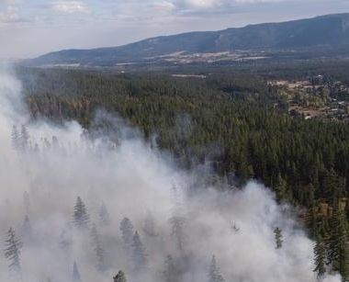
Future Work
Study effects of wildfire smoke on the health and air quality of the region
Incorporate more variables that influence likelihood of fire ignition by lightning (ladder fuel, topography, etc.)
Extend the study period, account for more lightning data
Include demographic data and proximity to populations
Image Source: John Marshall, TNC Washington
Notes:
Future studies could explore the effects of wildfire smoke on the health and air quality of the region Incorporate more variables that influence likelihood of fire ignition by lightning (ladder fuel, topography, etc.), Extend the study period to account for more lightning data (for example), and Include demographic data and proximity to populations (to enhance the risk analysis). We could also in the future incorporate in situ data on vegetation moisture or ground based lightning detection systems
-------------------------Image Information Below-------------------------
Image Credit: John Marshall, TNC Washington
Image Source: https://tncwashington.tandemvault.com/assets/28480621?lightbox_id=152048 We have written permission from the TNC to use these photos.

Slide 21
Brian Straniti, The Nature Conservancy Washington Chapter
Dr. Juan Torres-Pérez, Bay Area Environmental Research Institute, NASA Ames Research Center
Dr. Kenton Ross, NASA Langley Research Center
Dr. Christopher Schultz, Short-term Prediction Research and Transition Center (SPoRT), NASA Marshall Space Flight Center
Dr. Chris Hain, SPoRT NASA Marshall Space Flight Center
Dr. Vincent Ambrosia, NASA Ames
Gina Cova, NASA Ames Research Center
Zachary Bengtsson, NASA Ames Research Center
John Dilger, Spatial Informatics Group
Essence Raphael & Christine Evans, University of Alabama, Huntsville
Ian Lauer, NASA DEVELOP
Notes:
We would like to thank Brian Straniti of the Nature Conservancy for his collaboration throughout the project and our fellows Gina Cova and Zachary Bengtsson for their support and expertise. Thank you to everyone else throughout the various organizations who have helped us along the way.
This material contains modified Copernicus Sentinel data (2001-2017), processed by ESA.
Any opinions, findings, and conclusions or recommendations expressed in this material are those of the author(s) and do not necessarily reflect the views of the National Aeronautics and Space Administration.
This material is based upon work supported by NASA through contract NNL16AA05C.

