Slide 1
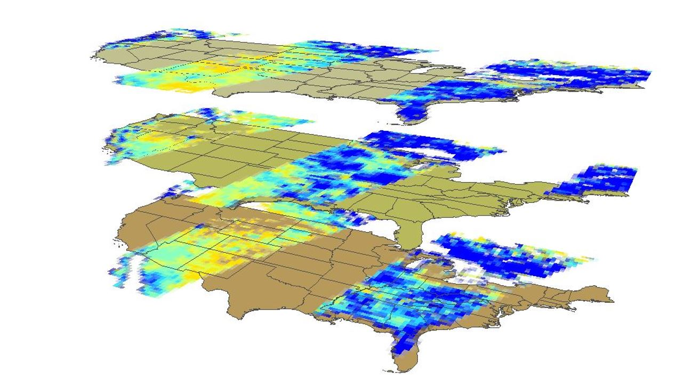

SOUTHEAST UNITED STATES AGRICULTURE
Yaping Xu (Project Lead)
Incorporating NASA Earth Observations into the USDA Southeast Regional Climate Hub Lately Identified Geospecific Heightened Threat System (SERCH LIGHTS) to Assist Farmers in Making Informed Decisions on Water and Crop Management
Yousra Benchekroun
Kimberly Berry
Grant Bloomer
Notes:
We are the Southeast United States Agriculture Team, the members involved are Yaping, Yousra, Kimberly, and Grant. The project’s purpose is to incorporate NASA Earth Observations into our partner’s tool, SERCH LIGHTS, in order to help farmers make informed decisions on Water and Crop Management.

Slide 2
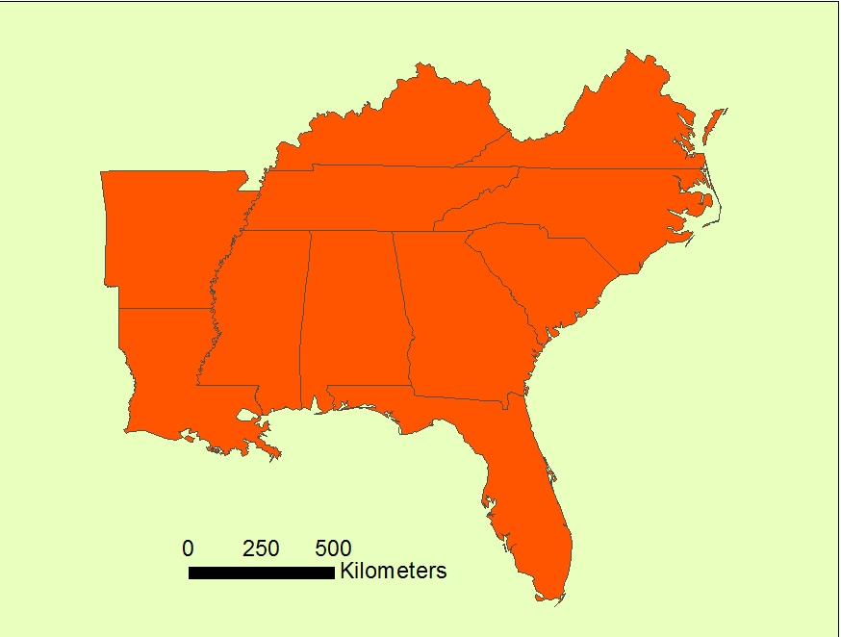
Study Area
Southeast USA
11 States
Alabama, Arkansas, Georgia, Florida, Kentucky, Louisiana, Mississippi, North Carolina, South Carolina, Tennessee, and Virginia
Includes all states receiving services from SERCH
KY
VA
TN
NC
AK
SC
MS
AL
GA
LA
FL
Notes:
Our project’s study area includes 11 states from the Southeastern region of the United States. All 11 states receive services from our project partners: Southeast Regional Climate Hub (SERCH)
Although this study area was the primary context of our concern, we produced our own dataset of the region.

Slide 3
Study Period
Daily data 2015-2016
SMAP
Daily Data
SCAN
In Situ Data
NLDAS
Hourly
Data
2015-Present 1980-2015 2006-Present
Notes:
The project’s study period consists primarily of daily data from 2015 to the present day.
However, the data is also related to soil moisture climatology from 1980-2015, daily data for 36 years.
We selected this amount of time (36 years) as this was the historic data available from the model we were using (NLDAS).
We used daily data from 2015 to current data through the NASA observation satellite, SMAP and the ground-station server SCAN.

Slide 4
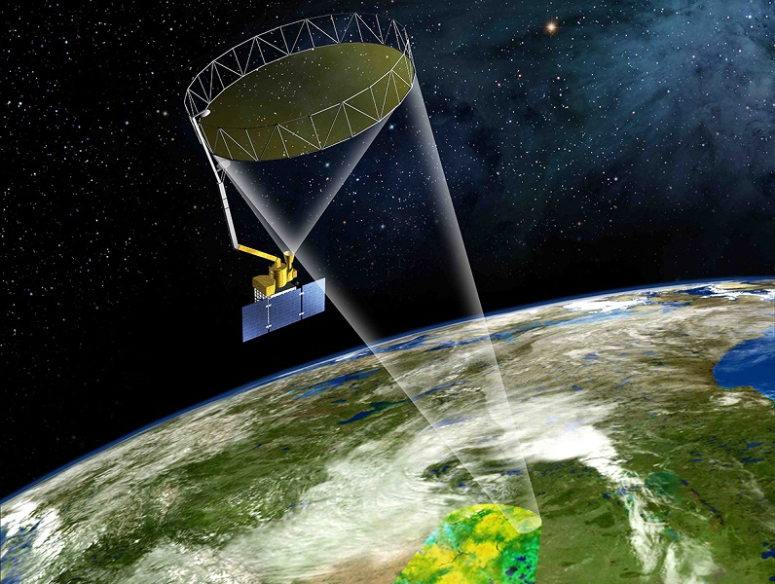

Objective
Improving LIGHTS
Demonstrating access to SMAP data
Incorporating soil moisture data in SERCH LIGHTS tool for better utility
Creating Reference Layers
Developing math and computer logic for augmentation of LIGHTS
Notes:
The project’s objective is to improve our partner’s tool, SERCH
LIGHTS (Lately Identified Geospecific Heightened Threat System) in order to assist farmer’s informative decisions on water and crop management.
The project’s purpose is to ultimately improve the SERCH LIGHTS tool’s accuracy by incorporating NASA Earth Observation SMAP, and data from the NLDAS model, into the tool.
Our objective is to therefore come up with three final products:
To grant our partners (SERCH) access to SMAP data
To create reference layers
To provide an algorithm (math and computer logic) for the development of the LIGHT system.

Slide 5
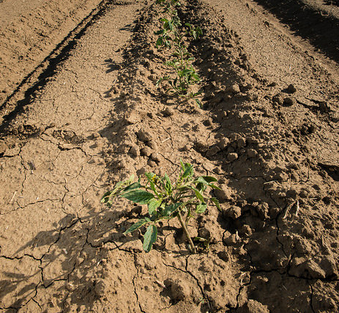
Community Concerns
Regional climate variability impacts on agricultural and forestry sector
Drought impacts on managing water resources in agriculture and forestry
LIGHTS tool lacks soil moisture data
Image Credit: USDA
Notes:
Why is our project important?
There is significant concern on climate variability in the region on the forestry and agricultural sectors. Drought impacts are particularly significant for managing water resources in agriculture.
Our partner USDA Southeast Regional Climate Hub deals with this concern through their tool, LIGHTS (Lately Identified Geo-Specific Heightened Threat System). The tool assists farmers with making informed decisions on water and crop management by identifying and alerting its users on drought.
It identifies drought through changes in two factors: 1. Temperature patterns and 2. Precipitation patterns
However, the tool does not look at another third important factor for detecting agricultural droughts: soil moisture patterns. It is important to look at soil moisture to better assist farmers in dealing with droughts.

Slide 6
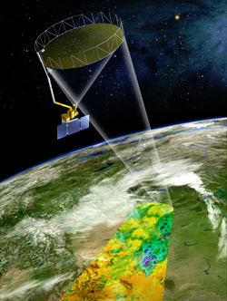
NASA Satellites/Sensors Used
Platform & Sensor | Parameter | Use
Soil Moisture Active Passive (SMAP), Passive Radiometer | Soil Moisture, Level-3, 36km Resolution | Soil moisture data will be incorporated into the SERCH LIGHTS tool to increase the relevance of the tool for water management purposes and better drought prediction
Image Credit: NASA
Notes:
The NASA Earth Observation we use is called SMAP, Soil Moisture Active Passive. It was launched on the 31st of January 2015.
As its name indicates, this Earth Observation detects soil moisture patterns on the Earth. We used the Level 3, 36km resolution soil moisture data from the SMAP satellite.
Our project’s purpose was to incorporate soil moisture data from this Earth Observation into our partner’s tool, to increase the relevance of the tool for better drought prediction. However, since it was launched very recently, we only have approximately less than 2 years worth of soil moisture data.
SMAP Level-3 data has a 50 hour Latency

Slide 7
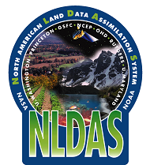
Ancillary Data used
Data | Parameter | Use
NASA North American Land Data Assimilation System (NLDAS) | Soil moisture | Soil moisture data will be incorporated into the SERCH LIGHTS tool to increase the relevance of the tool for water management purposes and better drought prediction
Image Credit: GSFC
Notes:
NLDAS, or NASA North American Land Data Assimilation System is a model that collects soil moisture data.
Given that we only had 2 year data from SMAP, we used the NLDAS model for historical records of soil moisture data in the region. We used 36 years of soil moisture data from NLDAS, from 1980-2015.
Getting historical record of soil moisture data was essential for the second part of our methodology: when making the calculations of mean and standard deviation.

Slide 8
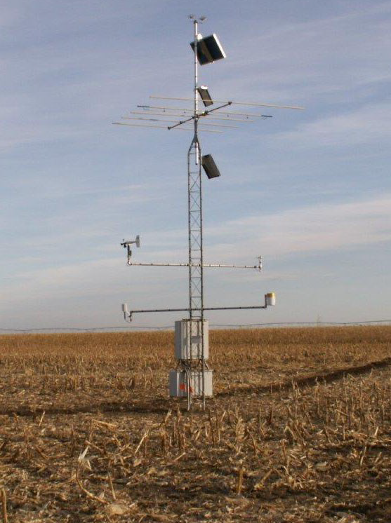
Ancillary Data Used
Sensor | Parameter | Use
USDA Soil Climate Analysis Network (SCAN) | Soil Moisture | SCAN Soil Moisture data from testing stations in the study area were used for validation. The sensor was a dielectric constant measuring device, at a depth of 5.08cm
Image Credit: NRCS
Notes:
Finally, we used SCAN - also known as - USDA Soil Climate Analysis Network. SCAN is a sensor with ground-based stations scattered all throughout the United States.
We used the soil moisture data collected at a depth of 5.08cm, in four selected SCAN stations in the Southeast of the United States.
We used data from this sensor for accuracy assessment of our project results. The entire validation process was based on comparing values from the test-SCAN stations with values from SMAP and NLDAS.

Slide 9
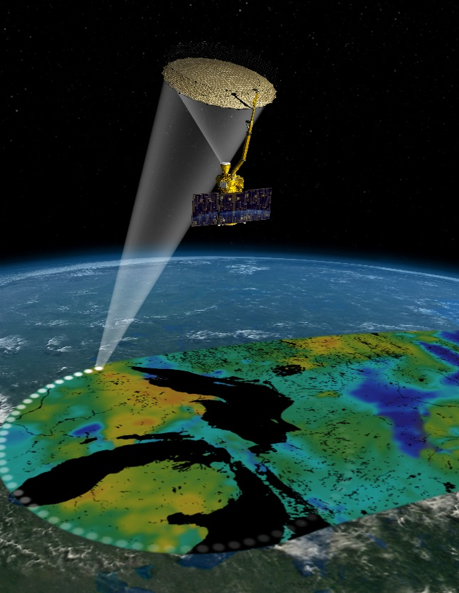
Methodology
Part I
Acquire Actual Soil Moisture Content
L3_SM_P (Soil Moisture) product downloading
Data preprocessing
Image Credit: NASA
Notes:
The Methodology consists of three main parts:
Part I
Getting the soil moisture data:
This includes the daily 6am (local solar time) data from SMAP for all of its 2 years (2015-2016), and the 36 year soil moisture daily data from NLDAS at 1200 UTC (approximate 6am local time for the center of continental U.S.).
This part of the methodology was more challenging. Given how large the data was, and that the individual data cover 5 time zone, retrieving data from the NLDAS website was a long manual process. It took approximately 2 weeks to obtain our data in full, and that was with the much appreciated help of our science advisors, and the full use of our entire office’s computers for an entire day.

Slide 10

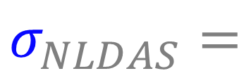
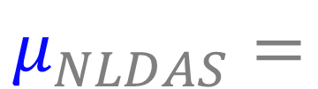

Methodology
Part II
$$\frac{x_{SMAP}−μ_{NLDAS}}{σ_{NLDAS}}$$
SSI =
Finding the Normal Conditions of Soil Moisture
NLDAS was used because the data has been collected from 36 years
The Standardized Soil Moisture Index (SSI) for each day of the year*
*Excluding February 29th
$$x_{SMAP} =$$
SMAP Soil Moisture (Current Date)
$$μ_{NLDAS}=$$
Average of Date
(36 years of NLDAS)
$$σ_{NLDAS}=$$
Standard Deviation of Date (36 years of NLDAS)
Notes:
Part 2 of the Methodology:
Calculating the Mean and standard deviation from the NLDAS data and SMAP data, and calculating the Standard Soil Moisture Index (SSI):
This process was achieved through processing the downloaded data into a model created by our team in ArcMap. Performing the calculations by processing the data in model-builder, helped our team immensely with making up for the time lost throughout the downloading process.
SSI equation we used was:
SSI = (Curr. Avg. SoilMoist – Hist. Avg. SM) / Hist. StdDev SM
Curr.Avg. SoilMoist → the soil moisture content from SMAP
Hist. Avg. SM → mean value of soil moisture content for the past 36 years from NLDAS
Hist. StdDev SM → the standard deviation of soil moisture content for the past 36 years from NLDAS

Slide 11
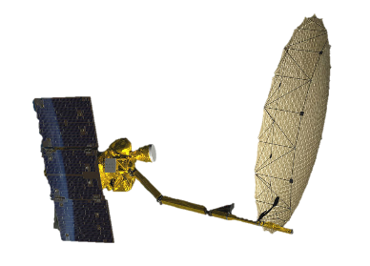
Methodology
Part II I
0.72
Accuracy Assessment
Compare SMAP soil moisture data with the SCAN data
The target correlation was desired to be equal to or above 0.7
0.78
Notes:
3. Point Validation:
This part of the methodology is an accuracy assessment to determine the accuracy of the SMAP and NLDAS soil moisture data. We selected four SCAN stations, and compared their data values with SMAP, and NLDAS point values. The desired correlation was set to be equal to or above 0.7.

Slide 12
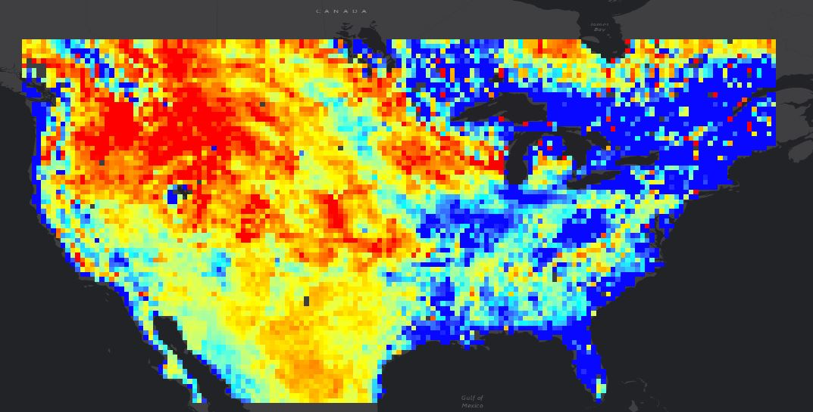

Results
Standardized Soil Moisture Index (SSI) Maps
Standardized Soil Moisture Index maps of 3 consecutive days
1st July, 2016
2nd July, 2016
3rd July, 2016
The Z-score is a simplified version of the SSI
Low: -5 High: 5
Notes:
These three maps are an example of what the Standardized Soil Moisture Index maps look like.
The SSI is a simplified z-score, thus indicating how many standard deviations a SMAP value is from the historic mean.
The red values indicate a low z-score, which means that the values are lower than the historic (36 years) soil moisture average of the United States.
The blue values indicate a high z-score, which means that the values are higher than the historic (36 years) soil moisture average of the United States.
The layers are visible in chunks in the SSI because they reflect the SMAP data, which is taken fully in a three day coverage. It is why three layers of three consecutive days are required to view the entire country.

Slide 13
Results
Station ID2013 (GA)
Station ID2024 (MS)
Station ID2053 (AL)
Station ID2006 (TX)
Year 2016: 0.9124
Year 2015:
0.6802
Year 2016: 0.6817
Year 2015:
0.7634
Point Validation
The four stations were located in Georgia, Mississippi, Texas, and Alabama
The correlations found throughout the stations range from about 0.5 to 0.9 (quite high)
Year 2016:
0.245
Year 2015: 0.6526
Year 2016:
0.9177
Year 2015: 0.4612
Notes:
This slide shows the results of the SMAP validation performed with the four selected SCAN stations.
We also performed NLDAS validation with the SCAN stations, and the correlation values were high.
The SMAP validation values are mostly very good, with either higher than a 0.7 or close to 0.7; the highest correlation value being at 0.9177.
However there are two significantly low values, the exceptions are the Texas station in 2016 and Alabama Station in 2015.
Texas 2016 value: 0.245
When analyzing the graph, the relationship in general looks correlated, but the relationship changes drastically on a specific date (April 31st, and continues until the present). Speculation is that this discrepancy may be caused by the Texas flood.
Alabama 2015 value: 0.4612
From late August to end of October, SMAP data are much lower than SCAN, as the SCAN data has uncharacteristically risen (something wrong with the sensor).

Slide 14
Results
SMAP Values
SCAN Values
Notes:
Validation graph based on SCAN Station WTARS in Alabama, in the year 2016
Indicates a high correlation of 0.9177 between SCAN station and SMAP, 2016 values
This graph is an example of the accuracy assessment performed on two stations: the highest correlation and lowest correlation.
We performed this point validation process, comparing SMAP and SCAN values for all four selected SCAN stations, in both years 2015 and 2016.
To do so, it was important to match up the SMAP and SCAN daily data since SMAP consisted of days with no data (due to its three day coverage). Days with missing values were dropped, and dates between the two sources were re-arranged.
The value 0.9177 is the highest correlation value found, and indicates SMAP’s accuracy.

Slide 15
Results
Texas Station 2016
SMAP Values
SCAN Values
Notes:
Texas 2016 value: 0.245
When analyzing the graph, the relationship in general looks correlated, but the relationship changes drastically on a specific date (April 31st, and continues until the present). Speculation is that this discrepancy may be caused by the Texas flood.

Slide 16
Conclusion
The Validation results show an overall high statistical correlation (R-Squared 0.7 to 0.9)
This indicates that SMAP is a reliable method of soil moisture monitoring
Thus, incorporating SMAP into the SERCH LIGHTS tool improves its usefulness
The tool’s expanded capability helps our partner’s subscribers deal with drought.
Notes:
The accuracy of using SMAP to monitor soil moisture content displayed a very high statistical correlation (R-Squared 0.7 to 0.9) with SCAN data, which indicated that SMAP is a reliable method of soil moisture monitoring.
By incorporating SMAP into the SERCH LIGHTS tool the service could enhance crop yield, water resource management, and optimize decision making in times of drought by giving accurate soil moisture measurements across the Southeast United States.

Slide 17
Errors and Uncertainties
1. Time Zones
2. NLDAS processing
3. Simplified SSI
4. Point Validation
5. Sensor distribution
The NLDAS data time zone versus SMAP time were not matching perfectly
Time consuming, manual data processing
Assumes normal distribution of historic soil moisture records
Area validation would be more valid
Sensor’s non-reflective of regional trends
Image Credit: NASA
Notes:
Time zone issues:
The NLDAS data time zone was Coordinated Universal Time (UTC). To match with the 6am SMAP local solar time , we should ideally combine five time zone layers. However, in the absence of time, we selected 12am NLDAS data, which does not perfectly match the SMAP 6am time.
2. Data processing: the manual process of downloading NLDAS data was extremely slow, such a process increases the likelihood of error (i.e. downloading same day twice) despite our double checking of the data.
3. Simplified SSI: We assumed normal distribution for the historic records of the soil moisture, but we need to consider in the future, non-normal distributed data. Although this is more complicated, it would be more accurate.
4. We used point validation as we had no time for kriging interpolation: a surface (area validation). Since we did not have the time to change point to area, we used stations for point data.
5. Also, two point validation values were exceptionally low, indicating either a discrepancy between the two data sources and/or a fault in one of the sensors.
A problem in one of the sensors (SMAP, or SCAN) could be reflected in the data and its analysis.

Slide 18
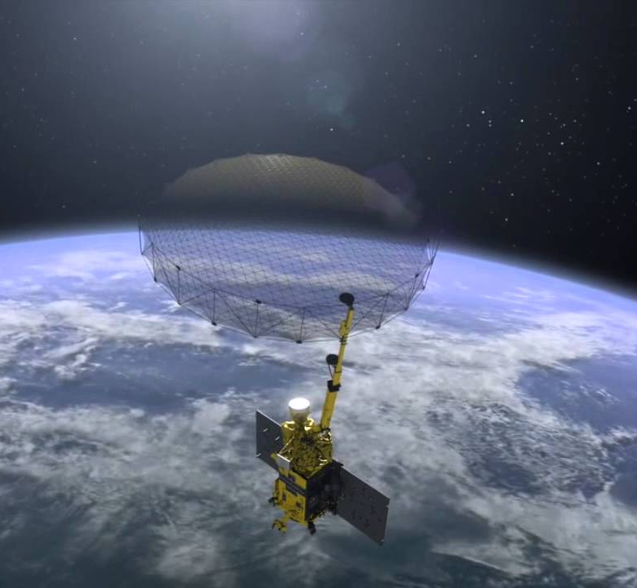
Future Work
Future research can:
Collect and reprocess NLDAS more completely
Alter the SSI calculation
Investigate long term climatic effects on soil moisture
Incorporate surface temperature data into LIGHTS tool
Image Credit: NASA
Notes:
1. As stated earlier we selected 1200 UTC NLDAS data, which does not perfectly match the SMAP 6am time. Future research could collect and reprocess NLDAS corrected to SMAP overpass time.
2. Another addition to the project could be to revisit the simplified SSI, or Z-score, in order to create a more accurate SSI. We assumed a normal distribution of the data which simplifies the reality, as the data could have non-normal distribution.
3. Our partners expressed interest in the investigation of long term climatic events, such as El Nino, and how these could alter the accuracy of the soil moisture measurements. A future project could examine climate records from other NASA Earth Observation Satellites to explore possible correlations.
4. A future project with our partner SERCH could look into incorporating soil temperature data using NASA Earth Observations, into their tool.

Slide 19
The Southeast United States Agriculture team would like to thank the mentors and partner who provided their time and support to make this project possible:
Partner
USDA Southeast Regional Climate Hub (SERCH) (End-user)
POC: Jennifer Moore Myers(Project Manager) and John Cobb(Lead Developer)
Mentors/Science Advisors
Dr. Kenton Ross
Dr. Dewayne Cecil
Bob VanGundy
Michael Bender

Slide 20
THANK YOU

