Slide 1
Impact Analysis FY 2017
Participants
Partners
Projects
Georgina Crepps Dash Cruz
Elaina Gonsoroski Sarah Carroll
Notes:
Design looks awesome! - Make contrast between “projects” and the circle stronger; hard to read

Slide 2
DEVELOP Impact Analysis
Evaluation/Tracking
Development
Compilation & Assessment
Determining the best metrics to track:
Advisors
Participants
Partners & End Users
Projects
Workforce development programs:
Professional development
Project Standards
Quantifiable Guidelines
Analyzing collected data
Determining best implementation practices
Periodic review of devices previously implemented
Notes:
No INTERNS!!!!! “Participants” is the probably the best word to use here.

Slide 3
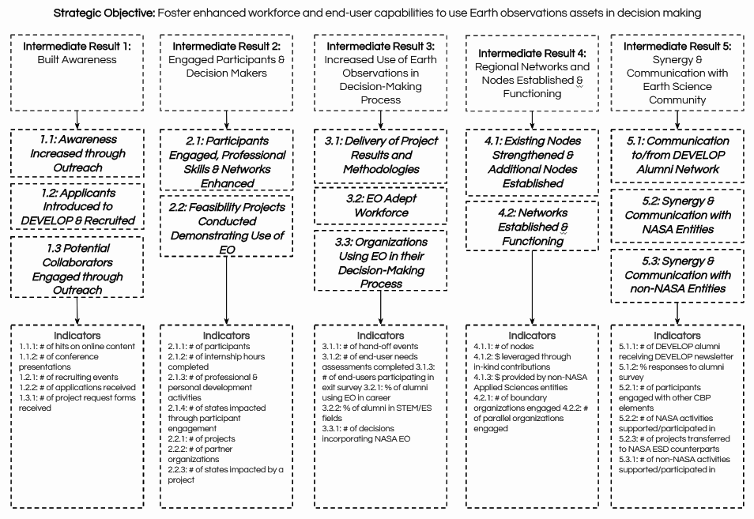
Results Framework & Indicator Tracking
Challenge 1
Challenge 2

Slide 4
Node Tracking Metrics
&
Equal Futures Reporting
Collect node tracking spreadsheets from all DEVELOP node locations
Leadership and gender
Resources used
Partner information for projects
Events supported
Equal Futures Reporting
Collect the required information from NPO
Includes information about participants such as gender, age, veteran status, education level etc.
Compile and submit an annual fiscal report to NASA HQ

Slide 5
Alumni Survey
Lead Alumni Survey Activities
Distribute the alumni survey
Collect submissions and compile statistics
Create a report and presentation of final results
Assess the survey questions and update questions as needed

Slide 6
Participant Assessments
Lead Participant Growth Assessments
Distribute an entrance and exit Participant Growth Assessment each term
Collect submissions and compile statistics
Report results
Evaluate the assessment questions and update as needed

Slide 7
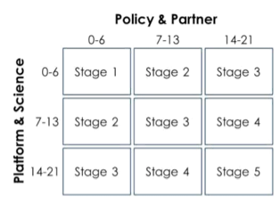
Project Strength Index (PSI) Tracking
Objective tool to track and evaluate projects
Calculated on a points system
Based on strength of applied science, strength of partnership, and capacity building component

Slide 8
Tracking Partnerships and Partner Capacity
Pre/Post-Project forms
Partner follow-up forms
Partnership longevity
Synthesis and analysis

Slide 9
Digging Deep:
Project Level Impact Analysis
New experiment!
In-depth analysis of impacts for a specific project
Three different application areas
Notes:
So because you have this slide, I would move slide 4 to be either before or after, i.e. use this to introduce the idea and then slide 4 as providing more details or slide 4 as the introduction to the concept, and then 10 as the details of aplication

Slide 10
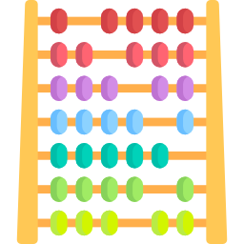
Socioeconomic
Goals:
Determine analytic method:
Project oriented
Application of this new method(s):
Introduction of analyses
Compile analysis reports:
Choose Analytic Approach
Specify Metrics
Identify Impact Relationships
Collect Data
Quantify Impacts
Possibly Monetize Impacts
Report Results
Impact Analysis
Notes:
Question about this slide: are you saying two because of te SOW? These analyses are your three individual projects. I would take out the “two”and just use this slide as an introduction to the concept

