Slide 1
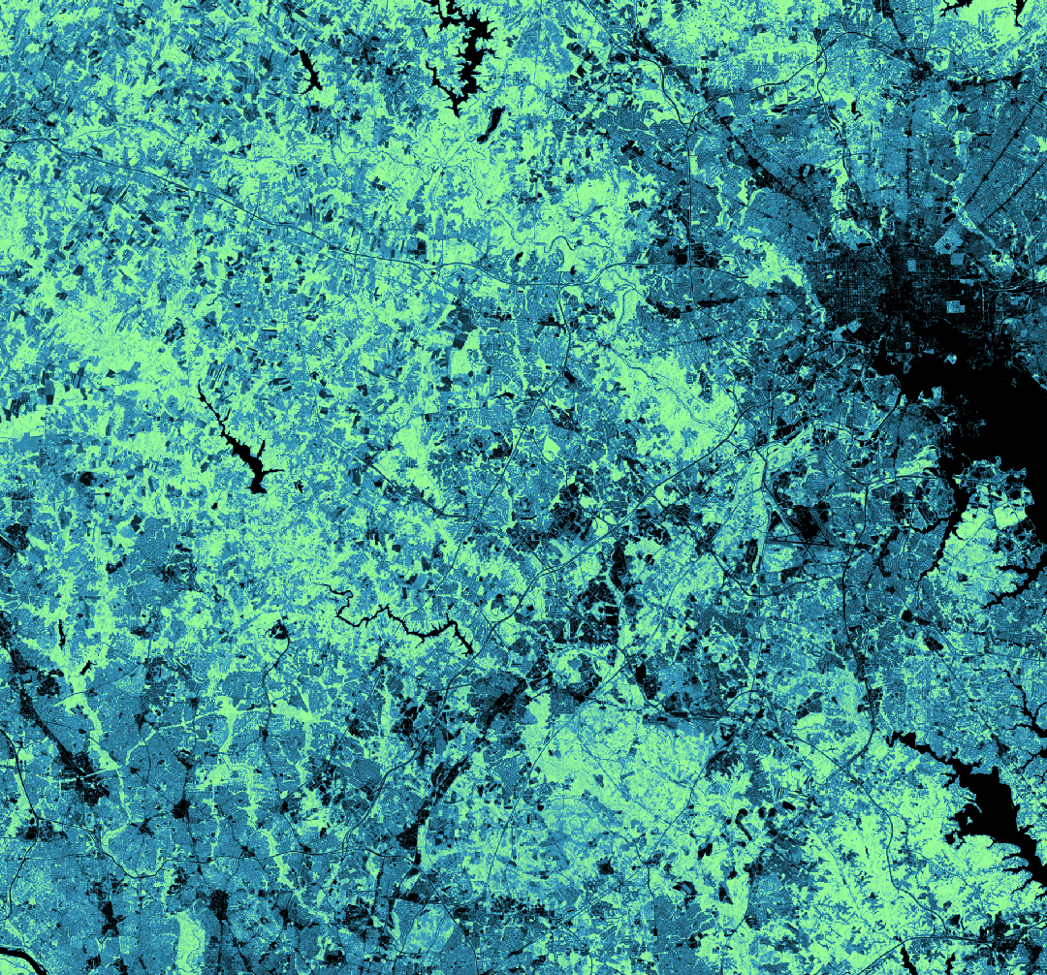
PATUXENT WATER RESOURCES
Assessing Land Cover and Land Use Change to Inform Watershed Resource Management
Stephanie Rockwood
Shaifali Prajapati
Connor Holzmann
Kyung “Robin” Kim
Virginia – Langley | Spring 2019
Notes:
Good Morning/Afternoon, my name is [Stephanie] and this is the Patuxent Water Resources team.
[Introductions]
Today we will be discussing our project to assist in the management of the Patuxent River Watershed.
Image Source: Website Image (Created by Team)

Slide 2
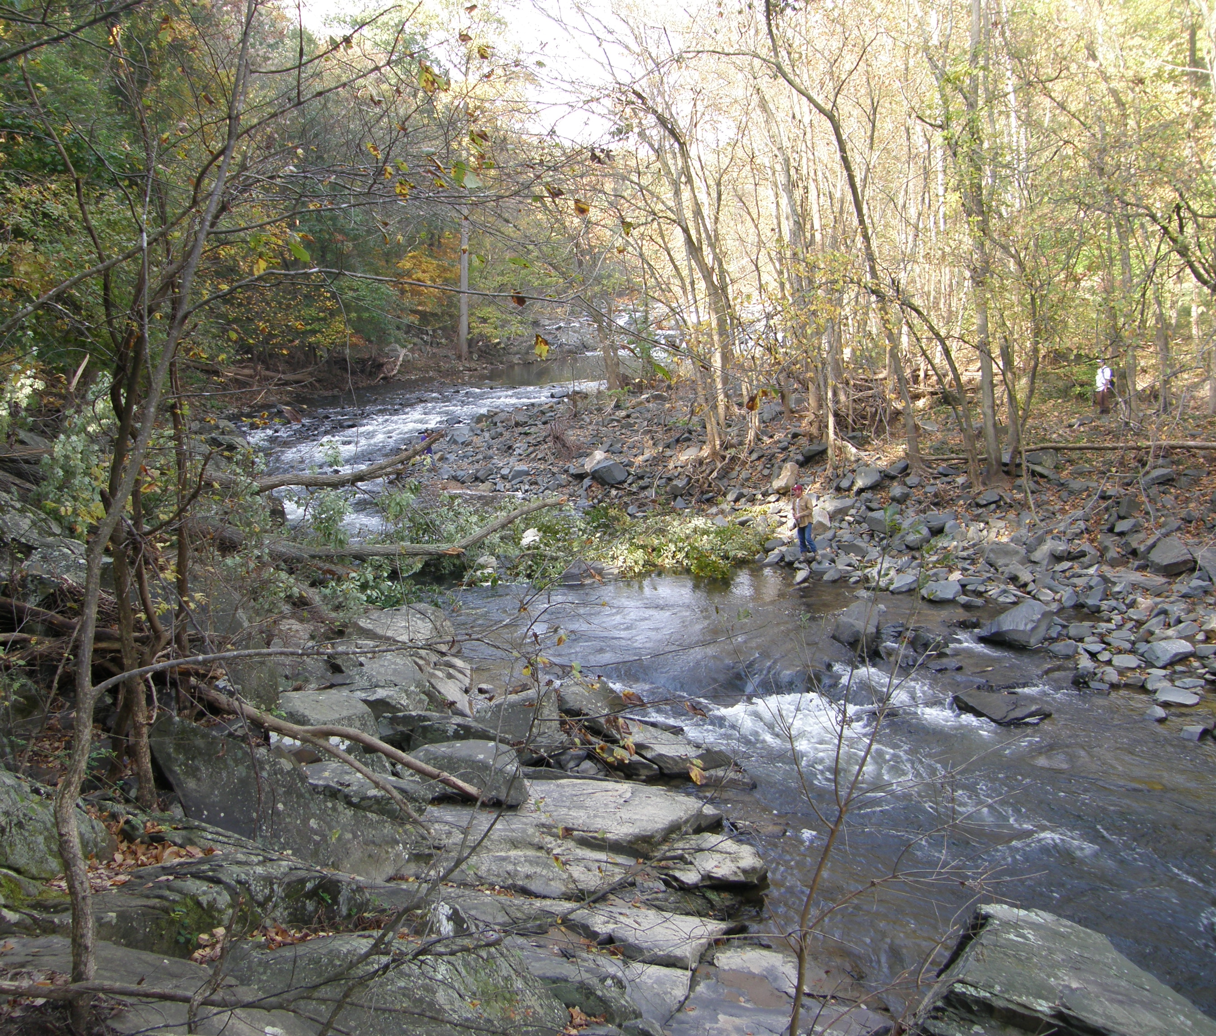
Background
The Patuxent River Watershed is one of six major river basins that drain into the Chesapeake Bay.
Spanning 1,400 square miles, the watershed falls within the boundaries of seven counties in Maryland.
Reservoirs in the Upper Portion supply drinking water to about 650,000 residents in the greater D.C. area.
Image Credit: Connellm
Notes:
[Stephanie]
The Patuxent River Watershed in Central Maryland is a major contributor to the contents of the Chesapeake Bay. With an area of over 1,400 square miles, it falls within the boundaries of seven counties. Reservoirs in the Upper Portion supply drinking water to about 650,000 residents in the greater D.C. and Baltimore areas.
Image Source:
https://commons.wikimedia.org/wiki/File:Trees_lining_the_Patuxent_River.jpg
Creative Commons Attribution-Share Alike 3.0 Unported License

Slide 3
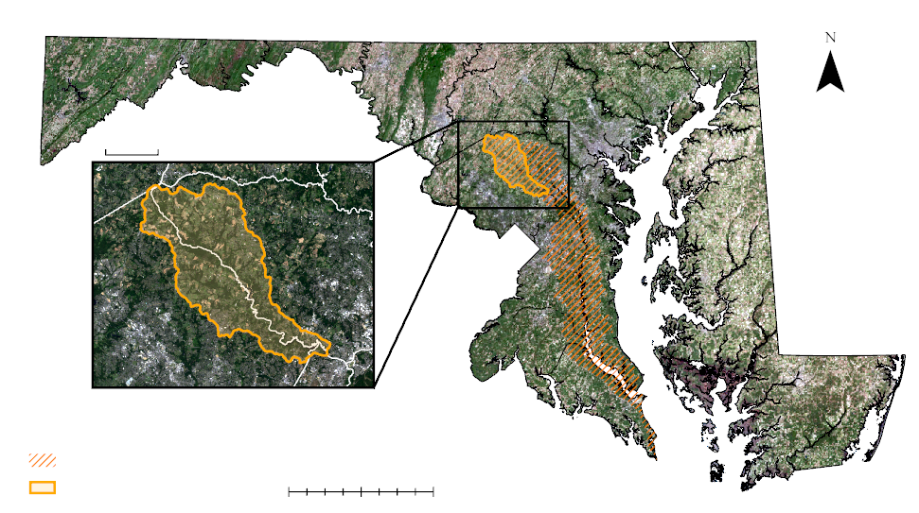
Study Area
5 miles
Howard County
Montgomery County
P.G.
Patuxent Watershed
0 10 20 40 miles
Study Area (132 mi²)
Notes:
[Stephanie]
Our project studied this upper portion of the watershed between Howard, Montgomery, and Prince George’s Counties. This 132 square mile area contains the Triadelphia and Rocky Gorge reservoirs, which are critical to the local water supply.
Image Source: Study Area Map (Created by team)

Slide 4
Project Partners
Patuxent Reservoirs Watershed Protection Group (PRWPG)
Technical Advisory Committee (TAC)
Multi-jurisdictional body with representatives from the Washington Suburban Sanitary Commission and Howard, Montgomery, and Prince George’s Counties.
Annual assessments regarding the state of the watershed and high priority items for safeguarding drinking water.
Action-oriented approach to the reduction of pollutant loads, preservation of open spaces, sustaining biological integrity, and public outreach.
Notes:
[Stephanie]
Our project partnered with the Patuxent Reservoirs Watershed Protection Group, Technical Advisory Committee. This multi-jurisdictional body is made up of representatives of the three counties in our study area, as well as the Washington Suburban Sanitary Commission. The group releases annual reports on the state of the watershed and recommends high priority items to safeguard drinking water. Elevated nutrient inputs to the river reduce overall water quality. As such, the TAC’s primary focus is on the reduction of pollutant loadings. Other concerns addressed by the committee include the preservation of open spaces, sustaining biological integrity, and public outreach.
Image Source:
Project Partner

Slide 5
Objectives
Incorporate NASA Earth observations into pre-established mapping procedures
Draw on strengths of land cover data provided by NOAA, USGS, & USDA
Produce a time series of coherent, land cover maps
Analyze land use change using land change matrices
Conduct comparative analysis between synthetic products and the TAC
Offer a reproducible methodology to the partners
Notes:
[Shaifali]
In order to better fulfill their mission, the TAC needs to know the state of the land. While they had comprehensive land use and land cover data for 2002 and 2010, they were in need of additional coverage and additional information. We set out to produce a time series of coherent, land cover maps that we could then compare to the TAC’s current datasets. This time series draws on the strength of datasets already available from the USGS, USDA, and NOAA. By providing this more holistic vision of the watershed, we assisted our partner in their decision-making, as well as in their capabilities moving forward by offering them a reproducible methodology.

Slide 6
NASA Earth Observations
Landsat 5 TM
Landsat 8 OLI
Notes:
[Shaifali]
Our imagery was sourced from Landsat 5’s Thematic Mapper and Landsat 8’s Operational Land Imager. The long lifespan of Landsat 5 in particular allowed us to reach back and provide a previously unseen analysis in the 1990s.
Image Sources:
www.devpedia.developexchange.com/dp/index.php?title=List_of_Satellite_Pictures
https://pixabay.com/illustrations/sunrise-space-outer-space-globe-1756274/

Slide 7
Methodology I
National Land Cover Database
+ Urban
Coastal Change Analysis Program
+ Wetlands
Cropland Data Layer
+ Agriculture
Notes:
[Shaifali]
We leveraged three existing datasets in the production of our synthetic maps. The National Land Cover Database from the USGS, for its accurate impervious surfaces and urban land cover. The Coastal Change Analysis Program from NOAA, for its detailed wetland data. And the cropland data layer from the USDA, which provides more specific information about agriculture and exactly what crops are being grown. It is important to note that these products are themselves derived primarily from NASA Earth Observations.
Image Sources:
https://www.mrlc.gov/viewer/ (Public Domain)
https://coast.noaa.gov/ccapftp/#/ (Public Domain)
https://nassgeodata.gmu.edu/CropScape/ (Public Domain)

Slide 8
Methodology II
Team
LULC
Synthetic Maps
TAC
LULC
NLCD
CCAP
CDL
Time Series
1996
2001
Compare
2006
2011
Compare
2016
Notes:
[Connor]
Our study period consisted of a 20-year timeline with products produced at 5-year increments. The availability and the years of publication of these datasets varied widely, so we decided to fill gaps with our own classifications of Landsat imagery. This resulted in many different map combinations as we attempted to synthesize and standardize the several different resources. The products closest in time to the TAC’s own land use and land cover maps were then compared with them as promised.

Slide 9
Methodology III
2
5
Acquire Imagery
Assemble Data Sets
Create Training Sites
Clip and Mosaic
Classify by Random Tree
Create Synthetic Map
Assess Accuracy
Land Change Matrices
Team LULC
Synthetic Time Series
Notes:
[Connor]
Our methodology could be broken down further into two separate workflows. On the left-hand side we have our process for classifying imagery to fill our previously-described data gaps. This process happened twice and involved a traditional random tree classification of Landsat data. These land use/land cover maps were then fed into the second process which assembled the data sets and mosaicked them into each synthetic map, an operation that occurred 5 separate times. The resulting maps could later be compared to each other in a time series.

Slide 10
Results I
<1%
2%
3%
1%
15%
24%
39%
67% Match
TAC LULC (2002)
Team LULC (2001)
50%
31%
35%
Forest
Agriculture
Urban
Wetlands
Water
Notes:
[Connor]
Now, we would like to discuss our results. Our 2001 synthetic map was the closest year to the TAC’s 2002 edition. This map matched the partner’s at a rate of 67%, based on their broadest definition of land cover classes. This does not, however, speak to the accuracy of either map, only the similarities. One particular point of interest was the large expansion of the wetlands class thanks to the addition of the NOAA data.

Slide 11
Results I
<1%
2%
3%
2%
15%
22%
68% Match
TAC LULC (2010)
39%
Team LULC (2011)
50%
30%
36%
Forest
Agriculture
Urban
Wetlands
Water
Notes:
[Connor]
The outcome of our second comparison was very close to the first. The most recent TAC map was compared to our 2011 synthetic with 68% of the pixels agreeing on the same classes.

Slide 12
Results II
Notes:
[Robin]
Over the course of 20 years, the Upper Patuxent Watershed has seen gradual changes in land use land cover. For simplicity’s sake, we present to you a bar graph showing the net change. The urban and forest covers exhibited the greatest amount of gain of about 5000 and 6000 acres, respectively, while the greatest loss came from agriculture—a change of about 11000 acres. Our final product provided to the TAC contained a total of up to 47 classes allowing them to visualize change at a more detailed level, such as specific crop types and low, medium, or high-grade levels of development.

Slide 13
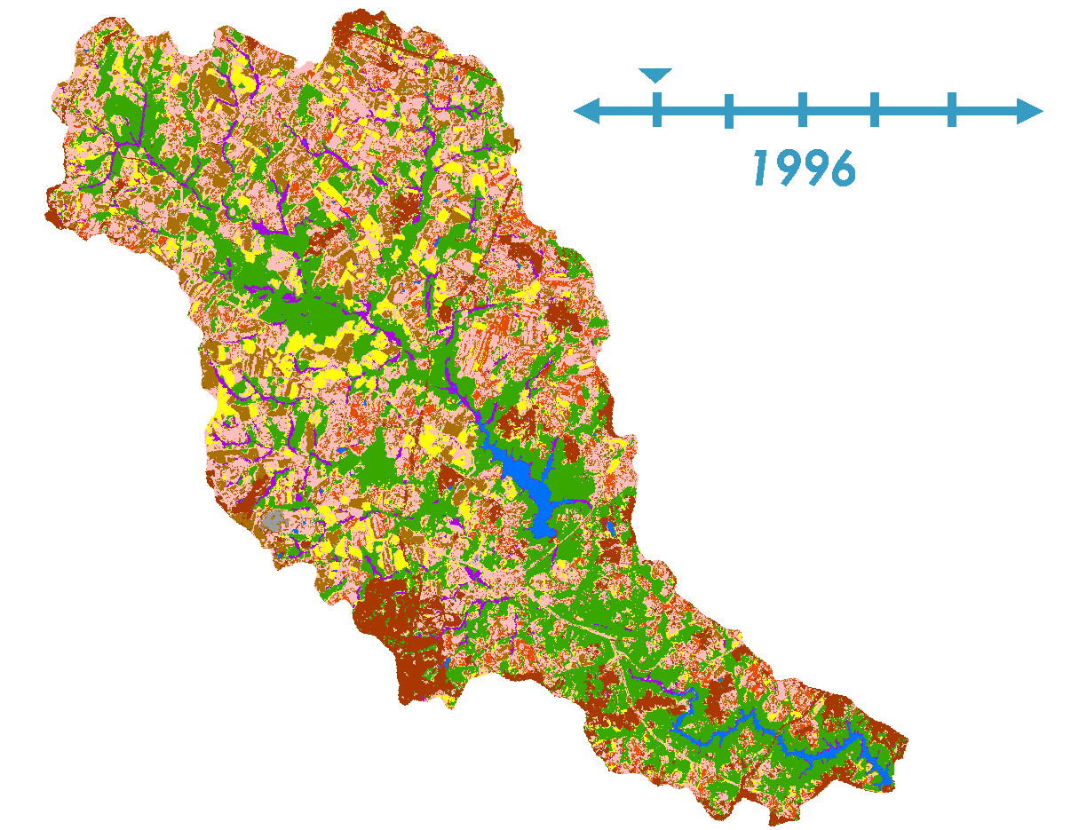
Results III
Corn
Soybeans
Winter Wheat
Other Agriculture
Forest
Urban
N
Water
Wetlands
Barren
Notes:
[Robin]
Here is an animated time series presented to you in a GIF. We isolated the three major crops, which include corn, soybeans, and winter wheat, in the region to show their variation across space and time. You may also notice the decrease in pink pixels and increase in green pixels overtime, indicating the change in agriculture to forest land cover as described in the previous slide.

Slide 14
Conclusions
Production of synthetic maps results in increased wetland and crop detail and is an efficient alternative to the TAC’s current mapmaking strategies.
Addition of historical data and more persistent coverage into the future will better inform decision-making within the PRWPG TAC.
Shifts from agricultural land use to forested and urban land cover suggest a decline in overall nutrient runoff within the watershed, leading to improved water quality.
Notes:
[Robin]
There are several important takeaways from this project. First, the production of synthetic maps could be an efficient alternative for the TAC as they continue to monitor land use change in their area. Furthermore, the team’s historical crop classification provides a more comprehensive understanding of how the watershed’s land use land cover has changed over time, allowing for smarter management practices. And finally, the team’s results suggest that a decrease in nutrient loading in the watershed is expected with the associated conversion of agriculture to other land covers.

Slide 15
Errors & Uncertainties
Differences in grid extents, cell sizes, and publication dates hindered efforts to synthesize such a wide collection of datasets.
Variation of classification methods between the team, the USDA, the USGS, and NOAA data introduced inconsistencies.
Lack of both ground truth data and reference imagery from the 1990s narrowed options for image classifications.
Notes:
[Robin]
Despite our best efforts to create uniform, consistent maps, inherent differences in the various datasets introduced marginal errors during the map making process. In addition, each agency has a unique method for classifying and verifying their land use land cover maps. And finally, our team’s customized land classification method lacked high resolution images to use as ground truth data to create more accurate maps for 1996 and 2001.

Slide 16
Jean Kapusnick, Montgomery County, MD
Steven Nelson, Washington Suburban Sanitary Commission
Susan Overstreet, Howard County, MD
Dr. Kenton Ross, NASA Langley Research Center
Dr. Makhan Virdi, NASA Langley Research Center
Patrick Frier, NASA Langley Research Center
Notes:
[Robin]
We would like to thank the following people for their support throughout the term. Without them, this project would not have been possible.

Slide 17
Accuracy Assessment
Confusion matrix of classified July 1996 Landsat image
 | Urban | Water | Forest | Crops | Hay/ Grass | Total | User Accuracy | Kappa
Urban | 101 | 4 | 1 | 3 | 5 | 114 | 0.89
Water | 0 | 10 | 0 | 0 | 2 | 12 | 0.83
Forest | 0 | 0 | 110 | 3 | 5 | 118 | 0.93
Crops | 3 | 0 | 3 | 85 | 13 | 104 | 0.82
Hay/Grass | 18 | 3 | 10 | 20 | 101 | 152 | 0.66
Total | 122 | 17 | 124 | 111 | 126 | 500
Producer Accuracy | 0.83 | 0.59 | 0.89 | 0.77 | 0.80 |  | 0.81
Kappa |  |  |  |  |  |  |  | 0.76
Confusion matrix of classified August 2001 Landsat image
 | Urban | Water | Forest | Crops | Hay/ Grass | Total | User Accuracy | Kappa
Urban | 116 | 0 | 0 | 1 | 4 | 121 | 0.96
Water | 0 | 10 | 0 | 0 | 0 | 10 | 1.00
Forest | 13 | 6 | 126 | 16 | 4 | 165 | 0.76
Crops | 6 | 0 | 1 | 63 | 10 | 80 | 0.79
Hay/Grass | 7 | 0 | 0 | 11 | 108 | 126 | 0.86
Total | 142 | 16 | 127 | 91 | 126 | 502
Producer Accuracy | 0.82 | 0.63 | 0.99 | 0.69 | 0.86 |  | 0.84
Kappa |  |  |  |  |  |  |  | 0.79
Notes:
Additional reference regarding accuracy assessments (errors & uncertainties), if questions arise post-presentation.

