Slide 1
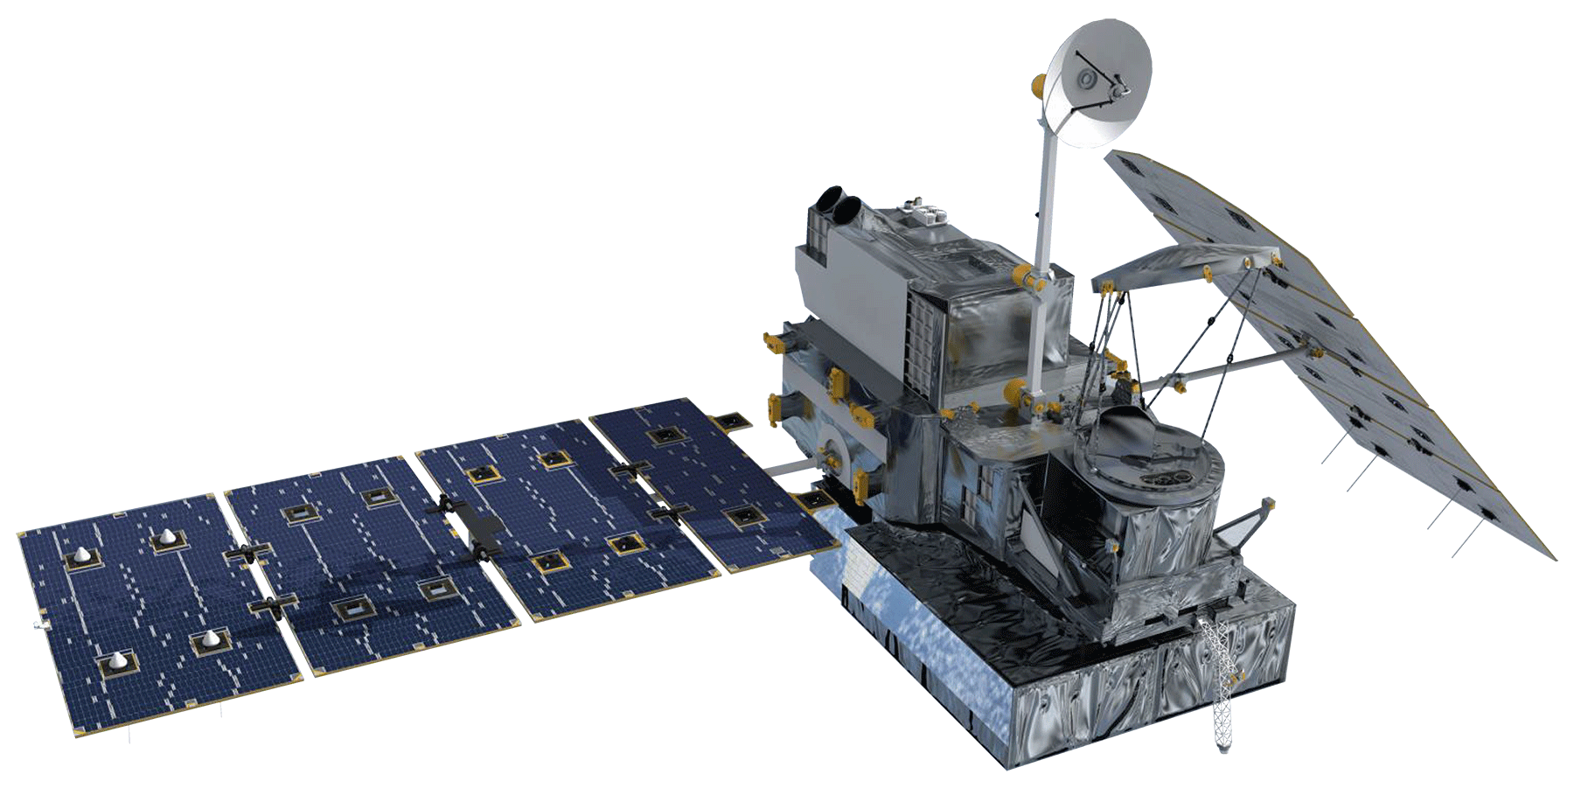
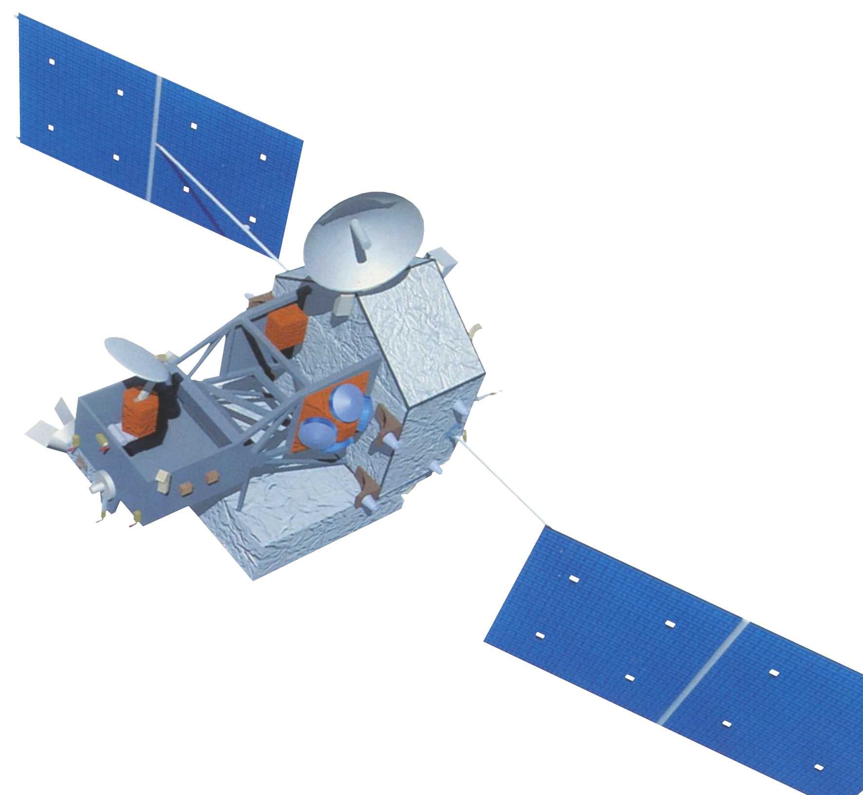
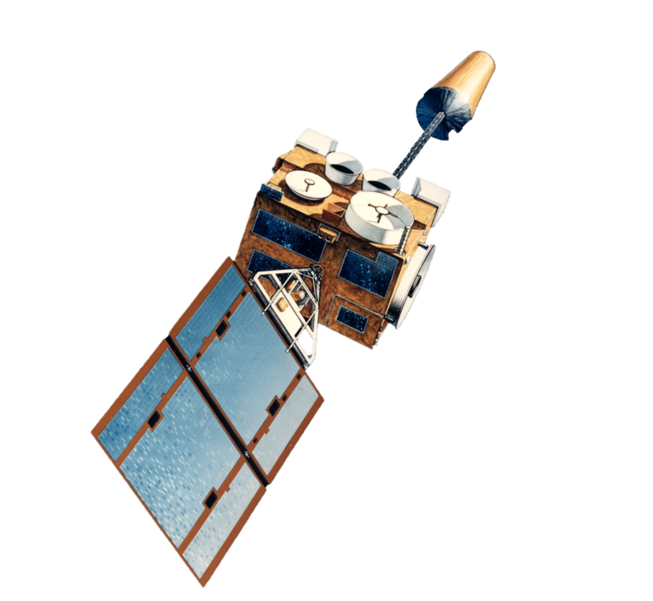
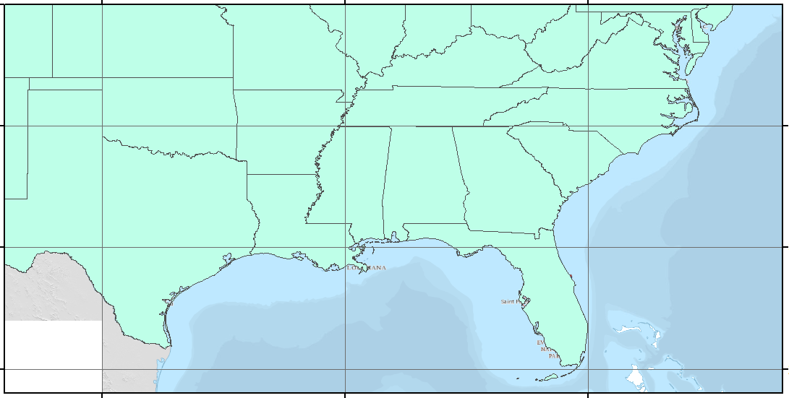
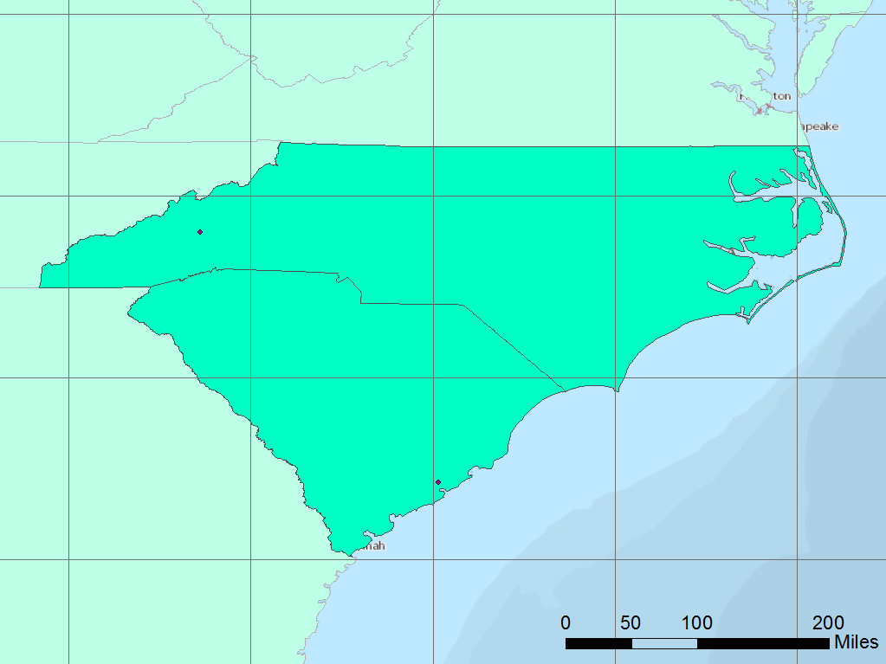
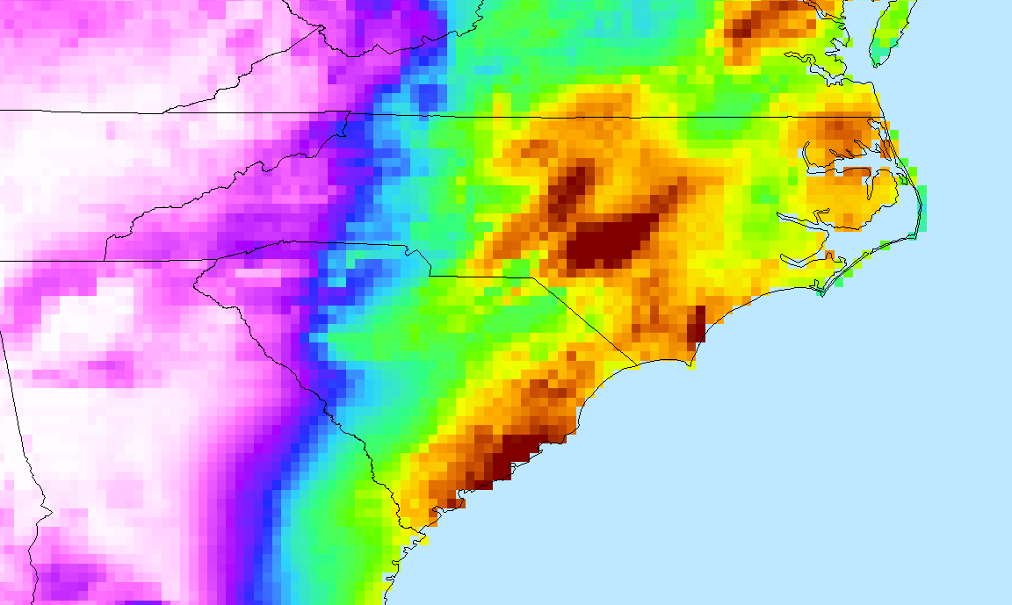
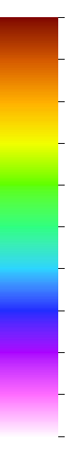
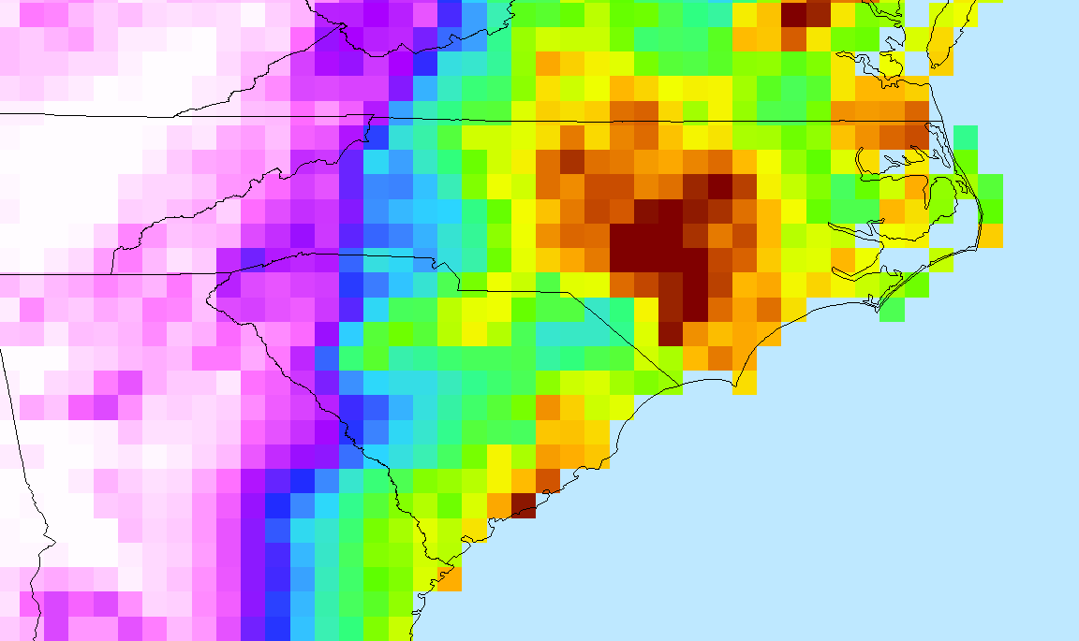
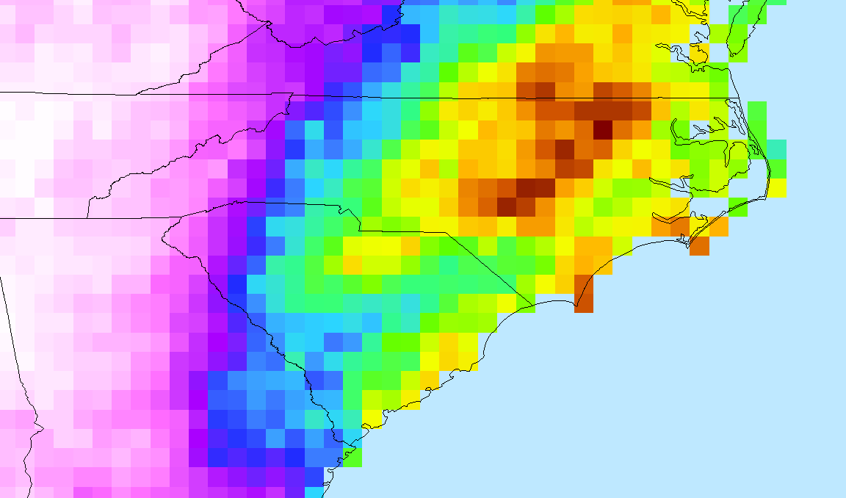





Utilizing Precipitation Estimates from NASA Earth Observations & NOAA Climate Data Records to Enhance Understanding of Extreme Events in the Carolinas
Abstract
Objectives
In October 2015, the state of South Carolina experienced a recording-breaking precipitation event leading to detrimental flooding that caused 19 fatalities and over one billion dollars of damages, which has prompted researchers and resource managers to enhance their understanding of extreme precipitation. This project explored multiple satellite-derived Quantitative Precipitation Estimates (QPE) in an effort to capture historical extreme precipitation patterns and risk-prone areas in both South Carolina and the greater southeastern United States. Using NASA Earth observations and NOAA Climate Data Records, we analyzed the benefits of using short-term, high-resolution datasets to measure extreme precipitation patterns compared to surface observations. Satellite observations included NASA’s Tropical Rainfall Measuring Mission (TRMM) and Global Precipitation Measurement (GPM) mission, as well as NOAA’s Precipitation Estimation from Remotely Sensed Information using Artificial Neural Networks Climate Data Record (PERSIANN-CDR). Surface observation records were retrieved from the Global Historical Climatology Network-Daily (GHCN-D) estimates, a network of global rain gauge stations. We highlighted areas prone to extreme precipitation with bias adjusted precipitation estimates. Results also assessed variability in precipitation measurements for recent years in an effort to integrate high-resolution QPE into regional climate resilience planning and to address spatial gaps in surface observation datasets. This project served to provide a better understanding of climate stressors for the Carolinas and to pose a discussion on effective methods of developing climate resilience practices integrated with satellite-derived datasets.
Demonstrate utility of NASA Earth Observations (NASA EO) & NOAA Climate Data Records (NOAA-CDR) to measure extreme precipitation in the southeastern United States
Evaluate performance of satellite-derived precipitation estimates (variability & bias) in comparison to rain-gauge observations
Collaborate with project partners (NEMAC & OCM) to engage data-user needs and develop a precipitation data-users guide
Earth Observations
NASA EO: GPM-IMERG 2014-present
.1° resolution
NASA EO: TRMM-TMPA 1998-present
.25° resolution
NOAA-CDR: PERSIANN 1983-present
.25° resolution
Data Acquisition
Visualization & Synthesis
Data Processing
Computation & Analysis
Study Area
Methodology
40 ° N
Subset to the Study Area
Quality Assurance
“Extreme” Value Calculations
Conditional Bias
Event-based Accumulation
35 ° N
Asheville, NC (NEMAC)
GPM-IMERG
TRMM-TMPA
PERSIANN-CDR
GHCN-D
30 ° N
Charleston, SC (OCM)
25 ° N
100 ° W
90 ° W
80 ° W
Cumulative Distribution Function
Scatterplots & Bias Charts
Percentile & Threshold Maps
Event Mass Curves & Maps
Results
Event Accumulation Maps for Hurricane Matthew (Sept 25, 2016 – Oct 10, 2016)
Cumulative Distribution Function for Satellite vs. Rain Gauge Measurements (2014 – 2016)
Bias Charts & Scatterplots for Satellite vs. Rain Gauge Measurements (2014 – 2016)
Rainfall (mm)
GPM-IMERG
PERSIANN
GPM-IMERG
PERSIANN
TRMM-TMPA
GPM-IMERG
>250
Bias Value for 90th Percentile
225
Percentile
200
175
150
Value (mm/day)
Value (mm/day)
Number of Gauges
Number of Gauges
Number of Gauges
TRMM-TMPA
125
TRMM-TMPA
All Satellites
GPM-IMERG
PERSIANN
TRMM-TMPA
100
75
50
Percentile
Satellite Measurement (mm/day)
25
PERSIANN
0
Value (mm/day)
Value (mm/day)
Rain Gauge Measurement (mm/day)
Rain Gauge Measurement (mm/day)
Rain Gauge Measurement (mm/day)
Project Partners
Conclusions
University of North Carolina at Asheville (UNC-A) - National Environmental Modeling and Analysis Center (NEMAC)
National Oceanic & Atmospheric Administration - Office for Coastal Management (OCM)
PERSIANN provided long-term (30+ years) information for accurate low to median value precipitation measurements in the region to better capture historical patterns and events.
GPM-IMERG and TRMM-TMPA better represented rain-gauge based (GHCN) precipitation observations at extreme values (90th percentile and above) compared to PERSIANN.
All satellite datasets displayed bias with GHCN as the true value of precipitation. However, GHCN stations showed limited spatial coverage and gaps in data record for some extreme events.
GPM-IMERG provided the highest spatial resolution data in the region and will be a useful dataset to measure precipitation trends as the period of data record increases in the future.
Team Members
Acknowledgements
We would like to thank our advisors, Brian Nelson and Olivier Prat, as well as our other mentors at the NOAA National Centers for Environmental Information, the Cooperative Institute for Climate & Satellites – North Carolina, and the NASA DEVELOP National Program Office, for their guidance and support of this research.
Michael VonHegel
Shelby Ingram
Andrew Shannon
Project Lead
Carolina Disasters
North Carolina - NCEI| Spring 2018

