Slide 1
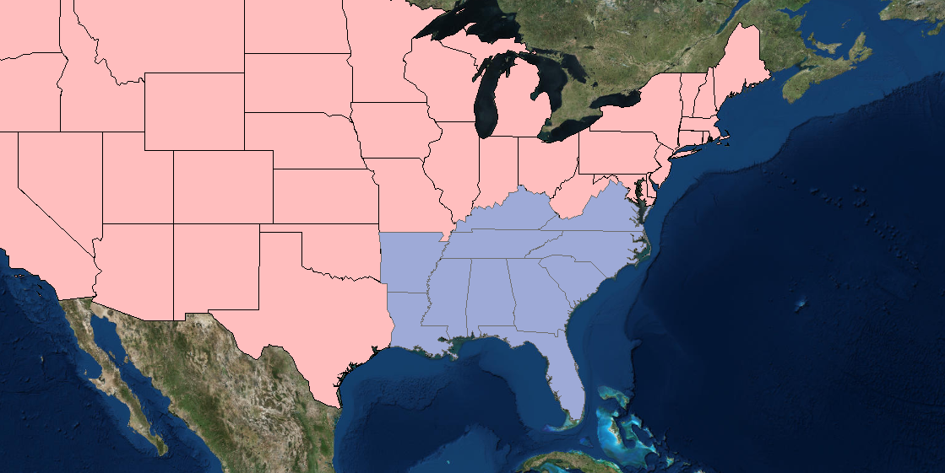
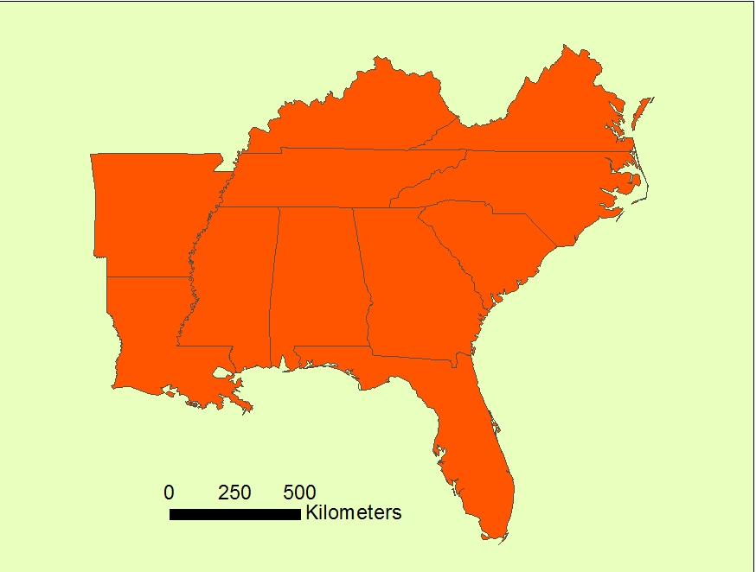
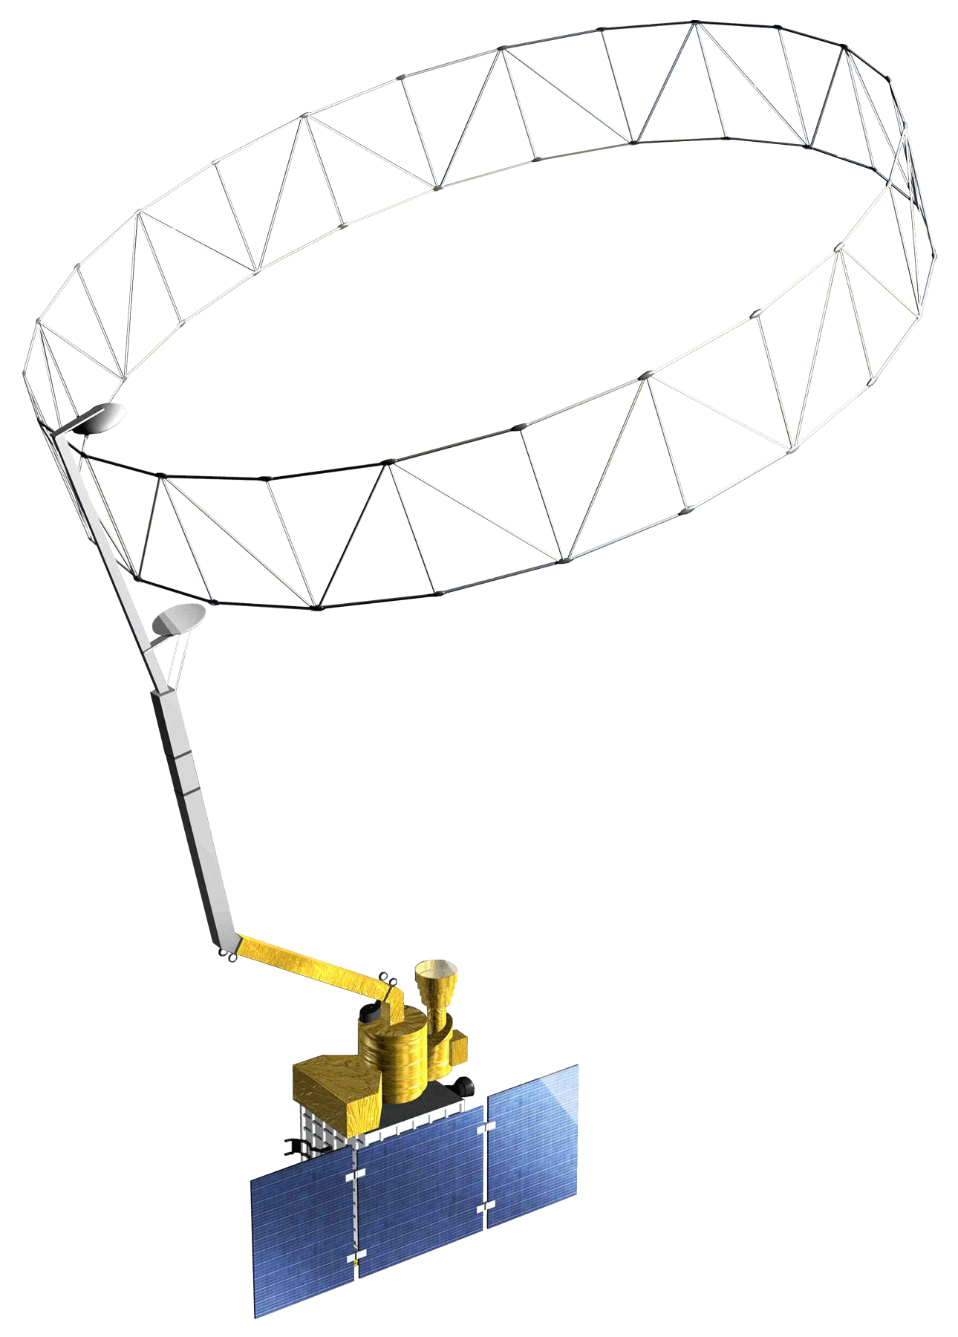
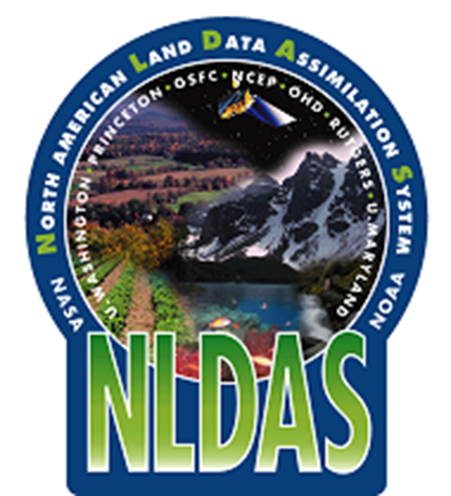
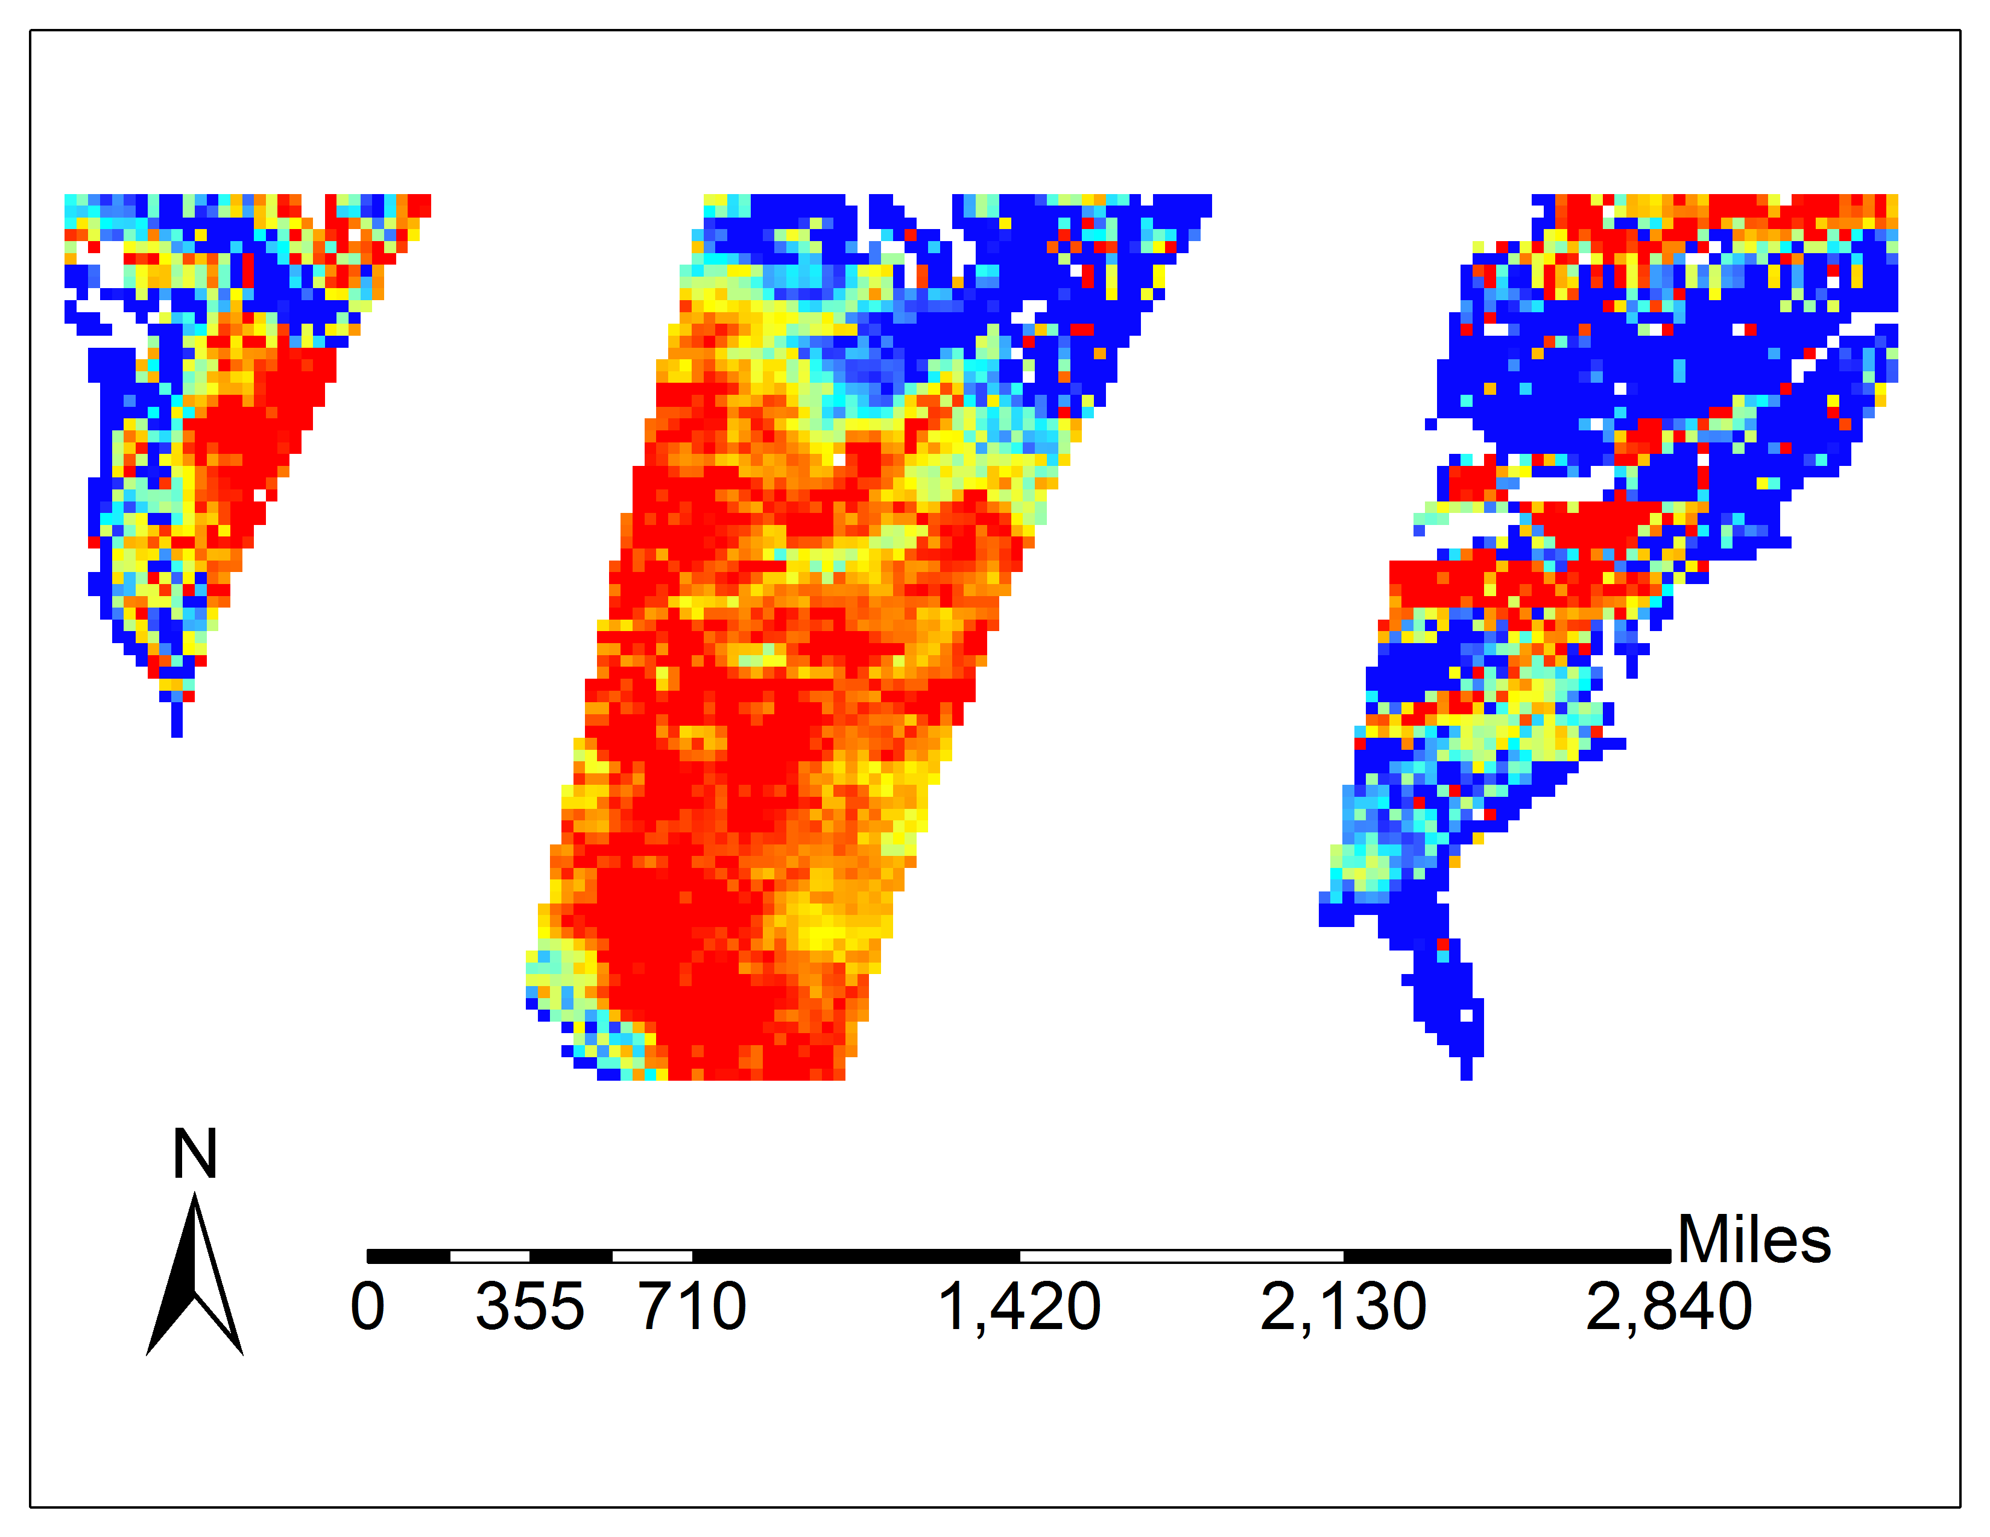
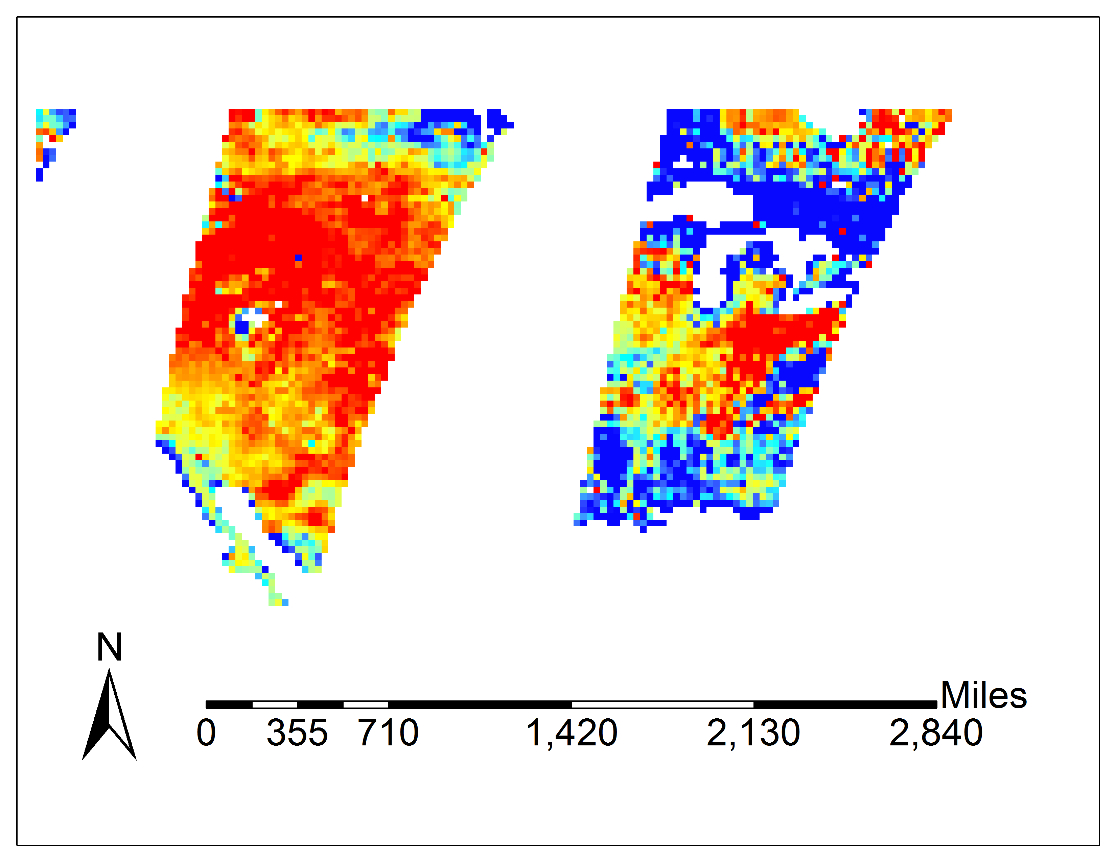






Incorporating NASA Earth Observations into the USDA Southeast Regional Climate Hub Lately Identified Geospecific Heightened Threat System (SERCH LIGHTS) to Assist Farmers in Making Informed Decisions on Water and Crop Management
Abstract
Objectives
Regional climate variability in the southeastern United States is a concern for agricultural and forestry management. Droughts are an important consequence of this variability, affecting both the agricultural and forestry sectors’ ability to manage their water resources. The United States Department of Agriculture (USDA) Southeast Regional Climate Hub (SERCH) has thus developed a tool called Lately Identified Geospecific Heightened Threat System (LIGHTS) in order to provide information for its users that would increase water management efficiency. It identifies and alerts users to changes in drought, temperature, and precipitation patterns. However, LIGHTS lacks soil moisture information, which also affects drought patterns. This project therefore aims to update the current drought monitoring system by incorporating Soil Moisture Active Passive (SMAP) level 3 data as a support layer, by retrieving Standardized Soil Moisture Index (SSI) as a measure and by using Python as the programming language. Ground truth soil moisture data from Soil Climate Analysis Network (SCAN) were collected for validation. As a result, this integration of SMAP data into SERCH LIGHTS will increase the end-user’s water management capabilities in response to drought conditions.
Improving resolution and usefulness of the Southeast Regional Climate Hub (SERCH) tool Lately Identified Geospecific Heightened Threat System (LIGHTS)
Incorporating NLDAS and SMAP soil moisture daily data into the SERCH LIGHTS tool
Study Area
TN
KY
VA
Methodology
AK
NC
Acquire Soil Moisture Content
Level 3 Soil Moisture product download
Data preprocessing
Finding the Norm of Soil Moisture Content
NLDAS data collection and processing
Calculating the Standardized Soil Moisture Index
Accuracy Assessment
Comparing SMAP soil moisture data with the SCAN data
Statistics based on data analysis
The expected correlation should be equal to or above 0.7
MS
AL
GA
SC
LA
FL
Earth Observations
Southeast United States Agriculture
SMAP L-band Radiometer
NLDAS
Results
Conclusions
SMAP Validation results based on four SCAN stations
July 24 2016
The accuracy of using SMAP to monitor soil moisture content displayed a very high statistical correlation (R-Squared 0.7 to 0.9) with SCAN data, which indicated that SMAP is a reliable method of soil moisture monitoring.
By incorporating SMAP into the SERCH LIGHTS tool the service could enhance crop yield, water resource management, and optimize decision making in times of drought by giving accurate soil moisture measurements across the Southeast United States.
Station ID2013 (GA)
Station ID2024 (MS)
Year 2016: 0.6817
Station ID2053 (AL)
Year 2016: 0.9177
Station ID2006 (TX)
Year 2015: 0.7634
Year 2016: 0.1838
Year 2015: 0.4612
Year 2015: 0.6526
Year 2015: 0.6802
Year 2016: 0.9124
July 25 2016
Acknowledgements
Dr. DeWayne Cecil (Global Science & Technology [GST] National Centers for Environmental Information [NCEI])
Michael Bender (NASA DEVELOP National Program)
Team Members
SMAP SSI daily images
Dr. Kenton Ross (NASA DEVELOP National Program)
Bob VanGundy (The University of Virginia’s College at Wise)
Any opinions, findings, and conclusions or recommendations expressed in this material are those of the author(s) and do not necessarily reflect the views of the National Aeronautics and Space Administration. This material is based upon work supported by NASA through contract NNL11AA00B and cooperative agreement NNX14AB60A.
Project Partner
Yaping Xu
Project Lead
Yousra Benchekroun
Grant Bloomer
Kimberly Berry
Wise County Clerk of Court’s Office - Summer 2016

