Slide 1
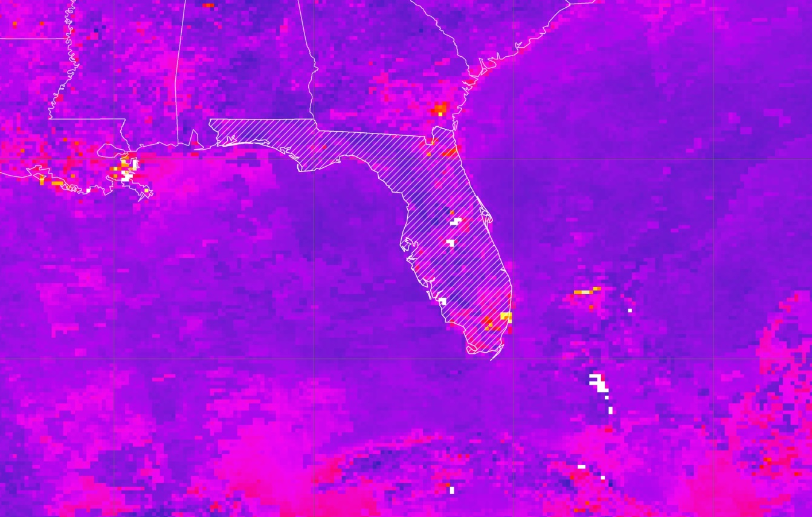


Coastal US Health & Air Quality
Christie Stevens
(Project Lead)
Understanding the Temporal and Spatial Variation of Air Quality to Support the Use of NASA Earth Observations
Toni Strauch
Alec Courtright
Notes:
Our project focused on assessing aerosol levels using both satellite and ground station data in the coastal United States.

Slide 2
We would like to thank Annette Hollingshead, Science Advisor, Dr. Xuepeng Zhao, Mentor, National Centers for Environmental Information, Alec Courtright, Center Lead at NOAA NCEI, Emma Baghel, Assistant Center Lead at NOAA NCEI and
our end-users Phil Dickerson, US EPA, and Dr. Jesse Bell, CDC.

Slide 3


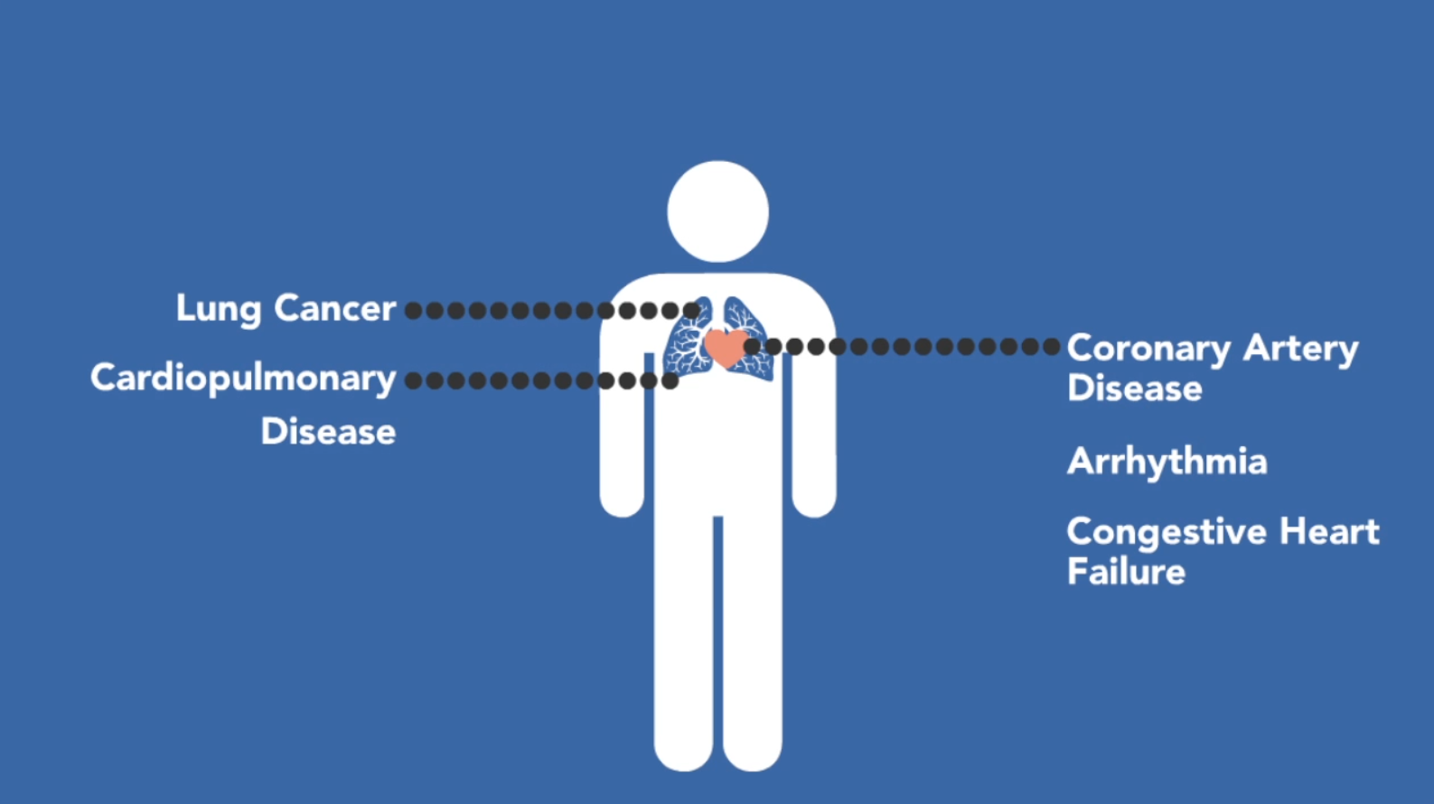
Health Effects of Aerosols
Notes:
Image Credit: Toni Strauch
Good air quality is a vital component of improving both human and environmental health.
In the case of our project, we looked specifically at particulate matter aerosols.
Particulate matter (PM) aerosols are especially hazardous as increased exposure is linked closely to serious health effects such as coronary artery disease and harm to the cardiovascular systems.

Slide 4
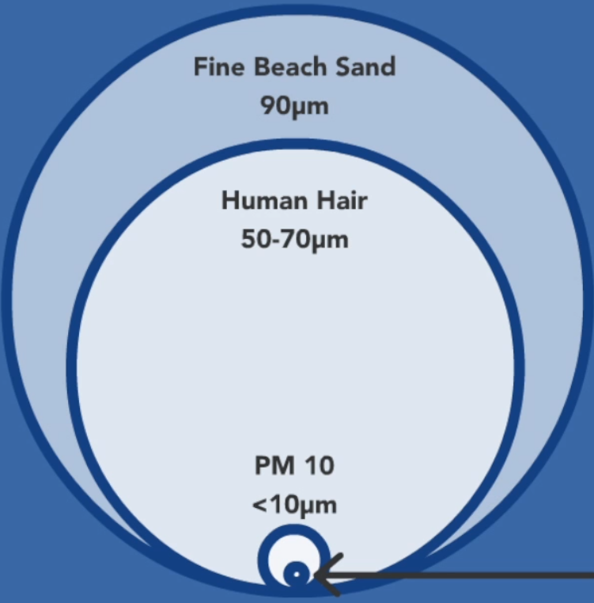

Particulate Matter
(PM)
Notes:
Image Credit: Toni Strauch
Particulate matter, also called aerosols, is a mix of liquid or solid substances in the atmosphere.
PM is most readily defined by size, with finer particles presenting a much higher health risk.
Particles labeled PM2.5 are smaller than one strand of human hair, and thus have a greater chance of entering the lungs and causing damage.

Slide 5
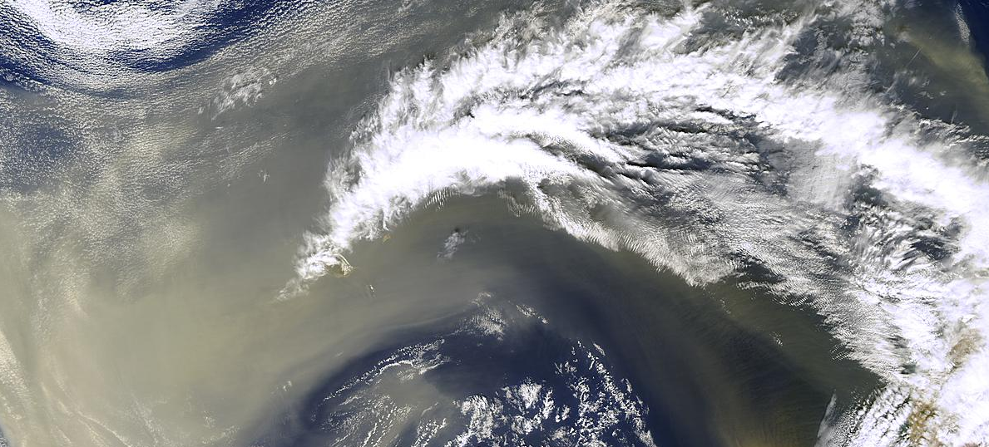

Image Credit: International Cooperative for Aerosol Prediction (ICAP)
Community Concerns
PM air pollution is the 13th leading cause of mortality
Aerosols originate from natural and human sources
40% of the US population currently lives on the coast – projected to rise by 8% by the year 2020
Gaps in land-based collection methods
Image Credit: MAPR
Notes:
Approximately 800,000 deaths each year can be attributed to exposure to PM air pollution, making it the 13th leading cause of mortality worldwide.
Particulate matter aerosols originate from natural and human sources, such as:
Volcanic eruptions
Wind-driven dispersal of dust or salt (as evident in the bottom picture)
Industrial processes such as the burning of fossil-fuels
A large percentage of the United States population lives on the coast and experiences unique air quality threats. By the year 2020, roughly half of the total US population is projected to live on the coast.
With large gaps in land-based collection methods, a more complete picture of aerosol measurements is essential for proper mitigation and improvement of air quality monitoring in coastal regions.
These gaps must be supplemented with additional datasets to create accurate air quality forecasts.
More robust aerosol measurements are needed for improved air quality monitoring in coastal regions
Image Source: http://icap.atmos.und.edu/
Image Source: www.flmapr.com/dock.html

Slide 6


Partner Organizations
The Environmental Protection Agency (EPA) currently collects air quality measurements using in situ monitoring stations that record an Air Quality Index (AQI) for the terrestrial United States.
The Centers for Disease Control and
Prevention (CDC) has an increasing
need to incorporate air quality data
into their various preventive human
health efforts.
Notes:
We partnered with the Environmental Protection Agency and the Centers for Disease Control to help build a basic picture of satellite and ground station (in situ) aerosol data.
The EPA’s AirNow product utilizes in situ air quality measurements that do not incorporate the coastal United States.
The CDC assesses various human health aspects through long-term case studies.
This project set the foundation for more comprehensive air quality studies that the EPA and CDC might perform in the future.

Slide 7

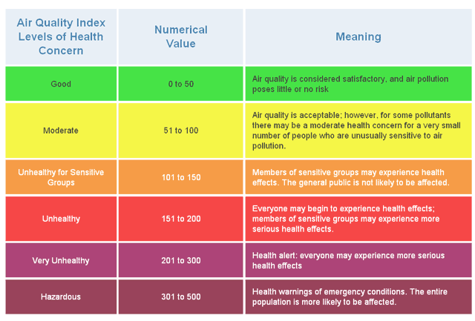
EPA’s
Image Credit: EPA
Notes:
In the United States, air quality is currently measured through a network of ground station monitors as part of the Environmental Protection Agency’s AirNow tool.
This is a publicly accessible product that uses surface measurements to determine a daily Air Quality Index, or AQI, for various pollutants.
Image Source: airnow.gov

Slide 8
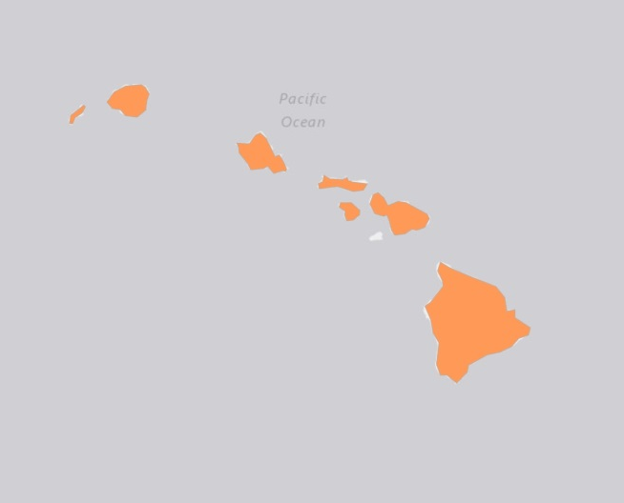

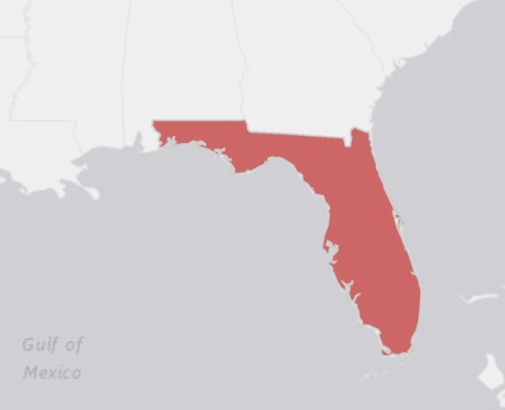
Hawaii coast
Study Area & Study Period
January 1981 –
December 2015
Florida coast
Notes:
This project assessed both surface and satellite aerosol levels in Hawaii and Florida from 1981 to 2015 to offer support for integrating satellite and in situ datasets to gather a more accurate and reliable air quality report.

Slide 9
Objectives
1
Create a comprehensive climatology of Aerosol Optical Depth (AOD) for Hawaii and Florida from 2000-2015
2
Analyze long-term trends in Aerosol Optical Depth (AOD) in comparison with surface PM2.5 at a seasonal temporal scale
3
Compare satellite and in situ aerosol measurements using
statistical methods
Notes:
Our goals for this project were to:
Create a climatology for Hawaii and Florida to assist the EPA and CDC in their assessments of aerosol estimates
Analyze long-term trends in air quality levels through seasonal variations as well as case studies with VOG and sugarcane burning events
Evaluate satellite and in situ aerosol data using statistical methods

Slide 10
Methodology
Regression Analysis &
Data Verification
Research
Data Processing
Long-Term Climatologies
Trend
Analyses
Climatologies
Anomalous
Events
Data Acquisition
Data Analysis
End-Product Creation
NASA
MODIS
in situ
PM_{2.5}, PM₁₀
NOAA
AVHRR
Data Download
Long-Term Study
Statistical Support for Satellite Integration
Conclusions
Notes:
Notes: Give a brief introduction to the process for this project.
We began by gathering our raw data from various sources (to be detailed in following slides). After converting and processing both satellite and in situ data, we were able to create 30-year global climatologies, 15-year climatologies for our specific study areas, and use these studies to perform trend analyses to identify anomalous periods of heightened aerosol levels. We also performed foundational statistical analyses to verify MODIS and AVHRR datasets with in situ measurements.
The intention for these analyses was to provide our partners with statistical support for integration of satellite data into current observations of aerosol levels. We also provided our partners with both raw and processed data for further aid in research of aerosol-related health and environmental trends.

Slide 11
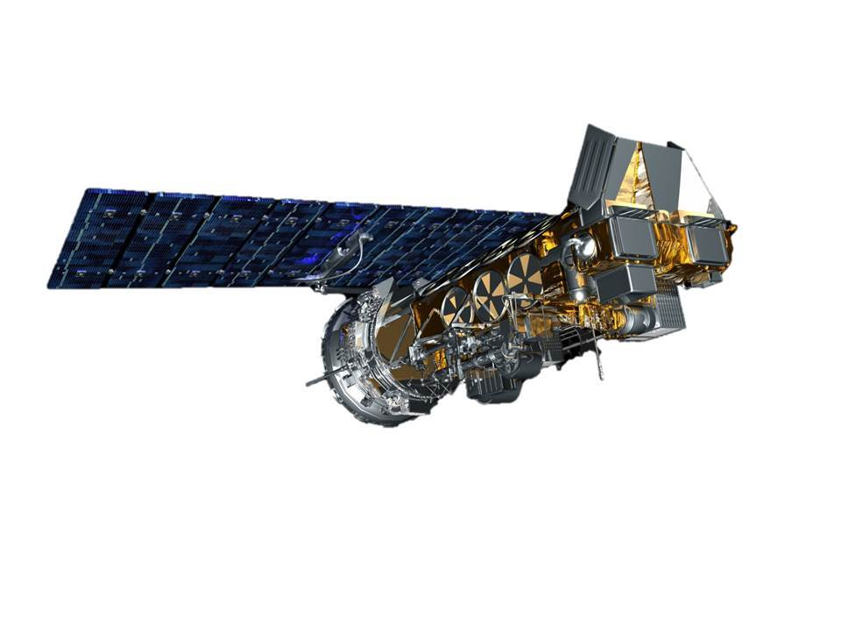
NOAA AVHRR
Aerosol Optical Thickness (AOT)
0.1° spatial resolution
Monthly
January 1981 - December 2015
Obtained from NOAA’s Climate Data Record
Interface Definition Language Development Environment (IDL DE)
Notes:
Notes: Discuss Data Acquisition and Processing for NOAA AVHRR Data
AOT data collected from NOAA’s Advanced Very High Resolution Radiometer (AVHRR) sensor was acquired through NOAA’s Climate Data Record. This dataset has a spatial resolution of 0.1 by 0.1 (or 10km x 10km), gathered monthly, from 1981 to 2015.
Through the Interface Definition Language Development Environment (IDL DE), we generated 30-year monthly and seasonal global climatologies and extracted point data for the locations of several ground stations located throughout our study areas for further comparision and validation against in situ measurements.
Acknowledgements:
Image:

Slide 12
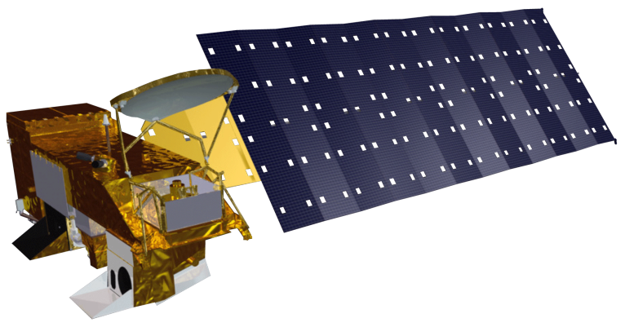

NASA MODIS Aqua & Terra
Aerosol Optical Depth (AOD)
0.1° spatial resolution
Daily
January 2000 - December 2015
Obtained from NASA’s Level 1 and Atmosphere Archive and Distribution System (LAADS)
Notes:
Notes: Discuss Data Acquisition and Processing for NASA MODIS Data
Aerosol Optical Depth (AOD) data, collected from NASA Terra and Aqua Moderate Resolution Imaging Spectroradiometer’s (MODIS) sensors, were downloaded and subset through NASA’s Level 1 and Atmosphere Archive and Distribution Sytem (LAADS). This dataset has a spatial resolution of 0.1 by 0.1  (10km x 10km), gathered daily, ranging from 2000 to 2016.
Aqua and Terra MODIS required conversions from HDF to GeoTIFF format. The data was manually subset by state as well as year before converting each yearly file to the proper format using the HDF-EOS to GeoTIFF (HEG) conversion tool. Using R Statistical Program, the data was further subset into months and days. After the data were converted and subset, we used Esri’s ArcMap Model Builder tool to compile the raster datasets into averaged monthly files. These were also further compiled into monthly and seasonal 15-year climatologies which will be seen later in this presentation.

Slide 13
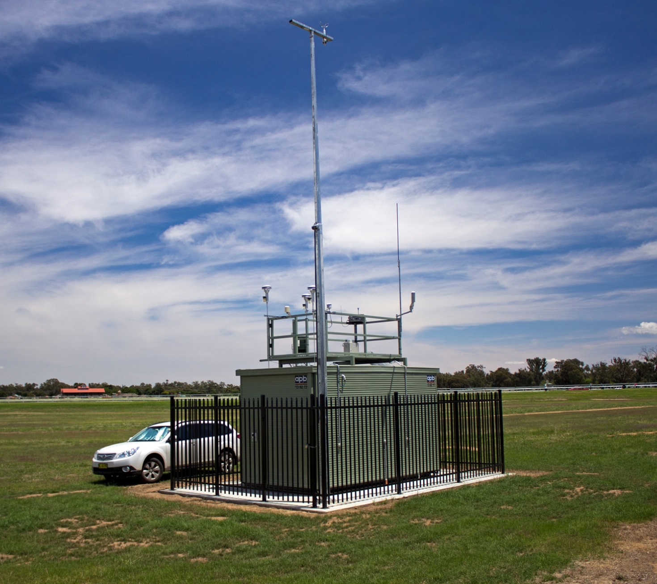
In situ Measurements PM_{2.5}
Station-dependent spatial resolution
Daily
January 1987 - December 2015
Obtained from EPA’s AirNow product
Image Credit: Wikimedia.org
Notes:
Notes: Discuss Data Acquisition and Processing for in situ Data
In situ air quality data for Hawaii and Florida PM_{2.5} measurements were acquired from contacts at EPA and Hawaii and Florida Departments of Health.
Temporal and spatial resolution varies from station to station.
These datasets were subset by station, month, and year using R Statistical Programing, and average monthly values were produced for further statistical validation and comparison with AVHRR and MODIS values.
Image Source: https://commons.wikimedia.org/wiki/File:NSW_EPA_air_quality_monitoring_station.jpg

Slide 14
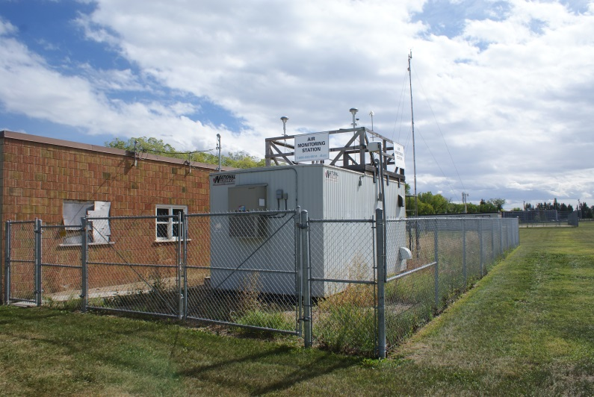
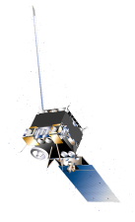
Measurement Techniques
Image Credit: Edmonton
Atm
Surf
Ground Station (in situ)
Satellite
AOD & AOT
  Measured as a column from top of atmosphere to surface
PM2.5
  Measured as mass per unit volume of particles less than 2.5µm
Notes:
Aerosol Optical Depth and Aerosol Optical Thickness are interchangeable terms that refer to a unitless measurement of aerosol data collected from the satellites.
Satellites measure aerosol levels in a column from the top of the atmosphere to the surface.
Ground station data, otherwise known as in situ data, measures Particulate Matter 2.5. PM2.5 is measured in microns per cubic centimeter.
Image Source: https://dashboard.edmonton.ca/reports/env-2014/Air-Quality
Image Source: Dr. Tom Zhao

Slide 15
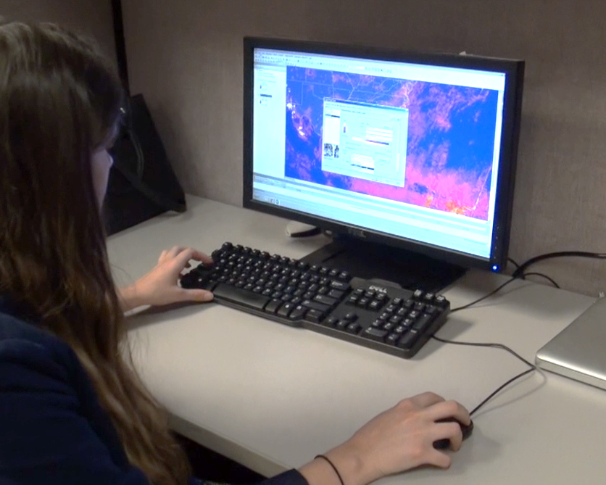
Data Analysis
Create long-term climatologies
Analyze trends & pollution events specific to Hawaii and Florida
Calculate data regression for statistical verification
Notes:
Notes: Just a refresher…
Seasonal and monthly climatologies inform end-users as to how aerosols have changed spatially and temporally in Hawaii and Florida
Analysis of general trends and anomalous events specific to Hawaii and Florida
Verification of satellite and in situ aerosol measurements strengthen the reliability of data provided for our end-users
Acknowledgements:
Image: Captured by team

Slide 16


Climatology Maps
Used MODIS AOD for 15-year maps
  Subset to study regions, covers land and oceans
Image Credit: Brian
Image Credit: Ricardo Mangual
Notes:
The first step in analyzing aerosol estimates was to create monthly and seasonal climatologies utilizing AVHRR AOT.
In conjunction with IDL DE that specifically used AVHRR AOT data from NOAA’s Climate Data Record, we assessed seasonal and monthly variations with 30-year climatologies for both study locations.
We further used these climatologies to analyze pollution events specific to both Hawaii and Florida (which will be discussed later in this presentation).
Image Source:
Right = https://www.flickr.com/photos/ricardo_mangual/7950551120/in/photolist-d7yDRA-dGMsLo-9vZbCc-9wvymB-9w3dgL-eEhp2j-d7yDs3-Ep3vf-9w3d2b-a3NtHP-nFeNJ9-dH6xZa-eEhodL-eEbhAR-aiw4Pi-dHbfM1-eEhox3-7UDHsV-q17N9Z-4dHhwB-fKCshN-bpmaPJ-77Fn8-a3Rjrs-9w3dby-r8rpZN-9vZbMH-rwruQ8-dHbVSY-dGMtNw-dqxv7h-d7yCWb-dHbWE9-96W2xv-dnzkik-dH6vsp-4LWbSr-4M1m6d-s9VnYp-b5QL6a-jY1dY9-dHbieQ-dGMS9N-ca6NPf-4wearn-8EpyYC-fLxewZ-4qf2X1-4CucUE-fbDjum
Left = https://www.theadventurejunkies.com/best-coastal-hikes/

Slide 17
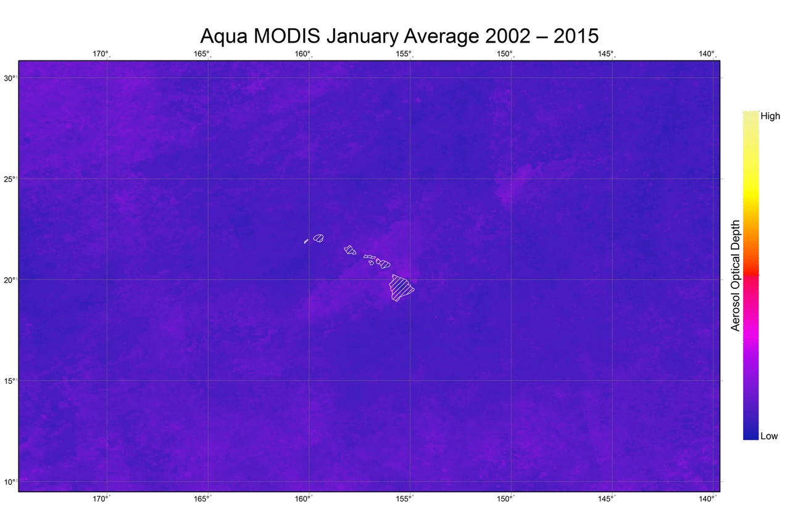
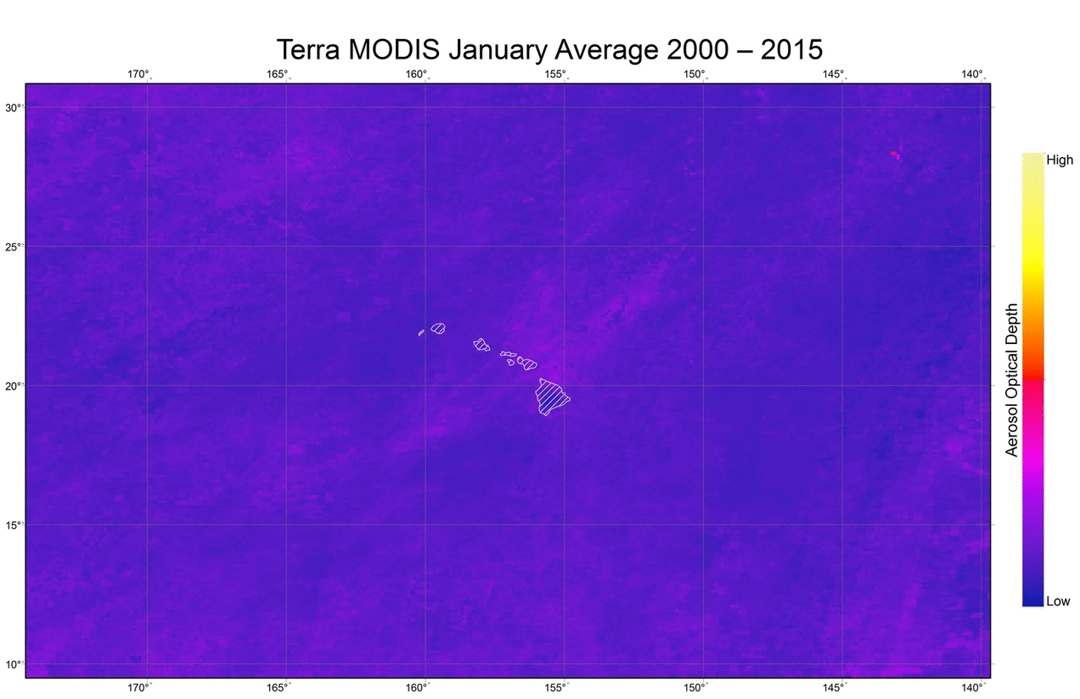
Notes:
Notes:
*Display MODIS climatology maps/ gifs

Slide 18
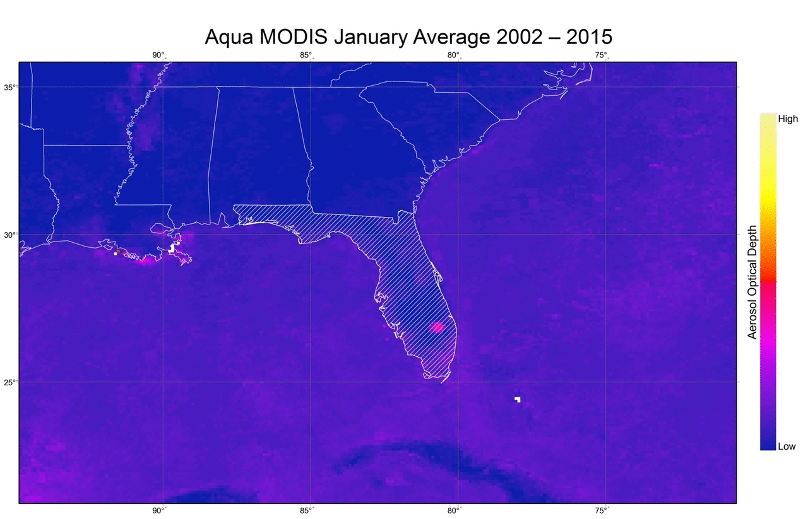
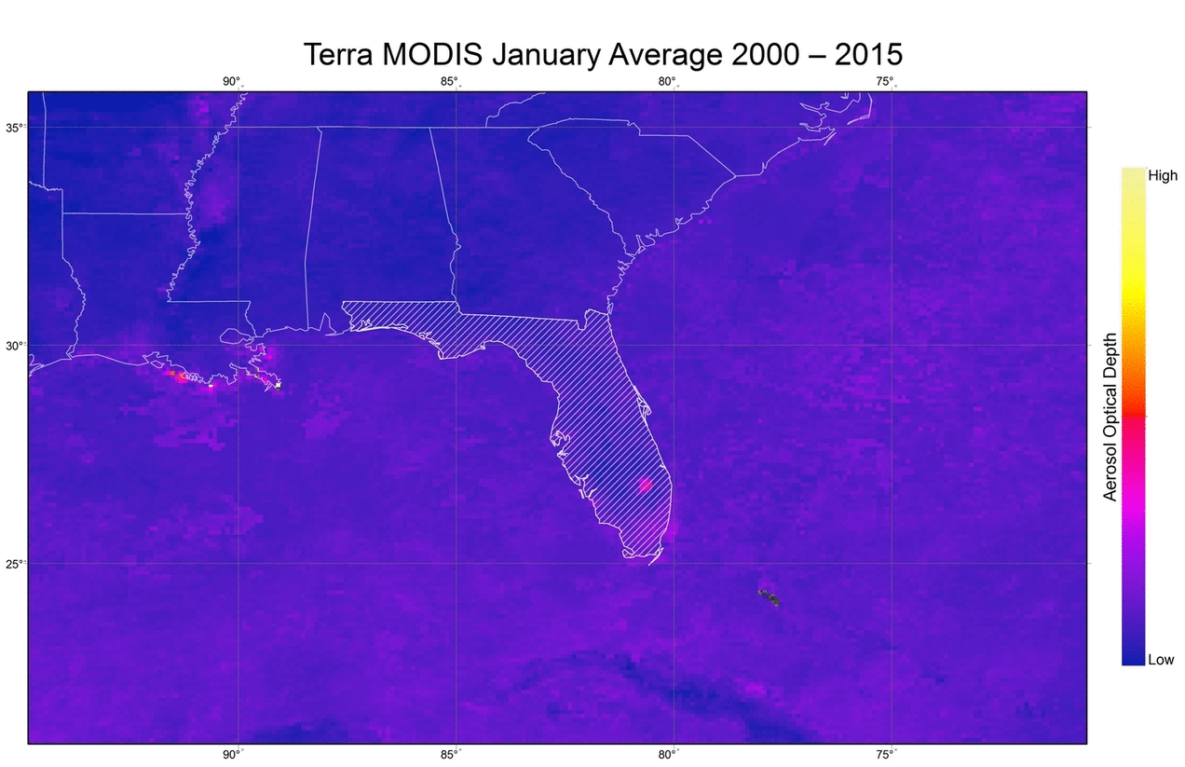
Notes:
Notes:
*Display MODIS climatology maps/ gifs

Slide 19
Time-series Plots
Graphed monthly average over time-series
  Plotted for stations of interest
Serve as visual overview of datasets
  Compare AOT, AOD, PM2.5 highs and lows over time
Image Credit: Brian
Image Credit: Ricardo Mangual
Notes:
-Time series plots of monthly averages
-Serve as visual comparison between data-sets
Image Source:
Right = https://www.flickr.com/photos/ricardo_mangual/7950551120/in/photolist-d7yDRA-dGMsLo-9vZbCc-9wvymB-9w3dgL-eEhp2j-d7yDs3-Ep3vf-9w3d2b-a3NtHP-nFeNJ9-dH6xZa-eEhodL-eEbhAR-aiw4Pi-dHbfM1-eEhox3-7UDHsV-q17N9Z-4dHhwB-fKCshN-bpmaPJ-77Fn8-a3Rjrs-9w3dby-r8rpZN-9vZbMH-rwruQ8-dHbVSY-dGMtNw-dqxv7h-d7yCWb-dHbWE9-96W2xv-dnzkik-dH6vsp-4LWbSr-4M1m6d-s9VnYp-b5QL6a-jY1dY9-dHbieQ-dGMS9N-ca6NPf-4wearn-8EpyYC-fLxewZ-4qf2X1-4CucUE-fbDjum
Left = https://www.theadventurejunkies.com/best-coastal-hikes/

Slide 20
Aerosol Optical Depth
Notes:
Notes:
-Green represents data from NOAA’s AVHRR sensors and is acquired by averaging the area around Miami Beach
-All of this data is derived from the ocean area around Miami Beach
-Blue data represents MODIS and Red represents Station data
-Satellite data was multiplied by 10 to make the visual comparison visible
-Moving averages (darker lines) were included to reduce noise and make trends more visible
-Typical peaks occur in the summer months for all data sets (as expected)
-station data tends to have a larger variability than the satellite data
-When looking at only MODIS AOD and Station data we see that AOD does not show the same peaks and valleys that we see in the surface PM2.5 measurements

Slide 21
Notes:
Notes:
-Green represents data from NOAA’s AVHRR sensors and is acquired by averaging the area around Miami Beach
-All of this data is derived from the ocean area around Miami Beach
-Blue data represents MODIS and Red represents Station data
-Satellite data was multiplied by 10 to make the visual comparison visible
-Moving averages (darker lines) were included to reduce noise and make trends more visible
-Typical peaks occur in the summer months for all data sets (as expected)
-station data tends to have a larger variability than the satellite data
-Visually, we found that between the beginning of 2002 and the end of 2006 the peaks and valleys of stations data lined up particularly well with satellite data (primarily MODIS)
-However, the satellite data does not capture the overall decrease in PM2.5 seen in the station data after 2006.

Slide 22
Correlation & Regression Analysis
Determine a relationship between
AVHRR, MODIS, and in situ datasets
  Correlation coefficient calculations
  Accuracy maps
  Linear regression analysis
Image Credit: Brian
Image Credit: Ricardo Mangual
Notes:
-Analyzed relationship between MODIS AOD and surface PM2.5
-Produced station correlation to AOD maps (Accuracy Maps)
-Created linear regression graphs
Image Source:
Right = https://www.flickr.com/photos/ricardo_mangual/7950551120/in/photolist-d7yDRA-dGMsLo-9vZbCc-9wvymB-9w3dgL-eEhp2j-d7yDs3-Ep3vf-9w3d2b-a3NtHP-nFeNJ9-dH6xZa-eEhodL-eEbhAR-aiw4Pi-dHbfM1-eEhox3-7UDHsV-q17N9Z-4dHhwB-fKCshN-bpmaPJ-77Fn8-a3Rjrs-9w3dby-r8rpZN-9vZbMH-rwruQ8-dHbVSY-dGMtNw-dqxv7h-d7yCWb-dHbWE9-96W2xv-dnzkik-dH6vsp-4LWbSr-4M1m6d-s9VnYp-b5QL6a-jY1dY9-dHbieQ-dGMS9N-ca6NPf-4wearn-8EpyYC-fLxewZ-4qf2X1-4CucUE-fbDjum
Left = https://www.theadventurejunkies.com/best-coastal-hikes/

Slide 23
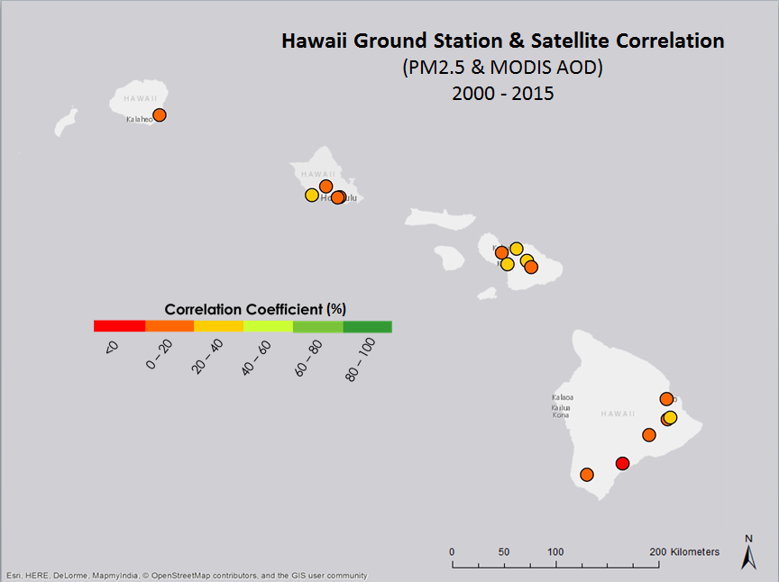
Accuracy Maps
Overall Correlation Coefficient
0.1596 or ~ 16%
Notes:
-This map highlights the ground station locations that we used to compare MODIS AOD to surface PM2.5 measurements
-The colors indicate how well both measurements relate to each other:
-orange and red colors indicate poor-low correlations
-green colors indicate good correlations
-As you can see, for our study period (2000-2015), station data and AOD do not correlate well directly
-The highest correlation coefficient is just under 0.3
-These poor correlation values could be caused by resolution issues in such small areas. With an ~ 10km by 10km resolution, a correlation between extracted satellite data and station point data does not capture capture much of the surface fluctuations
Future studies may want to incorporate meteorological conditions and other remotely sensed datasets such as MISR, VIIRS, or Aeronot to get more robust collection of satellite data
-Resolution

Slide 24
Notes:
-We also analyzed the basic relationship between ground station PM2.5 and AOD using a linear regression analysis
-surface measurements are on the y-axis – Satellite measurements on the x axis
-We divided each correlation into 90 day seasons (i.e. Dec., Jan., Feb.)
-Low R squared values -> high variation
-expected when comparing two measurements as different as point measurements and optical depth of vertical column
-less variation in AOD measurements during the Winter

Slide 25
Notes:
-Higher correlation in fall and winter as we saw in the slide before
-We believe this can be explained by fewer trade winds during the winter months
-Fewer trade winds can mean more consistency in aerosols – beneficial to correlation between the two different temporal scales of the initial measurements for AOD and surface PM2.5

Slide 26
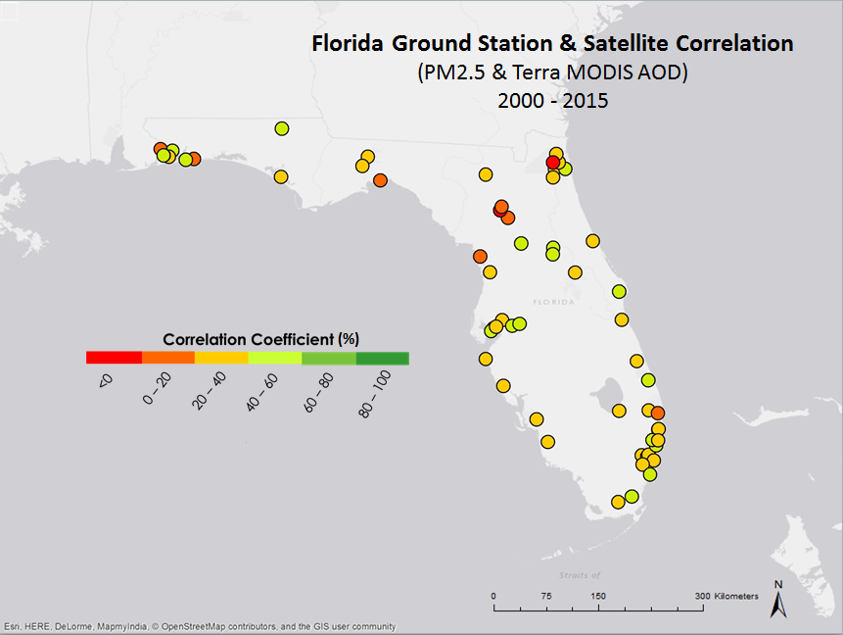
Accuracy Maps
Overall Correlation Coefficient
0.2419 or ~ 24%
Notes:
-We also tested the correlation coefficient of MODIS AOD data to ground station PM2.5 data in Florida
-Many of the Florida stations showed a higher correlation coefficient than Hawaii
-Max correlation coefficient of ~57% - Plant City, FL (to the Right of Tampa)
-majority of stations showed a correlation over 20%
-The overall correlation coefficient of Florida was approximately 24%

Slide 27
Notes:
-As with Hawaii, we plotted surface PM2.5 measurements against MODIS AOD from 2000-2015
-Then performed a linear regression to test the relationship between these datasets
-As you can see, there is a lot of variability and the trendline does not give the most accurate depiction of the relationship
The graph also shows a lot of AOD values between 0 and 0.5 can indicate similar surface PM2.5
Meaning there are other factors that affect AOD values not captured in Surface PM2.5
Winter negative linear trend
Possible aerosol activity above the scope of surface measurements
Or more variation in the upper atmosphere for aerosols
In the spring we see the strongest linear trend – less variation

Slide 28
Notes:
-As with Hawaii, we plotted surface PM2.5 measurements against MODIS AOD from 2000-2015
-Then performed a linear regression to test the relationship between these datasets
-As you can see, there is a lot of variability and the trendline does not give the most accurate depiction of the relationship
We see the second strongest correlation during the summer months
Indicating that AOD and surface measurements compare better with higher aerosol levels

Slide 29

Image Credit: Jeff Kubina
Conclusions & Future Work
AOD and surface PM2.5 follow similar seasonal trends
  Florida shows better correlation between AOD and surface PM2.5
Long-term aerosol climatologies can be a foundation for further air quality studies
  Public health trends (i.e. Asthma, Cardiovascular Disease)
Notes:
Image Source: https://commons.wikimedia.org/wiki/File:Na_Pali_Coast,_Kauai,_Hawaii.jpg
AOT and AOD values follow similar seasonal trends as ground station PM2.5 values when comparing monthly averages from 1981 - 2015.
Satellite-observed measurements generally show a stronger correlation with in situ values in Florida than they do Hawaii, possibly due to the resolution issues when looking at a small island and inherently clustered stations
Providing satellite-derived climatologies to our end-users will enable them to incorporate long-term aerosol trends into further studies.
We are working with the CDC to enable them to take these foundational results, improve them, and compare them to public health data (i.e. asthma rates, and cardiovascular disease)

