Slide 1
Using the USGS’s ESPA Ordering Interface
An Alternative to Earth Explorer For Imagery and Spectral Indices

Slide 2
Why ESPA?
Have the USGS process your spectral indices for you!
At least at Langley, Earth Explorer’s Bulk download client is blocked by a firewall… this may be your only hope!!!
Download Multiple Surface Reflectance Images at Once!

Slide 3
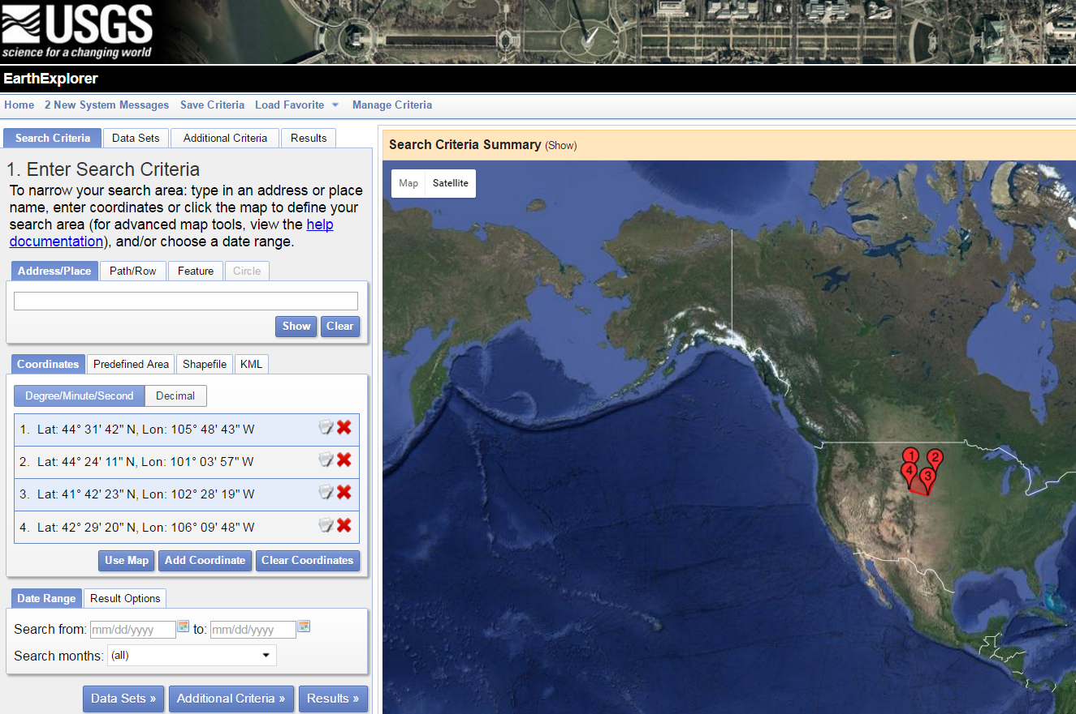
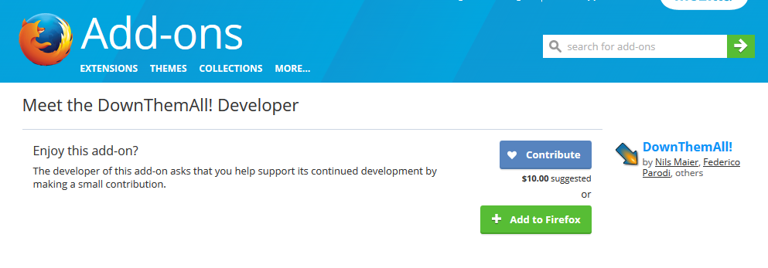
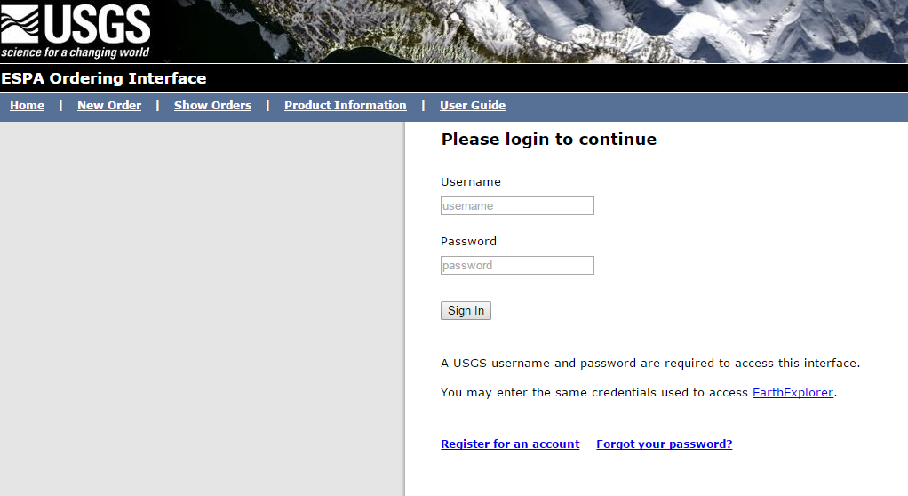
You will need to use…
Earthexplorer.usgs.gov (just for creating a scene list in .csv format)
https://addons.mozilla.org/en-US/firefox/addon/downthemall/developers
(allows you to automatically download multiple hyperlinks)
http://espa.cr.usgs.gov/ordering/new/

Slide 4
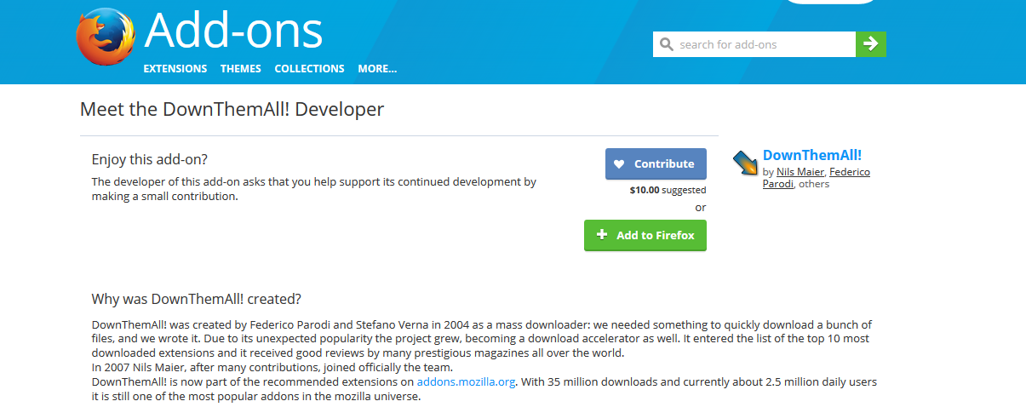
Let’s begin! Step 1.
Add it!!! We will use later.
Notes:
What to do – look to see a team member’s university offers access to the materials
Possibly investigate requesting the article if you have to – chances are similar material will get the job done

Slide 5
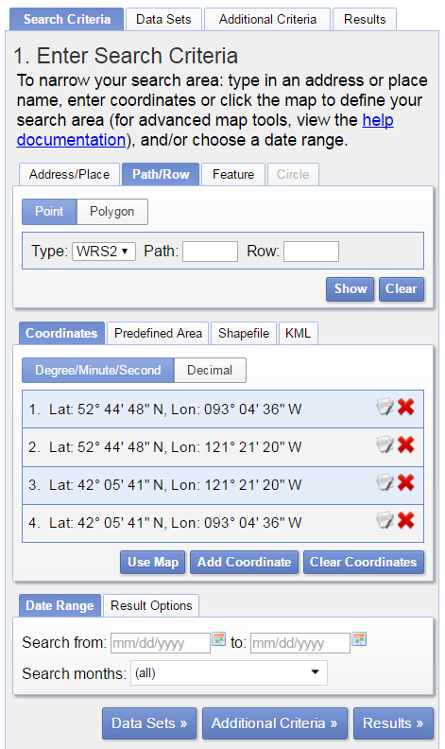
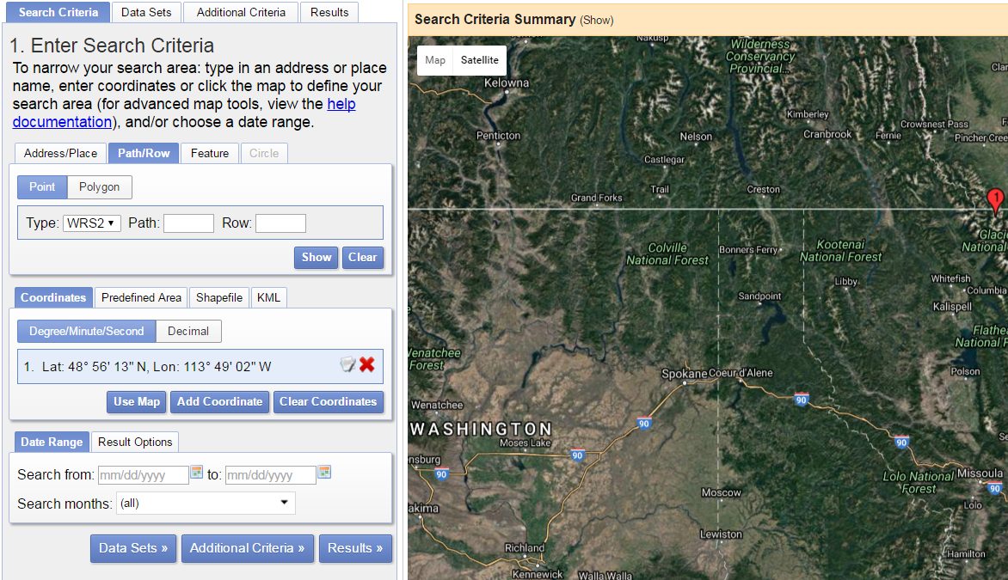
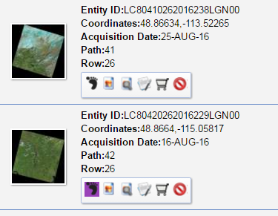
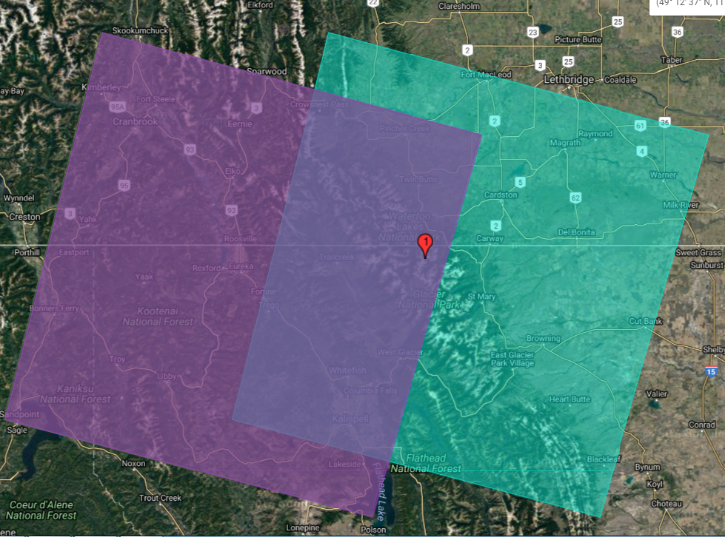
Step 2- Follow the Flow in Earth Explorer
Hit ”Results” after all search criteria is input
Compare which Path/Row combo provides best coverage of study area.
Click “Use Map”. Remove all the automatic points. Put down a point in/near your study area
Notes:
We will be using Earth Explorer to generate a .csv file that contains a list of the scenes that you would like to download for your project.
This flowchart shows you how to export a .csv of the scenes you’d like to eventually download. TRUST ME. This is easier than downloading scenes one by one if you are trying to download multiple scenes. And it is necessary if you are trying to bulk download Surface Reflectance and/or spectral indices
Specify Date Range (subset to month ranges within each year if necessary), data product, and path/row

Slide 6
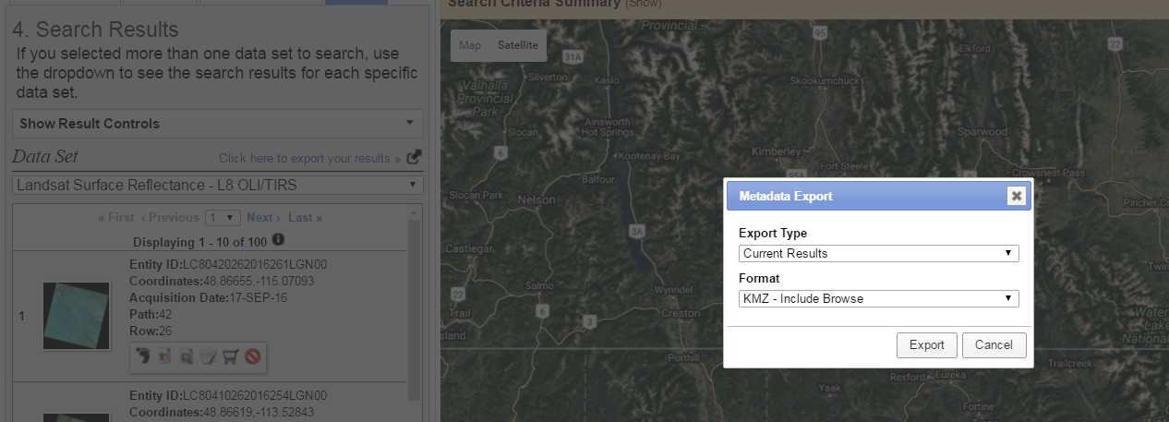
Step 3 – Get that List!
Save this .csv so that you can upload it to ESPA!
Choose Comma Delimited for Format
Notes:
Export the results, as this will contain all the scenes under the conditions you chose for your scene list.

Slide 7
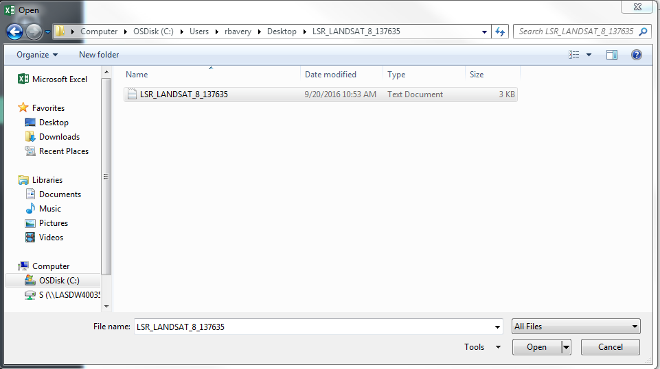
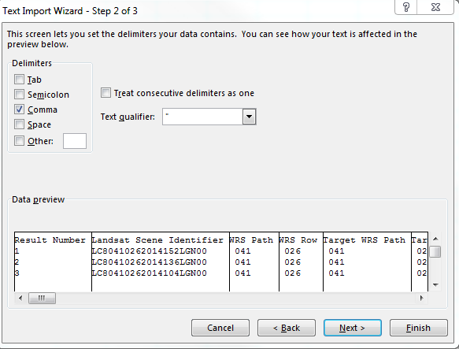
Step 4 – Clean Up that List!
Open Excel. Make sure to choose “All Files” to open the .txt document. Remove unnecessary fields and headers. We only want all scenes under the “Landsat Scene Identifier Field Heading”. But not the Heading!
Notes:
For some reason, when I tried this it came out as a text file. So we convert that to a .csv here.

Slide 8
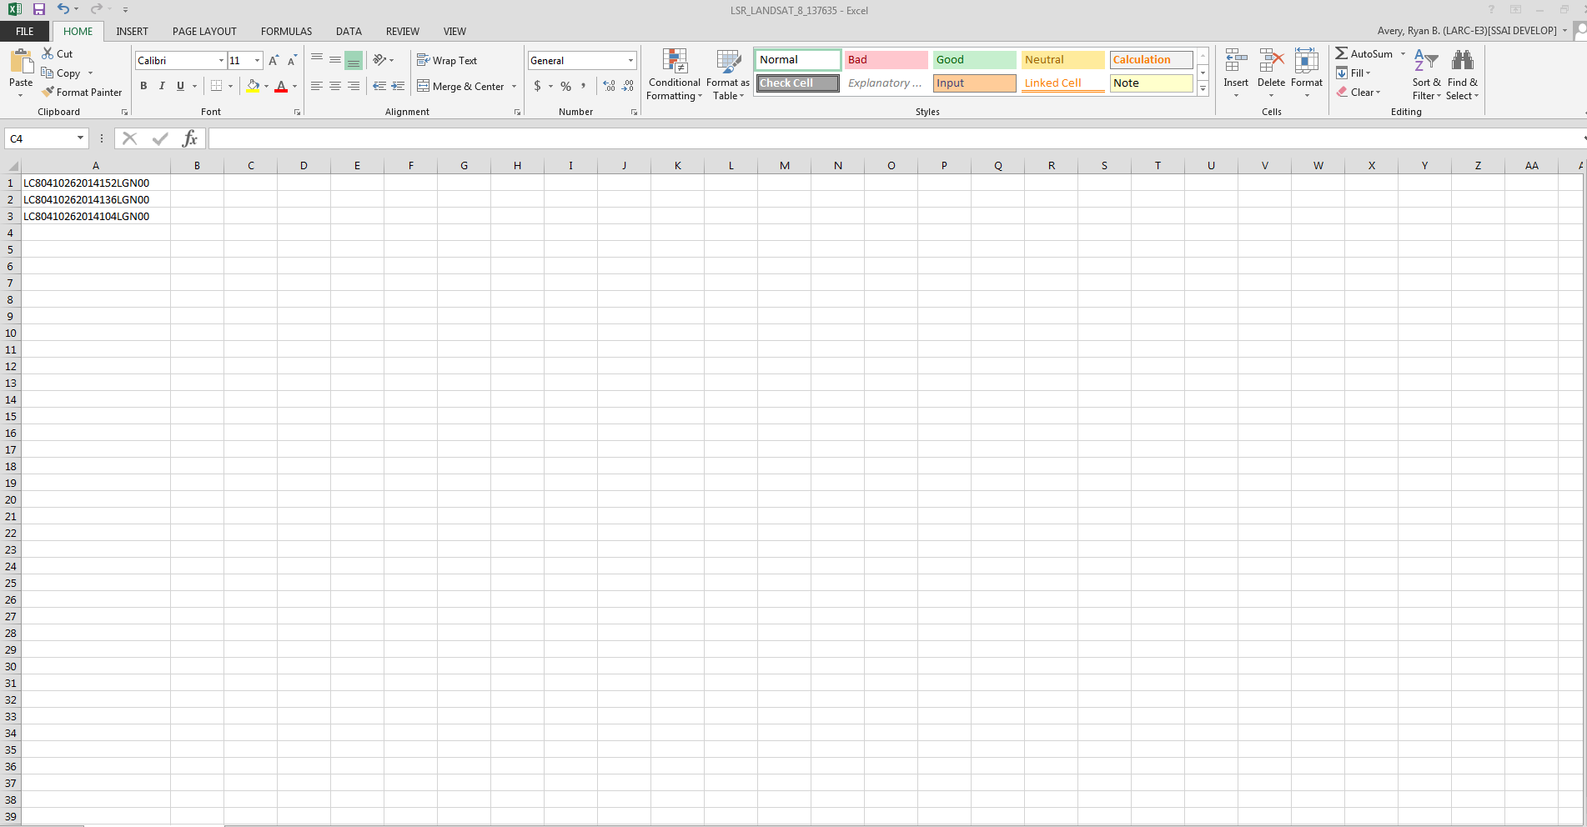
Your CSV File should look like this (you may have more scenes)
Notes:
Save this in a good place, you will use it in a moment.

Slide 9
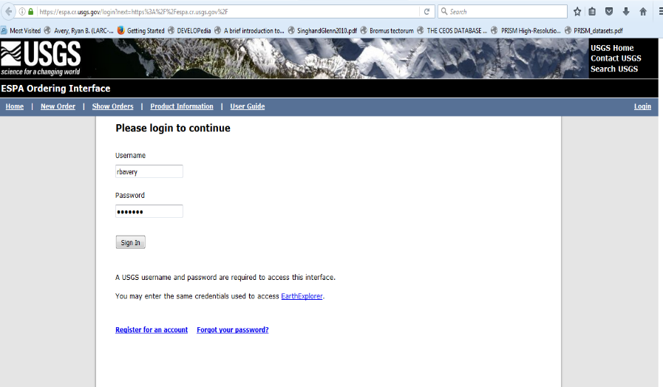
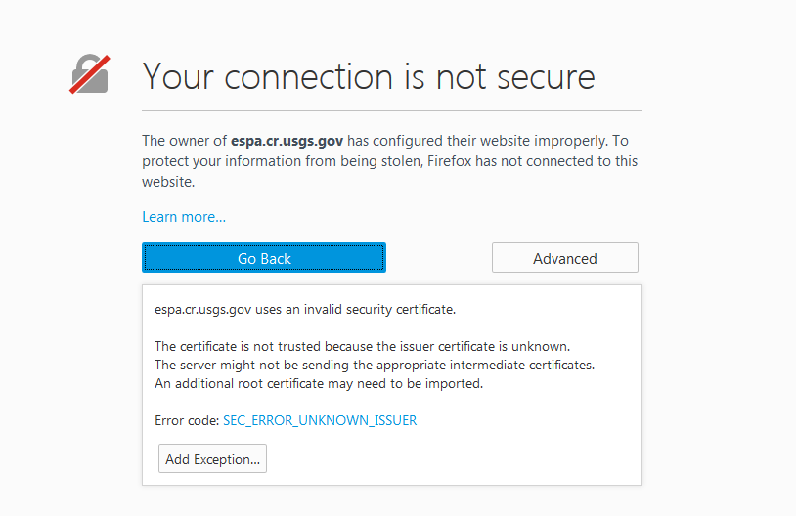
Step 5 – ESPA Ordering Interface
Use Firefox to go to https://espa.cr.usgs.gov/
Login with your USGS EarthExplorer account or register
SIDE NOTE: If a window pops up when you navigate to the EROS webpage or login, just click “Advanced” and click “Add Exception”.

Slide 10
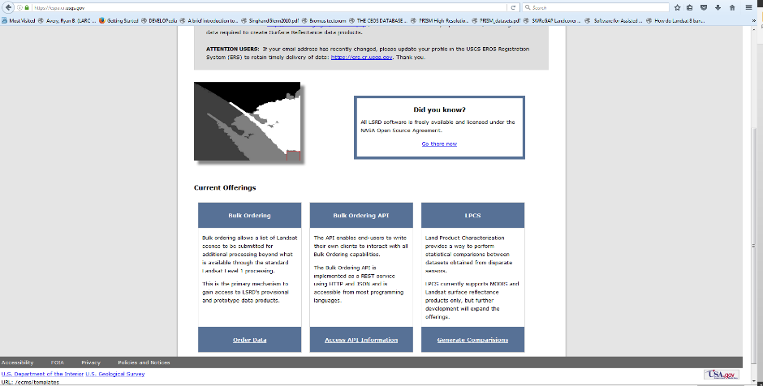

Slide 11
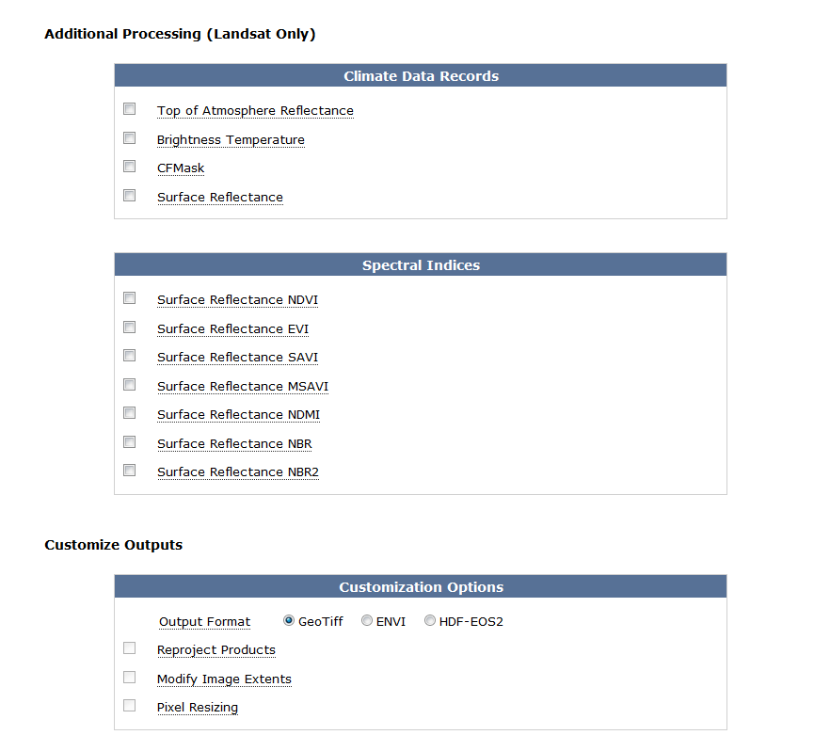
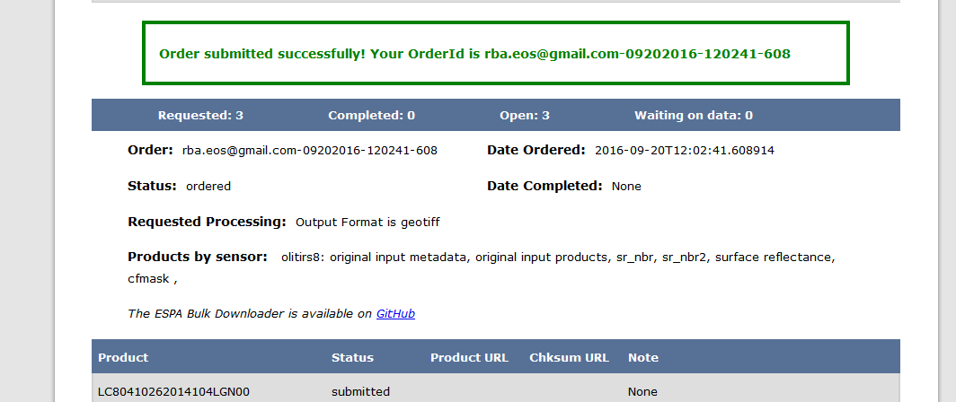
Step 6 – Congrats You Made it!
Upload the .csv comma delimited file that you made in Step 4.
Check the boxes “Input Products and “Input Product Metadata”
Select additional indices and records you would like to download (we recommend trying out different spectral indices and the CFMask if your study area is cloudy)
Select you data format and submit order
Notes:
You order should be emailed in a web link form within 1-3 days.

Slide 12
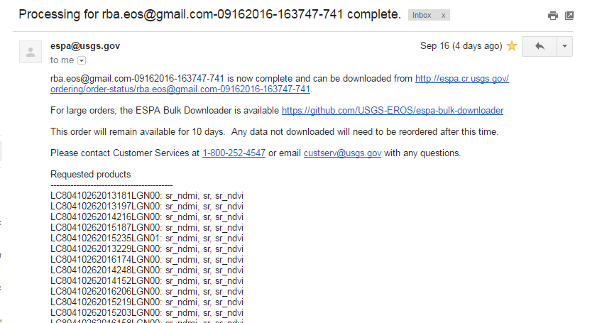
Step 7 – The Waiting Game……….
Can be anywhere from 1-3 days (Usually 1). Possibly longer with system delays.
At the end of the wait you get an email.
Click the link to go to your download page and have DownThemAll! Installed and ready to go on Firefox

Slide 13
Step 8 – Set Up Download Them All!
On Windows Press F10 and go to Tools (This information is also at page 19 of this document: http://landsat.usgs.gov/documents/espa_odi_userguide.pdf )
Select “DownThemAll! Tools”
Select “Preferences”, then “Network”
In the “Location or domain” window at the bottom of the dialog box, type http://espa.cr.usgs.gov/ and click “New Limit” button to the right
Set slider to “1” and the Connections to “Limited”. Click “Create” and then “OK”
Then….
Notes:
This tutorial was made just from trial and error and following page 19 of the guide. It should work for NASA computers on a NASA network and personal laptops on personal networks.

Slide 14
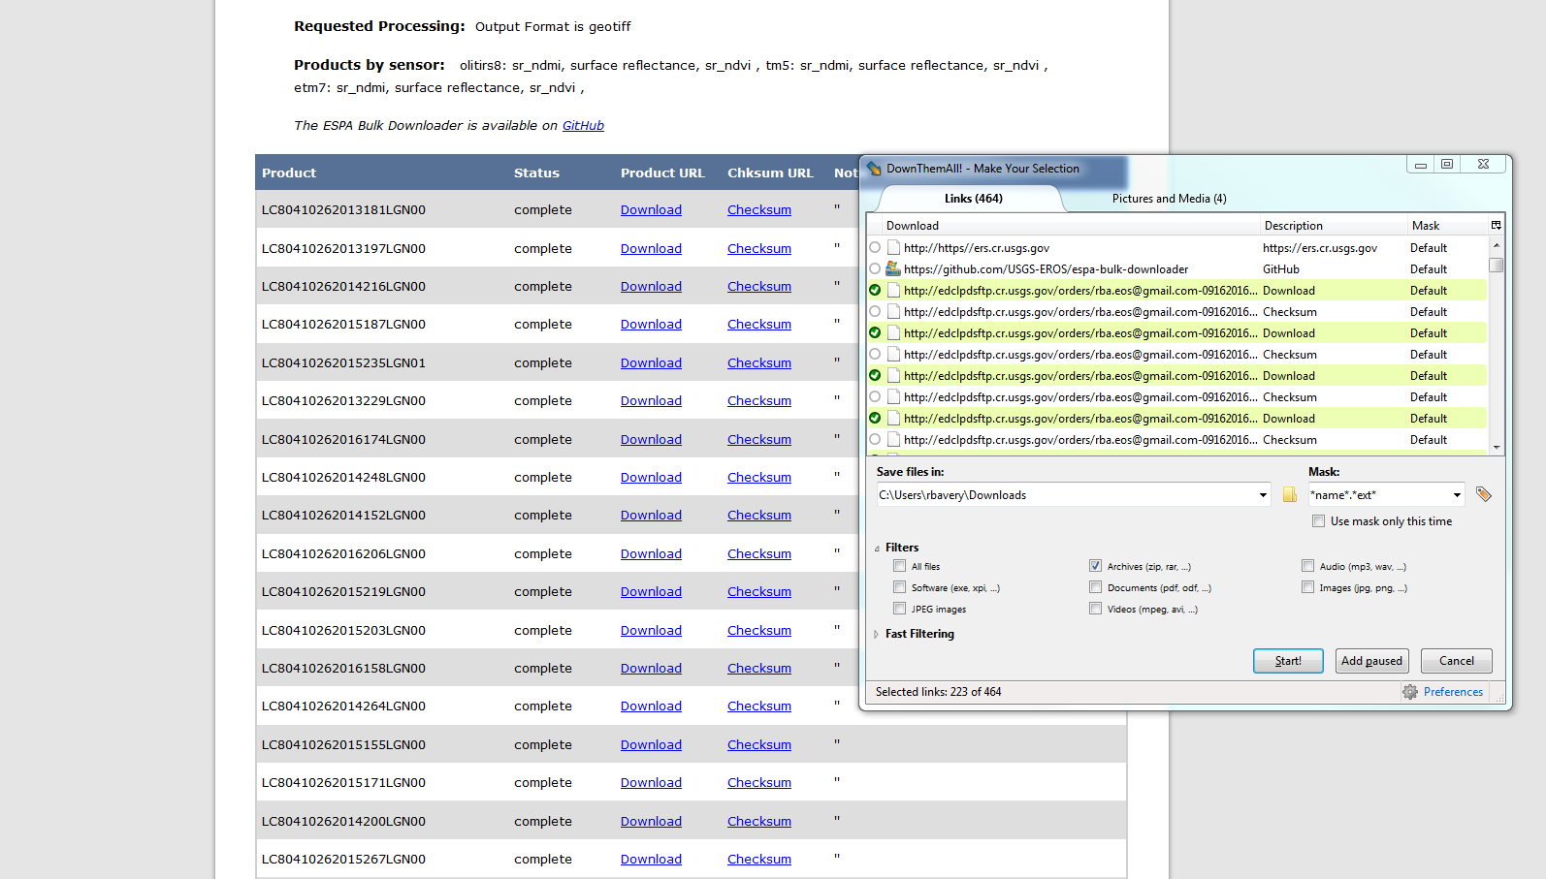
Download Them All!
Go to Tools again and select the DownThemAll! Tool
Go to “Filters” and uncheck all boxes except for “Archives”
Choose your save directory
Start downloading!
It may take awhile but now you can let it run
Notes:
The filter is important, if it is not selected you will download a bunch of unrelated material. You only want the zip files.

Slide 15
PRESTO!
At the end of this you should have a file full of your scenes.
Depending on what data format you downloaded these as, there may be further pre processing to do (unzipping, compositing bands, projecting, etc.)
Contact the Geoinformatics team at develop.geoinformatics@gmail.com with any future questions
Let us know what you think!

