Slide 1
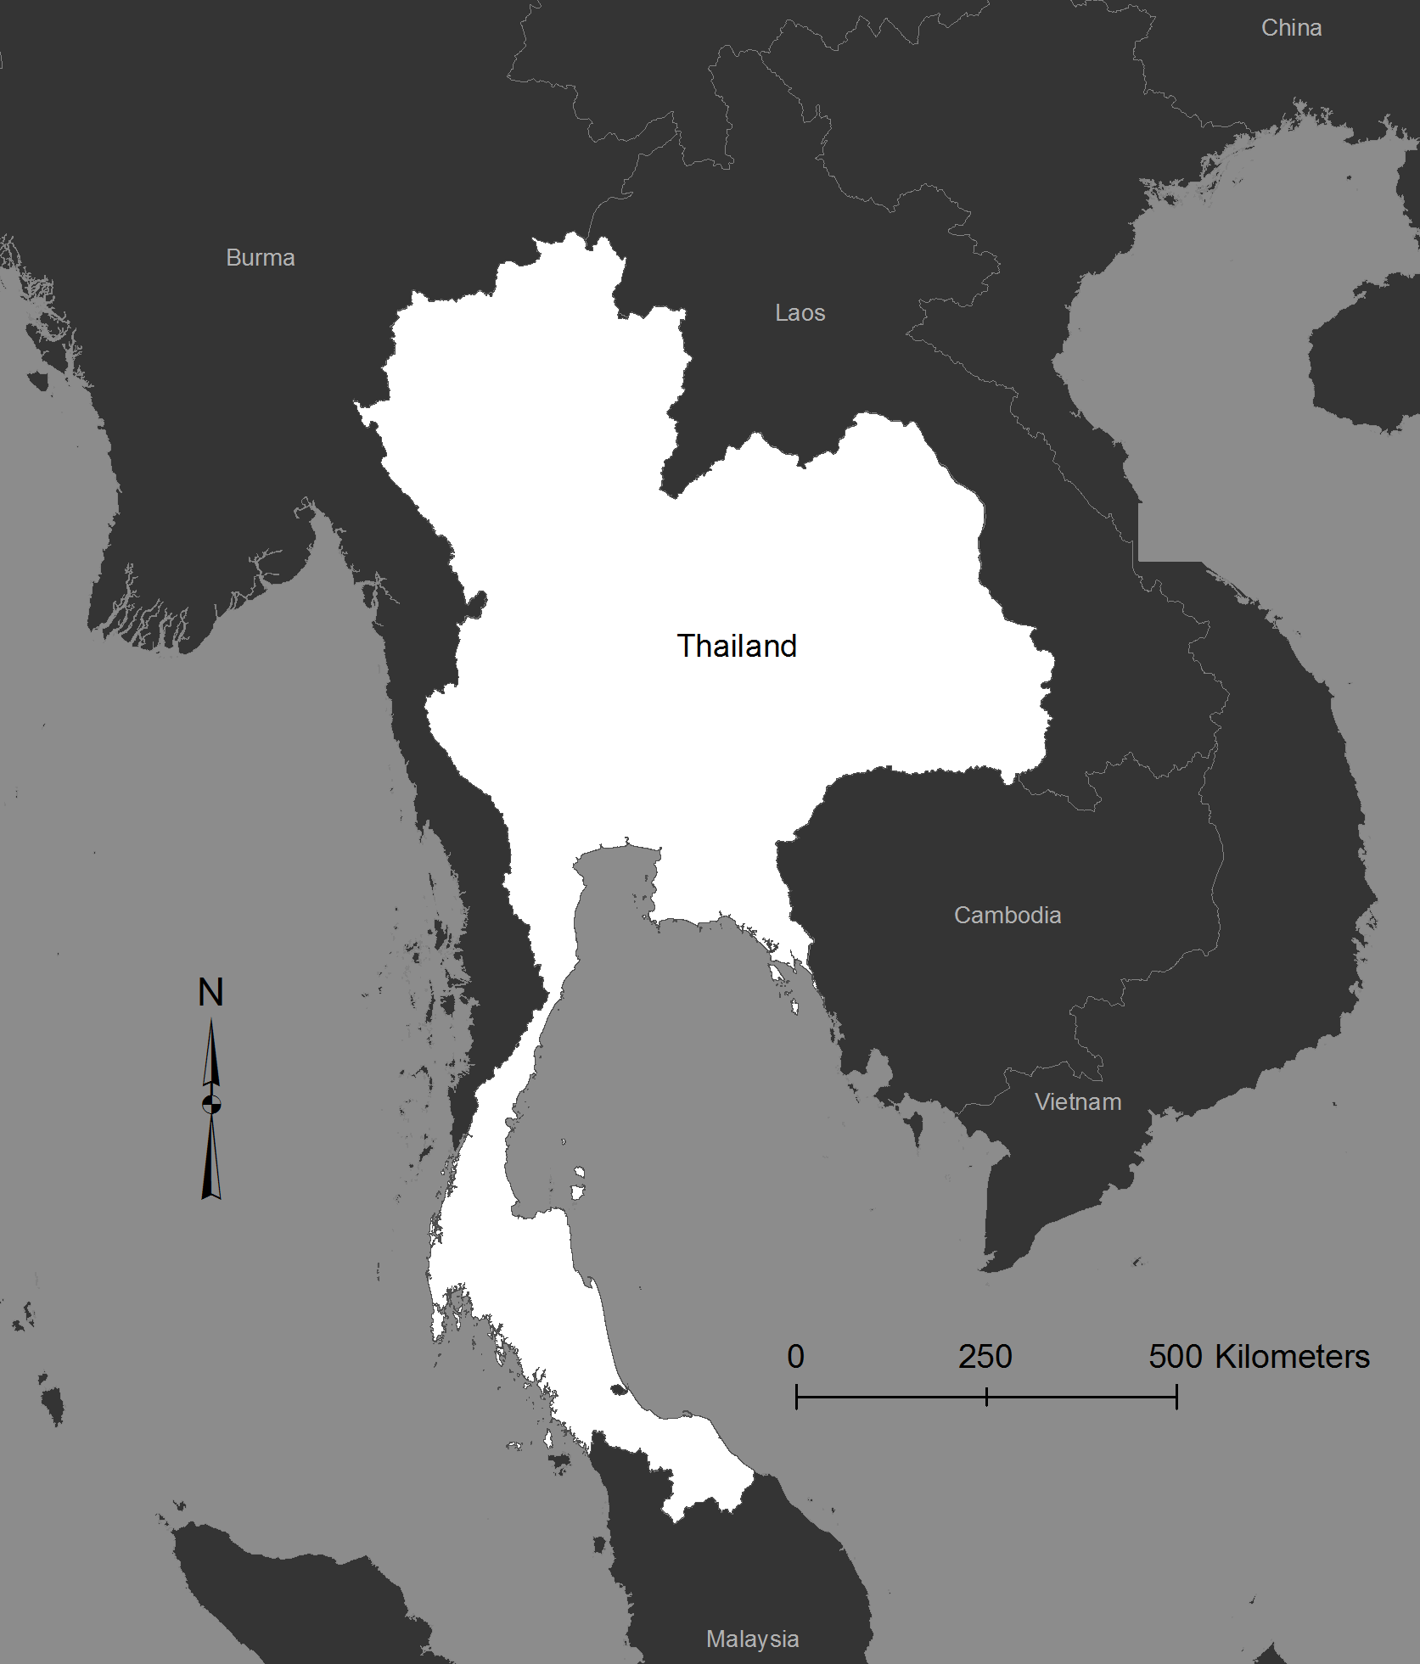
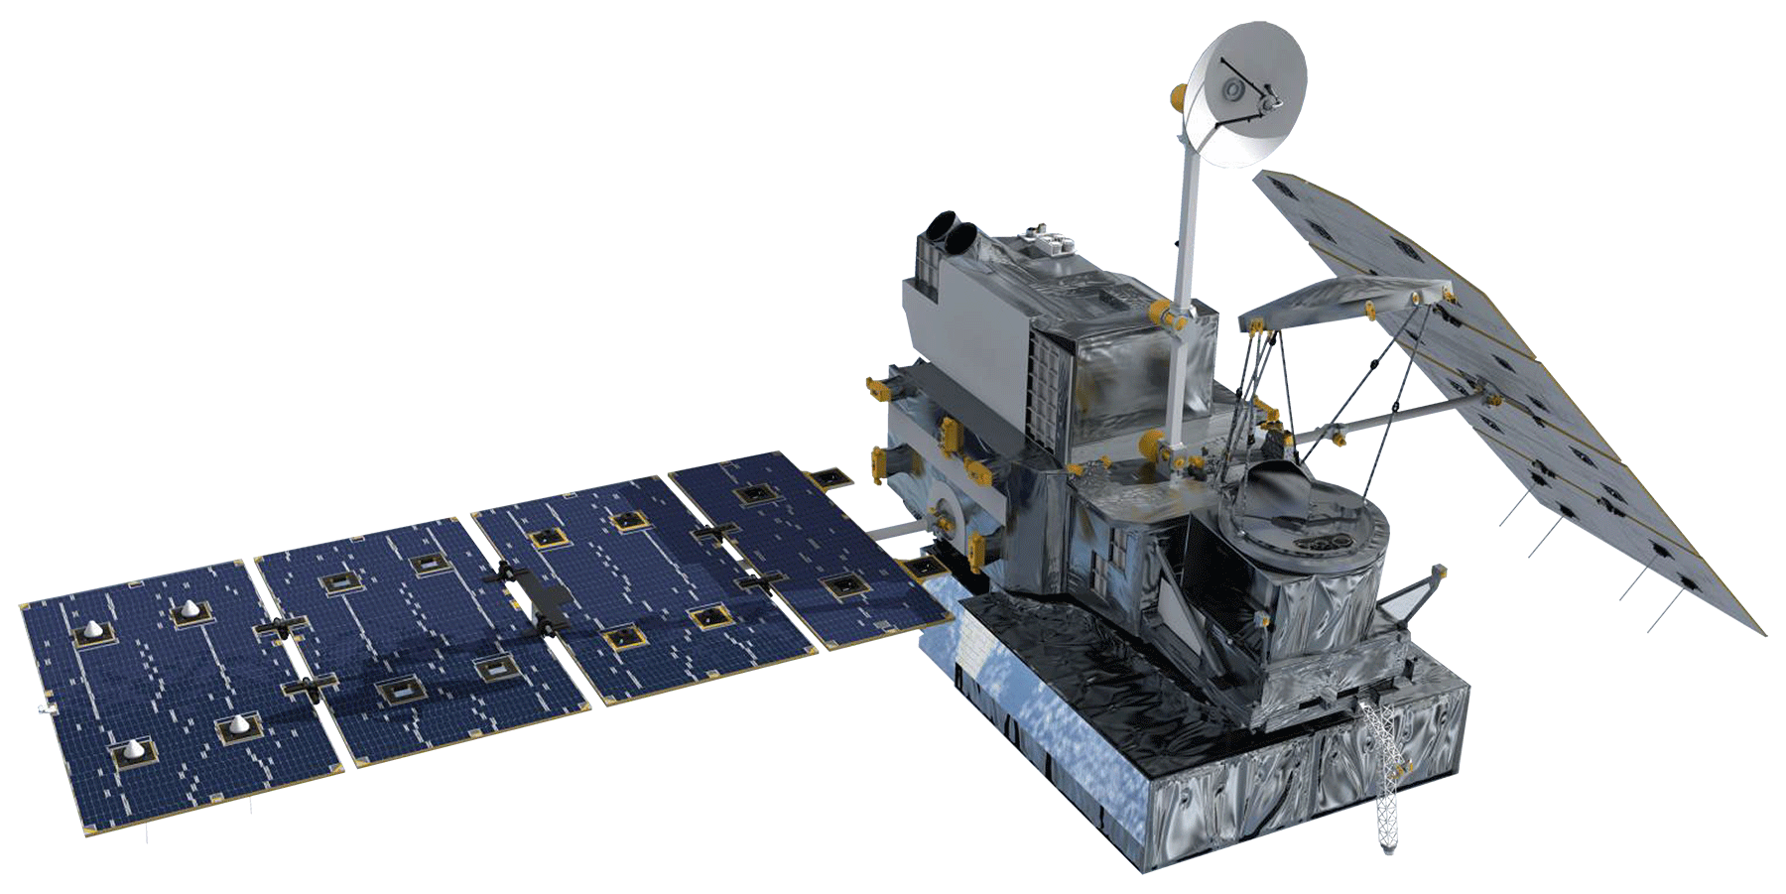
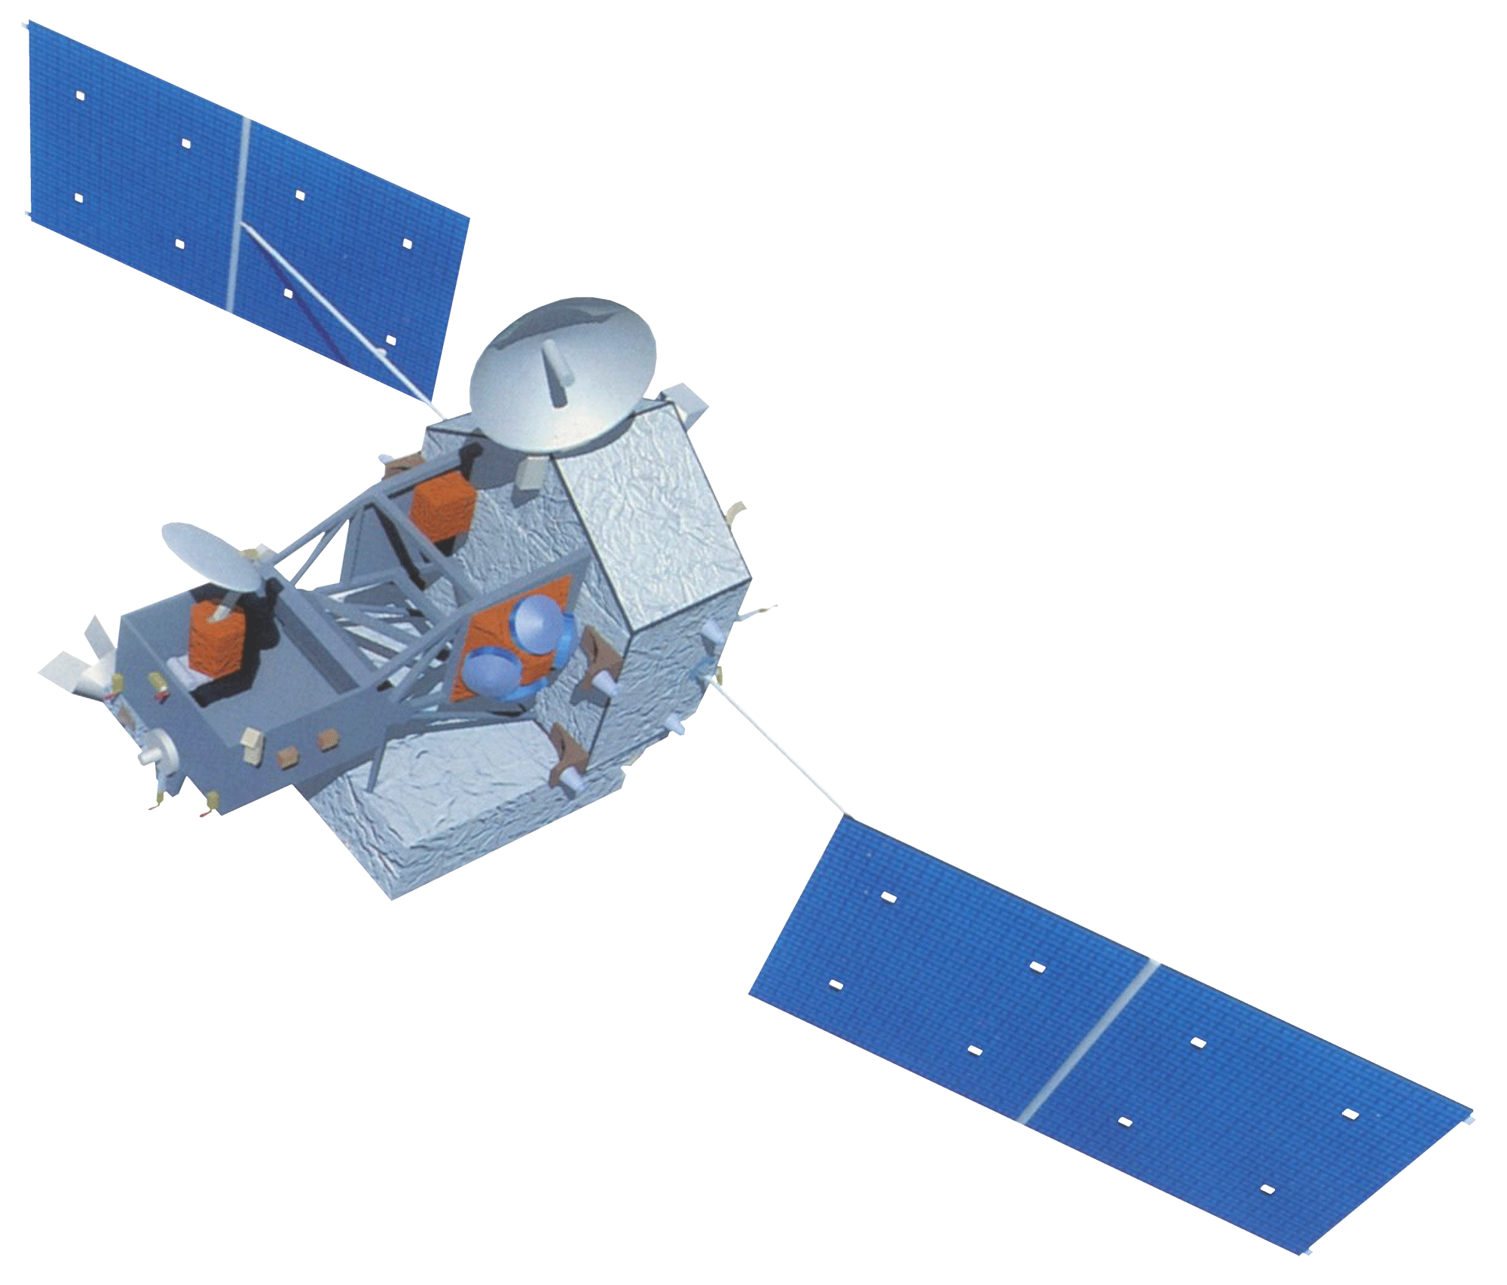
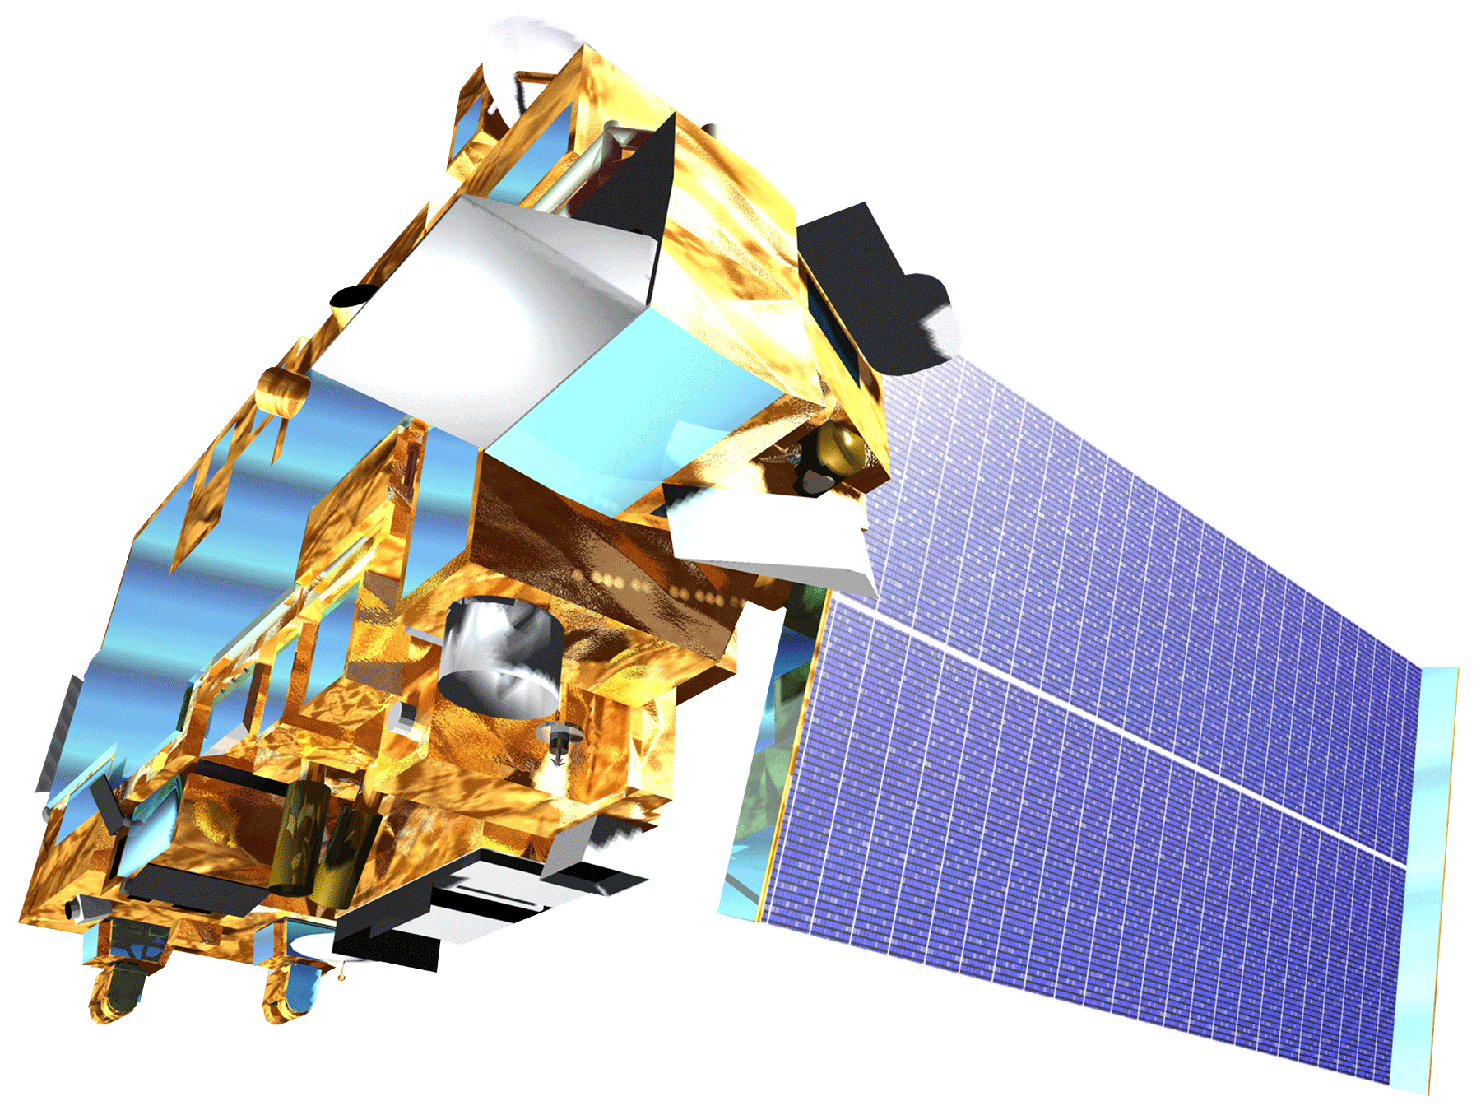
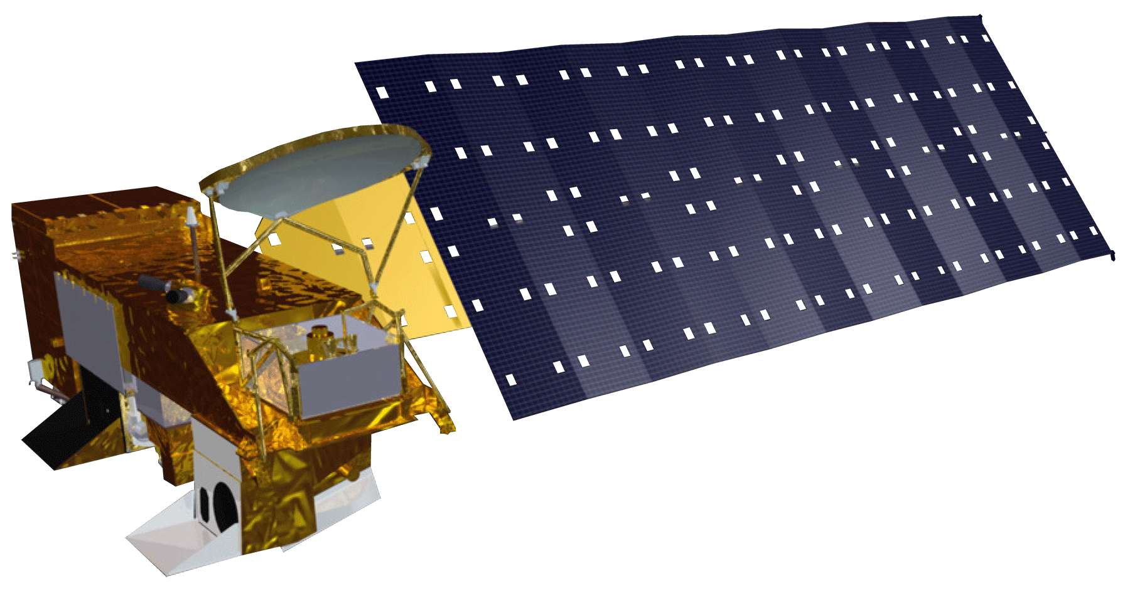
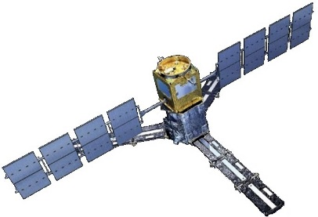
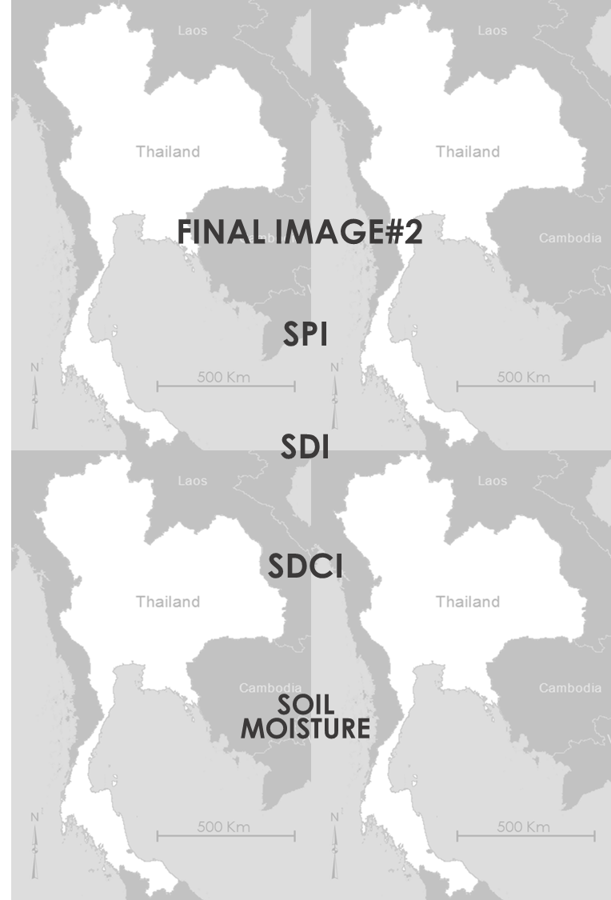
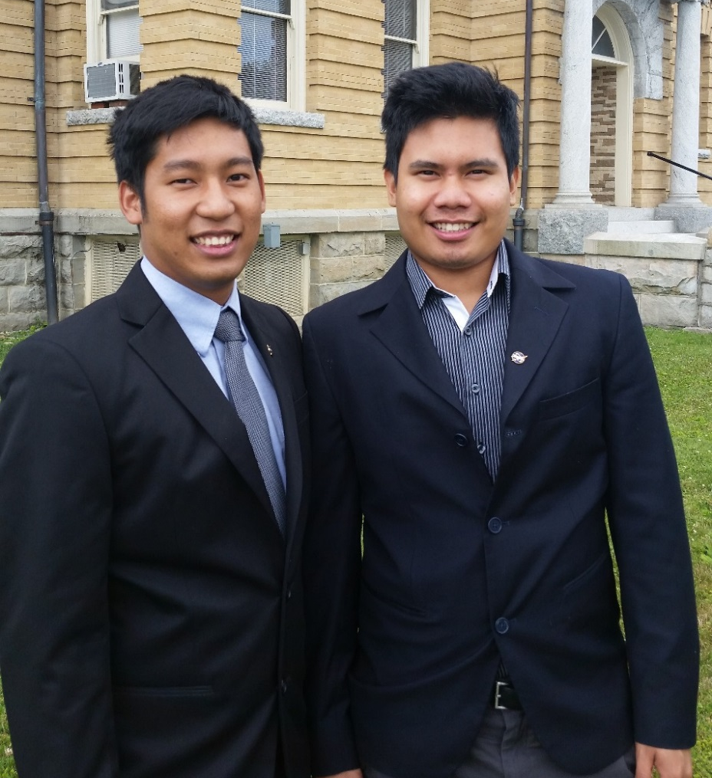
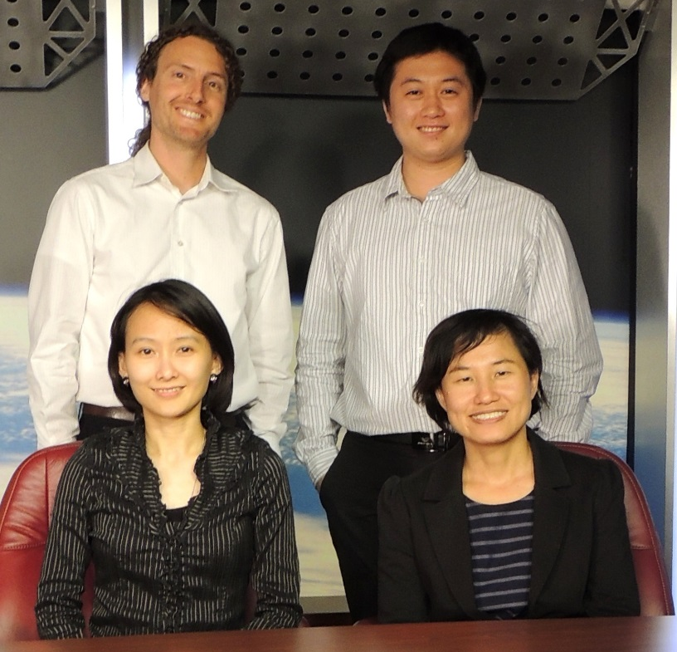
Thailand Disasters
Monitoring Risk and Extent of Drought for Enhanced Decision Making and Resource Allocation in the Kingdom of Thailand
Sean McCartney (Project Lead – NASA DEVELOP), Nobphadon Suksangpanya (NASA DEVELOP), Chisaphat Supunyachotsakul (NASA DEVELOP), Srisunee Wuthiwongyothin (NASA DEVELOP), Sahakait Benyasut (NASA DEVELOP), Thanapat Vichienlux (NASA DEVELOP)
Abstract
Objectives
Keep this blank for now.
Body text point size should be at least 24.
Caption text point size should be at least 16.
Feel free to rename, move, and resize sections as needed.
Use 3 different drought indices to monitor meteorological, hydrological and agricultural drought in Thailand to assist in drought management and mitigation.
Identify extreme drought anomalies based on a climatological baseline.
Study Area
Methodology
GPM – GMI
30-min precipitation rate (mm/hr)
0.1°-Spatial Resolution
IMERG Level 3 product
Standardized Precipitation Index (SPI)
Monthly Precipitation
Resampled to
0.1°-spatial resolution
TRMM – TMI
Daily precipitation (mm)
0.25°-Spatial Resolution
3B42 Level 3 product
Scaled Drought Condition Index
(SDCI)
0.01°-spatial resolution
NDVI
0.01°-spatial resolution
MOD13A3 and MYD13A3 products
TERRA & AQUA
– MODIS
Earth Observations
LST
0.05°-spatial resolution
MOD11C2 and MYD11C2 products
TRMM
Streamflow Records
26 ground-based stations on the main streams and rivers
Monthly Streamflow (m³)
Streamflow Drought Index
(SDCI)
AQUA
TERRA
GPM
SMOS
Results
Conclusions
Show and discuss February 2015 raster images of SPI, SDI, SDCI, and Soil Moisture over the Kingdom of Thailand.
Show plots of SPI, SDI, SDCI, and Soil Moisture at a specific region over time in each index and find drought anomalies to determine the cause and effects of drought.
Use bullets.
Use complete sentences with periods.
Team Members
Project Partners
Acknowledgements
Royal Thai Embassy
Asian Disaster Preparedness Center (ADPC)
SERVIR Mekong
Dr. John Bolten (DEVELOP National Science Advisor)
Dr. Kenton Ross (DEVELOP National Science Advisor)
Dr. Dalia Kirschbaum (DEVELOP National Science Advisor)
Colin Doyle (NASA GSFC - USRA)
Dr. Peter Cutter (ADPC)
Lance Watkins (DEVELOP)
Summer 2013 Great Plains Agriculture Team (DEVELOP)
L to R: Thanapat Vichienlux, Sahakait Benyasut
(Wise node)
Back L to R: Sean McCartney, Nobphadon Suksangpanya
Front L to R: Chisaphat Supunyachotsakul, Srisunee Wuthiwongyothin (Goddard node)

