Slide 1
CHEROKEE
Water Resources
Mapping Forest Health and Hemlock Tree Composition Using NASA Earth Observations to Enhance Drought and Watershed Health-Related Forest Management for the Eastern Band of the Cherokee Indians
Travis Newton, Chloe Schneider, Wilson Goode, Richard Murray
North Carolina - NCEI
Notes:
[Speaking]
Hello Everyone! We are the Cherokee Water Resources team are excited to share from our ten-week journey exploring the feasibility of using Earth Observations to Map Forest Health and Hemlock Composition.
[introductions + individual background]

Slide 2
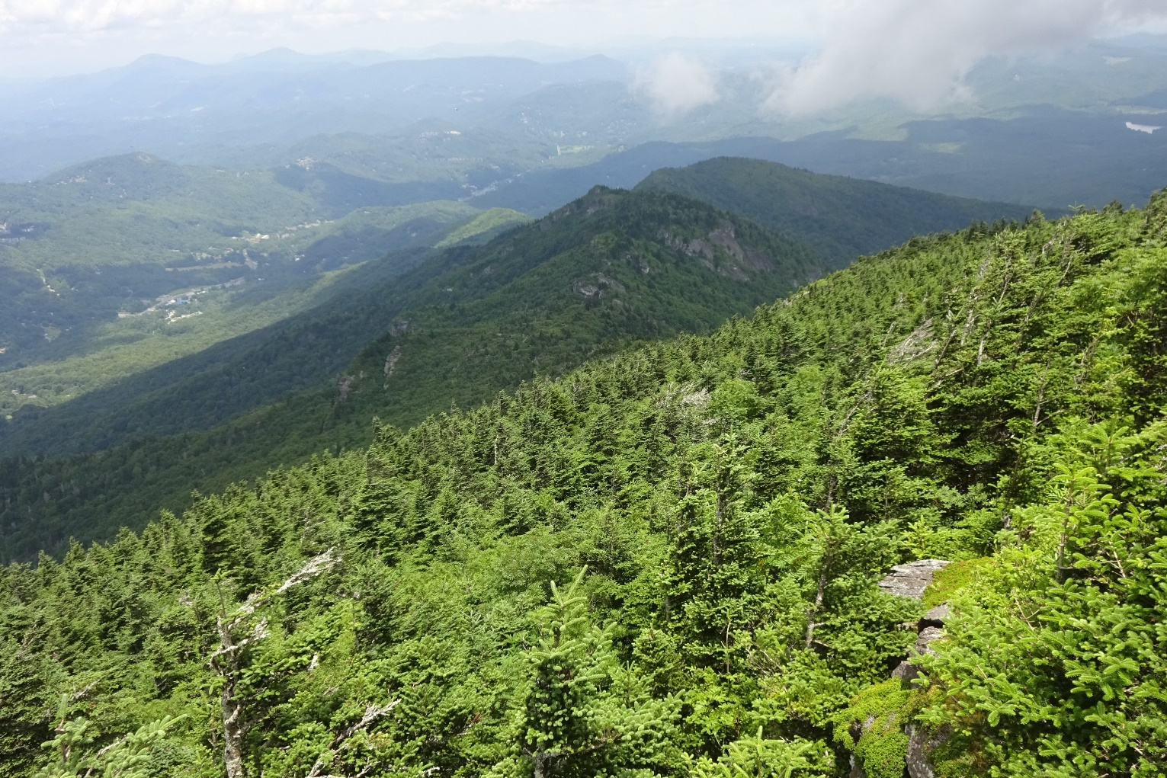
Road Map
Project Partner & Community Concerns
Project Objectives
Study Area
Methods & Analyses
Results & Inferences
Limitations & Errors
Future Work
Image Credit: DEVELOP team member Travis Newton
Notes:
Speaker [Chloe]
We will first introduce to you our study area, our partners and their concerns, the spatial methods we employed to address these concerns, followed by our findings!
------------Image Information Below------------
Image of North Carolina Landscape:
Image Credit: Travis Newton (written permission received to use image from Travis Newton)

Slide 3
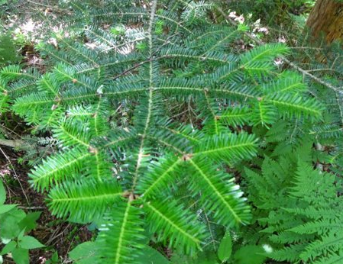
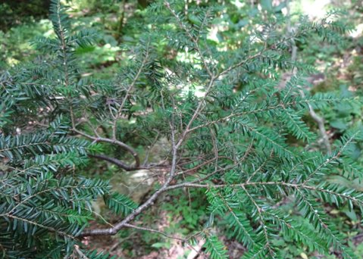
Project Partners & Community Concerns
Eastern Band of Cherokee Indians - Natural Resources Department
Conservation and management of >50,000 Acres
Hemlock Decline
Hemlock Woolly Adelgid (HWA)
Why?
Ecological cycle
Healthy Hemlock
Hemlock Wooly Adelgid Present
Image Credit: DEVELOP team member Travis Newton
Notes:
Speaker [Chloe]
Our project partner is the Eastern Band of Cherokee Indians Natural Resources Program, or the EBCI Natural Resources Program, a program responsible for the conservation and management of Cherokee lands. The EBCI National Resources program owns and manages over 50,000 acres of land in the southern Appalachian Mountains of western North Carolina. This area has a history of high-grading, or the selective cutting of large and high-value trees, which has left behind a mixed forest with a high concentration of less economically valuable tree forms. In addition to these past cuts, more recently, the hemlock woolly adelgid (HWA) has spread throughout the Appalachians and is present in nearly every stand of eastern and Carolina Hemlock. Which resulted in a decline of Hemlock populations.
Why care?
Hemlocks are a crucial component of the ecological cycle. Not only does the Hemlock provided habitat for animal species (for example, the endangered Carolina northern flying squirrel), but it also contributes to the aquatic environments by stabilizing water temperatures, and mitigating erosion.
------------Image Information Below------------
Image Credits:
Microsoft PowerPoint 16 ClipArt
CreativeCommons
Image of Healthy Hemlock and Non-Healthy Hemlock
Image Credit: Travis Newton (written permission received to use image from Travis Newton)

Slide 4
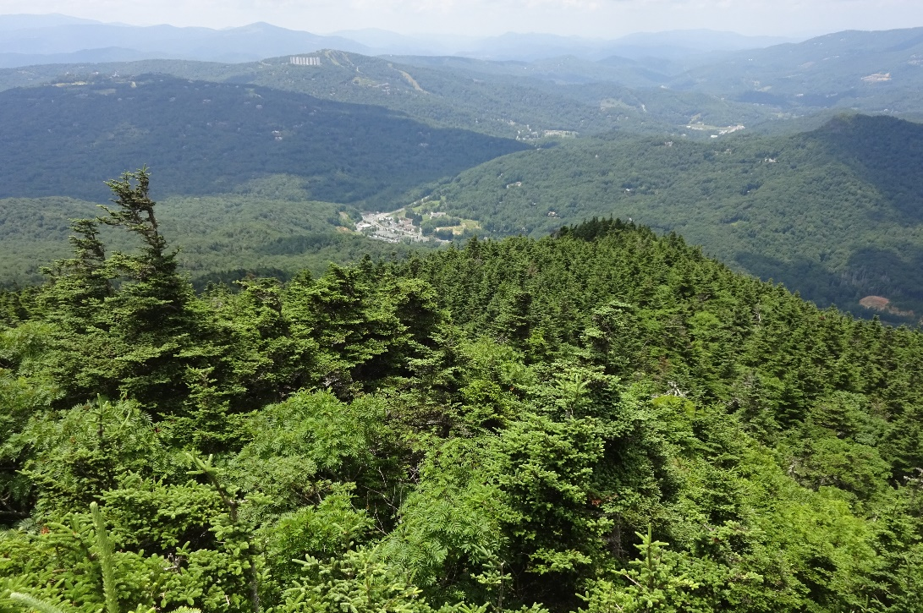
Project Objectives
Apply Earth observations to aid in forest health monitoring and change detection
Analyze winter NDVI decline to identify areas of evergreen and potential hemlock decline
Explore and identify hemlock suitable areas through a Weighted Suitability Analysis
Produce a tutorial package to guide and strengthen ECBI’s capacity to use remote sensing
Image Credit: DEVELOP team member Travis Newton
Notes:
Speaker [Chloe]
With these community concerns in mind, our project objectives consist of four points Apply, Analyze, Explore, and Produce.
First, we review existing practices for the application of NASA Earth observations for forest health monitoring and change detection. Second, analyzed winter NDVI decline to identify areas likely affected by the Hemlock woolly adelgid. Third, explore and identify hemlock niches through a weighted suitability Map. Finally, Produce a tutorial package to guide and strengthen EBCI’s capacity to use remote sensing data to address environmental and policy concerns.
------------Image Information Below------------
Image of North Carolina Landscape
Image Credit: Travis Newton (written permission received to use image from Travis Newton)

Slide 5
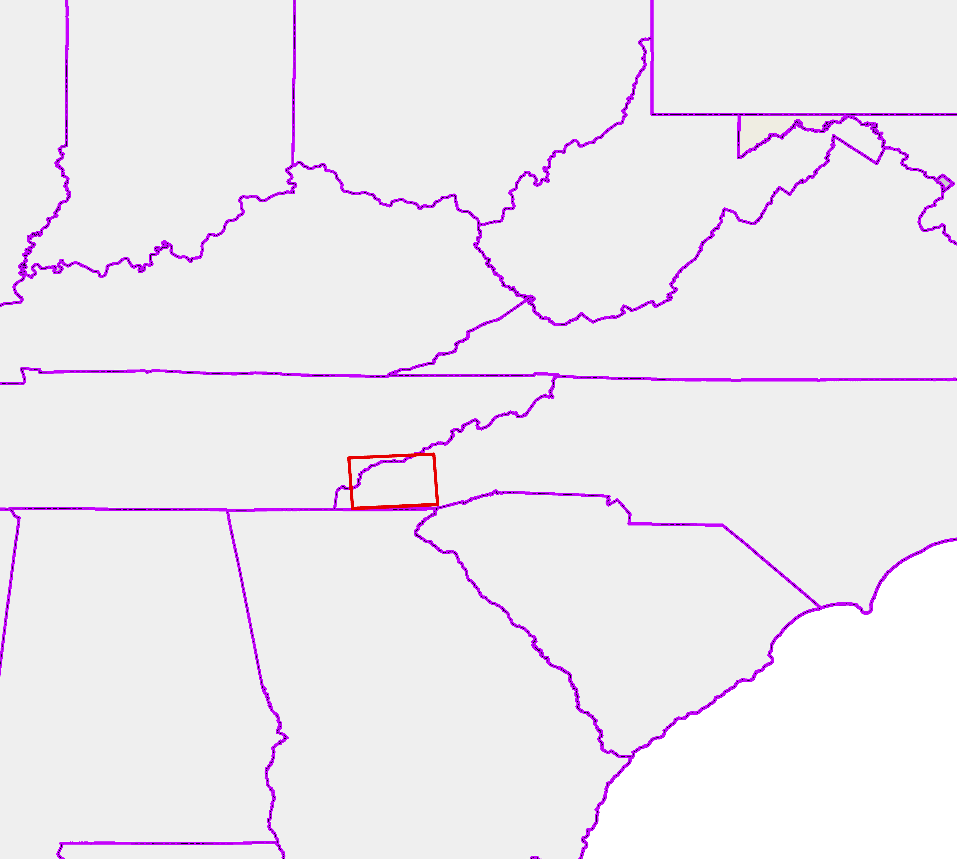
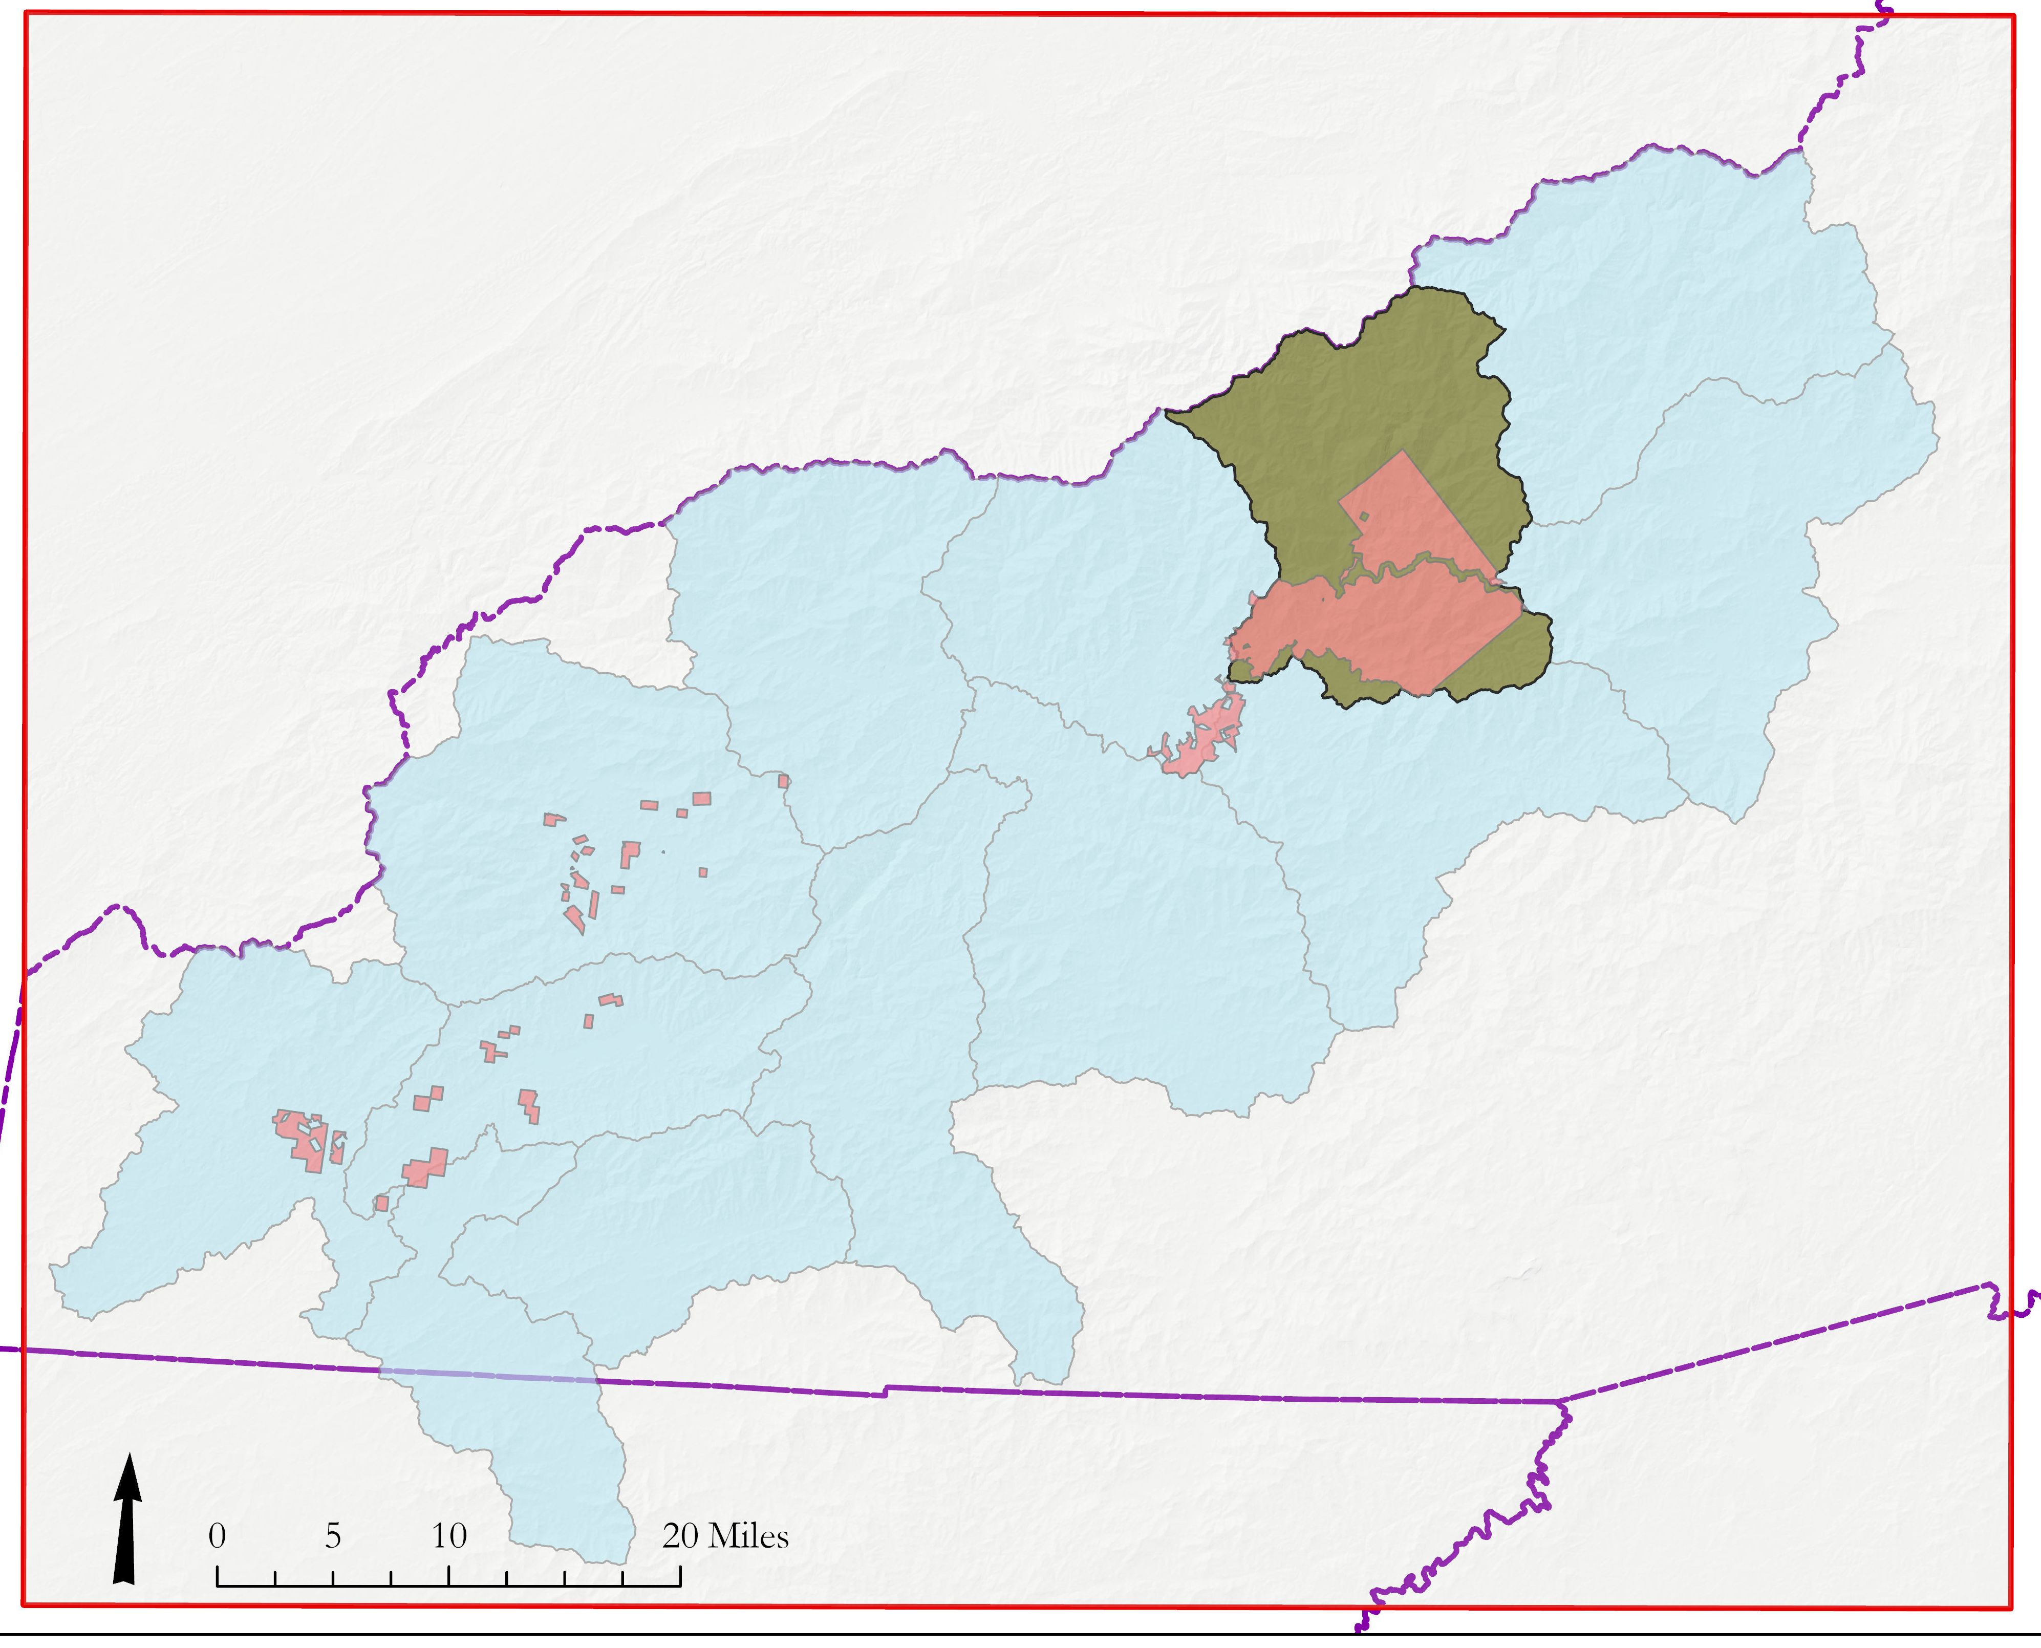
Study Area
Eastern Band of Cherokee Indians
NASA DEVELOP – Cherokee Water Resources Study Area
Location
Oconaluftee River and surrounding watersheds
Study Period
June 2000 –2020
Forest disturbances
Appearance of HWA
2016 wildfires
PA
IN
OH
WV
KY
VA
TN
NC
SC
AL
GA
Oconaluftee Watershed
EBCI Land Tracts
Watershed Boundary
Study Area Extent
U.S. States
Notes:
Speaker [Chloe]
The Map displayed before you is the EBCI region of interest and region of interest (ROI) depicted by the red box outline. ROI encompasses both the EBCI land tracts in the pink and the watershed boundaries in light blue. We included the watershed boundaries to better to highlight changes within watersheds of interest to the partners, particularly, the Oconaluftee River watershed (highlight in green). The study period was composites of summer and winter between 2000 – 2020. Choosing this as our study period, we can identify the change rate of hemlock with emphasis on the introduction of the Hemlock woolly adelgid and the 2016 wildfire impacts.
------------Image Information Below------------
Image Created in ArcGIS by the DEVELOP Team using USGS, USDA-NRCS, and U.S. Census Data
Map of Study area:
Image Credit: Produced In ArcGIS Esri
Base Map: Light Gray Canvas
North Arrow: available through CC0 1.0 Universal (CC0 1.0 (https://publicdomainvectors.org/en/free-clipart/North-arrow/58771.html)

Slide 6
Methods Overview
Data Acquisition
Data
Processing
End-Products
Data
Analysis
Modeling Approach
Multi-Spectral
Imagery
Vegetation Index Calculation
NDVI Winter Change Analysis
Data Products & Tutorial
Next Steps for Other Modeling Approaches
Topography
Land Cover Masking
Weighted Suitability Analysis
Virtual Hand-off
Land Cover
Hemlock Data
Notes:
Speaker [Richard]
Our project workflow is broken into 5 stages with our end goal to create to perform different approaches to mapping and tracking potential areas of hemlock. (List methods)
------------Image Information Below------------
Image Credits:
Microsoft PowerPoint 16 ClipArt
CreativeCommons

Slide 7
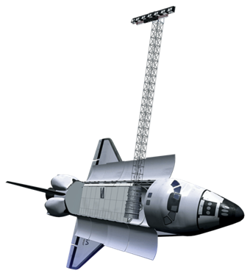
Earth Observations & Data
Landsat 5
TM
Parameter | Collection Years | Spatial Resolution | Use
Level 2 Surface Reflectance | 2000 - 2011 | 30 meter Bands 2-5 | NDVI and False Color Composite
Level 2 Surface Reflectance | 2013 - 2019 | 30 meter Bands 2-5 | NDVI and False Color Composite
Digital Elevation Model | 2001& 2013 | 1/3 arc second or 30 meter | Topographic Modeling
Landsat 8
OLI
SRTM
Additional Datasets
National Land Cover Database
U.S. Census TIGER
Hemlock Conservation Area Polygons
Image Credit: NASA
Notes:
Speaker [Richard]
Here is the list of the satellites that were used in this project (list). Starting with Landsat we gathered tier- 1 level-2 Landsat 5 thematic Mapper (TM) , and 8 Operational Land Imager or OLI to monitor the surface reflectance for the summer and winter composites between 2000 and 2020 from U.S. Geological Survey (USGS) Earth Explorer.
Additionally, we accessed the same Landsat 5 and 8 data from USGS using Google Earth Engine. For the topography, digital Elevation models derived from SRTM were downloaded from USGS. The SRTM data, collected was reprocessed at 1/3 arc second which is a 30-meter resolution the same as all Landsat images obtained. Using the SRTM data set to create the base raster for the outputs.
To supplement these Earth observations we acquired three additional data sets to sets. The National Landcover Cover classification which gave the team references for know tree categories, both deciduous and evergreen ; The U.S. Census Tiger for a raster of Urban Development, roads and American Indian lands; finally we gathered know Hemlock polygons from the Hemlock Restoration initiative and the Great smoky national park to compare the suitability maps produced.
------------Image Information Below------------
NASA Satellite Image:
1. NASA DEVELOP: http://www.devpedia.developexchange.com/dp/index.php?title=List_of_Satellite_Pictures
Stock Satellite image

Slide 8
Analytic Approaches
NDVI Winter Change Analysis
Weighted Suitability Analysis
Where has winter NDVI declined in evergreen and mixed forests between 2003-2010?
What areas in 2018 exhibit topographic and vegetative characteristics suitable for hemlocks?
Notes:
Speaker [Richard]
To guide our methodologies our team asked certain question(s) for each product to help our hunt for hemlocks. Starting with NDVI winter change ..When analyzing the NDVI winter change for the years between 2003 & 2010 .. Where has winter NDVI declined in evergreen and mixed forest? This can display evergreen decline that could indicate hemlock die-off.
For Hemlock Suitability, we take partner-identified land characteristics and demonstrate a weighted method to show where hemlocks could have suitable habitat.
------------Image Information Below------------

Slide 9
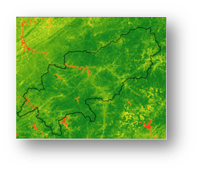
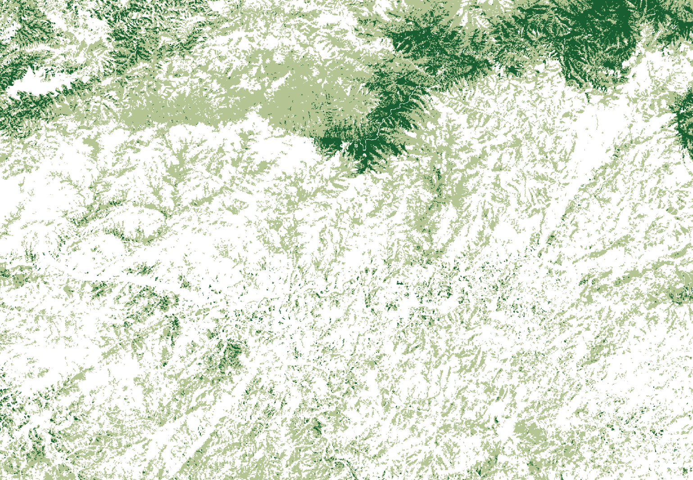
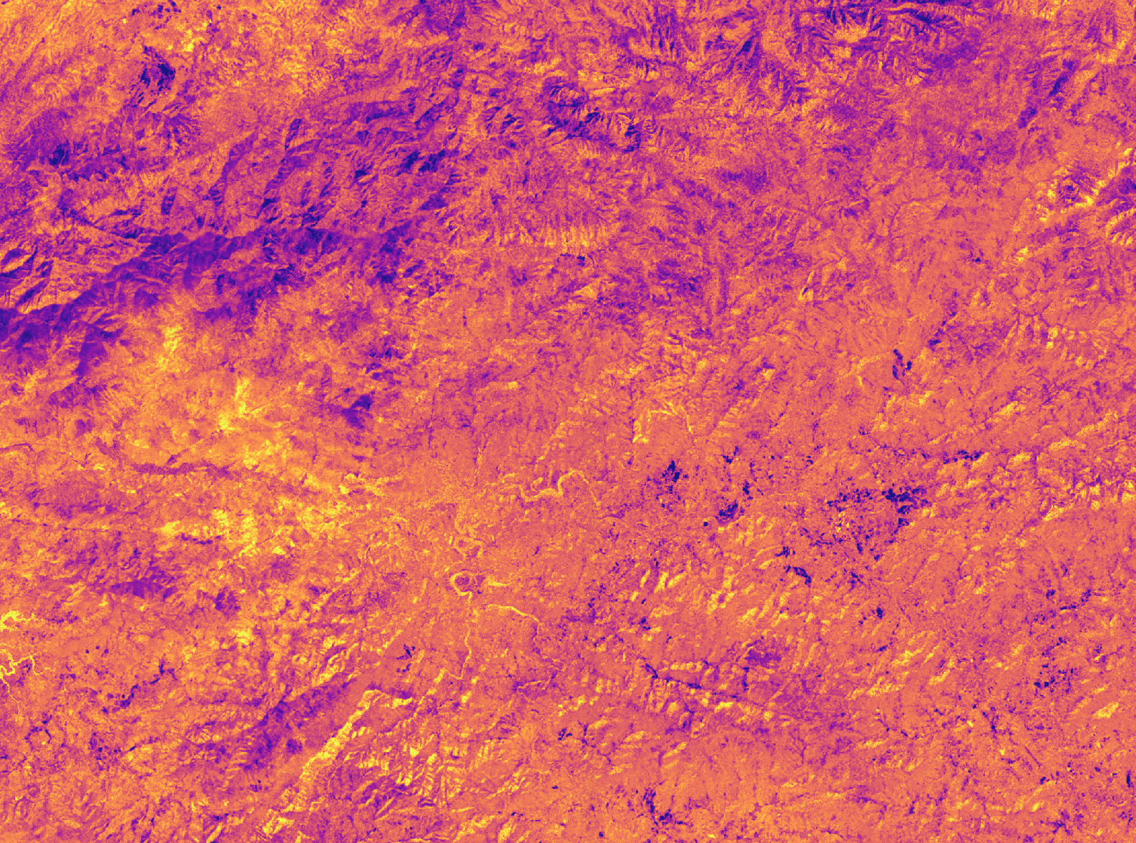
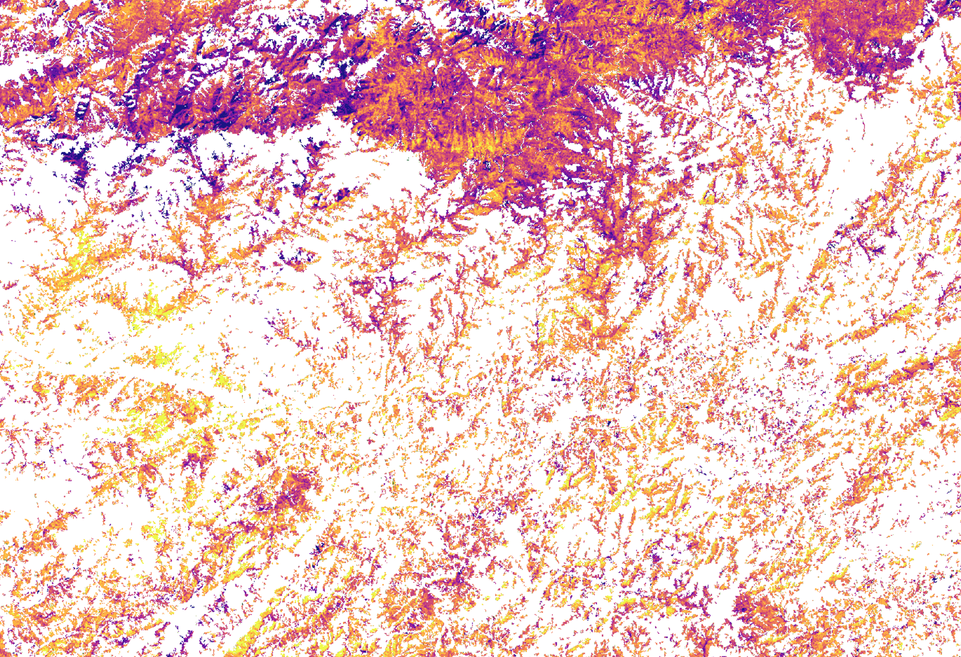
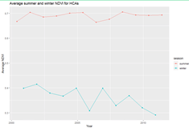
NDVI Calculation
Evergreen & Mixed Forest Mask
Winter NDVI Change & Time Series
Potential Hemlock Decline in Evergreen & Mixed Forests
NDVI Winter Change Overview
Notes:
Speaker [Wilson]
Displayed before you is the Teams general workflow to achieve a NDVI Winter Change results.. (list)
------------Image Information-------
Images created by DEVELOPers using ArcGIS Pro

Slide 10
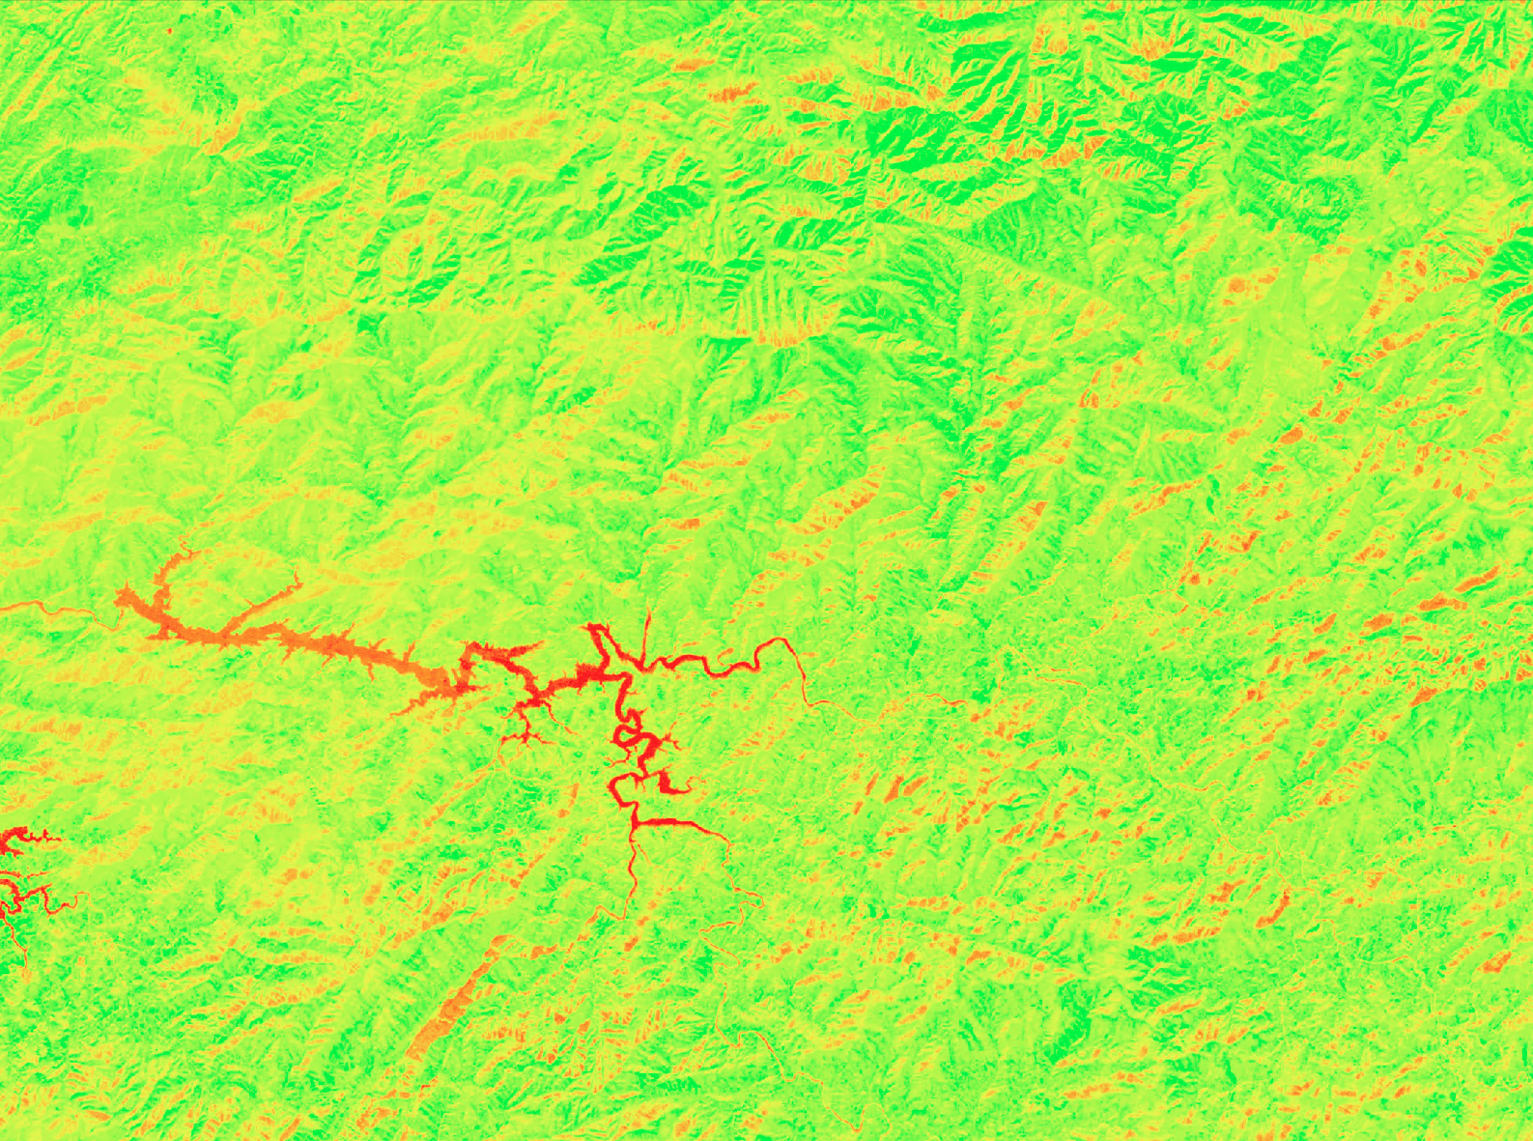
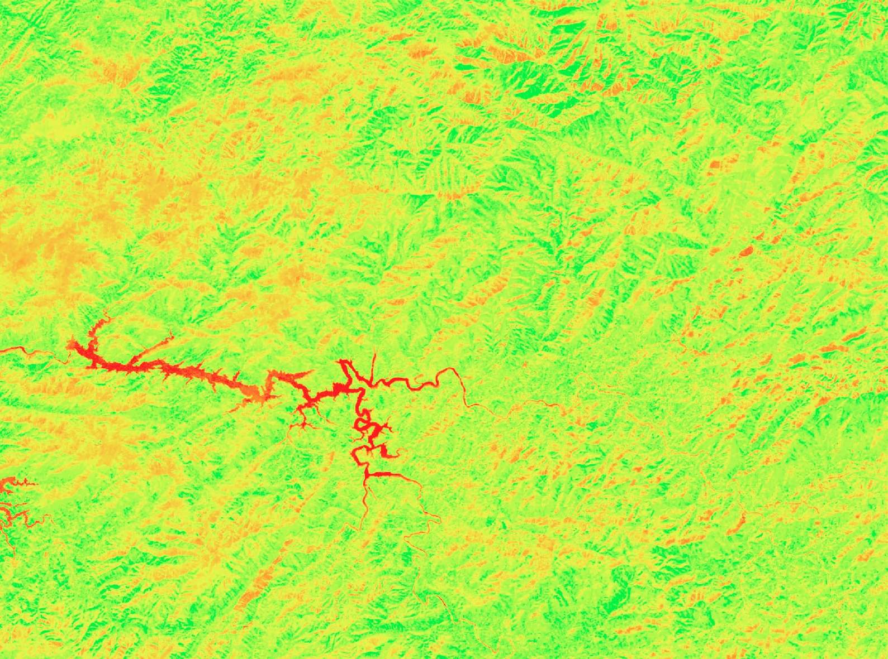
NDVI Winter Change Analysis
NDVI Calculation
Years of interest: 2003-2010
Winter definition: 01 Dec – 01 Mar
NDVI =
NIR - R
NIR + R
Value
0.78
-0.52
Average Winter 2003/2004
Average Winter 2009/2010
Winter NDVI Change 2003-2010
Increase
Decrease
Notes:
Speaker [Wilson]
Created average winter NDVI images for 2003/2004 and 2009/2010 - local knowledge indicates that these are the years that capture most of the hemlock decline occurrence
For reference, the NDVI equation is added here
Vegetation (green) Forest Grassland
Non vegetation (red) Urban, Water, Impervious Surfaces
------------Image Information Below------------
NDVI Images:
Created by DEVELOPers using ArcGIS Pro

Slide 11
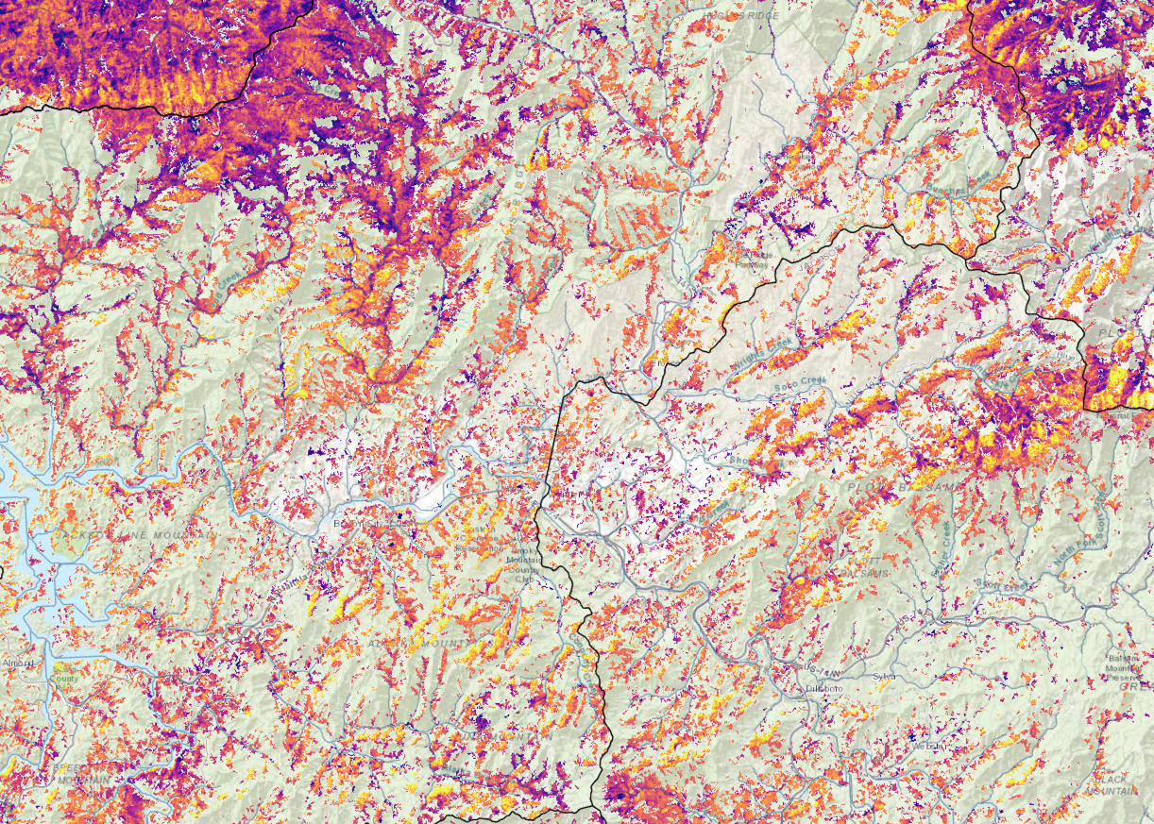
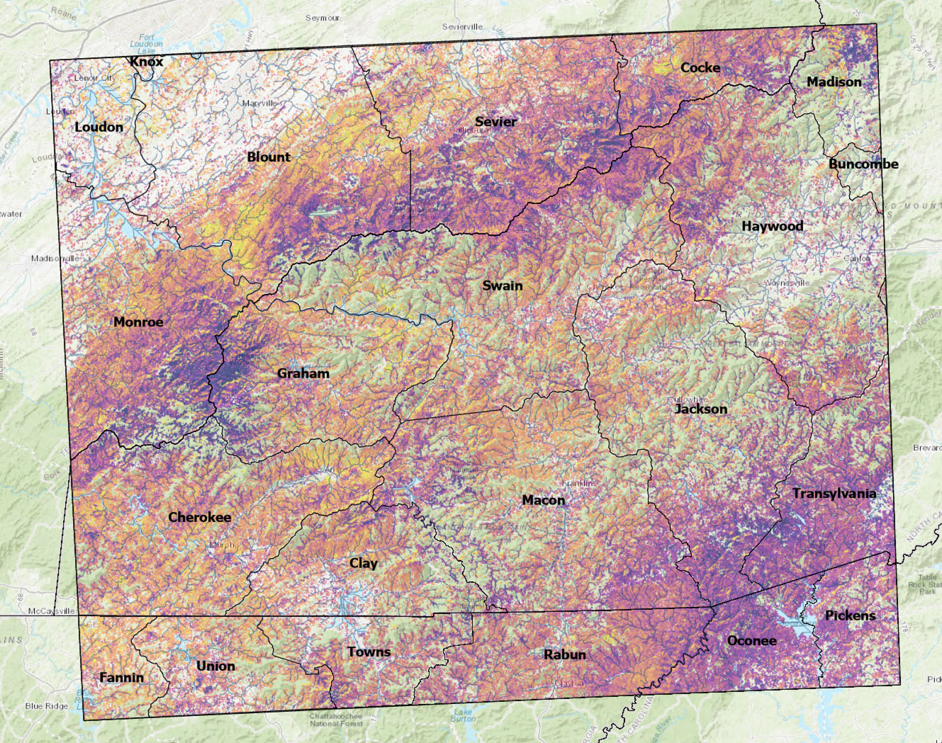
NDVI Winter Change Results & Inferences
High: 70
Low: -50
Notes:
Speaker [Wilson]
Evergreen + Mixed Forest
Mask NDVI change map by 2004 National Land Cover Database to investigate areas designated as Evergreen and Mixed Forest – purple indicates NDVI decline, yellow indicates NDVI increase
We observe areas displaying both increases and declines of vegetation greenness during this time. There are a few factors that could account for vegetation increase, such as growth of rhododendron. Initial inspection of areas experience NDVI decline against hi-resolution imagery (USDA Forest Service NAIP imagery) show that this method does capture areas of hemlock decline. We can observed pockets of greatest NDVI decline along headwaters of stream along the border between Sevier County, TN and Swain County, NC
In Evergreen and Mixed Forests, where we would expect to find hemlocks, we see patches of steep NDVI decline.
These areas could be surveyed from the ground to test their accuracy
Caveats
While we believe most of the decline occurs between 2004 and 2010, we are limited in our ability to compare forward in time through 2020 because the Landsat 5 mission ended in 2011 and the wavelengths captured by the Landsat 8 instrument are slightly different.
------------Image Information Below------------
NDVI Images:
Created using ArcGIS Pro

Slide 12
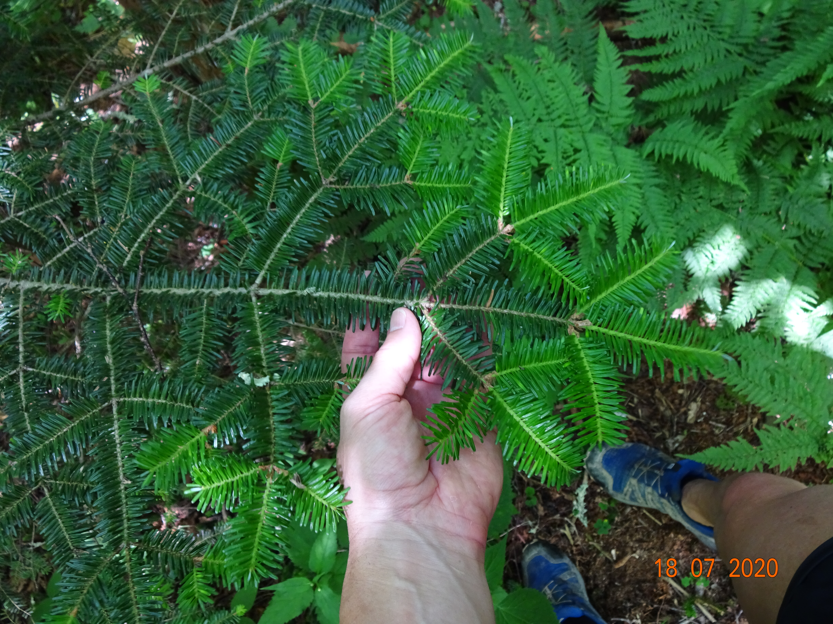
Weighted Suitability Analysis Overview
Weighted Overlay of Suitability Characteristics
What areas meet a ranked list of criteria?
User-identified criteria
Human, environmental, topographic variables
Masked by land cover (evergreen & mixed forest)
Two approaches
Multiple variables, single category
Multiple variable, multiple categories
Sources for identifying suitability criteria:
Image Credit: DEVELOP team member Travis Newton
Published Research
Expert & Local Knowledge
Investigation of Hemlock Conservation Areas (HCA)
Notes:
Speaker [Travis]
Three types of models the team used to investigate include fuzzy memberships, weighted overlay, and Random forest. Of these three methods, so far, we have produced example results with the weighted overlay we are discussing today.
How does weighted overlay work?
The user creates variables from earth observation platforms (landsat and srtm) and ancillary data sets (census). The model will look at both environmental and human factors that have an impact on Hemlocks.
Users can use a mask for any modeling, for this model a mask blocking out large rivers and lakes and an internal proxy mask in the form of the categorical forest raster.
A first option uses multiple variables, but each one of these has a single range created.
The second option uses multiple variables that have a full range of data throughout your study area. Categorical or Continuous.
The team set out to investigate where Hemlocks were most likely located based on Research Articles, collaborating with field experts, and extracting data.
Journal Articles = list publications from our project summary and technical report
Industry Experts = See acknowledgment slide: HRI, GRSM, NCIC, USFS
Averages = For the Oconaluftee Watershed known treatment polygons using random point generation and extraction
Slope: 4.97 deg
Road dis: 16,919.35 ft
NDVI sum: .596
NDVI win: .176
Aspect: 194.02 deg
Elevation: 3,510.80 ft
Stream dis: 777.31 ft
Urban dis: 8390.00 ft
Total treatment observation points in Oconaluftee Watershed = 95
------------Image Information Below------------
Image Credits:
Microsoft PowerPoint 16 ClipArt
Creative Commons
Image of Healthy Hemlock
Image Credit: Travis Newton (written permission received to use image from Travis Newton)

Slide 13
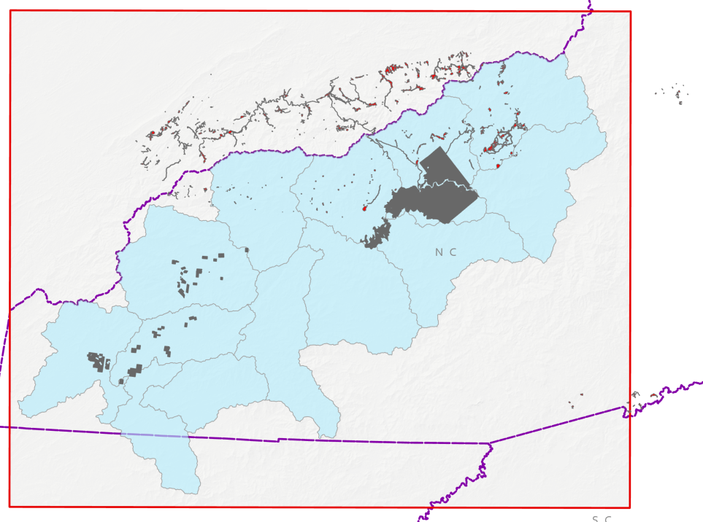
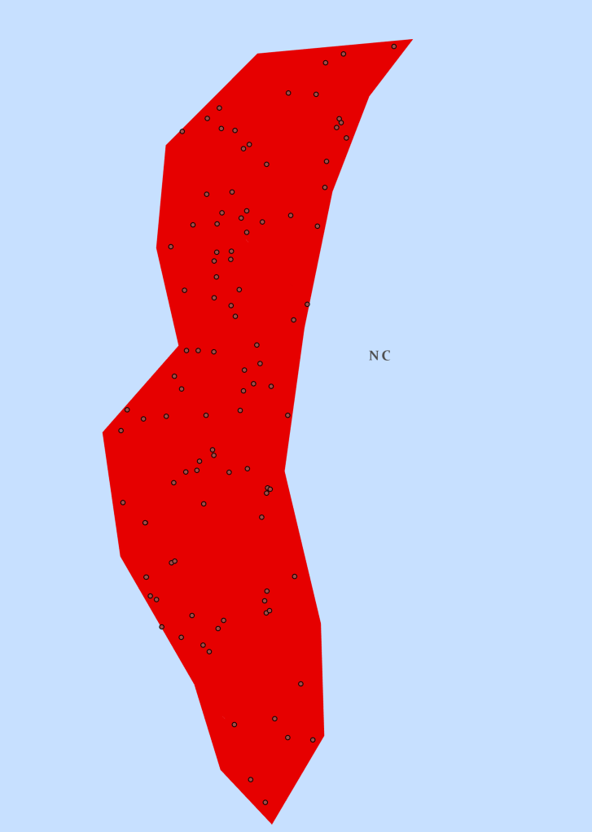
Investigating Criteria of Known Hemlock Sites
Generate random points from Hemlock Conservation Areas (HCA)
95 observation points in Oconaluftee watershed
Extract data from each variable
Summarize the mean of each variable
Hemlock Conservation Areas
EBCI Land
Example
Oconaluftee Watershed
95 Observation points
Elevation
2075 feet
Slope
15 deg
Aspect
23 deg
NDVI
0.83
Streams Dis
623 feet
Spectral En
0.76
Treatments taken place between 2012-2018
Notes:
Speaker [Travis]
The team was able to gather polygons for tree stands where the GRSM and HRI had sprayed for the insect called the Hemlock Whooly Adelgid (HWA).
Generate random points in treatment areas (polygon)
Extract data from each variable
Summarize the mean of each variable within the Oconaluftee Watershed
Random Generation kept all polygon slivers versus using a dissolved method. 6 points per polygon with a minimum distance of 100ft ensured small polygons did not gather too much data from one area. Total 1505 observation points used across the region, with 95 points inside the Oconaluftee.
Extract data tool allows user to drop in all the rasters and then collect by "drilling for values."
Afterwords, summarize the values for watersheds. You can then use this information to build models or display cartography maps.
Averages = For the Oconaluftee Watershed known treatment polygons using random point generation and extraction
Slope: 4.97 deg
Road dis: 16,919.35 ft
NDVI sum: .596
NDVI win: .176
Aspect: 194.02 deg
Elevation: 3,510.80 ft
Stream dis: 777.31 ft
Urban dis: 8390.00 ft
Total treatment observation points in Oconaluftee Watershed = 95
------------Image Information Below------------
Example & Treatment map:
Created using ArcGIS Pro 2.5.2

Slide 14
Example Rank & Weight of Suitability Criteria
Weighted Overlay Approach: Multiple variables, single category
Weighted Suitability Single Category Raster
Data | Range | Rank | Weight
Stream | < 2000 ft | 1 | 25
NDVI Winter | Value between .0 and 03 | 2 | 20
Forest cover | Evergreen or Mixed | 3 | 18
Aspect | Between 180 & 45 degrees | 4 | 15
Elevation | > 2500 ft | 5 | 12
Slope | Between 4 and 6 degrees | 6 | 4
Urban | > 500 ft away | 7 | 3
Road | > 1000 ft away | 8 | 2
NDVI summer | Value between .4 & .7 | 9 | 1
Notes:
Speaker [Travis]
Design a range for categorical data based on averages for the Oconaluftee Watershed.
We do this because we know that Hemlocks have a large variability when taking in climate, topography, and human factors. For instance, the average elevation in Oconal is 3500ft compared to Abrams Creek watershed, which is 1750ft.
Because these are averages, we build a model that accounts for the findings along with the industry and research knowledge.
Example: The average stream distance was 777ft for the Hemlock treatment area. The team did a field visit that found Hemlocks on the banks of riparian and further away. Hemlocks at high elevation were farther away from streams and relied more upon air moisture.
The user decides that 2000ft and under are appropriate.
Each variable range is processed using Raster Calculator outputs a 0/1 cat, and then Con removes 0 value, so the raster is left with a single input of what a user wants to input
Variables are then weighted. The values are ADJUSTABLE as partners refine the schema. The higher the weight, the more the model makes that value mandatory in the search.
Tabulate Area, Zonal Statistics along with Add Field, Calculate Geometry, Calculate Field allow users to gather geometry of rasters or vectors.
------------Image Information Below------------
Image User Interface from ArcGIS Pro 2.5.2: Model Builder
Screen Shot from ArcGIS Pro 2.5.2:: Model Builder

Slide 15
Example Rank & Weight of Suitability Criteria
Weighted Overlay Approach: Multiple variables, multiple categories
Weighted Suitability Multi Category Raster |  |  |  |  |  | Remapping
Data | 3 = High | 2 = Mod | 1 = low | Rank | Weight | Values
Stream | < 1000ft | 1000 to 3000 | > 3000 | 1 | 25 | 3,2,1
NDVI Winter | .1 to .3 | > .3 | < .1 | 2 | 20 | 1,3,2
Forest cover | evergreen | Mixed forest | deciduous | 3 | 18 | 1,3,2
Aspect | 190 to 360deg | 0 to 90 | 90 to 190 | 4 | 15 | 2,1,3
Elevation | 2500 to 4500ft | > 4500 | < 2500 | 5 | 12 | 1,3,2
Slope | 3.43 to 8.53 deg | < 3.43 | > 8.53 | 6 | 4 | 2,3,1
Urban | > 25000ft | 5000 to 25000 | < 5000 | 7 | 3 | 1,2,3
Road | 15000 to 34000ft | < 15000 | >34000 | 8 | 2 | 1,3,2
NDVI summer | >.4 | -.2 to .4 | < -.2 | 9 | 1 | 1,2,3
Notes:
Speaker [Travis]
Creating a multi variability multi category raster gives us more suitability versus the probability. These two terms are interchangeable but carry subtle differences.
"Probable: supported by evidence strong enough to establish presumption but not proof"
"Suitable: adapted to a use or purpose"
When looking at the last model, the user determines the Hemlock probable location from the inputs. Now that we have multiple categories, it changes probability to suitability.
Example: The average stream distance was 777ft for Hemlock treatment area. So it is assigned High below 1000ft, and so forth.
Reclassify uses a segmentation that MUST go in order based on the values. For instance, the user decides <1000ft is the highest probability but must be classified as a 1 at this stage. Reclassing numerical values out of sequence will throw errors later.
In the weighted overlay, set your scale range to the number of values you have. You get options to choose from but must be decided during the reclassification process (1,3,5 or 9).
Example, A user, can bump to 5 and then have 5=Very High, 4=high, 3 = mod, 2=low, 1=very low
------------------------------------------------------------------------------------------------------------------------
https://www.merriam-webster.com/dictionary/
Probable: supported by evidence strong enough to establish presumption but not proof
Suitable: adapted to a use or purpose
Probability: the quality or state of being probable
Suitability: the quality or state of being especially suitable or fitting
Predict: declare or indicate in advance
Predictability: able to be known, seen or declared in advance
------------------------------------------------------------------------------------------------------------------------
------------Image Information Below------------
Image User Interface from ArcGIS Pro: 2.5.2
Screen Shot from ArcGIS Pro 2.5.2

Slide 16
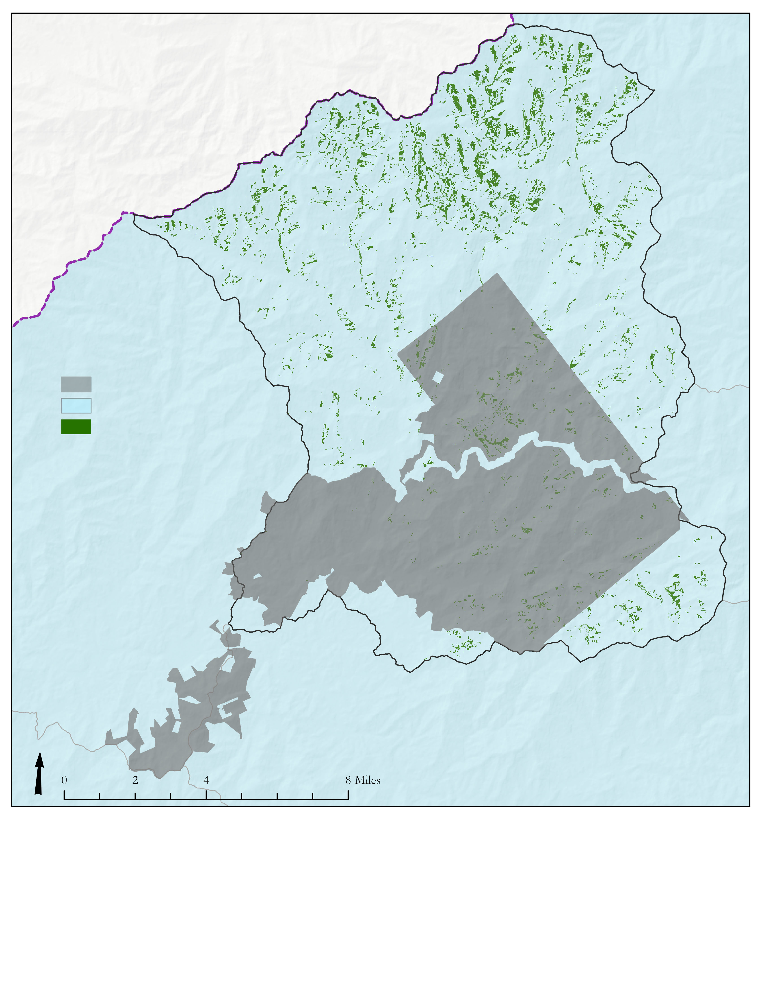
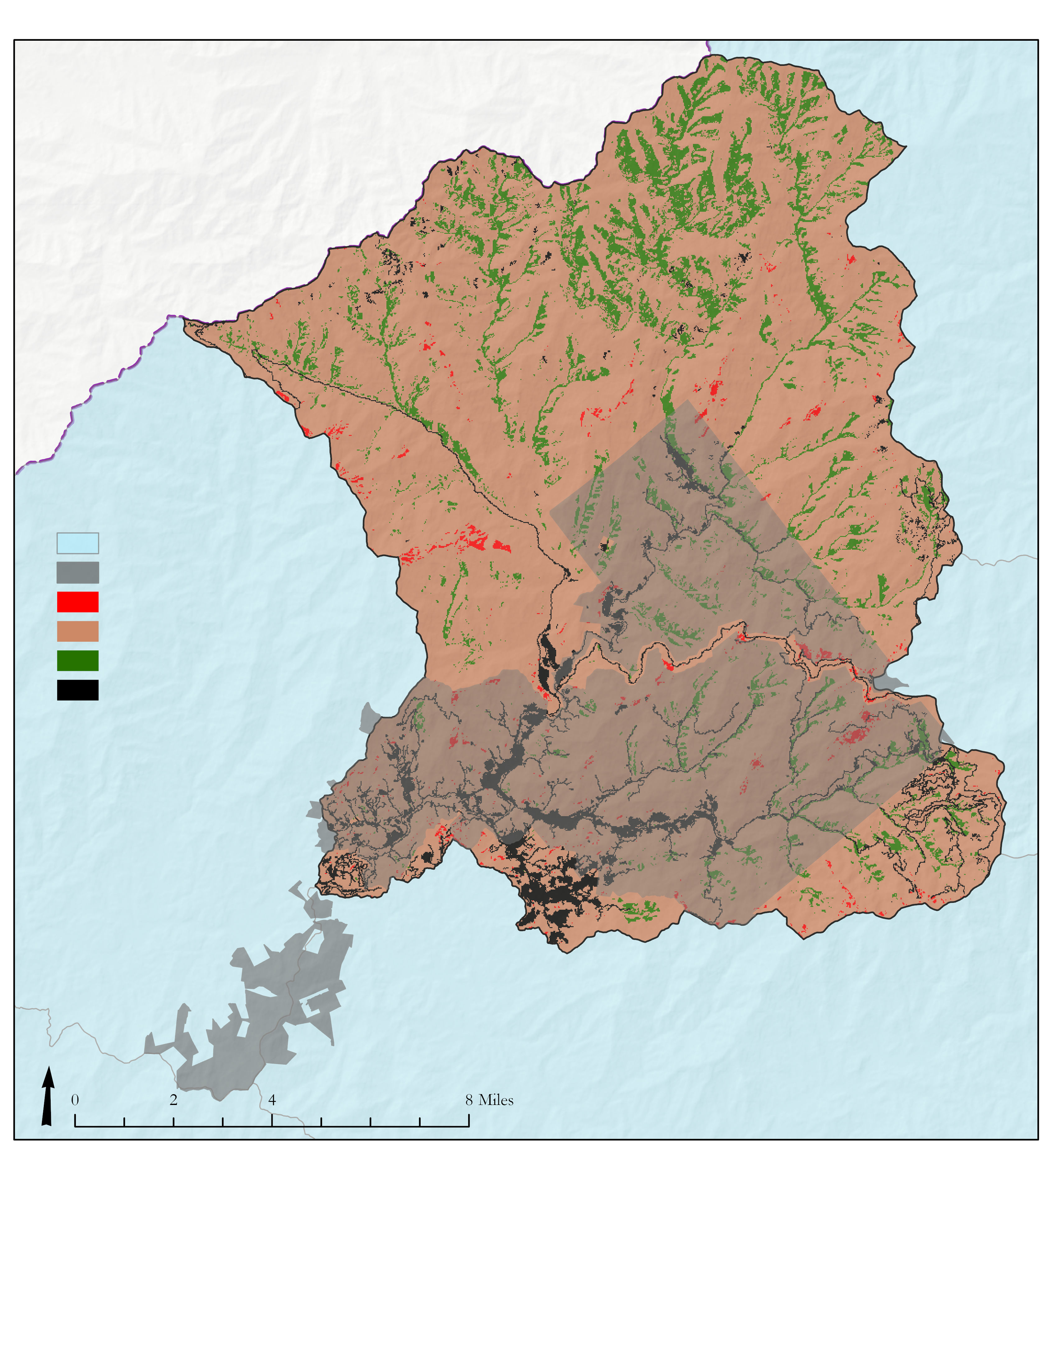
Example Weighted Suitability Outputs
Multiple variables, single category
Multiple variables, multiple categories
EBCI Land
EBCI Land
Hemlock suitable areas
Low
Mod
Suitability
High
No Forest
8.54 mi² of hemlock suitable area
4.54% of Oconaluftee
17.91 mi² of Hemlock
9.53% of Oconaluftee
Notes:
Speaker [Travis]
Here are the two results.
By giving the model only a single value raster, the algorithm does not have anywhere else to consider. Giving us the probable location. Here we end up with 4.54% of the Watershed with the probable location.
Now that we expanded the categorical search, we have an increase in probable locations (high), and the area considered moderate or low suitability. Of the high probability location, Hemlock now makes up 9.53%
You can see how large the moderate suitability is, and this is because 94% of this Watershed is covered in forest.
------------Image Information Below------------
Image of Suitability Map Results: (left) probable Hemlock locations (right) suitable hemlock locations
Created in ArcGIS Pro: 2.5.2

Slide 17
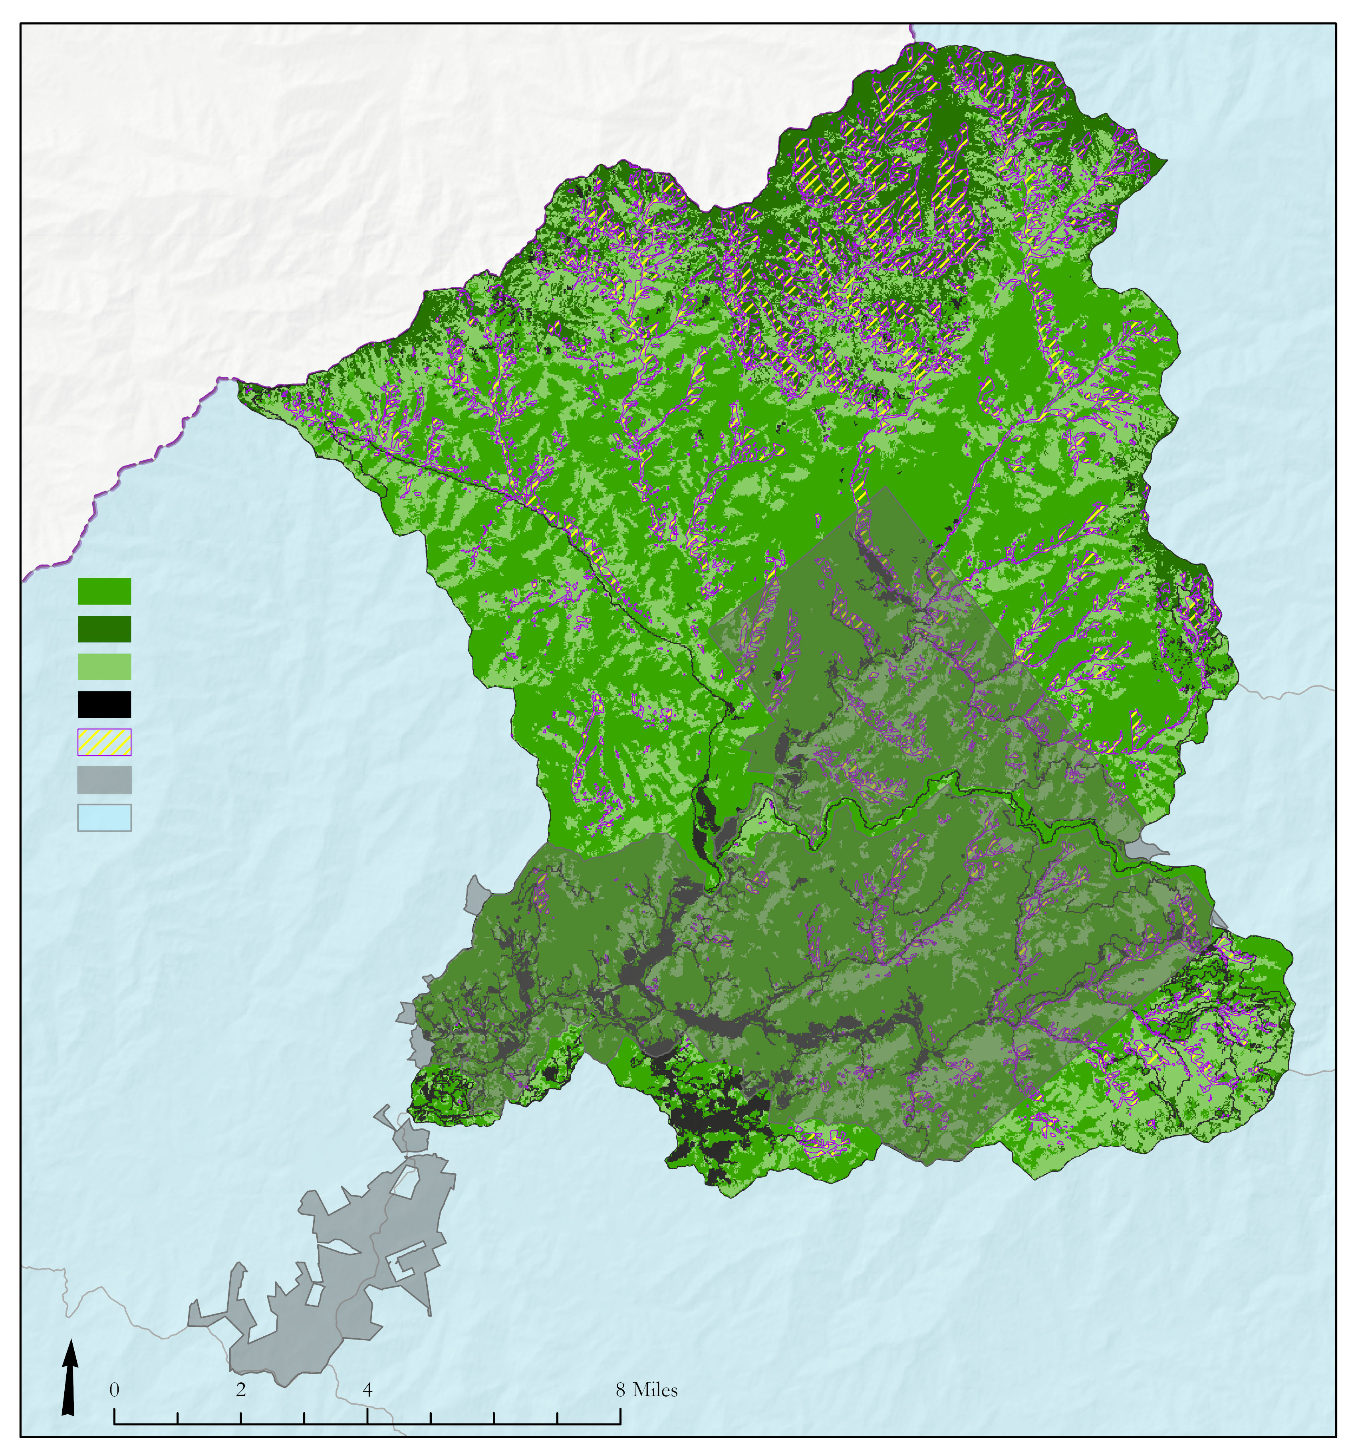
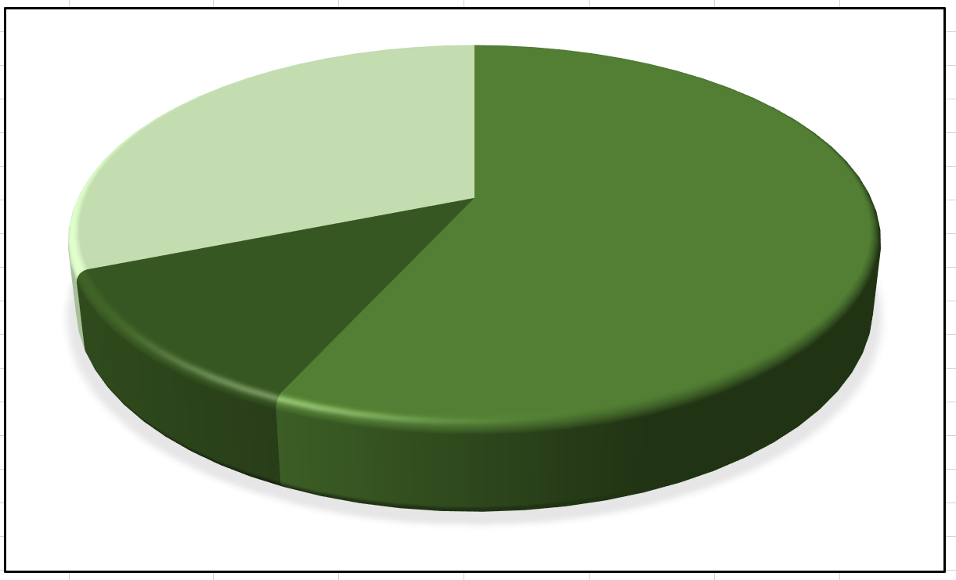
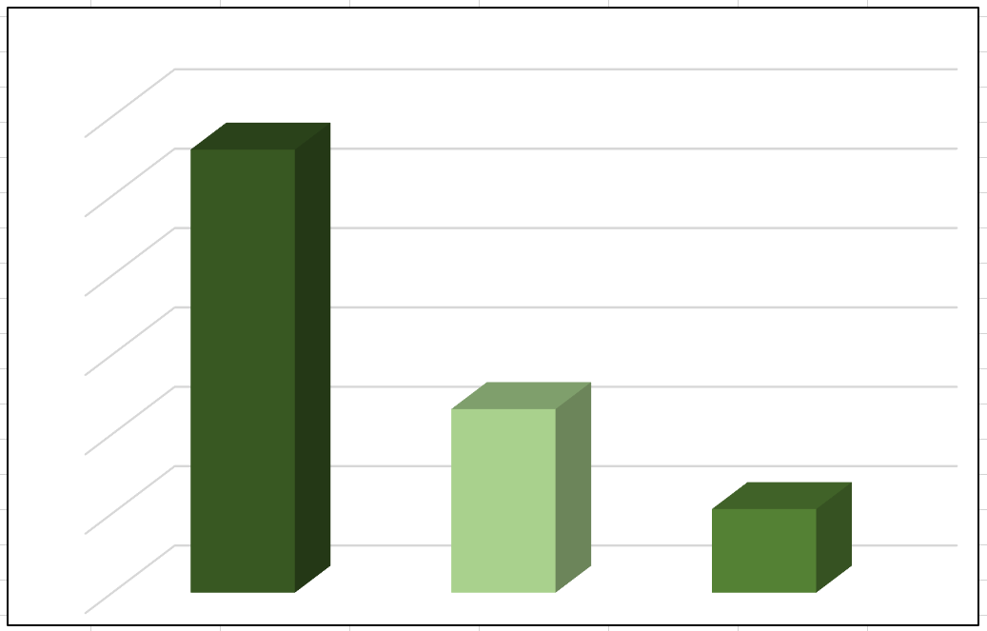
Weighted Suitability Inferences
Oconaluftee Forest Composition
Mixed Forest 29%
Deciduous 54%
Evergreen 11%
Deciduous
Evergreen
Mixed Forest
No forest cover
Hemlock Probability
EBCI Land
Watershed
% forest type suitable for Hemlock
Evergreen 28%
30
Mixed Forest 12%
15
Deciduous 5%
Deciduous 5%
0
High Probability areas against available forest area. Oconluftee has 94% of land in forest.
Notes:
Speaker[Travis]
When we look at the overall availability of forest cover within the Oconaluftee, the bulk of the Watershed is made up of deciduous, which is common across the entire ROI.
We normalize the data to view the real implications of where the probable location of Hemlocks.
In the previous slide are data was even across the board, but viewed against the percent of forest cover, we now see that 28% of evergreen areas are suitable hemlocks locations.
Normalizing data gives the suitable amount in each forest cover.
When normalized, evergreen dominates the ratio per Hemlock.
In this image, you can see the northern area with the bulk of both evergreen and hemlock suitability.
------------Image Information Below------------
Image of a High Probability Map:
Created in ArcGIS Pro 2.5.2
Microsoft Excel Pie Chart

Slide 18
Conclusions
Between 2003-2010, the study region displayed areas of both winter NDVI decrease and increase, often in adjacent 'pockets'.
Pockets of greatest winter NDVI decrease were observed near stream headwaters along the boundary of the national park.
Of the forest cover classified as evergreen for the Oconaluftee watershed in 2018, 28% contains high hemlock suitable areas based on the example weighted suitability analysis.
The two example weighted suitability approaches show between 8.5 to 17.9mi² of land suitable hemlock in 2018.
Notes:
Speaker [Richard]
We investigated both qualitative and quantitative conclusions from our results, which the audience can see here [read conclusion points]

Slide 19
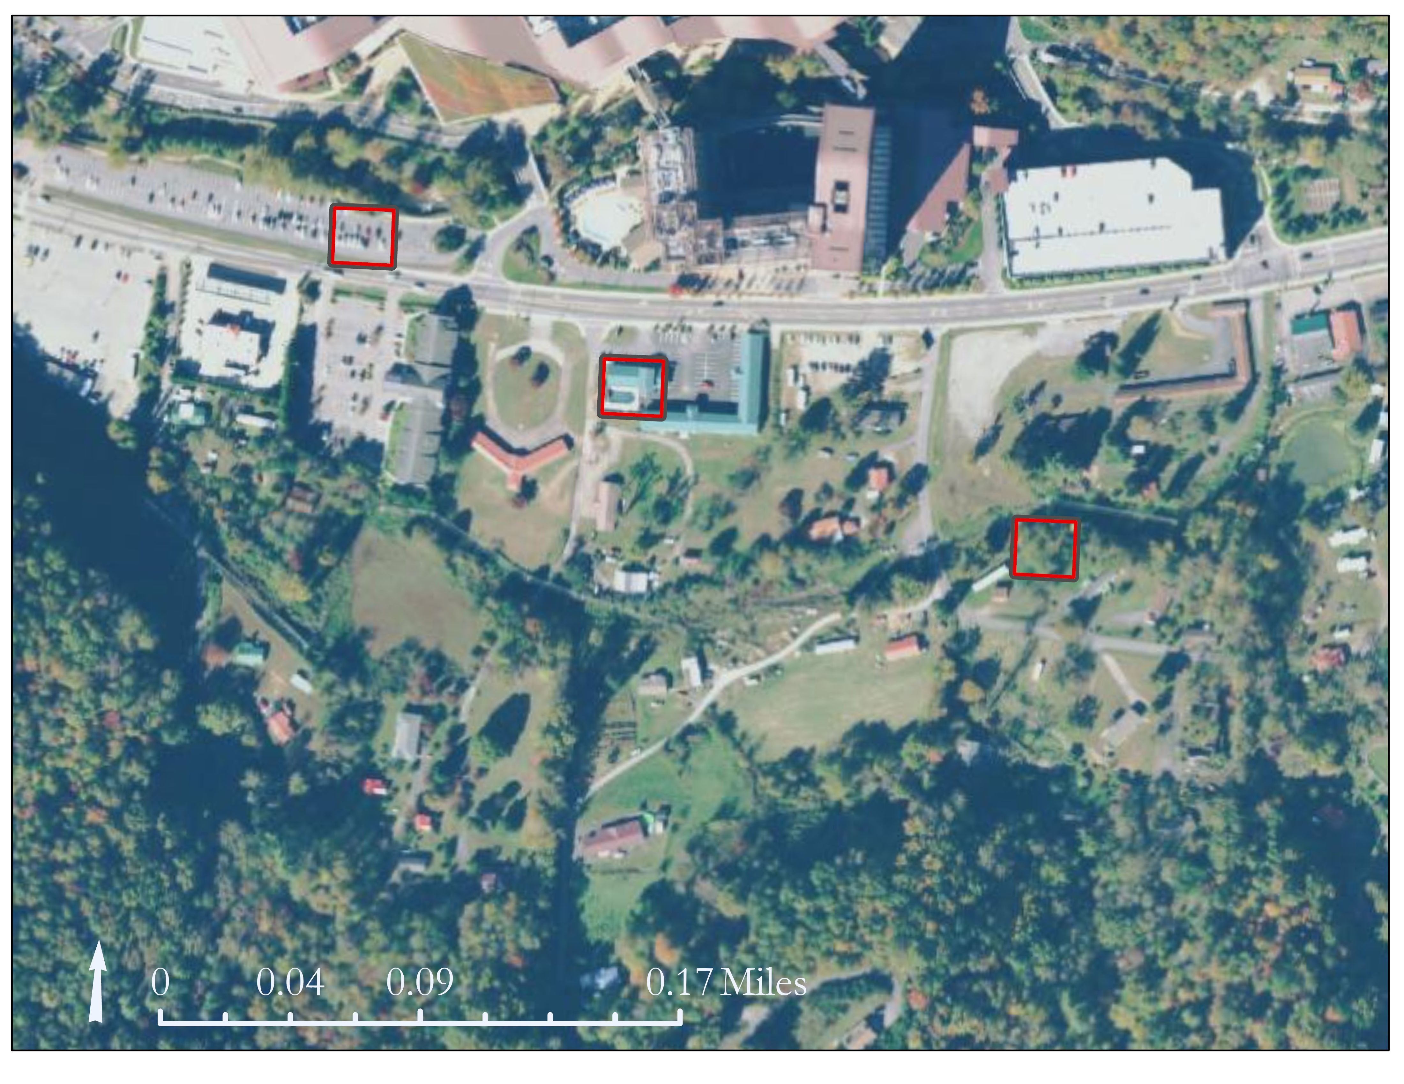
Limitations & Errors
Data Processing & NDVI Calculation
Cloud cover
Winter shadows
Landsat 5 TM vs. Landsat 8 OLI
Hemlock vs. other evergreens
Selection of Suitability Criteria
Criteria varies across landscapes
Not all points in HCAs represent hemlock
Spatial & temporal resolution limitations
Example: Landsat 8 pixel size
Notes:
Speaker [Richard]
We found some limitations in the availability of satellite imagery without cloud cover which hinder the NDVI processing, but we supplemented the Data sets the GEE API Code editor to replace manually processed cloud removal images that did not pass quality control by team members.
In regards the to the SRTM data, it only accounts for the year 2000 and will not provide any additional data after the year 2000
As mentioned earlier in the presentation An Error could occur in the NDVI Winter Change map due to the Landsat 5 mission ending in 2011 and the wavelengths captured by the Landsat 8 instrument are slightly different.
Errors or limitations pertaining to the Suitability map the random points generated can fall on a deciduous tree with a mixed forest. Furthermore the Pixels are 30m which can lead to missing attributes or data
------------Image Information Below------------
Image of an urban area backed up to forest displaying the relative size
Created in ArcGIS Pro 2.5.2

Slide 20
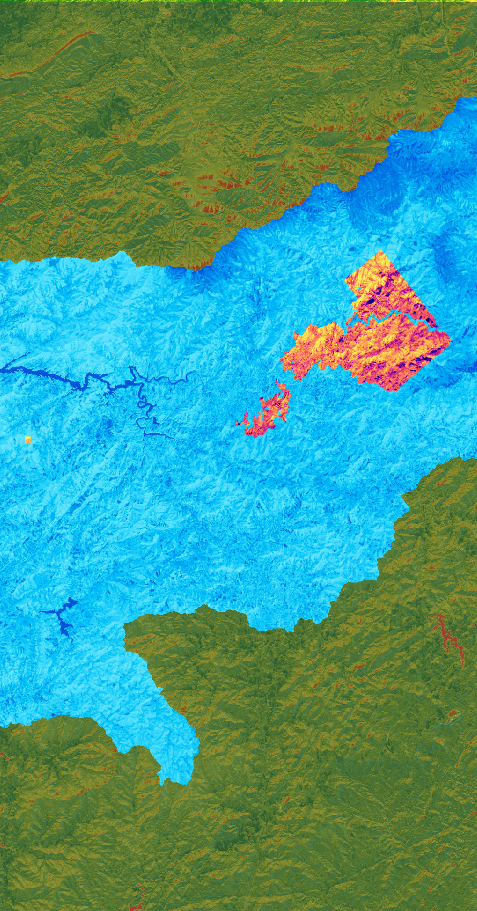
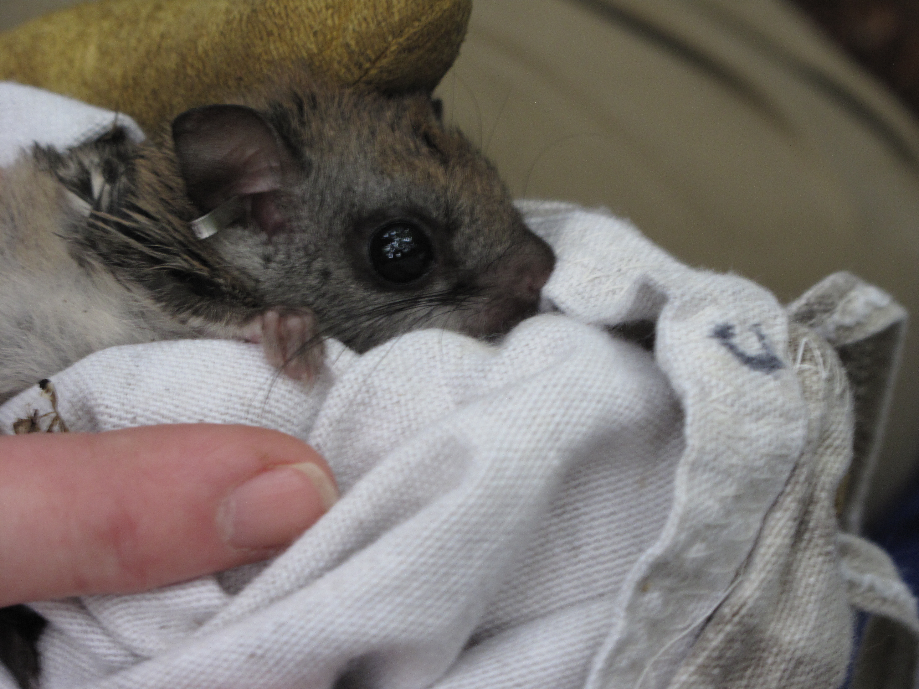
Future Work & Next Steps
Experimenting with suitability criteria ranks & weights
Comparing decline maps to suitability maps
Other modeling approaches
Detection vs. Suitability
Addition of other multi-spectral indices
Suitability analysis for wildlife associated with hemlock
Carolina Northern Flying Squirrel
Image Credit: U.S. Fish & Wildlife Service Southeast Region
Notes:
Speaker [Richard]
In the Future we recommend that a Continuation of machine learning to prediction Hemlocks using remote sensing.
Incorporating field studies with the weighted overlay model by conducting Site visits to determine the accuracy in combination with the Identification of Hemlock stands for further study.
Furthermore, in future analyses we recommend that Building upon water quality and wildlife management monitoring by asking the following question the Will fish thrive in these areas? Does wildlife use Hemlocks as corridors? Are endangered animals like the grey squirrel nesting at Hemlock locations?
------------Image Information Below------------
Image Credits:
Clip Art
Microsoft PowerPoint 16 ClipArt
Creative Commons
Web image
Created In ArcGIS Pro
US Fish & Wildlife Service Southeast Region (CC BY 2.0): https://www.flickr.com/photos/usfwssoutheast/7651413424/in/photolist-cE8uD7-85siFB-85shqH-85shNg-85sjBc-GMSqkq-cE8ted-GWUwe1-85vs1d-2dfQjDz-GTaxj5-cE8zGd-85vqJb-85sirP-GF5Hky-85skbc-85sgra-85vtbo-cE8ug7-85vtHj-e2UJu6-cE8ysj-e2UGkB-e31oEJ-e31mdw-e31n8q-e31kAQ-e2UCS8-e31pjQ-e2UDpV-gL6tDj-gL7fzD-gL6ibo-gL6w6U-2e5XKNk-gL6tkc-gL6oUC-gL6sbD-gL6pc3-gL6hjz-gL6mm1-gL6j1j-gL7p3k-gL6q5q-gL6i8j-gL6jCx-gL6uDV-gL6ihX-gL6gyA-gL6sHm

Slide 21
Future Work & Next Steps
Capacity Building Approach
Refining Project Methods & Results
Producing Tutorial & End Products
Virtual Hand-off
EBCI Use Cases
Teamwork
Statistics
Story Map Design
Forest Management
Cartography
Data Programming
Remote Sensing
Geospatial Analysis
Video Production
Notes:
Speaker [Chloe]
In the next two weeks, the team will refine the end-products package and before handing-off the information to project partners.
------------Image Information Below------------
Image Credits:
Clip Art
Microsoft PowerPoint 16 ClipArt
Creative Commons

Slide 22
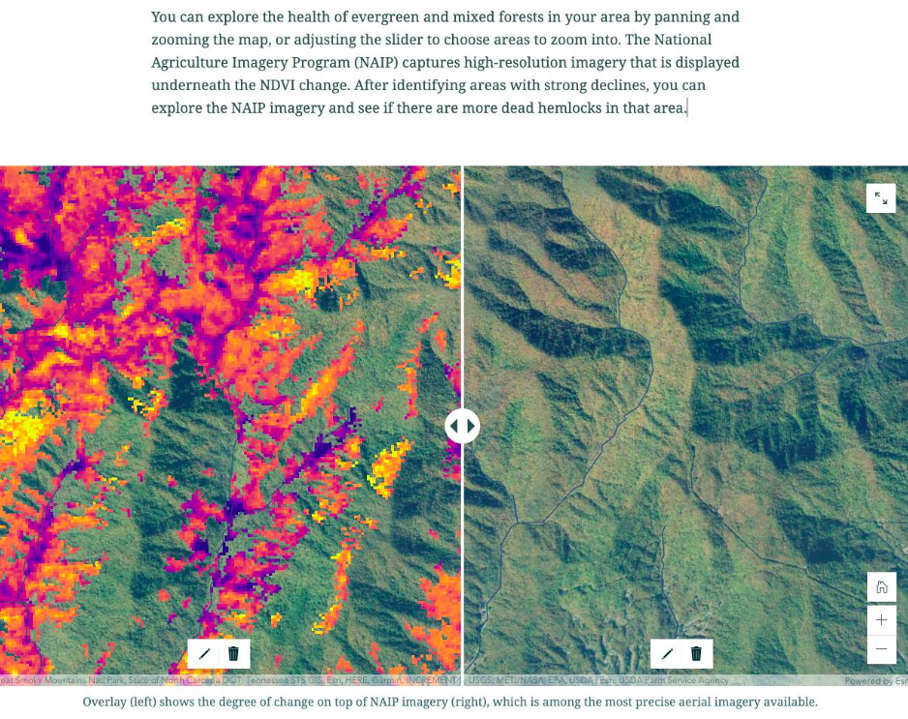
Project Communication: Story Map Demo
Data exploration tools for NDVI decline compared to hi-res imagery
Notes:
Speaker [Chloe]
The team will also be creating a StoryMap to share with the partners.
::AGOL story map demo::
------------Image Information Below------------
Image Credits:
Clip Art
Microsoft PowerPoint 16 ClipArt
Creative Commons

Slide 23
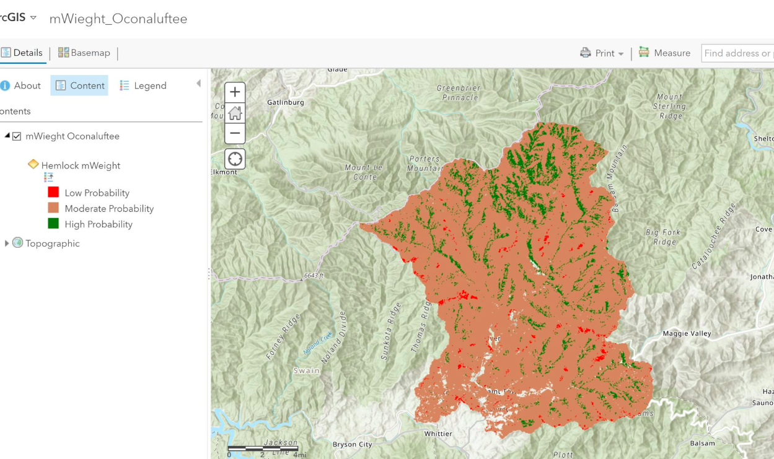
Project Communication: Story Map Demo
Interactive layers of hemlock weighted suitability maps
Notes:
Speaker [Chloe]
The team will also be creating a StoryMap to share with the partners.
------------Image Information Below------------
Image Credits:
Clip Art
Microsoft PowerPoint 16 ClipArt
Creative Commons

Slide 24
Final Thoughts
"We always try to tie everything to our culture, language, revitalization, and I think protecting our natural resources is our vital link to those things. So, any of the information this develops can help us do that."
- Dr. Caleb Hickman, Supervisory Fisheries & Wildlife Biologist,
EBCI Natural Resources
Notes:
Speaker [Chloe]
Within the broader ecology and climate communities, remote sensing provides a lot of utility for decision making.
This project served as an introduction and overview to some remote sensing methods for forest management for this partner group.
As the partners of this project look toward expanding their own management practices, remote sensing provides an additional toolset - one that can help the partners build more autonomy in understanding, and therefore, managing their landscape.

Slide 25
Advisors:
Dr. BJ Brooks: NOAA NCEI, North Carolina Institute for Climate Studies
Dr. Steve Norman: USDA FS, Eastern Forest Environment Threat Assessment Center
EBCI Partners:
Maria Dunlavey (Outreach Coordinator)
Tommy Cabe (Tribal Forest Resource Specialist)
Dr. Caleb Hickman (Supervisory Fisheries & Wildlife Biologist)
Hemlock Consultants:
Margot Wallston: Hemlock
Restoration Initiative (HRI)
Jesse Webster: Great Smoky Mountains National Park
Notes:
Speaker [Chloe]
The Cherokee Water resources team would like to thank all our mentors and partners who helped make this project possible. We would especially thank: (list)
Hemlock Restoration Initiative (HRI) : https://savehemlocksnc.org
Great Smoky Mountains National Park: https://www.nps.gov/grsm/index.htm

Slide 26
Appendix
Notes:
Extra slides
Appendix slides will only be shown at the request of the audience.

Slide 27
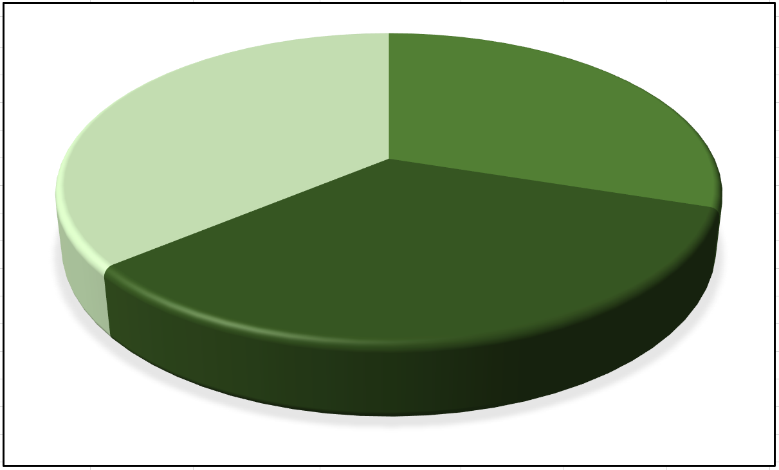
Weighted Suitability Inferences
Further Analysis
Where does Option II Multi Category predict the High probability locations within MRLC forest cover and how much land is still available?
HEMLOCK PROBABILITY
Deciduous 30%
Mixed Forest 36%
Evergreen 34%
Forest Cover
Hemlock Cover
High Probability
Zonal Statistics
Hemlocks are shown to grow in a variety of tree stands within the Oconaluftee Watershed; Mixed Forest being the predominant.
Extrapolate data between raster sets.
Notes:
Speaker[Travis]
We mentioned the chance for error in statistical analysis, and we reduce that error by running a variety of tools.
A vector of the Watershed allows calculate geometry to find sqMiles and Acres to ensure raster outputs.
When calculating Rasters, Zonal geometry gives a cell count for the Watershed, and the Tabulate Area will generate the sq area of your maps units. For our project, we use SPCS and feet.
Once you know this information, you can add tables and calculate fields of your raster or table output. The data is checked, ensuring the geometry matches using sqmiles, and pixel counts to generate a percentage of area.
We can see that are Hemlocks were almost even across the board with mixed acting as a buffer between the stands.
------------Image Information Below------------
Image Credits:
Microsoft Excel Pie Chart
Microsoft PowerPoint 16 ClipArt
Creative Commons

Slide 28
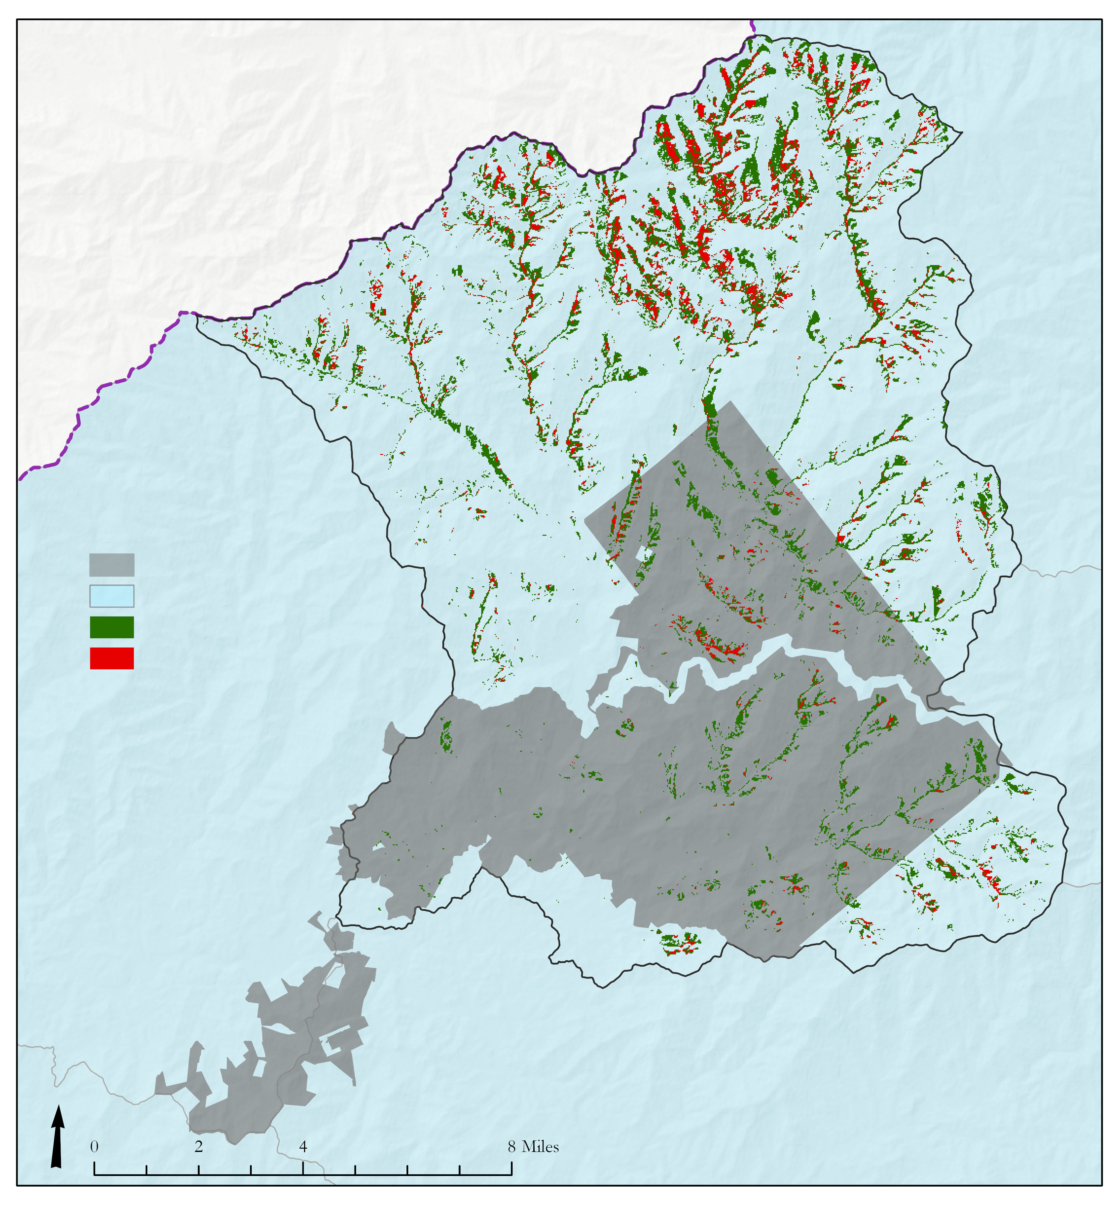
Suitability Conclusion
Option I: Single Category
Pro
User directed binary option 0/1
Reduced error in operation
Con
Limit capacity of weighted suitability to detect best variables
Get a single location
Option II: Multi Category
Pro
Greater information on suitability
Additional statistics on land capability for Hemlocks
Con
Complexity increases
Increase chance of error
EBCI Land
Watershed
Evergreen
Difference Single – Multi Category
Using a multi value approach provides more flexibility in suitability habitat for Hemlocks. Doing so provided an additional 9.37 mi² to the analysis. Red shows the change between analysis procedure.
Notes:
Speaker[Travis]
What are the Pros and Cons of the weighted overlay?
With a single value, you reduce your chance of error during the modeling inputs, but you're limited to a "vector intersect" with importance levels.
The multi-value weight gives more flexibility to the model, provides increased statistical power, but the complexity leaves room for greater error.
Most often, the chance for error comes from misinterpreting reclass value to weighted value.
The second highest chance for error comes from generating your statistics.
The image here shows the difference between the two methods, where we add an additional 9.37sqMiles. The greater increase helps to find probable locations to monitor how Hemlocks affect the landscape for fires, wildife, and stream ecology.
------------Image Information Below------------
Image of Suitability Map Results: Difference in weighted overlay methods
Created in ArcGIS Pro 2.5.2

