Slide 1
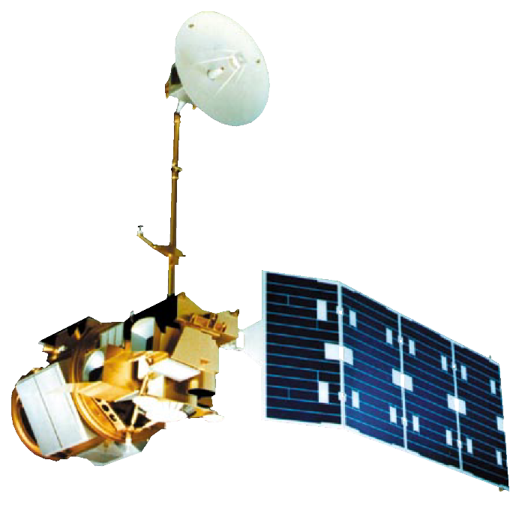

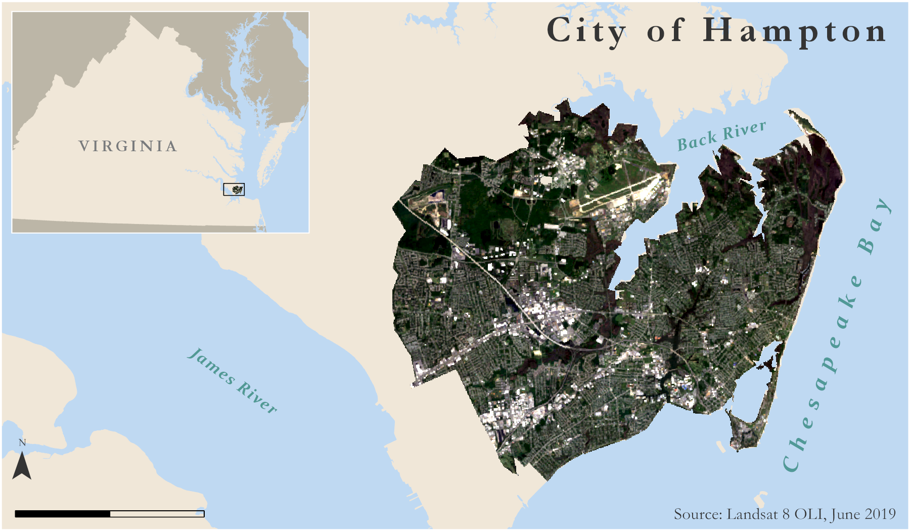
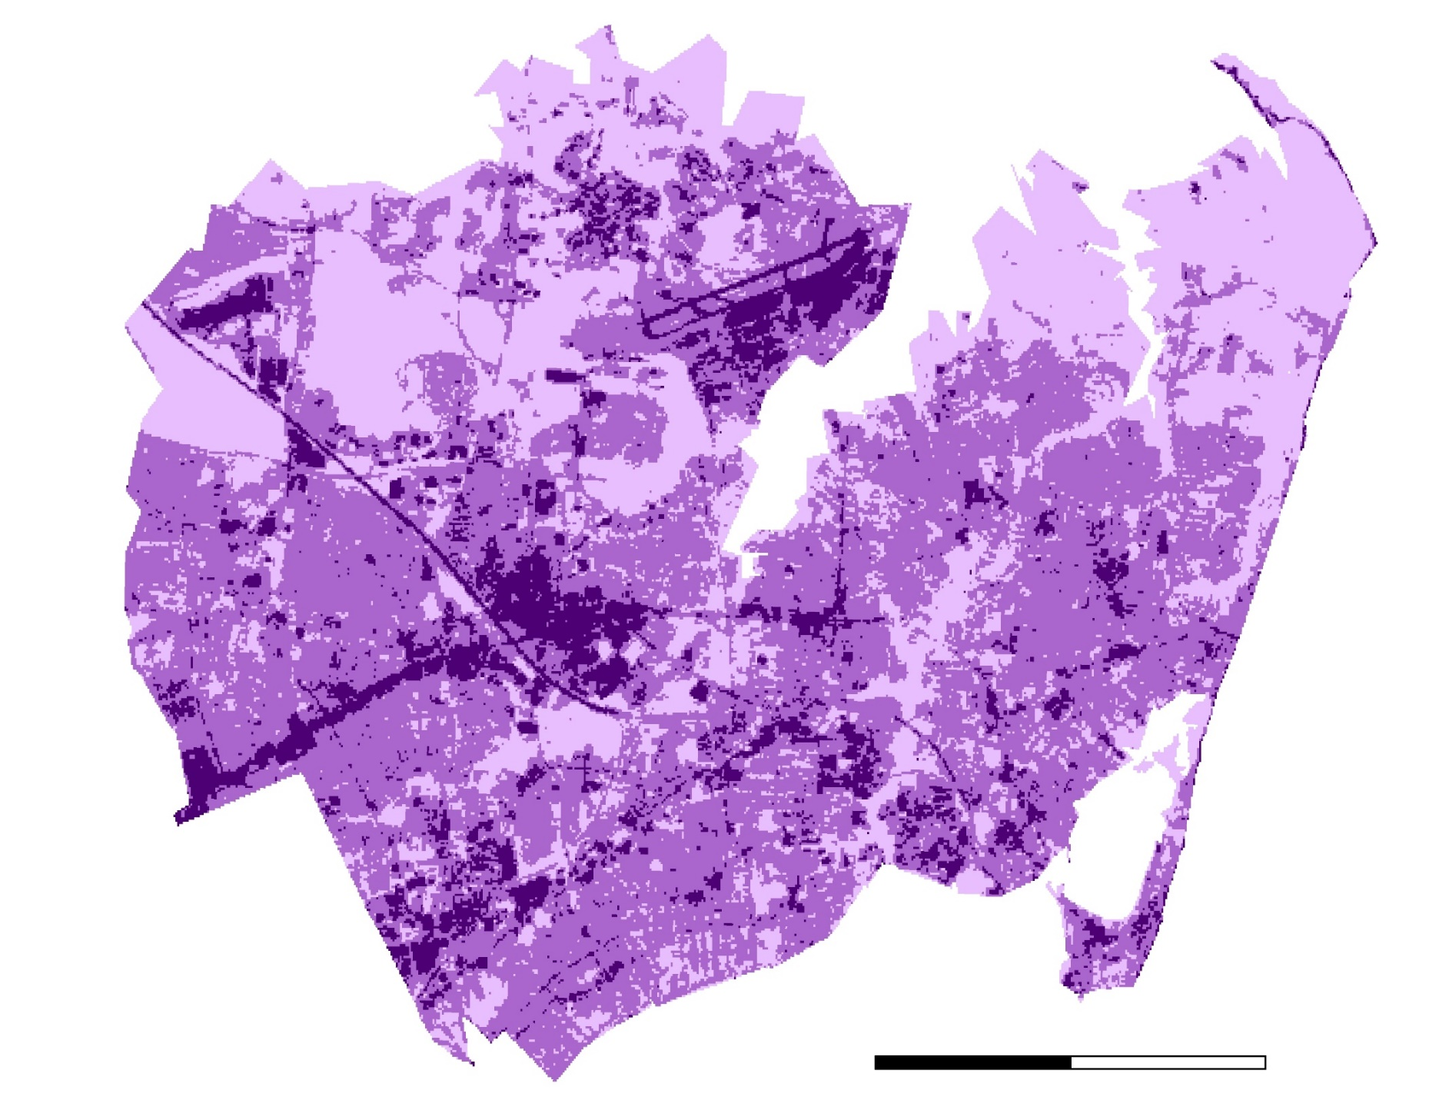
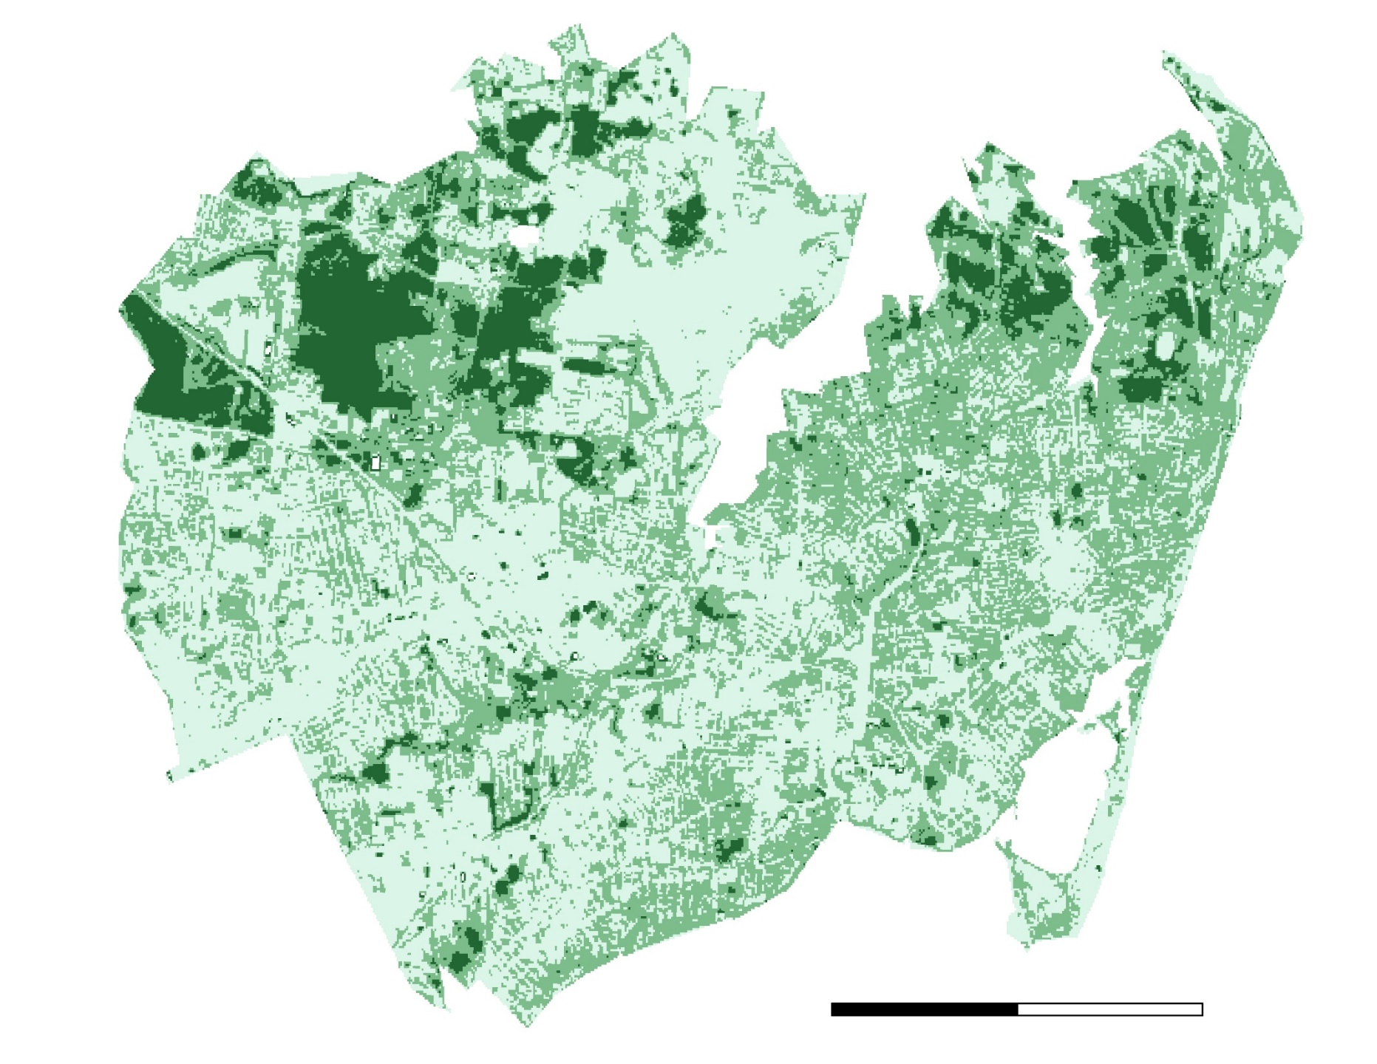






Assessing Urban Tree Canopy and Impervious Surface Distribution to Inform Urban Planning in Hampton, Virginia
Abstract
Objectives
Hampton Roads Urban Development II
Hampton Roads’ 1.6 million residents thrive on bustling military, harbor, and environmental industries. The region’s stakeholders identified an increasing flood and water quality risk due to urbanization, a changing climate, and sea level rise. These hazards threaten not only the livelihood of Hampton Roads residents, but also the well-being of the entire country as several key federal facilities exist in the region. Impervious surface cover and urban tree canopy cover are two known variables that influence flood risk. Using Landsat 5 Thematic Mapper and Landsat 8 Operational Land Imager, the team created maps of impervious surface and tree canopy cover change from 2000 to 2019 for the City of Hampton. These maps supported City of Hampton officials in directing resiliency efforts towards areas of greatest vulnerability within their municipality. Additionally, the team used the Impervious Surface Analysis Tool (ISAT) to illustrate how changes in impervious surface coverage impact local water quality and how different land management scenarios might alter these consequences. The team’s methodology allowed city officials to create updated impervious surface and tree canopy cover maps any time new imagery became available. Moreover, the team supported the city officials’ goals of using a place-based approach by demonstrating how the methodology can be applied to the smaller Newmarket Creek watershed in order to empower residents as active custodians of the environment.
Map the current distribution of impervious surfaces, tree cover, and land cover change from 2000 to 2019
Identify regions within the study area that are most susceptible to flooding
Empower Hampton Roads residents and city officials to work together in combatting local environmental problems by demonstrating the utility of freely available NASA Earth observation data
Project Partners
The City of Hampton
Waggonner & Ball
Earth Observations
Study Area
Methodology
Landsat 5 TM
Landsat 8 OLI
Data Acquisition
Data Processing
Data Analysis
Landsat 5
Landsat 8
City of Hampton Imagery
National Land Cover Database
Conservation Center Land Cover
Google Earth Engine- filter, mask, reduce, export
Calculate predictors for regression
Classify land cover
Prepare metrics for ISAT
Run regression
Calculate percent tree and impervious cover
ISAT – calculate impacts of impervious surfaces on water quality
5
Results
Miles
Percent
Impervious by
Census Block
Percent Impervious Surface 2019
Percent Tree Canopy 2019
50-100%
50-100%
25-50%
0
2,500
5,000
10-50%
0
2,500
5,000
Newmarket Creek Watershed Boundary
0-25%
Meters
0-10%
Meters
Conclusions
Acknowledgements
A decreasing trend in percent tree canopy cover and an increasing trend in percent impervious surface indicates Hampton’s flood risk is increasing over time.
ISAT analysis revealed Hampton does not contain any Census Blocks with less than 10% impervious surface, indicating that none accommodate water infiltration and storage adequately.
Within the Newmarket Creek watershed, 79% of Census Blocks demonstrated impacted or significantly impacted infiltration and water storage capacity, therefore indicating potential areas of rehabilitation.
City of Hampton DEVELOP partners, Sydney Neugebauer (Center Lead at NASA DEVELOP Virginia - Langley), Dr. Kenton Ross (Lead Science Advisor for NASA DEVELOP National Program), previous contributors to this project: Eric Deutsch, Holly Gould, Shaifali Prajapati, Danielle Ruffe, Patrick Frier, and Matthew Tisdale
Team Members
Stephanie Kealy
Project Lead
Sophie Barrowman
Paige Haley
Alina Schulz
Virginia – Langley | Summer 2019

