Slide 1
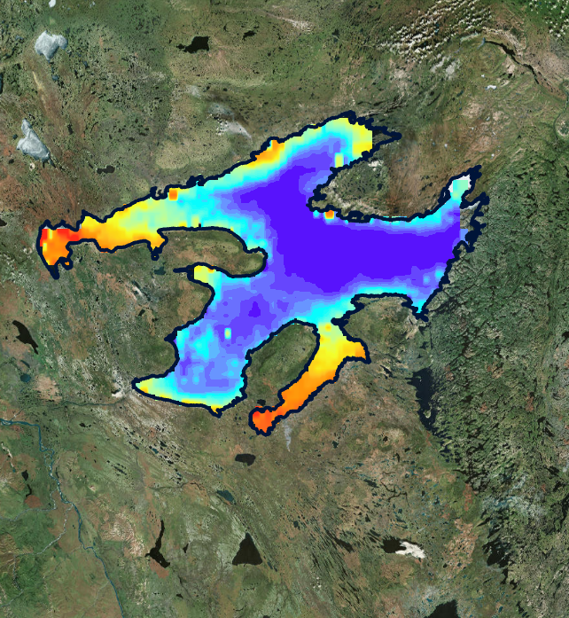


2018 Fall | Massachusetts – Boston
GREAT BEAR LAKE WATER RESOURCES
A Long-Term Remote Sensing Analysis to Evaluate Changes in Water Quality of Great Bear Lake
Krishna Sharma
Juan Jaimes
Huan Mi
Mahrokh Moknatian
Zach Bengtsson

Slide 2
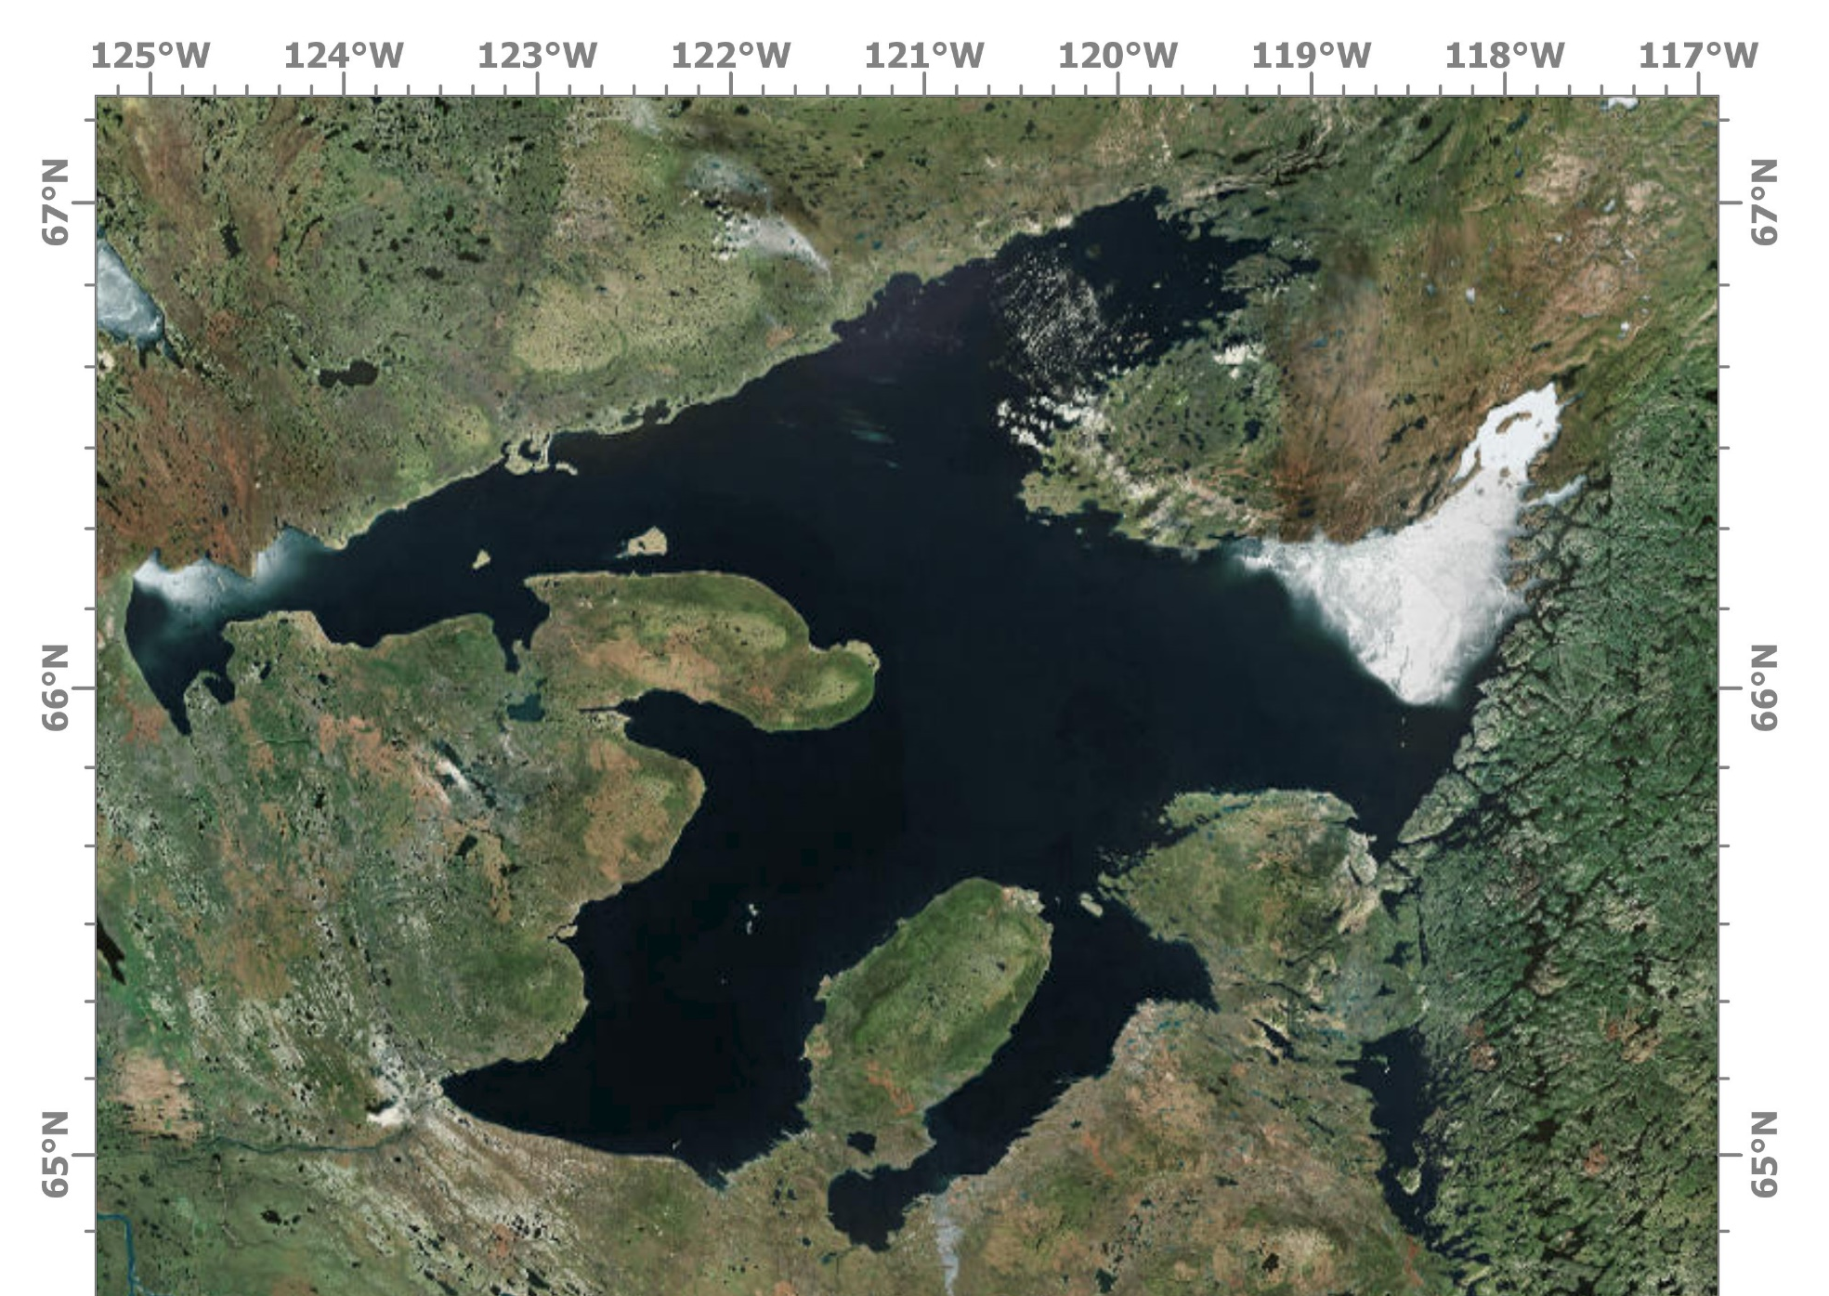
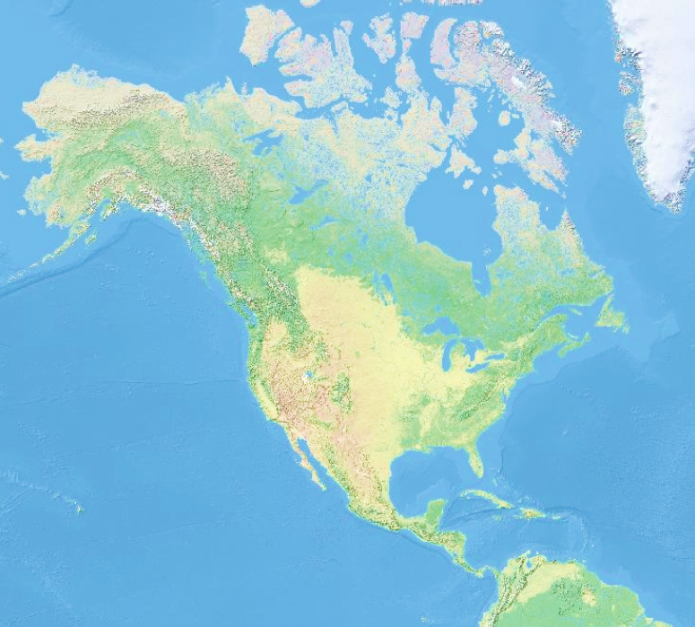
Study Area: Great Bear Lake
Artic
Ocean
Alaska
Canada
United States
Atlantic
Ocean
Pacific
Ocean
Délįnę
Image: ArcGIS-Pro
Source: ESRI
“The Water Heart” is of immense cultural importance to the people of Délįnę, designated as a UNESCO World Biosphere Reserve.
Notes:
Speaker notes:
Great Bear Lake, known as “The Water Heart” by the indigenous community of Délįnę, is of immense cultural importance. Beyond being a traditionally sacred site, it is a vital source of food and transportation routes. It is also the world’s last large pristine arctic lake, remaining relatively untouched by mankind or industrial pollution. It was designated a UNESCO World Biosphere Reserve in 2016.
Source image (right): ESRI, Digital Globe, Earthstar Geographics, CNES/Airbus DS, USDA, USGS, AeroGRID, IGN, and the GIS User Community

Slide 3
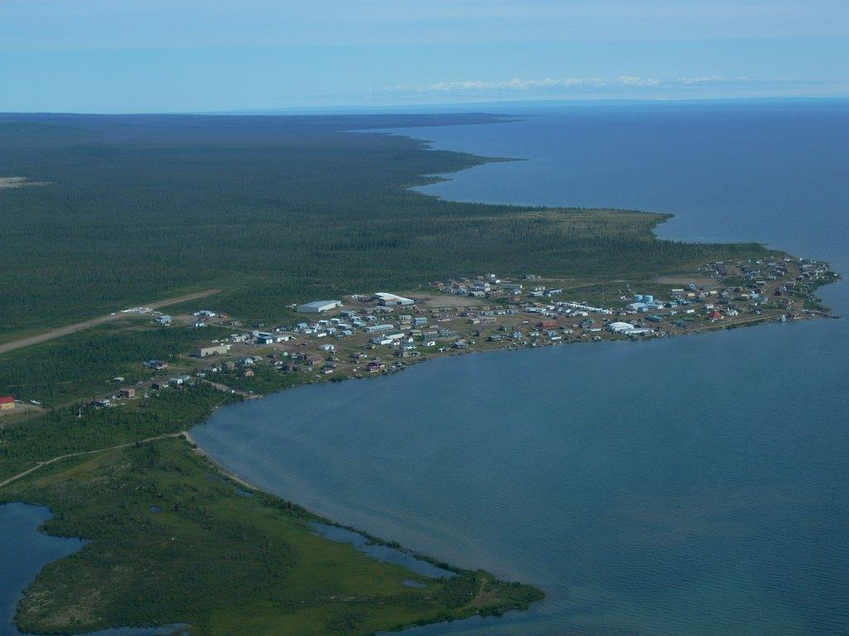
Community Concerns
Lake fisheries health
Potential change in temperature and mixing cycles
Lack of consistent landscape-level analysis of water quality
Partners:
Fisheries and Oceans Canada
Délįnę Renewable Resources Council
Environment and Climate Change Canada
Aerial photo of Délįnę. Credit: Ed Reeves
Notes:
Photo: Ed Reeves, written permission obtained
Speaker notes:
The community of Délįnę seeks to preserve Great Bear Lake for future generations. They have noticed many environmental changes over recent decades including rising temperatures, a green discoloration in the water, changing wind patterns, shorter seasonal ice cover, and thinner ice. These changes may threaten lake ecology and fishery health. While there are several environmental research projects in the area, there are few that look at long term trends or water quality due to its remoteness and high monitoring costs. Remote sensing offers to abate these challenges by offering long term data over large areas of land.
To address these concerns, we partnered with Ed Reeves of the Délįnę Renewable Resources Council and Marlene Evans of Environment and Climate Change Canada.

Slide 4
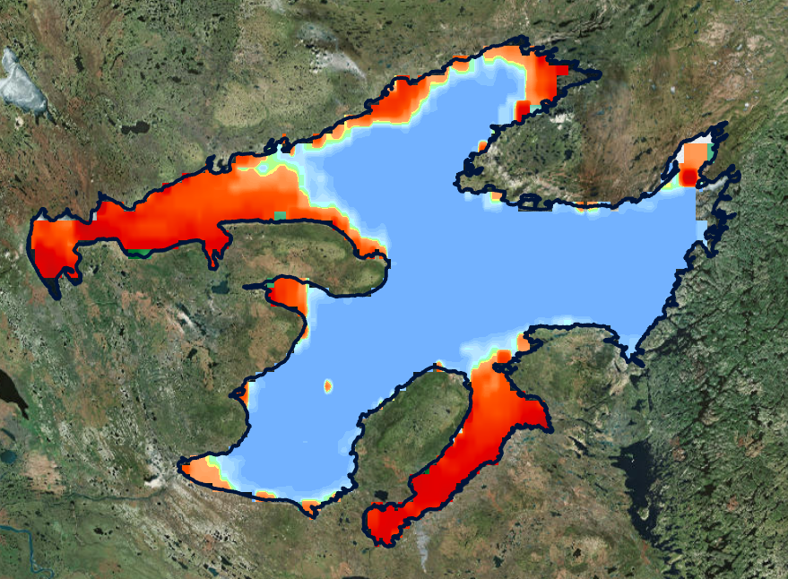
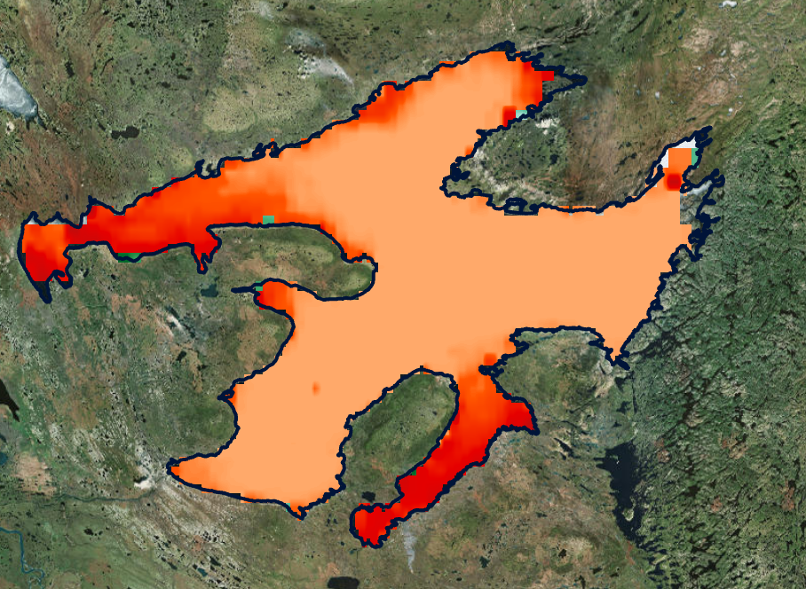
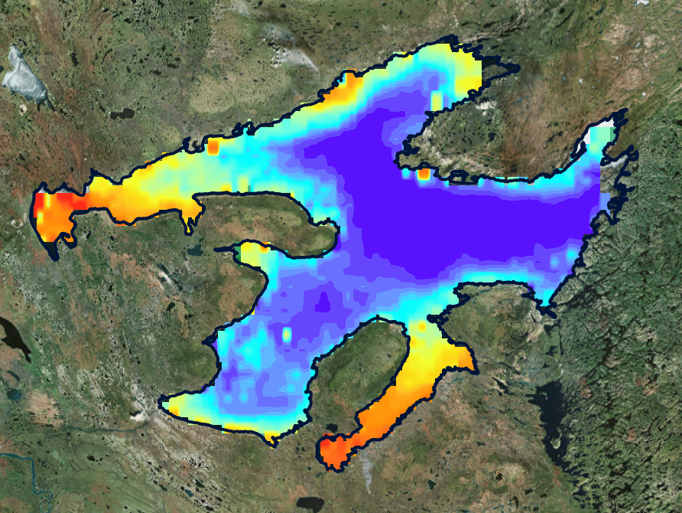
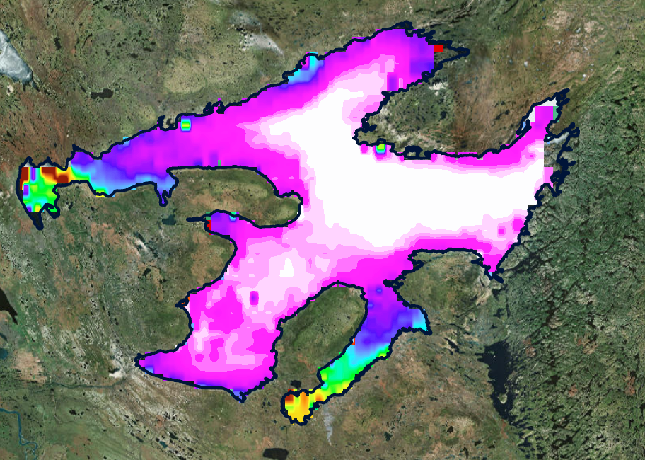
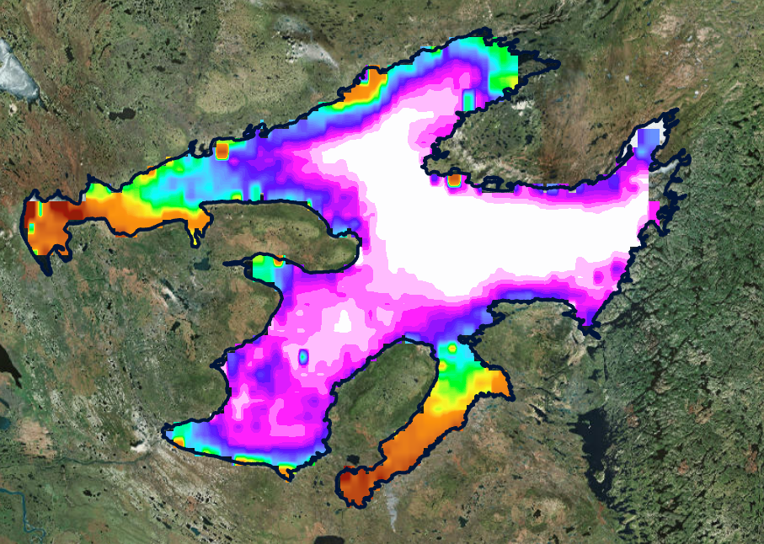
Objectives
Water Quality
Assess changes in Great Bear Lake over the past 20 years for the following parameters: lake surface water temperature (LSWT), Chlorophyll-a (Chl-a), and CDOM content.
Provide the end user with maps and data visualizations to display how GBL has changed over time.
Share the potential of remote sensing to address water resources issues.
1998
2018
Temperature
Chlorophyll-a
Dissolved
Organic
Matter
Notes:
Images: NASA Goddard Space Flight Center, Ocean Ecology Laboratory, Ocean Biology Processing Group. Moderate-resolution Imaging Spectroradiometer (MODIS) Aqua Photosynthetically Available Radiation Data; NASA OB.DAAC, Greenbelt, MD, USA. doi: 110.5067/AQUA/MODIS/L3M/PAR/2018.
Accessed on10/01/2018
Speaker notes:
An example of data visualization. This gif displays solar radiation in Great Bear Lake that algae can use to photosynthesize throughout the season. We wanted to use these kinds of visualizations to understand if certain variables of Great Bear Lake were on an ecological trajectory of change. These variables include lake surface water temperature, chlorophyll-a, which is an indicator for algae, and CDOM. For those unfamiliar, CDOM is chromophoric dissolved organic matter. This means dissolved and decaying natural substances that absorb light and affect the color of the water. The reason we examined these variables is their importance to the entire lake’s ecology: algae and CDOM represent the foundation of the food web, while temperature impacts all biological and abiotic processes in an ecosystem.

Slide 5
Water quality parameters
Temperature
Impacts all biotic and abiotic processes in a lake ecosystem.
Directly measured
Algae
Primary producers. Source of all biological productivity in a lake, supporting upper trophic levels.
Measured by chlorophyll-a levels
Chromophoric Dissolved Organic Matter (CDOM)
DOM sustains the base of the food web. CDOM is the fraction which interacts with light, altering light conditions and thus phytoplankton growth potential.
Measured by algorithms applied to Remote Sensing reflectance (Rrs)
Notes:
Speaker notes:
the 3 water quality parameters we examined. Temperature, acquired from ArcLake data base, impacts all ecosystem processes. Algae, measured by cholorphyll levels, compose the base of the food web. DOM sustains microbial populations. CDOM interacts with light in the water and alters what photosynthesizers can you use. Measured via Rrs values.

Slide 6
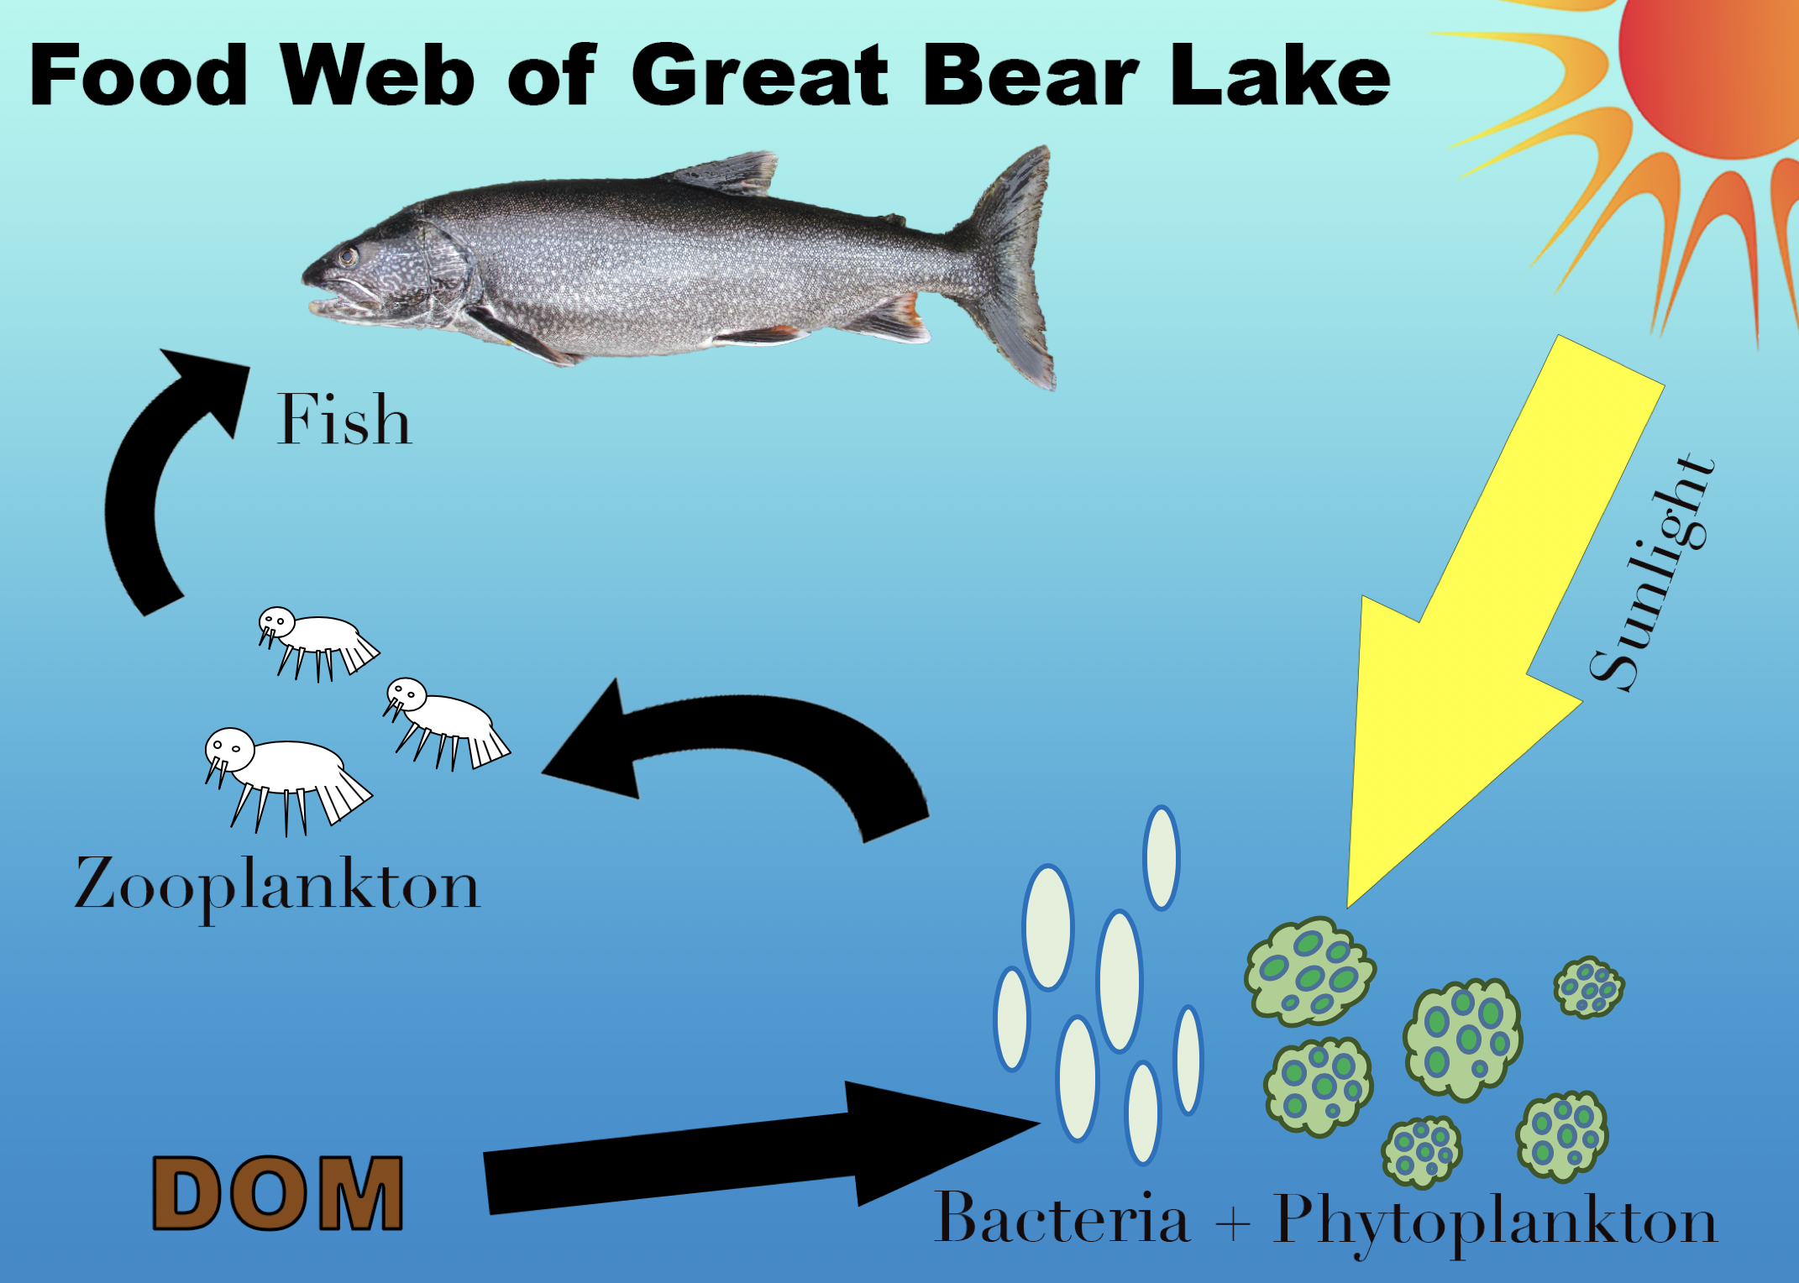
Notes:
Visual created by Krishna Sharma (DEVELOP member).
Lake Trout: Ed Reeves (written permission obtained)
Speaker notes:
1. Food web of Great Bear Lake. DOM feeds bacteria and phytoplankton, which feed zooplankton (tiny animals), which feed fish. Sunlight & DOM form the foundation for the primary producers.
2. CDOM is the fraction of DOM that interacts with light. It generally absorbs blue, green, and UV while reflecting yellow. It adds a yellow tint to the water. It photodegrades into DOM.
3. Thus, we can now include CDOM in our food web. Note that it restricts light available to the primary producers, affecting the entire ecosystem.

Slide 7
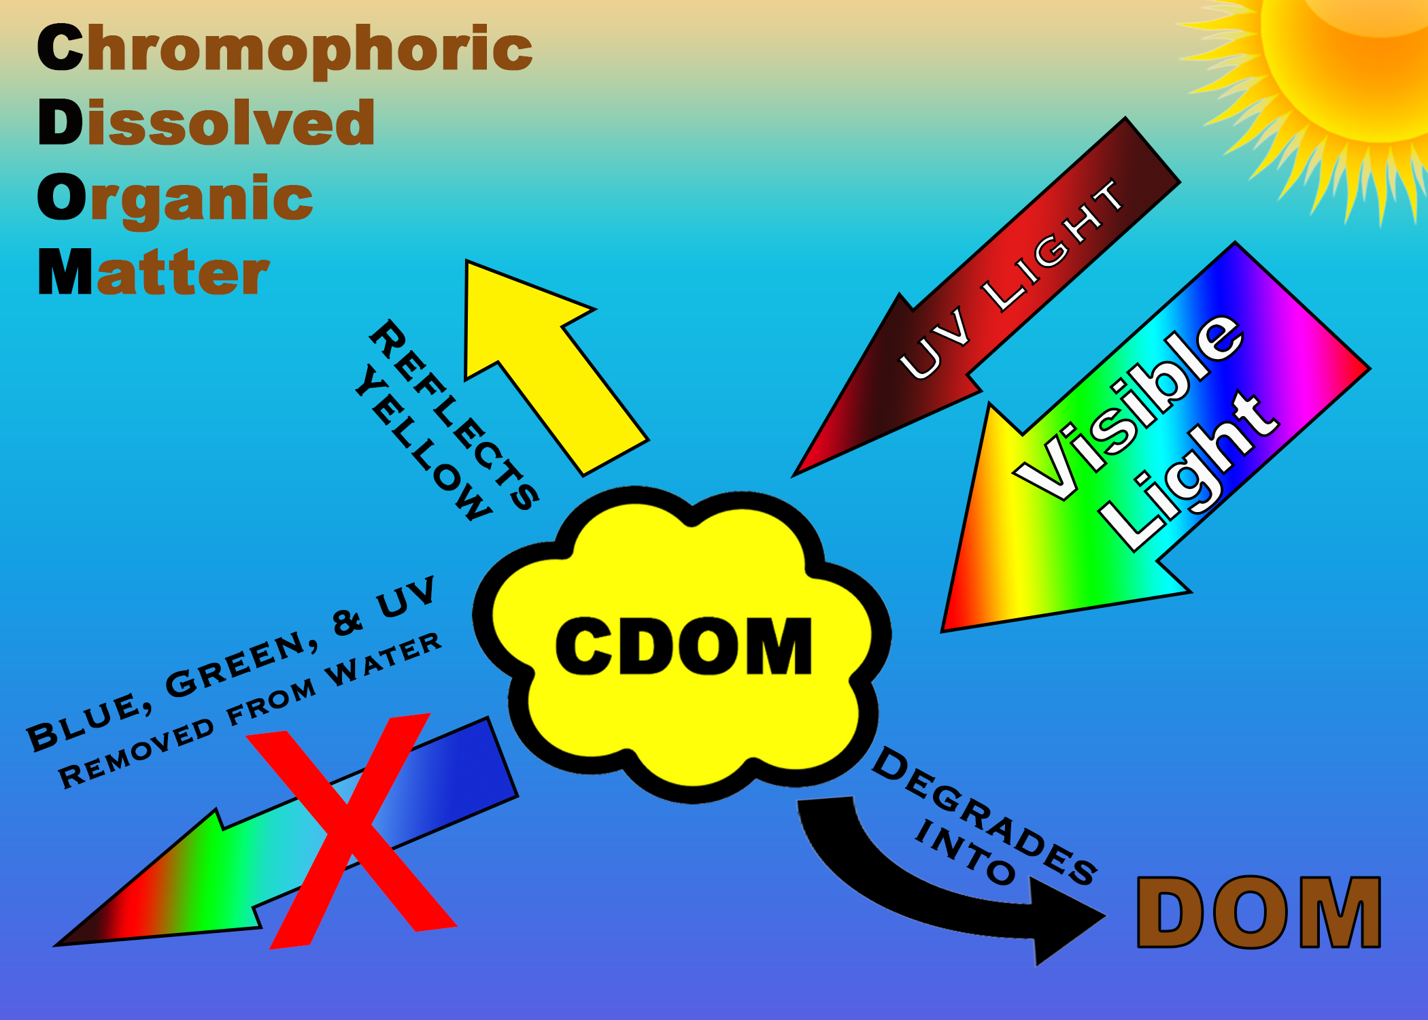

Slide 8
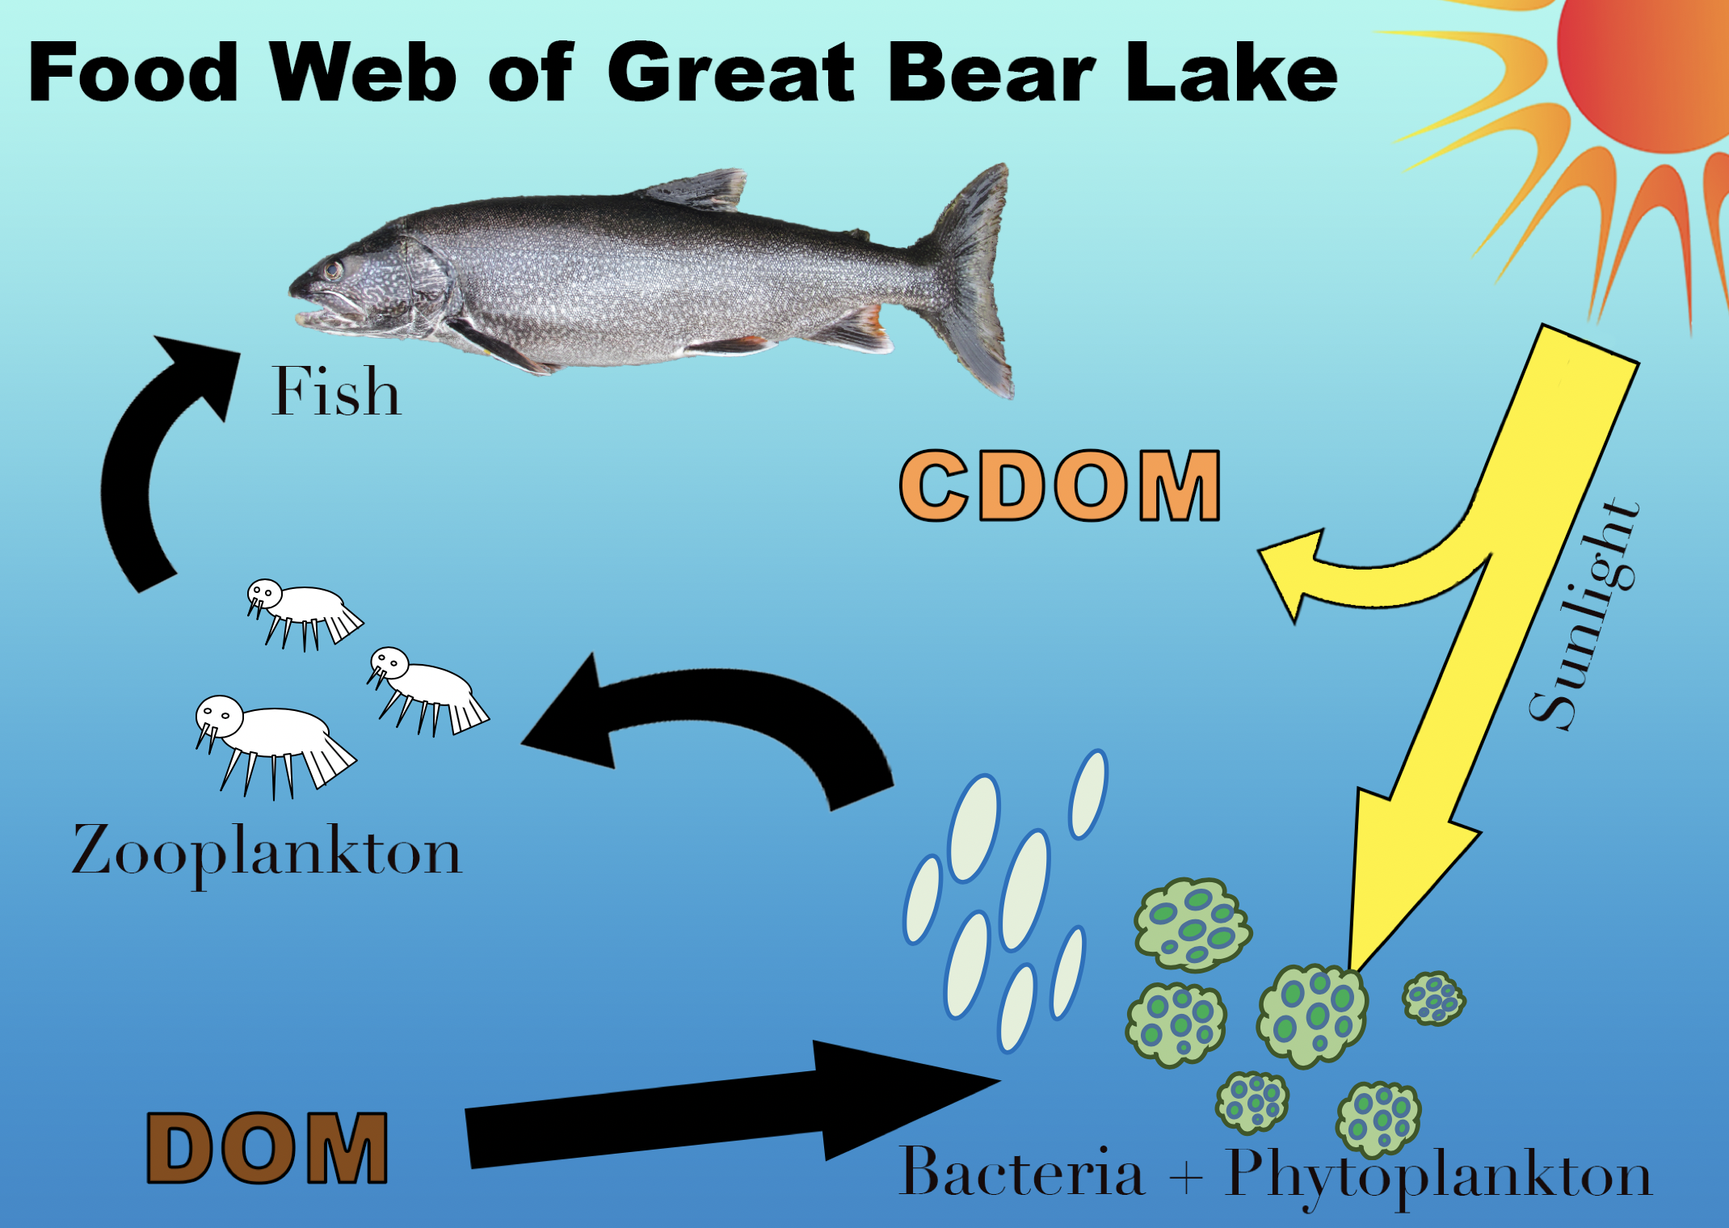

Slide 9
What Changes in Temperature can Affect
Amount of sunlight that reaches the water
Lake
Ice Cover
Chlorophyll light absorption
Impact on Phytoplankton
Impact on Ecosystem
Temperature
Ice Melt
Organic
Matter
(DOM) flowing into the Lake
CDOM levels
Runoff
The chosen variables for this study
Notes:
Speaker Notes:
Changes in temperature can effect overall lake ecology in many ways. Levels of CDOM and Chlorophyll can fluctuate with temperature, impacting the food web of Great Bear Lake and thus the fisheries Deline depends on.

Slide 10
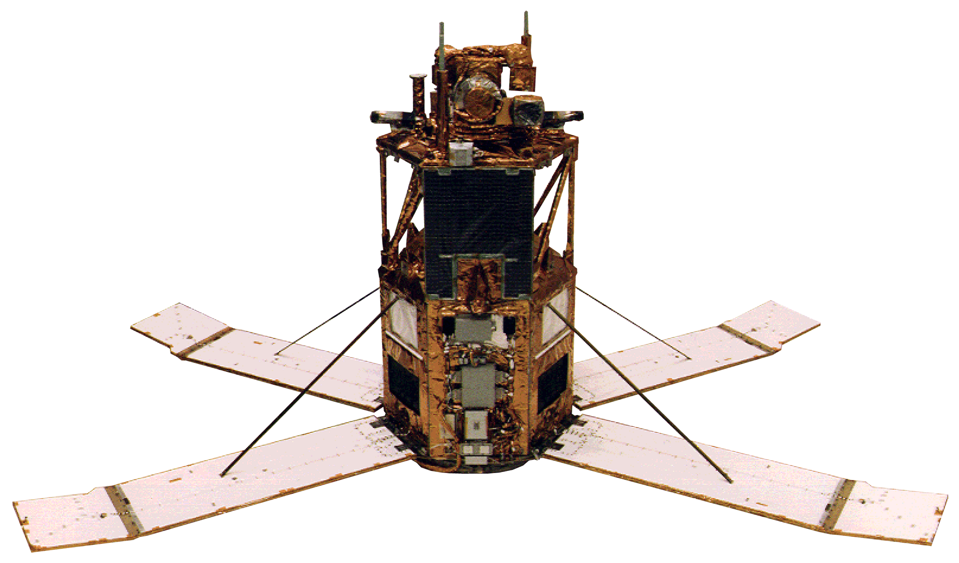

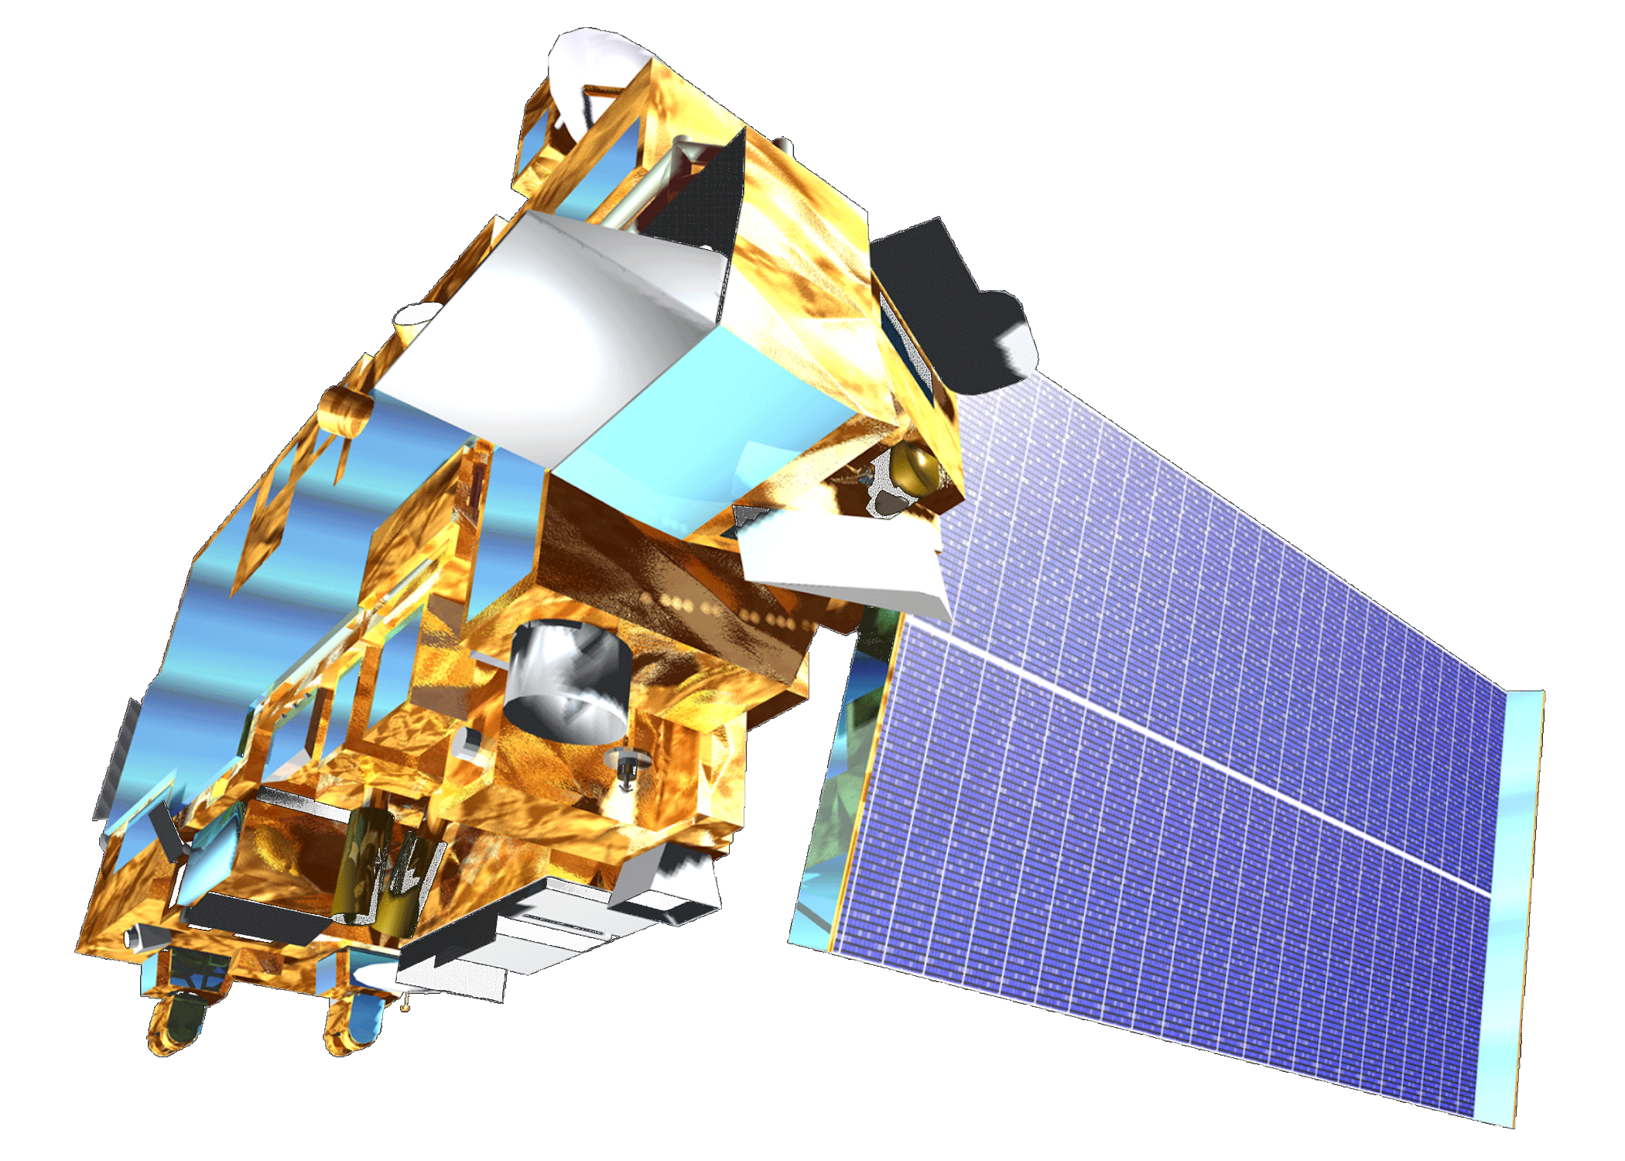
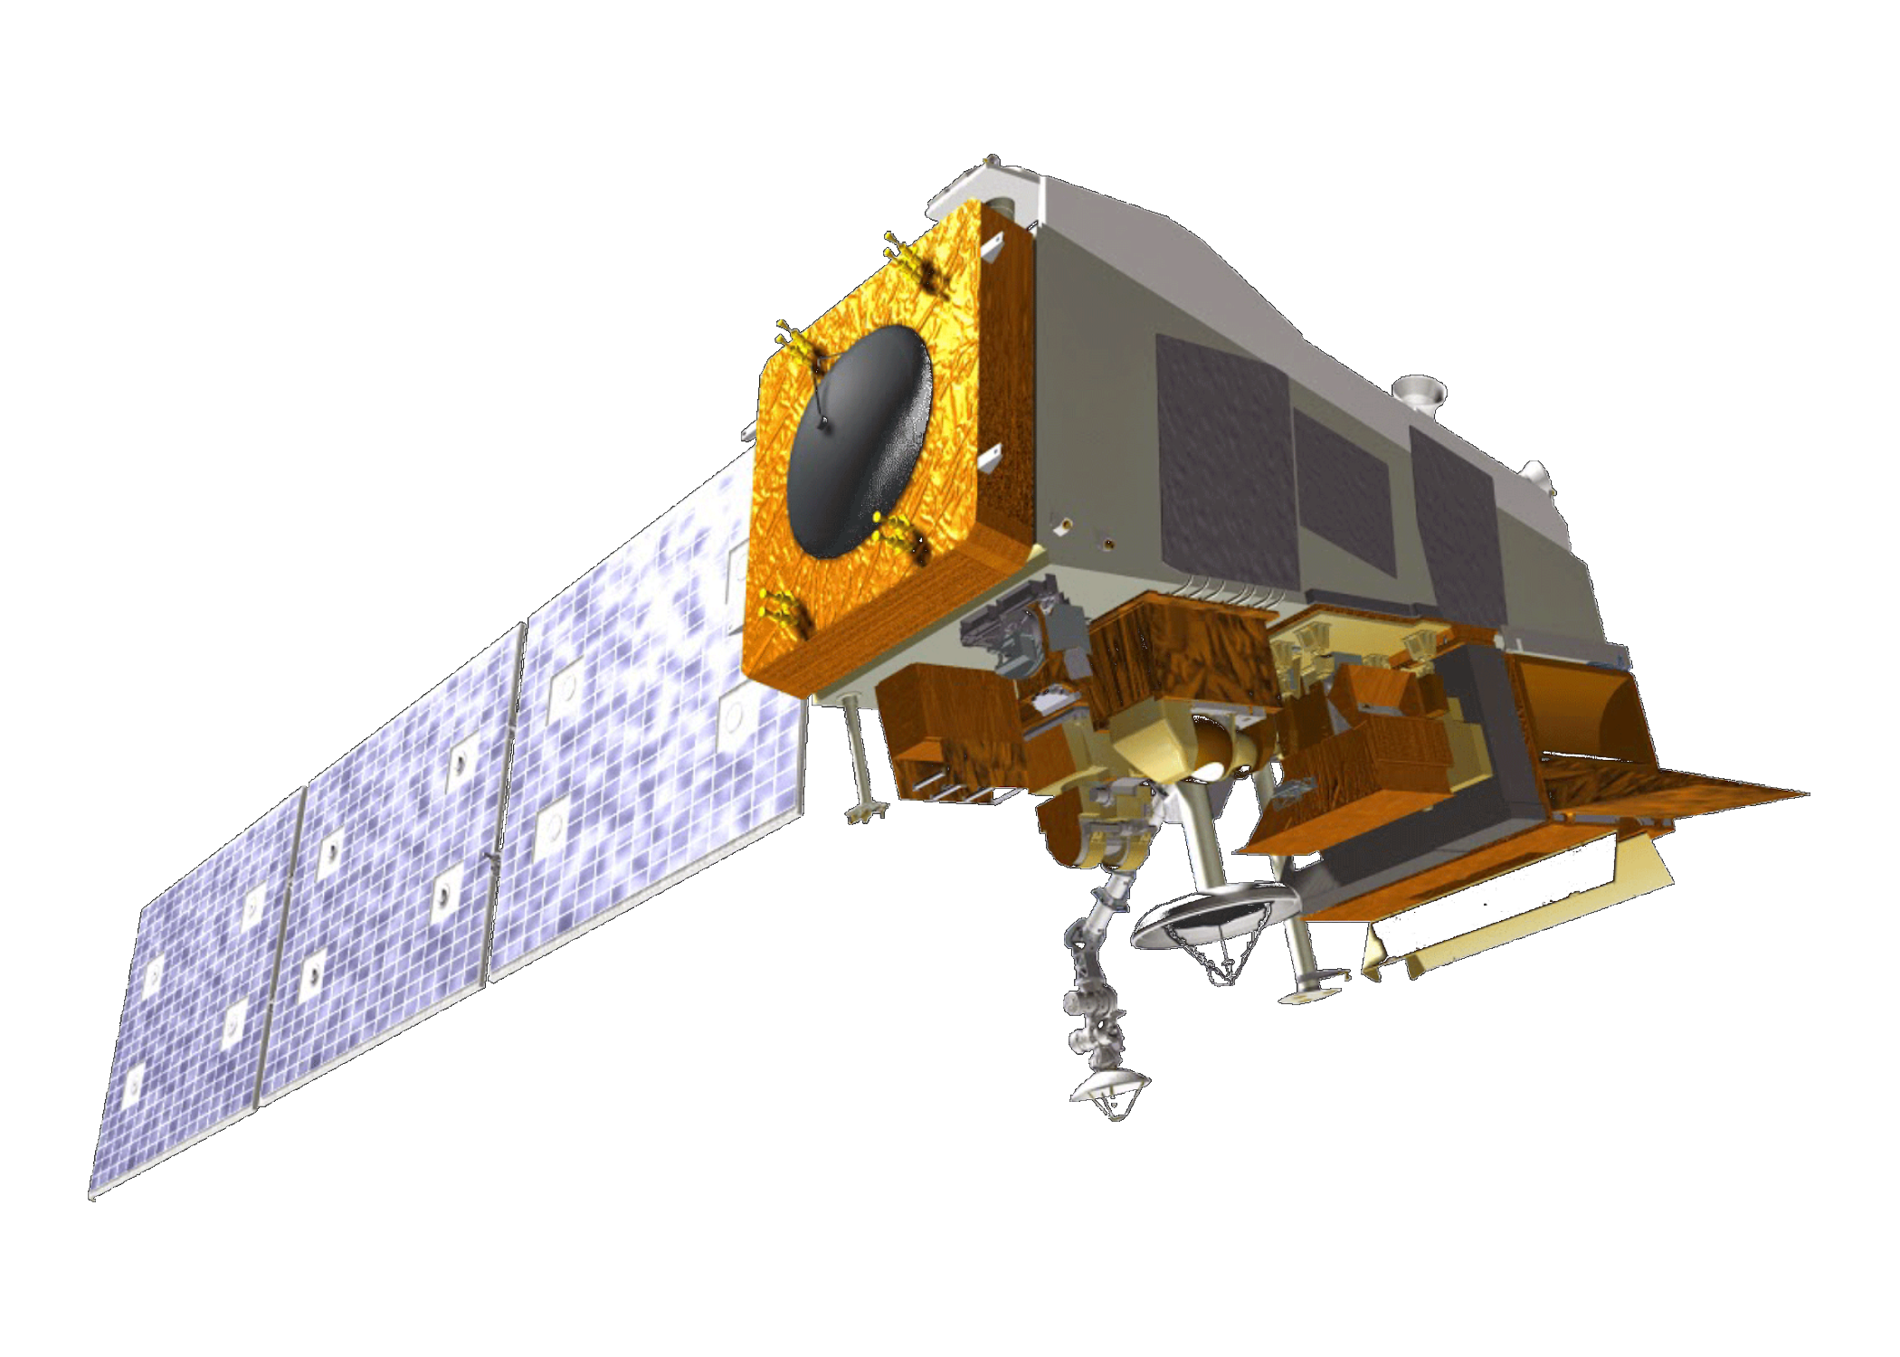
NASA Satellites and Sensors
SeaStar SeaWiFS
Satellite | Sensor | Period | Resolution | Products
SeaStar | SeaWiFS: Sea-Viewing Wide Field-of-View Sensor | 1997 to 2010 | 9 km | Rrs IOP (443 nm)
Aqua | MODIS: MODerate resolution Imaging Spectroradiometer | 2002 to 2018 | 4 km | Rrs IOP (443 nm)
Suomi National Polar-orbiting Partnership (NPP) | VIIRS: Visible Infrared Imaging Radiometer | 2011 to 2018 | 4 km | Rrs IOP (443 nm)
Terra | MODIS: MODerate resolution Imaging Spectroradiometer | 2002 to 2018 | 4 km | Rrs IOP (443 nm)
Aqua MODIS
Terra MODIS
Suomi NPP VIIRS
IOP: Inherent Optical Properties
Rrs: Remote Sensing Reflectance
Ancillary Datasets:
ARCLake Project ARC-Lake LDB v3.0 – LSWT data of Great Bear Lake
Notes:
Images: DEVELOPedia
Speaker notes:
Due to the lack of temporally and spatially consistent in situ water quality measurements, we chose NASA earth observation as our main source for this study.
We used remote sensing products of for satellites including Aqua MODIS, Terra MODIS, SeaWiFS, and VIIRS to extract water quality variables.
We also used ArcLake products as ancillary source to extract Lake Surface Water Temperature (LSWT).

Slide 11
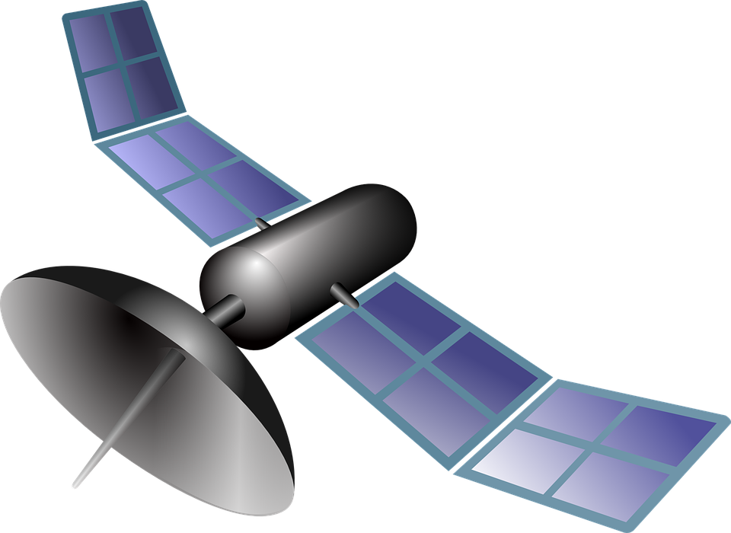

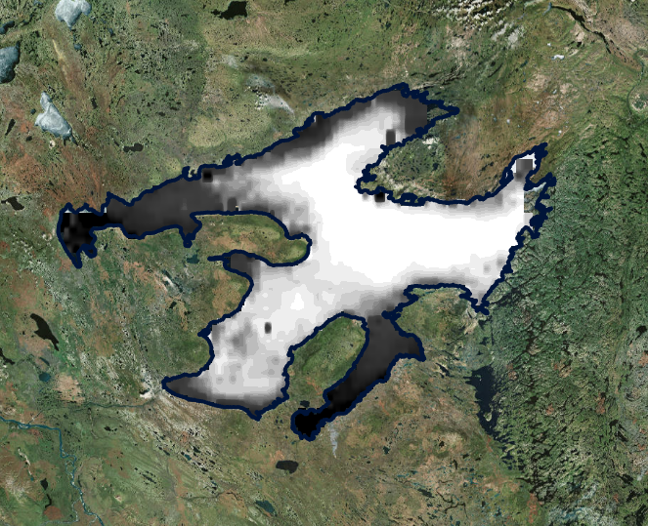

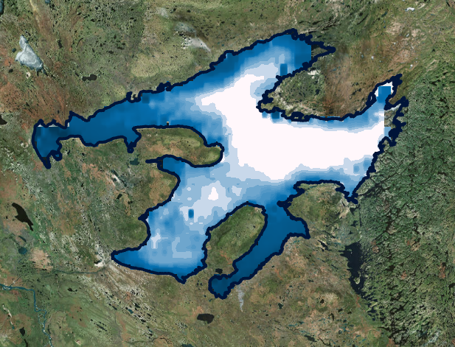
Data Processing
Atmospheric Correction
(Global Algorithm)
Raw Satellite Images:
Data the sensor receives
Corrected Satellite Images:
The surface data
North Pole
Notes:
Earth Clipart: https://pixabay.com/en/globe-earth-world-map-sphere-34526/, CC0 license
Satellite Clipart: https://www.maxpixel.net/Internet-Satellite-Transmit-Icon-Wireless-98427, CC0 license
Sun Clipart: https://commons.wikimedia.org/wiki/File:Emojione_2600.svg
Speaker notes:
For data to be usable for further analysis, they have to be atmospherically corrected
Atmospheric correction is a process during which the effects of the atmosphere column through which the light travels is removed so that the images taken by satellite reflect the true information of the earths surface.

Slide 12
Data Processing
Atmospheric Correction
(Global Algorithm)
Raw Satellite Images:
Data the sensor receives
Corrected Satellite Images:
The surface data
Arctic areas are challenging for satellites to image
North Pole
Atmospheric correction of satellite images are more reliable during the summer months for high latitude areas based on the angle of sun
Notes:
Earth Clipart: https://pixabay.com/en/globe-earth-world-map-sphere-34526/, CC0 license
Satellite Clipart: https://www.maxpixel.net/Internet-Satellite-Transmit-Icon-Wireless-98427, CC0 license
Sun Clipart: https://commons.wikimedia.org/wiki/File:Emojione_2600.svg
Speaker notes:
This procedure, which follows a global algorithm, is suitable for arctic region in high latitudes because of the angle of the sun (a irregular relative positioning to the sun).
This limited our data usage to summer months during which global atmospheric correction provide more reliable images for high latitude regions.

Slide 13
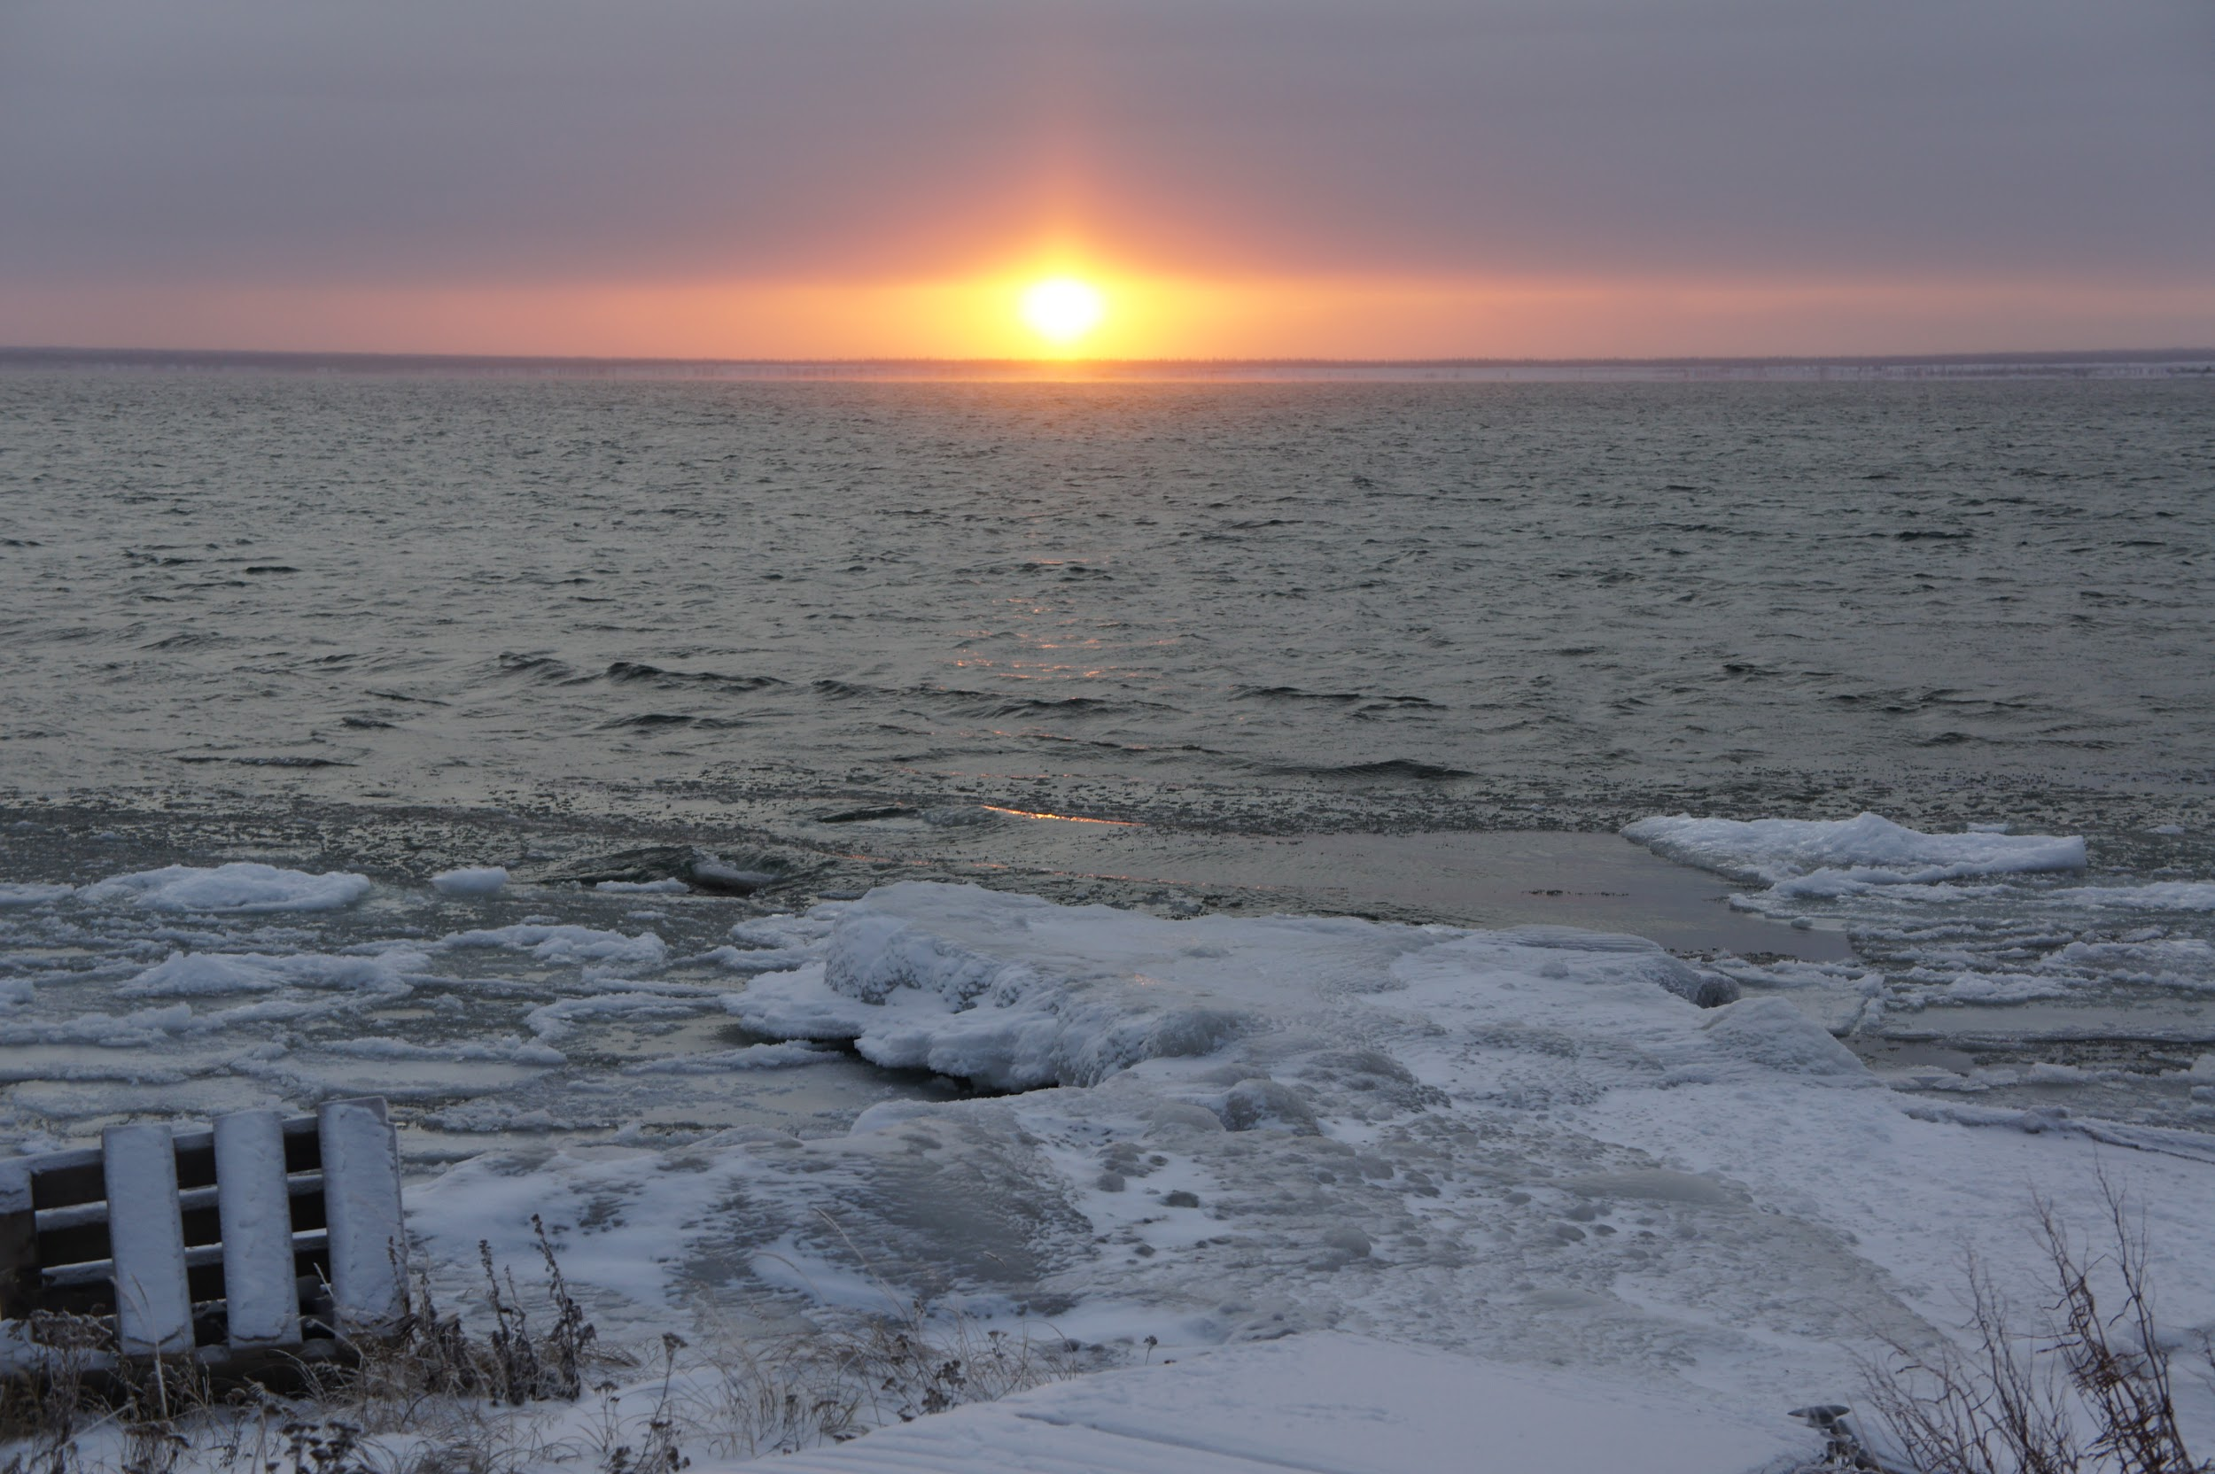
Data Processing
Atmospheric Correction
(Global Algorithm)
Raw Satellite Images:
Data the sensor receives
Corrected Satellite Images:
The surface data
Credit: Ed Reeves
North Pole
In our study area, the lake surface is covered fully and partially with ice starting from mid-fall to mid-summer
Study Period: 1998-2018, August
Notes:
Earth Clipart: https://pixabay.com/en/globe-earth-world-map-sphere-34526/, CC0 license
Satellite Clipart: https://www.maxpixel.net/Internet-Satellite-Transmit-Icon-Wireless-98427, CC0 license
Sun Clipart: https://commons.wikimedia.org/wiki/File:Emojione_2600.svg
Photo: Ed Reeves, written permission obtained.
Speaker notes:
On the other hand, GBL surface is covered fully or partially by ice from mid-fall to mid-summer.
Therefore to avoid ice cover interference, we only chose August between summer months as it provided the information for the whole surface of the lake.

Slide 14
Data Processing
Checking data quality
Corrected Satellite Images:
The surface data
Analyzing data:
Applying mask
Rrs 443 nm (2003 to 2017)
Possible reasons why coastal data was unreliable
Adjacency effects (nearby land reflected light)
Aerosol interference (trees or other sources may give off substances that interact with light)
Inappropriate satellite algorithms not suited for high northern latitudes
Low Confidence Data
High Confidence Data
Notes:
Image: Processed by DEVELOP team
Speaker notes:
Checking for the quality of information embeded in each images, we noticed that around the edges of the lakes the values of Rrs are negative. Although the normal range of Rrs has to be positive.
Therefore, these negative values were clearly errors and they were also more common in the blue & green bands, which are robustly required to assess chlorophyll and CDOM concentrations.
The possible/potential sources of the existence of negative values can be due to presence of aerosols such as haze, fog or dust in the air, adjacency effects, where land can reflect light and skew readings of nearby water. And also is may indicate atmospheric over-correction for a small water body as opposed to the large ocean environments that the satellites are
suited for.
Water surfaces also generally have variations in sunlight glint and reflection, as well as varying levels of organic matter that can be hard to correct for.

Slide 15
Data Processing
Checking data quality
Corrected Satellite Images:
The surface data
Analyzing data:
Applying mask
Rrs 443 nm (2003 to 2017)
Solution
Since most of the coast proved unusable, we only analyzed the center of the lake (white square)
Compared all sensor products
Low Confidence Data
High Confidence Data
Study area
Notes:
Image: Processed by DEVELOP team
Speaker notes:
Since we didn’t have any means to validate the optical data of remote sensing reflectance,
We decided to focus of the center of the lake as the most reliable part of the lake with positive values
And also to cooperate the products of four satellite sensors and compare the results in hope of getting a better and more reliable view of water quality changes in the study area

Slide 16
Challenges when Using Different Sensors
Remote Sensing Reflectance at different wave length
The Differences in Satellite Sensor Data for Rrs
Rrs 412
Rrs 443
Rrs 555
Processing
CDOM
Chlorophyll-a
All satellite data products displayed inconsistent results
Notes:
Speaker notes:
However, this solution also proved to be challenging. Since the data provided by different satellites for Rrs which is our input to calculate CDOM and Chlorophyll displayed inconsistency
Here we have one of the Rrs at 412nm as an example. We can see that the variability among them in the same period displayed inconsistency. We can’t get any conclusion that which satellite product is more reliable.

Slide 17
Results: Chlorophyll-a
SeaWiFS
Aqua MODIS
Sensor | Trend (center of GBL)
SeaWiFS | Increase
Aqua MODIS | Increase
Terra MODIS | Increase
VIIRS | Decrease
SNPP VIIRS
Terra MODIS
Notes:
Images: processed by DEVELOP team
Speaker notes:
Using these four NASA Earth observation satellites’ ocean color level 3 products, we put absorption coefficient of phytoplankton at 443 nm as an indicator for chl-a. The yearly time series of this parameter in August were calculated in the lake center using the same mask. Trend analysis shows that Chlorophyll-a had a non-significant increasing trend over respective time periods for SeaWiFS, Aqua MODIS and Terra. However, there is a non-significant decreasing trend for SNPP VIIRS which only has data for the past 7 years. Actually, to determine if the different model was the source of data inconsistency between satellites, we also generated time series of absorption due to phytoplankton at this same band from the other model products. The results were similarly inconsistent, and so no further trend analysis was pursued.

Slide 18
Results: CDOM
SeaWiFS
Aqua MODIS
Sensors | Trend (center of GBL)
SeaWiFS | Decrease
Aqua MODIS | Increase
Terra MODIS | Decrease
VIIRS | Increase
SNPP VIIRS
Terra MODIS
Notes:
Images: processed by DEVELOP team
Speaker notes:
Based on these remote sensing products, absorption coefficient of gelbstoff at 443 nm were employed as an indicator for CDOM. This parameter also means absorption due to non-algal materials plus CDOM. The analysis showed a non-significant decreasing trend for SeaWiFS and Terra, but a non-significant increasing trend for Aqua MODIS and SNPP VIIRS. As with chl-a, we used multiple products derived from other models to determine if satellite sensor discrepancies. Finally, there’s no algorithm resolved satellite inconsistency. It’s so hard to confirm the trends of the water quality for Great Bear Lake using these level 3 products until now.

Slide 19
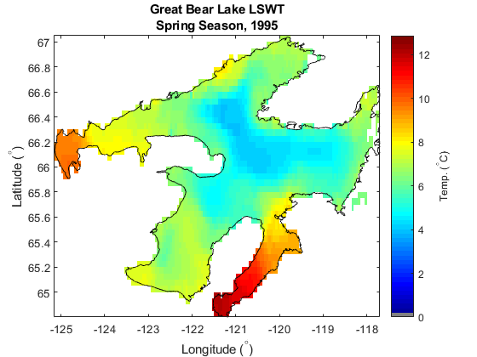
Results: Lake Surface Water Temperature
Summer

Slide 20
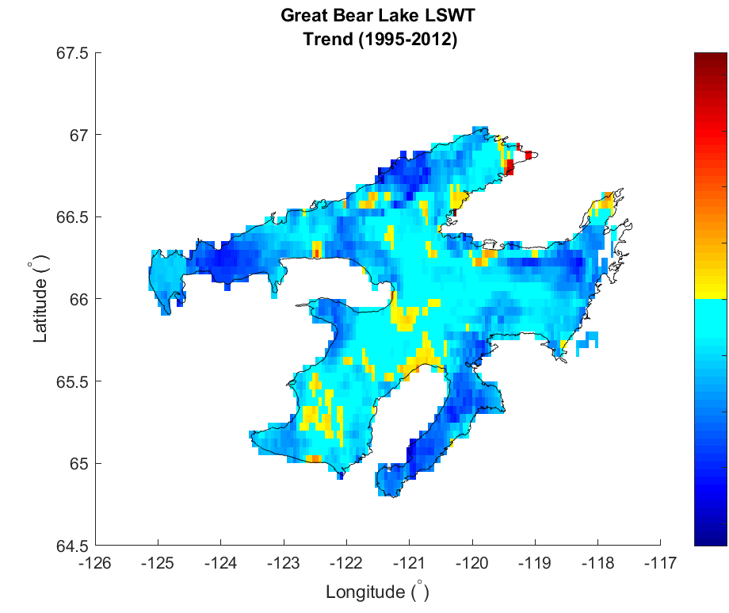
Results: Lake Surface Water Temperature
Positive trend
Negative trend
Not a significant decreasing trend
Notes:
Images: data processed by DEVELOP team. Raw data from ARCLake (ancillary dataset)
Speaker notes:
For temperature, what we obtained was a non significant decreasing trend in the lake.

Slide 21
In Situ Chlorophyll-a and Temperature (2012 to 2018)
Impossible validation between RS and in situ:
In situ data were collected around the edges of GBL
Remote Sensing data were more reliable at the center of the lake
The in situ data were collected in different years and months for each location
The in situ temperature were gathered after 2012 while the RS temperature were from 1995 until 2012. No overlap in time
Note: Points near Délįnę were sampled later in the season (September)
Data samples shared by Dr. Kimberly Howland
Notes:
Speaker notes:
Since 2012 on, there have been attempts in collection water quality data from GBL. This graphs shows the location of sample sites.

Slide 22
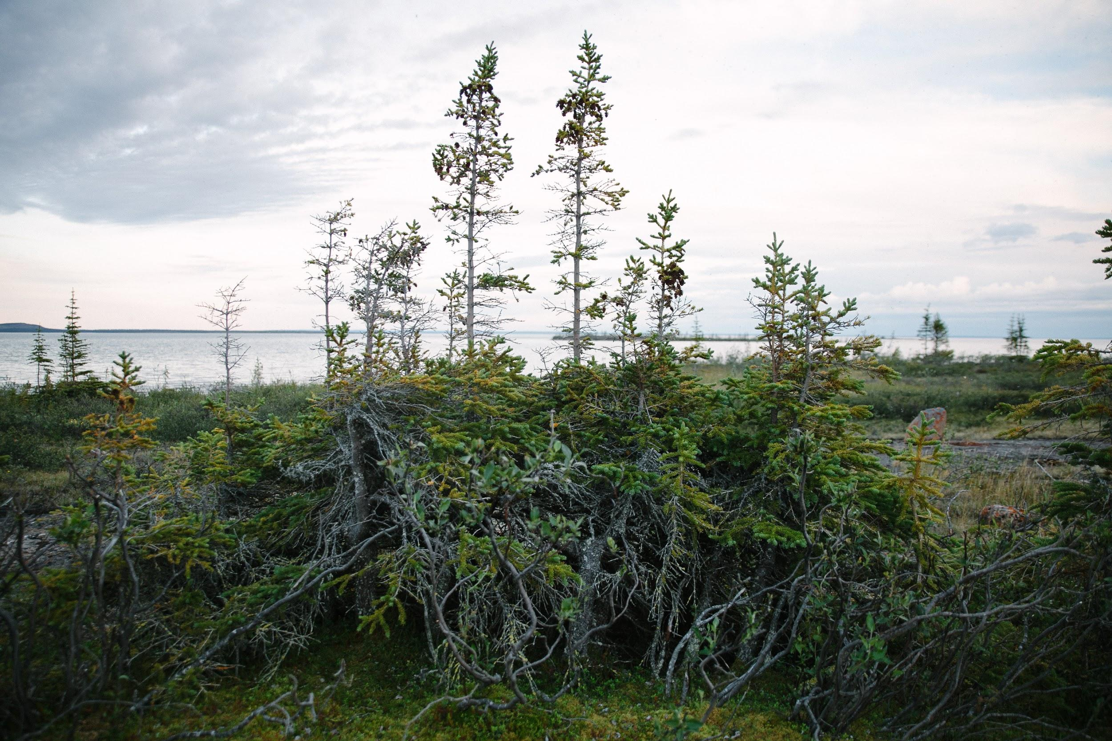
Conclusions
Arctic lakes present many unique challenges to remote sensing.
Sensor datasets differed most for blue & green wavelengths. This compromised Chlorophyll-a and CDOM estimation.
No drastic changes in water quality parameters were observed over the 20 year study period.
Visual inspection showed a non-significant, decreasing trend in water temperature.
Trees of Great Bear Lake. Credit: Heather Clark
Notes:
Photo: Heather Clark. Written permission obtained.
Speaker notes:
Conclusions. Remote sensing reflectance is unreliable along GBL’s coastline. CDOM and chlorophyll-a trends were insignificant between satellite data products. Chlorophyll and CDOM seem relatively stable over 20 years at the lake center. Temperature had a slight decrease over 20 years.

Slide 23
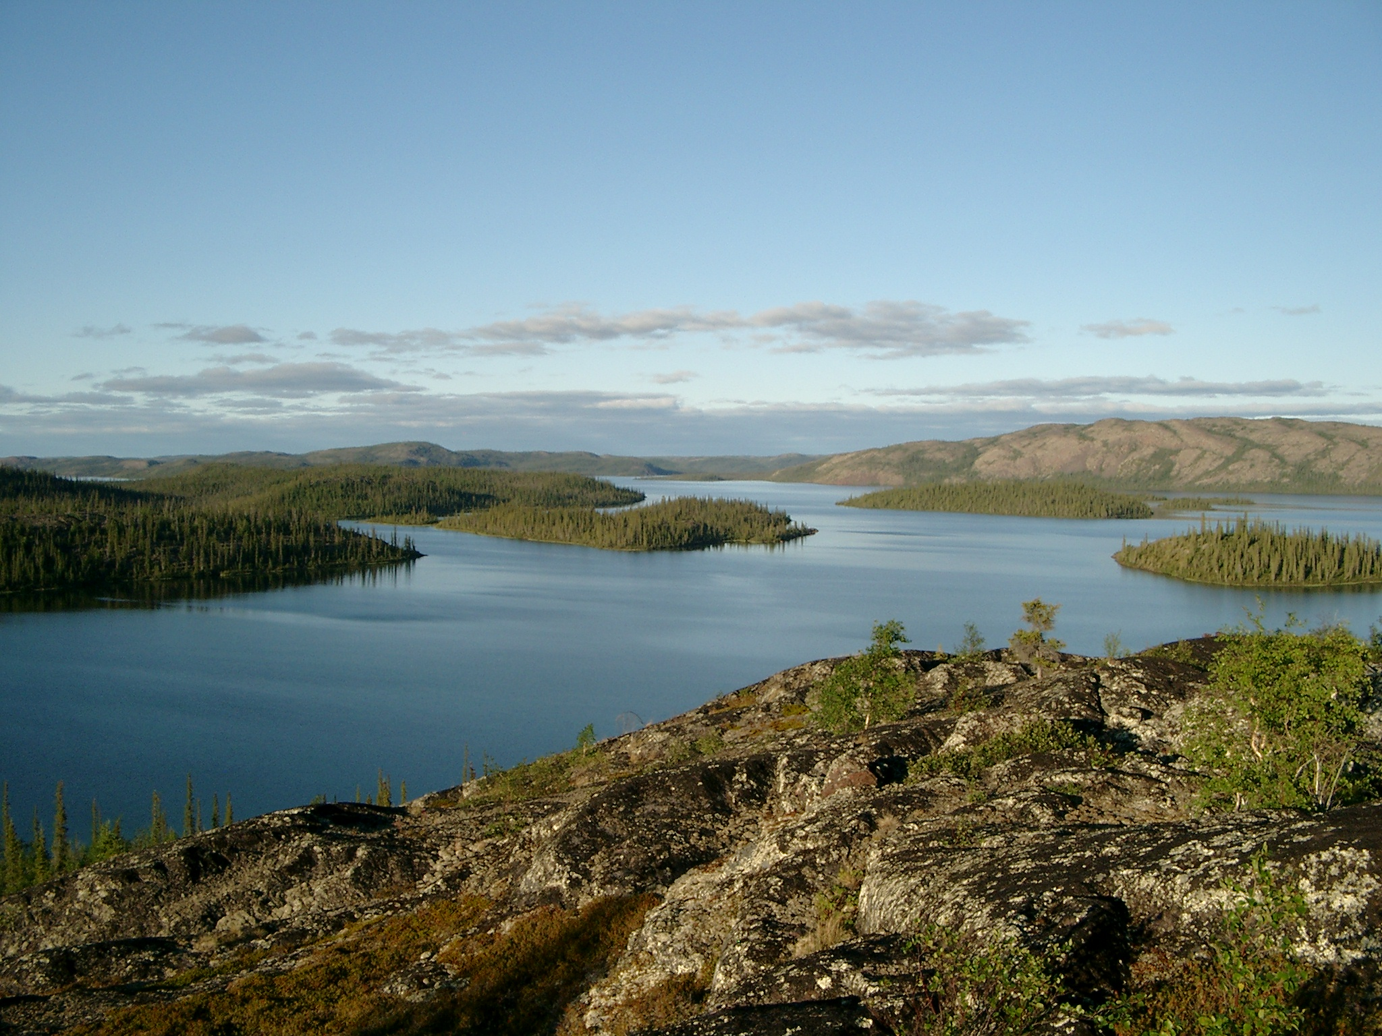
Future Work
Validate remote sensing data with in situ data, with more sample sites at the lake center
Modify atmospheric correction algorithms to properly handle high latitudes
Compare land cover change to trends in water quality
Given the presence of mercury contamination & important fisheries in GBL: relate DOM to mercury biogeneration
Image Credit: Monet
Great Bear Lake’s pristine natural cover
Credit: Kimberly Howland
Notes:
Photo: Kimberly Howland, written permission obtained.
Speaker notes:
This research leaves fertile land to grow many new projects. Trend analysis could be validated and refined with in-situ data to better define Great Bear Lake’s change over time.
In situ data near the center of the lake would help validate remote sensing reflectance.
Land cover change could be compared to water quality change for an overarching environmental change trend.
Great Bear Lake also has a curious presence of mercury pollution from radioactive mining that could be collated with CDOM presence. CDOM is known to have complex interactions with microbial activity, including those that convert mercury to monomethylmercury, which is mercury’s bioavailable form and extremely toxic. Research on this would offer novel insight on local fishery health and mechanisms of a wide-spread environmental issue.

Slide 24
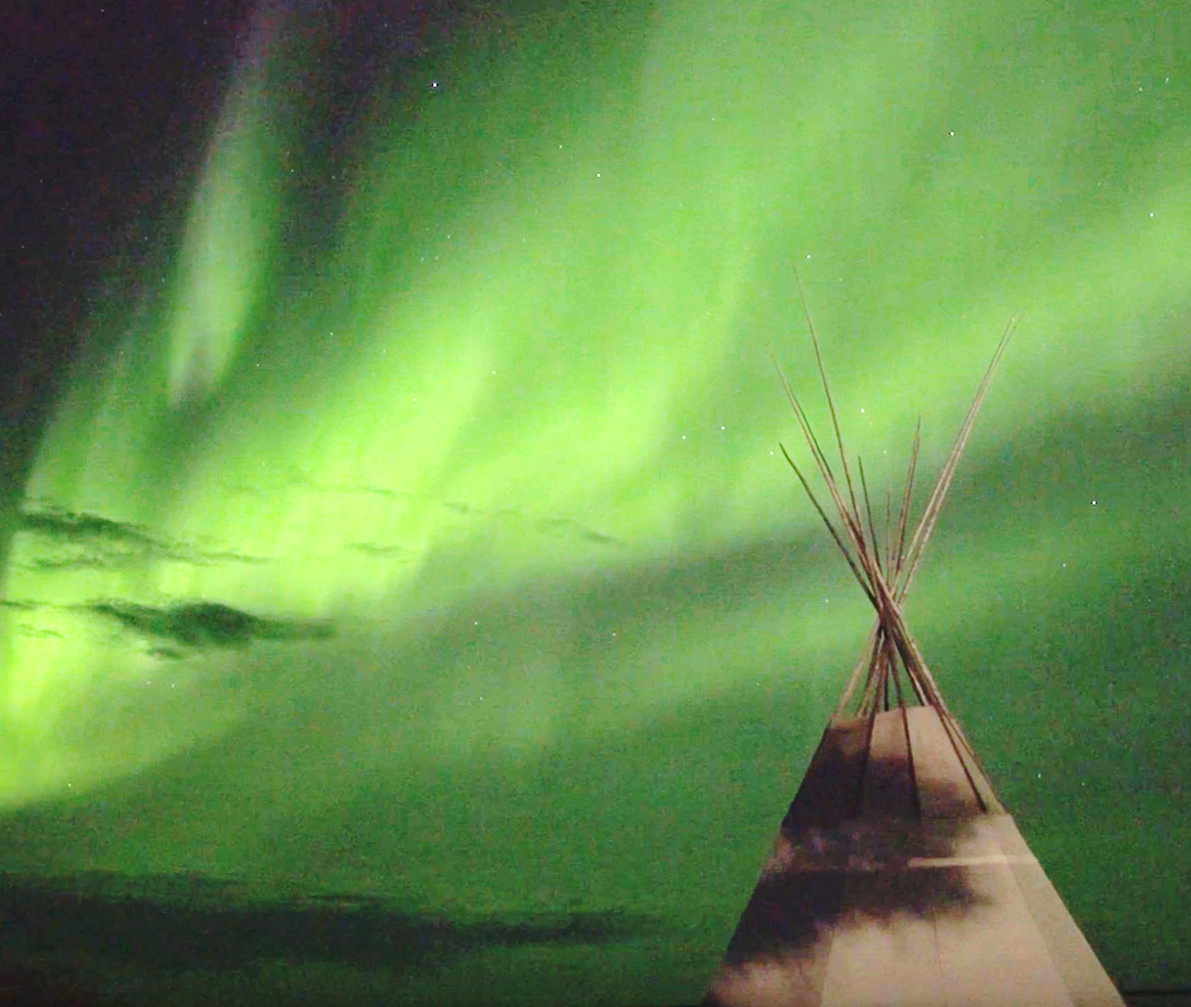
Acknowledgements
The Community and Government of Délįnę
Dr. Cédric G. Fichot, Boston University
Ed Reeves, Délįnę Renewable Resources Council
Dr. Marlene Evans, Environment and Climate Change Canada
Kimberly Howland, Fisheries and Oceans Canada
Mandy Bayha, UNESCO Tsá Tué World Biosphere Reserve
Image: Artless Collective
Northern Lights above Délįnę
Notes:
Screenshot of Déline - Lights above Prophet Ayah's house video by Artless Collective: https://www.youtube.com/watch?v=-8XU2F2CJY4 (written permission obtained)
Thank you! Questions?

