Slide 1
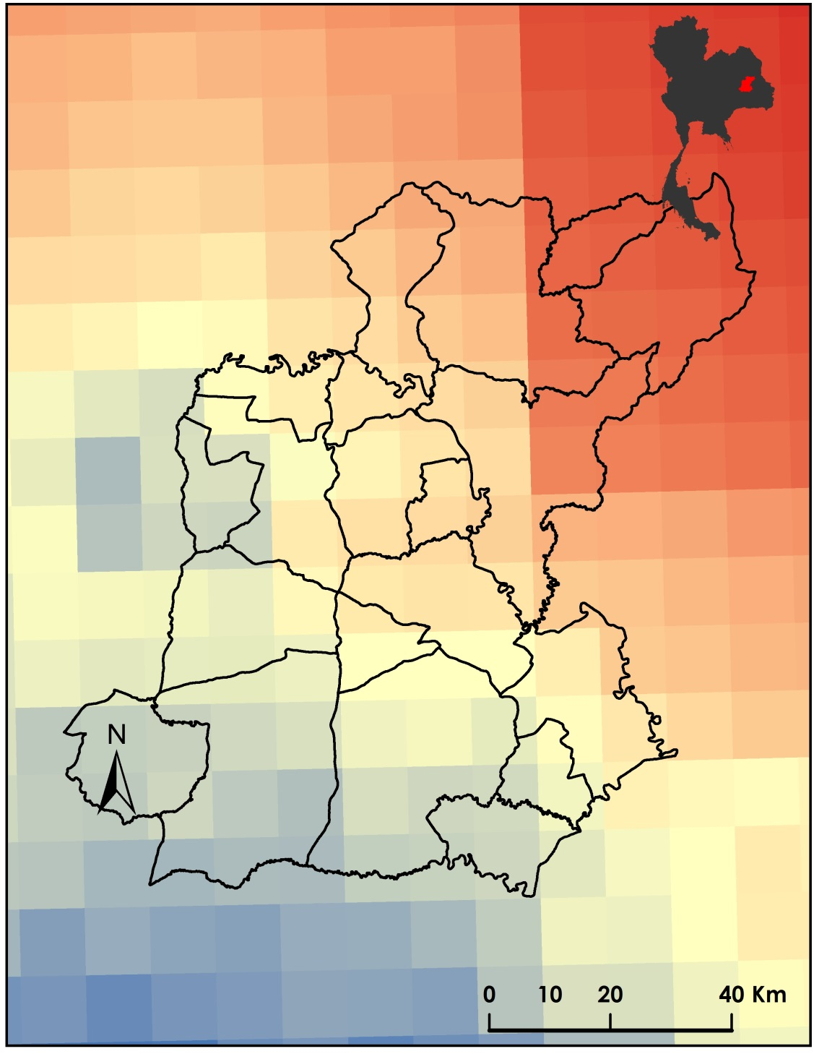
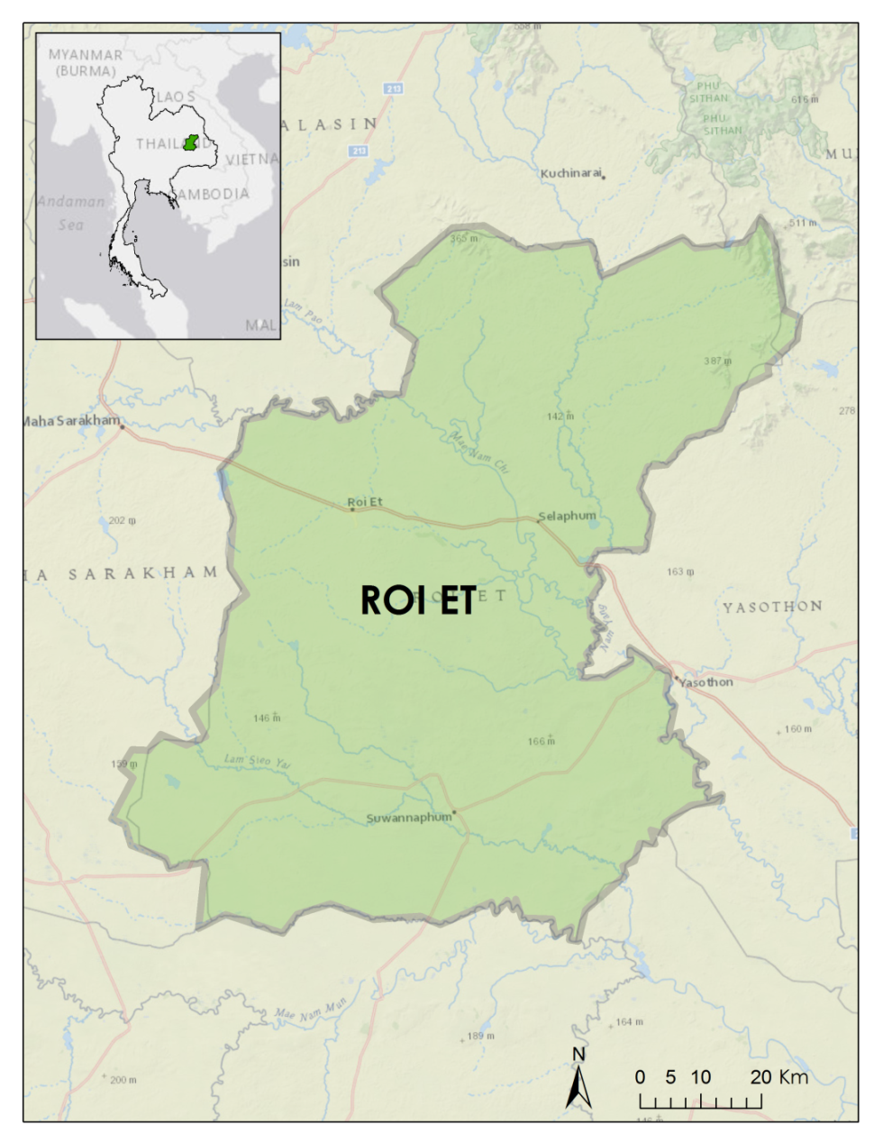
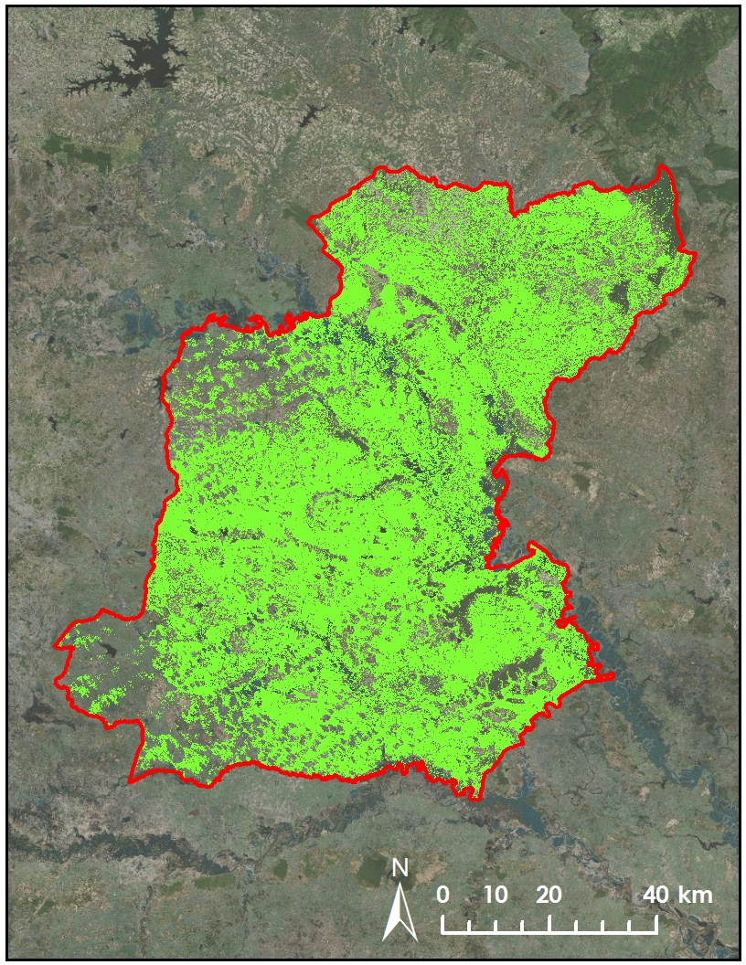
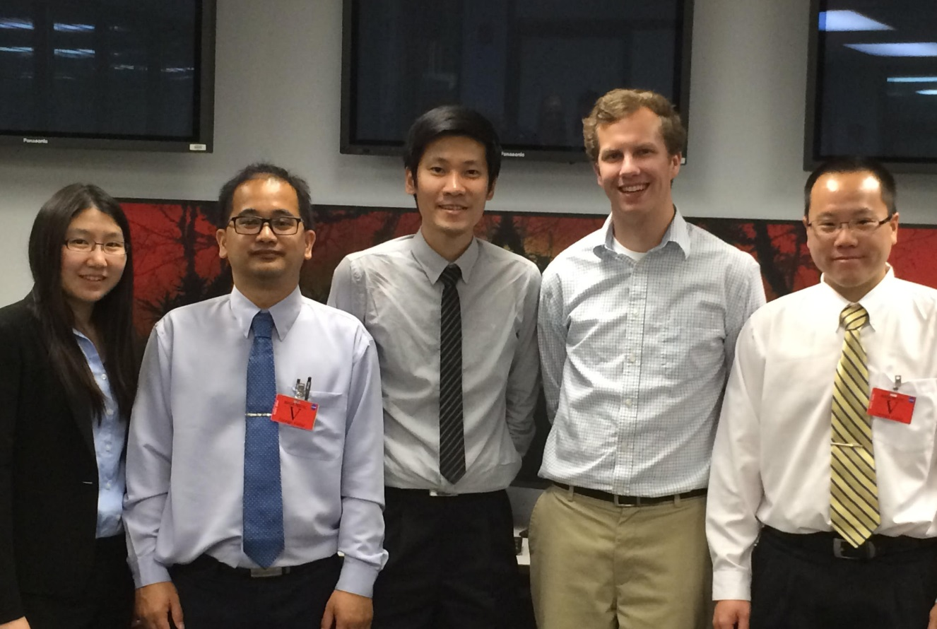


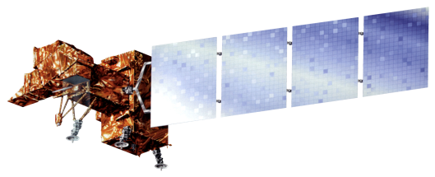

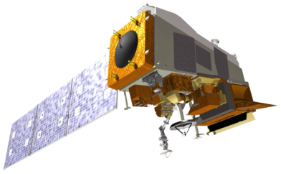
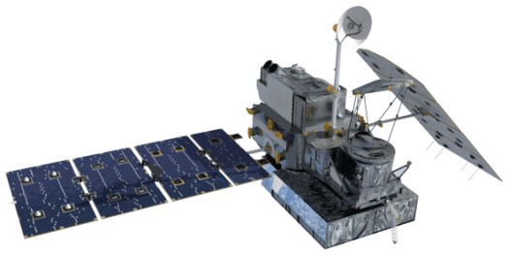
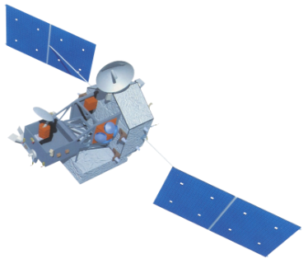

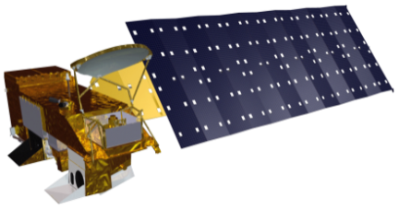
Thailand Agriculture
Monitoring Food Crop Health and Stress Due to Changing Climate for Enriched Agricultural Land Management
Tim Klug (Project Lead), Arom Boekfah, Chayanit Choonwattana, Komsan Rattanakijsuntorn, Watanyoo Suksa-ngiam, Atipat Wattanuntachai
NASA DEVELOP National Program
Abstract
Objectives
Results
Keep this blank for now.
Body text point size should be at least 24.
Caption text point size should be at least 16.
Feel free to rename, move, and resize sections as needed.
To monitor agricultural lands under the change of environmental variables
To improve the understanding of agricultural lands under changing climate patterns
GPM precipitation
Study Area
Paddy field in Roi Et, a province in Northeastern Thailand.
Study from Jan 2000 to present
Methodology
1
Data
2
Processing
Landsat 5, 7, 8 (Land Cover and Temperature)
MODIS, VIIRS (Temperature)
TRMM and GPM (Precipitation)
Atmospheric Correction (dnppy)
Supervised Land Cover Classification
NDVI, NMDI
Conclusions
[TBD]
3
Analysis
[TBD]
Project Partners
Royal Thai Embassy
SERVIR Mekong
Team Members
Earth Observations
Acknowledgements
Landsat 5
Landsat 7
Landsat 8
Suomi NPP
We would like to thank our advisor, Dr. Jeffrey Luvall (NASA at National Space Science and Technology Center) and Dr. Robert Griffin (University of Alabama in Huntsville) for their guidance and suggestions on this project.
We also would like to thank Gam Raksaphaeng (Royal Thai Embassy), Dr. Bill Crosson (SERVIR Mekong) and Dr. Peter Cutter (SERVIR Mekong) for their collaboration and useful information.
Chayanit Choonwattana, Watanyoo Suksa-ngiam, Komsan Rattanakijsuntorn, Tim Klug, Arom Boekfah, Atipat Wattanuntachai
GPM
TRMM
Terra
Aqua
NASA Marshall Space Flight Center

