Slide 1
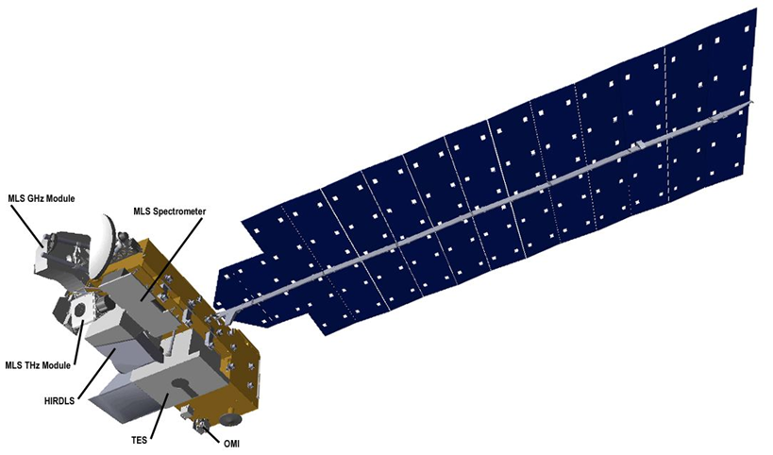
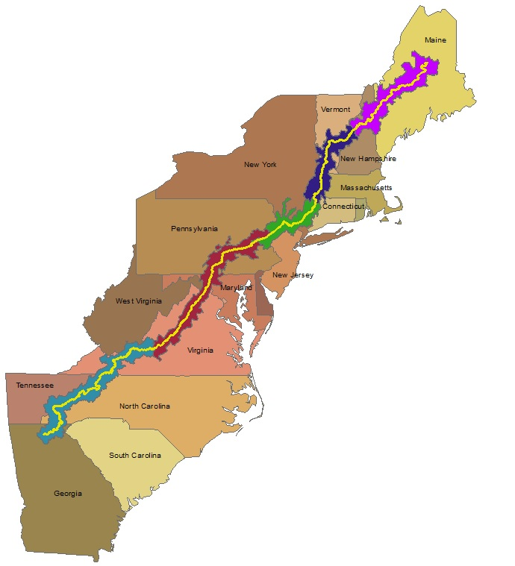
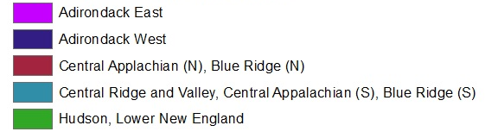
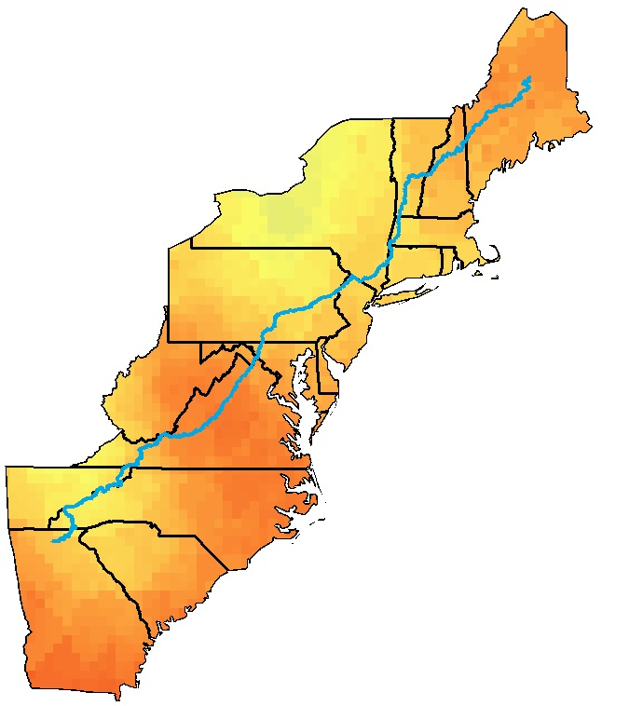
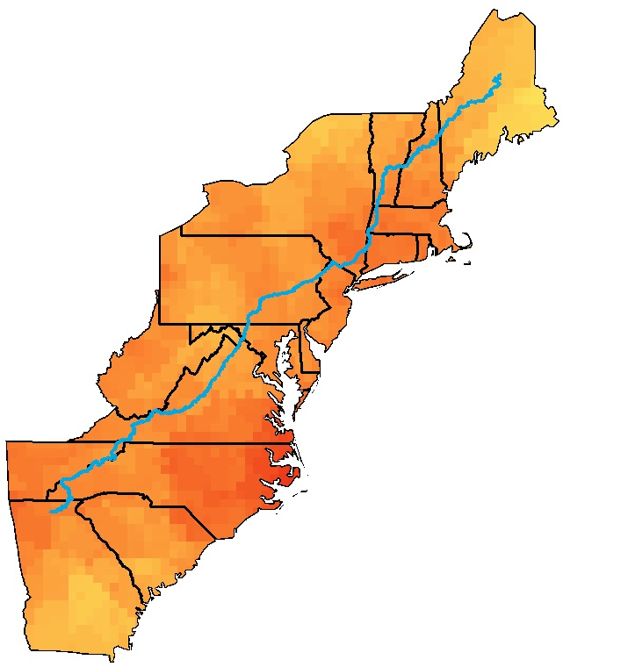
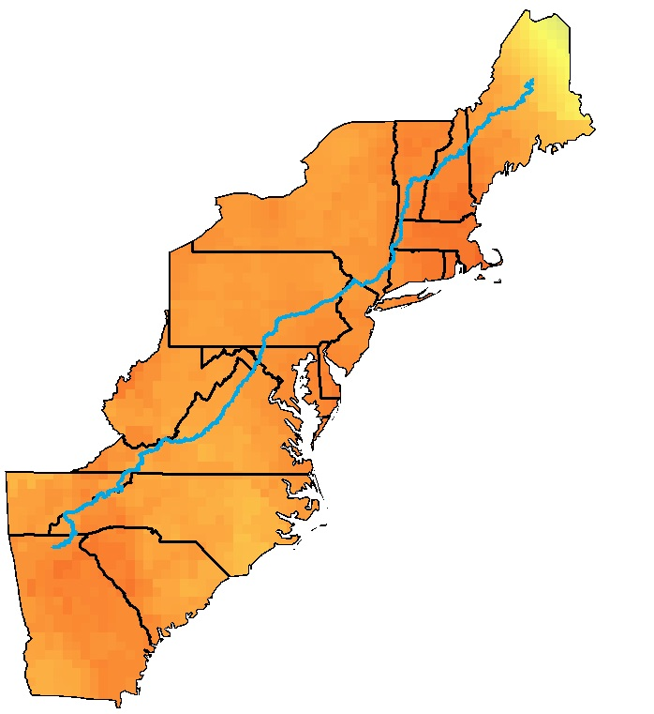
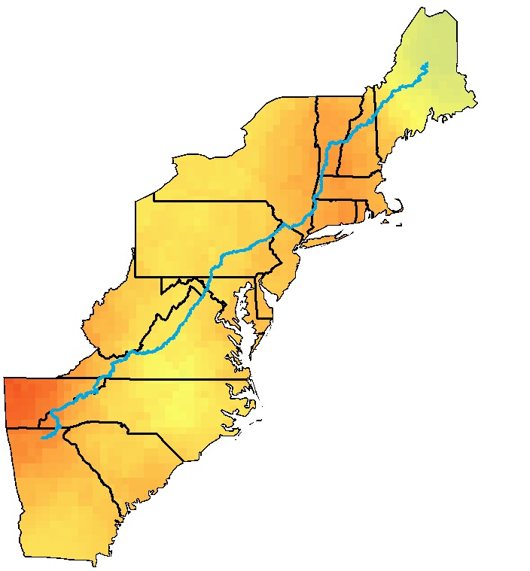
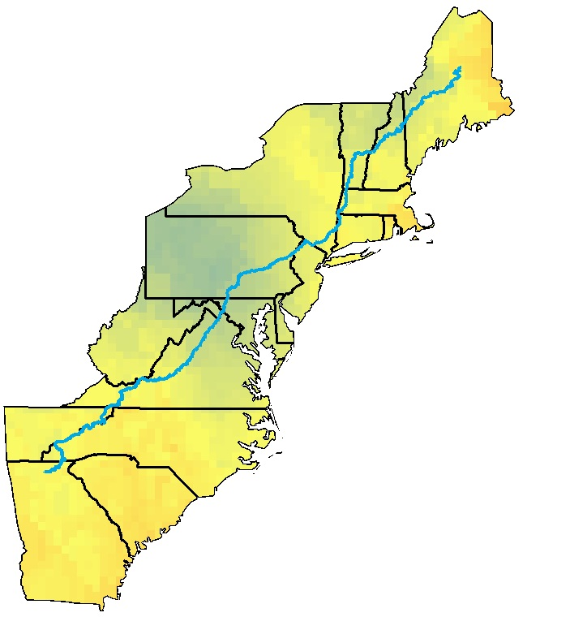
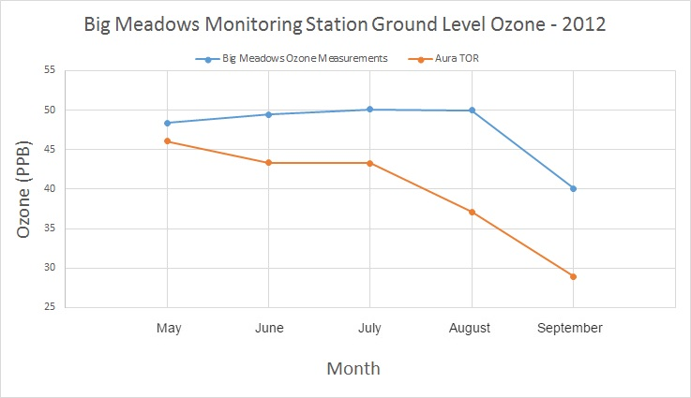
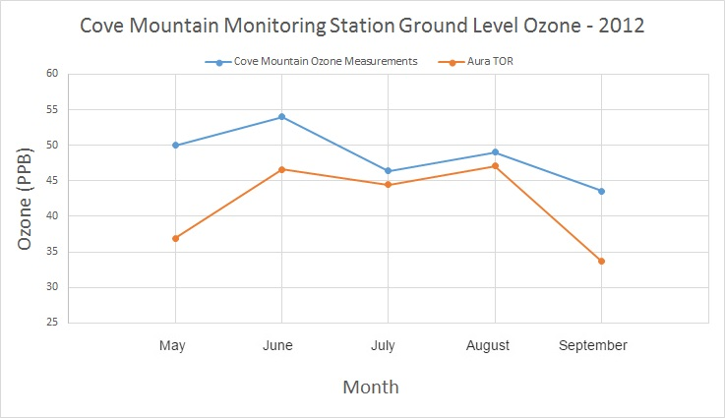
Monitoring Ozone in the Troposphere to Help Regulate Point Source Emissions and to Improve Ozone Advisory Messages by the National Park Service
Abstract
Earth Observations
Objectives
Ozone in the stratosphere serves as a boundary that absorbs harmful ultraviolet radiation from the sun. Ozone in the troposphere is hazardous to both human and plant health. Anthropogenic activities, such as fossil fuel combustion, are the main catalysts for high levels of tropospheric ozone, nitrogen oxides, and sulfur oxides. The warmer months, from May to September, typically display higher levels of tropospheric ozone located near urban areas with large populations. Tropospheric ozone forms from nitrogen oxides and volatile organic compounds (VOCs) reacting with sunlight, and fluctuates throughout the day displaying its peak concentration during mid-to-late afternoon. Lower concentrations occur during the early morning when the planetary boundary layer (PBL) is lowest and ozone molecules have not formed from the nitrogen oxide and VOCs reacting. NASA Earth observations can be used to monitor these atmospheric constituents. This project used Aura’s Ozone Monitoring Instrument (OMI) and Microwave Limb Sounder (MLS) to look at tropospheric ozone, nitrogen dioxide, and sulfur dioxide. The analysis and mapping of these atmospheric constituents provided data to compare to the National Park Service’s ground-level air quality stations. This project determined whether OMI and MLS are effective sensors for observing air pollutants in the troposphere and create visual aids of correlations and general trends.
Introduce applications of NASA Earth observations to the National Park Service to supplement current monitoring method
Assess the effectiveness of using the MLS / OMI sensors on board Aura to measure air pollutants
Display maps of the seasonal variation of ozone along the Appalachian Trail
Aura Satellite
Study Area
Methodology
Study Period:
2012 – 2015
May - September
Data Acquisition
Data Processing
Data Analysis
Total Column Ozone from OMI
Stratospheric Ozone from MLS
Surface Measurements from Big Meadows and Cove Mountain Stations
Diurnal data for OMI and MLS sensors downloaded
NetCDF files converted to raster files
Stratospheric Ozone data extracted from the HDF5 files and placed into CSV files for use in ArcMap
Tropospheric Ozone Residual (TOR) calculated
Points interpolated using Kriging
Zonal Statistics over AT Ecoregion/Air-shed Associations
Compared surface measurements with calculated TOR
Appalachian Trail Sections
Big Meadows Monitoring Station
Cove Mountain Monitoring Station
Results
Appalachian Trail
May
June
July
August
September
Appalachian Trail Health & Air Quality
Figure 1. Monthly averages of tropospheric ozone residual (TOR) for the year 2012.
Conclusions
Ozone monitored from Big Meadows and Cove Mountain ground stations compared with the TOR calculated from NASA Earth observations show similar trends.
The largest differences were observed for the months of May and September. The difference could be a result of random variability, scaling, or changing tropopause height.
For future studies, the TOR calculation could incorporate more variables and utilize more advanced satellites to monitor air pollutants, such as TEMPO scheduled to launch in 2019.
Study other atmospheric species such as nitrogen and sulfur oxides.
Figure 2. Comparisons of the calculated TOR with surface level monitoring stations
Team Members
Acknowledgements
Project
Partners
We would like to thank our two science advisors, Dr. Travis Knepp (SSAI)tions Incorporated at NASA Langley Research Center and Dr. Kenton Ross from the NASA DEVELOP National Program.
We would also like to thank the following individuals from the National Park Service:
Barkley Sive - Program Manager for Gaseous Pollutant Monitoring Program (Air Resources Division)
Holly Salazar - Air Resources Coordinator of Natural Resources Program (Northeast Region)
Liz Garcia - Physical Science Technician (Shenandoah National Park)
Jim Von Haden – Integrated Resources Program Manager (Appalachian National Scenic Trail)
Jalyn Cummings - Program Manager of Air and Water Quality (Shenandoah National Park)
Andrew Lee - Resource Management Specialist (Harpers Ferry National Historical Park)
Fred Dieffenbach - Environmental Monitoring Specialist (Inventory & Monitoring Program, Northeast Temperate Network)
Jim Renfro - Air Quality Specialist (Great Smoky Mountains)
National
Park
Service
Amy Wolfe
Project Lead
Amber Showers
Emily Beyer
Any opinions, findings, and conclusions or recommendations expressed in this material are those of the author(s) and do not necessarily reflect the views of the National Aeronautics and Space Administration. This material is based upon work supported by NASA through contract NNL11AA00B and cooperative agreement NNX14AB60A
Eric White
Tyler Rhodes
NASA Langley Research Center & Wise County Clerk of Court’s Office – Summer 2016

