Slide 1
Alaska Disasters
Utilizing NASA Earth Observations to Identify Oil Spills and Natural Seeps off the Northern Shore of Alaska
Will Manion (Project Lead)
Amy Ferguson
Jordan Vaa
Kristen Noviello
Katelyn Quinn
Nicole MacDonald

Slide 2
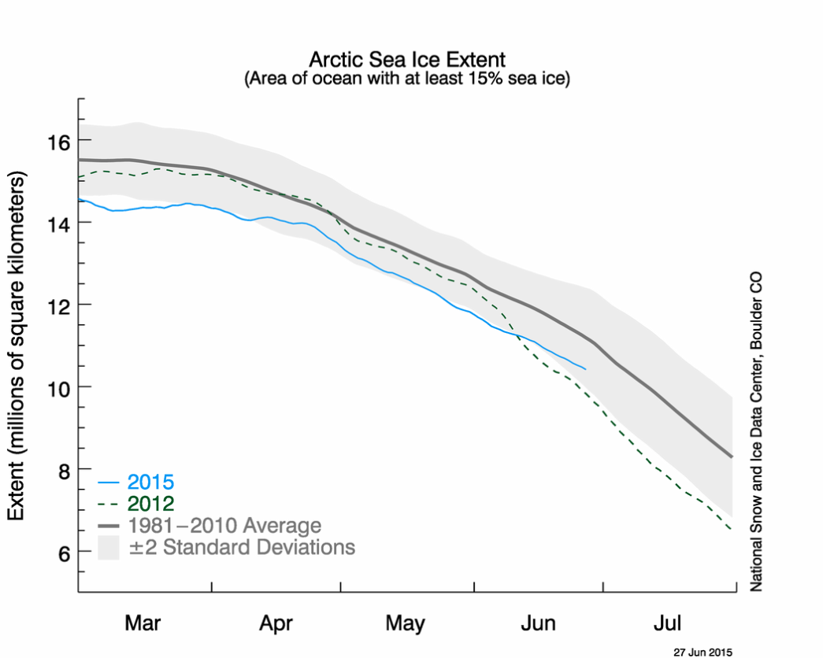
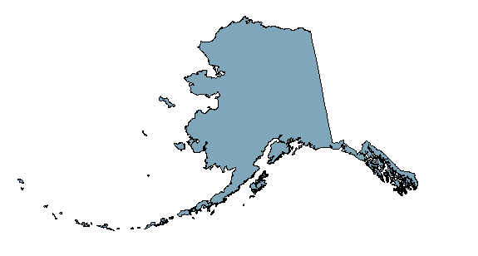
Background Information
Image Credit: NSIDC, 2015
Arctic sea ice maximum extent is the
lowest on satellite record
Notes:
http://nsidc.org/news/newsroom/arctic-sea-ice-maximum-reaches-lowest-extent-record

Slide 3
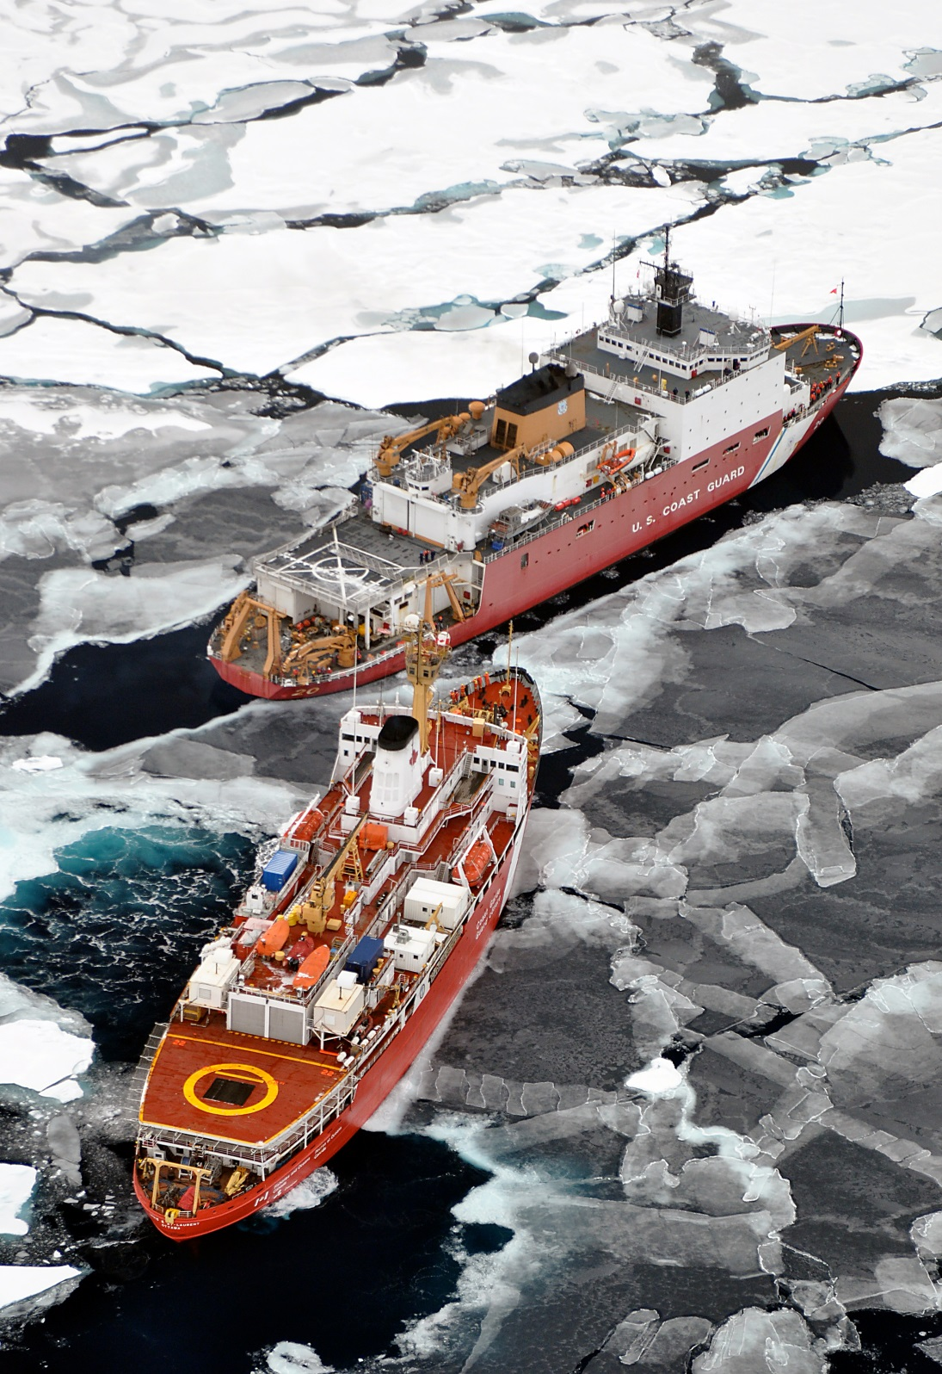
Background
Information
Oil spill risk increases
as transportation,
tourism and energy
exploration increases
Image Credit: NSIDC, 2015
Image Credit: USCG, 2009
Notes:
Creative Commons, Photo Credit: Patrick Kelley, U.S. Coast Guard, https://www.flickr.com/photos/usgeologicalsurvey/4370266187/in/album-72157623467470824/

Slide 4
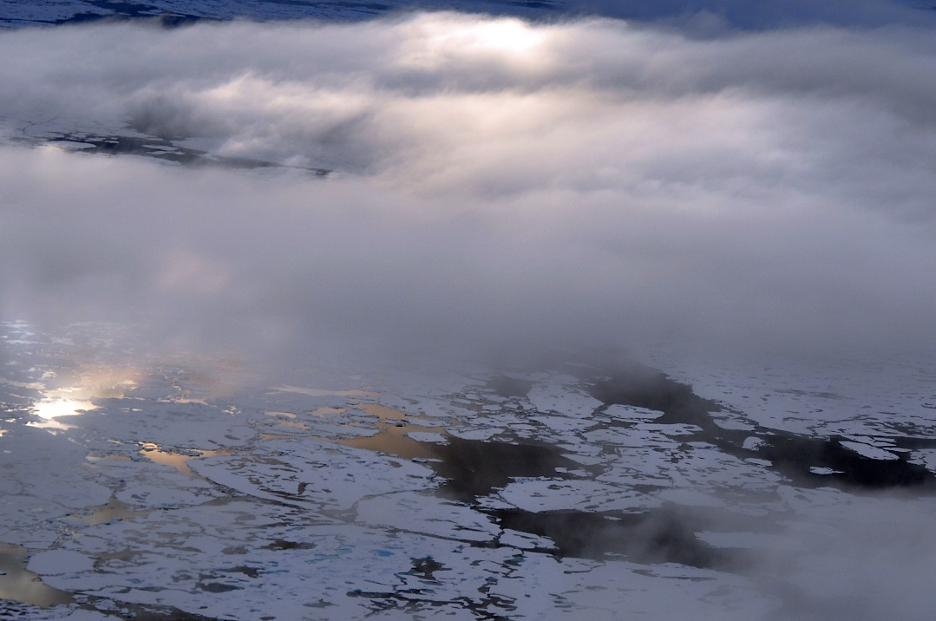
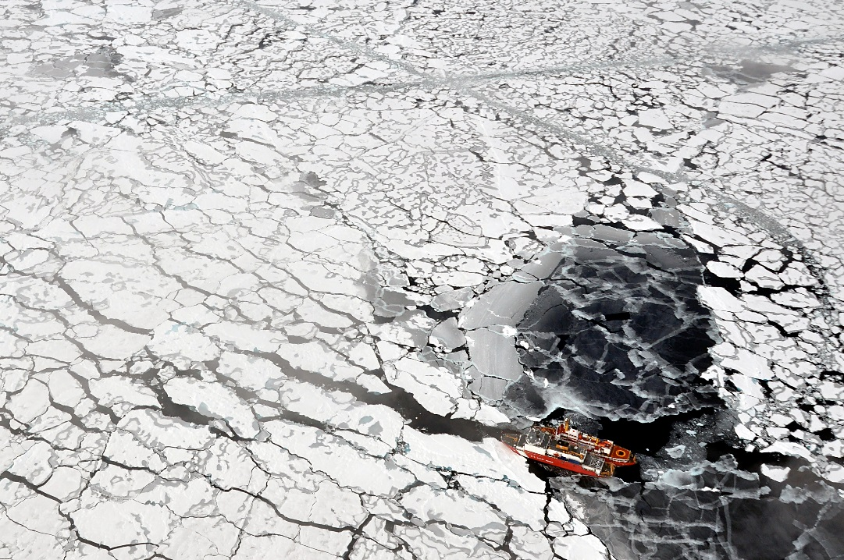
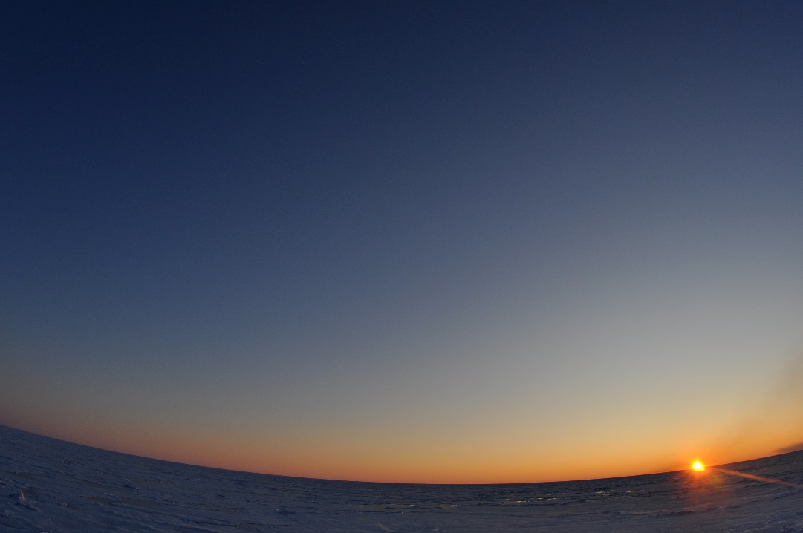
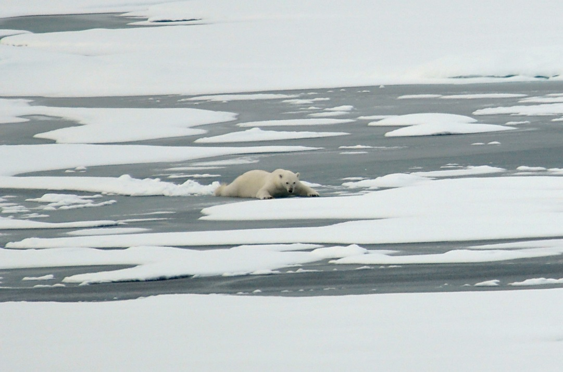
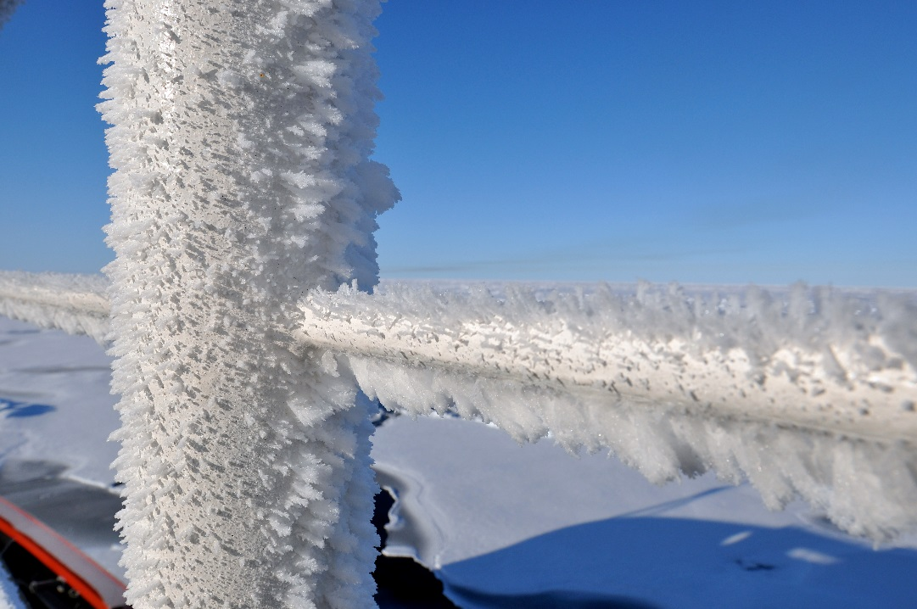
Community Concerns
Environmental impact is more severe in Arctic
Oil spill clean up is difficult in harsh Arctic environment
Oil behavior is poorly understood in freezing environments
Oil spills shut down valuable shipping channels
Image Credits: USCG, 2009
Notes:
Creative Commons, Public Domain, Photo Credit: Patrick Kelley, U.S. Coast Guard,
https://www.flickr.com/photos/usgeologicalsurvey/4370266339/in/album-72157623467470824/
https://www.flickr.com/photos/usgeologicalsurvey/4370264559/in/album-72157623467470824/
https://www.flickr.com/photos/usgeologicalsurvey/4371011748/in/album-72157623467470824/
https://www.flickr.com/photos/usgeologicalsurvey/4371011032/in/album-72157623467470824/
https://www.flickr.com/photos/usgeologicalsurvey/4370262379/in/album-72157623467470824/

Slide 5
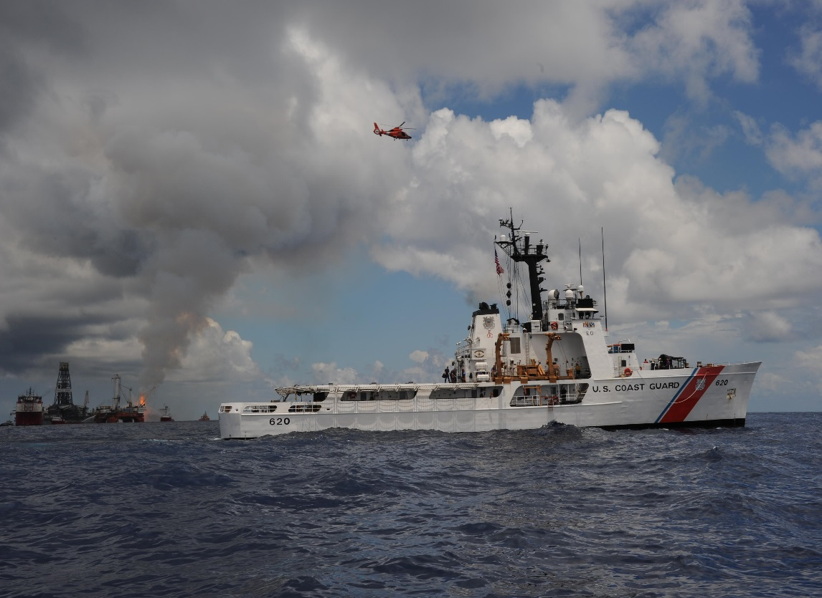
Project Partner
The United States Coast Guard is the lead agency for oil spill response in US coastal waters
Image Credit: USCG, 2010
Notes:
Creative Commons, U.S. Coast Guard photo by Petty Officer 1st Class Matthew Belson: https://www.flickr.com/photos/deepwaterhorizonresponse/4761356357/in/photolist-8fKcmZ-4yHSa2-p9pHKY-7X8Vjm-7Xjc7n-nCt5Lv-89mZXd-mpzivv-8w7yf8-uiFpB-r4sDBV-7WKZ5c-8oYDza-8p2Prd-87qSui-8bpe5b-8b1giF-8hwyTM-oRWkyF-nqYgBo-9CMP7A-8cXCAC-837X5D-4nxvGE-q78jK7-7KWbHw-s2J49o-8GiZN8-8GiZGv-6at2Tn-8vDqxr-7ZAW7N-9CJSeT-a4fVye-8tKcMh-82jBH1-8v95Ah-83VbB2-7ZVsXY-oX9Jzp-kam7jw-83uu44-mnJmKF-43xt2N-9d7wjz-rLMVK9-bMonWB-89JJea-8dj1VA-8zo4cR

Slide 6
Objectives
Identify
Identify natural oil seeps across coastal Alaska
Create a tool to facilitate fast visualization of an oil spill incident
Inject spatial dataset into Arctic Emergency Response Management Application
Create
Inject

Slide 7
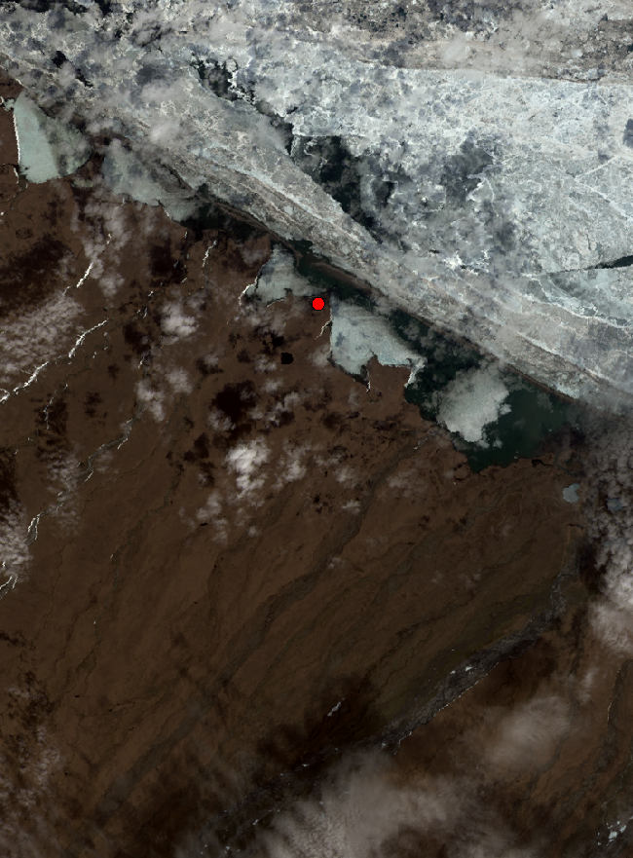
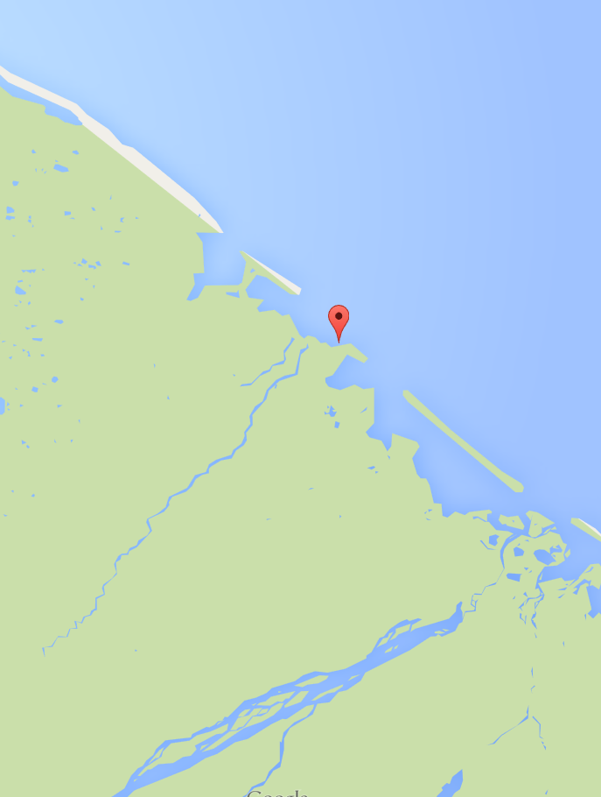
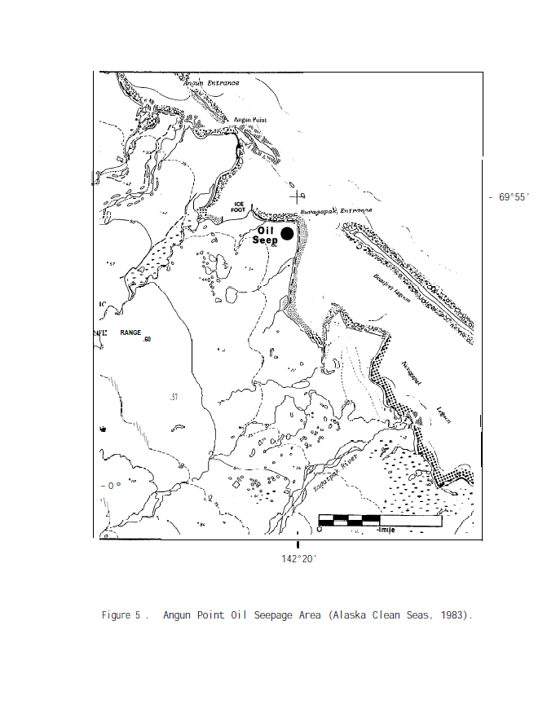
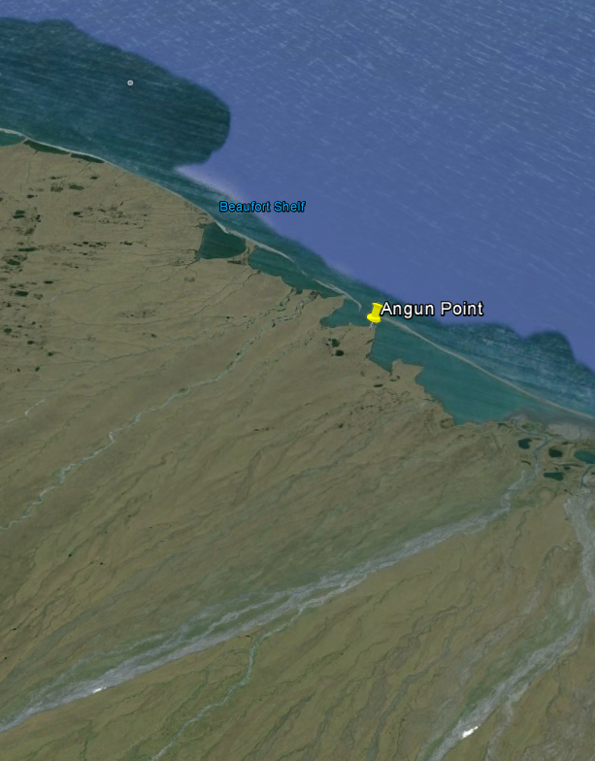
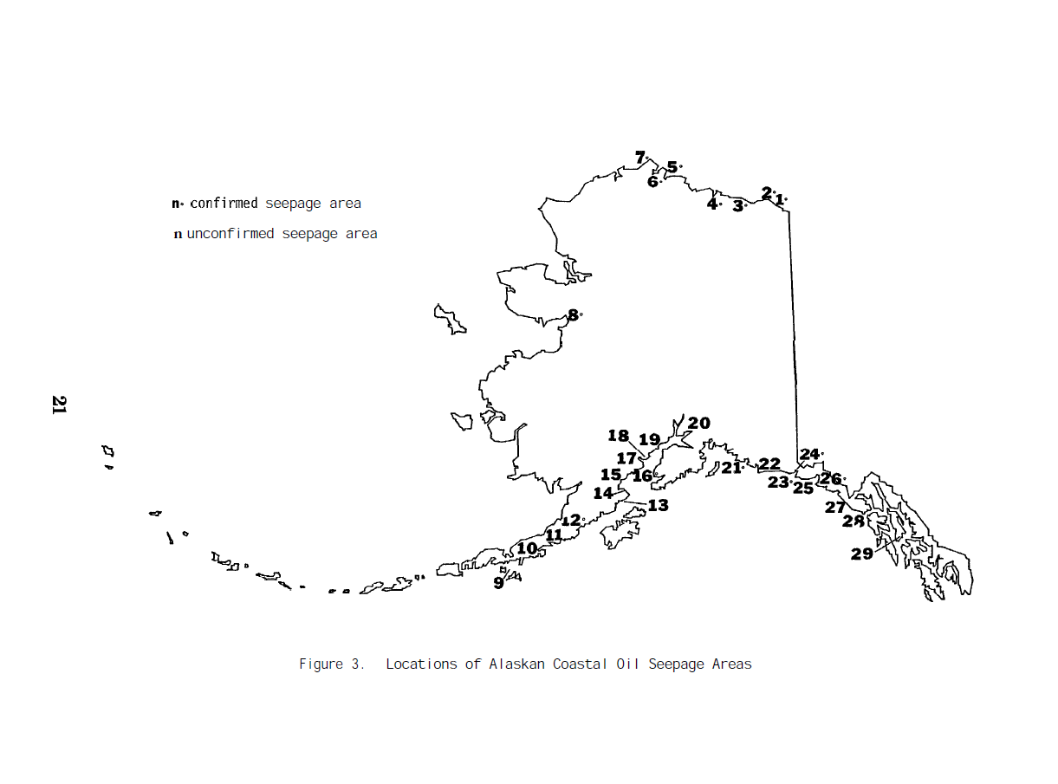
Methodology
Natural Oil Seeps
1
Google Maps
3
Google Earth
Landsat 8
4
2
Becker and Manen (1988)
5
ArcGIS
Notes:
*Trying to decide whether to animate a single slide or break it out into multiple*

Slide 8
Methodology
Natural Oil Seeps

Slide 9
Methodology
Natural Oil Seeps
1
Google Maps
3
Google Earth
Landsat 8
4
2
Becker and Manen (1988)
5
ArcGIS

Slide 10
Methodology
Natural Oil Seeps
1
Google Maps
3
Google Earth
Landsat 8
4
2
Becker and Manen (1988)
5
ArcGIS

Slide 11
Methodology
Natural Oil Seeps
1
Google Maps
3
Google Earth
Landsat 8
4
2
Becker and Manen (1988)
5
ArcGIS

Slide 12
Methodology
Natural Oil Seeps
1
Google Maps
3
Google Earth
Landsat 8 OLI/TIRS
4
2
Becker and Manen (1988)
5
ArcGIS

Slide 13
Methodology
Natural Oil Seeps
1
Google Maps
3
Google Earth
Landsat 8
4
2
Becker and Manen (1988)
5
ArcGIS

Slide 14

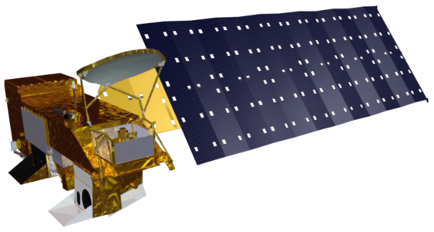

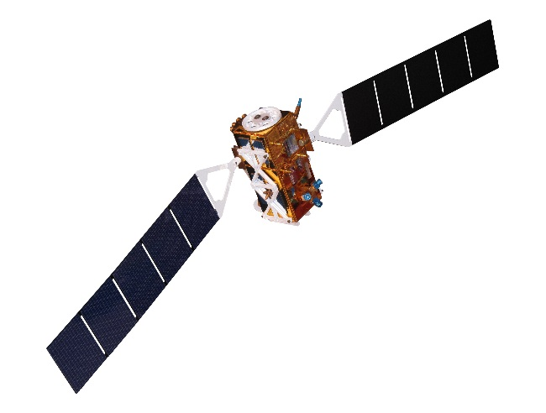

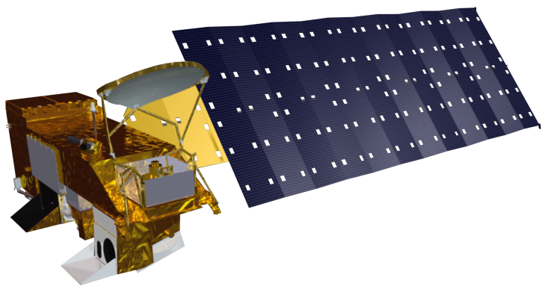

Earth Observing Systems
Remote sensing in the Arctic requires a combination of sensors to overcome individual limitations
All-weather
High Spatial Resolution
High Temporal Resolution
Aqua MODIS
Terra MODIS
Sentinel-1
Landsat 8

Slide 15
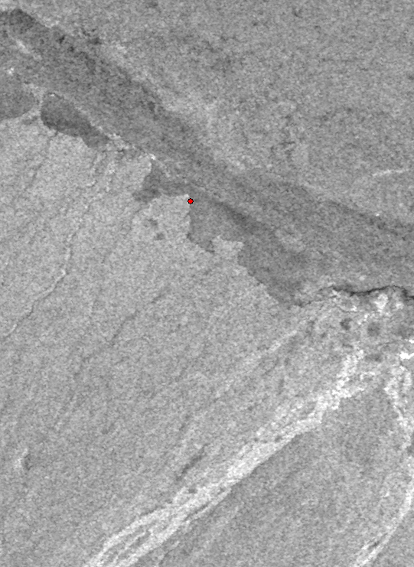
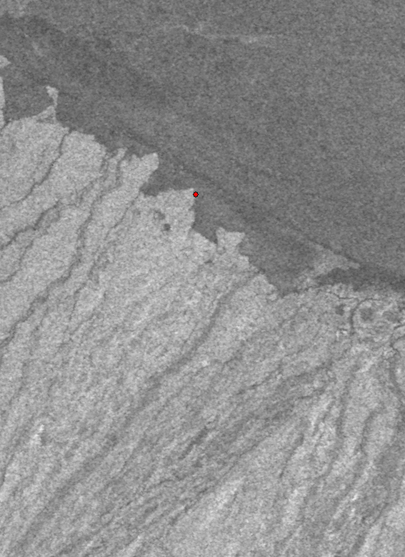
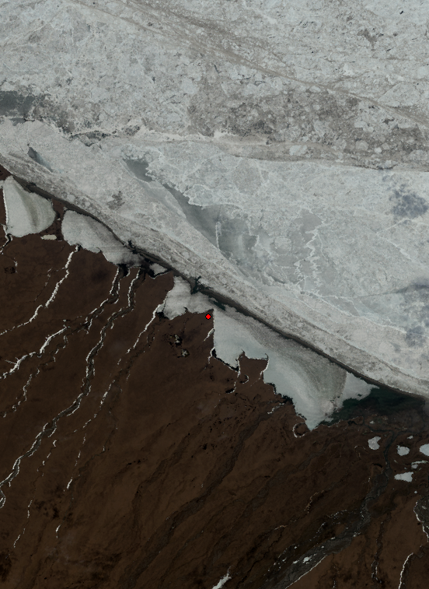
Methodology
Imagery Retrieval Tool
Sentinel-1
s1a-ew-grd-hh-20150523t163403-20150523t163503-006051-007d22-001
Sentinel-1
s1a-ew-grd-hv-20150523t163403-20150523t163503-006051-007d22-002
Data Repositories
Sentinel-1 Scientific Data Hub
USGS EarthExplorer
Software
Python 2.7
Product
Graphical User Interface
Landsat 8 OLI/TIRS
LC80690112015159LGN00
GUI Screen Shot Here
Terra MODIS
###################
Aqua MODIS
##########################
Image Credit: AmericanPolar.org
Notes:
*Need to animate*

Slide 16
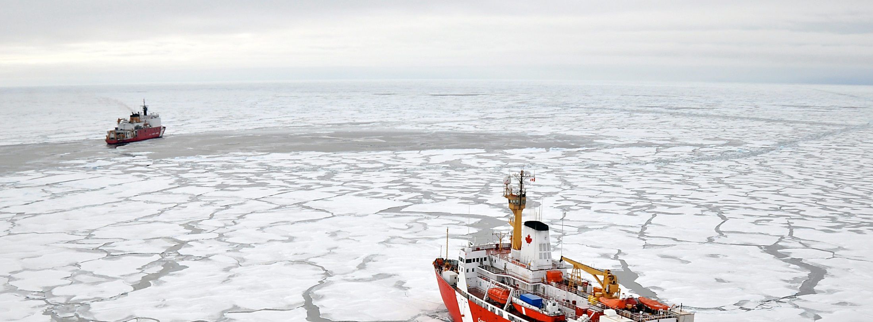
Results
Robust complement of geographic and spectral data for USCG strategic oil response planning
Rapid visualization capability for improved strategic, operational and tactical coordination efforts
Image Credit: USCG, 2009
Notes:
Creative Commons, Photo Credit: Patrick Kelley, U.S. Coast Guard: https://www.flickr.com/photos/usgeologicalsurvey/4371016246/in/album-72157623467470824/

Slide 17
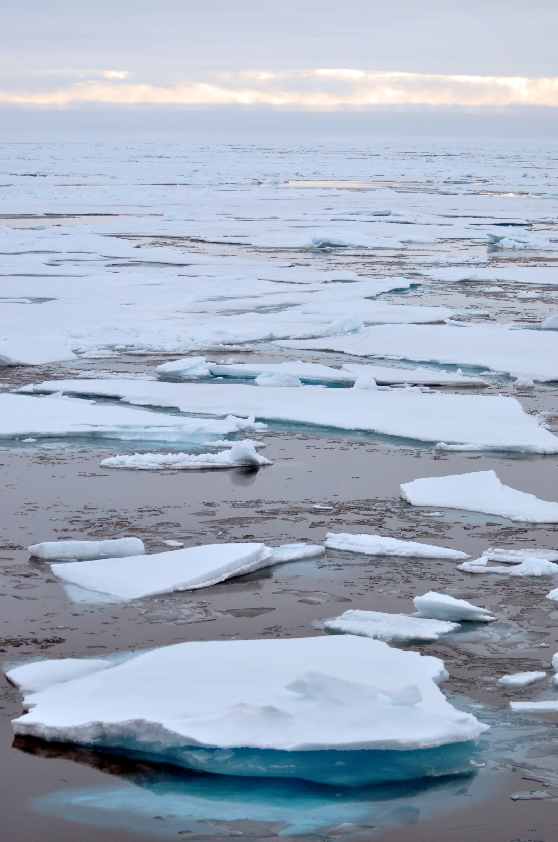
Future Work
Incorporate
optical and radar parameters
into GUI code to better refine oil detection methodology
Image Credit: USCG, 2009
Image Credit: AmericanPolar.org
Notes:
Creative Commons, Photo Credit: Patrick Kelley, U.S. Coast Guard: https://www.flickr.com/photos/usgeologicalsurvey/4370261777/in/album-72157623467470824/

Slide 18
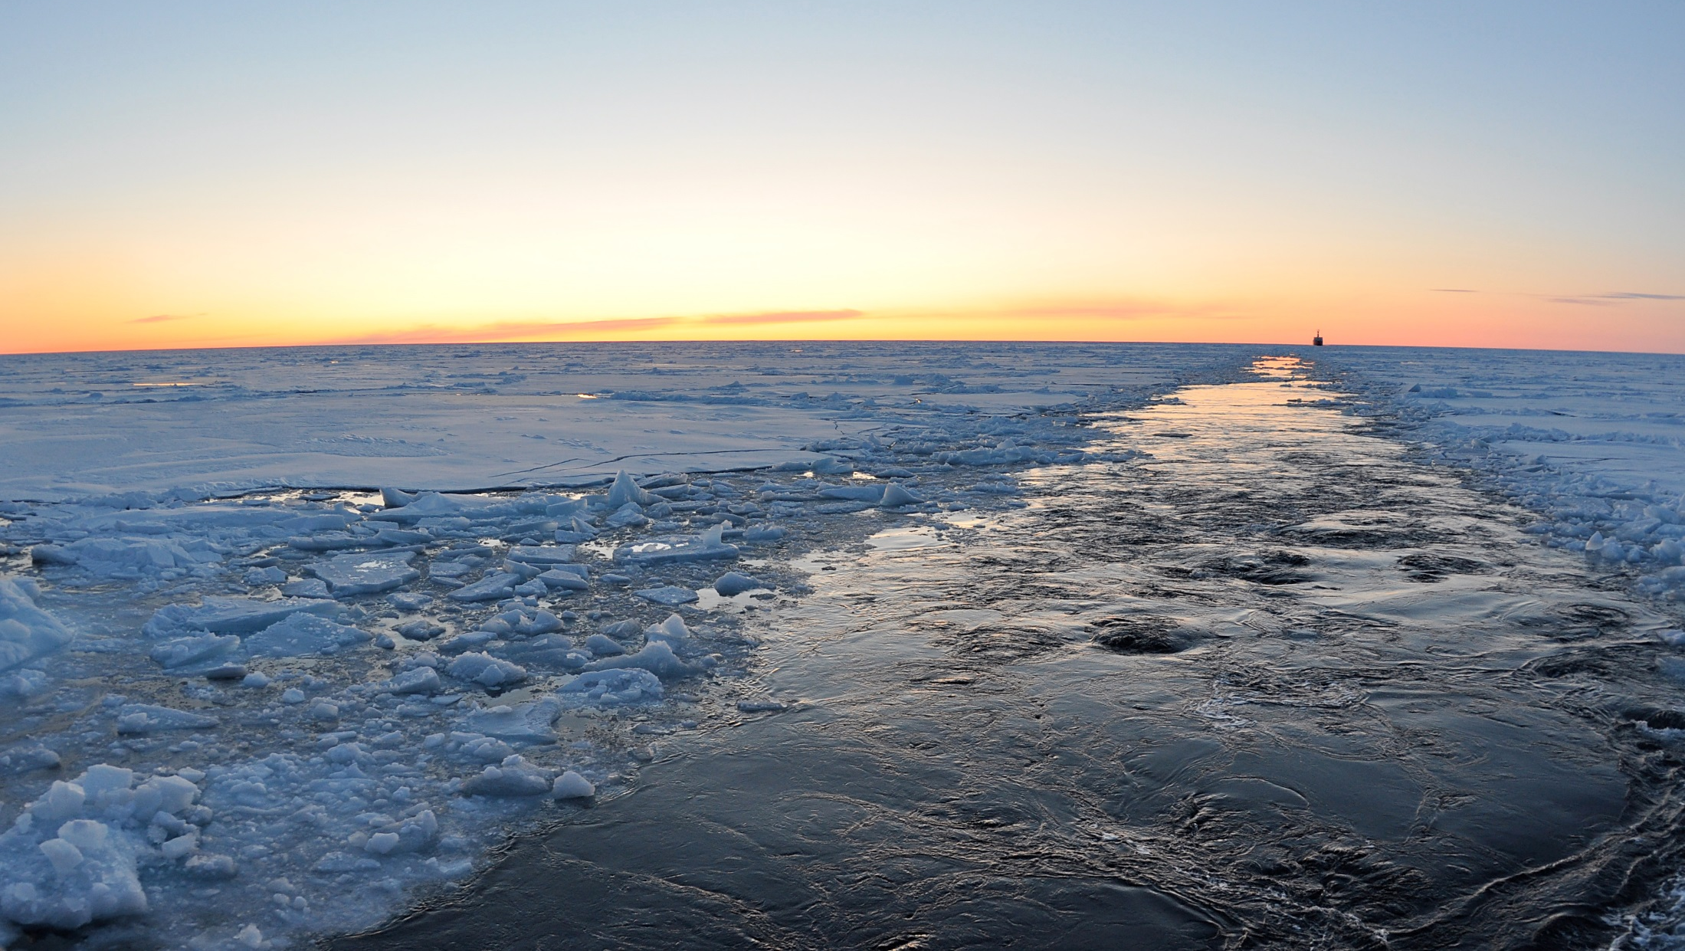
Acknowledgements
Advisors
Dr. Kenton Ross, NASA DEVELOP National Program
MST1 Justin Hoffer, United States Coast Guard
Dr. Amy Merten, NOAA Spatial Data Branch
Jeff Ely, NASA DEVELOP National Program
Partners
Others
Image Credit: USCG, 2009
Notes:
Creative Commons, Public Domain, Photo Credit: Patrick Kelley, U.S. Coast Guard
https://www.flickr.com/photos/usgeologicalsurvey/4371016084/in/album-72157623467470824/

