Slide 1
Coastal Texas Water Resources II
Using NASA Earth Observations to Assess the Health of the Laguna Madre through Land Cover Mapping and Thermal Analysis
Elaina Gonsoroski (Project Lead)
Vishal Arya
Jennifer Boyd
Notes:
We will add a script including sources for all of these images for the final draft

Slide 2
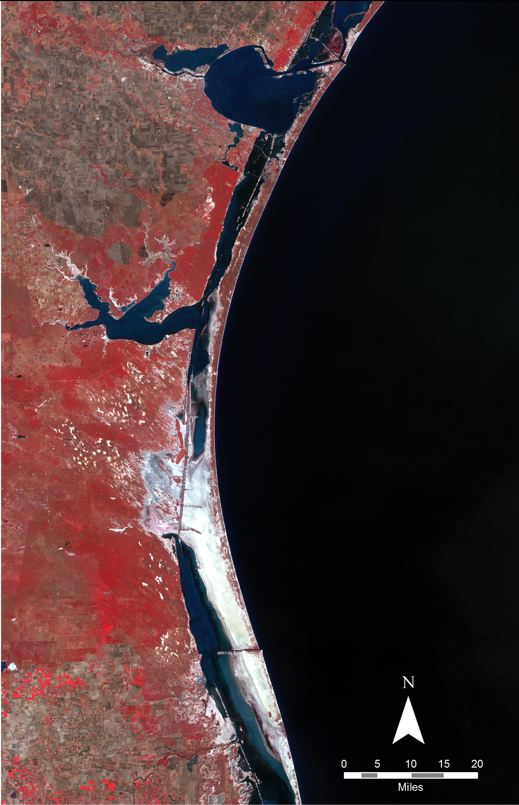
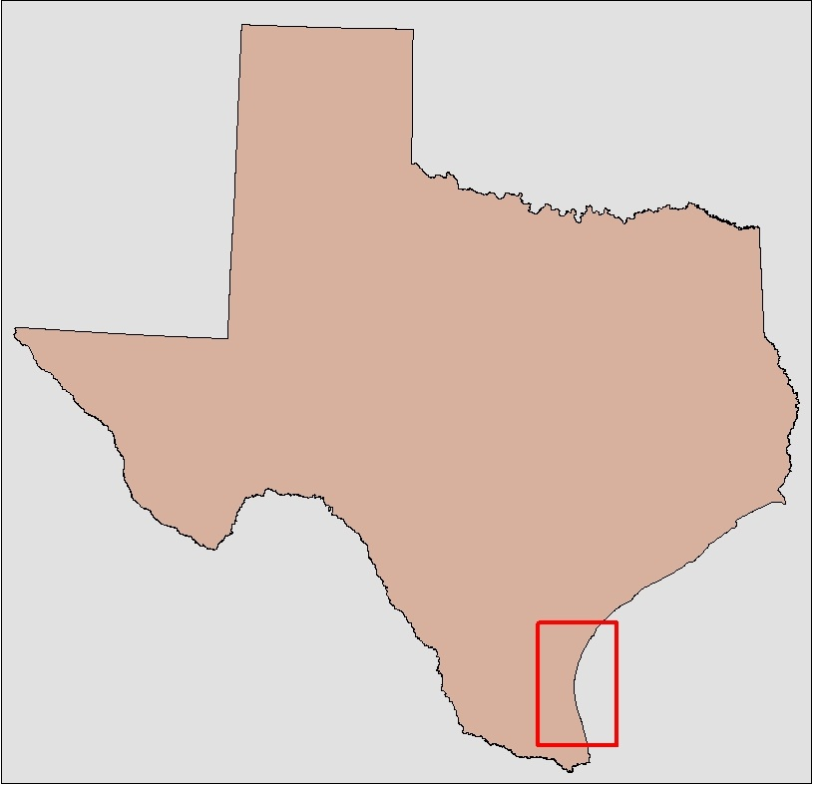
The Laguna Madre
Hypersaline estuary within Padre Island National Seashore
Habitat for numerous protected species
Study period: 1984-2000

Slide 3
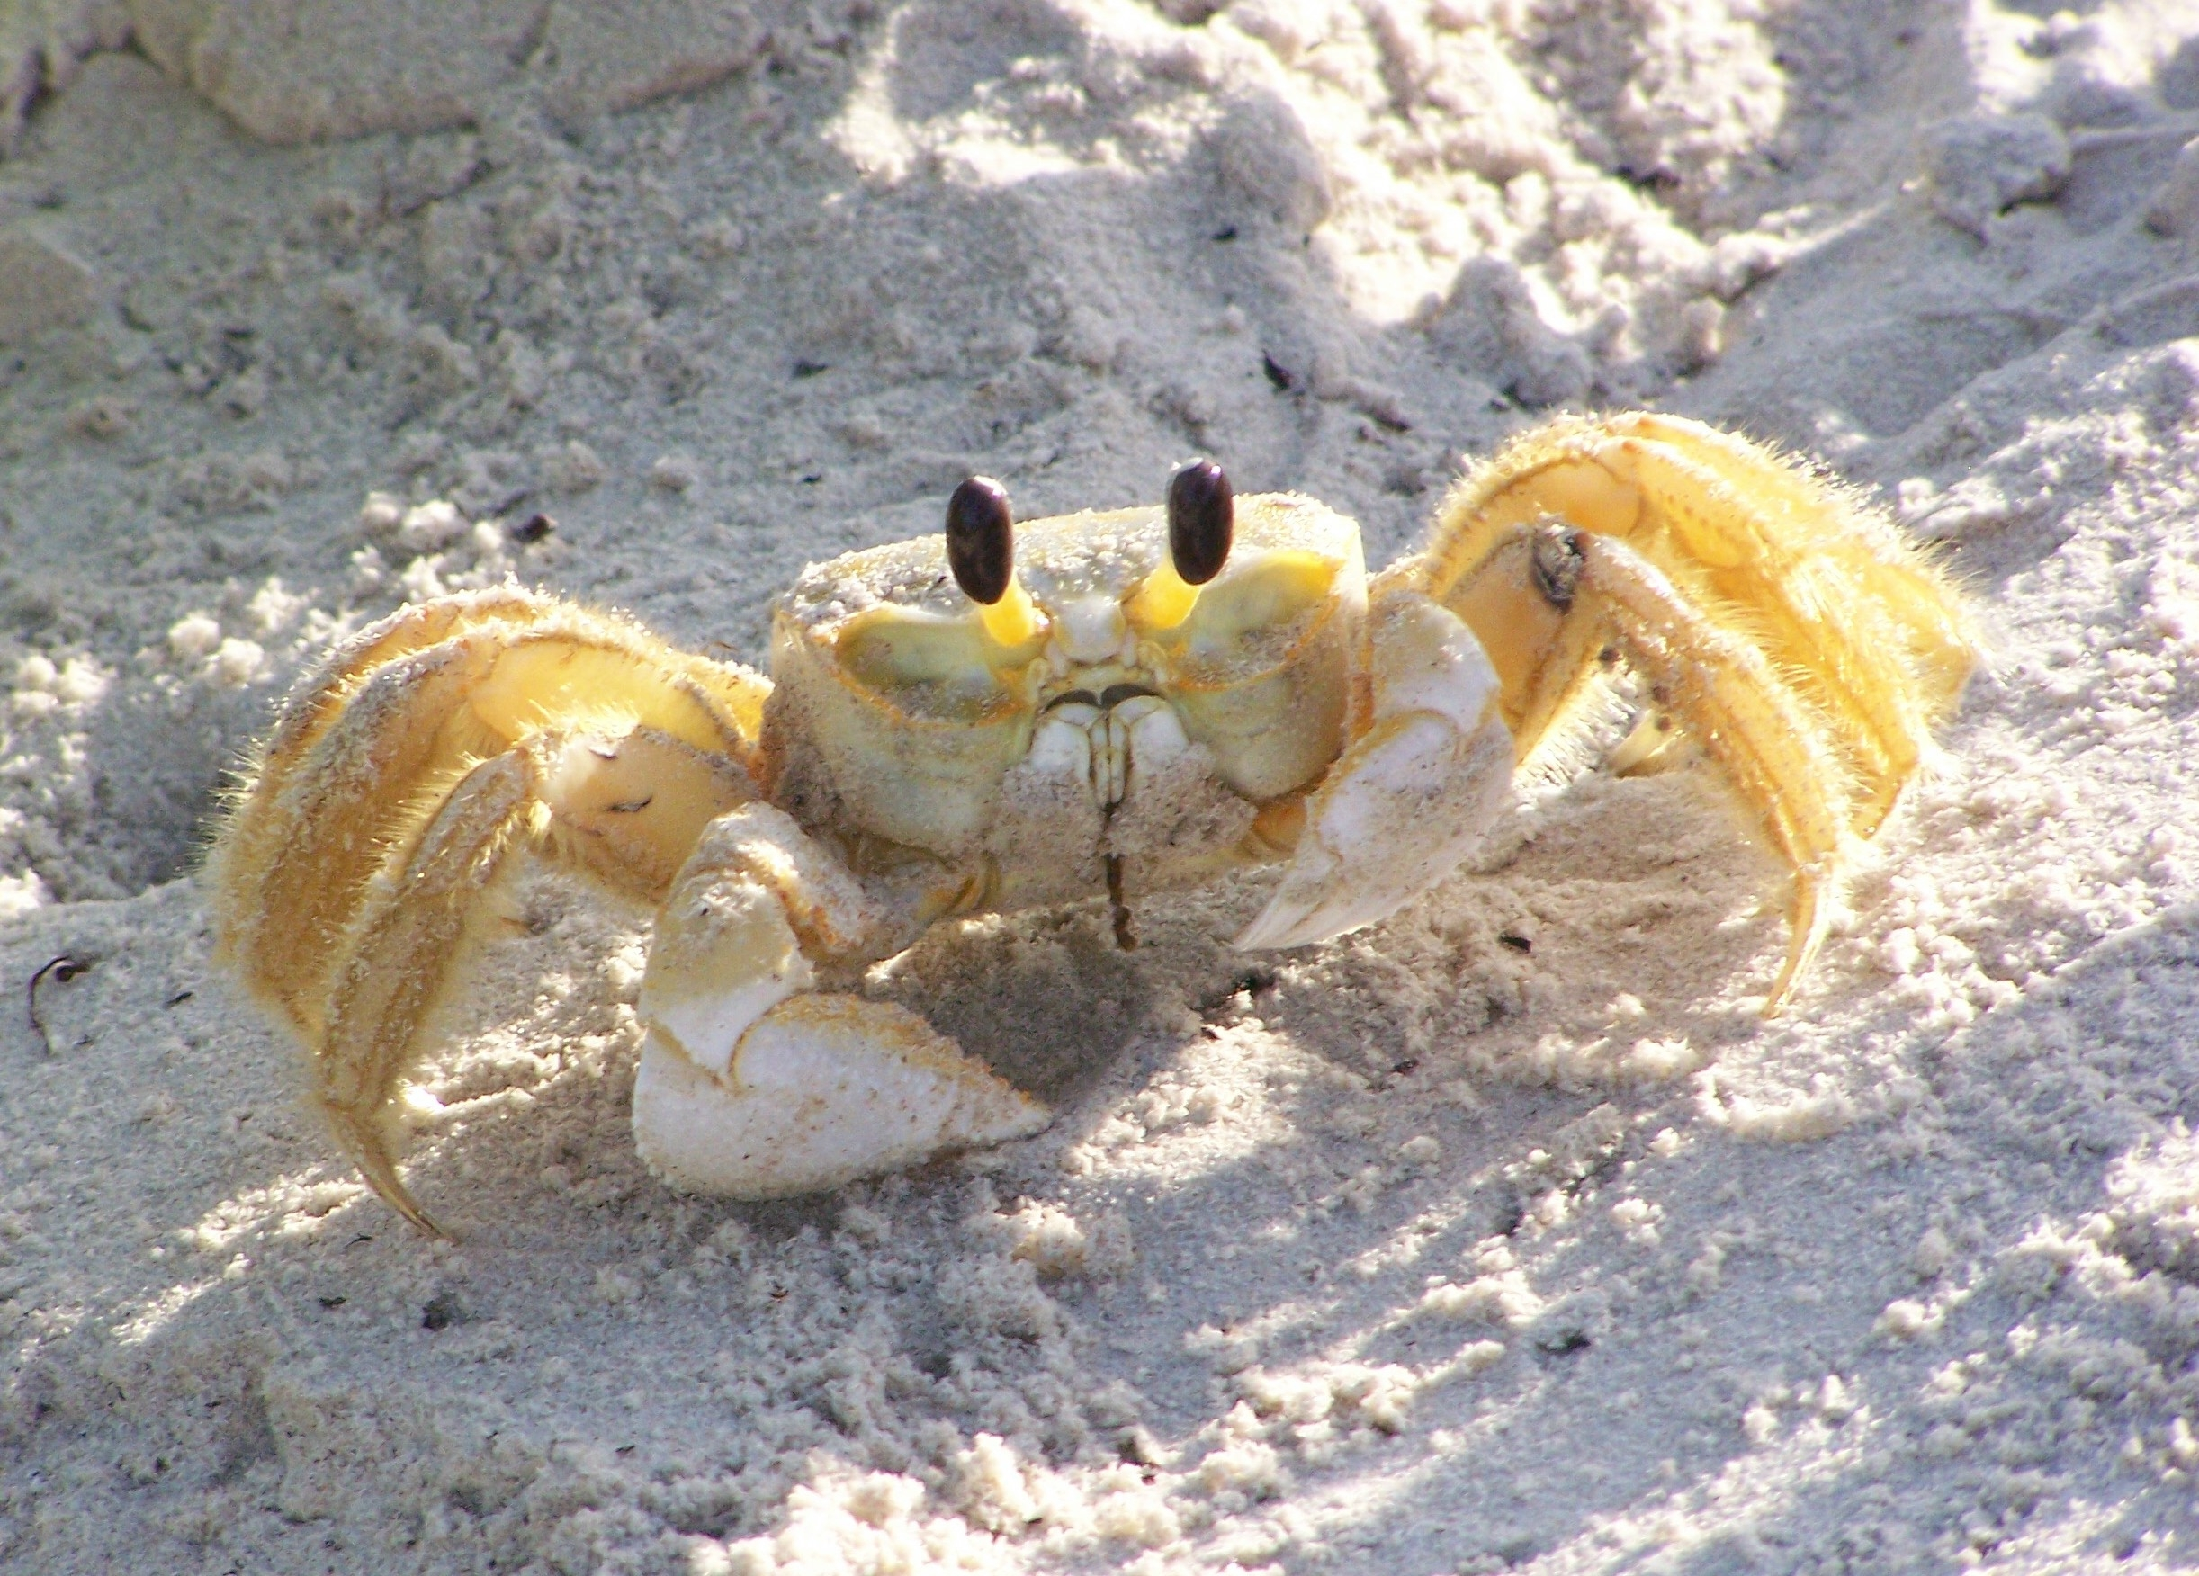
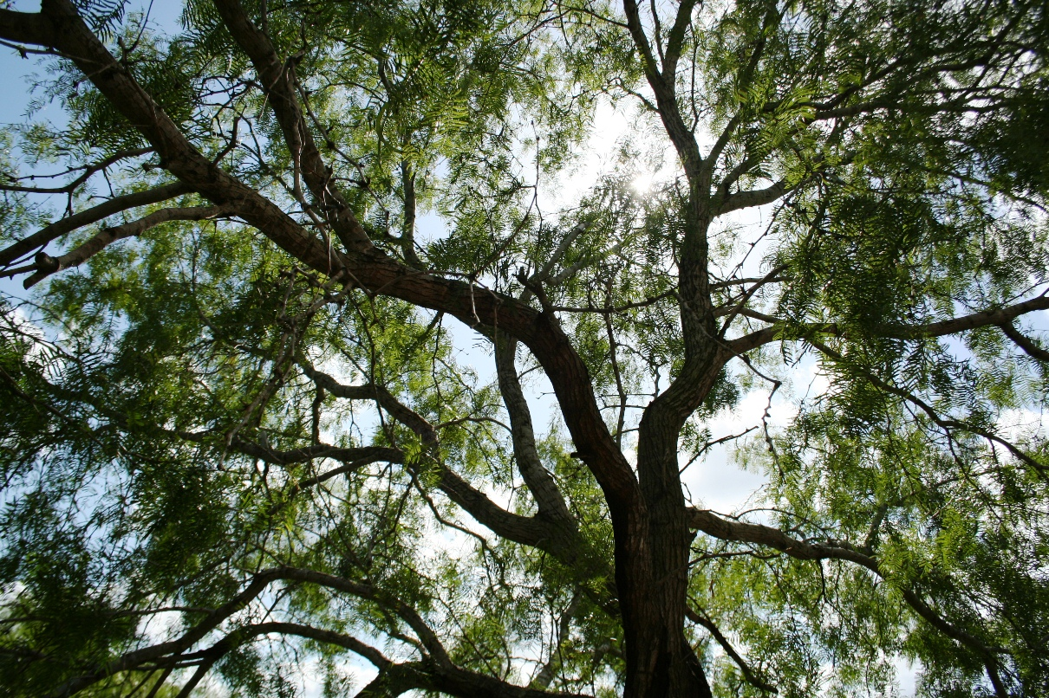
Community Concerns
Increasing salinity of Laguna Madre
Surrounding lands privately owned
Proliferation in spatial extent of honey mesquite tree
Ghost Crab (Image Credit: National Park Service)
Honey Mesquite Tree( Image credit: National Park Service)

Slide 4
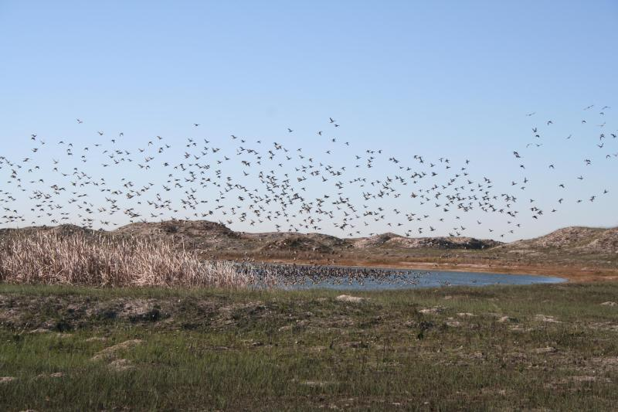
Objectives
Investigate relationship between Laguna Madre and honey mesquite trees
Identify areas of fresh groundwater inflow to the lagoon
Forecast future expansion of mesquite trees
Develop a systematic method to study relationships
Automate process
Redhead ducks over Padre Island (Image credit: National Park Service)
Notes:
These notes should be thorough enough for someone not familiar with the project to clearly present the material.
Image Source: http://commons.wikimedia.org/wiki/File:Claude_Monet_-_The_Magpie_-_Google_Art_Project.jpg

Slide 5
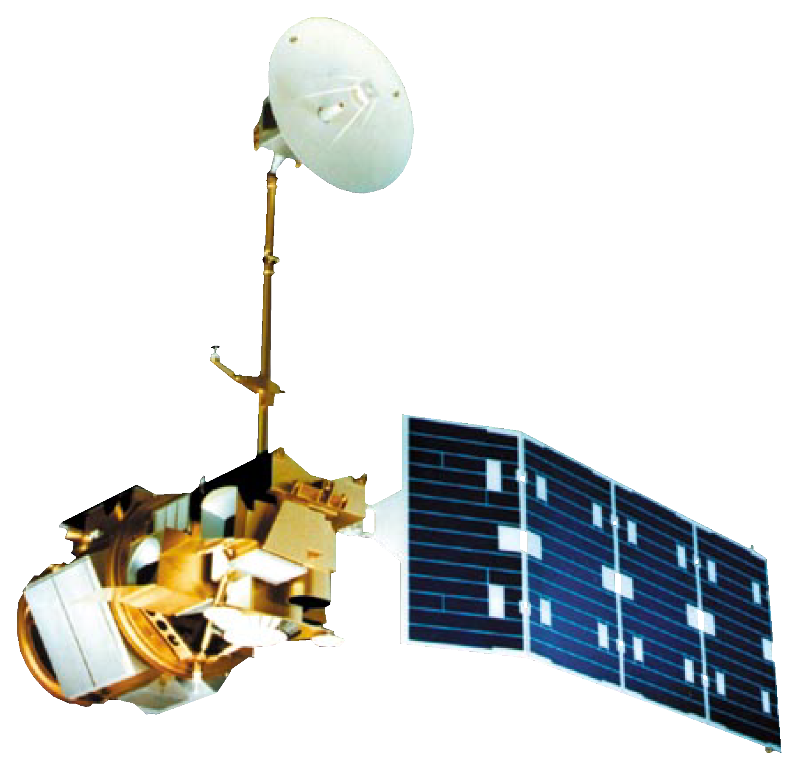
NASA Earth Observations Data
Landsat 5 (TM)

Slide 6



Precipitation Data
Ancillary Datasets
Models
PRISM Climate Group
In situ precipitation Data

Slide 7
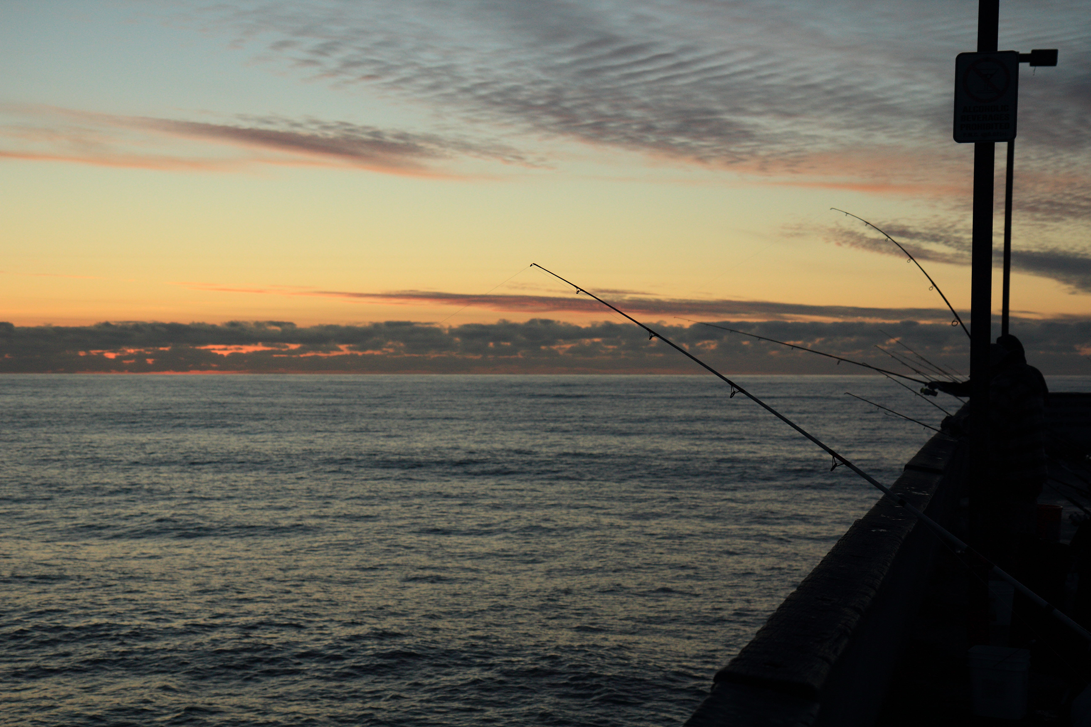
Methodology
Image Credit: John Loo

Slide 8

Methodology Workflow
Acquire Landsat and Precipitation Data
Thermal Analysis
Land Use/Land Cover

Slide 9
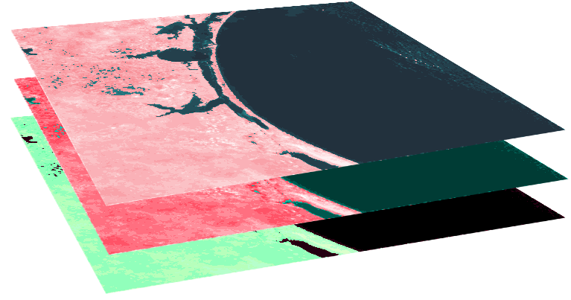
Land Use/ Land Cover (LULC)
Acquire Landsat Data
Landsat 5 Bands 2,3,4
Accuracy Assessment
Converted to TOA reflectance, and stacked for infrared visualization
Unsupervised and Supervised classifications

Slide 10


Normalized Difference Vegetation Index (NDVI)
The NDVI indicates the photosynthetic activity of vegetation
Landsat 5 Bands 3 and 4
Band | Wavelength
Band 3 - Red | 0.63 µm – 0.69 µm
Band 4 – Near Infrared (NIR) | 0.77 µm – 0.90 µm
$$NDVI= \frac{NIR −Red}{NIR+Red}$$

Slide 11
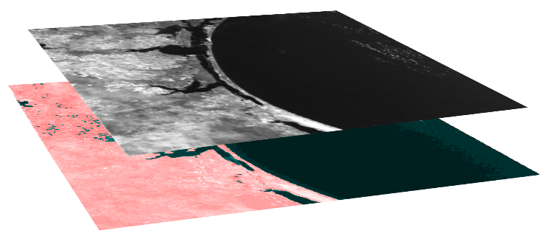

Normalized Difference Infrared Index (NDII)
The NDII indicates the water content in vegetation
Landsat 5 Bands 4 and 7
Band | Wavelength
Band 4 – Near Infrared (NIR) | 0.77 µm – 0.90 µm
Band 7 – Short Wave Infrared (SWIR) | 2.08 µm – 2.35 µm
$$NDII= \frac{NIR −SWIR}{NIR+SWIR}$$

Slide 12
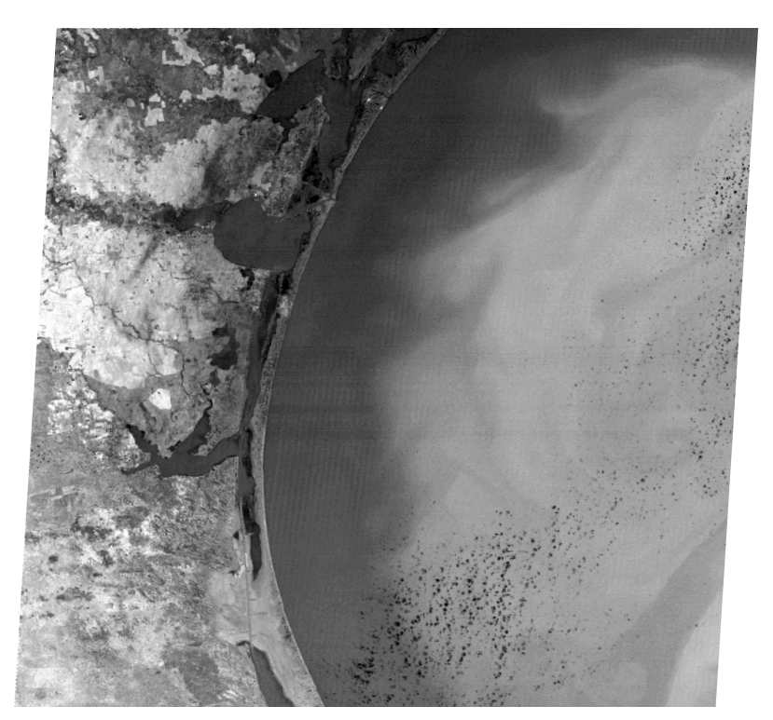
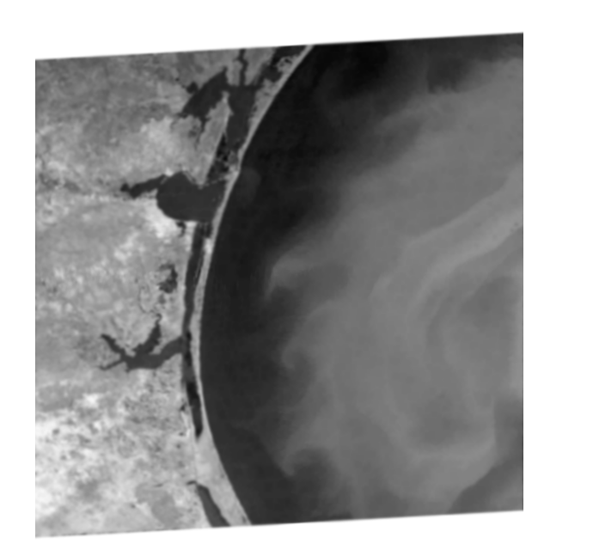
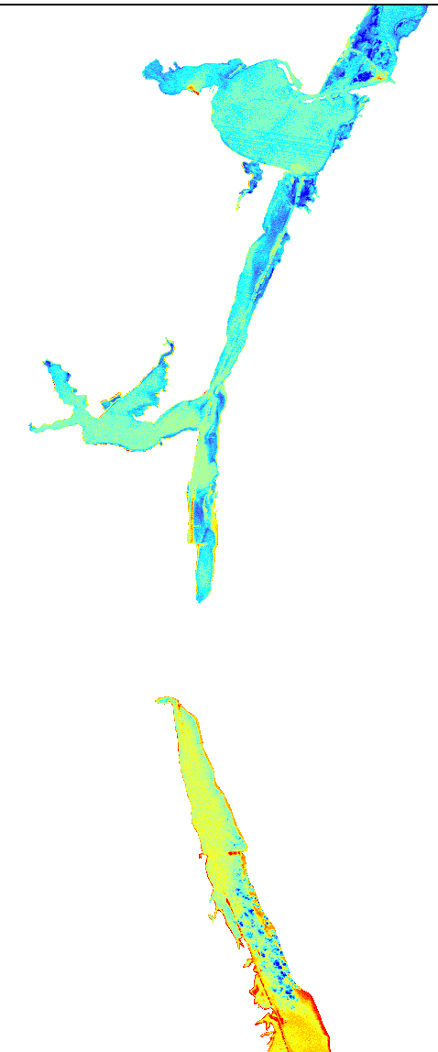
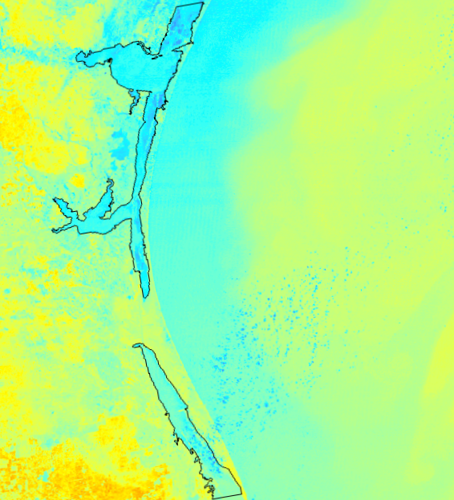
Thermal Analysis
Convert DN to TOA Radiance
Landsat 5 Band 6
Extract the Laguna Madre and convert temperature to Celsius
Mask out clouds and land

Slide 13
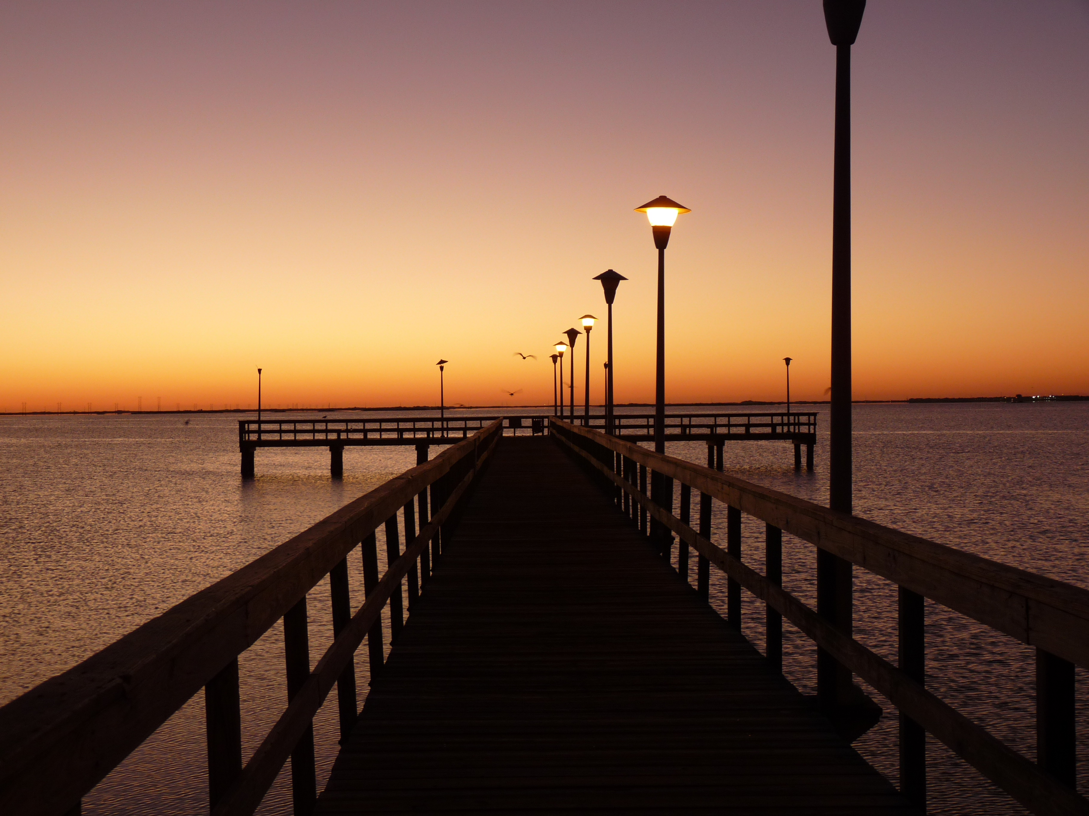
Results
Photo Credit: Terry Ross

Slide 14
LULC
TBD

Slide 15
NDVI
TBD

Slide 16
NDII
TBD

Slide 17
Thermal Analysis
TBD

Slide 18
Conclusions, Errors, and Uncertainties
TBD

Slide 19
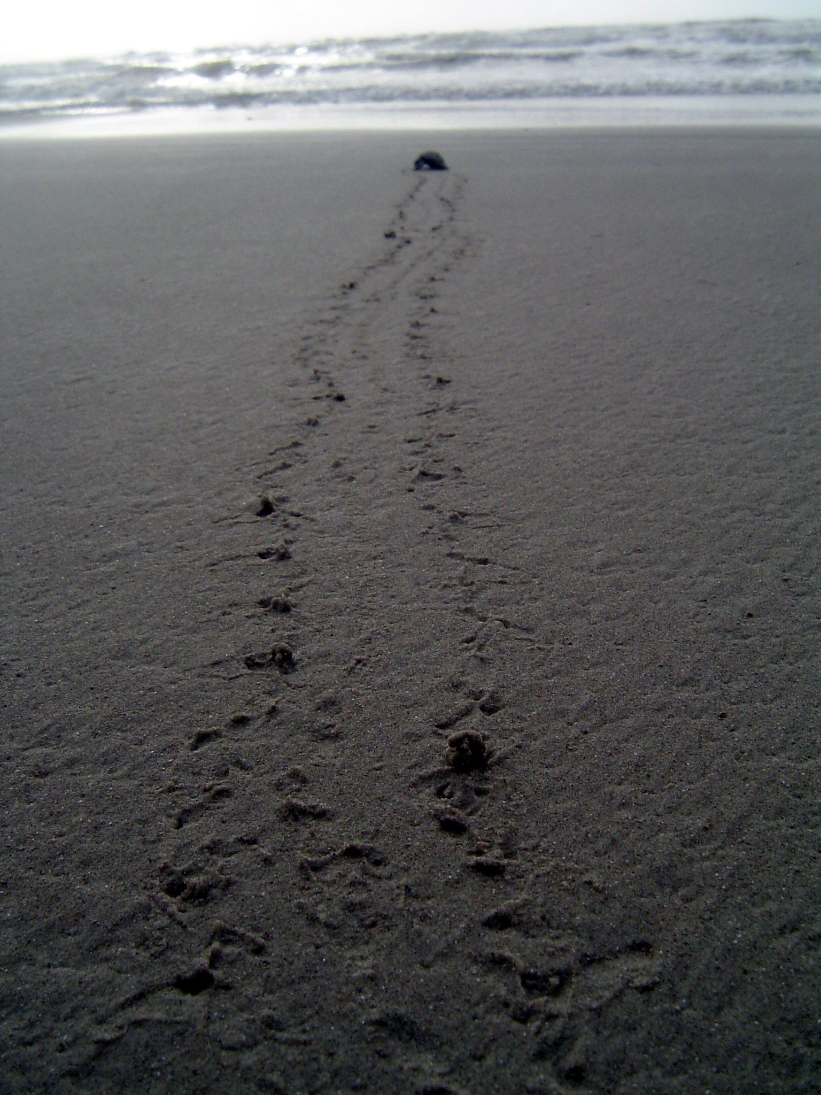
Future Work
TBD
Sea Turtle on Beach (Image Credit: National Park Service)

Slide 20
Advisors
Joe Spruce (NASA Stennis Space Center)
James “Doc” Smoot (NASA Stennis Space Center)
Dr. Dorina Murgulet (Texas A&M University, Corpus Christi)
Dr. Kenton Ross (NASA Langley Research Center)
Partners
Joe Meiman (National Park Service)
Others
Dr. Bernard Eichold, M.D., Dr. PH – Mentor (Mobile County Health Department)
Summer 2015 Coastal Texas Water Resources Team: Georgina Crepps, Tyler Lynn, Rodrigo Pereira da Silva, Ryan Schick

