Slide 1
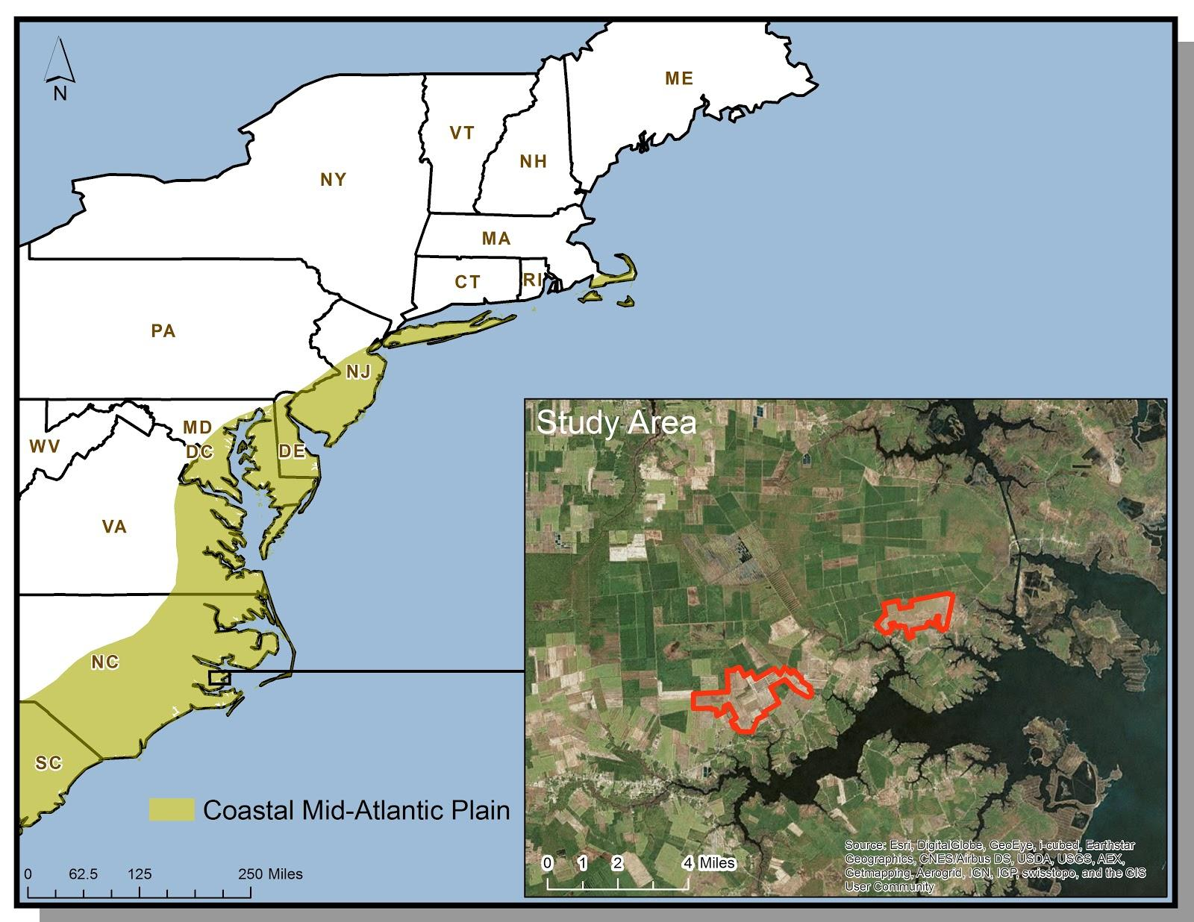
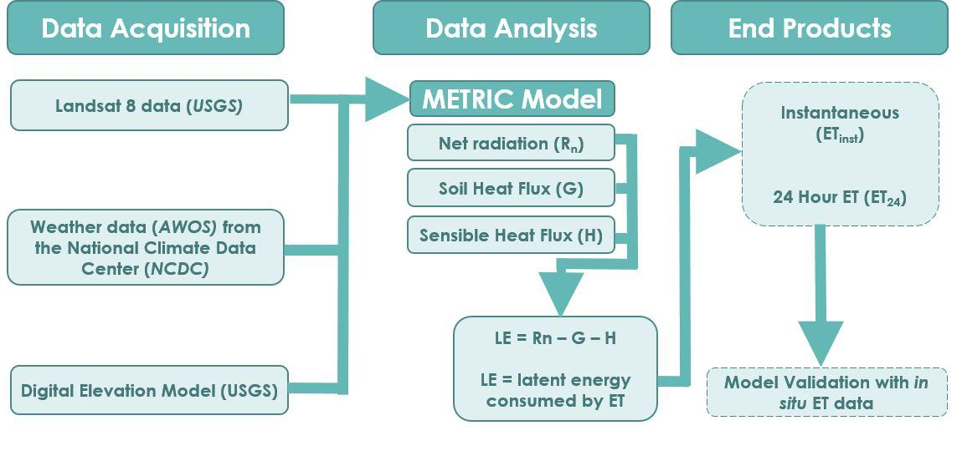
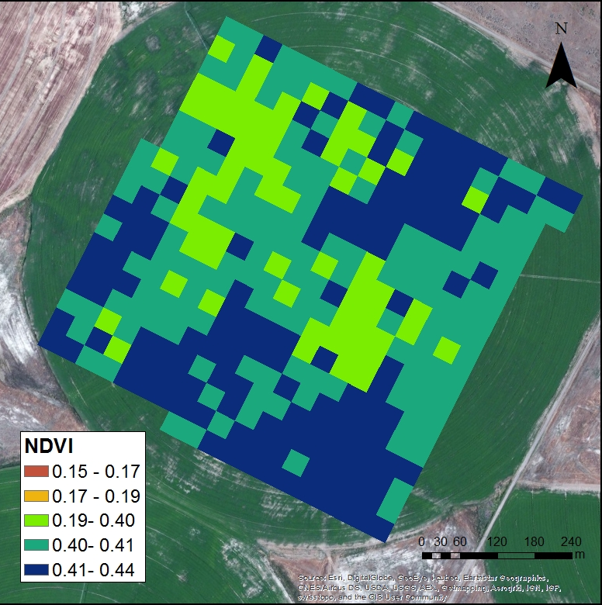
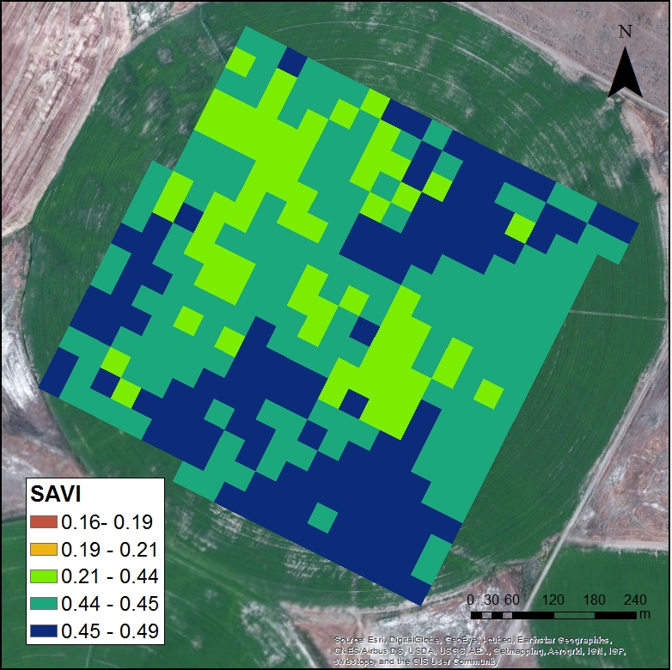
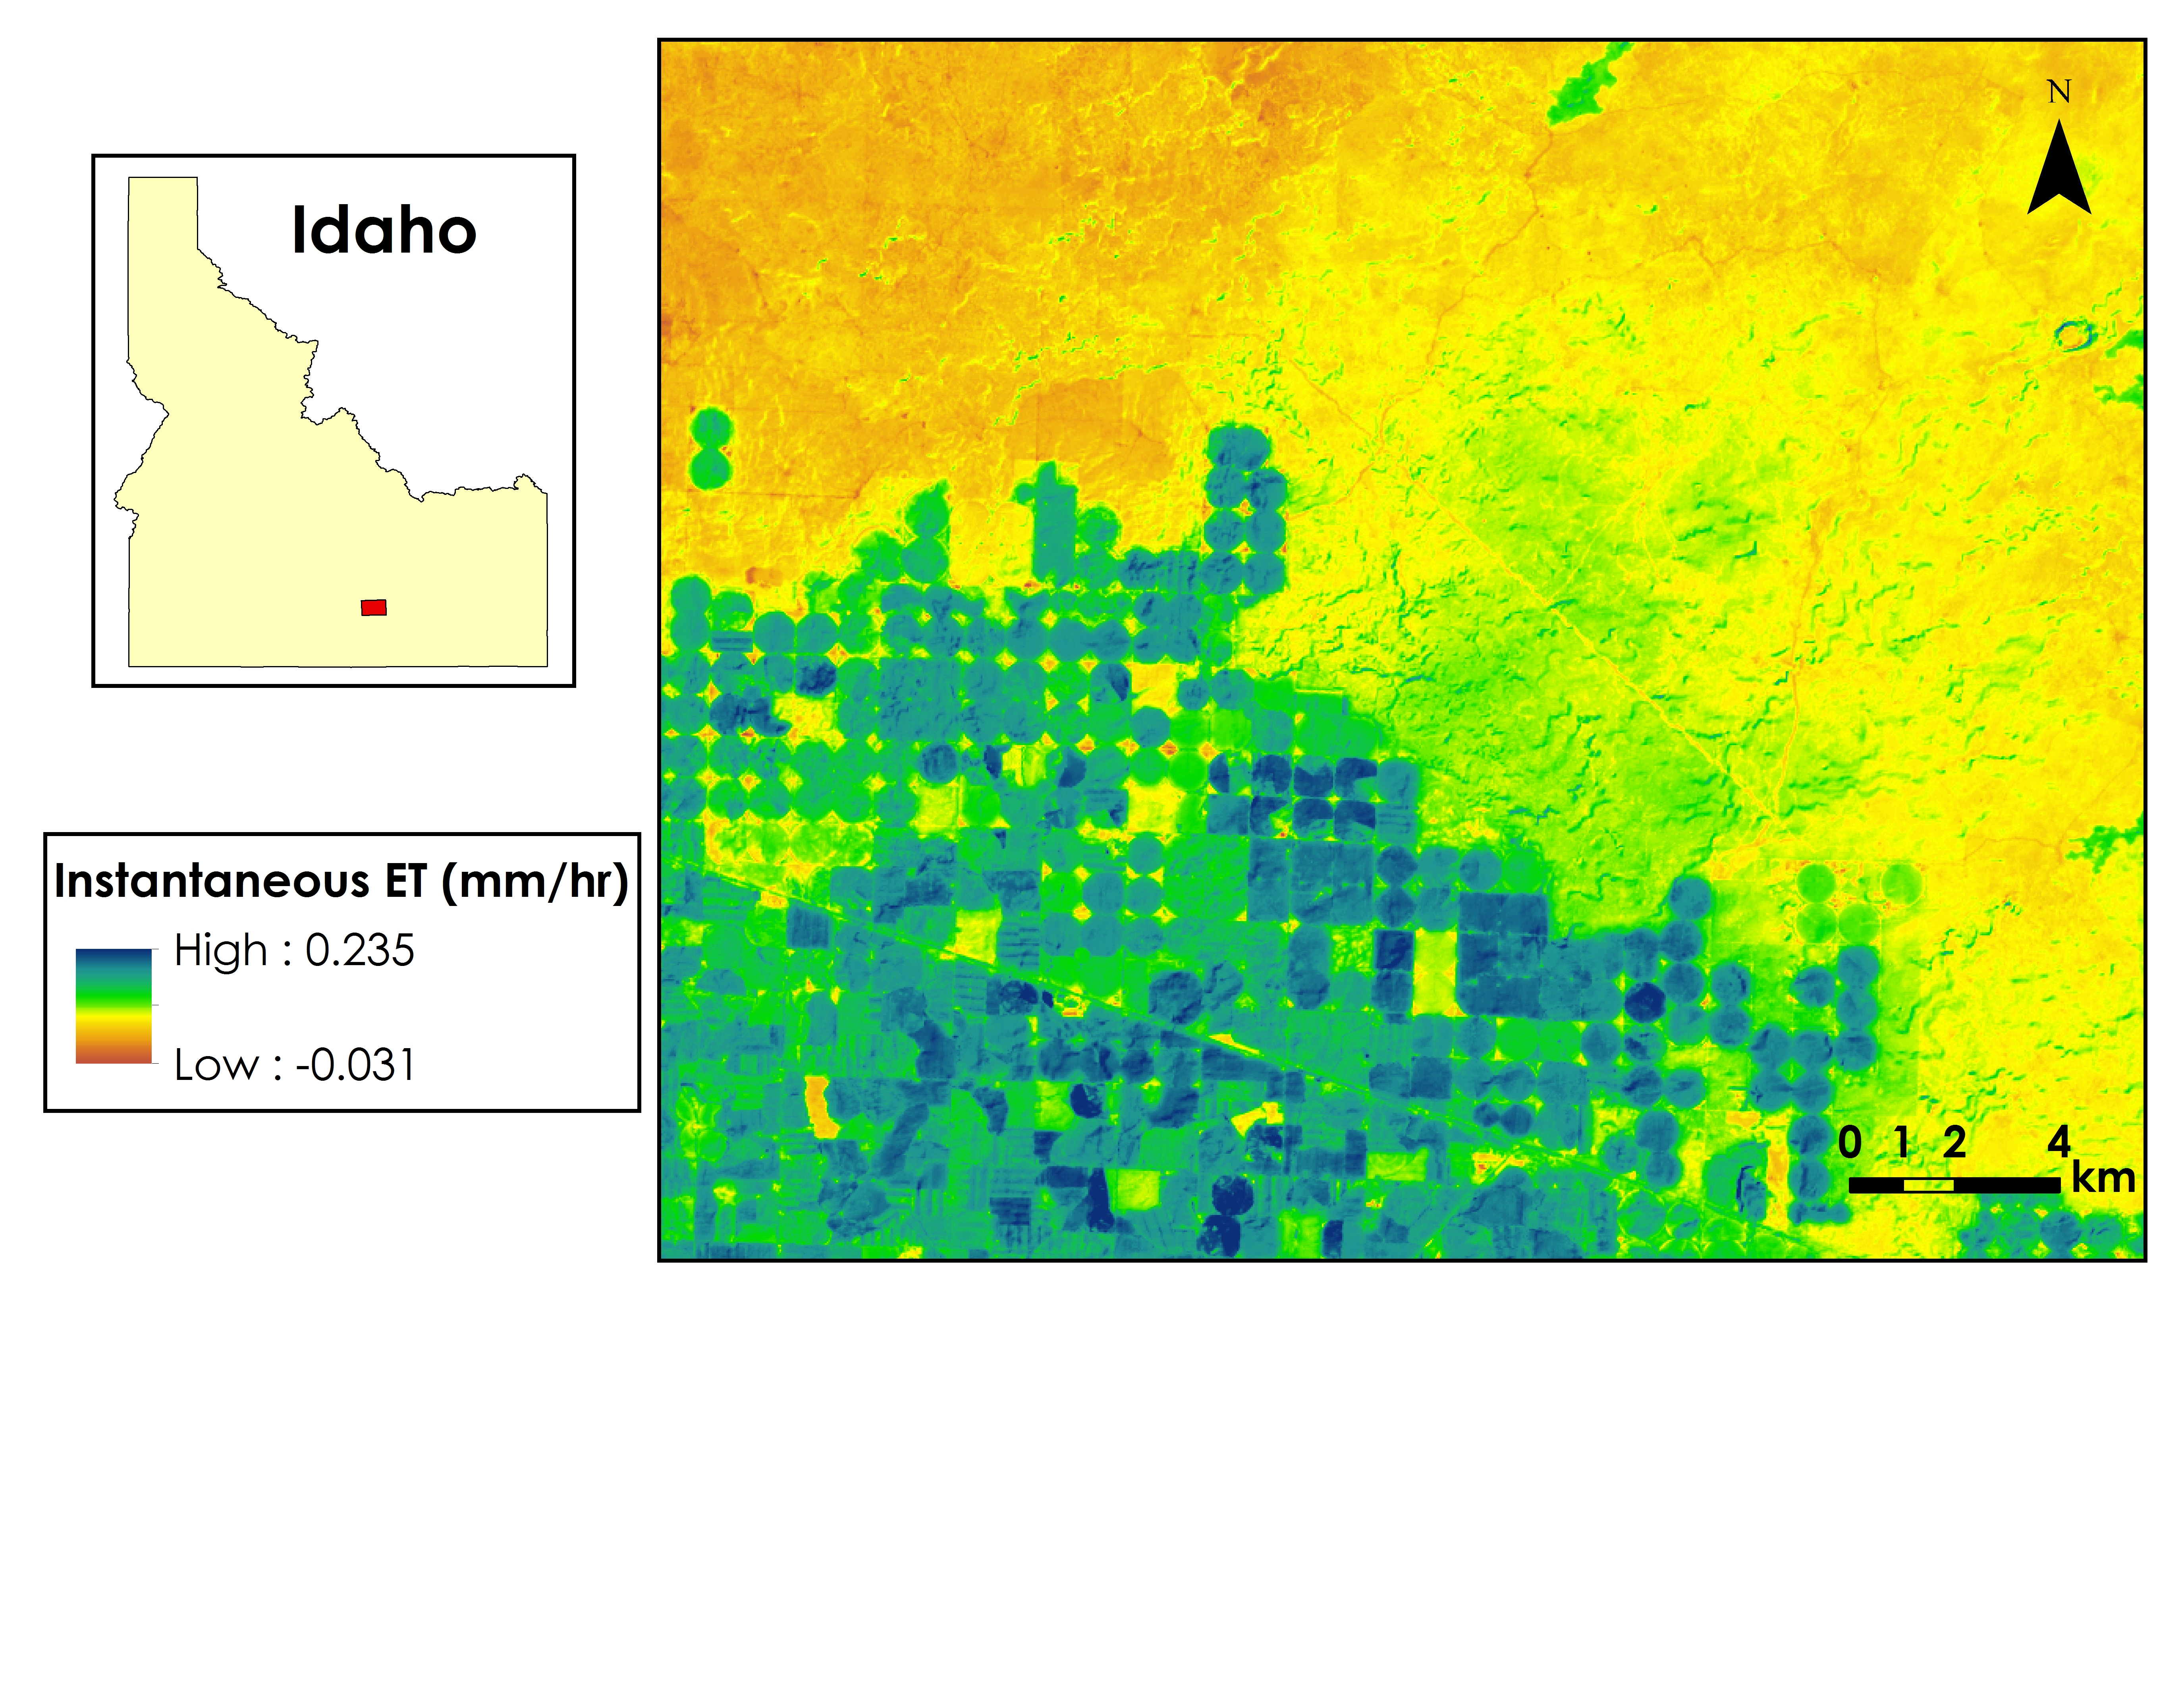
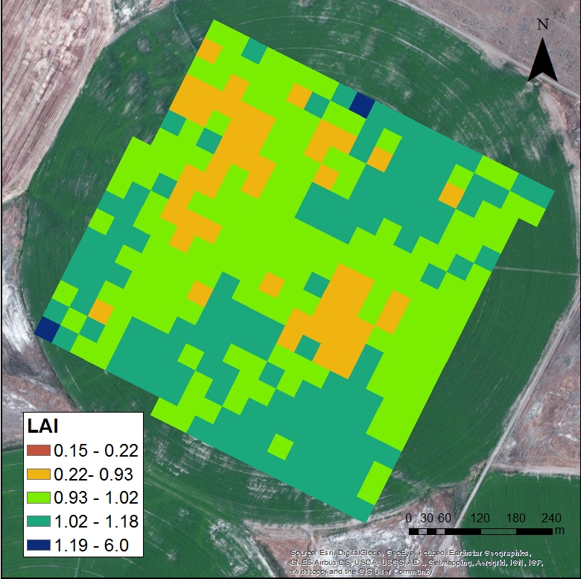
Coastal Mid-Atlantic Water Resources II
Using METRIC to Estimate Evapotranspiration for Coastal Mid-Atlantic Region
Kent Sparrow, Nathan Qian, Cassandra Morgan,
Jelly Riedel, Zakaria Boston, Oyinlayifa Porbeni
NASA Langley Research Center & Patrick Henry Building
Crop irrigation accounts for a considerable amount of water use in the Coastal Mid-Atlantic region. Better understanding of how much water farmers need to irrigate their fields will help decrease water waste and the economic burden for farmers. The Mapping Evapotranspiration at High Resolution with Internalized Calibration (METRIC) model is a powerful tool that calculates evapotranspiration (ET) based on localized data. Executable from a Python script, the model can be used as a decision support tool that allows farmers to make more informed decisions about when irrigation is necessary. METRIC estimates ET using a series of equations where local input variables are acquired from Landsat 8 sensors, a United States Geological Survey (USGS) survey-based Digital Elevation Model (DEM), and local weather conditions. While METRIC derived ET estimates are beneficial for irrigation purposes, it can also provide state officials with a useful means of drought monitoring. Utilizing data from NASA Earth observations in the Coastal Mid-Atlantic region will contribute to a large-scale, more-complete, understanding of the water consumption behavior in an area that can be used for both policy and individual agricultural decisions.
To develop a more accurate method of using the METRIC model, which will be used to calculate ET in the coastal plain of Virginia, Maryland, and North Carolina
Provide end users with a model executable from a Python Toolbox in ArcGIS to assist in efficient irrigation planning
Landsat 8 OLI/TIRS
NDVI
SAVI
The Python script written to run the METRIC model successfully calculated ET_{inst} using Landsat 8 imagery, AWOS weather data, and a DEM.
The model is in the final stages of becoming a useful tool for calculating ET₂₄ to improve irrigation planning and drought monitoring for the agriculture industry.
The use of the METRIC model will be beneficial to government officials and private industries involved in the agriculture industry.
Future work will need to focus on the methods of Allen et al. (2007) to derive ET₂₄ and validate the model in Idaho and the Coastal Mid-Atlantic region.
Once a validated model for deriving ET₂₄ rates is established, it should be packaged into a tool, available in ArcToolbox.
LAI
From Left:
Nathan Qian
Oyinlayifa Porbeni
Zakaria Boston
Kent Sparrow(Team Lead)
Jelly Riedel
Not pictured:
Cassandra Morgan
Digital Harvest
Young Kim, General Manager
Virginia Secretary of Natural Resources
Molly Ward, Secretary
Travis Hill, Deputy Secretary
Virginia Secretary of Technology
Karen Jackson, Secretary
Virginia Secretary of Agriculture & Forestry
Todd Haymore, Secretary
Virginia Department of Environmental Quality
David Paylor, State Water Commission
DEVELOP Program National Science Advisor
Dr. Kenton Ross
DEVELOP Program International Lead
Jamie Favors
Summer 2014 Coastal Mid-Atlantic Water Resource DEVELOP Team

