Slide 1
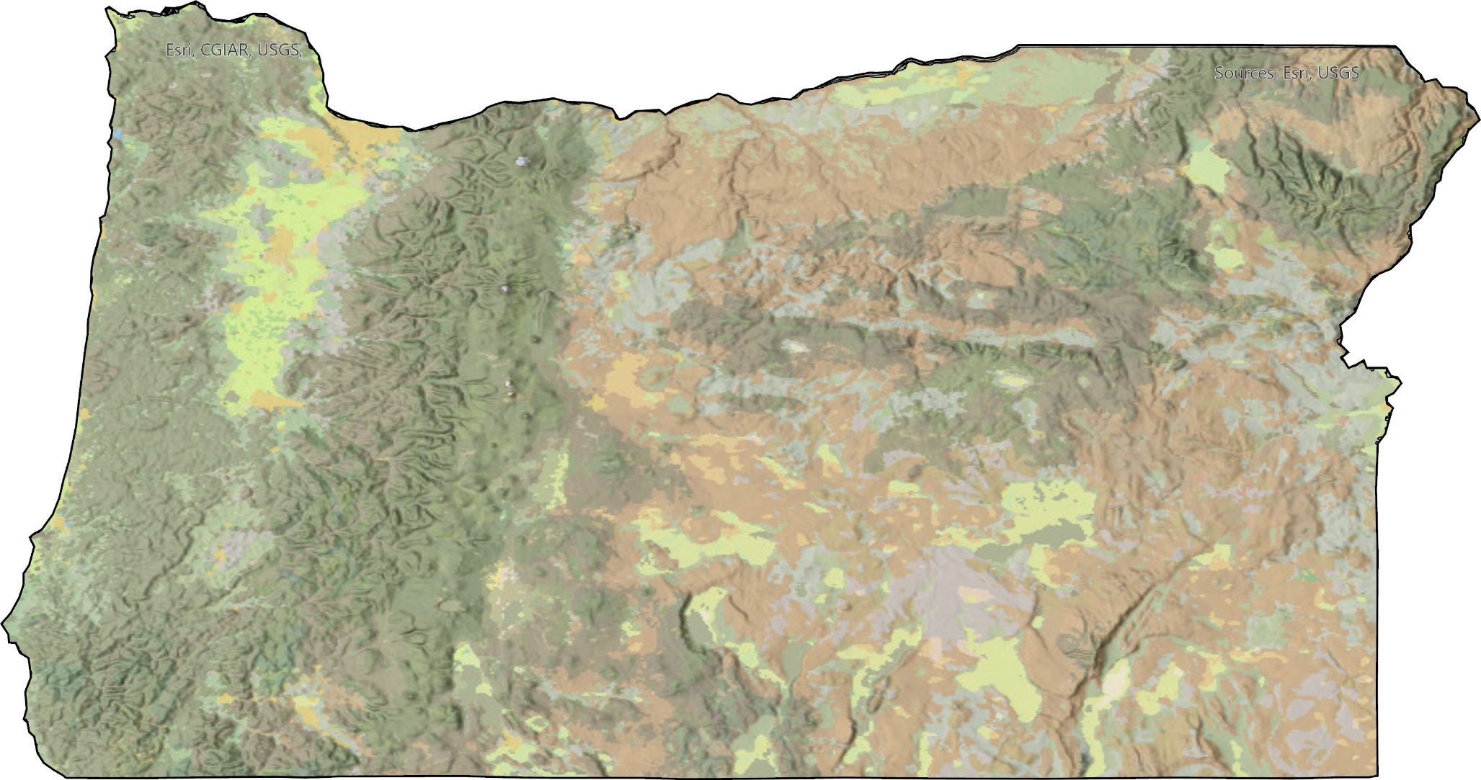
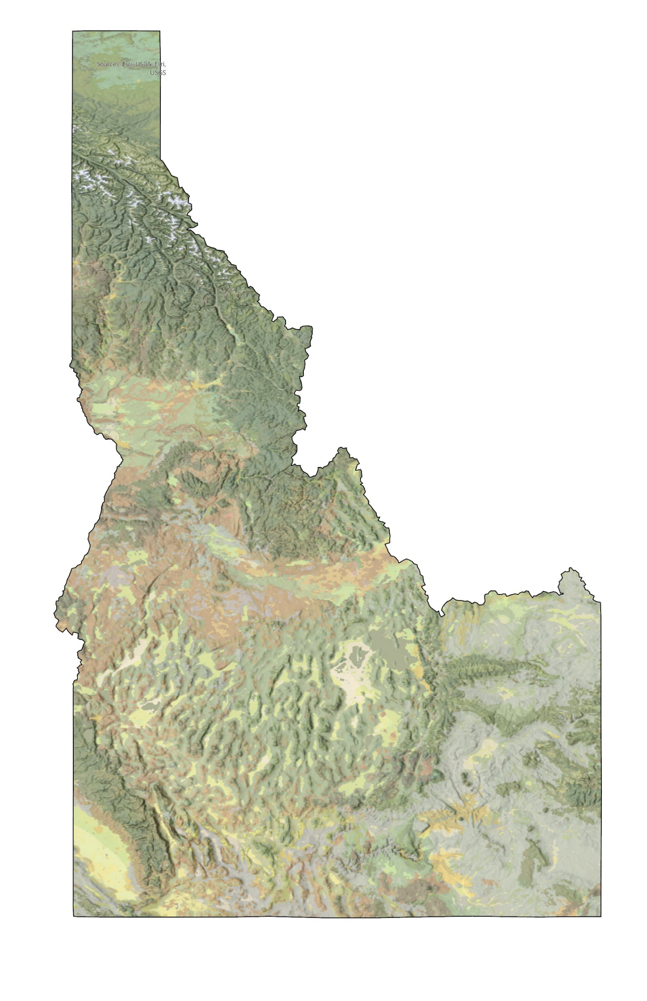
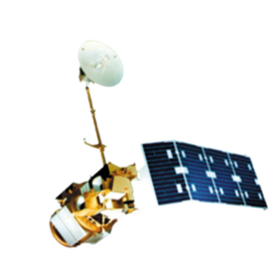
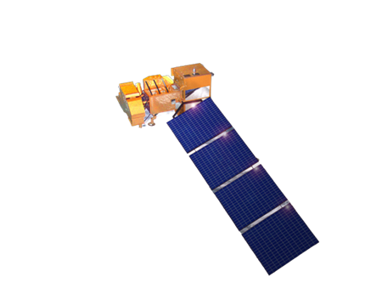
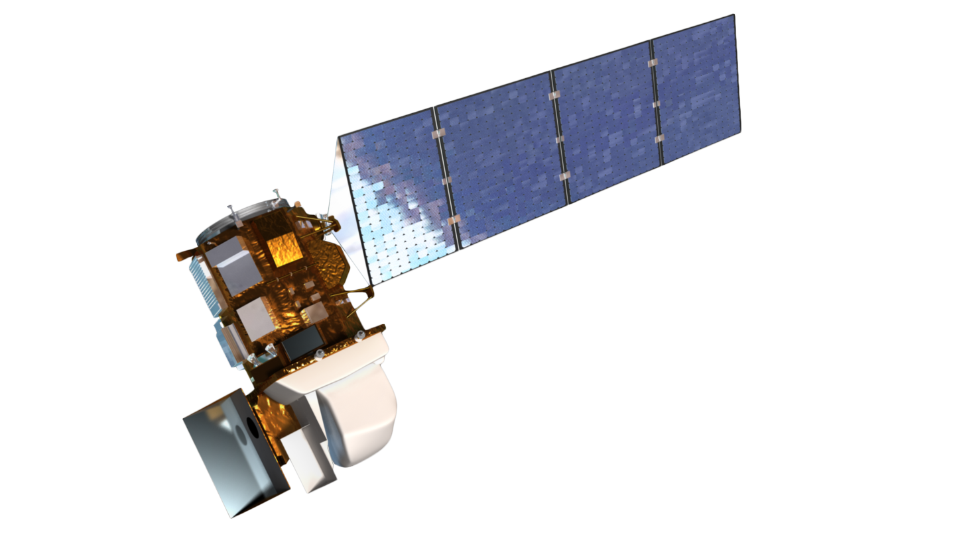
Oregon and Idaho Agriculture
Monitoring Vegetation Impacts of Livestock Management Practices Used to Reduce Predator Conflicts on Idaho and Oregon Grazing Allotments
Why Study Night Penning?
By confining livestock to small pens at night, ranchers have reduced conflicts with predators.
Night pen sites have a noticeable visible impact on the landscape during and after penning.
Remote sensing can help monitor the impact of these sites through measuring vegetation changes before and after site use.
Takeaways
Control Site Selection is critical for analyzing impacts on vegetation in night pens
The applicability of Rangeland Analysis Platform (RAP) is limited for night pens comparable in size to a RAP pixel
Ranch Locations
Ranches like these are interesting in using remotely sensed data from satellites to assess the effects of Night Penning on the landscape
The accuracy of night pen locations is important when comparing them to control sites
Satellites and Sensors
RAP’s bare-ground landcover could provide different insights into disturbance at night pen sites
Team Members
Landsat 5 TM
Landsat 7 ETM
Landsat 8 OLI
Acknowledgements
Partners: Glenn Elzingha (Aldersprings Ranch), Cameron Krebs (Krebs Livestock) Dr. Stewart Breck (U.S.D.A.)
Advisors: Anthony Vorster, Nicholas Young, Dr. Paul Evangelista, Christopher Tsz Hin Choi (Colorado State University, Natural Resource Ecology Laboratory); Dr. Catherine Jarnevich (United States Geological Survey, Fort Collins Science Center)
DEVELOP Lead: Truman Anarella (Colorado – Ft. Collins)
Garret Weichel
Project Lead
Aarushi Jhatro
Hannah Willis
Jack Hagenbuch
Colorado – Fort Collins | Spring 2024
Notes:
-----Image Citations-----
Landsat 5 TM, public domain: https://www.usgs.gov/media/images/desert-forest
Landsat 7 ETM Image Credit, public domain: https://landsat.gsfc.nasa.gov/article/successful-maneuver-spells-beginning-of-the-end-for-landsat-7/
Landsat 8 OLI Image Credit, public domain: https://landsat.gsfc.nasa.gov/article/landsat-data-continuity-mission/
Oregon Map: ESRI, USGS
Idaho Map: ESRI, USGS

