Slide 1
Bhutan
Water Resources III
Assessing Changes in Bhutan’s Vegetation and Climate Variables to Assist the Himalayan Environmental Rhythm Observation and Evaluation System (HEROES) Project
Tashi Choden, Kinley Dorji, Yeshey Selden, & Sherab Dolma
Alabama – Marshall
Notes:
Tashi:
Hi my Name is Tashi! We're the Bhutan Water Resources III team. For this term, we're assessing changes in Bhutan's vegetation and climate variables to assist the Himalayan Environmental Rhythm Observation and Evaluation System (HEROES) Project.
Kinley: I'm Kinley.
Yeshey: I'm Yeshey.
Sherab: And I'm Sherab.

Slide 2
China
STUDY AREA
Nepal
India
Bangladesh
Country : Bhutan
Population : 763,092
Area of Interest : Bumthang and Haa
Myanmar
Bhutan
Area of Interest
Bumthang
STUDY PERIOD
BUMTHANG
HAA
2000 – 2018 (18 years)
April - October
N
0 100 Kilometers
Notes:
Yeshey:
The study area of the project is the country of Bhutan located in the Himalayas between China and India. With elevations ranging from 318 ft to 24,836 ft, this geographical diversity contributes to Bhutan's outstanding range of biodiversity.
Bhutan has a population of approximately 765,000.
Bumthang and Haa were specifically chosen as areas of interest because of major bark beetle infestation that was detected in 2016. The study period for this project is from 2000 to 2018, mainly focusing on the months October 31st to May 31st when there are lowest cloud formation.
---
DEVELOP Team Generated map

Slide 3
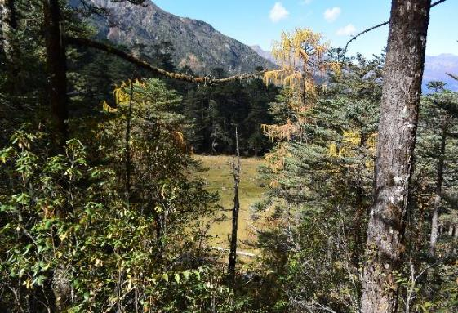
OBJECTIVES
Identify forest disturbances for focus districts in Bhutan from 2000-2018
Analyze the rate, magnitude, prevalence,
duration and year of disturbance
DEVELOP Google Earth Engine-based app to assess maps of forest damage
Image Credit: Pema Choden
Notes:
Yeshey:
The main objective for the term was to identify forest disturbances from 2000-2018 in the districts of Haa and Bumthang.
We also wanted to see the year of disturbances, and investigate specific variables such as the rate, duration, magnitude, and prevalence for those disturbances.
We designed a Google Earth Engine (GEE)-based app that would help us assess maps of forest disturbances that might be of some use to our partners.
------------------------------Image Information Below ------------------------------
•Image Credit: Pema Choden
•Image Source: Pema Choden
•Image License: Written permission to use

Slide 4
PROJECT PARTNERS
Ugyen Wangchuck Institute for Conservation and Environmental Research (UWICER)
Himalayan Environmental Rhythm Observation and Evaluation System (HEROES) project
Bhutan Foundation
Karuna Foundation
Notes:
Sherab:
This project was conducted in collaboration with the Ugyen Wangchuck Institute for Conservation and Environmental Research (UWICER), the Karuna Foundation, and the Bhutan Foundation.
These organizations are cooperatively working on the Himalayan Environmental Rhythm Observation and Evaluation System (HEROES) project, a school and community-based citizen science initiative to monitor climate change and its impact on the Himalayan Mountain ecosystem.

Slide 5
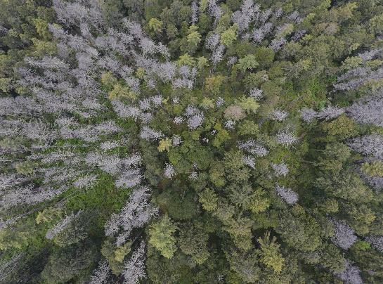
COMMUNITY CONCERNS
Increased warming, with decrease in
annual rainfall and snowfall
Impact on national food and fiber security as a result of climate variability
Need for forest damage mitigation
due to bark beetle infestations
Image Credit: Changa Tshering
Notes:
Sherab:
Here are the list of community concerns with respect to our project:
Bhutan has experienced increased warming, with a decrease in the annual rainfall and snowfall over the past decade and is facing high risk from glacial lake outburst floods.
Changes in agricultural patterns due to climate change affect agricultural and forest productivity, which in turn impact national food and fiber security.
Forest pests such as bark beetle infestations contribute to forest disturbances, resulting in tree mortality and increased action of felling.
------------------------------Image Information Below ------------------------------
•Image Credit: Changa Tshering
•Image Source: Changa Tshering
•Image License: Written permission to use

Slide 6
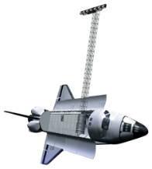
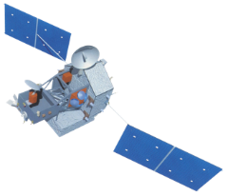
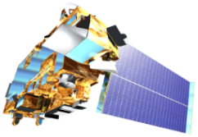
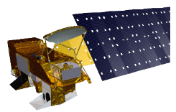
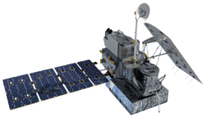
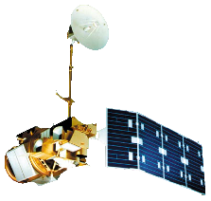
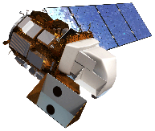
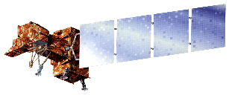
SATELLITES AND SENSORS
Tropical Rainfall Measuring Mission (TRMM)
Aqua - Moderate Resolution
Imaging Spectroradiometer (MODIS)
Terra - Moderate Resolution Imaging Spectroradiometer (MODIS)
Shuttle Radar
Topography Mission
(SRTM)
Global Precipitation Measurement Core Observatory (GPM Core)
Landsat 5 - Thematic Mapper (TM)
Landsat 7 - Enhanced Thematic Mapper Plus (ETM+)
Landsat 8 - Operational Land Imager (OLI)
Image Credit: NASA
Notes:
Kinley:
For the satellites and sensors, we used data that was available from 3 different Landsat sensors via Google Earth Engine to assess trends in forest disturbances.
From the previous terms, Climate Hazards Groups Infrared Precipication with Stations (CHIRPS), data based on observations, was used to assess trends in precipitation for Haa and Bumthang. We had also used modeled products from the Famine Early Warning Systems Network (FEWS NET) – Land Data Assimilation System, to assess the near surface air temperature for the focus districts.
------------------------------Image Information Below ------------------------------
Image Credit 1: NASA
Image Source: http://www.devpedia.developexchange.com/dp/index.php?title=List_of_Satellite_Pictures
Image License: Public Domain
Image Credit 2: NASA
Image Source: http://www.devpedia.developexchange.com/dp/index.php?title=List_of_Satellite_Pictures
Image License: Public Domain
Image Credit 3: NASA
Image Source: http://www.devpedia.developexchange.com/dp/index.php?title=List_of_Satellite_Pictures
Image License: Public Domain
Image Credit 4: NASA
Image Source: http://www.devpedia.developexchange.com/dp/index.php?title=List_of_Satellite_Pictures
Image License: Public Domain
Image Credit 5: NASA
Image Source: http://www.devpedia.developexchange.com/dp/index.php?title=List_of_Satellite_Pictures
Image License: Public Domain
Image Credit 6: NASA
Image Source: http://www.devpedia.developexchange.com/dp/index.php?title=List_of_Satellite_Pictures
Image License: Public Domain
Image Credit 7: NASA
Image Source: http://www.devpedia.developexchange.com/dp/index.php?title=List_of_Satellite_Pictures
Image License: Public Domain
Image Credit 8: NASA
Image Source: http://www.devpedia.developexchange.com/dp/index.php?title=List_of_Satellite_Pictures
Image License: Public Domain

Slide 7
METHODOLOGY
INPUT DATA
PROCESSING & ANALYSIS
RESULTS
PRECIPITATION
(CHIRPS)
GOOGLE EARTH ENGINE (GEE)
NDVI was used to develop the LandTrendr model
TEMPERATURE
(FLDAS)
FOREST DISTURBANCES:
Landsat images (from TM, ETM+, and OLI)
HISTOGRAMS
ArcGIS MAPS
TREND ANALYSIS
CORRELATION
APPLICATION
SHAPEFILE and MAPS ArcGIS
GROUND DATA
Notes:
Yeshey:
The team used CHIRPS, FLDAS and MODIS data generated by the two previous terms.
Landsat images were accessed and processed from GEE
Ground data was provided by Ugyen Wangchuk Institute Conservation and Environmental Research and processed in ArcGIS.
---
Phenology, precipitation, and temperature data was used from the previous terms’ results. Accompanying that, this term we used Landsat images and ground data from our partner: Ugyen Wangchuk Institute Conservation and Environmental Research.
The Landsat images consist of historical images of land cover which was then collaborated with an algorithm called LandTrendR by Dr. Kennedy on Google Earth Engine. The variables collected from LandTrendR were Year of Disturbances, Duration, Magnitude, Prevalence, and Rate of forest disturbances.
The algorithm was implemented in Google Earth Engine and the team generated codes to create an application. Any end user that accesses the application can see LandTrendr results of all these variables in a histogram which can help in trend analysis, correlation, and assist in creating maps.
The ground data was displayed in ArcGIS with a background of LandTrendR magnitude result to see if there were indeed a disturbance observed in the given locations.
---
DEVELOP Team Generated Figures

Slide 8
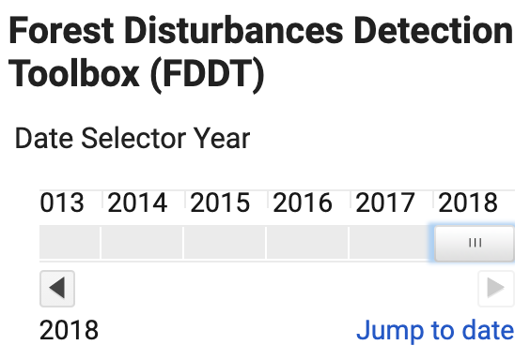

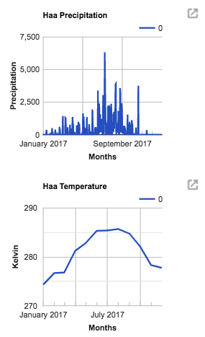
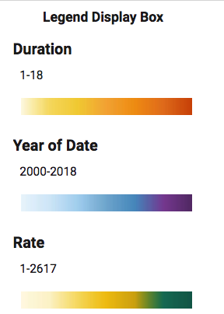
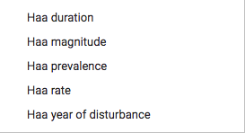
RESULTS: FDDT APP FEATURES
Slider
Dropdown menu
Histograms of climatic variables
Legend
Notes:
Sherab:
Moving on to the main focus of our project which is the Google Earth Engine tool. The team implemented the LandTrendr algorithm developed by Dr.Robert Kennedy to built the tool or so called the app. We decided to name the app Forest Disturbances Detection Tool, or in short, FDDT.
The app consists of four different features including the slider, the dropdown menu, the graph section, and the legend.
-----
DEVELOP Team Generated Figures

Slide 9
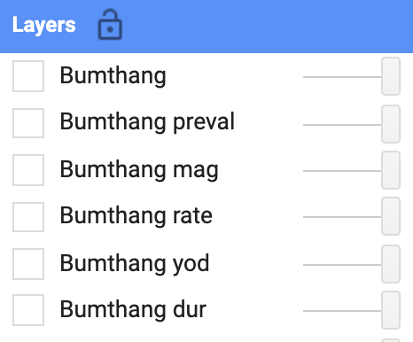
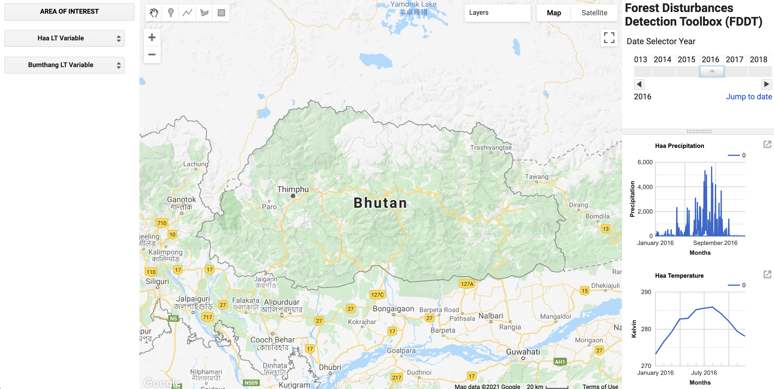
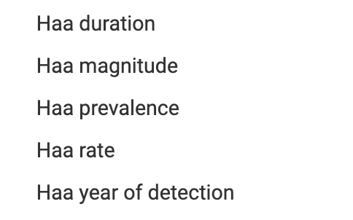
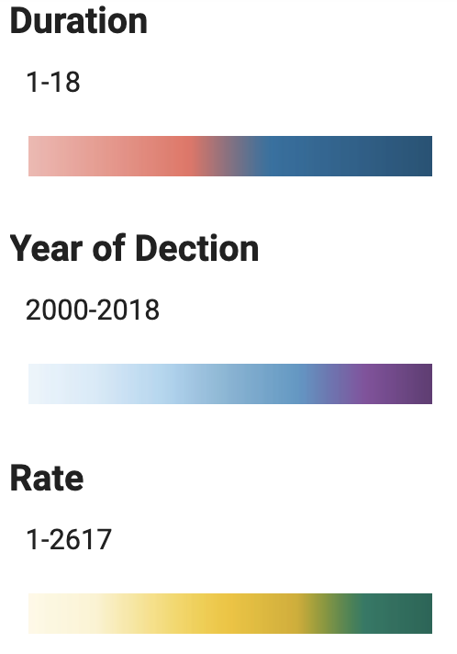
RESULTS: FDDT APP
Dropdown menu
Date Slider
Histograms
for
climatic
variables
Notes:
Sherab:
To provide an overview of the how app works, when we run the code, this is how the current app developed by the team looks like and this is how the features of the app mentioned in previous slide are displayed.
The Date slider to the top right corner allows the user to select a date or a year of interest to display the results for the variables. The years on the slider ranges from 2000-2018. Selecting a year from the slider, generates a graph for each climatic variables for that particular year right underneath the slider in the graph section.
So basically, the Graph section on the bottom right provides a visual representation of the climatic variables which includes temperature and precipitation of each district for which, as mentioned earlier, the data was collected from the previous terms.
The dropdown menu which you can find on the top left corner, displays the options to select a LandTrendr variables for the specific area of interest and includes rate, year of detection, prevalence, magnitude and duration for each area of interest. The LandTrendr variables in our project regards to the Normalized Difference Vegetation Index (NDVI).
The legend section on the bottom-left displays the legend for the five LandTrendr variables.
After selecting a LandTrendr variable from the dropdown menu, the best-fit graph for the selected variable will be displayed right below the dropdown menu. The graph displays the spectral values and the vertices indicating whether there are any disturbances for the selected region. The sample graphs of the variables are not visible in the image here because of the limited space provided. However, we will be looking at each of these graphs individually in the next few slides.

Slide 10

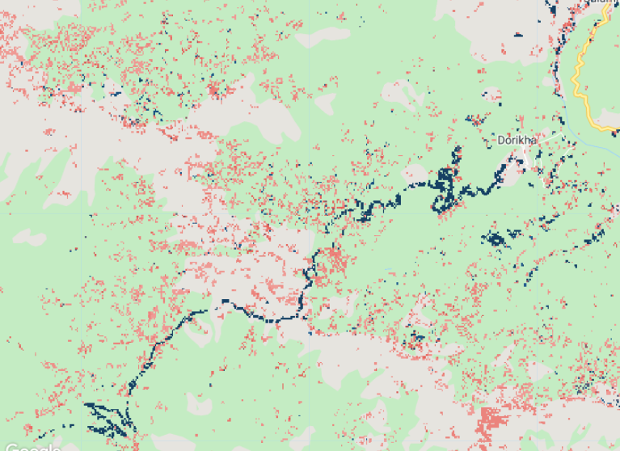
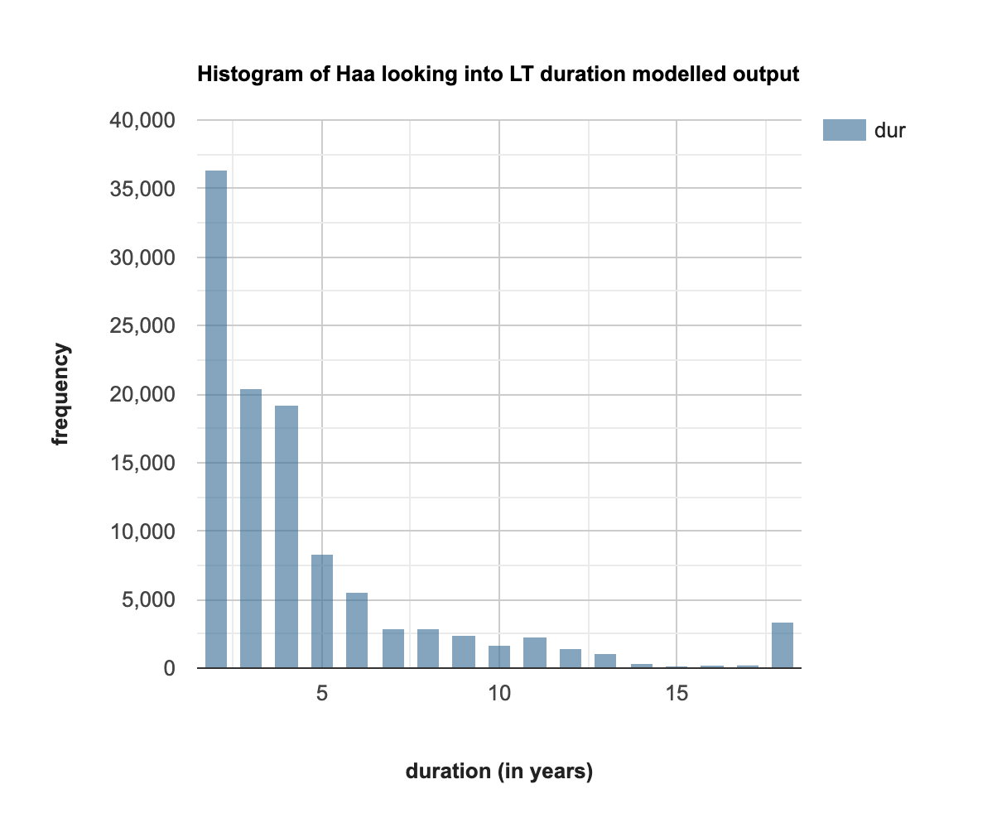
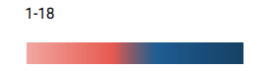
EXAMPLE: DURATION
Enlarging chart
Notes:
Sherab:
So, for example, if we pick a variable from Haa, let's say "Duration"
It zooms into the area of interest on the map, provides a histogram and legend for duration on the left-hand panel as well as a visualization of the variable on the which allows the user to observe and analyze the duration of forest loss in years.
It also provides users with the option, right next to the graph, to enlarge the histogram.

Slide 11
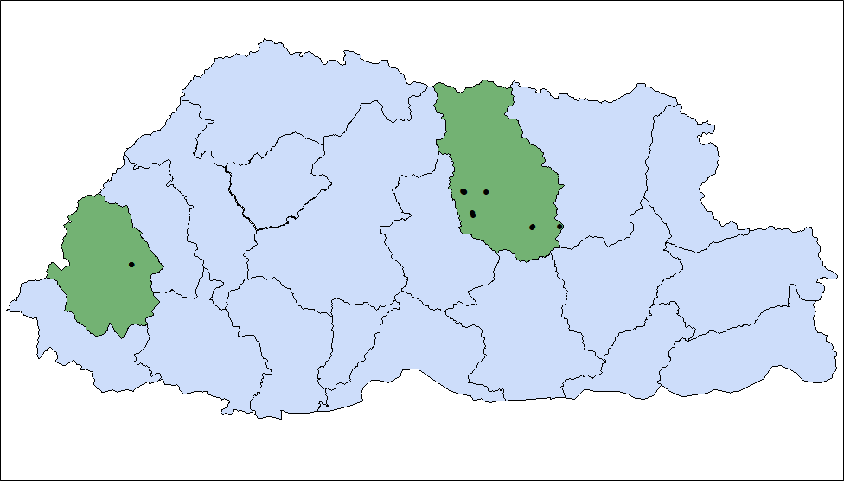
RESULTS
Ground Data
Area of interest
Districts
Gasa
Thimphu
Bumthang
Yangtse
Punakha
Paro
Lhuentse
Trongsa
Haa
Wangduephodrang
Mongar
Tashigang
Tsirang
Samtse
Dagana
Sarpang
Zhemgang
Chukha
Samdrupjongkhar
Pemagatshel
N
0 100 Kilometers
Notes:
Tashi:
On the map, the black points represent some of the ground data which came from Changa Tshering from UWICER for the correlation analysis.
---
DEVELOP Team Generated Figures

Slide 12
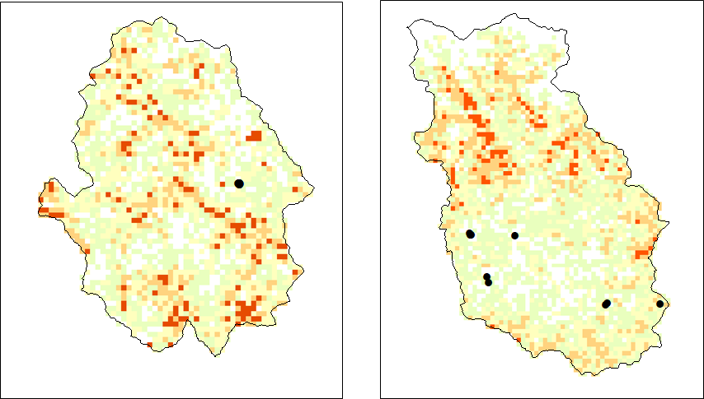
RESULTS: MAGNITUDE
Haa
Bumthang
Magnitude
(2000 - 2018)
``
Low (1)
Medium Low
Medium High
High (378)
Ground Data
N
No Data
0 100 Kilometers
Notes:
Tashi:
The magnitude is representing the spectral delta of change event.
With the magnitude, spatially we're looking at how big the spike was and how often it occurred across all the pixels.
For Bumthang, the orange pixels suggest that there was relatively low magnitude event happening and that there was a sharp decline.
15 locations of ground data are displayed on the maps using a black circle, 5 being in Haa and 10 in Bumthang which was provided by the partners: UWICER. The yellow represents lower magnitude, orange represents higher magnitude and white represents No Data. The partners have determined these locations as places that have experienced land disturbances over the years.
The in-situ data was then compared with the data observed from the LandTrendR analysis for magnitude of land disturbance ranging from 1 to 378 units. The circles do fall on the colored pixels instead of the white. This suggests that the Ground data and GEE are closely related.
DEVELOP Team Generated Figures

Slide 13
RESULTS: DURATION
800
700
600
Frequency
500
400
300
200
100
0
2 3 4 5 6 7 8 9 10 11 12 13 14 15
Duration (in years)
Bumthang
Haa
Notes:
Tashi:
Duration is the number of years a change of event took to complete. Across the entire image, it is run for 18 years. This chart shows the duration of disturbance for the focus districts. The Y axis-shows the frequency count and the X axis represents the duration in years.
For our project, not many of the disturbances were observed to have lasted for longer duration since the graph is slightly left skewed.
The duration observed for both the area of interest, the majority of the duration was 6, 7 and 8 years.
As clearly observed in the graph, the duration frequency is more in Haa as compared to Bumthang.
------------
DEVELOP Team Generated Figures

Slide 14
RESULTS: RATE OF DISTURBANCE
Haa
Bumthang
1
375
No Data
N
0 100 Kilometers
Notes:
Tashi:
The rate is the number of years a change event took to complete which means it is the quotient of magnitude over duration of disturbances occurred.
As the color ramp changes from blue to beige to orange, it represents increase in rate across the two districts.
The two districts have experienced medium-high rate which has more probability of forest disturbance.
---------------
DEVELOP Team Generated Figures

Slide 15
RESULTS: PREVALENCE
Haa
Bumthang
1
571
No data/ Reference image
N
Bumthang
0 100 Kilometers
Notes:
Tashi:
The prevalence is the pre-change spectral value before any major changes had occurred. From the map, what this tells us is that most of what's observed was already teal; meaning the forest remained unaffected. The prevalence is displayed here with a background of satellite image as a reference image, The areas with brown pixels represent higher risk for disturbances while areas with teal pixels means lower risks of disturbances.
The rate is looking into the magnitude of change over the duration in years and displaying what the change was like.
------------
DEVELOP Team Generated Figures

Slide 16
RESULTS: YEAR OF DETECTION
4500
4000
3500
3000
2500
Frequency
2000
1500
1000
500
0
2000
2001
2002
2003
2004
2005
2006
2007
2008
2009
2010
2011
2012
2013
2014
2015
2016
2017
2018
Year
Bumthang
Haa
Notes:
Tashi:
For the year of detection over a period of almost 20 years, the disturbance observed was mainly in 2000 and 2001.
From this graphs we can see that in 2001, most of the forest disturbance were detected in Haa and decreases drastically. Some disturbances were detected again from 2010 to 2018.
------------
DEVELOP Team Generated Figures

Slide 17
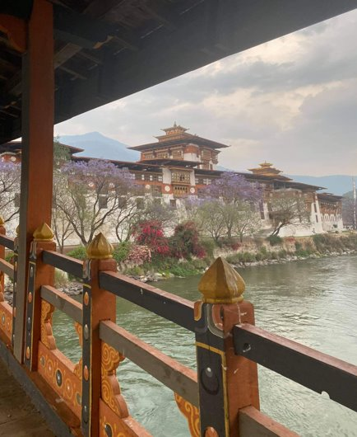
CONCLUSION
The Forest Disturbances Detection Toolbox (FDDT) was used to assess forest changes from 2000 – 2018
There were rare observed instances of high magnitude events
A longer duration was observed in Haa as compared to Bumthang
Disturbance was mainly detected in 2000
The project's FDDT will be provided to project partners to aid forest management efforts in Bhutan
Additional work is needed to further test and refine the FDDT
Image Credit: Yeshi Keltsho
Notes:
Kinley:
Using the GEE LandTrendr code acquired from the Landsat data, the team developed an app called FDDT that helps to assess forest changes in Bhutan for the focus districts from 2000-2018. With LandTrendr, we're looking at a minimum of ten years to observe any significant changes.
For the ground data, the geocoordinates for known disturbances were provided to us by the end-users. We then had those points mapped to see if there was a correlation between the ground and satellite data.
For magnitude, we mainly investigated how big the spike was and how often it occurred. Based on our findings, the magnitude remained relatively low and there was a sharp decline. The modelled output observed a longer duration for Haa when compared to Bumthang. The year 2000 saw some big spikes suggesting that there was a lot of disturbances then.
The project's FDDT will be provided to project partners to aid forest management efforts in Bhutan.
Additional work is needed since there wasn't much quantitative validation of any of the presented products.
------------------------------Image Information Below ------------------------------
•Image Credit: Yeshi Keltsho
•Image Source: Yeshi Keltsho
•Image License: Written permission to use

Slide 18
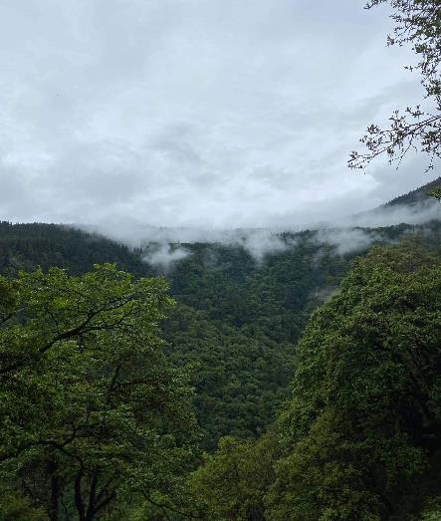
LIMITATIONS
Availability of cloud-free data for early detection
Forest recovery observed in multiple locations
where previous disturbances had occurred
The topography can negatively affect detection of forest damage in higher elevations
The tool did not make much use of the coniferous forest mask
The tool does not include a means to compare Landsat RGB imagery to various disturbance assessment maps
Image Credit: Yeshi Keltsho
Notes:
Kinley:
It’s difficult to pinpoint if forest mortality is specifically due to a singular factor since there may be other potential factors involved such as climate variability, bark beetle outbreaks, and droughts. Trees experiencing droughts or dry conditions may lose the ability to fight bark beetles, resulting in deaths or the trees turning blue from the diseases.
The availability of cloud-free data for the time of year that would be useful for early detection.
Forest recovery was observed in multiple locations where previous disturbances had occurred. It's challenging to detect and trace back due to late morality symptoms and most of the affected areas are inaccessible.
The topography is also another factor affecting detection of forest damage in the higher elevation forests of Bhutan. Topographic shadows can obscure the ability to see forest damage on Landsat data, though the parts of the data that is shadow free can be useful for identifying areas with forest damage.
There was only time to do a limited amount of validation of the FDDT and disturbance mapping products from the tool. Eliminating areas that are not coniferous forest would help the end-user know which areas to consider for field surveys. Such a comparison would help in assessing the context of apparent disturbances on the FDDT/LT data products.
------------------------------Image Information Below ------------------------------
•Image Credit: Yeshi Keltsho
•Image Source: Yeshi Keltsho
•Image License: Written permission to use

Slide 19
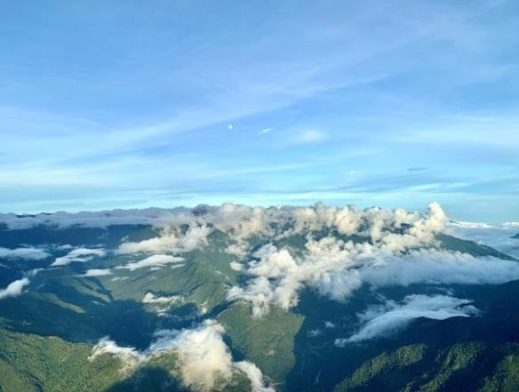
FUTURE WORK
Further test and validate the detection of forest dieback with the FDDT
Use a higher spatial resolution satellite data to enable earlier detection of disturbances
Assess main causes for forest disturbances
Look at additional areas with coniferous forest disturbances in western and central Bhutan
Image Credit: Namgyal Wangchuk
Notes:
Kinley:
The project probably will only be able to do a preliminary validation of the application at hand. Further testing and validating the usage of forest dieback would be required.
More work could be done with higher spatial resolution satellite data other than Landsat - like with Sentinel-2 data at 10-meter spatial resolution and PlanetScope data at ~3-meter spatial resolution. The Sentinel-2 data also has spectral bands that might help for early detection of forest damage. Also, there are efforts to use Landsat and Sentinel-2 data together in order to get more timely cloud-free data for times of year when bark beetles are actively causing damage.
The project results will be of use in future research by project partners (potentially including other project being done by NASA SERVIR in support of Bhutan) in identifying early detection of tree dieback, measuring the extent of forest damage, and regularly monitoring to see if there’s bark beetle outbreak over the years.
Any future related projects could also look at additional areas with coniferous forest disturbances in western and central Bhutan.
------------------------------Image Information Below ------------------------------
•Image Credit: Namgyal Wangchuk
•Image Source: Namgyal Wangchuk
•Image License: Written permission to use

Slide 20
Advisors & Contributors
Timothy Mayer (NASA SERVIR Science Coordination Office)
Caily Schwartz (NASA SERVIR Science Coordination Office)
Sean McCartney (NASA Goddard Space Flight Center)
Joseph Spruce (Consultant to Science Systems & Applications, Inc.)
Kenton Ross (NASA Langley Research Center)
Robert Griffin (The University of Alabama Huntsville)
Jeffrey Luvall (NASA Marshall Space Flight Center)
A.R Williams (NASA DEVELOP Fellow)
Past Contributors
Tenzin Wangmo
Tashi Kaneko
Deki Namgyal
Sonam Dorji
Notes:
Tashi:
Lastly, we would like to thank the following individuals for their influence in our work.

Slide 21
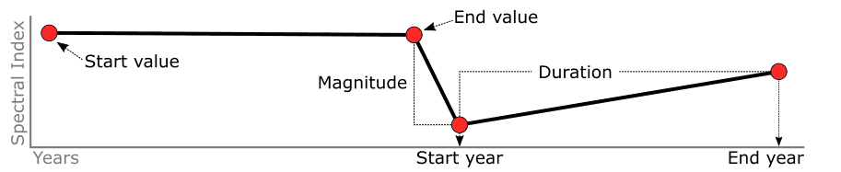
Backup
Image Source: LT-GEE Guide
Notes:
This chart tells us the processes that we can capture
The black line represents the segments and the red dots represents the vertices. Based on the segments and vertex, the temporal duration and spectral magnitude can be calculated for each segment.
These attributes enable us to summarize and query when changes occur and how frequently they occur etc.
The magnitude shows the spike and the duration shows the comeback (recovery)
------------------------------Image Information Below ------------------------------
•Image Source: LT-GEE Guide

