Slide 1
DEVELOP National Program
African great lakes weather ii
Wise county
SPRING 2016
Imagery Gallery

Slide 2
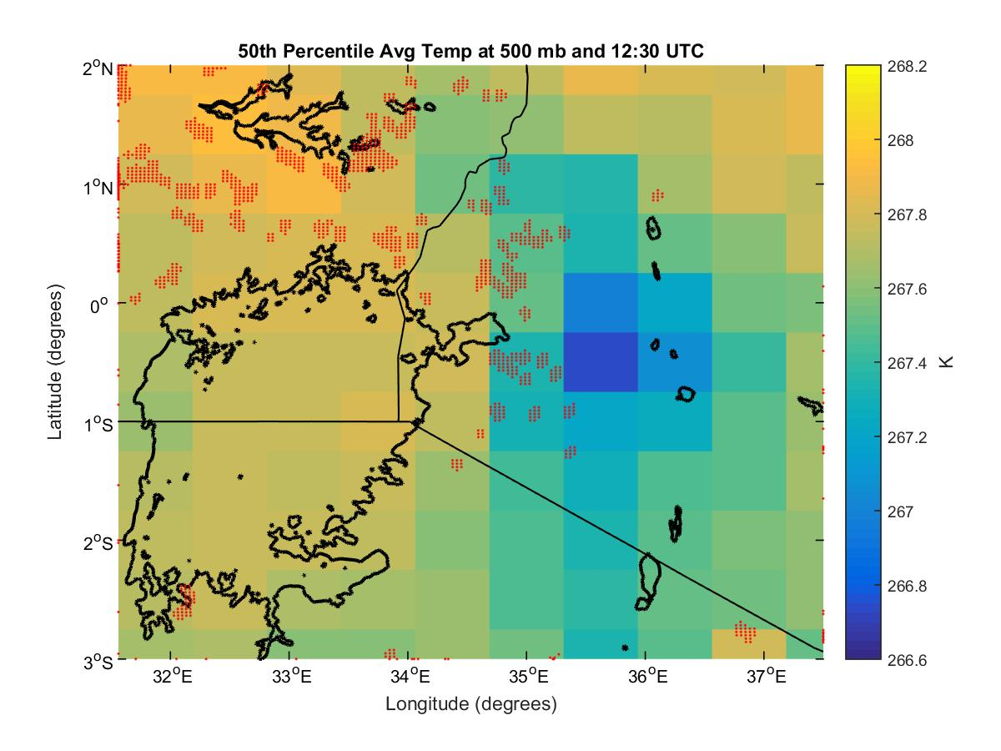
Wise County
African Great Lakes Weather II
50th percentile 30-day average temperature at 500 mb and 12:30 UTC (coordinated universal time) complied using temperature data from NASA’s Modern-Era Retrospective Analysis for Research and Applications (MERRA) and plotted in MATLAB. This can be used to determine meteorological conditions leading up to days with average weather and days with severe storms.

Slide 3
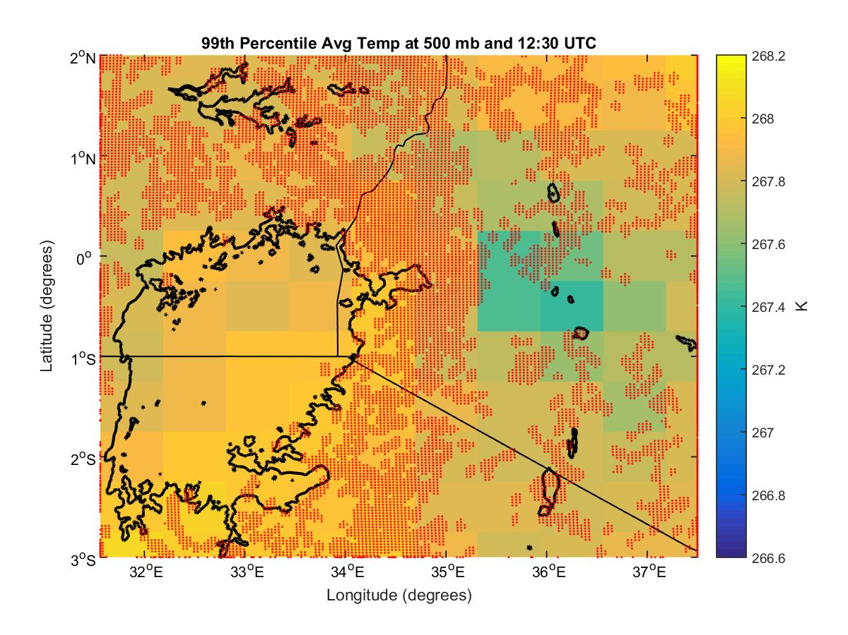
Wise County
African Great Lakes Weather II
99th percentile 30-day average temperature at 500 mb and 12:30 UTC (coordinated universal time) complied using temperature data from NASA’s Modern-Era Retrospective Analysis for Research and Applications (MERRA) and plotted in MATLAB. This can be used to determine meteorological conditions leading up to days with average weather and days with severe storms.

Slide 4
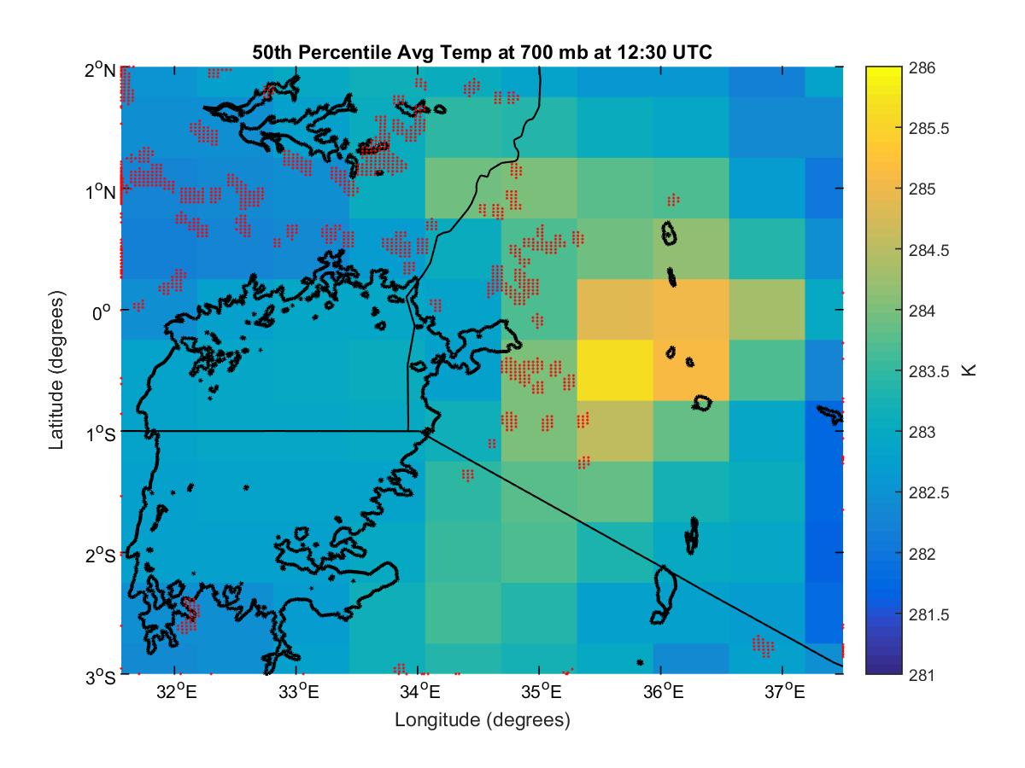
Wise County
African Great Lakes Weather II
50th percentile 30-day average temperature at 700 mb and 12:30 UTC (coordinated universal time) complied using temperature data from NASA’s Modern-Era Retrospective Analysis for Research and Applications (MERRA) and plotted in MATLAB. This can be used to determine meteorological conditions leading up to days with average weather and days with severe storms.

Slide 5
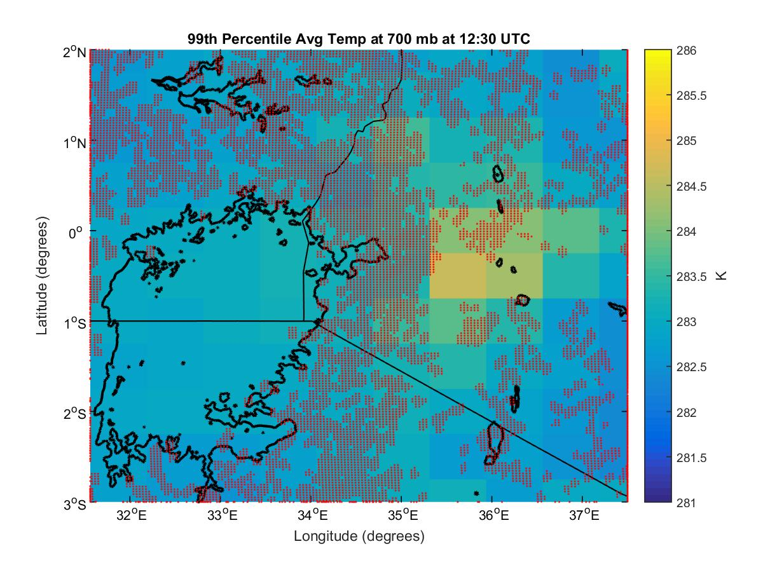
Wise County
African Great Lakes Weather II
99th percentile 30-day average temperature at 700 mb and 12:30 UTC (coordinated universal time) complied using temperature data from NASA’s Modern-Era Retrospective Analysis for Research and Applications (MERRA) and plotted in MATLAB. This can be used to determine meteorological conditions leading up to days with average weather and days with severe storms.

Slide 6
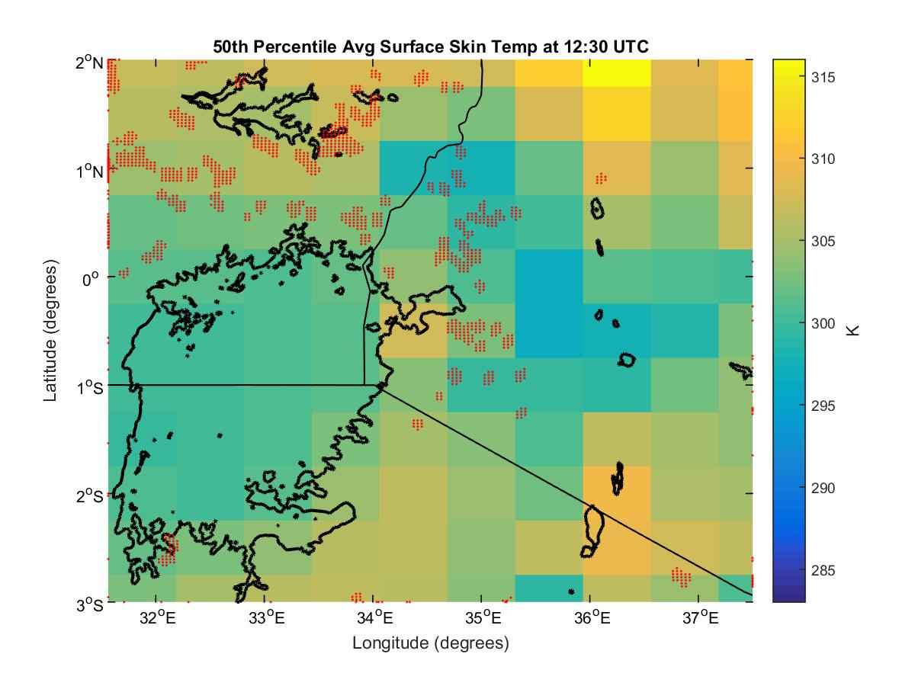
Wise County
African Great Lakes Weather II
50th percentile 30-day average temperature at the surface and 12:30 UTC (coordinated universal time) complied using temperature data from NASA’s Modern-Era Retrospective Analysis for Research and Applications (MERRA) and plotted in MATLAB. This can be used to determine meteorological conditions leading up to days with average weather and days with severe storms.

Slide 7
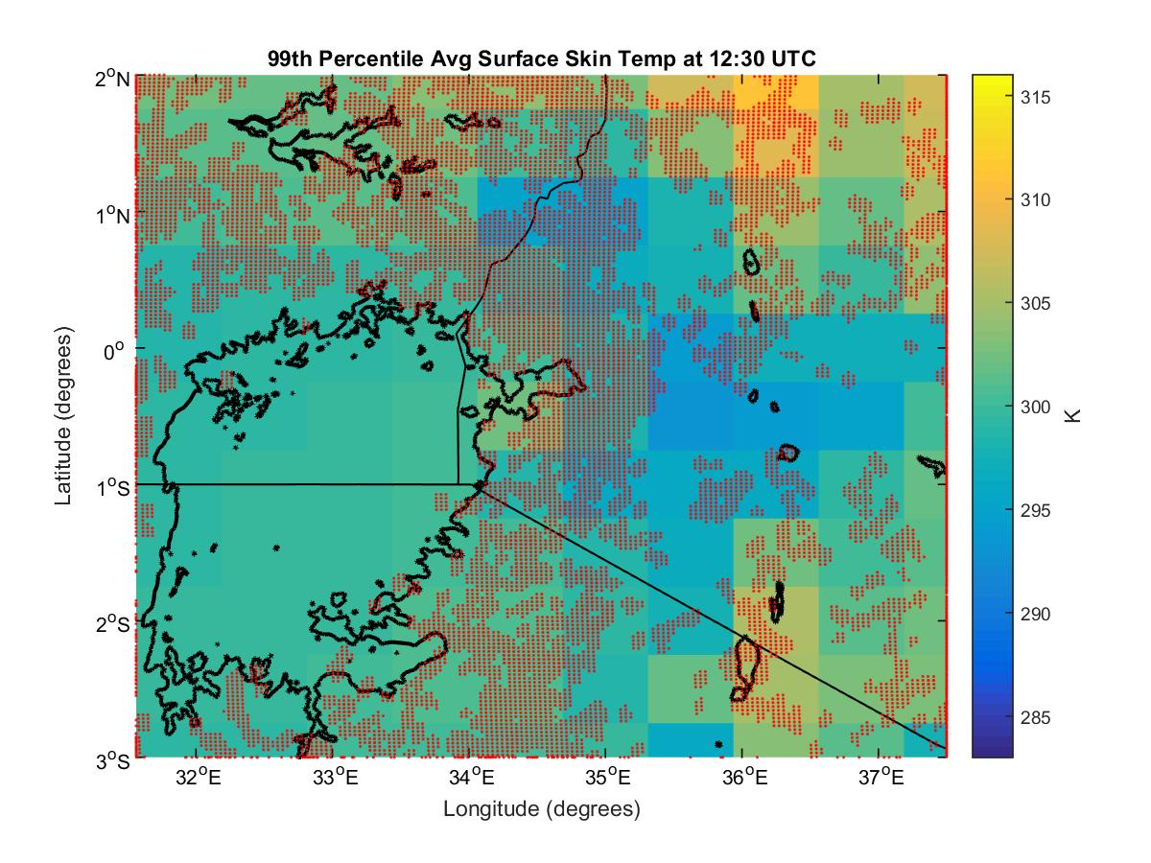
Wise County
African Great Lakes Weather II
99th percentile 30-day average temperature at the surface and 12:30 UTC (coordinated universal time) complied using temperature data from NASA’s Modern-Era Retrospective Analysis for Research and Applications (MERRA) and plotted in MATLAB. This can be used to determine meteorological conditions leading up to days with average weather and days with severe storms.

