Slide 1
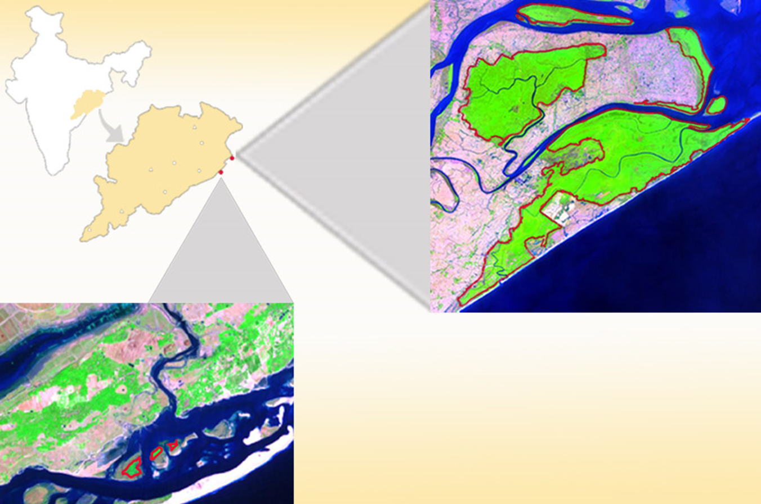
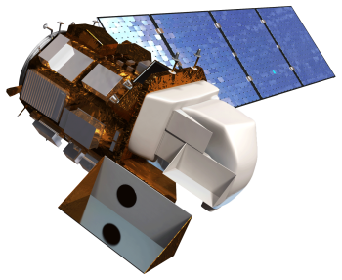
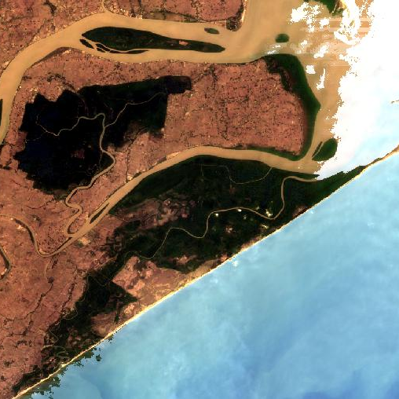
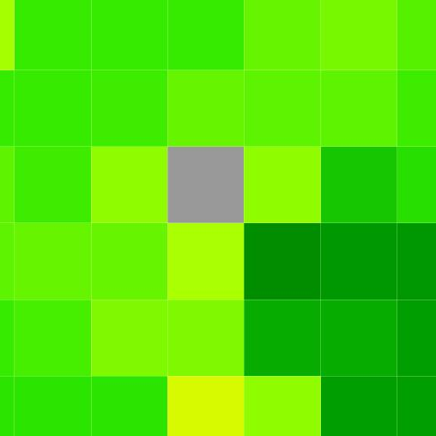
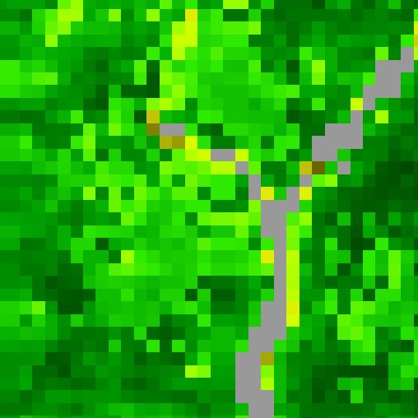
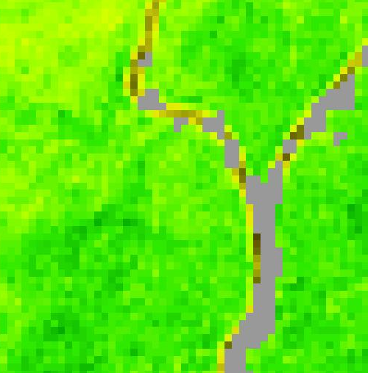
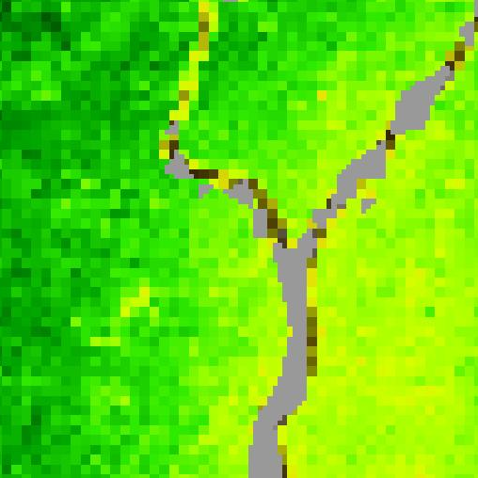
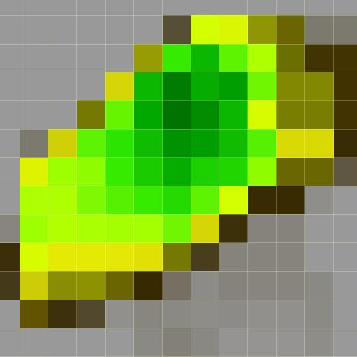
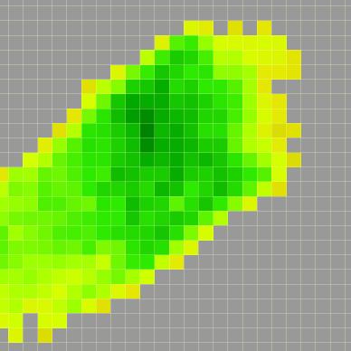
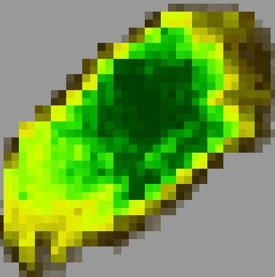
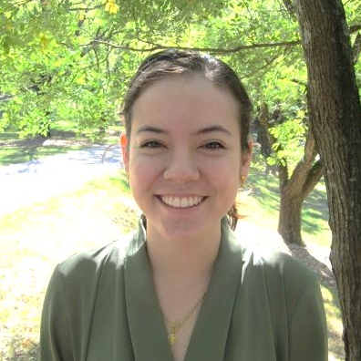
A Multi-Sensor Approach to Enhance the Prediction of Mangrove Biophysical Characteristics in Bhitarkanika Wildlife Sanctuary and Chilika Lagoon, Odisha, India
Abstract
Objectives
Mangroves, one of the most productive ecosystems on Earth, play a major role in coastal ecosystem processes from mitigating erosion to acting as a barrier against tidal and storm surges associated with tropical cyclones. India has about 5% of the world’s mangrove vegetation, and over half of it is found along the east coast of the country. Chilika Lagoon and Bhitarkanika Wildlife Sanctuary are Ramsar sites of international wetland importance that are both situated in the state of Odisha along the east coast of India. Chilika Lagoon holds three small, but distinct mangrove patches, while Bhitarkanika Wildlife Sanctuary has several large, dense patches of mangroves. There is growing concern for the effective management and conservation of these mangrove forests. This study demonstrated the ability to identify early-stage mangrove degradation using data collected from Terra and the Landsat series. Biophysical characteristics of mangroves were determined through the evaluation of chlorophyll content (CHL), leaf area index (LAI), and gross primary productivity (GPP). Sentinel-2 and ASTER data were used to enhance the spatial resolution. Various vegetation indices were implemented to examine band sensitivity in relation to mangrove leaves. The time series developed in this study revealed a phenological pattern for mangrove biophysical characteristics corresponding to different seasons such as higher concentrations during the wet season and lower during the dry season due to fluctuations in salinity and soil moisture content. The results of this study will be used as an efficient and non-destructive biophysical mapping and monitoring protocol for mangrove forests in restoration decision-making.
Develop a multi-sensor mangrove biophysical characteristics prediction tool for Bhitarkanika Wildlife Sanctuary and Chilika Lagoon by using moderate resolution remote sensing reflectance data.
Derive a phenology in order to enhance management and restoration efforts by the Department of Forest and Environment in Odisha, India.
Study Area
India
Odisha
Satellite Data
Standard Surface Reflectance Products
Landsat OLI | Terra MODIS
CHL Model
Spatiotemporal Bio-physical
Parameter Maps
LAI, GPP, CHL
True Color Images
TOA Products
Sentinel-2 | Terra ASTER
8-Day Standard Product
Terra MODIS
Resampled to 1km
Surface Reflectance
(500m)
GPP, LAI
(1km)
Vegetation Index
NDVI
Seasonal Mangrove Analysis
Atmospheric Correction
GPP, LAI Model
Bhitarkanika Wildlife Sanctuary
Methodology
0
kilometers
15
Red polygon outlines mangrove area
Chilika Lagoon
Image Credit: Eastern India Ecological Forecasting
Earth Observations
Satellite | Instrument(s) | Image
Landsat 8 | Operational Land Imager (OLI)
Terra | Advanced Spacebourne Thermal Emission and Reflection Radiometer (ASTER) Moderate Resolution Imaging Spectroradiometer (MODIS)
Sentinel-2 | MultiSpectral Instrument (MSI)
Correlation
Eastern India Ecological Forecasting
Comparison
Results
Conclusions
Fall
Winter
Spring
Summer
78
Bhitarkanika
The methodology developed in this study can be used to predict mangrove biophysical parameters, including CHL, GPP, and LAI.
All biophysical parameters followed a similar seasonal pattern reaching peak values in the fall season, moderate values in the winter and spring seasons, and low values in the summer season.
Cross-calibration is required for Top of Atmosphere (TOA) Products, such as Sentinel-2 and ASTER, because they differ in atmospheric correction technique.
The accuracy of biophysical models can be further improved by incorporating field data.
CHL (µg/cm²)
MODIS
OLI
0
56
CHL (µg/cm²)
Bhitarkanika – Landsat 8 OLI
GPP (gC/m²)
0 78
ASTER
MSI
0
6
Chilika
Acknowledgements
LAI
Science Advisor: Dr. Deepak Mishra, University of Georgia, Department of Geography
Partner: Dr. Gurdeep Rastogi, Senior Scientist, Chilika Development Authority
0
MODIS
OLI
78
Project Partners
CHL (µg/cm²)
CHL (µg/cm²)
ASTER
MSI
Government of Odisha, Department of Forest and Environment, Chilika Development Authority
0
0 78
Team Members
Chilika – Landsat 8 OLI
56
GPP (gC/m²)
0
LAI
6
0
Abhishek Kumar
Team Lead
Roger Bledsoe
Caren Remillard
María José Rivera
Jessica Staley
Patricia Stupp
University of Georgia – Fall 2016
This material is based upon work supported by NASA through contract NNL11AA00B and cooperative agreement NNX14AB60A.

