Slide 1
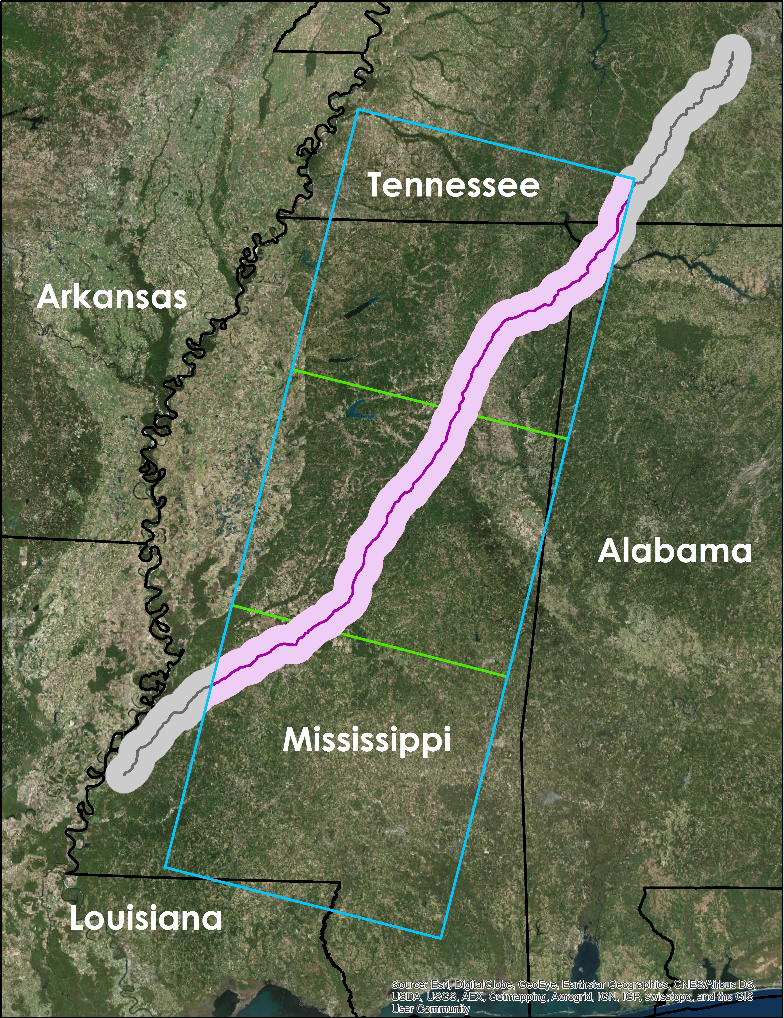
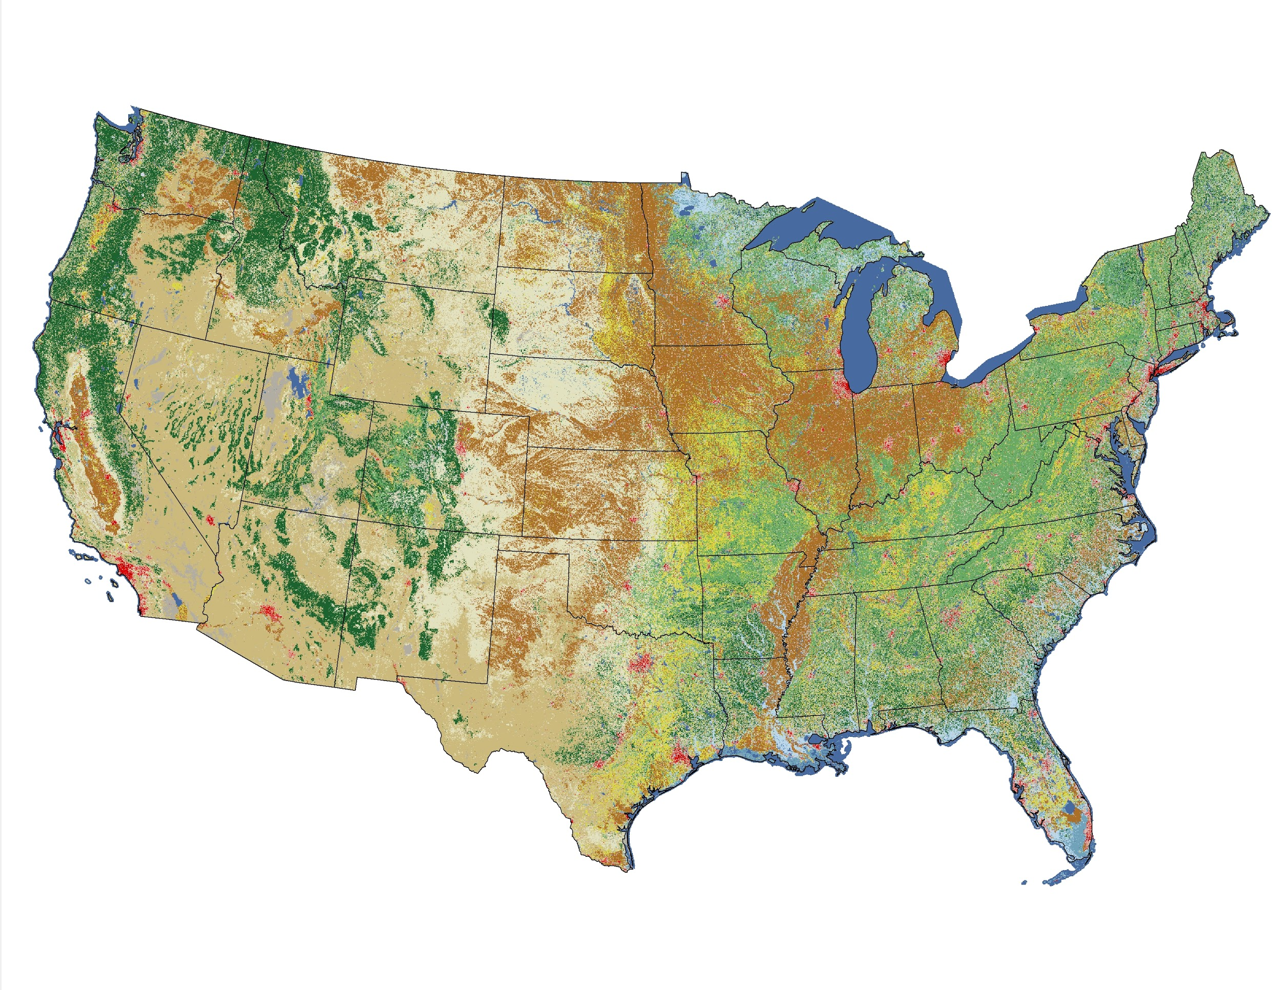
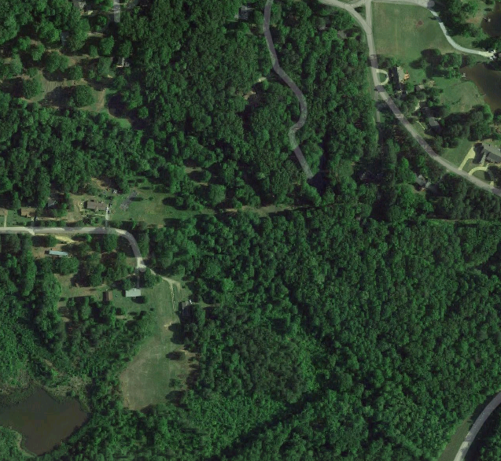
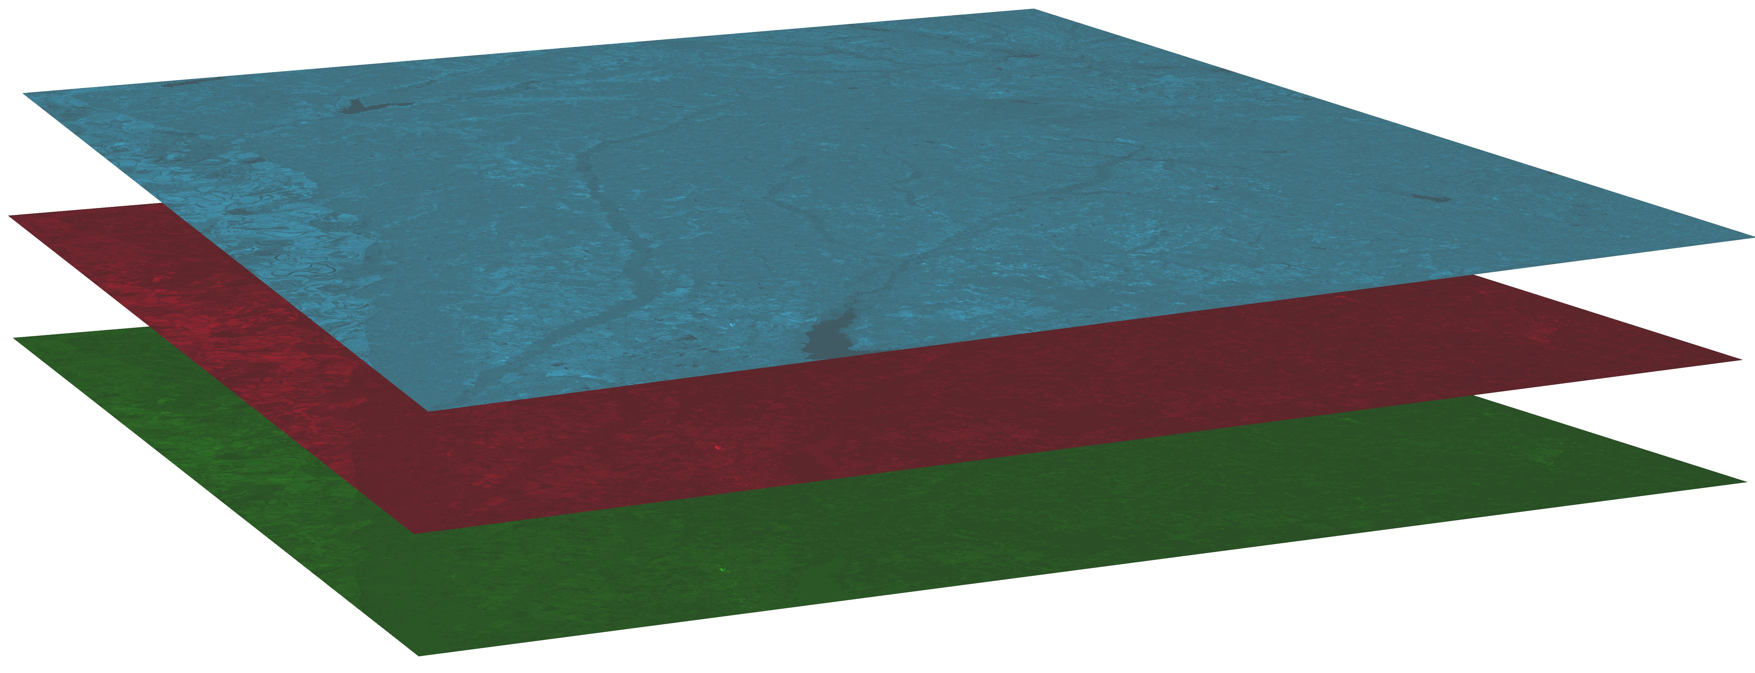
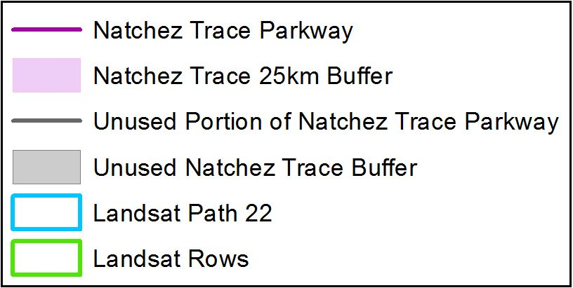
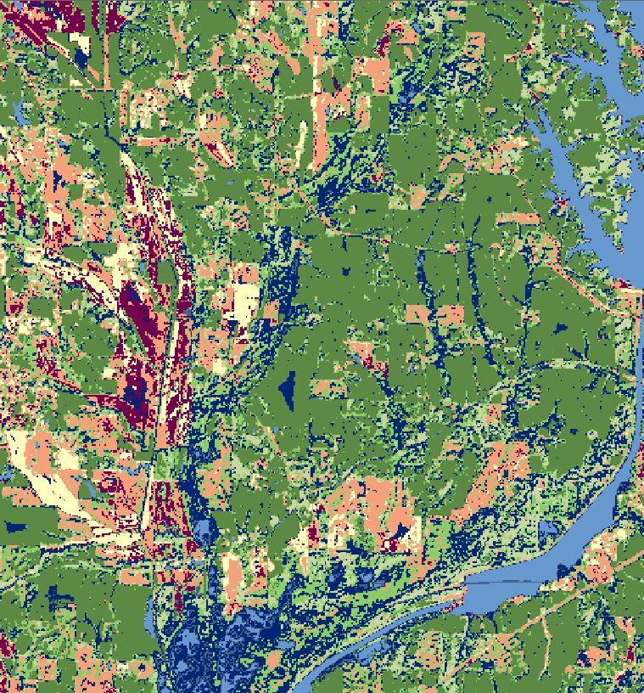
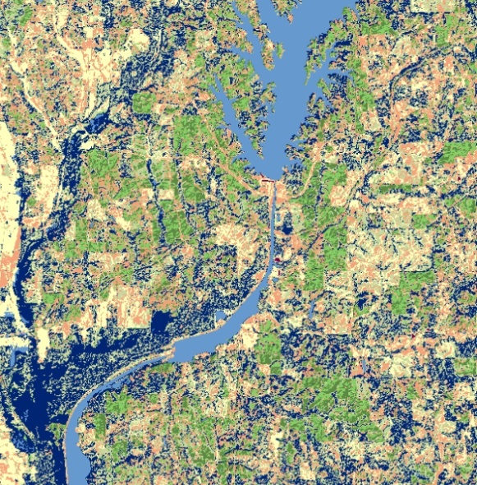
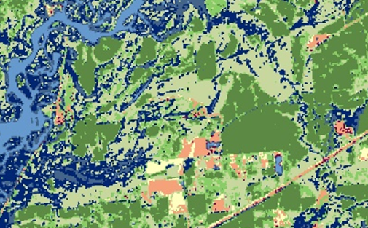
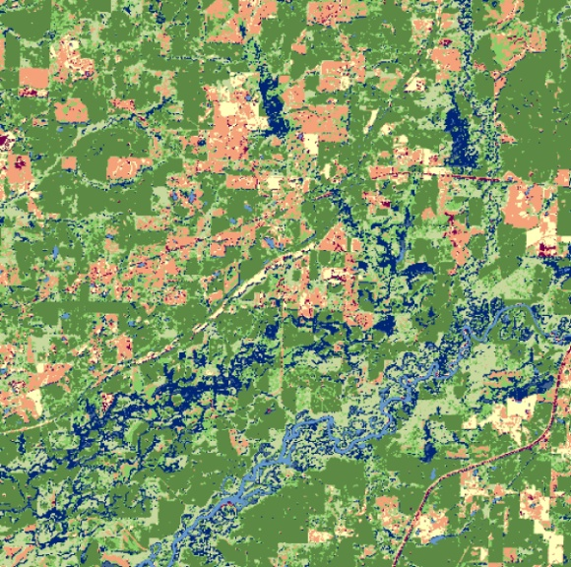
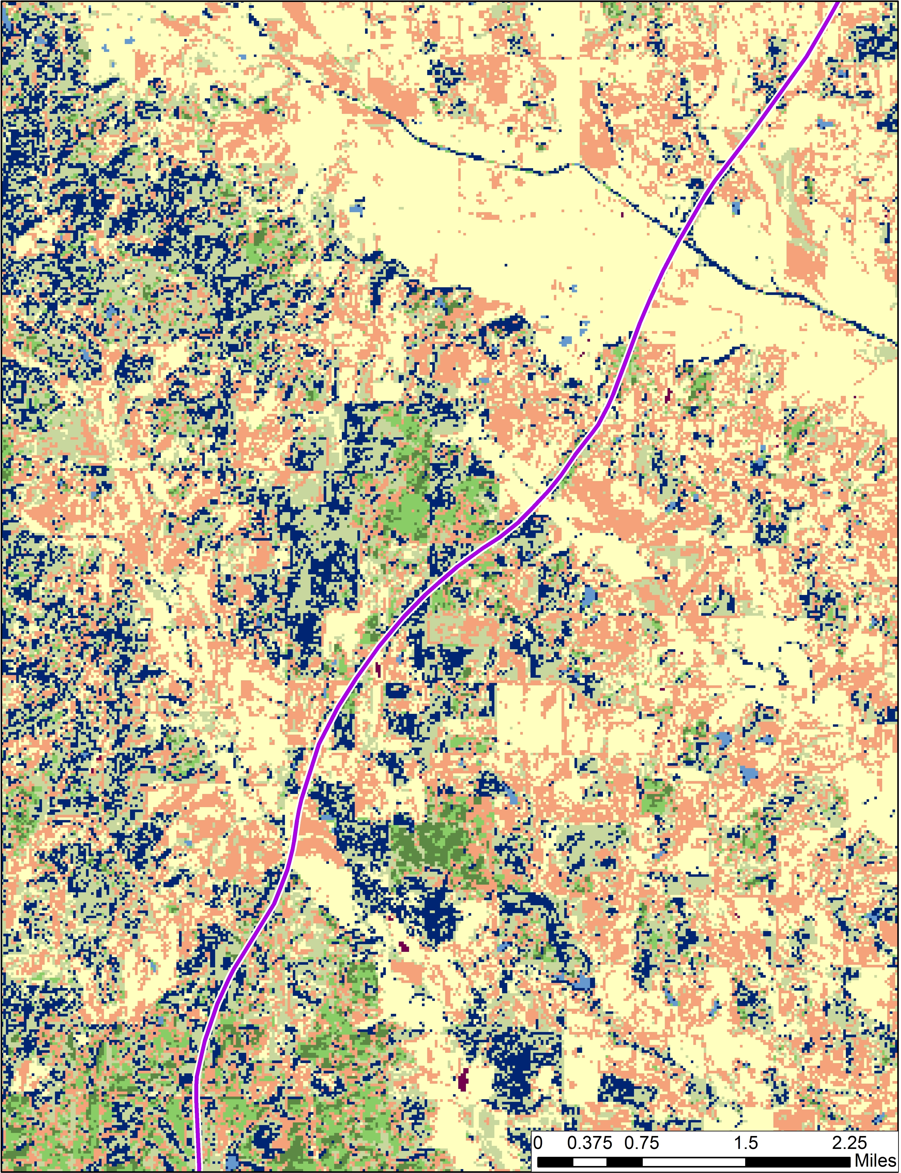
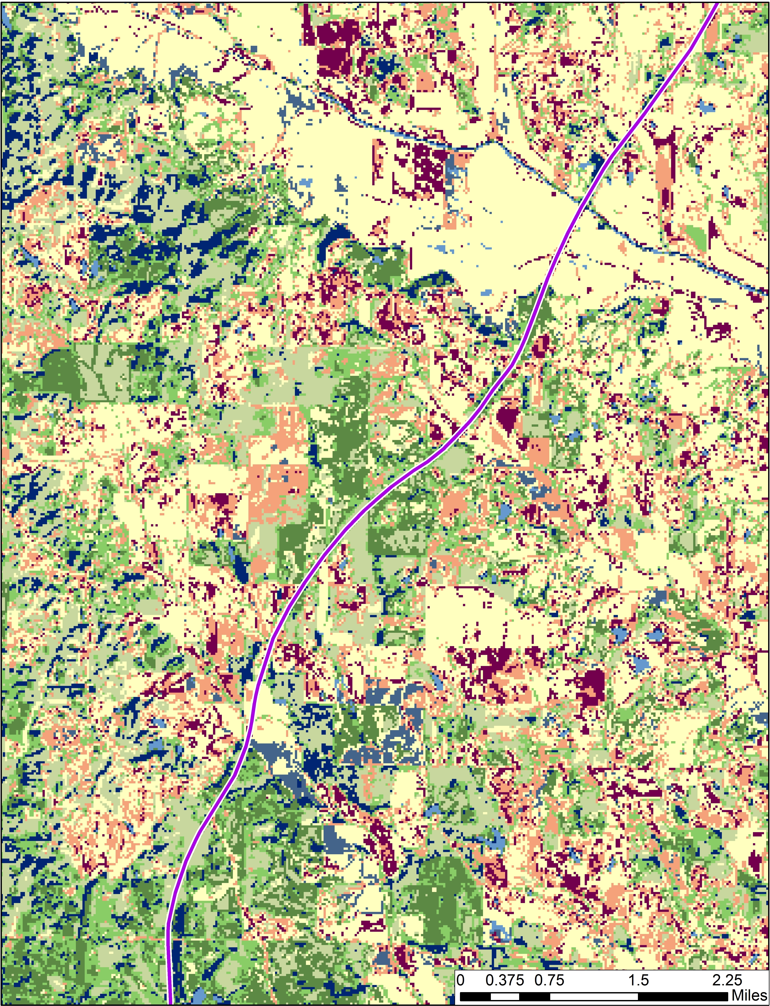
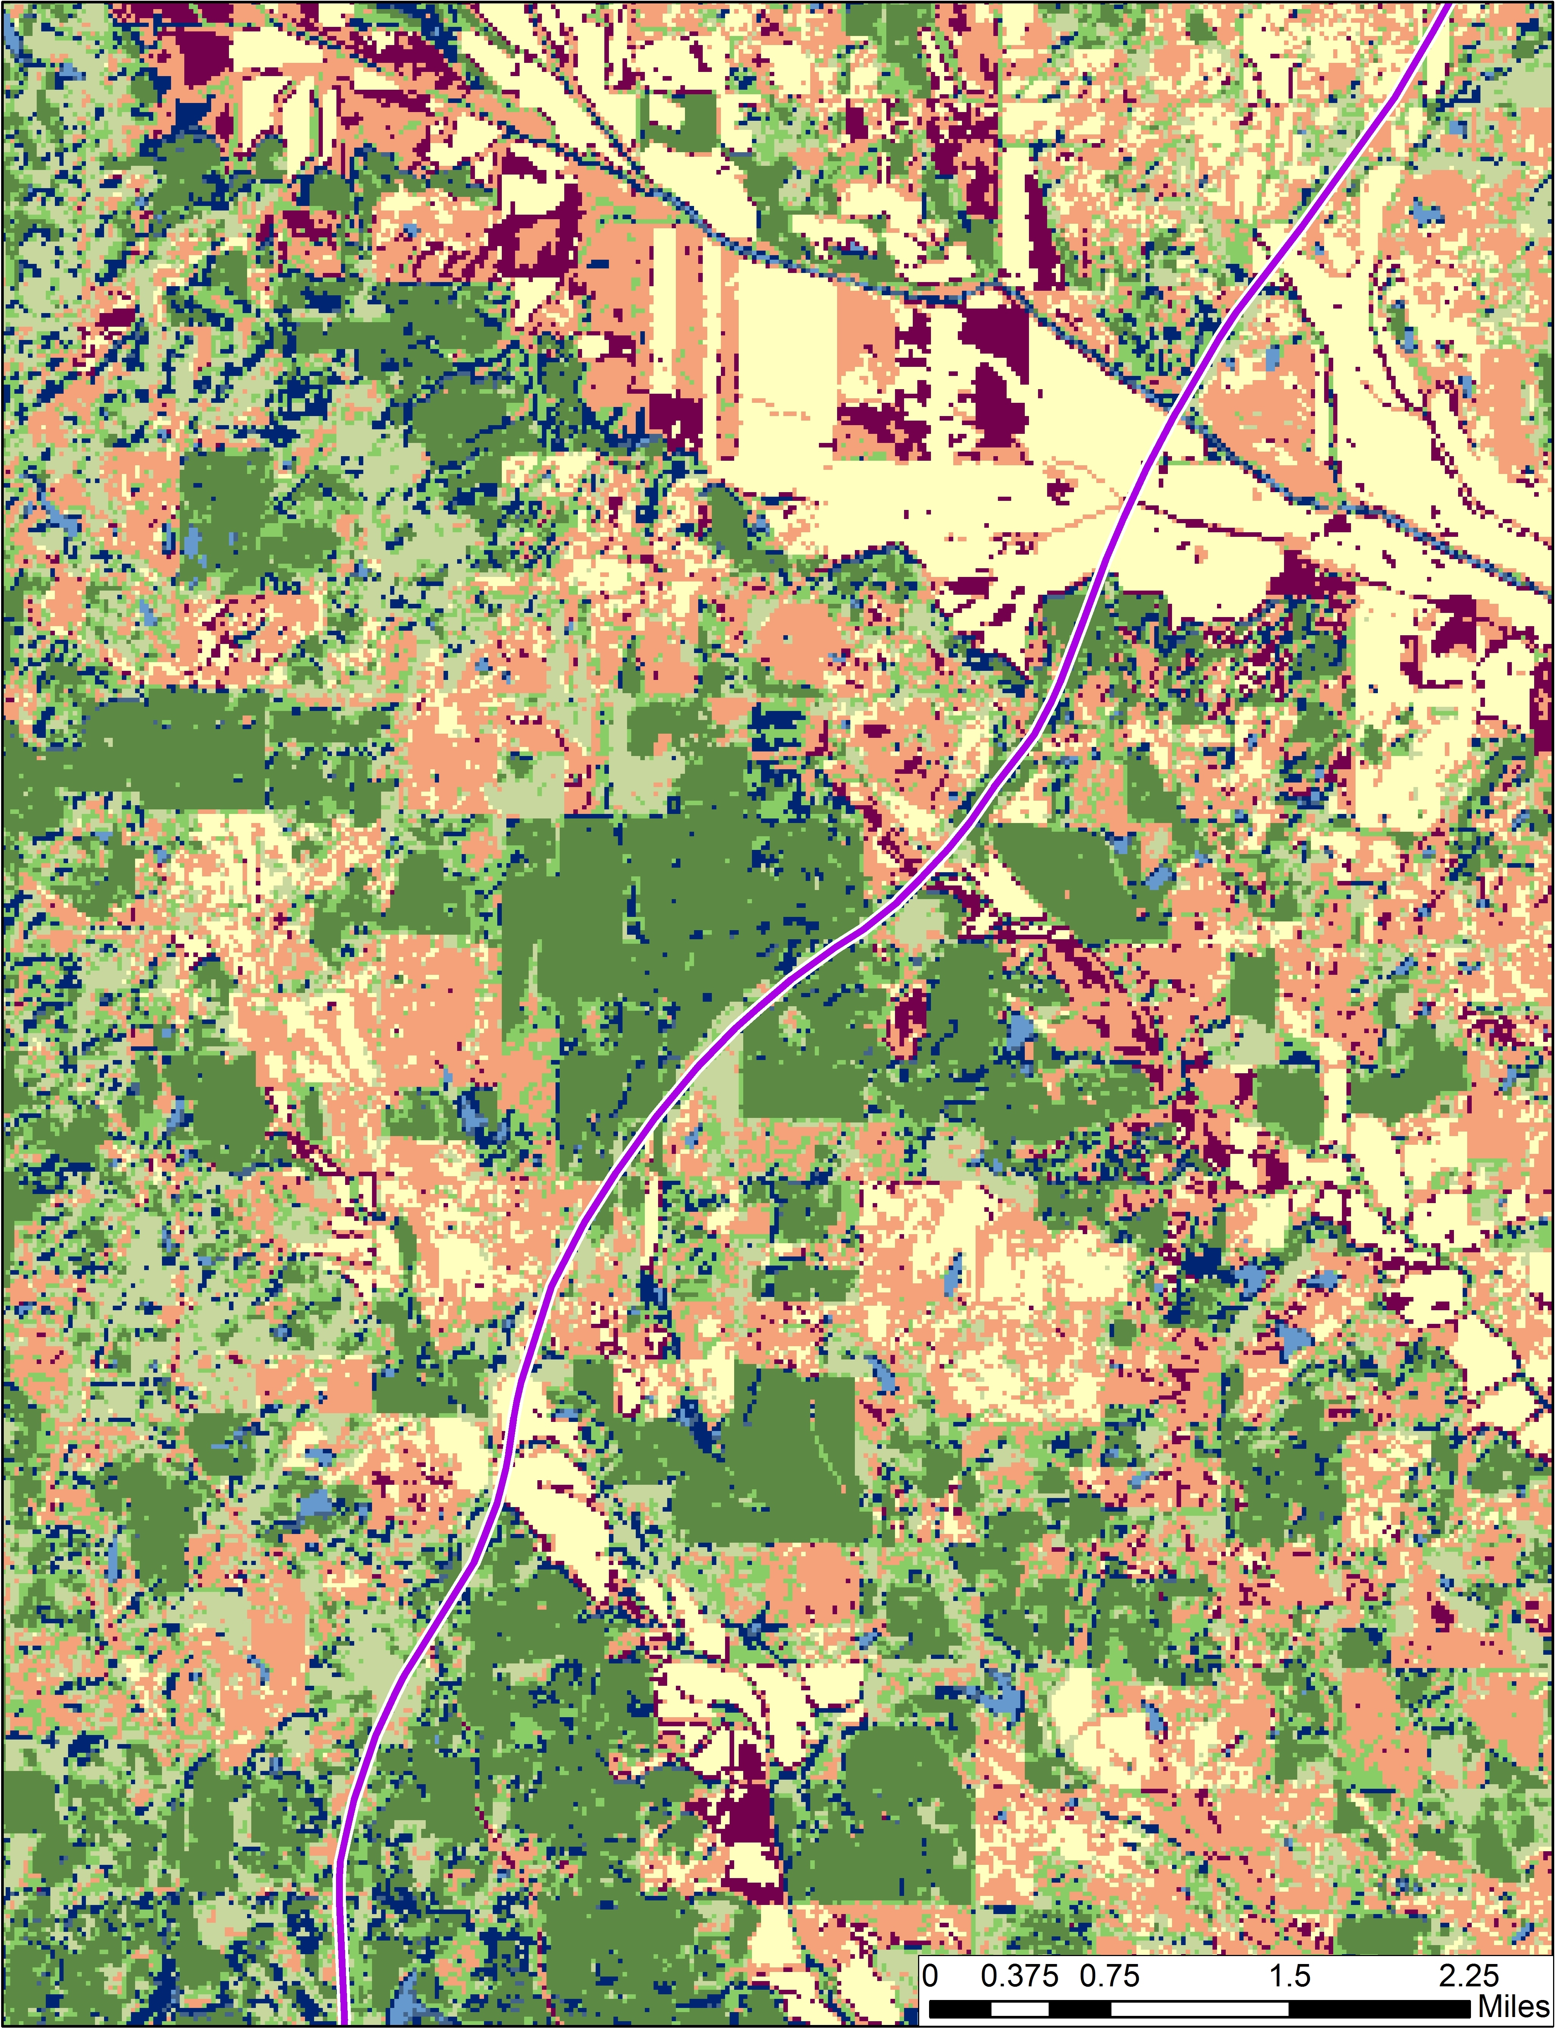
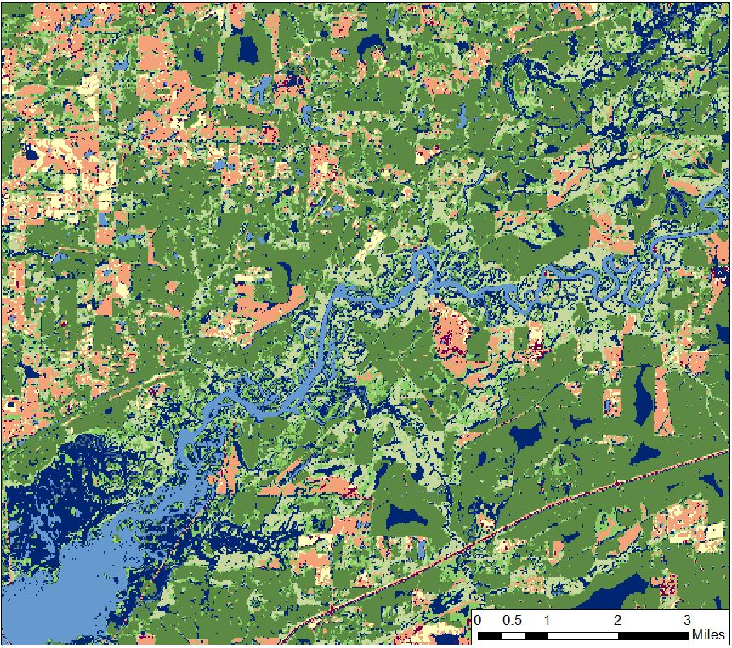
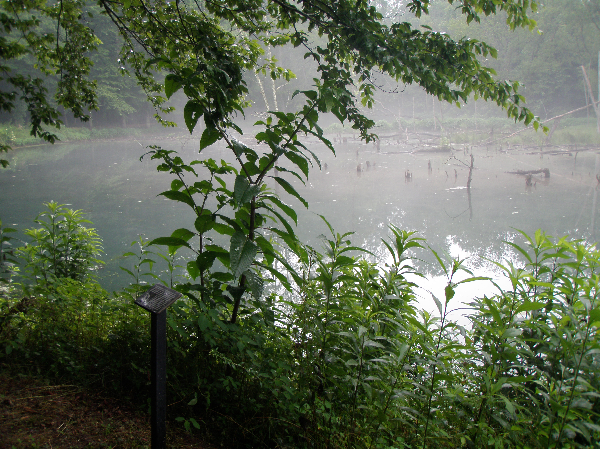
Natchez Trace Eco Forecasting
Utilizing NASA Earth Observations to Assess Current and Historic Wetland Extent along the Natchez Trace Parkway
Jennifer Rackley (Project Lead), Ashley Gideon, Tyler Lynn
NASA DEVELOP National Program at Mobile County Health Department
Abstract
Objectives
This project partnered with the National Park Service (NPS) to produce needed land cover mapping products for the Natchez Trace Parkway and to address community concerns involving the past, current, and future wetland conditions of this area. The parkway occurs in Mississippi, Alabama, and Tennessee. Beavers have altered current and historic wetland conditions in the study area by changing streamflow along adjacent rivers and tributaries. While the ecological services provided by these beavers can benefit wetland ecosystems, indiscriminate and excessive dam building has caused issues with flooding, property damage, and road maintenance within the parkway. NASA Earth observations (Landsat 5 TM, 7 ETM+, and 8 OLI) and ERDAS IMAGINE were used to generate a time series of land use/land cover (LULC) classification maps from October 1992 to January 2015 showing wetland status occurring along the parkway. A projected LULC classification map was also produced using TerrSet LCM software. This LULC time series and modeled projection will aid the NPS in wetland conservation and beaver management plans throughout the Natchez Trace Parkway.
Provide information for wetland extents to aid management and maintenance strategies
Produce a time series of wetland extents for the Natchez Trace Parkway from1992 to 2015
Produce a map of modeled wetland extents for 2020
Study Area
The study area included the portion of the parkway contained within the Landsat path 22, spanning across Mississippi, Alabama, and Tennessee. The study period ranged from 1992 to 2015.
Methodology
Data
Landsat 5 TM
Landsat 7 ETM+
Landsat 8 OLI
USGS National Land Cover Database (NLCD)
Google Earth
Red
NIR
SWIR
Processing
Earth Observations
Leaf-on data
Leaf-off data
Accuracy Assessment
1992 classification
TerrSet Land Change Modeler
Landsat 7
Enhanced Thematic Mapper Plus (ETM+)
Stacked Landsat data for leaf-on and leaf-off months
Classified image
2015 classification
2020 predicted land cover change
Landsat 5
Thematic Mapper (TM)
Landsat 8
Operational Land Imager (OLI)
Results
Time Series Land Cover Classification
Wetland Extent Prediction
Conclusions
Decreases in agriculture land
Large increases in coniferous forest
Net loss in wetland classes
Increases in all priority areas
Milepost 293 had few changes
Milepost 330 developed several new wetland pockets
1992 – 2015: General trends
2015 – 2020: Wetland changes for NPS priority areas
1992 Classification
2002 Classification
2015 Classification
Team Members
2020 Predicted Land Cover Change
Project Partner
Acknowledgements
National Park Service (NPS)
Dr. Bert Eichold, M.D., Dr. PH
Public Health Officer, Mobile County Health Department
Joe Spruce
Science Advisor, NASA Stennis Space Center
Dr. Kenton Ross
DEVELOP National Science Advisor, NASA Langley Research Center
From left to right: Jennifer Rackley, Tyler Lynn, and Ashley Gideon
Image credit: Deanna Boensch
National Park Service
Mobile County Health Department

