Slide 1
New England Water Resources
Multispectral Monitoring of New England Freshwater Resources to Assess Turbidity, Algal Blooms, and Water Quality for Enhanced Natural Resource Management
Tiffani Orne (Liberty University)
Hayley Solak (Clark University)
Sam Weber (Virginia Polytechnic Institute and State University)
Notes:
Name, School, Major
Location?
New England Water Resources Team

Slide 2
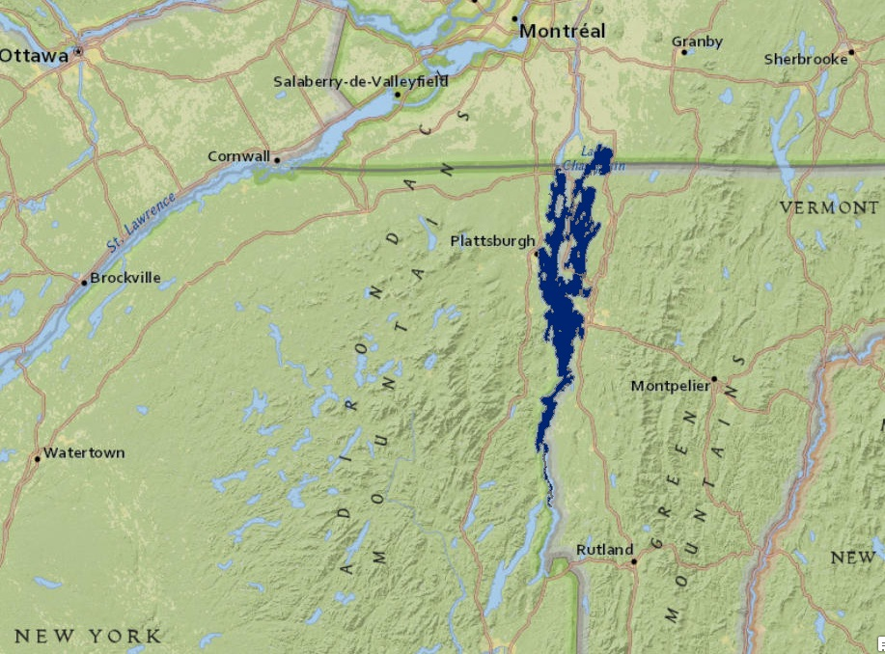
Lake Champlain
2002 - 2013
May through October
Notes:
The study area for this project was Lake Champlain, which is located on the border between the states of New York and Vermont. The northern part of the lake also branches into Quebec, Canada.
The study period was May through October, 2002-2013
-Summer months were selected, because they are the months in which Harmful Algal Blooms (HABs) occur
-Aqua was launched in 2002, so the earliest data are from July
-Most recent data collected were from June 2013
The partners for this project were the Lake Champlain Basin Program, Vermont Department of Environmental Conservation, and Lake Champlain Committee. Currently project partners use in situ measurement stations and volunteers to collect data. Algae concentration varies drastically throughout the lake, so measurements collected in a specific area do not provide adequate data for surrounding areas. This project provides partners with methodologies that would allow them to monitor water quality throughout the entire lake while utilizing fewer resources.

Slide 3
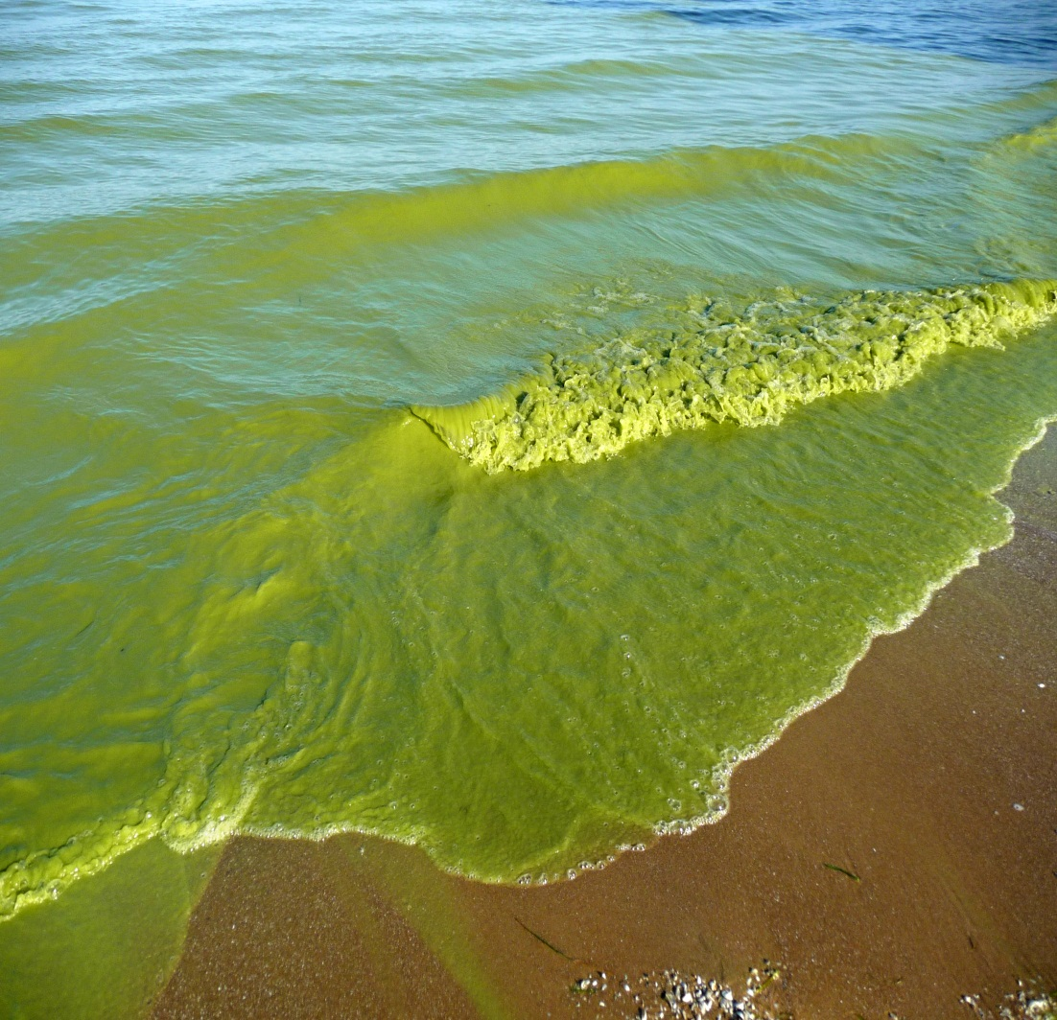
Community Concerns
Pollution sensitive organisms
24 of 300 bird species are endangered
Causes a wide range of human illnesses
No known remedies
145,000 rely on lake for drinking water
Millions of dollars in losses each year
Maybe shorten down these bullet points (either the text or number of – you could combine some [like health and economic impacts] in the bullets and then talk about the specifics for each)
http://www.newswise.com/images/uploads/2013/03/27/algae-waves.jpg
Notes:
This project is important because of the negative impacts that Harmful Algal Blooms (HABs) have on ecological and human health
Negative Impacts on Ecological Health
-Pollution sensitive organisms are unable to survive
-Underwater vegetation is starved of sunlight and oxygen
-Major stopping point and breeding ground for migrating birds
-More than 300 species of birds are found in the Champlain Basin, 24 of which are endangered
Negative Impacts on Human Health
-Toxins bioaccumulate in organisms commonly consumed by humans
-Affected organisms do not always show signs of toxic exposure
-Can cause a wide range of illnesses, including various types of shellfish poisoning
-No known remedies, illnesses must be waited out
-Lake Champlain provides drinking water for ~145,000 people
-No sanitizing methods to remove toxins from the water
-Local economy, tourism, and recreation impacted by millions of dollars in losses each year due to illnesses and beach closures.

Slide 4
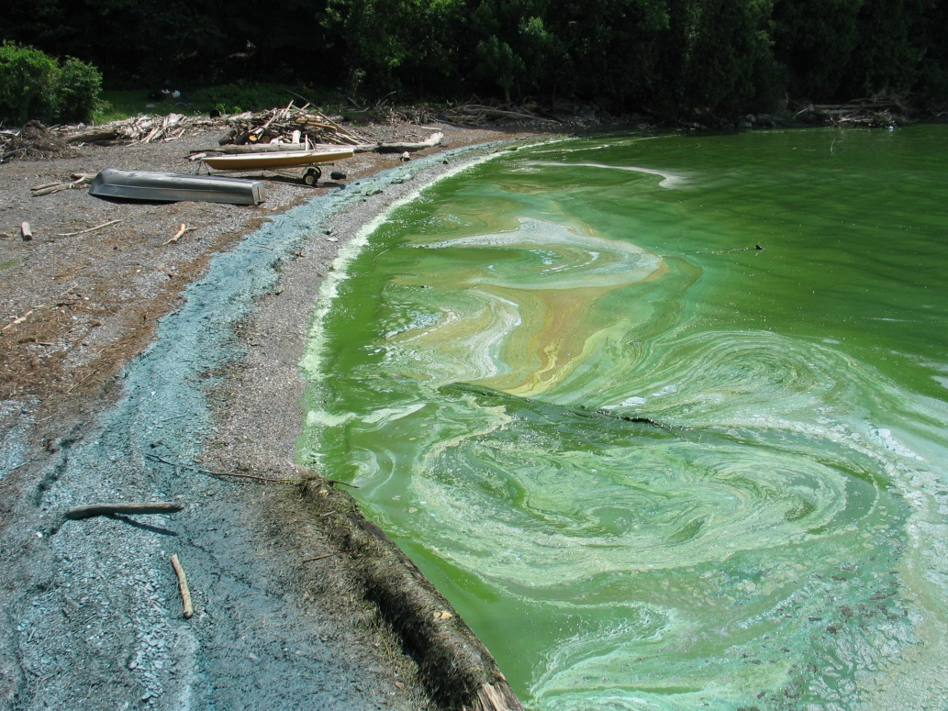
Project Objectives
Create time series of maps showing trends in algal bloom presence over time
Create concentration maps, with correlation to measured values
Chlorophyll-a
Cyanobacteria
Phycocyanin
Total Suspended Sediment (TSS)
Photo credit: http://www.fox44abc22yourvoice.com
Notes:
The purpose of this project was to create maps showing the concentrations of chlorophyll-a, cyanobacteria, phycocyanin, and suspended sediment throughout Lake Champlain in order to demonstrate that water quality can be accurately assessed using NASA Earth observations. Maps of estimated TSS were created to show that algal blooms can be detected on a more regular basis using algorithms for Total Suspended Sediment. Scatterplots and statistical correlation analyses were used to show correlation between in situ measurements and calculated values. Maps of each parameter were also compiled into a time series to show change throughout the study period.

Slide 5
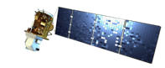
Maps of Different Concentrations
Landsat 7 ETM+
Landsat 8 OLI
Chlorophyll-a Band Ratio
-46.51 + 105.30(RB2/RB1) – 40.39(RB3/RB1)
Cyanobacteria Band Ratio
-0.6858 + 1.616(RB2/RB1) – 0.8025(RB3/RB1)
Phycocyanin Single Band
0.78 – 0.0539(B1) + 0.176(B3) – 0.216(B5) + 0.117(B7)
Notes:
To create the concentration maps, Landsat 7 ETM+ and Landsat 8 OLI level one data were acquired from USGS Global Visualization Viewer (GloVIS), and the Extract by Mask tool within ArcGIS was used to clip the image using a shape file of Lake Champlain
Then, chlorophyll-a, cyanobacteria, and phycocyanin concentrations were then calculated using the Raster Calculator tool
Bands one, two, and three were used to create ratios for the chlorophyll-a and cyanobacteria equations, while the phycocyanin equation used band one, three, five, and seven individually
Once the calculations were completed, the Set Null tool was used to remove erroneous cloud pixels

Slide 6
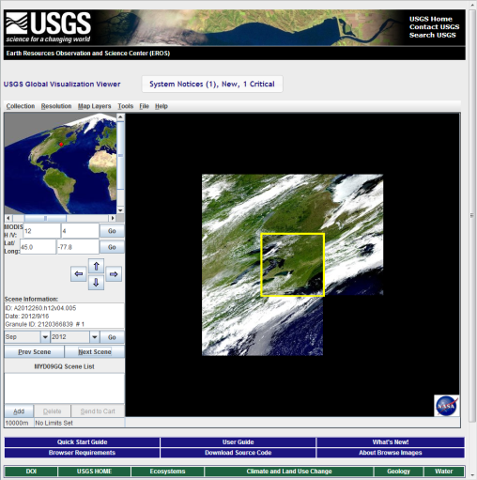
Total Suspended Sediment
MODIS L2 Daily Surface Reflectance
Aqua MODIS
TSS=602.63*(0.5157*((MODIS_Reflectance_Band)*0.0001)-0.0089) +3.1481
Total Suspended Sediment Concentration
Notes:
Aqua MODIS level two daily surface reflectance products were acquired from USGS GloVIS. A model developed by Science Advisor Dr. Kenton Ross and former DEVELOP intern Ande Ehlen was used to calculate Total Suspended Sediment.
A python script written by the team used the Extract Subdatasets tool in ArcGIS to obtain the specific bands needed for the model. The state file was extracted from the 500m/1km product, and band one and the near infrared reflectance (NIR) bands (one and two) were extracted from the 250m product.
The model used band one to calculate suspended sediment. The state file and the NIR bands were used to create cloud and water masks and remove them from the image. A shapefile of the area was also used to clip the image to the study area.

Slide 7
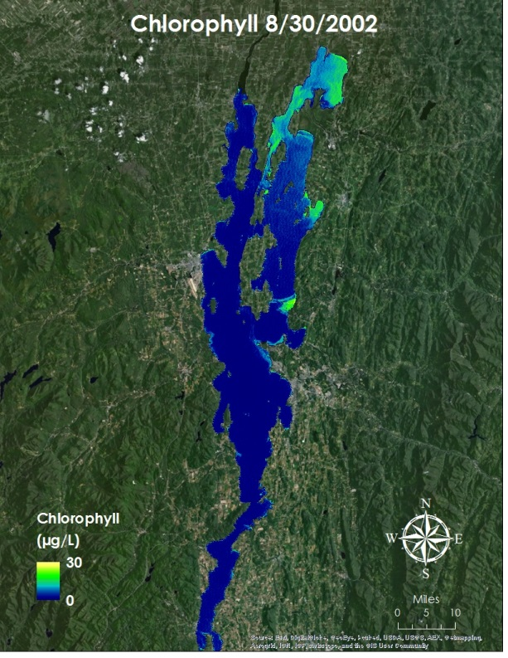
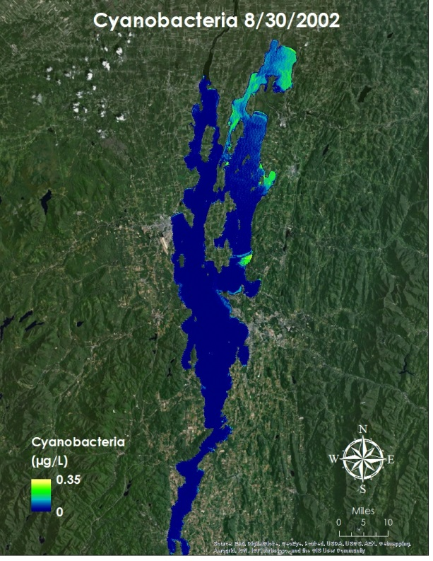
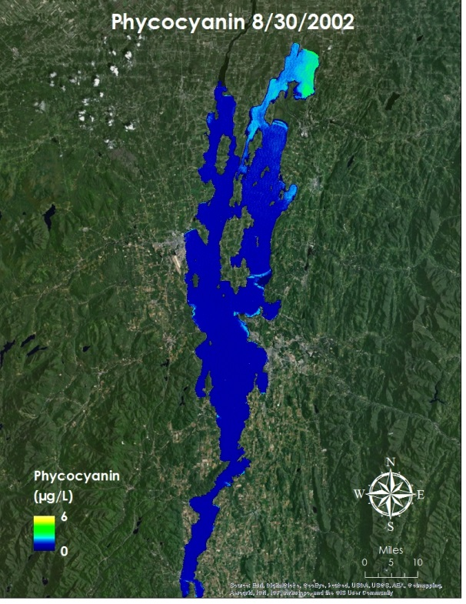
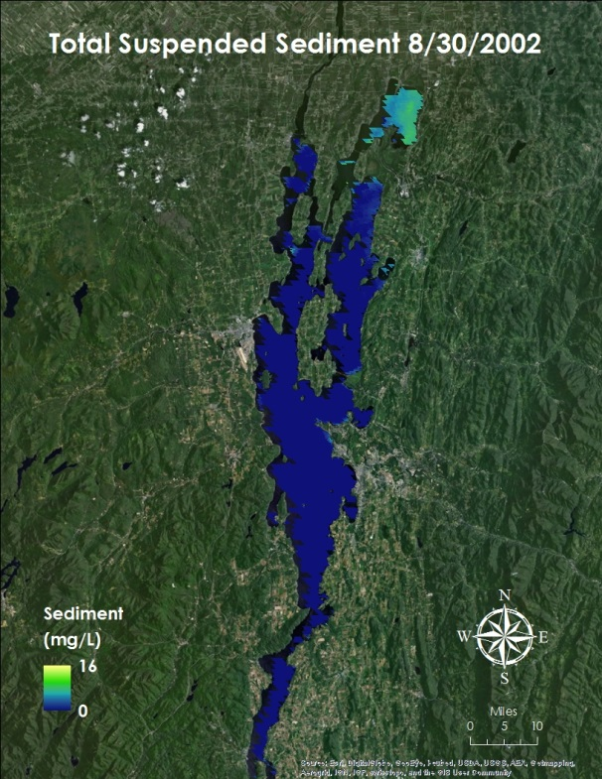
Results
Shorten the caption (or just create a title with the date at the top) or remove it all together
You could also increase the size of the titles for each map if you want what each is to be clear to the audience
Maps showing (from left to right) chlorophyll-a concentration, cyanobacteria concentration, phycocyanin concentration, and total suspended sediment concentration in Lake Champlain on August 30, 2002.
Notes:
Concentration maps were created for chlorophyll-a, cyanobacteria, phycocyanin, and TSS for every day with available data. These values were then compared to in situ data on days for which remote sensing and in situ data were both available.

Slide 8
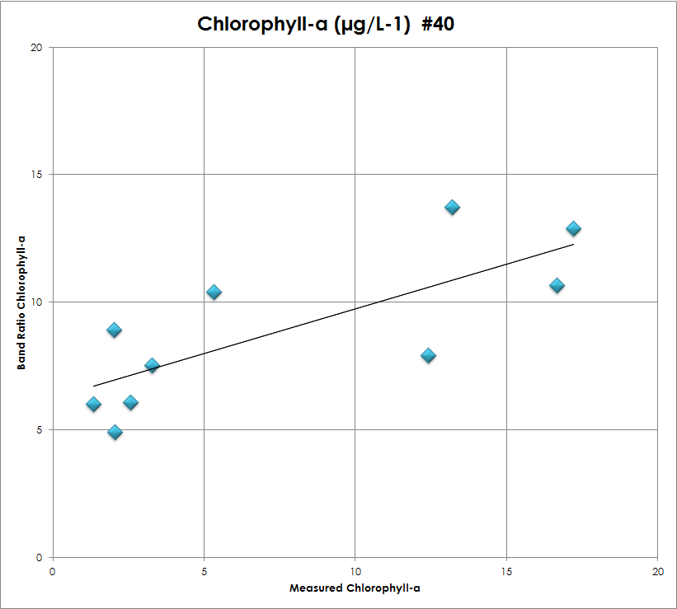
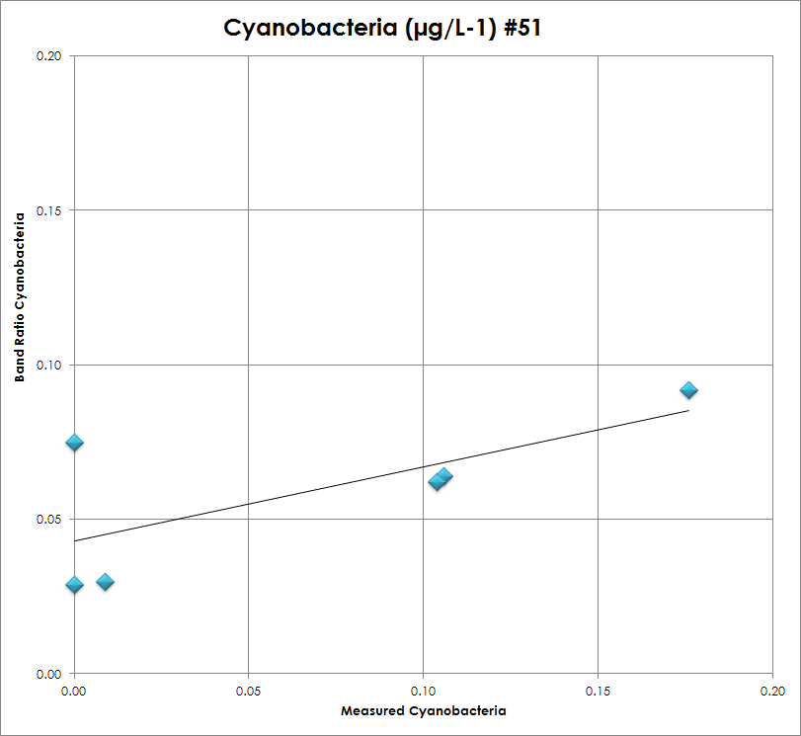
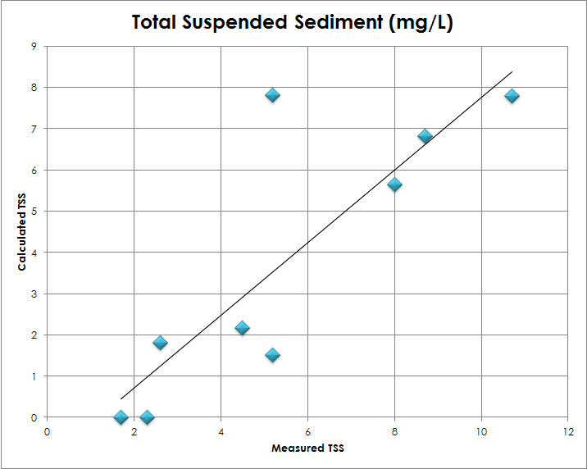
Results (Cont.)
(Left) Scatterplot showing correlation between in situ and calculated values for chlorophyll-a. (N=10, r=0. 76715)
Depending on how these look/show up during the practice on Tuesday you might want to put a block of color behind or darken the text so it shows up better
(Above) Scatterplot showing correlation between in situ and calculated values for cyanobacteria (N=6, r=0.70915)
(Right) Scatterplot showing correlation between in situ and calculated values for TSS (N=9, r=0.84074)
Notes:
Scatterplots were created to show the correlation between measured and calculated values for each parameter. Chlorophyll-a and cyanobacteria plots were created using data from one station. The TSS plot was created using data from two stations.

Slide 9
Change in Total Suspended Sediment
Notes:
Six day segment shows significant change that can occur in a single day
-Algae concentrated in Mississiquoi (miss-ISS-i-coy) Bay on Sept. 1, throughout the lake on Sept. 2, and then limited to Mississiquoi Bay again on Sept. 3
-Algae in Mississiquoi Bay decreases from Sept. 4 to Sept. 5, but then increases again from Sept. 5 to Sept. 6

Slide 10
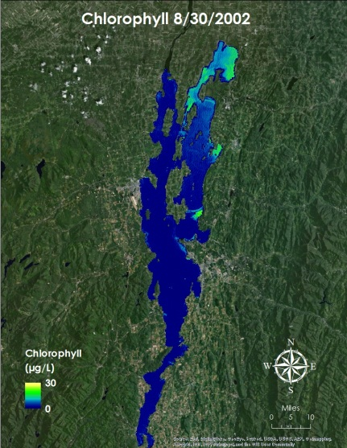
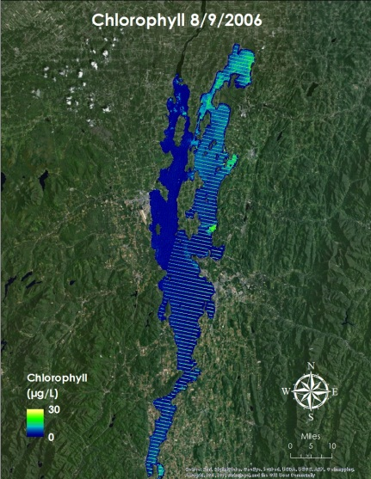
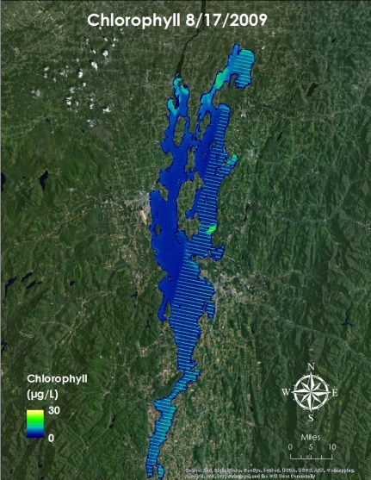
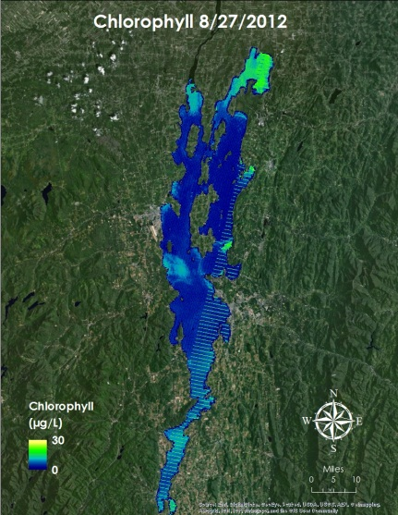
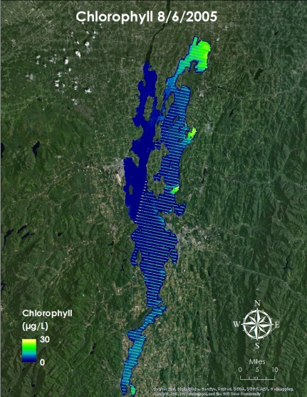
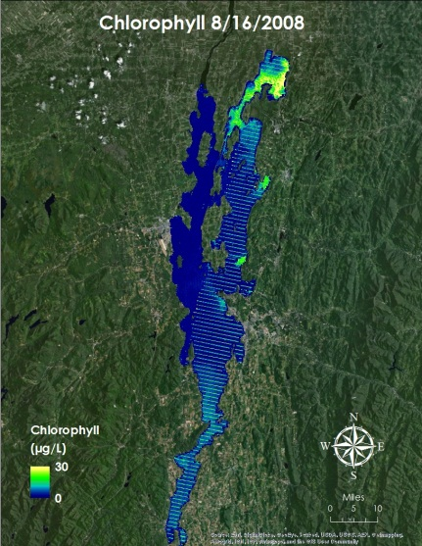
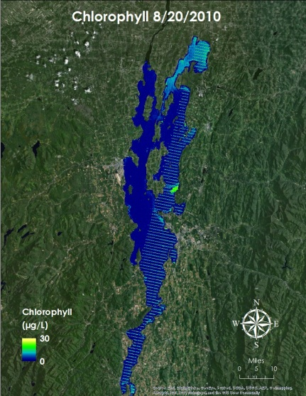
Chlorophyll-a Over Time
Same as before – consider just putting the date at the top, or you could insert a time-lapse video if you have one for cholorphyll
Chlorophyll concentration maps showing Lake Champlain during the month of August throughout the study period.
Notes:
Another collection of maps shows chlorophyll concentration in August for the years 2002, 2005, 2006, 2008, 2009, 2010, and 2012. Mississiquoi Bay and St. Alban’s Bay show consistently high chlorophyll levels.

Slide 11
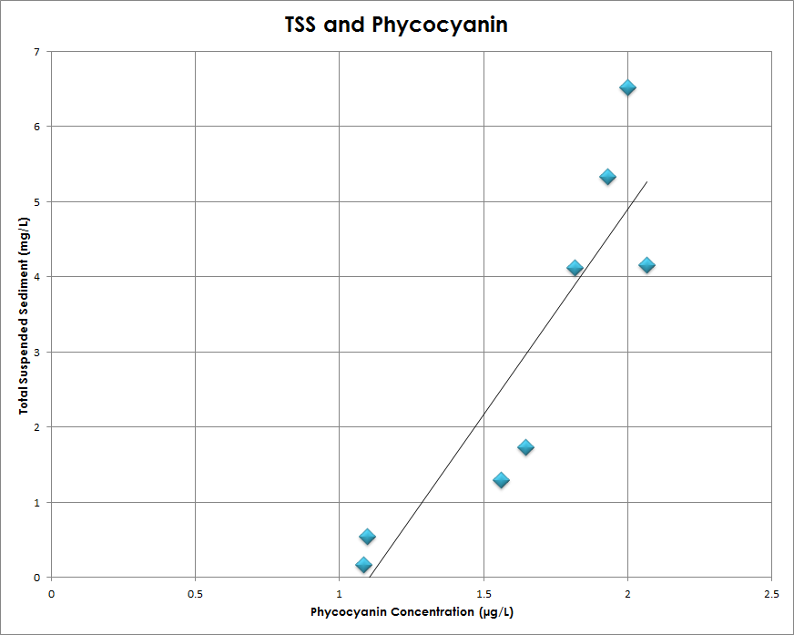
Conclusions
Biophysical parameters show correlation with in situ measurements
TSS correlates with in situ measurements, and with other parameters
A combination of the two data types provides a valuable tool for water quality monitoring
Shorten amount of text
Notes:
Concentration maps show accurate measurements
----throughout the lake rather than only in key areas
----Landsat data without significant cloud cover in this area is limited
----water quality tracking would be less frequent
Using Aqua MODIS, algal blooms can also be detected as sediment in the water
----less clear (sediment in general, not just algal blooms) and has a coarser resolution
----data is available on a much more regular basis
A combination of the two data types may provide a valuable tool for water quality monitoring.

Slide 12
Future work? Acknowledgements?
If you don’t think you’ll have enough time to get to these you’ve got all the main components ☺

