Slide 1



2019 Fall
NATIONAL
ORIENTATION
MODULE 3. Participant Expectations

Slide 2


First Week Overview
Week 1 is focused on orientation, getting to know each other, and beginning literature review.
Orientations this week fall into two categories:
  SSAI Orientation – SSAI is your contracting employer and this orientation covers logistics and company-specific systems, tasks, requirements, etc.
  DEVELOP Orientation – this introduces you to NASA DEVELOP, provides information about the people you will interact with, resources available to you, federal regulations and requirements, and insight into what you will be doing.
Fellows are your one-stop-shop when you have questions. If they can’t answer a question, they will point you to the right person to reach out to!
By The Way
It’s really typical that during the orientation overload, you will forget things. A best practice is to take notes and refer back to the materials throughout the term!

Slide 3
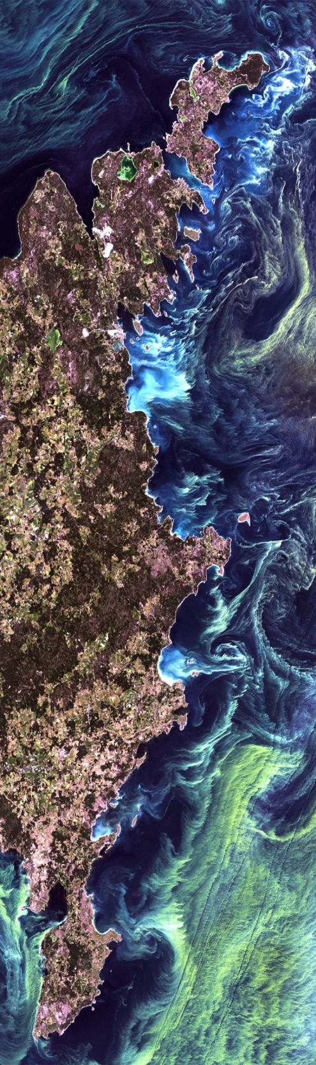
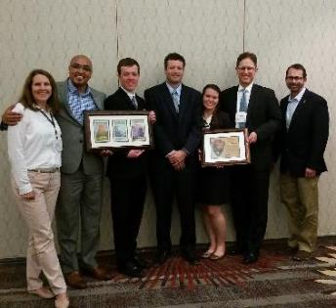
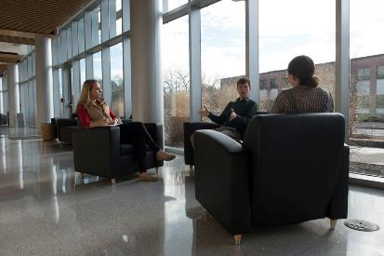
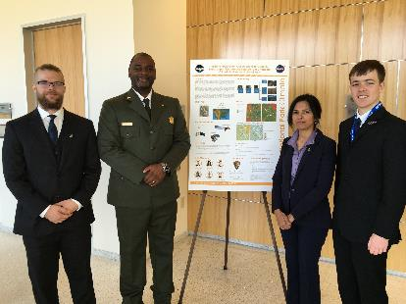
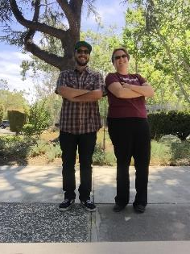
Guidebook
Provides participants with the history and logistics of DEVELOP, as well as an overview of NASA’s Applied Sciences & Capacity Building Elements, operational guidelines, information about deliverables, and resources available.
Read the guidebook and fill out and sign the NASA media release on your first day in the office.
The guidebook is a great resource for information throughout the term!
If you have a question - check there first!

Slide 4
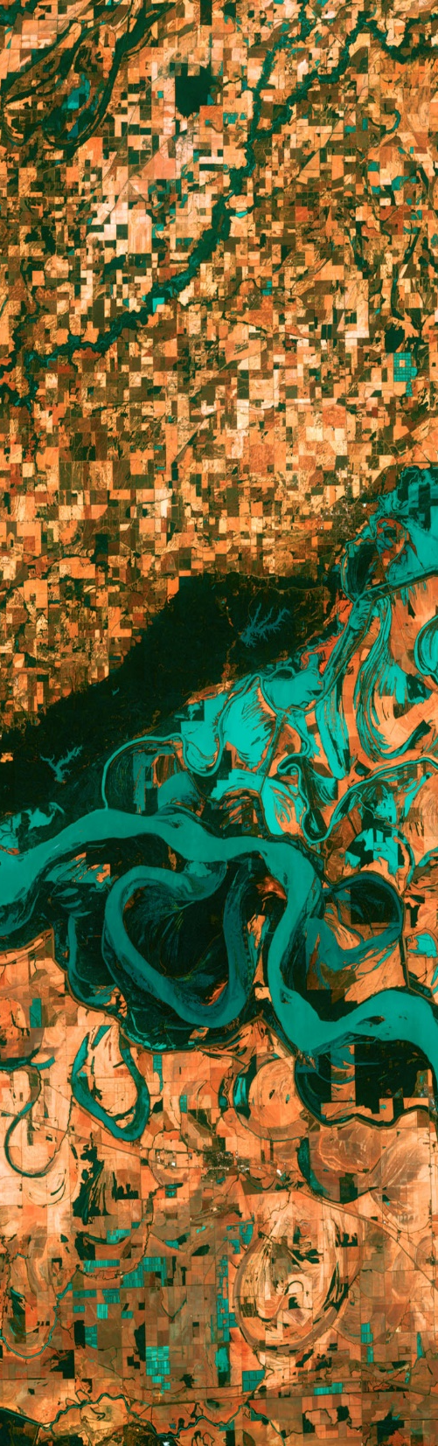
Tips for Success:
Be flexible
Have an open mind
Stay organized
Teamwork is key
Learn from those around you
Go above and beyond
Help and encourage others
Be mindful and respectful
Demonstrate integrity
Follow the rules
Have fun
Build your résumé
Be on time
Maintain a positive attitude
Promote harmony
Be ready to present any moment
Accept that things change
Expect the unexpected
Keep track of deadlines
Nomenclature matters
File management is key
Be innovative
Never plagiarize
Explore opportunities
Try new things
Network! Network! Network!

Slide 5

Professionalism & Dress Code
Professionalism is “the conduct, aims, or qualities that characterize or mark a profession or a professional person.”
DEVELOP is an opportunity for all participants to improve in their professionalism.
Characteristics of professionalism:
Reliable
Competent
Ethical
Poised
Organized
Mindful
Polite
Orderly Appearance
Calm Demeanor
Good Written & Oral Correspondence
Accountable
Daily Dress Code = Business Casual
  Pants: Khakis or slacks
  Skirts: Appropriate business casual skirts at/near knee length
  Dresses: Appropriate length (at/near knee) dresses, no spaghetti straps
  Shirt: Collared shirts, polo shirts, blouses, sweaters
  Shoes: Dress shoes (no sandals, no sneakers, no flip flops)
  Accessories & Makeup: Be conservative
  For Presentations = Formal
  Formal Suits (in simple colors – black, navy or gray) & Dress Shoes
By The Way
Why? DEVELOP’s signature is that of professionalism and respect. We respect ourselves, our partners, and NASA. We go above and beyond. We stand out from our peers. We strive for excellence in all things we do.

Slide 6

Use of Government Equipment
If you sit on a NASA Center or NOAA facility, you must ensure you follow federal protocols.
US Government computers are for authorized users only.
It is NASA's policy to permit limited personal use of Government office equipment, including information technology (IT).
The limited personal use of Government office equipment by NASA employees and contractors shall not interfere with official business, violate existing laws, and should involve only minimal additional expense to the Government.
Unauthorized use of the computer accounts and computer resources to which you are granted access is a violation of Federal Law; constitutes theft; and is punishable by law.
Misuse of assigned accounts and accessing others' accounts without authorization is strictly forbidden.
Failure to abide by these provisions may constitute grounds for termination of access privileges, administrative action, as well as civil or criminal prosecution.
NASA 2540.1G & NPR 2810.1A: http://insidenasa.nasa.gov/ocio/policy/policy_direct/index.html

Slide 7

Privacy
Expect NO privacy when using a government computer OR when emailing a government email address.
Strict computer use policy in effect – every keystroke is stored, every NASA email is public domain.
NASA Policy:
NASA employees and contractors do not have a right to expect privacy while using Government office equipment at any time, including accessing the Internet and using email.
The Government maintains call details and network access records to monitor telephone activity and internet access.
The Government also employs monitoring tools to track system performance and improper usage.
This applies to those emailing a NASA email as well.
NASA 2540.1G & NPR 2810.1A: http://insidenasa.nasa.gov/ocio/policy/policy_direct/index.html

Slide 8

Computer Usage
Online Policies:
Internet should be used for official purposes only, meaning absolutely no games, commercial radio, or music/video downloads (unless it’s for the VPS).
No Facebook, Twitter, etc. unless it’s for DEVELOP purposes!
Limited personal emails are acceptable as long as they DO NOT interfere with your project work.
Be mindful of the websites you visit and links you click on.
Be diligent against phishing attempts.
Software:
Installation of legally licensed software is permitted if the software is necessary to complete your project – but you must have approval from your Fellow.
Do not make copies of proprietary software.
If you have questions regarding permissibility of software, please contact your Fellow.
By The Way
If you log into a personal gmail while on a government computer, they can see your entire browsing history! Do you want them to see it? Think twice before you log in to personal accounts!

Slide 9


Cell Phone Usage
Be considerate of those around you and set your ringer to silent or vibrate during work hours.
Cell phone usage should be kept to a minimum, including texting.
Personal phone calls should be made during breaks or before/after work.

Slide 10

Participant Reporting
Info Sheet: This is a spreadsheet used to maintain accurate participant records & report demographic stats about program (e.g. diversity, education).
Personal Growth Assessments: These are two online assessments (entrance & exit) that collect information relating to participant skill levels and expectations, which help to gather the impact of DEVELOP, and provide valuable feedback to nodes and the program.
  Entrance Assessment - week 1
  Exit Assessment - week 10
Exit Survey: This is an anonymous online survey that we ask all participants to take. It is DEVELOP’s performance review and allows for a national perspective on the program, leadership, and advisors. It helps DEVELOP evolve and improve, and we value your input greatly!
  Link emailed - week 10
Performance Reviews: DEVELOP’s main objective is to assist participants in developing both professionally and personally. Part of this process is giving feedback in performance reviews at the middle and end of the term. Please consider this process constructive and take any feedback as goals for improvement.
  Midterm Review - typically weeks 5 or 6
  End of Term Review - typically weeks 9 or 10
Alumni Survey: In recent years, a survey has been shared with alumni to assess the impact of DEVELOP, enhance the network of alumni engaged with the program, and assess the career fields that participants progress into. We look forward to surveying you in the near future! Before you leave this term, please make sure that DEVELOP has the best email address to reach you.

Slide 11

Dealing w/Personnel Issues
Things will arise!
We are all human and sometimes forget that others are too.
#1 – Don’t put anything in writing. Should a personnel issue arise, immediately and verbally communicate the situation up the chain.
Do not send emails about the situation - remember that NASA emails are NOT private.
Make all efforts to maintain a positive work environment.
Participants can feel comfortable coming to Fellows with issues they are having with other DEVELOPers.
If you are having an issues with a Fellow or Advisor, call Karen or Amanda.
If you would like counseling for how to respond to a specific situation call Karen or Amanda.
Karen or Amanda
Fellow
Participant

Slide 12

Payments & Taxes
Pay Scales
All participants are part-time, temporary employees of SSAI
Participants are paid on a step scale based on applicant classification and education level. Each node has a specific pay rate for each classification at the various education levels.
Your classification and education level was self-identified in your application to the program.
  Classification = student, recent graduate, early/transitioning career professional
  Education level = degree held for non-students or current grade level for students
Some nodes have locality adjustments – these are set by the federal government based on cost of living in specific geographic areas.
In order for a participant to qualify for the next step pay rate, the individual must be currently taking classes or graduated at that grade level.
  Ex. a participant who finishes their sophomore year in May is only eligible to move to the next pay step in the fall once he/she begins taking junior level classes.
Taxes & Insurance
All necessary taxes will be withheld from your paycheck based on your tax enrollment forms
Foreign nationals who are from countries that do not have a tax treaty with the United States will see an automatic 30% of their payment withheld by their funding organization and sent to the IRS. To see which countries have tax treaties with the US visit this website.
It is your responsibility to have the appropriate health and medical coverage. SSAI does not provide insurance coverage for temporary employees.

Slide 13

Reapplication & Eligibility
DEVELOP Terms: 10 weeks
Classifications:
  Currently Enrolled Student
  Recent Graduate (within 2 years of graduation)
  Early or Transitioning Career Professional (2+ years after graduation from last degree)
By The Way
The spring 2020 application window opened on September 2nd and closes on October 11th. Despite it being early in the term, if you are even potentially interested, get your application in to keep options open!
Eligibility Requirements:
  18+
  Minimum 3.0 GPA (for paid positions)
  Strong interest in Earth science and remote sensing
  Able to provide personal transportation to and from DEVELOP location
  DEVELOP does not provide transportation to nodes nor can DEVELOP provide a badge to a participant’s driver to gain access to NASA Centers
  U.S. citizenship is required to apply to: ARC, JPL, LaRC, MSFC, GSFC, NCEI
Reapplication:
  Required if you would like to continue with DEVELOP in a future term
  Returning Application is shorter and does not require letters of recommendation

Slide 14
Quiz Time!
Are media release forms due in week 1?
What should participants wear if giving a formal presentation?
Are participants permitted limited personal use of government office equipment?
Is it ok to use your teammate’s account log-in when you can’t get access?
Can you expect privacy when using a government computer OR when emailing a government email address?
Should you email personnel problems to NPO?
What are the 5 reporting mechanisms for participants?
Does SSAI provide insurance coverage for temporary employees?
Do you need to reapply if you want to come back in a future term?

Slide 15



THANK YOU!
“Respect for ourselves guides our morals, respect for others guides our manners.”
-- Lawrence Sterne --

