Slide 1
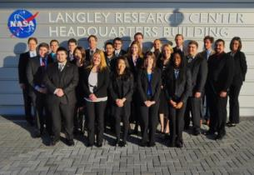
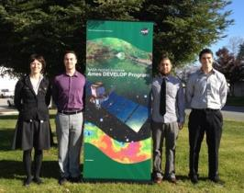
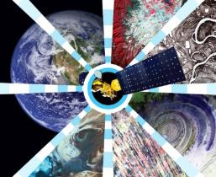
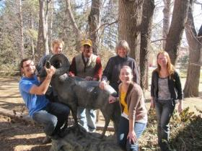
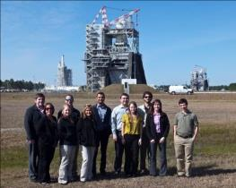
Science Mission Directorate
Earth Science Division
Applied Sciences Program’s
Event Location
Event Name
Date of Presentation

Slide 2
Agenda
NASA Organization & Programs
About DEVELOP
Projects, Partners & Participants
Opportunities & How to Apply
DEVELOP website: http://develop.larc.nasa.gov

Slide 3
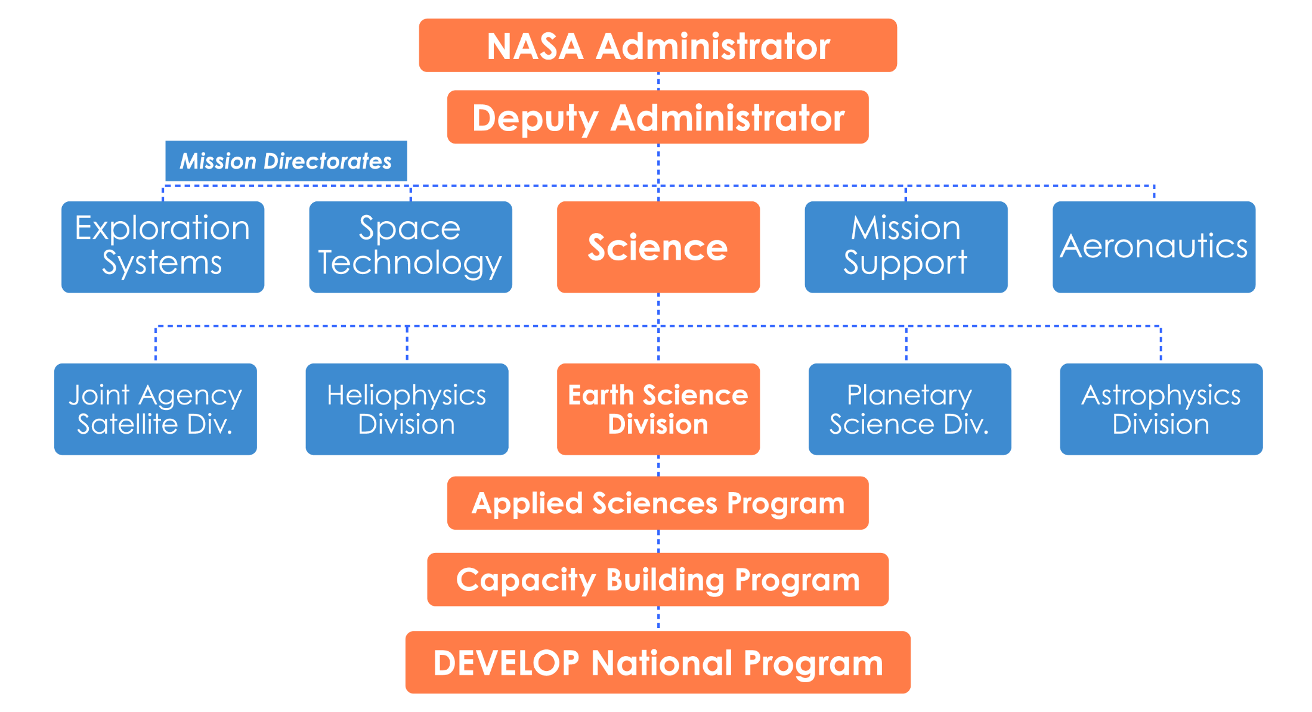
NASA Organization

Slide 4
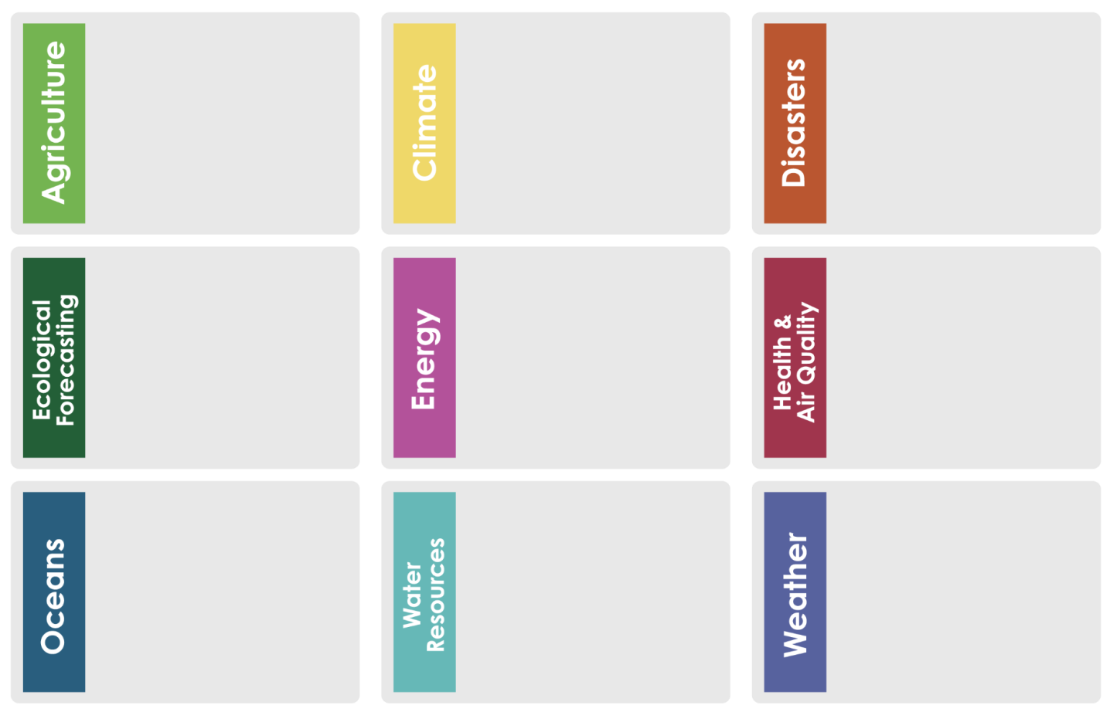
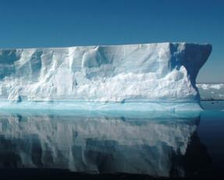
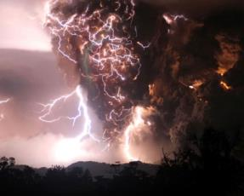
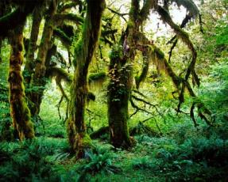
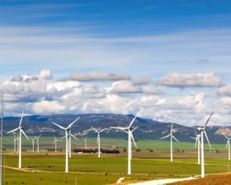
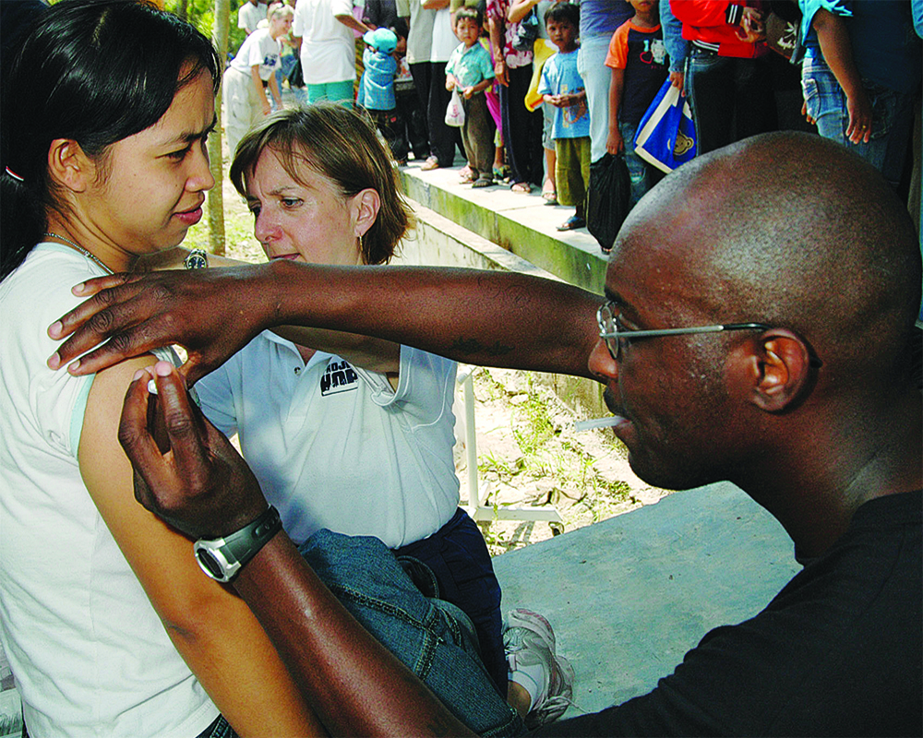
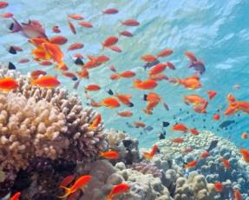
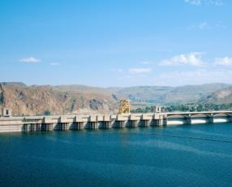
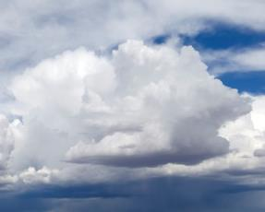
NASA Applied Sciences Program
“Discovering Innovative & Practical Applications of NASA Earth Science”
Demonstrating innovative uses and practical benefits of NASA Earth science data, scientific knowledge, and technology
Bridging the gap between NASA Earth science and decision-maker needs
Organized thematically around 9 national application areas:
Applied Sciences Program Website: www.nasa.gov/applied-sciences

Slide 5
NASA Capacity Building Programs
Participating in Interagency & Global Capacity Building Activities
SERVIR Coordination Office (MSFC): Building international capacity with hubs in East Africa, Hindu Kush-Himalaya, Mesoamerica
Gulf of Mexico Initiative, GOMI (SSC): Building Gulf region’s capacity for local issues
Applied Remote SEnsing Training, ARSET (GSFC): Online and hands on basic/advanced training to build domestic skills
DEVELOP (LaRC National Office): Dual workforce/local government capacity building using collaborative feasibility projects
5
Capacity Building : www.nasa.gov/applied-sciences/capacitybuilding

Slide 6
About DEVELOP

Slide 7
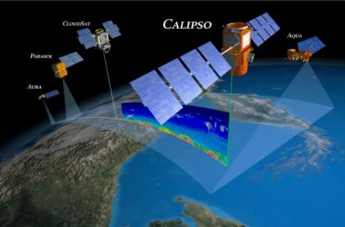
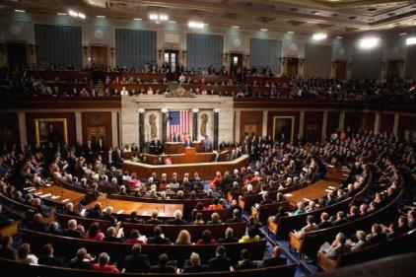
So what is DEVELOP?
DEVELOP is part of NASA’s Applied Sciences Program, addresses environmental and public policy issues by conducting interdisciplinary feasibility projects that apply the lens of NASA Earth observations to community concerns around the globe. Bridging the gap between NASA Earth Science and society, DEVELOP builds capacity in both participants and partner organizations to better prepare them to address the challenges that face our society and future generations. With the competitive nature and growing societal role of science and technology in today’s global workplace, DEVELOP is fostering an adept corps of tomorrow’s scientists and leaders.
Measurements
and Predictions
Communities
DEVELOP’s Website: http://develop.larc.nasa.gov

Slide 8
DEVELOP History
DEVELOP began in 1998
In 1998, three interns at NASA Langley Research Center co-authored the white paper “Practical Applications of Remote Sensing” (Bauer et al., 1998). At that time, the Digital Earth Initiative, a federal interagency project dedicated to creating a virtual representation of the Earth to further human understanding of the world, was piloting an effort to increase public access to federal information about the Earth and the environment. A proposal combining NASA’s Digital Earth Initiative and the students’ paper advocated the formation of a program, and in 1999 DEVELOP was officially formed.
Beginning in 2001, new offices were established across the country and expansion has continued to today. DEVELOP is always looking for new opportunities to expand the DEVELOP network and those benefiting from DEVELOP activities.

Slide 9
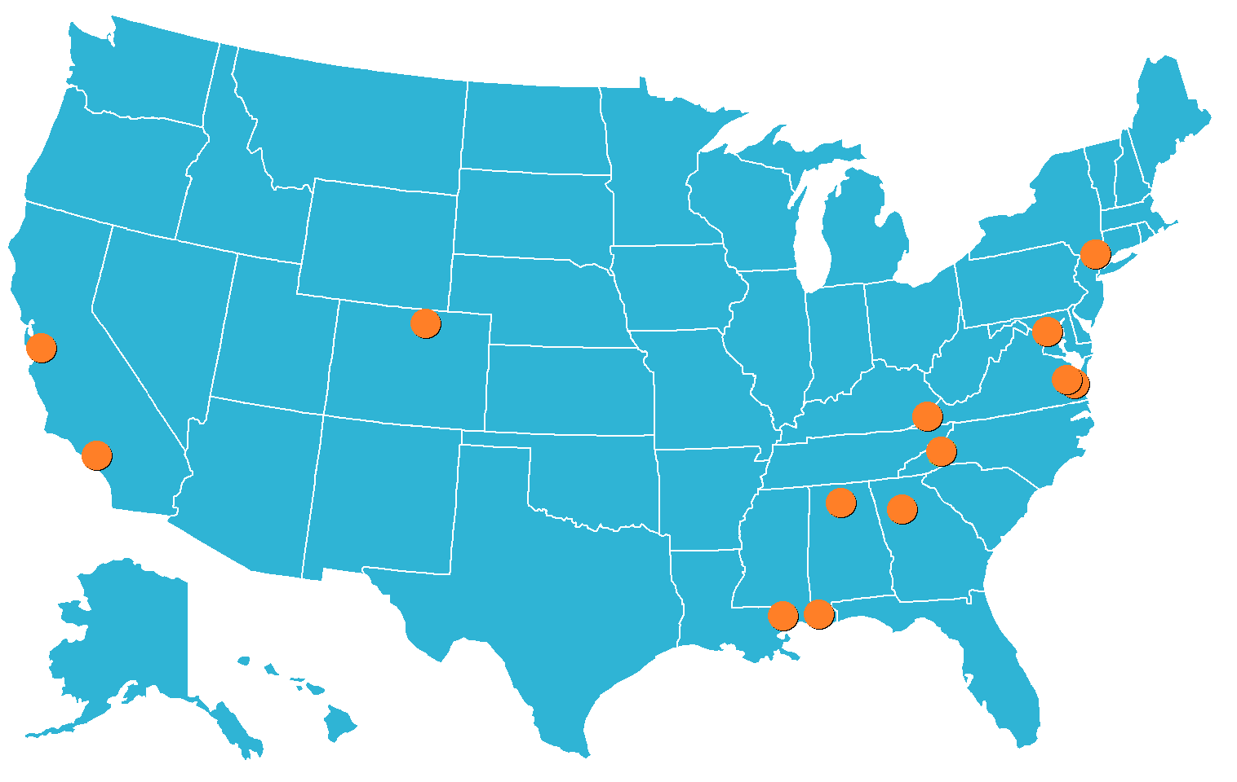
DEVELOP Locations
NASA Center Locations
Ames Research Center – Moffett Field, CA
Goddard Space Flight Center – Greenbelt, MD
Jet Propulsion Laboratory – Pasadena, CA
Langley Research Center – Hampton, VA
Marshall Space Flight Center – Huntsville, AL
Stennis Space Center – Stennis, MS
Regional & Academic Locations
Idaho State University – Pocatello, ID
International Research Institute – Palisades, NY
Mobile County Health Department – Mobile, AL
NOAA National Centers for Environmental Information– Asheville, NC
Patrick Henry Building – Richmond, VA
University of Georgia – Athens, GA
USGS at Colorado State University – Fort Collins, CO
Wise County Clerk of Court’s Office – Wise, VA

Slide 10
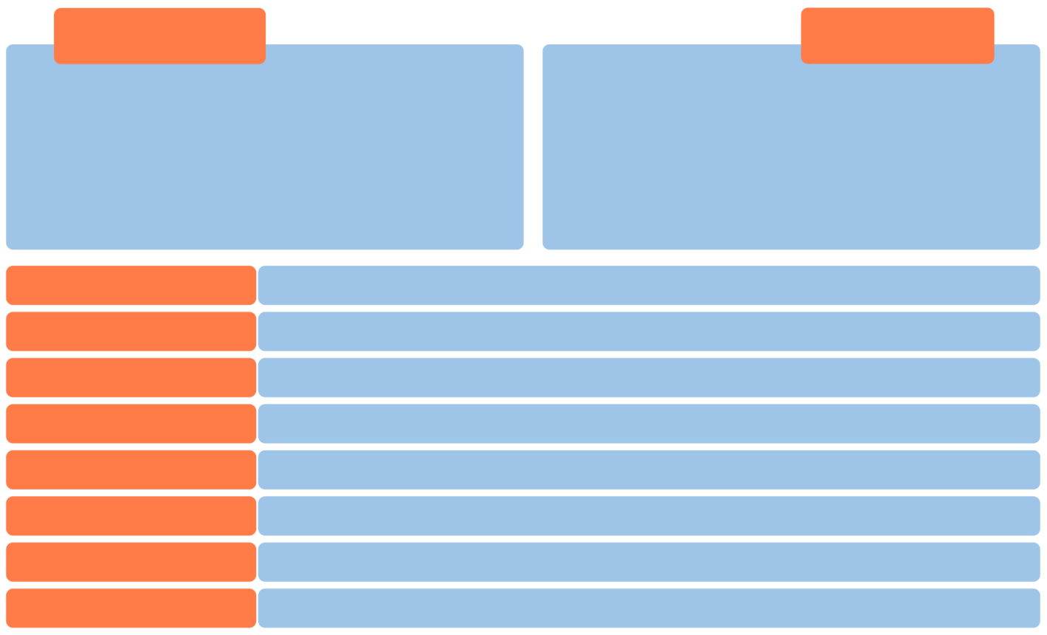
DEVELOP’s Mission, Vision & Core Values
MISSION
VISION
Uniting NASA Earth observations
with society to foster future innovation and cultivate the professionals of tomorrow by addressing diverse environmental issues today.
To maximize NASA’s Earth science investments by enabling the next generation to accelerate innovative applications in technology, resource management, policy development, and decision making.
INNOVATION
Generate new and creative Earth science applications to meet societal needs by utilizing existing technologies
SERVICE
Devote ourselves to the success of our people and the communities we serve
INTEGRITY
Define ourselves by truth, honor, character, and ethical conduct
PASSION
Pursue all endeavors with energy, excitement, and enthusiasm
PROFESSIONALISM
Maintain a high level of excellence and respect in work, actions, and appearance
STEWARDSHIP
Utilize resources and talents to benefit society and the environment
SCHOLARSHIP
Foster an organizational culture where continued learning is a priority
COLLABORATION
Promote teamwork, open communication, and shared resources

Slide 11
Projects & Partners

Slide 12
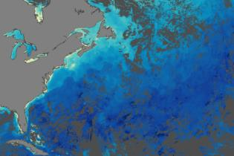
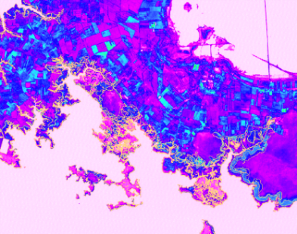
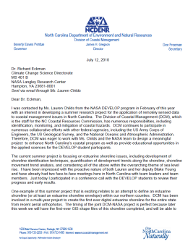
Project Characteristics
Focus on the utilization of NASA Earth observations
Highlight the capabilities of NASA satellite and airborne Earth remote sensing science
Address community concerns relating to real-world environmental issues
Align with at least one of the nine NASA Applied Sciences Program’s National Application Areas
Partner with organizations who can benefit from using NASA Earth observations to enhance decision making
Meet partner needs by providing decision support tools
Research is conducted by teams with diverse backgrounds
Science advisors and mentors from NASA and partner organizations provide scientific guidance

Slide 13
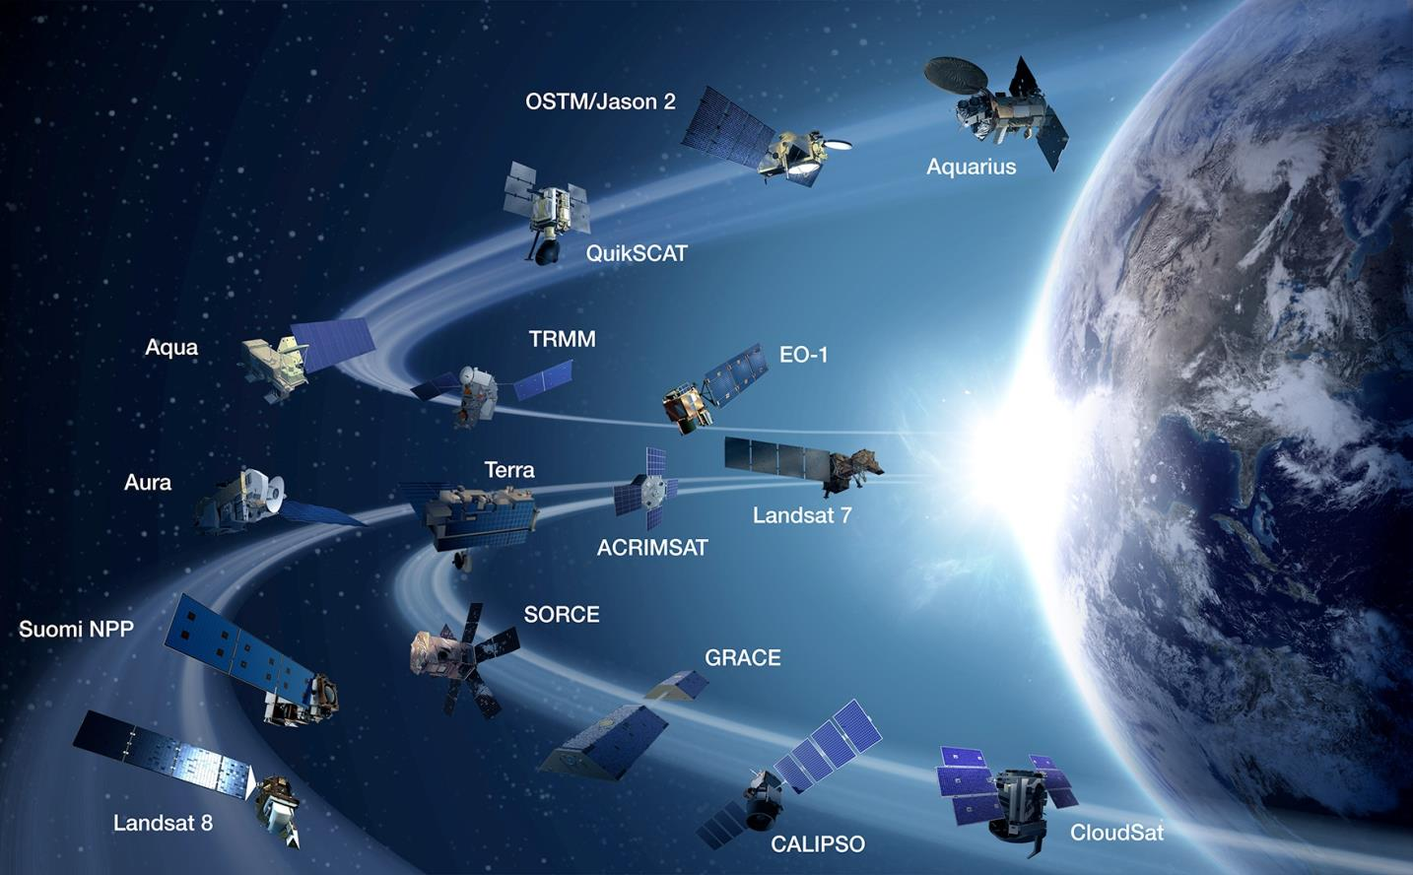
NASA Earth Observations
NASA Earth Observations include a coordinated series of polar-orbiting and low inclination satellites for long-term global observations .
NASA Earth Science Missions: www.nasa.gov/missions/current/index.html

Slide 14
Who are DEVELOP Partners?
Partner: An organization that contributed any of the following resources - advising, data, time, office space, money
Collaborators - location host organizations
North Central Climate Science Center(Federal)
Mobile County Health Department (Local)
Wise County Clerk of Court’s Office (Local)
International Research Institute (Academic)
University of Georgia (Academic)
Tecnológico de Monterrey, Saltillo (Academic)
Project end-users
Local - ex. Williamsburg Winery
State - ex. Virginia Department of Agriculture & Forestry
Regional - ex. Lake Champlain Basin Program
Federal - ex. USDA Agricultural Research Service
NGO - ex. Lake Pontchartrain Basin Foundation
Academic - ex. Drake University – Environmental Science & Policy Program
International - ex. Rwanda Ministry of Agriculture & Animal Resources

Slide 15
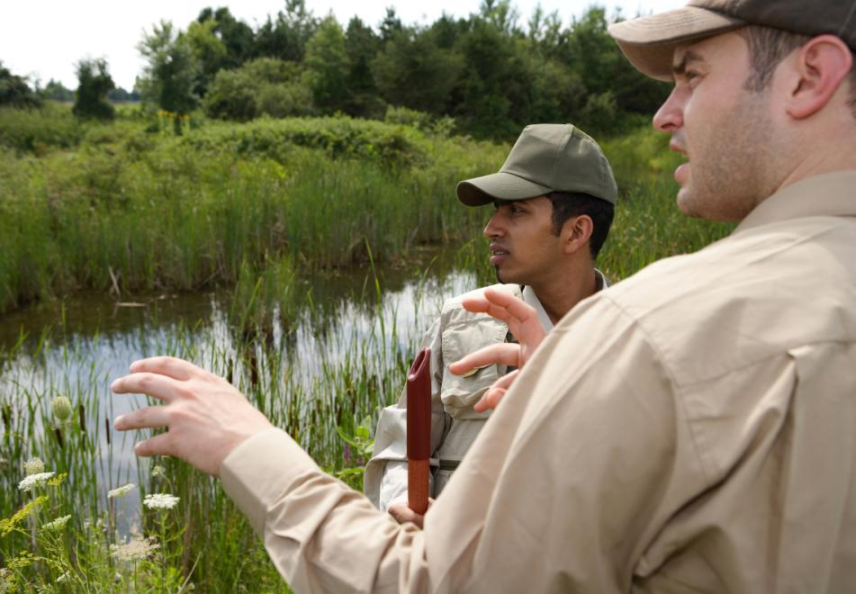
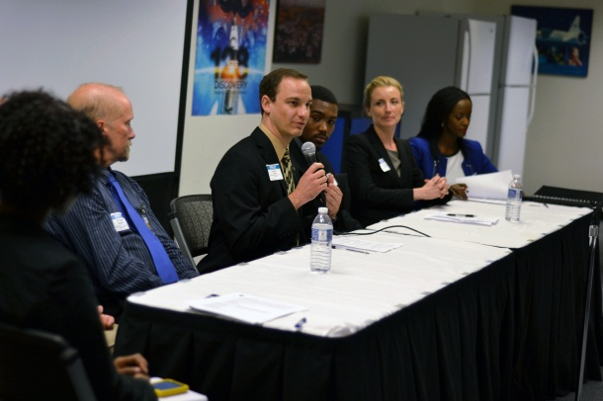
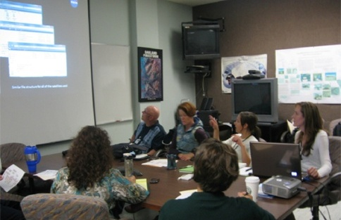
Benefits to Partners
Introduction to new methods to augment current practices: Cost-saving & time-saving
Enhanced decision support through use of NASA EOS
Increased exposure to NASA Earth Science technologies and capabilities
Introduction to NASA’s Applied Sciences Program and its contributions to local communities, the country, and the world
Hands-on training with practical applications of remote sensing and NASA Earth science
Improved remote sensing and geographic information science (GIS) capabilities
Interaction with bright and innovative young professionals
Opportunities for networking with the NASA community
Strong recruiting pool of early career professionals with a knowledge of Earth observations and their capabilities

Slide 16
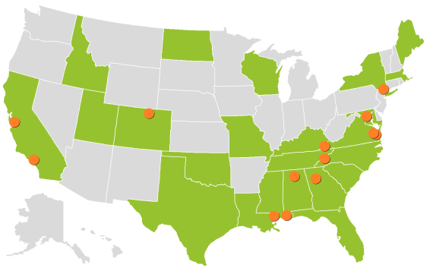
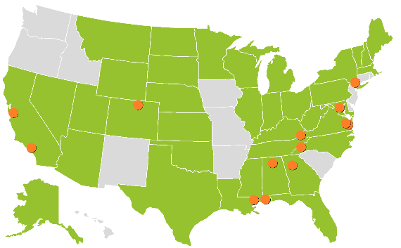
2014 Summer Portfolio
Coastal Mid-Atlantic Water (LaRC)
Ethiopia Water (FC)
Georgia Inland Water (UGA)
Lake Champlain Water III (LaRC)
Peru Water (LaRC)
SE US Water II (MSFC)
Andes Mountains Disasters (MSFC)
California Disasters (SSC)
Global Disasters III (JPL)
SE Asia Disasters II (GSFC)
Great Lakes Disasters (LaRC)
Alaska Eco (FC)
Coastal Colombia Eco (JPL)
Colombia Eco (UGA)
Louisiana Eco (SSC)
Miami-Dade Eco II (UGA)
New England Eco (GSFC)
Sierra Nevada Eco III (ARC)
Virginia Eco II (WC)
East Africa Health/AQ (IRI)
North America Health/AQ (JPL)
Texas Health/AQ (LaRC)
Appalachia Energy (WC)
S. Central Africa Energy (MCHD)
American Samoa Oceans (ARC)
Argentina Oceans (GSFC)
Southern California Oceans (JPL)
Great Plains Ag III (LaRC)
Niger Ag (LaRC)
Rwanda Ag II (WC)
Great Basin Climate (ARC)
Americas Climate (LaRC/NCDC)
DEVELOPedia (LaRC)
AIP-7 App Development (LaRC)
Participant Impacts
Project Impacts

Slide 17
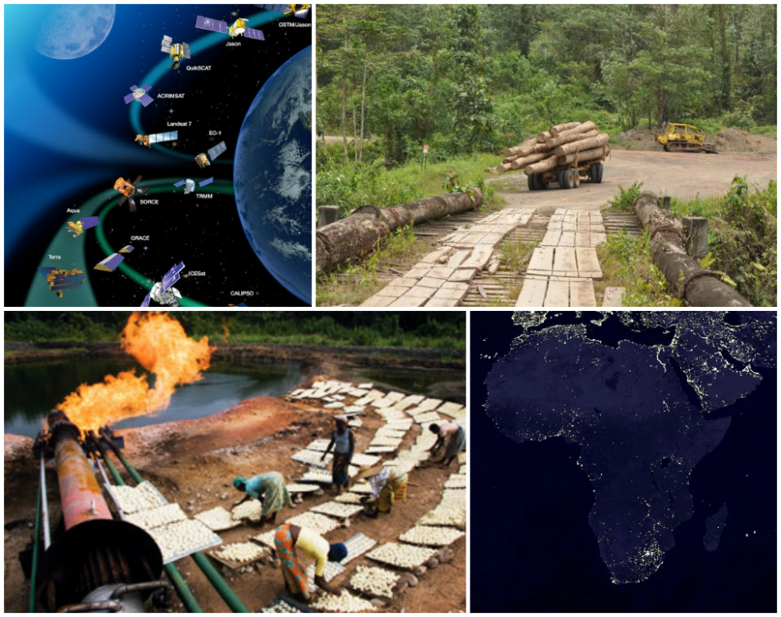
South Central Africa Energy
Community Concern: In communities where the majority of the population uses burning biomass from deforestation as their primary energy source, while most of the petroleum-associated gas is disposed of, NASA Earth observations have the ability to measure flared energy losses, deforestation losses, atmospheric impact, and suitable site locations for infrastructure.
End-Users/Partners:
World Bank’s Global Gas Flaring Reduction (GGFR) Partnership
Planet Earth Institute (PEI)
Earth Observations:
Suomi NPP, VIIRS
Aqua/Terra, MODIS
Terra, ASTER
Landsat 5/7/8, TM/ETM+/OLI
Impact: The results of this project will support the efforts of partners to demonstrate small scale-scale natural gas use while reducing flaring and barriers to gas utilization, and will also serve as a model for partners leading the continent in its pursuit of scientific independence through the Global Scientific Community.

Slide 18
Your Project Title Here ☺
So that last slide was there mostly as an example of a project overview – please feel free to substitute your own project in, or another project you think is relevant to your audience whom you know better, (and feel free to delete my example!)

Slide 19
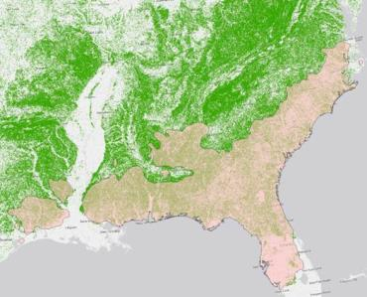
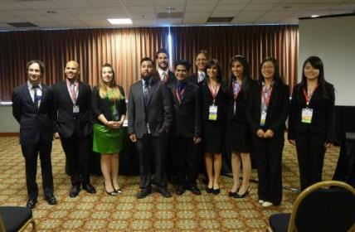
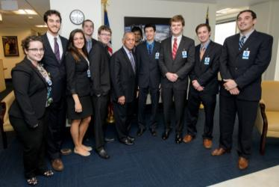
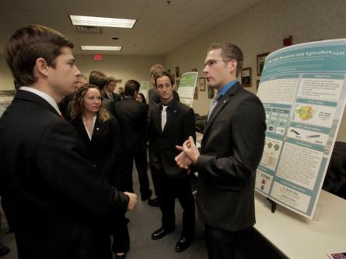
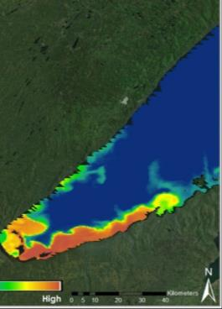
FY2014 Program Stats
Fall 2013
96 Participants working on
22 Projects with
53 Partners & End-Users
Spring 2014
109 Participants working on
25 Projects with
61 Partners & End-Users
Summer 2014
154 Participants working on
34 Projects with
87 Partners & End-Users
FY14 Totals: 359 Participants, 81 Projects (66% US/33% Int’l), 160 Unique Partners

Slide 20
Opportunities

Slide 21
Eligibility Requirements
General Requirements:
At least 18 years of age
Ability to provide personal transportation to and from the DEVELOP location
US citizenship required for DEVELOP locations on NASA sites
Interns come from diverse background, no experience is required but a strong interest in GIS, remote sensing, and science is important
Three Classifications for Applicants:
Currently Enrolled Students: Students who are currently enrolled at a U.S. accredited community college, undergraduate or graduate college or university. Open to all majors.
Recent Graduates: Individuals who have graduated with an undergraduate or graduate degree from a U.S. accredited college or university within the past two years.
Early/Transitioning Career Professionals: Individuals transitioning into a new career field, who are pursuing further experience in the Earth sciences and remote sensing (including transitioning/recently transitioned veterans from the U.S. Armed Forces)

Slide 22
Classifications for Applicants
Currently Enrolled Students:
Evidence of enrollment at an accredited U.S. school
Minimum 3.0 GPA on a 4.0 scale (cumulative or most recent)
Recent Graduates:
Evidence of successful graduation from a college or university
Minimum 3.0 cumulative GPA on a 4.0 at last institution
Eligible within 2 years of graduation for up to 4 terms with DEVELOP
Early/Transitioning Career Professionals:
At least 3 years of work experience in a professional environment
Minimum 3.0 cumulative GPA on a 4.0 scale at last institution of education
Eligible within 2 years after leaving previous career/service to apply for up to 4 terms with DEVELOP
Three 10-week terms per year
Spring, Summer, and Fall
must reapply each term

Slide 23
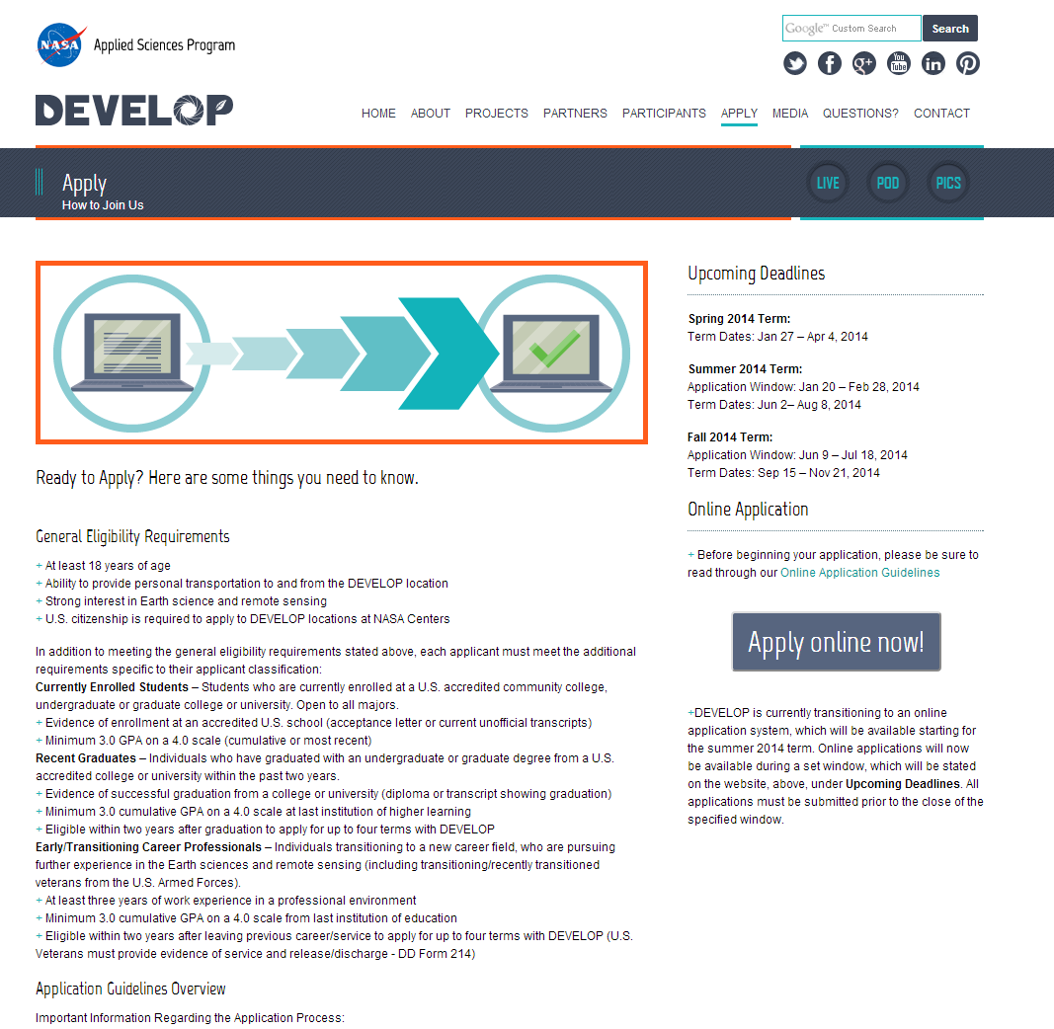
Application Process
Entirely online
Through the DEVELOP website under the “Apply” tab
Create account, can save progress and return later
Application only open during a specific window
For Fall 2015: May 25th – July 3rd

Slide 24
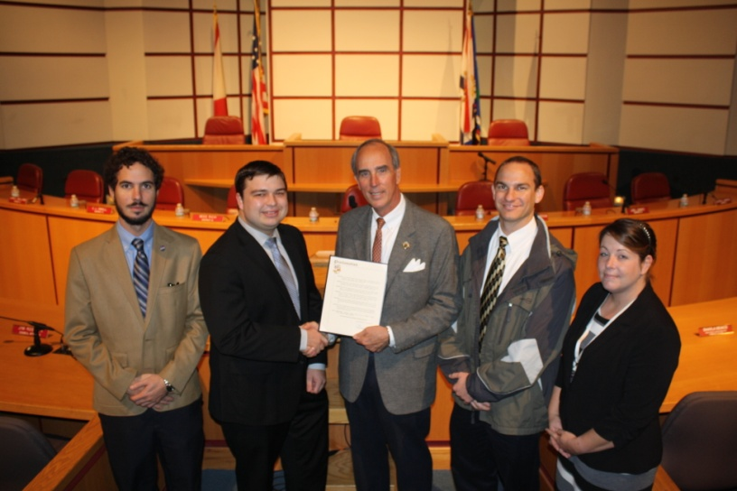
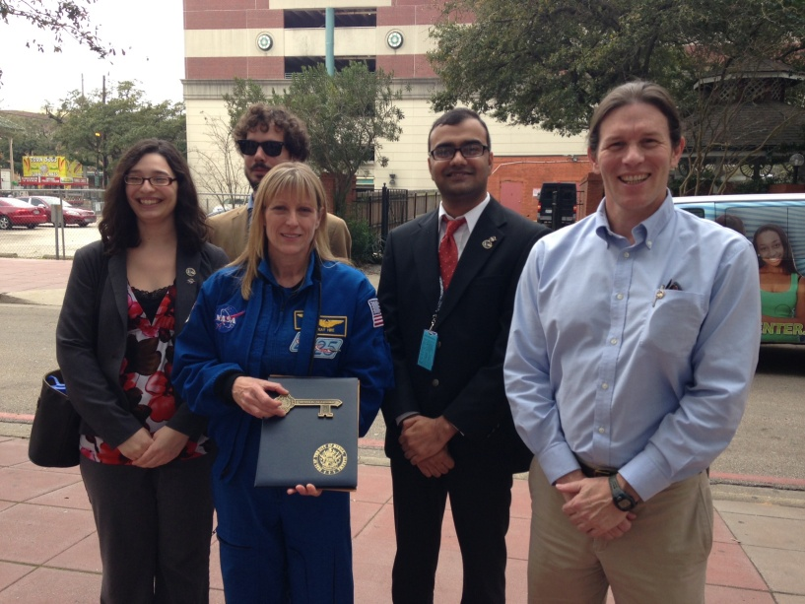
Benefits to Participants
Scientific/Professional Development:
Experience using Earth observations
GIS and Remote Sensing
Working in a group environment
Management and leadership skills
Personal Development:
Presentation and communication skills
Proper business place etiquette and dress
Personality typing and working with diverse groups
Professional Networking:
NASA scientists and managers
Partner organizations
Peers – teams, center, and national

Slide 25
More Info
Example Majors/Interests:
Computer Science
Environmental Science
Biology
Engineering
Chemistry
Geography
Atmospheric Science
Physics
Web Development
Accounting
Economics
Mathematics
Public Policy
Communications
Summer Term 2015
June 1st – August 7th
Online application window:
January 19th – February 27th
Fall Term 2015
Sept. 14th – Nov. 20th
Online application window:
May 25th – July 3rd

Slide 26
One more thing….

Slide 27
Follow us on Social Media
Facebook: www.facebook.com/developnationalprogram
Twitter: http://twitter.com/#!/nasa_develop
YouTube Channel: www.youtube.com/user/NASADEVELOP
Google+: http://ow.ly/auqy8
LinkedIn:www.linkedin.com/groups?gid=4343498&trk=group-name

Slide 28
Thank You
DEVELOP National Program
http://develop.larc.nasa.gov/

