Slide 1
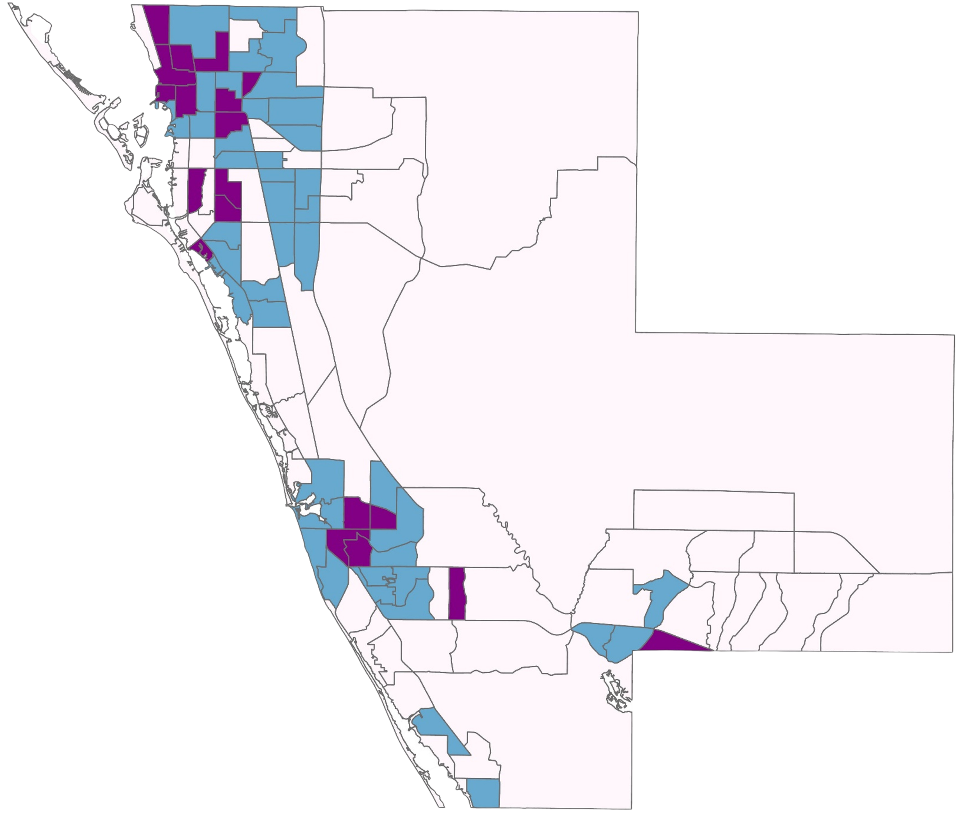
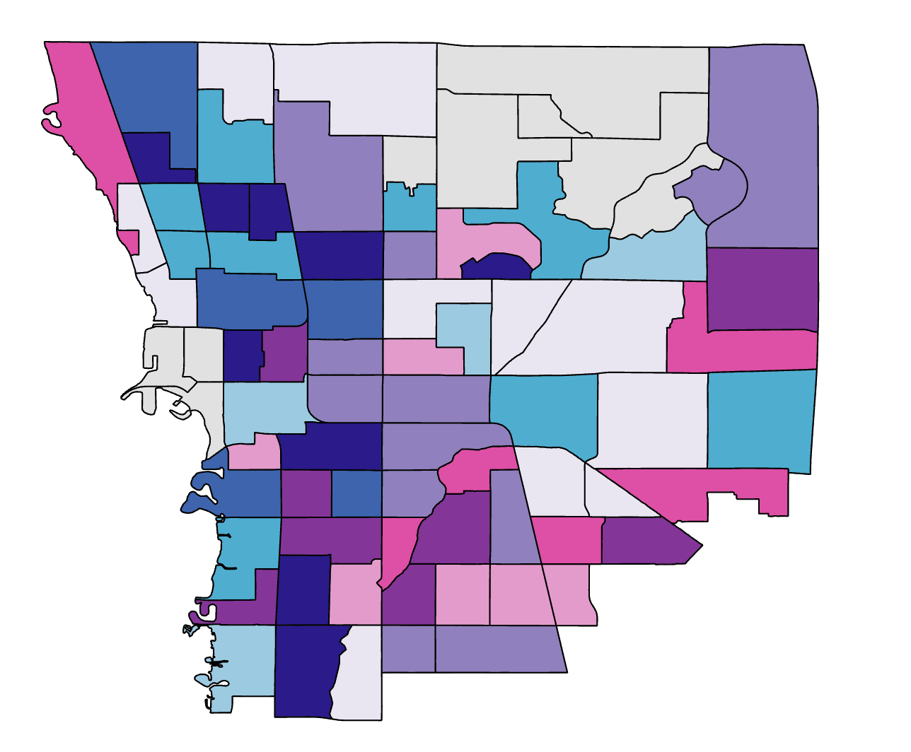
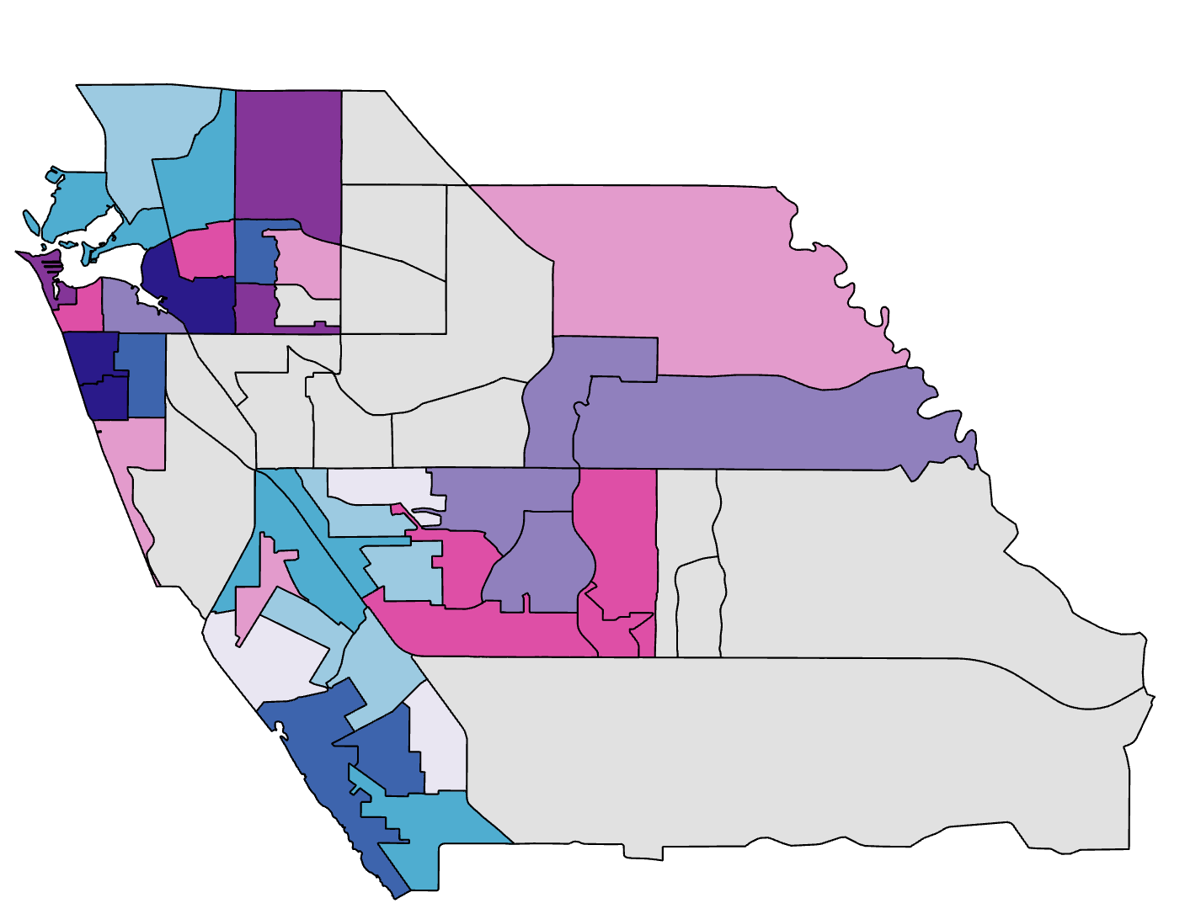
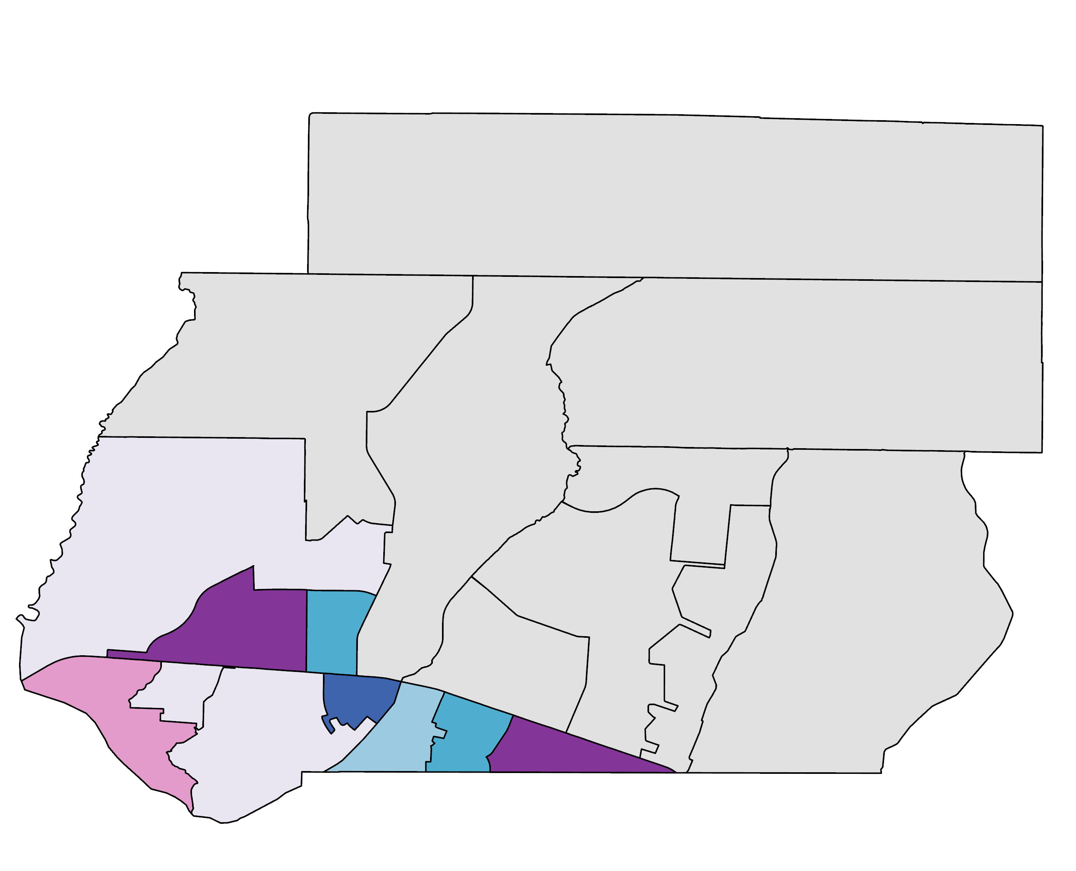
Sarasota Climate
Monitoring Heat and Assessing Heat Vulnerability to Identify Locations for Heat Mitigation Efforts in Sarasota, Florida
Since 2005, Sarasota County has experienced at least 50 extremely hot days per year when the “feels like” temperature exceeds 100° F.
With climate change, this number will continually increase to 131 days per year in mid-century (2030-2060s)
Sarasota County government is interested in identifying areas to kick-start extreme heat mitigation efforts, such as tree planting and building cooling centers. Earth observing satellites can help us determine where to begin.
Problems emerged from Extreme Heat
Landsat 8 OLI-TIRS
Landsat 9 OLI-TIRS
ISS ECOSTRESS
Negative impacts on air quality
Increased heat-related illness
Heat Vulnerability Mapping Variables
Higher energy consumption
Disproportionate risks in
low-income & underserved communities
Land Surface Temperature,
Canopy Cover, Albedo, Evapotranspiration
Building Footprint,
Land Cover
Population, Age, Race,
Income level, Health Insurance & Vehicle Ownership
Socioeconomic Profile
North Sarasota
Land Surface Temperature
Gulf of Mexico
FLORIDA
Sarasota
County
Sarasota
County
0
1
2
4
6
8
Miles
Venice
% Unemployed
% Age 65 and over
SARASOTA COUNTY
No Data
% Below Poverty Line
No Data
% Below Poverty Line
High
High
Low
Low
High
Low
Average Summer 2019-2023
Daytime LST (°F)
Low
High
Above 100
95-100
Socioeconomic Profile
Land Surface Temperature
90-95
85-90
80-85
Socioeconomic Profile
North Port
Land Surface Temperature
Team Members
Heat Mitigation Priority
Low
Medium
High
Acknowledgements
Partners: Alia Garrett, Gary Schells, Anna Leavitt (Sarasota County Government - UF/IFAS Extension)
Advisors: Dr. Marguerite Madden (University of Georgia)
Joseph Spruce (Analytical Mechanics and Associates)
Lead: Megan Rich (Georgia – Athens)
William Hadley
Project Lead
Catherine Gallagher
Theresia Phoa
Casmir Brown
Georgia, Athens | Spring 2024
Notes:
Icon credit: Microsoft Office

