Slide 1
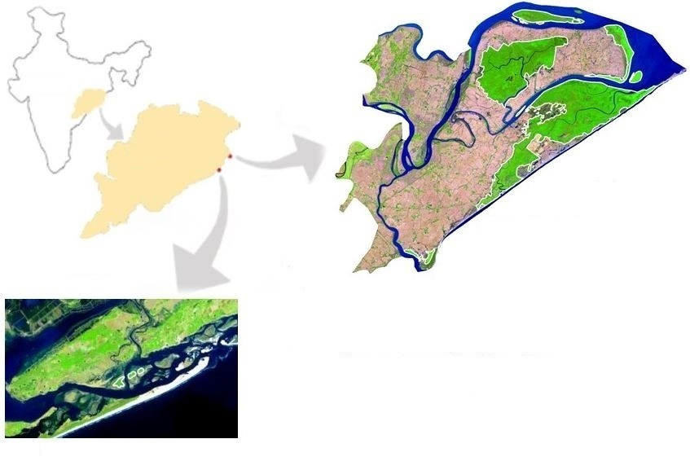
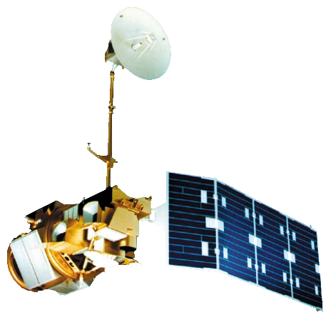
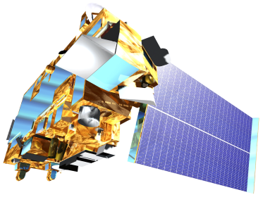
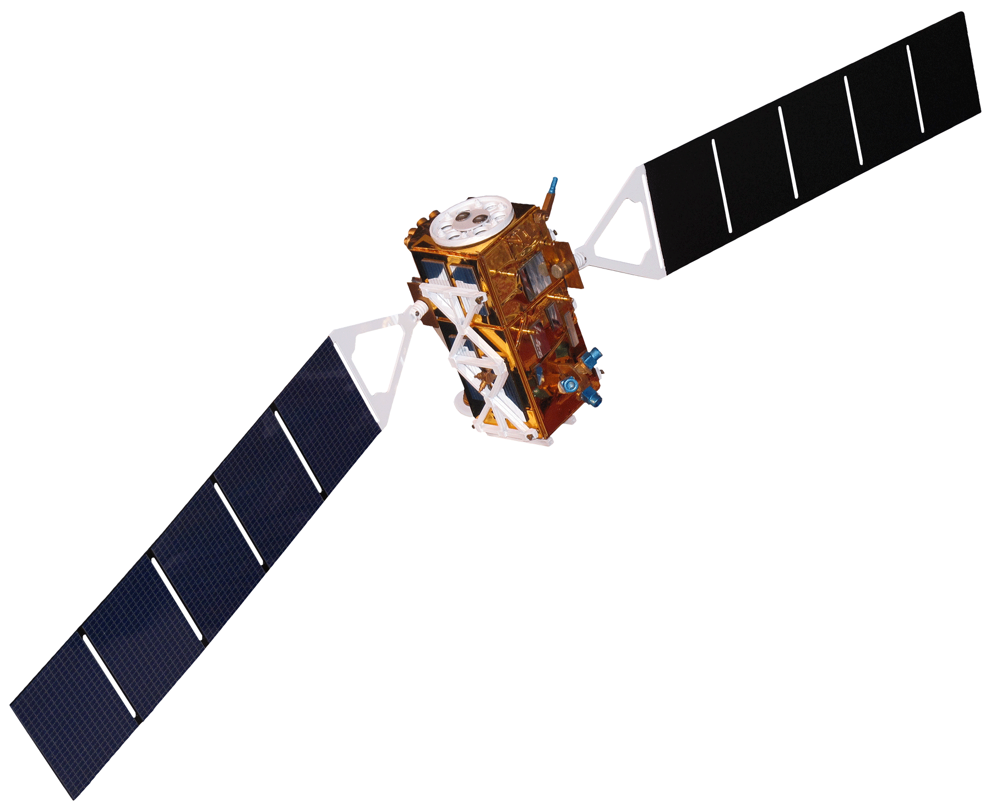
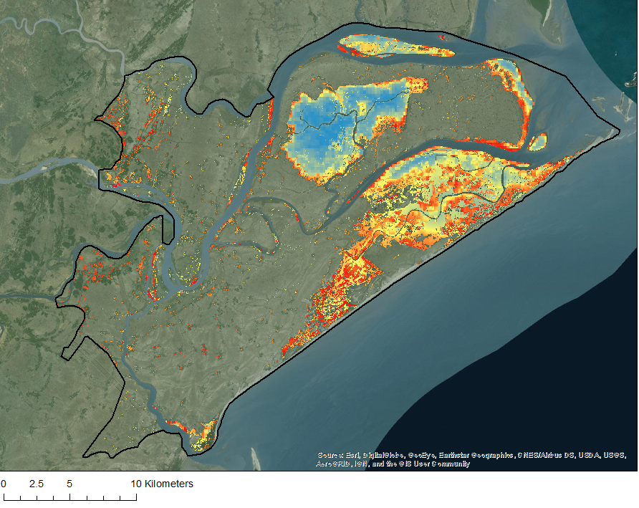
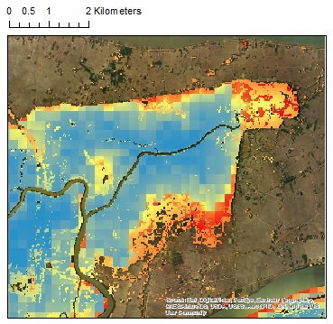
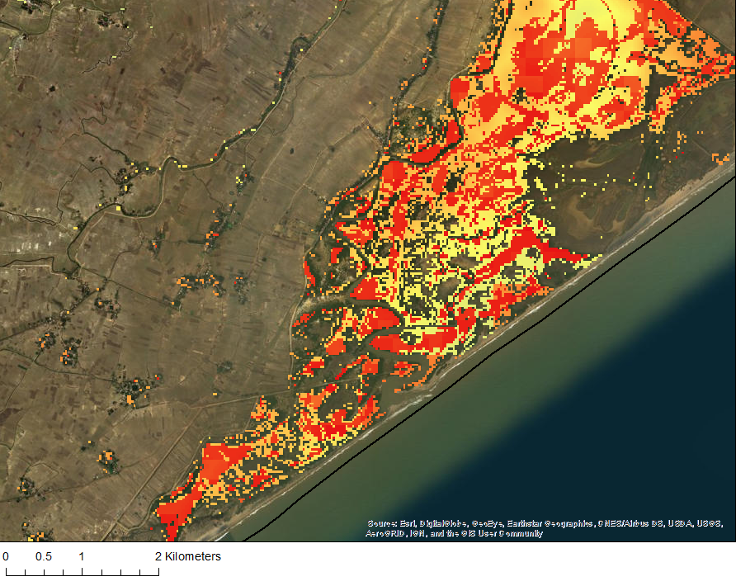
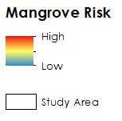
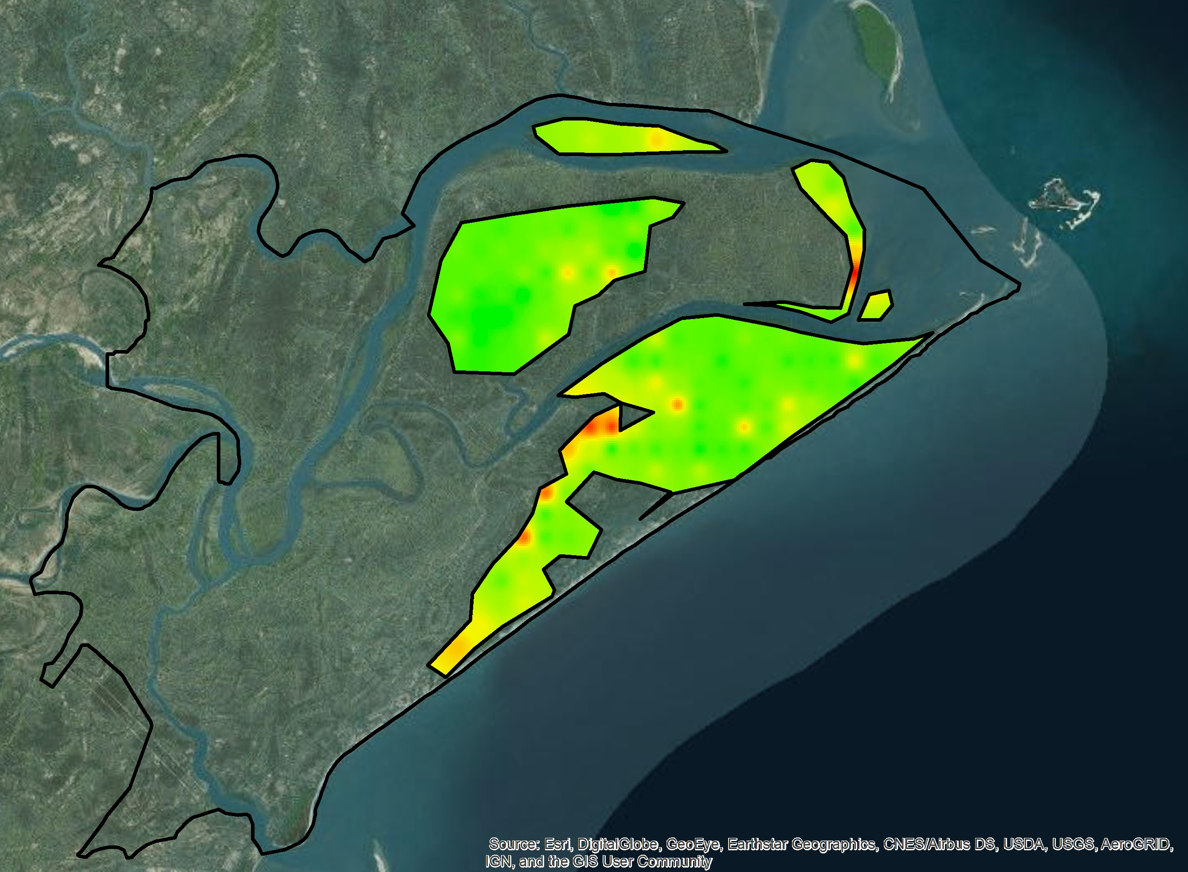
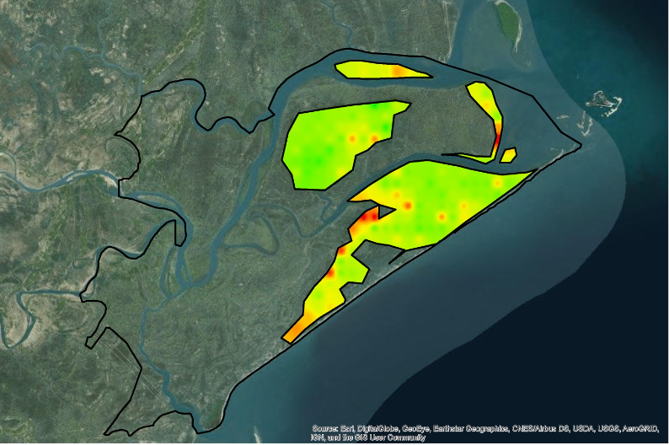
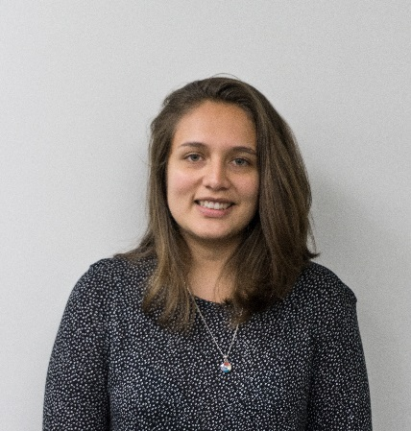
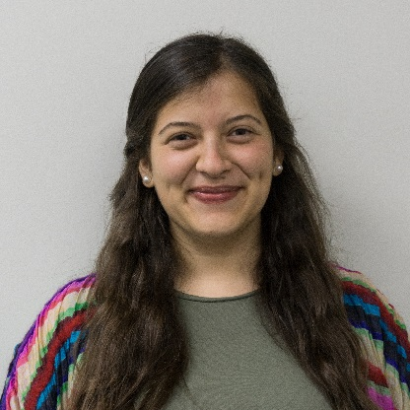
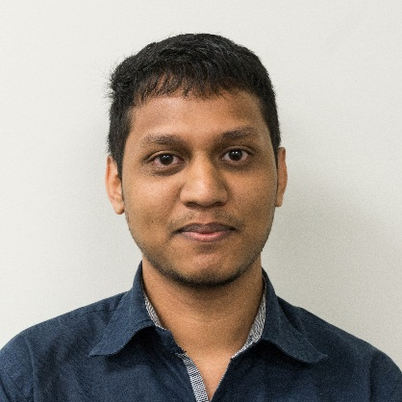
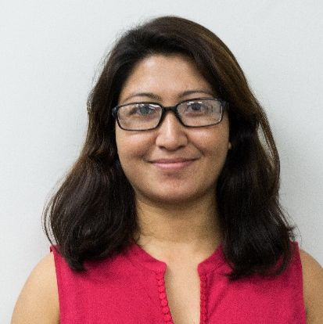
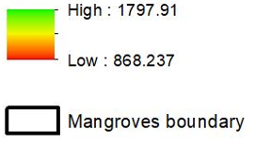
A Multi-Sensor Approach to Enhance the Prediction of Mangrove Biophysical Characteristics in Chilika Lagoon and Bhitarkanika Wildlife Sanctuary, Odisha, India
Abstract
Objectives
Across the globe, mangroves play a major role in coastal ecosystem processes mitigating erosion and serving as barriers against storm surges. India holds approximately 5% of the world’s mangroves, over half of which are along its east coast. Situated in the state of Odisha, Chilika Lagoon and Bhitarkanika Wildlife Sanctuary sustain mangrove sites of local importance in need of effective management. This study demonstrated the use of Terra, Landsat, and Sentinel-1 satellite data for spatio-temporal monitoring of mangrove health for both sites. Several indices including Normalized Difference Vegetation Index and Enhanced Vegetation Index, were examined to develop biophysical prediction tools and derive a 17-year time-series (2000 to 2016) of leaf chlorophyll (CHL), Leaf Area Index (LAI), and Gross Primary Productivity (GPP). Parallel to this assessment, a long-term (2000 to 2016) analysis of meteorological factors such as precipitation and temperature was completed to determine an association between these parameters. The correlation between meteorological parameters and mangrove biophysical characteristics enabled forecasting of mangrove health and productivity. A historical analysis of land cover maps was produced using Landsat 5 and 8 data to determine decadal changes in mangrove area estimates between 1995 and 2017. This analysis was used to predict land use-land cover change or fragmentation of Bhitarkanika mangroves. Based on IPCC data availability, the soft prediction map for 2050 showed the probability of mangrove risk to disturbance in the eastern part of Bhitarkanika. This study revealed the advantages of using a multi-sensor approach to monitor mangrove health and inform monitoring protocols.
Analyze long-term (2000-2016) spatio-temporal variability of biophysical parameters (GPP, LAI, CHL) using MODIS surface reflectance data
Produce a biophysical forecasting tool by utilizing 17 years of time series MODIS derived LAI, CHL and GPP data and meteorological data derived from NASA’s Giovanni and IPCC meteorological projections
Create a mangrove extent forecasting tool using Landsat 5 TM and Landsat 8 OLI data in Land Change Modeler on TerrSet
Study Area
Methodology
MODIS 8-day
Surface Reflectance
MODIS 8-day
LAI, GPP
LS5 TM
LS8 OLI, Sentinel-1
India
Vegetation Indices (NDVI, EVI)
Correlation
LAI, GPP, CHL
Classification
(Random Forest)
Odisha
NASA’s Giovanni
LAI, GPP, CHL Model
Land Change Modeler
Chilika
0
6
12 Km
Precipitation
Bhitarkanika Wildlife Sanctuary
Runoff
Long-term Phenology
(2000-2016)
Temperature
Correlation
Change Detection
CO2
Eastern India Ecological Forecasting III
IPCC Projected
Precipitation, Temperature and CO2
Spatial-Temporal Analysis (LAI, CHL, GPP 2000-2016)
Risk Area
Forecasting
(MLP)
Green polygon with white outline represents mangrove area
0
6 Km
Forecasting GPP
(Based on meteorological
parameter correlation)
Comparison
Earth Observations
Results
2050 Forecasted Mangrove Risk to Disturbance
0
2 Km
A
Landsat 5
Landsat 8
Terra
Sentinel-1
Thematic Mapper (TM)
Operational Land Imager (OLI)
Moderate Resolution Imaging
Spectroradiometer (MODIS)
C-Band Synthetic Aperture Radar (C-SAR)
Conclusions
Despite conservation efforts, the current extent of dense mangrove in Bhitarkanika Wildlife Sanctuary is projected to decrease up to 10% by the year 2050.
A comparison between the classification for 1995, 2004, 2017 and the projected classification for 2050 indicates that dense mangrove extent decreased while open mangrove and agriculture extents increased.
The mean annual GPP forecasted for 2050 was 7.7% less compared to the mean annual GPP for 2016.
By 2050, patches of mangrove along the south-west and northern coast of Bhitarkanika Wildlife Sanctuary are projected to decrease in GPP are also at a higher risk of disturbance.
B
0
5
10 Km
Mangrove Risk
High
0
2 Km
Acknowledgements
Low
Science Advisor: Dr. Deepak Mishra, University of Georgia, Department of Geography
Partner: Dr. Gurdeep Rastogi, Senior Scientist, Chilika Development Authority
Study Area
Mean Annual GPP (2016)
Forecasted Mean Annual GPP (2050)
Project Partners
Government of Odisha, Department of Forest and Environment, Chilika Development Authority
Team Members
GPP (g-C/m²/yr)
High: 1797.91
Low: 868.237
Abhishek Kumar
Team Lead
Isabel Miranda
Maria Luisa Escobar Pardo
Taufiq Rashid
Shanti Shrestha
Mangrove Boundary
University of Georgia – Summer 2017

