Slide 1
ALASKA ECOLOGICAL CONSERVATION II
Using NASA Earth Observations to Identify Recent Changes in Vegetation Phenology and Its Impacts on Caribou Migration
Levi Mitchell
Jackie Encinas
Peter Vailakis
Gareth Miller
Massachusetts – Boston | Summer 2024

Slide 2
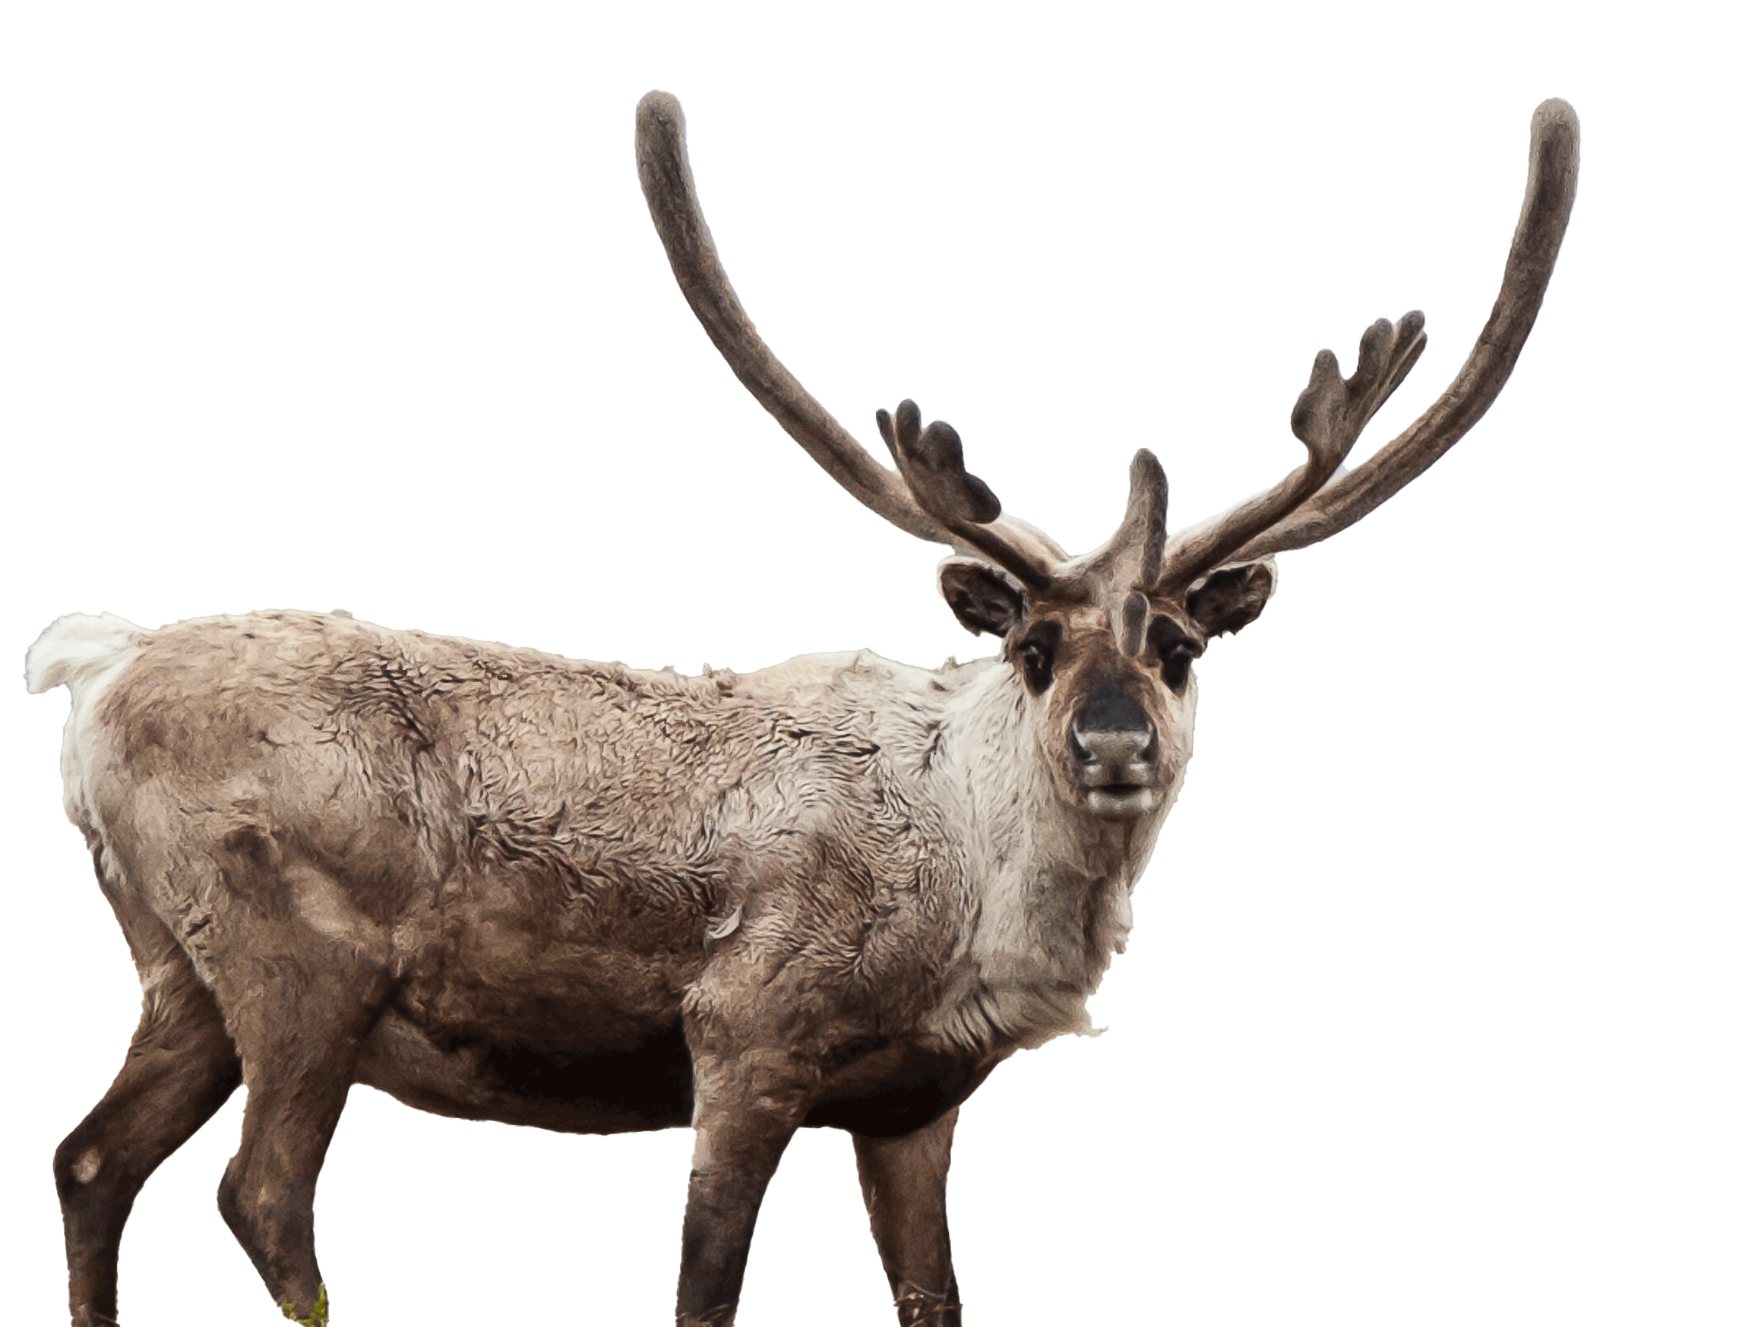
Presentation Outline
Background
Research Partners
Community Concerns
Methods
Study Area
Objectives
Earth Observations
Results
Errors &
Uncertainties
Conclusion
Feasibility
Acknowledgements
Credit: BLM/Bob Wick
Notes:
This presentation will cover the project background, our partners and community concerns, and our research methodology, including our study area, objectives, and Earth observations used. We will discuss our results and cover our errors and uncertainties, overall feasibility, and partner implementation. Lastly, we will end with our conclusions and acknowledgments.​
----------Image Information Below----------
[Microsoft Icons]
Image Credit: [Microsoft Office]
Image Source: [Microsoft Office]
[Caribou Image]
Image Credit: Bob Wick, Bureau of Land Management, CC BY-NC 2.0
Image Source: https://www.flickr.com/photos/iip-photo-archive/20851224770

Slide 3
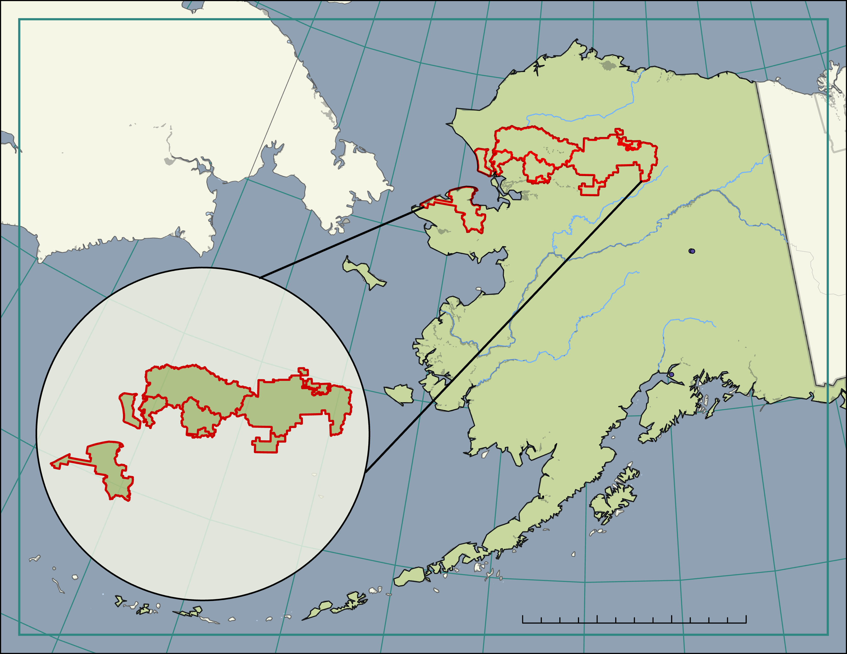
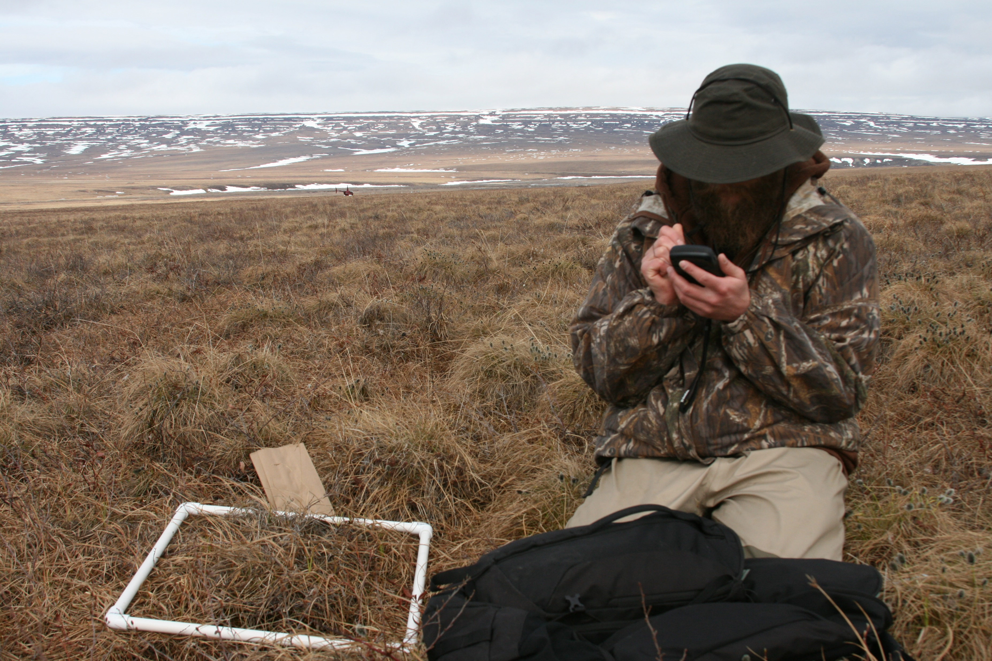
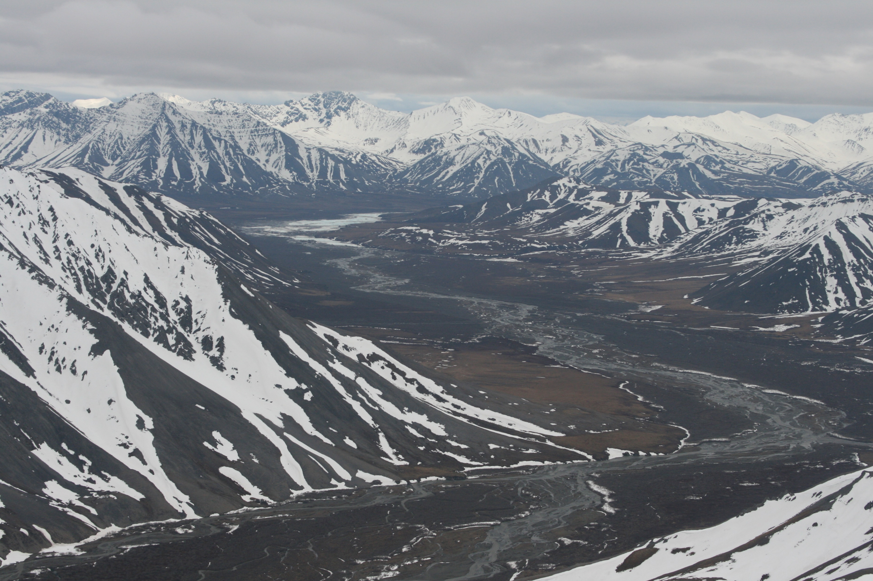
Partner
Arctic Inventory and Monitoring Network
Parks of Interest
A. Gates of the Arctic National Park and Preserve
B. Kobuk Valley National Park
C. Bering Land Bridge National Preserve
D. Cape Krusenstern National Monument
E. Noatak National Preserve
Fairbanks
E
Anchorage
D
B
A
C
0
125
250
500
Kilometers
750
Data from WWU and Alaska Geoportal
Credit: NPS/ Kyle Joly
Credit: NPS/Kyle Joly
Notes:
Our research took place in Northwestern Alaska, a wilderness region characterized by mountains, alpine tundra, shrubland, boreal forest, sedge meadow, riverine, and coastal ecosystems. Indigenous peoples, including Athapaskan and Inupiat descendants, have inhabited the land for thousands of years. The various ecosystems support a diversity of large terrestrial species like moose, wolves, grizzly bears, and caribou. ​
​
We partnered with the U.S. National Park Service, Arctic Inventory and Monitoring Network in Northwestern Alaska. The Network is a collection of five parks and preserves, including Gates of the Arctic National Park and Preserve, the second-largest national park of the US Park Service. Wildlife biologists in the Network research Arctic ecosystem dynamics. Our partner, Dr. Kyle Joly, specifically studies the spatial ecology of caribou. During the Spring 2024 DEVELOP term, another team partnered with Kyle to identify changes in river ice phenology that the caribou use during their winter migration. The results from the past project helped evaluate caribou migratory shifts and contextualize recent regional caribou declines. ​
----------Image Information Below----------
[Bottom Right]
Image Credit: NPS/ Kyle Joly, used with permission
[Bottom Right]
Image Credit: NPS/ Kyle Joly, used with permission
[Middle Right Logo]
Image Credit: National Park Service, an Agency of the United States Department of Interior
Image Source: https://en.wikipedia.org/wiki/National_Park_Service#/media/File:Logo_of_the_United_States_National_Park_Service.svg

Slide 4
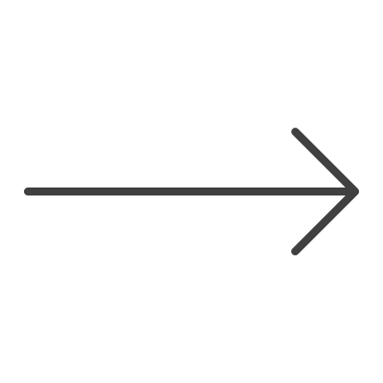
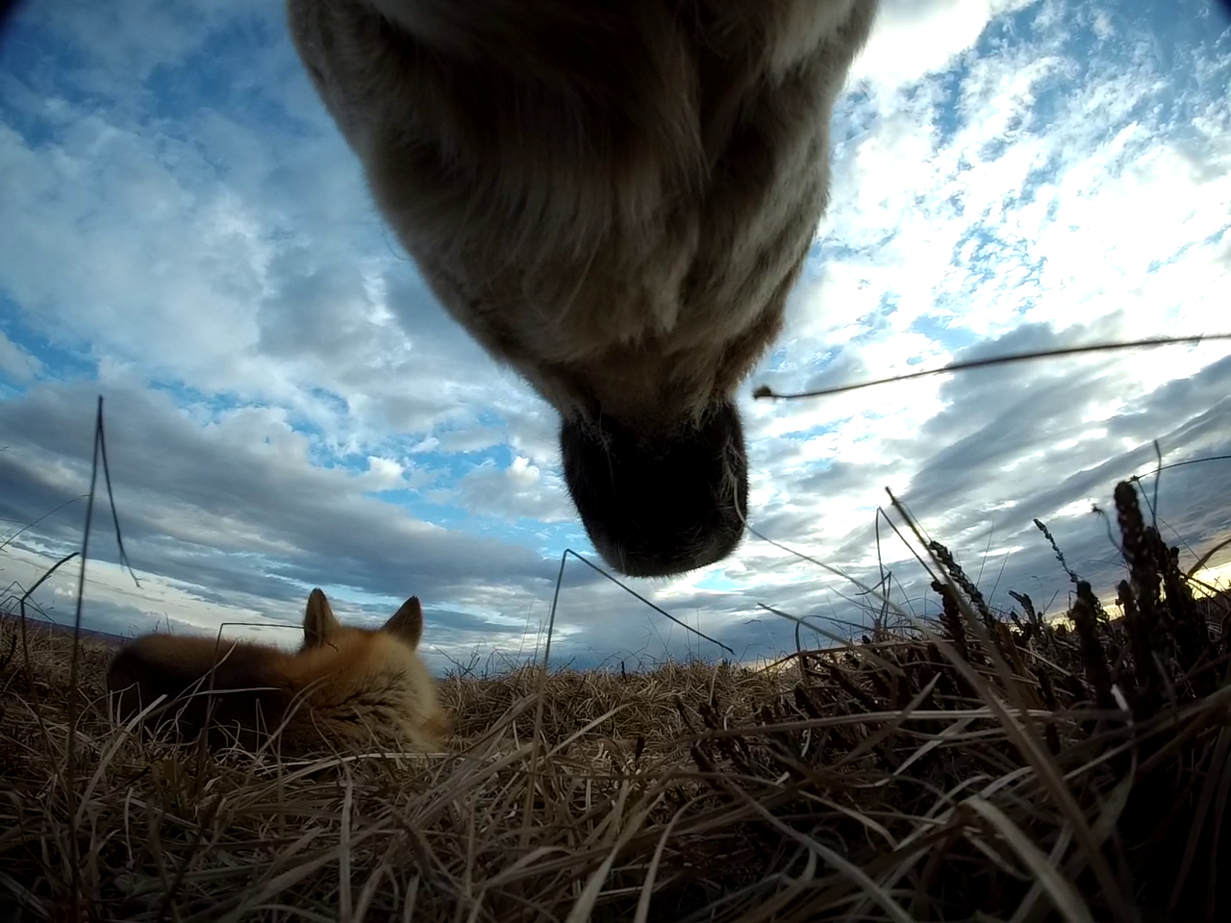
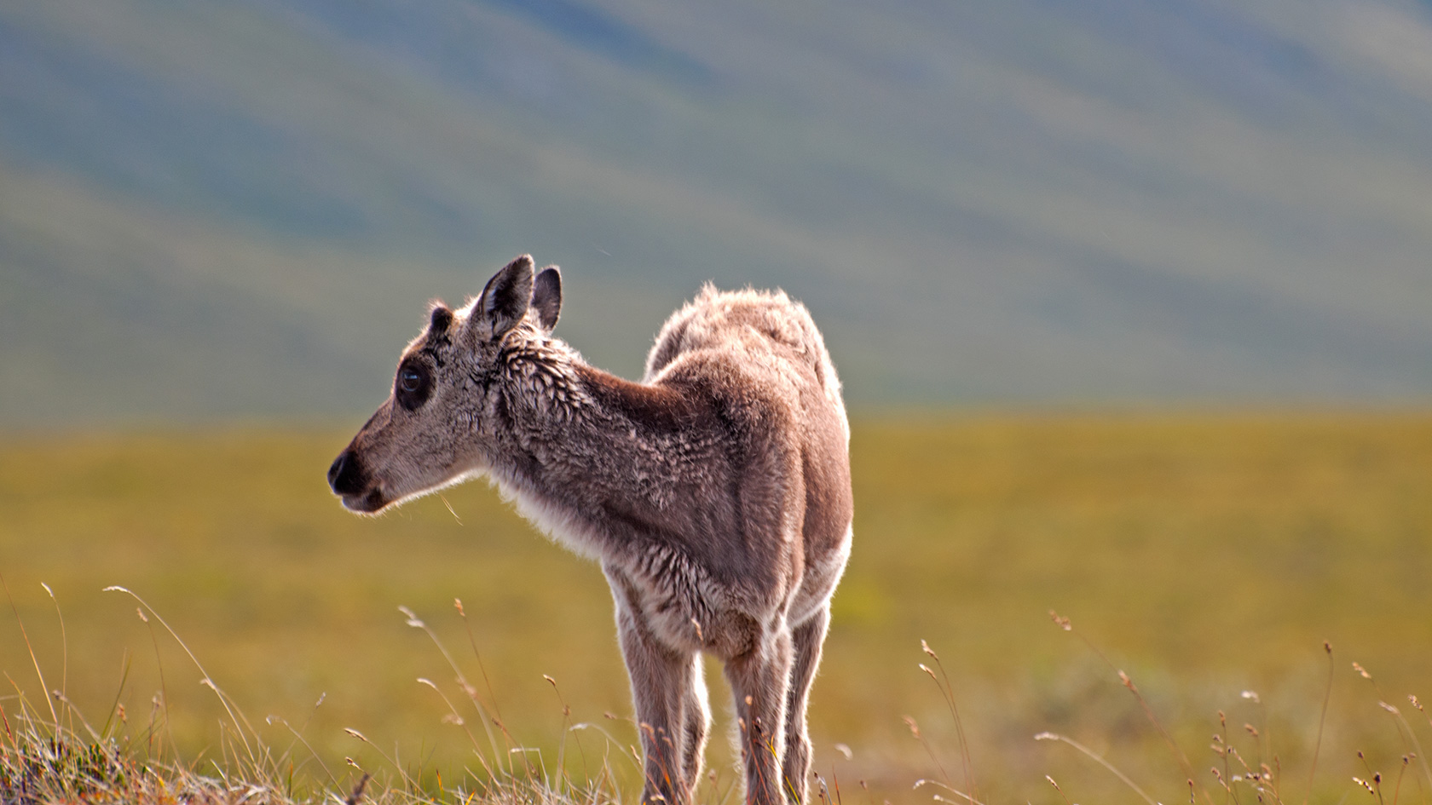
Community Concerns
Caribou calving is influenced by the availability of nutrient-rich vegetation.
Credit: BLM/Bob Wick
Credit: NPS
Credit: NPS/Zak Richter
Notes:
Our focal region is home to the caribou Western Arctic Herd. In 2022, the herd’s population was estimated to be 164,000 caribou – making it one of the largest caribou herds in the world. The herd migrates yearly from their wintering grounds to specified calving areas. Caribou calving areas are highly predictable since caribou exhibit strong fidelity to distinct calving zones. Previous research suggests that calving zones are correlated with the presence of nutrient-rich vegetation. This finding is significant for caribou persistence because females need high-quality vegetation to restore their body condition from the winter and provide nutrients to their calves.
Caribou are an adaptable species; however, throughout the 21st century, the population of the Western Arctic Herd has declined. Biologists want to understand the ecological and anthropogenic pressures caribou face so that populations can be managed and protected from further decline. Additionally, the timing of the Wester Herd’s migration has shifted, and our partner wants to determine if these shifts are due to changes in vegetation phenology.
Furthermore, research suggests that the herd’s calving grounds are located further north than previously thought within the National Petroleum Reserve – Alaska boundaries. Insight on habitat availability of calving grounds can inform future policy regarding the boundaries of the reserve and caribou conservation.
-------------------------------------
----------Image Information Below----------
[Top left]
Image Credit: Bureau of Land Management, CC by 2.0 Attribution 2.0 Generic
Image Source: https://www.flickr.com/photos/mypubliclands/18725729354/in/photolist-uwTVhi-2g7Fwxi-2g7Fwoq-22mZhs7-2g7FNYs-vcacaQ-fuHk7m-2oueKBQ-qwWP3W-vtJQQx-2g7Fwho-2pj6Nm2-2oudMcx-2oudNk4-vtcFCJ-2oueKcw-2ouaHF1-2g7FwR4-2oufTeh-2oug6x3-2oufSE6-2oug61b-2oug65V-dYxG8p-dWffUj-2pivXsj-2oZQ2v8-2ouerJk-2fNs6LB-2fNs6Cv-vtJQyF-2ouaPWx-2oueLtj-2oudRPt-2fNs77r-2fHQsFu-uwJfWE-2fHQsQY-dT4gyc-uwJfsJ-uwJfSm-vcakTj-2oueAB5-HZjERV-2oug6TU-2oueLVr-8pw5vM-njDPZ-7oBjMh-8B2AVF
[Bottom left]
Image Credit: Kyle Joly, National Park Service, used with permission
[Bottom right]
Image Credit: National Park Service Alaska Region, PUBLIC DOMAIN MARK 1.0 UNIVERSAL
Image Source: https://www.flickr.com/photos/alaskanps/9024877543
Icon Credit: Microsoft Office
Icon Source: Microsoft Office

Slide 5
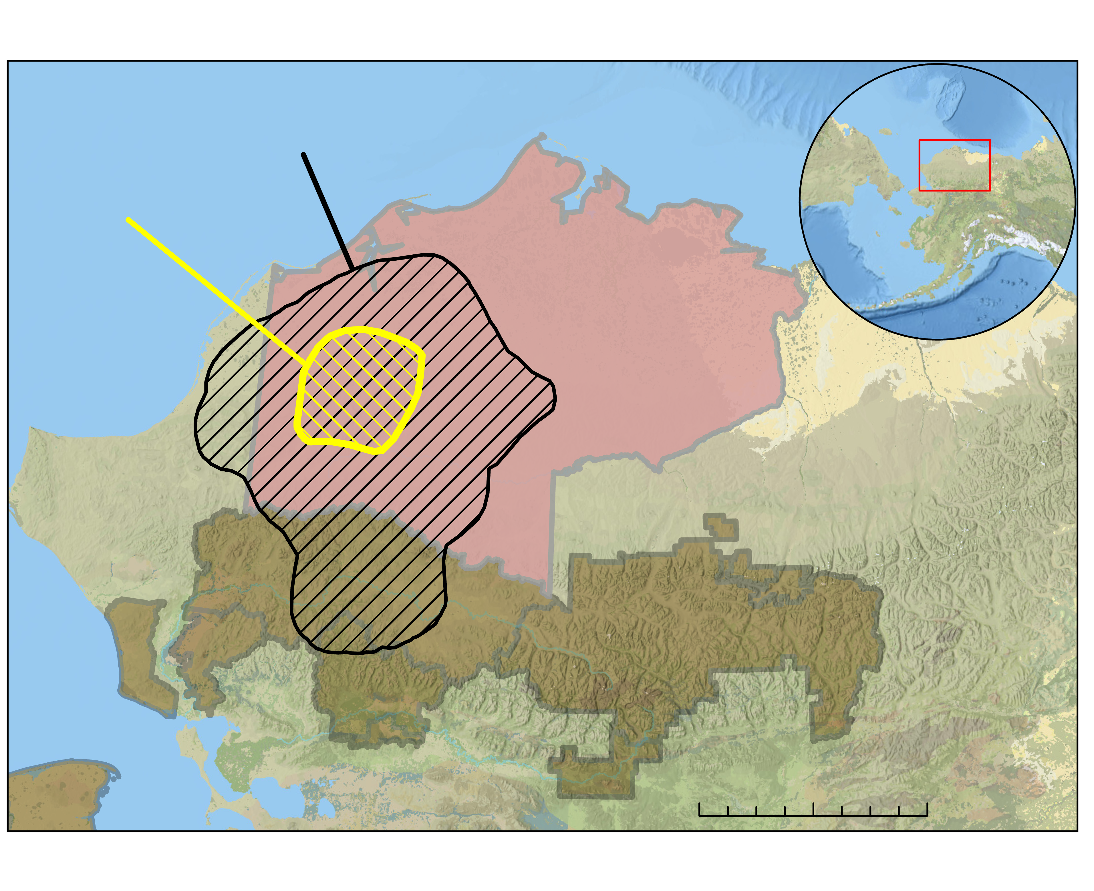
Study Area & Period
B
A
Site A: Highest density of calving sites
Study Site A
Study Site B
National Petroleum Reserve
Site B: Lower density of calving events
National Parks &
Preserves
0
45
90
180
Kilometers
Data from Esri, Alaska Geoportal, Earthstar Geographics, and USGS
Notes:
Our study area consisted of 2 calving zones occupied by the Western Arctic Herd and were identified by our partner. Site A represents the core calving zone, while Site B represents the cumulative area used by most pregnant caribou across numerous years. The calving zones overlap with the National Petroleum Reserve of Alaska. The Arctic Inventory and Monitoring Network park units are also shown here for context.
----------Image Information Below----------
Basemap Credit: Alaska Eco II Team, Data from Esri, Alaska Geoportal, Earthstar Geographics, and USGS

Slide 6
Objectives
Time Series Plots
2000 – 2024
Time Series Maps
Yearly
NDVI Composite
2000 – 2024
Annual Green-up, ΔNDVI, peak NDVI, and length of season
Time lapse visualization of seasonal vegetation phenology
Composite image of reoccurring high density NDVI values
Notes:
Our primary objective was to investigate changes in vegetation phenology within caribou calving areas using the Normalized Difference Vegetation Index (NDVI). NDVI is a metric that uses infrared and red spectral signatures reflected by vegetation to quantify vegetation greenness. NDVI values range from -1 to 1. Negative values are associated with water, snow, or clouds. Values close to 0 indicate little to no vegetation, and values near 1 are healthy, green vegetation.
We used NDVI to assess the timing of vegetation green-up, peak NDVI values, and changes in NDVI during specified calving periods. We plotted annual vegetation phenology to visualize shifts in the length of the growing season and mapped the spatial variation of phenology across the years. Finally, we identified sites with overlapping peak NDVI values.
----------Image Information Below----------
[Microsoft Icons]
Image Credit: [Microsoft Office]
Image Source: [Microsoft Office]

Slide 7
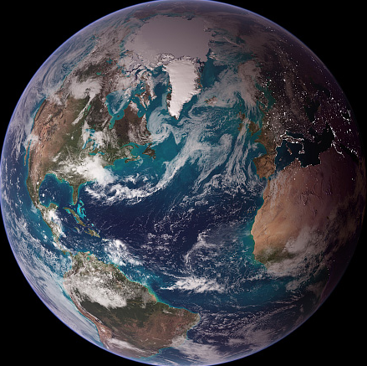
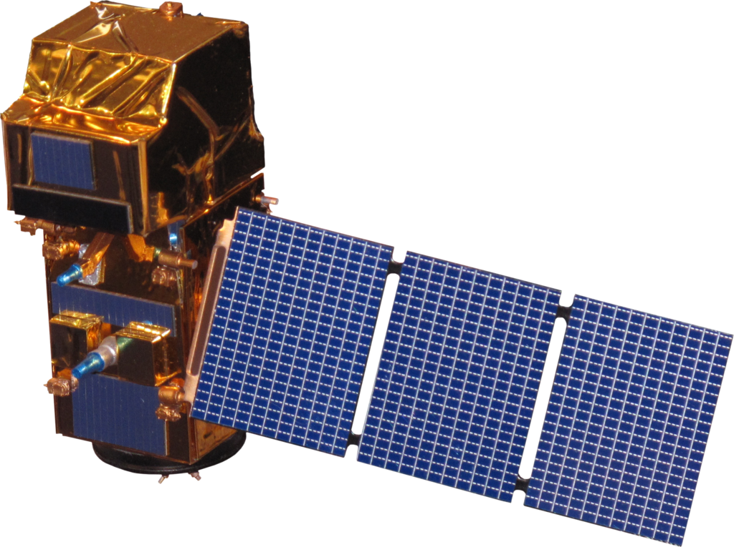
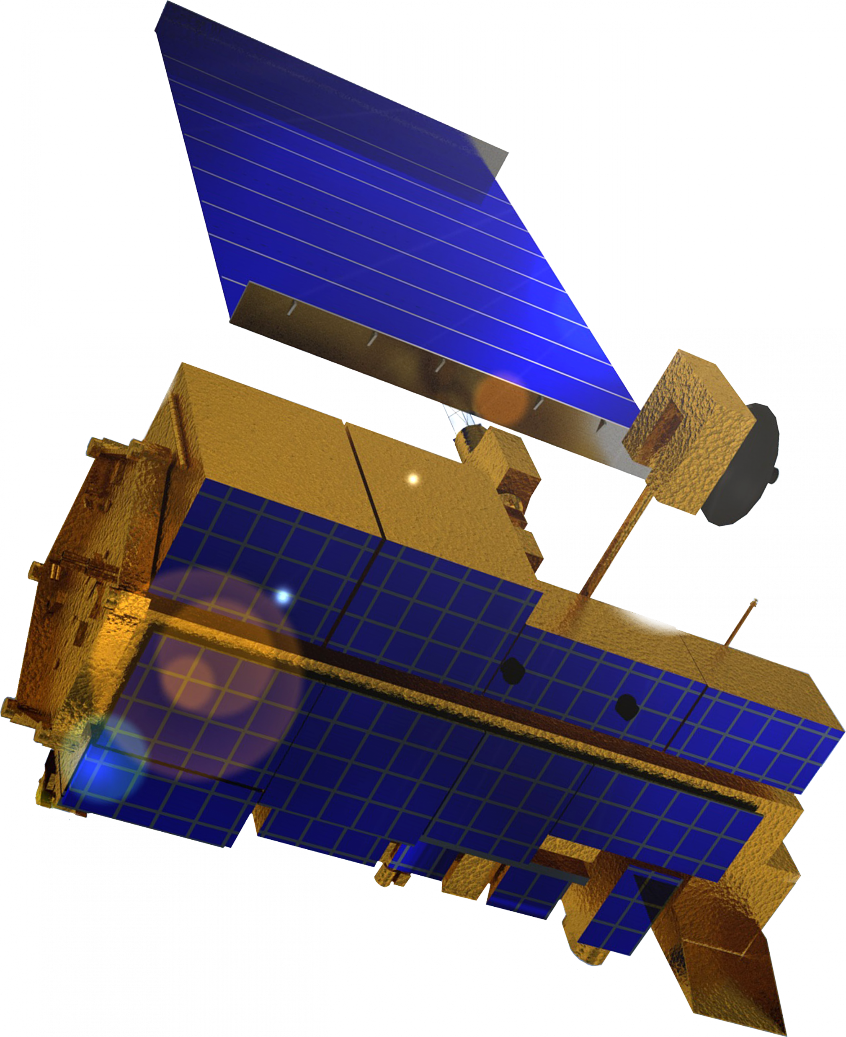
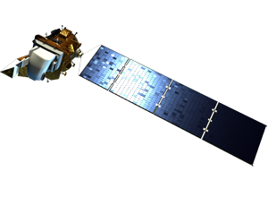
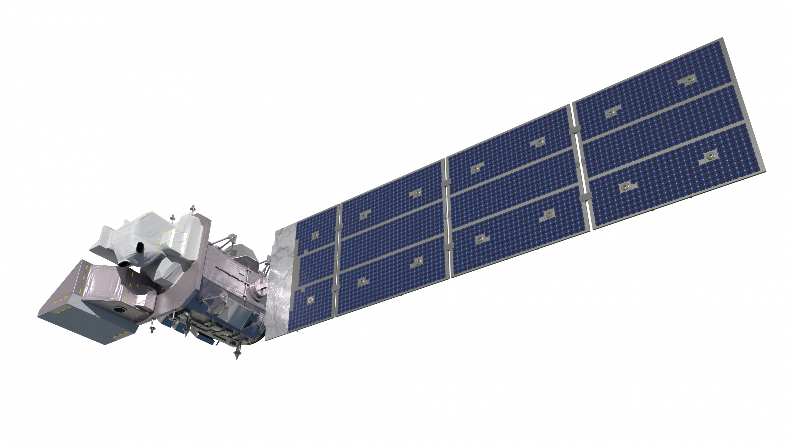
Earth Observations
Aqua MODIS
Sentinel-2A/B MSI
Landsat 8 OLI
Terra MODIS
Landsat 9 OLI-2
HLS Product (30m)
NBAR MODIS Product (500m)
2000 2005 2010 2015 2016 2020 2023 2024
Notes:
We collected daily, 500-meter resolution imagery from the NBAR MODIS dataset from 2000 – 2024, represented by the green labels. NBAR stands for “Nadir Bidirectional Reflectance Distribution Function Adjusted Reflectance.” MODIS sensors on the Aqua and Terra satellites scan from side-to-side, resulting in oblique views. The data is pre-processed to remove the effects of the different observation angles, helping to standardize the data. The data is produced daily based on a 16-day retrieval period, with the composite image’s date occurring on the 9th day. Essentially, this product creates daily estimations of land cover using the two MODIS sensors.
The algorithm weights images over the 16-day retrieval period differently based on the day they were taken in relation to the date of interest. For example, an image taken on May 25th will be weighted less heavily than an image taken on May 29th if the composite image is for May 30th.
The blue labels represent 2-3 Day Harmonized Landsat and Sentinel-2 (HLS) imagery from 2016 – 2023. This product is derived from the OLI, OLI-2, and MSI sensors from the Landsat 8 & 9 and Sentinel-2 satellites, respectively. Imagery from the satellites are standardized and processed with an atmospheric correction, cloud mask, view angle correction, and band pass adjustment.
----------Image Information Below----------
Earth Icon
Image Credit: NASA, Visible Earth
Image Source: https://www.visibleearth.nasa.gov/images/8108/twin-blue-marbles
Landsat 9 icon
Image Credit: NASA
Image Source: https://science.nasa.gov/wp-content/uploads/2023/05/landsat9.png
Landsat 8 icon
Image Credit: NASA
Image Source: https://science.nasa.gov/wp-content/uploads/2023/05/landsat8_ldcm.png
Sentinel-2A/B
Image Credit: Rama
Image Source: https://upload.wikimedia.org/wikipedia/commons/3/3d/Sentinel_2-IMG_5873-white_%28crop%29.jpg
Aqua MODIS icon
Image Credit: NASA
Image Source: https://science.nasa.gov/wp-content/uploads/2023/05/Aqua.png
Terra MODIS icon
Image Credit: NASA
Image Source: https://science.nasa.gov/wp-content/uploads/2023/05/Terra.png

Slide 8
Methodology
Google Earth Engine
Earth Observation #1
NDVI Calculation
NBAR MODIS (500m)
May 1 – July 5
2000 – 2024
ArcGIS Pro
Outputs
Water, pixel quality, & negative NDVI Masking
Time Series Maps
Descriptive Statistics
Median NDVI
Composite
MSLSP Algorithm
Time Series Plot
Earth Observation #2
Cloud, water & snow mask
ΔNDVI Table
HLS (30m)
2016 – 2023
Excel
Topographic correction
Phenology Curve
Day of Year vegetation metrics
Notes:
We acquired MODIS imagery from Google Earth Engine (GEE). Our code processed the data which included: hardcoding NDVI bands, filtering images to maintain the highest quality pixels, water-masking images to strengthen our analysis, generating descriptive statistics exportable as .csv’s, and creating downloadable GeoTIFFs for ArcGIS pro.
We pulled HLS imagery from the Boston University server through our scientific advisors, Seamore Zhu and Dr. Mark Freidl, and applied imagery to the Multisource Land Surface Phenology (MSLSP) algorithm. MSLSP applies cloud, water, and snow masks as well as topographic corrections to create Day of Year vegetation phenology metrics for entire years. The metrics are based on percent greenness, date of cycle peaks, NDVI max and amplitude, and quality assurance measurements.
We uploaded GEOTiff files of our MODIS and HLS products into ArcGIS Pro and created time series maps and NDVI composite images. Finally, we used Microsoft Excel to create time series plots, a phenology curve, and tables of delta NDVI values.
** More information about this HLS product can be found on Github, GitHub - BU-LCSC/MSLSP at master_2_0. **

Slide 9
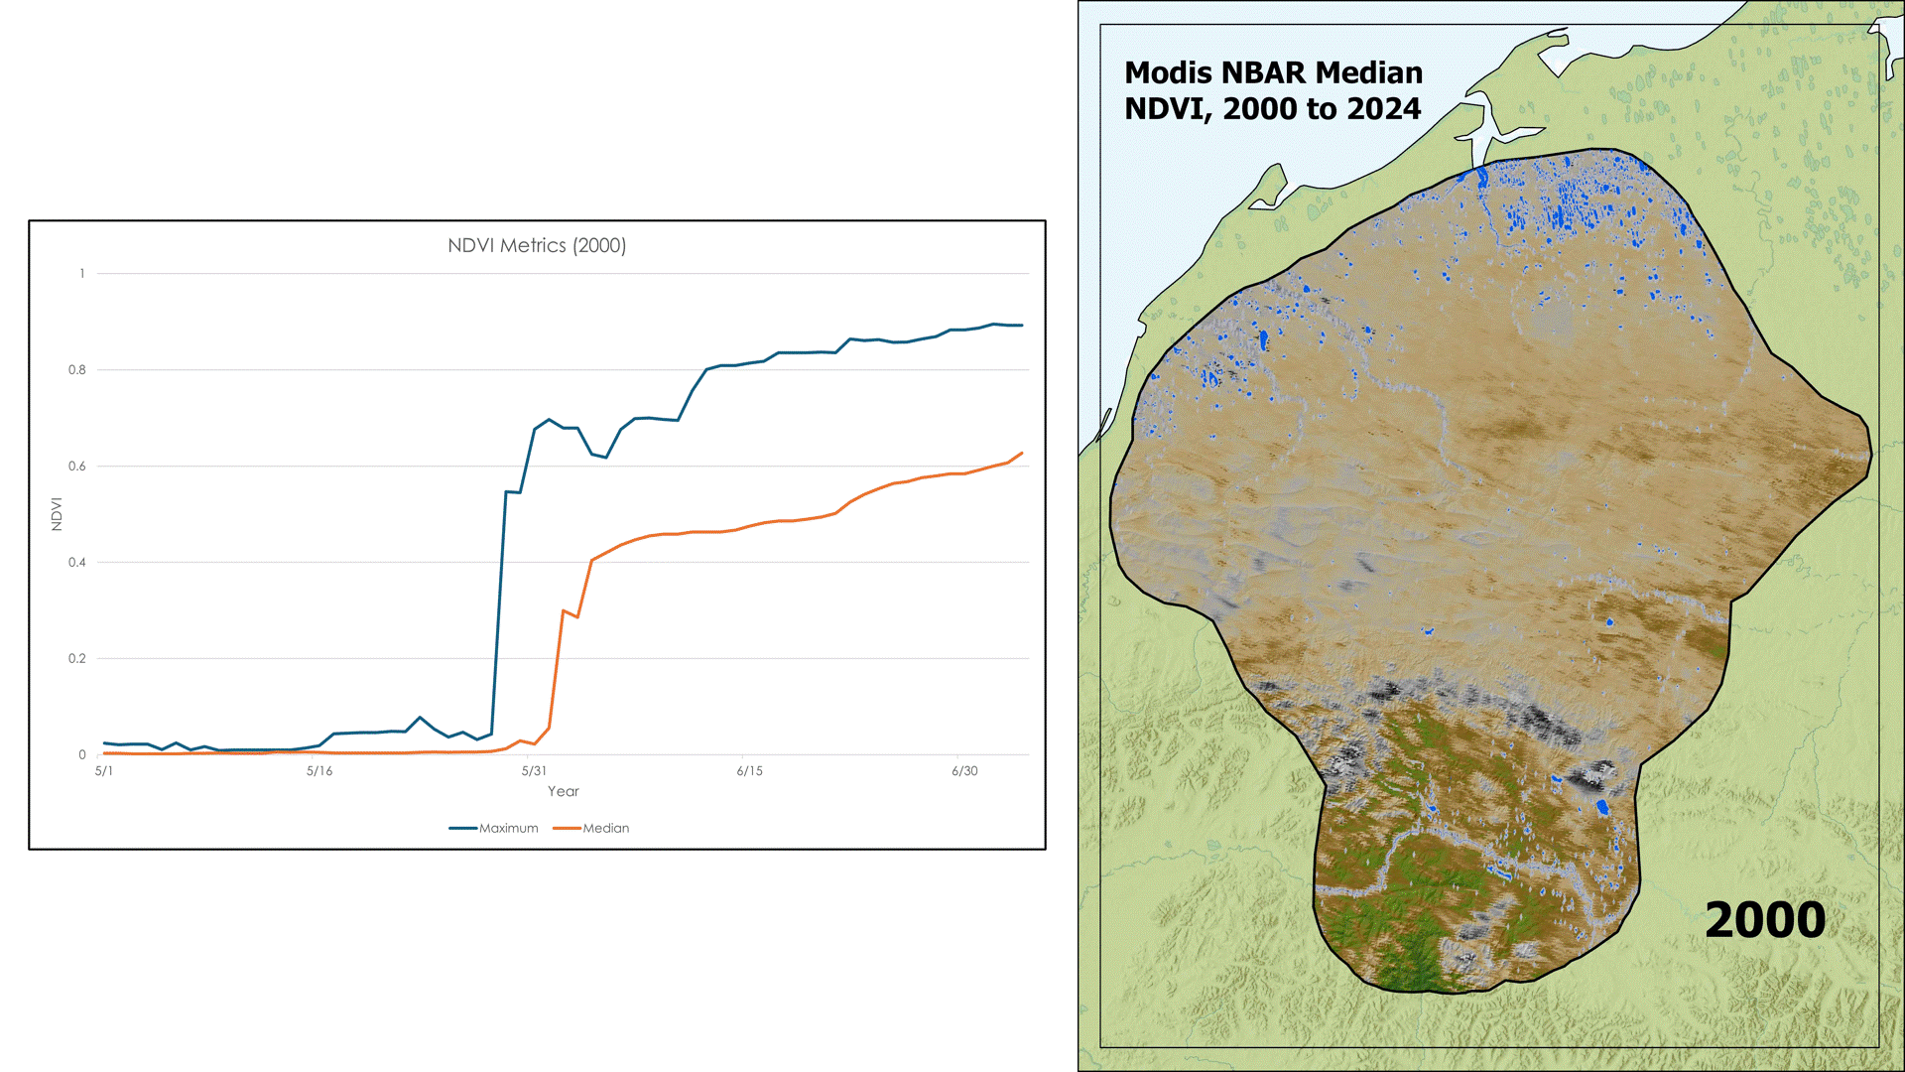
Results - NBAR MODIS Time Series
NBAR MODIS Median
NDVI, 2000 – 2024
Site A: Core Calving
1
0.8
0.6
0.4
0.2
0
NDVI Metrics
NDVI
Brooks Range
5/1 5/16 5/31 6/15 6/30
Maximum Median
Median NDVI
High
Medium
Data from
Data basin,
USGS, Esri terrain
Low
0
20
40
80
Kilometers
Notes:
This time series GIF illustrates the changing vegetation dynamics within the WAH calving region from 2000 to 2024. Each image is a median composite of NBAR MODIS imagery taken from May 1st to July 5th. The initial spikes in the NDVI metrics plots can be attributed to spring snowmelt rather than rapid vegetation growth. Interestingly, the area south of the Brooks Range consistently experiences strong vegetation growth annually; whereas Calving Site A is only suggestive of moderate vegetation growth from year-to-year. Lower levels of predation in Site A may be indicative of WAH’s fidelity toward this region over the southern end of the brooks range. It is also important to note that certain years, such as 2001, are marked by significant image error, which may give the impression of dramatic land cover changes. These data gaps are represented as missing data values in the corresponding time series plots and their NDVI Metrics should be considered cautiously.

Slide 10
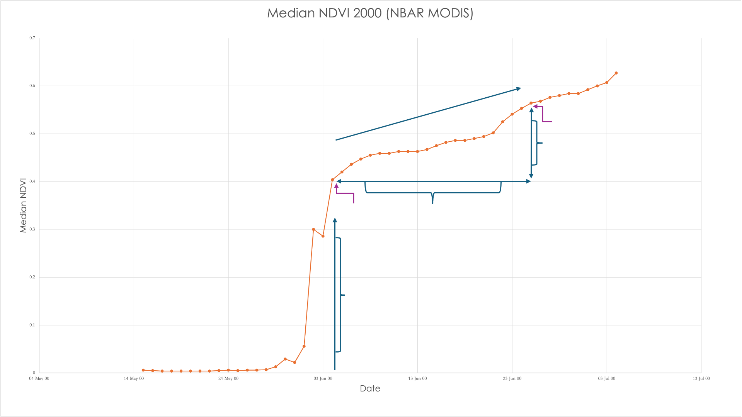
Results – MODIS ΔNDVI
Year | Date Range | △ NDVI
2000 | June 4- June 25 | 0.0076
2001 | May 31 - June 19* | 0.0063
2002 | May 19 - June 25 | 0.0043
2003 | June 2 - June 25 | 0.0057
2004 | May 22 - June 25 | 0.0069
2005 | May 20 - June 25 | 0.0049
2006 | May 25 - June 25 | 0.0067
2007 | May 22 - June 25 | 0.0067
2008 | June 2 - June 25 | 0.0066
2009 | May 17 – June 25 | 0.0041
2010 | May 19 - June 25 | 0.0054
2011 | May 23 - June 25 | 0.0050
2012 | May 19 - June 25 | 0.0052
2013 | May 20 - June 25 | 0.0050
2014 | May 17 - June 25 | 0.0043
2015 | May 17 - June 25 | 0.0048
2016 | May 13 - June 25 | 0.0052
2017 | May 21 - June 25 | 0.0042
2018 | May 15 - June 25 | 0.0046
2019 | May 12 - June 25 | 0.0066
2020 | May 22 - June 25 | 0.0063
2021 | May 24 - June 25 | 0.0049
2022 | May 28 - June 25 | 0.0046
2023 | May 18 - June 25 | 0.0040
2024 | May 23 - June 25 | 0.0050
MODIS NBAR Median NDVI (2000)
0.7
0.6
Δ NDVI
NDVI₂ (last day of calving)
0.5
Increase in NDVI
0.4
Median NDVI
NDVI₁
Number of days
0.3
ΔNDVI = (NDVI2 - NDVI1) / DOY2 - DOY1)
0.2
Snowmelt
0.1
0
May 14
May 24
June 3
June 13
June 23
July 3
Date
Notes:
We calculated the rate of daily vegetation change or 'delta NDVI' from 2000-2024 with data from NBAR MODIS by using NDVI values from the first day of green-up, following the annual snowmelt spike. We used the end of the calving period June 25th, as our second day of year ('Day of Year 2’). In 2001, there was an exception to our second day due to a gap in data because of sensor malfunction. Between 2000-2024, our delta NDVI analysis period varied between 19 and 44 days, with an average of 33.8 days. Our two determined dates gave us NDVI values, which we incorporated in a slope calculation to determine daily rate of change. Our results varied between years, ranging from 0.0042 - 0.0076. Our partner may utilize these results to determine years with rapid increases in NDVI and vegetation green-up in relation to caribou calving.

Slide 11
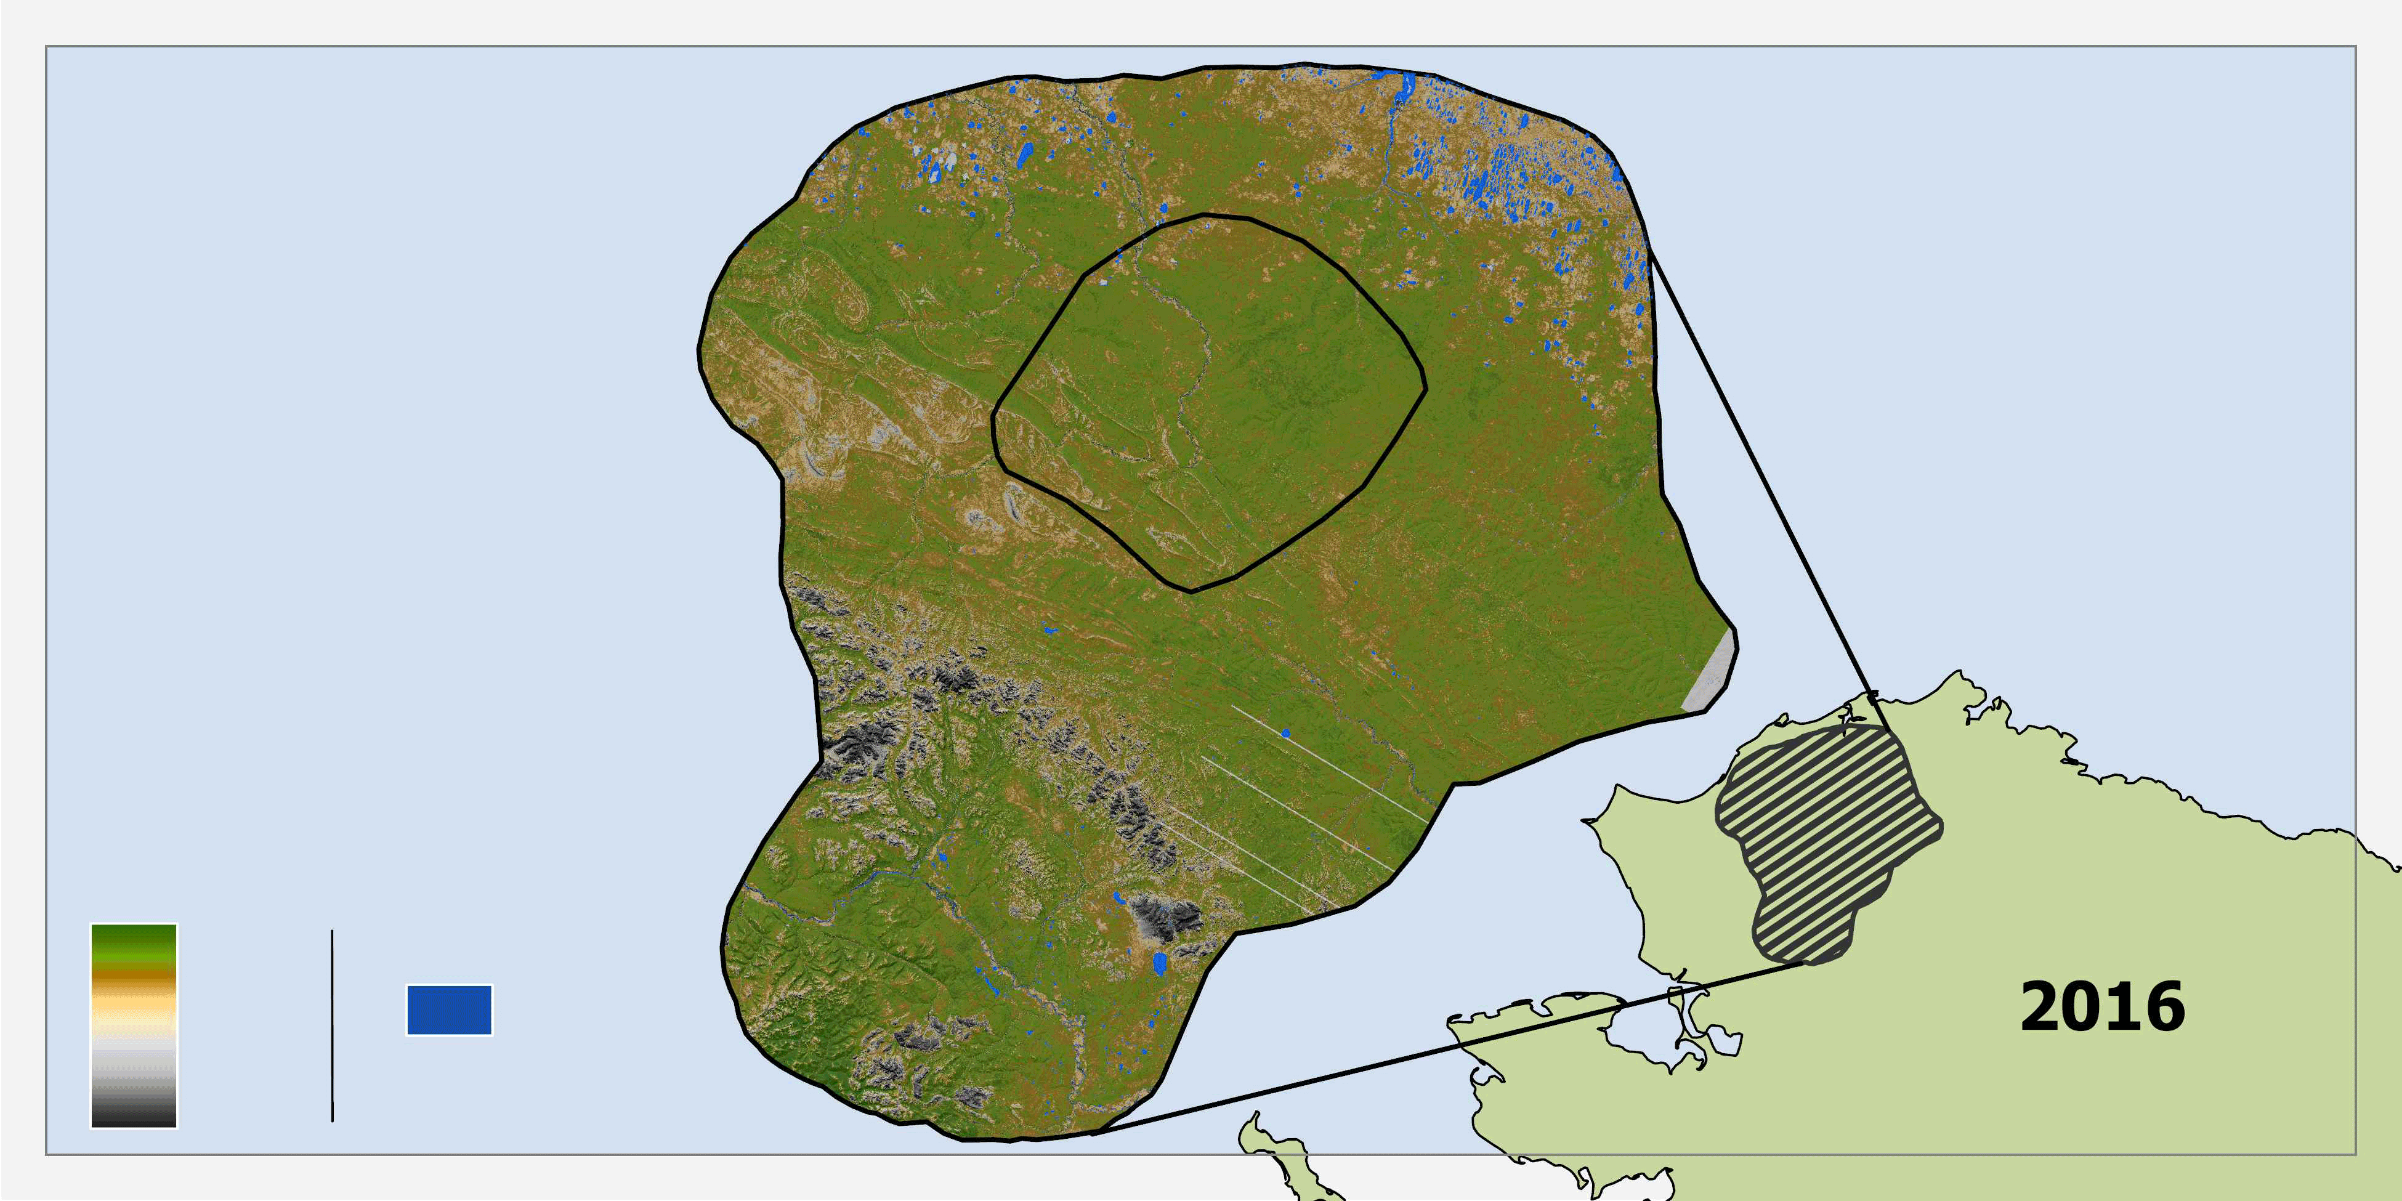
Results – HLS Time Series Maps
HLS, Peak Normalized Difference Vegetation Index
Study Area A
Study Site A
Study Site B
Inland Water
Max NDVI
NDVI Concentration
High
High
Medium
Inland Water
Medium
0
25
50
100
Kilometers
Low
Low
No Data
Notes:
This GIF displays peak NDVI between 2016 – 2023 derived from HLS imagery. Areas of dark green represent high NDVI, while brown and grey values represent low NDVI. This map is an example of the maps produced for each year in our study period. They represent the max NDVI values, with black and gray values representing very low to no vegetation change, brown and tan areas representing moderate changes in vegetation, and green regions illustrating areas of high vegetation change. Also present in the map are Study Areas A and B, these are included to facilitate the comparison of NDVI distribution between the sites.

Slide 12
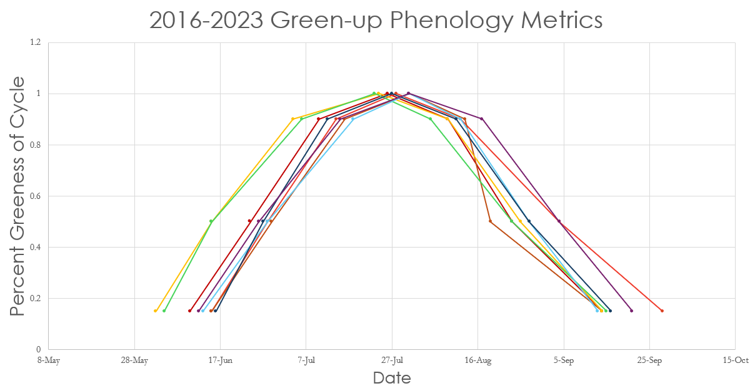
Results – HLS Phenology Curve
2016 – 2023 Phenology Metrics
1.0
0.8
Percent Greenness
0.6
(Scaled 0-1)
0.4
0.2
May 8
May 28
June 17
July 7
July 27
Aug. 16
Sep. 5
Sep. 25
Oct. 15
Date of Year
2016
2017
2018
2019
2020
2021
2022
2023
Notes:
We constructed this time series phenology curve using HLS data from 2016 - 2023. It displays the interannual shifting of phenology timing starting from onset (15% greenness) in late May, midpoint increase (50%), maximum onset (90%) and cycle peak, followed by the onset of NDVI decrease, midpoint decrease and onset greenness minimum in September. The percent greenness is scaled 0-1 per year, with 1 being the peak of the annual NDVI values from observations in a single season. The curve does not display changes in NDVI values each year. Instead, it is normalized to display the shift in timing of onset, increases and decreases in midpoints, and peaks.

Slide 13
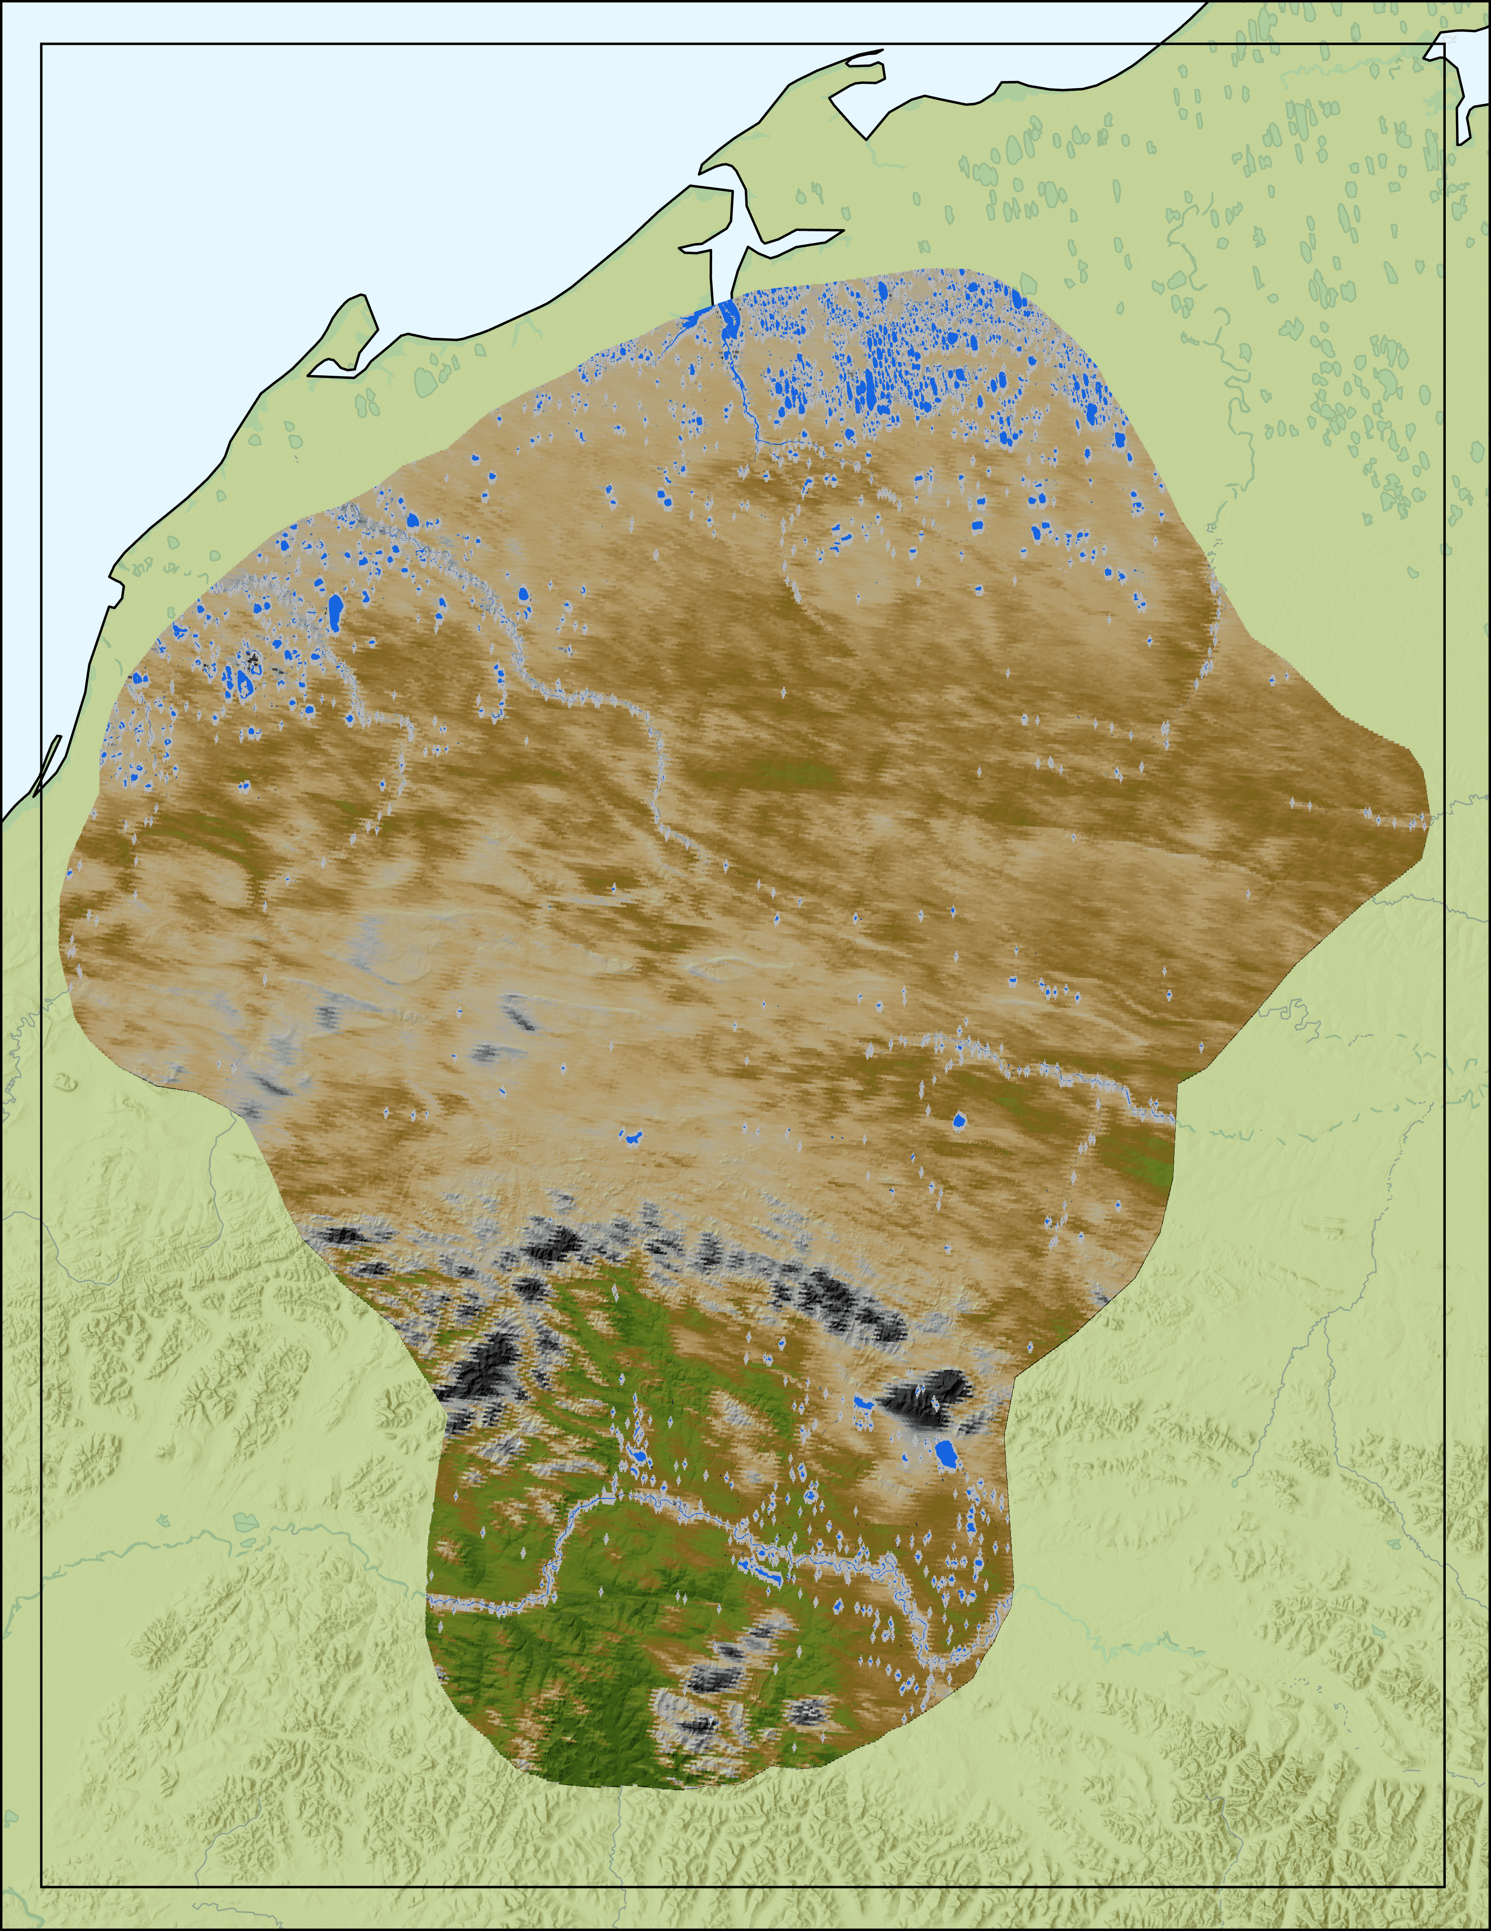
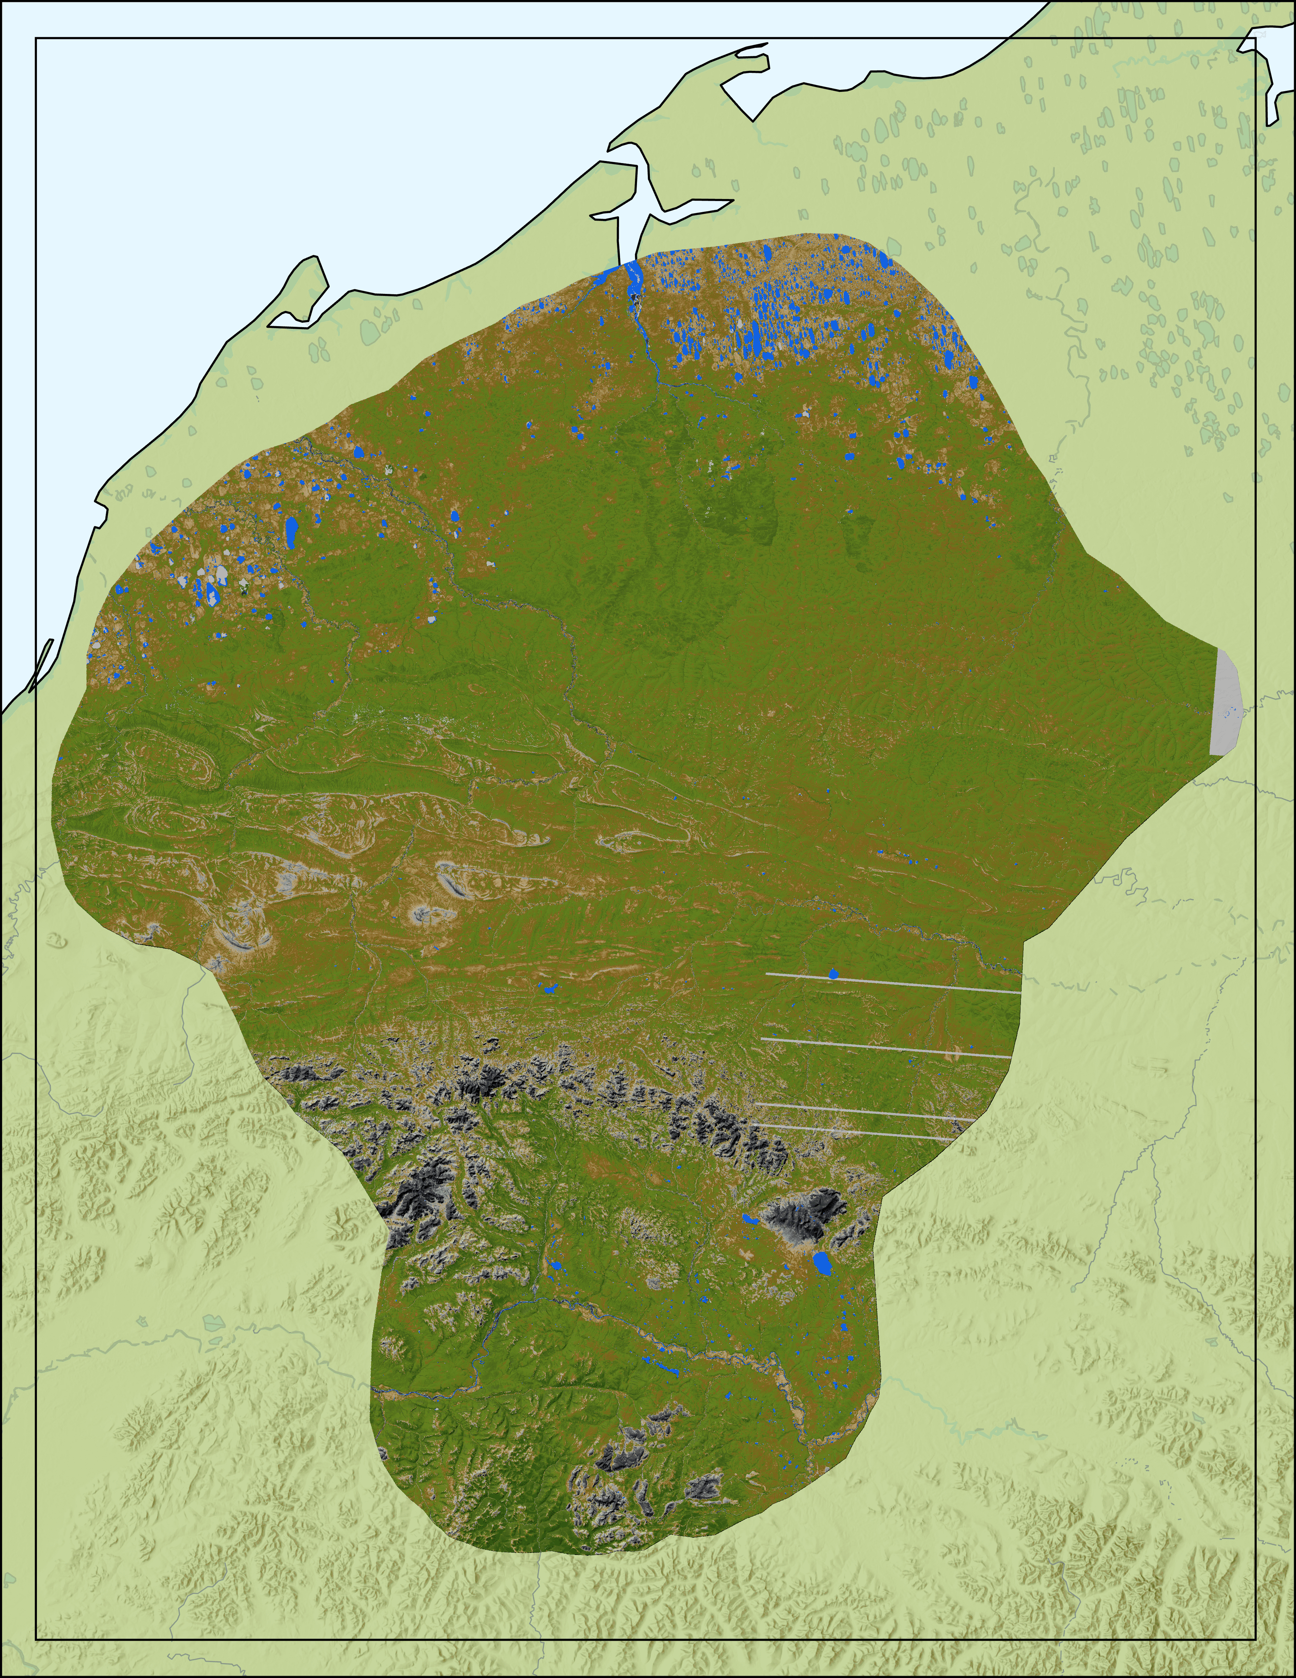
Results – MODIS / HLS NDVI Composite
MODIS NDVI
Composite
2000-2023
HLS NDVI
Composite
2016-2023
Median
NDVI
Median
Peak NDVI
High
High
Medium
Medium
Low
0
20
40
80
Low
0
20
40
80
Data from Data basin, USGS, Esri terrain
Kilometers
Kilometers
Notes:
These maps represent the composite images of NDVI for HLS and MODIS. Each cell represents the median NDVI values for that span across all years, 2000 – 2023 for MODIS, and 2016 – 2023 for HLS. As with the other maps produced in this project, low NDVI values are represented by blacks and dark grays, middle NDVI values are represented by light grays and browns, and high NDVI values are represented by shades of green. The two sensors have noticeably different results which is likely the product of their different resolutions, as well as the different years covered, MODIS covers 23 years while HLS only covers 8 years. Additionally, the HLS features the median cell values from the max or peak for that cell, while the MODIS map features the true median of that cell. ​

Slide 14
Errors & Uncertainties
NBAR MODIS Smoothing & Sensor Error
Water Masking
MSLSP Product Timeframe
Negative NDVI values
Notes:
The MODIS dataset provides daily estimations of land cover over a given period. This approach encountered challenges in acquiring high-quality images, as certain images contained significant cloud cover which created data gaps and high levels of image error. Therefore, even with the high efficacy of the NBAR algorithm, errors persisted and may have affected our NDVI analysis.​
​
Additionally, we clipped our 500m MODIS dataset to a 30m resolution inland water dataset. The difference in spatial resolutions meant that the water mask did not effectively clip all the 500m MODIS water pixels. To address this discrepancy, we applied a buffer to the water mask that filtered out surrounding water pixels. Although this process was imperfect and resulted in spottier imagery, the dilated water mask strengthened our NDVI analysis.
Furthermore, we masked out negative NDVI values from our MODIS dataset. We assumed that NDVI values below zero represented non-vegetated areas like bare land, rock, and cloud structures; however, this created “image holes” that may have skewed our analysis. To combat the image visualization, we added a no-data and water layer to each MODIS image in ArcGIS Pro so the removed pixels were not as apparent. ​
​
Finally, the MSLSP algorithm resulted in phenology curves outside the caribou calving period of May 25th – June 15th. The earliest our phenology product dates back to is June 2nd, cutting halfway into our study period. Our vegetation phenology metrics, therefore, illustrate vegetation peaks more closely related to WAH insect harassment periods. Generating effective Delta NDVI measurements from this product also proved difficult. The MSLSP algorithm encoded Julian days of year to our imagery, making it difficult to extract precise calendar dates to Max NDVI values.
----------Image Information Below----------
[Microsoft Icons]
Icon Credit: Microsoft Office
Icon Source: Microsoft Office

Slide 15
Conclusions
Feasibility of using NASA Earth observations for temporal NDVI analysis
NBAR MODIS was limited by its spatial resolution and image smoothing
ΔNDVI is a useful calculation of vegetation quality and rate of growth
MSLSP was limited by its temporal availability
Notes:
Our project demonstrated the effectiveness of using NASA Earth observations to investigate vegetation phenology dynamics to monitor shifts in WAH caribou calving. We observed high levels of vegetation in Calving Sites A and B during the WAH’s peak calving season of May 25th – June 15th.
Daily observations from the NBAR MODIS dataset were the most valuable, illustrating dynamic NDVI variations annually from 2000-2024. However, the low 500m spatial resolution imagery made detailed analysis challenging. These results are only indicative of general vegetation phenology changes and should not be specified to smaller regions within our study. Additionally, observations from NBAR MODIS produce estimations of daily land cover, which may not always provide reliable information, as further ground truthing is needed. The NBAR algorithm effectively adjusts for oblique sensor angles, but certain images still exhibit sensor error and pixel blurring. This was of particular concern in areas with large amounts of water, where mixed water, land, and vegetation areas were represented by a single water pixel, potentially skewing our NDVI analysis.
The MSLSP model proved valuable for assessing detailed vegetation shifts and quality metrics from 2016-2023; however, the resulting phenology curves did not effectively encompass our primary study period, limiting its overall usefulness. We found it more feasible to use the MSLSP algorithm to determine vegetation growth and quality post-WAH calving and into the annual insect harassment periods.
We found Delta NDVI to be a useful statistic to illustrate the rate of daily vegetation growth over a specific time. This analysis provided insights into areas of healthiest vegetation growth and could help further specify caribou migratory routes. This data can be combined with ground truthing datasets, such as Caribou GPS tracking, to better understand WAH’s memory-based migratory routes.
----------Image Information Below----------
[Microsoft Icons]
Icon Credit: Microsoft Office
Icon Source: Microsoft Office

Slide 16
Project Partners and Advisors:
Kyle Joly – National Park Service, Gates of the Artic National Park & Preserve
Seamore Zhu – Lead Science Advisor (Boston University PhD Candidate)
Dr. Mark Friedl – Science Advisor (Boston University)
Madison Arndt – NASA DEVELOP Massachusetts – Boston Lead
Past Contributors:
Christian Sarro – NASA DEVELOP Spring 2024 Project Lead
Levi Mitchell – NASA DEVELOP Spring 2024 Participant
Mahnoor Naeem – NASA DEVELOP Spring 2024 Participant
Ben Silver – NASA DEVELOP Spring 2024 Participant
* “This material contains modified Copernicus Sentinel data (2016-2023), processed by ESA.” *
Notes:
For this project, we wish to recognize our partner, Kyle Joly at the National Park Service; our lead science advisor, Seamore Zhu, without whom we would not have come this far; our other exceptional science advisor, Dr. Mark Friedl; and our outstanding MA Boston Node lead, Madison Arndt, who was integral to making this project possible.
We wish to recognize the past contributors to the Alaska Ecological Conservation project. First and foremost, we want to express our appreciation for Levi Mitchell, a two-time DEVELOP participant, who has remained a vital member of the Alaska Ecological Conservation II project as a team lead. We also extend our gratitude to the previous Spring 2024 DEVELOP participants: Christian Sarro – project lead, Mahnoor Naeem – a two-time DEVELOP participant, and Ben Silver.

