Slide 1
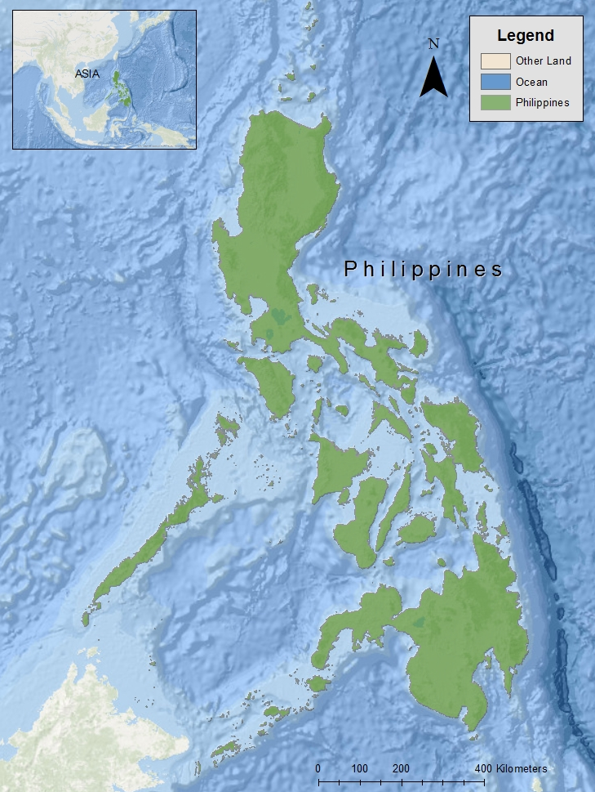
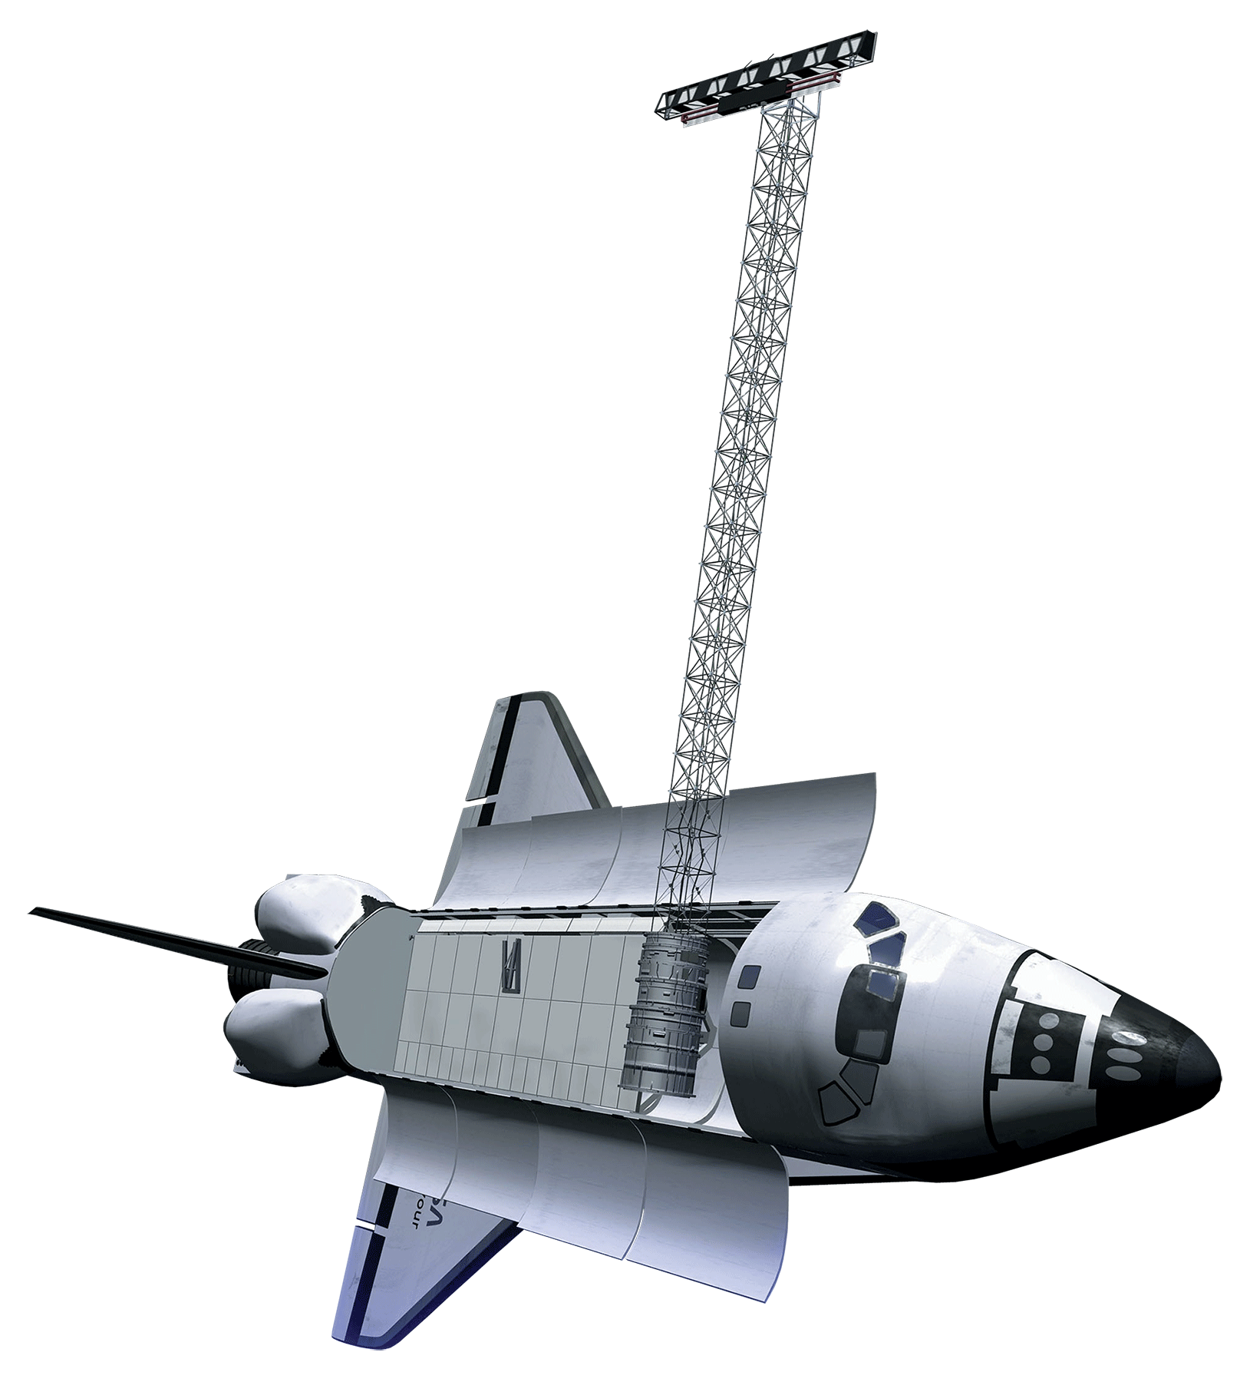
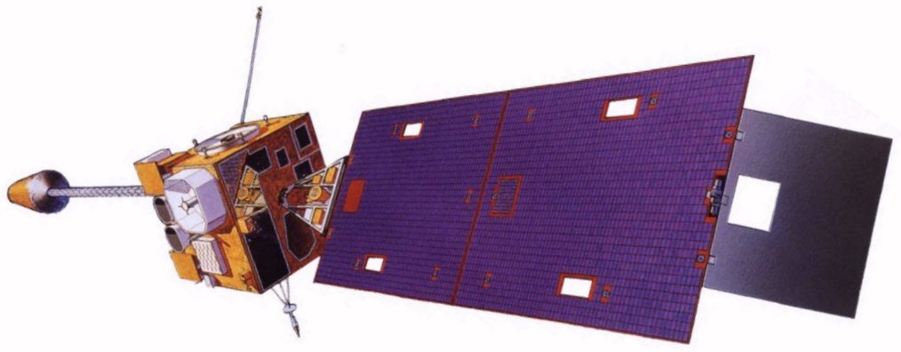
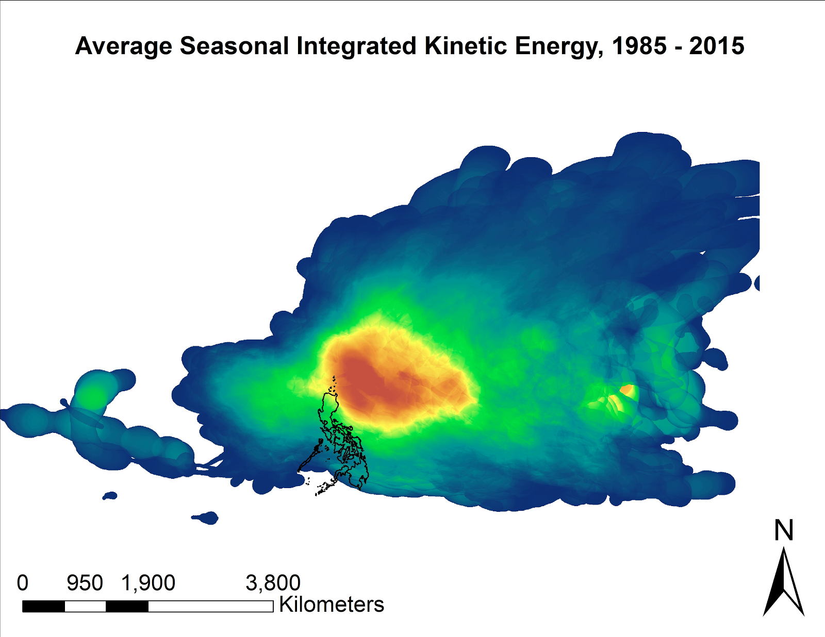
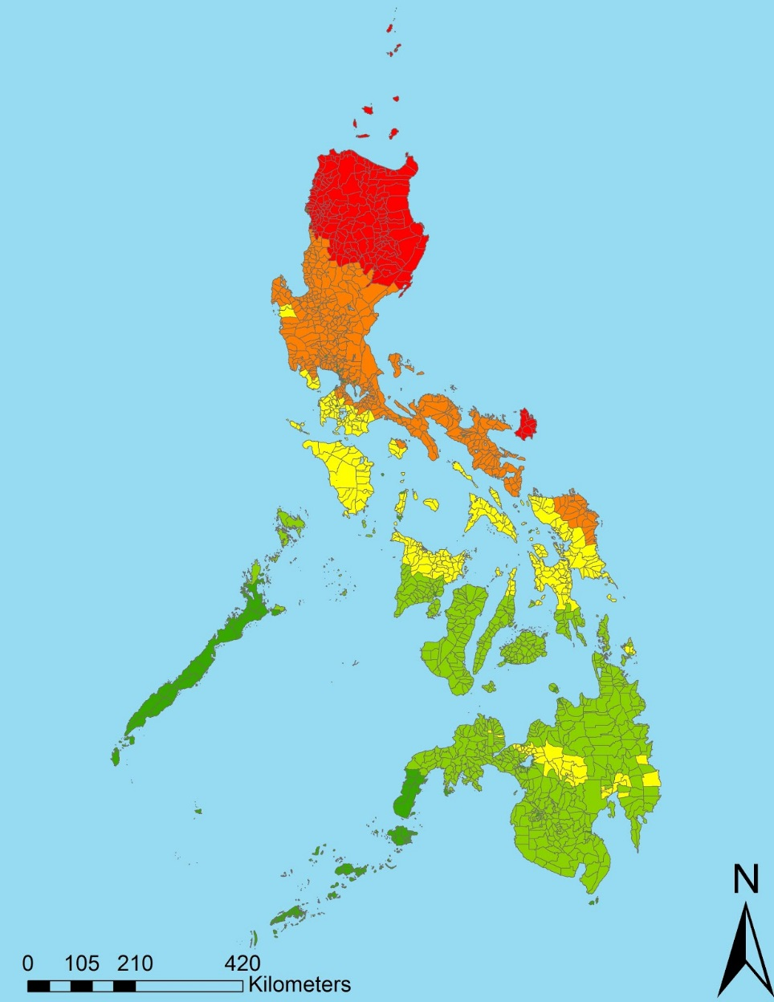
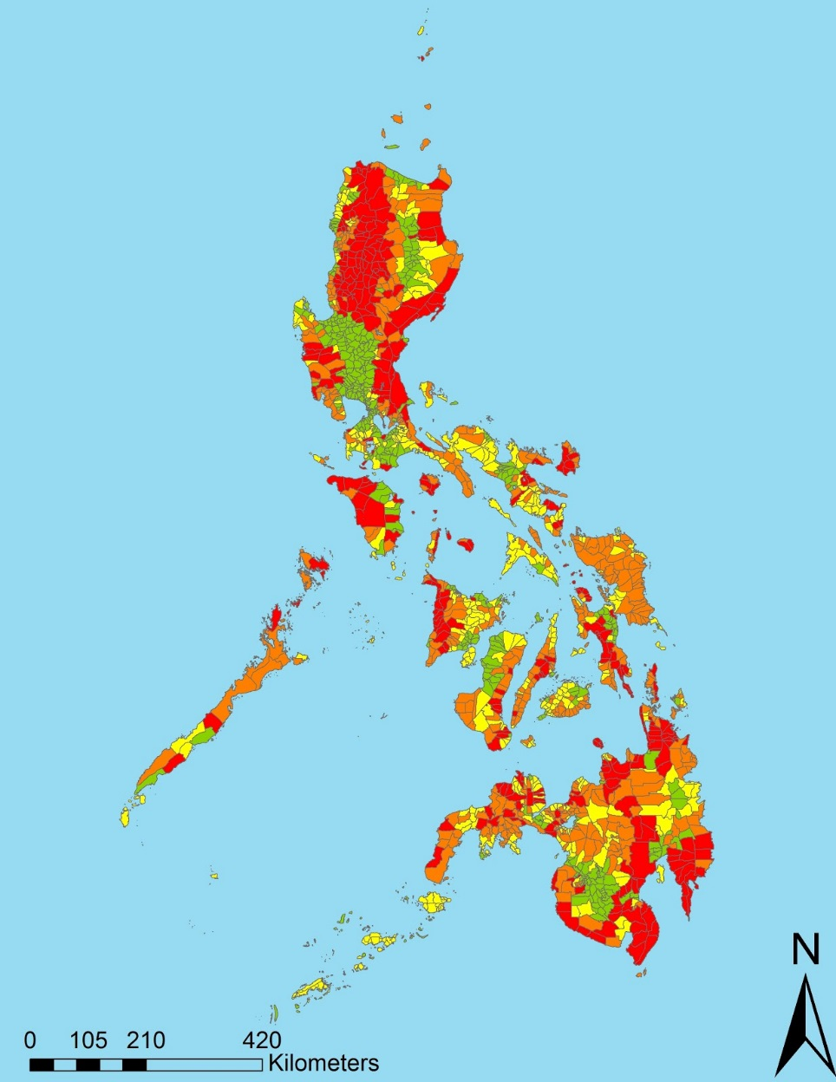
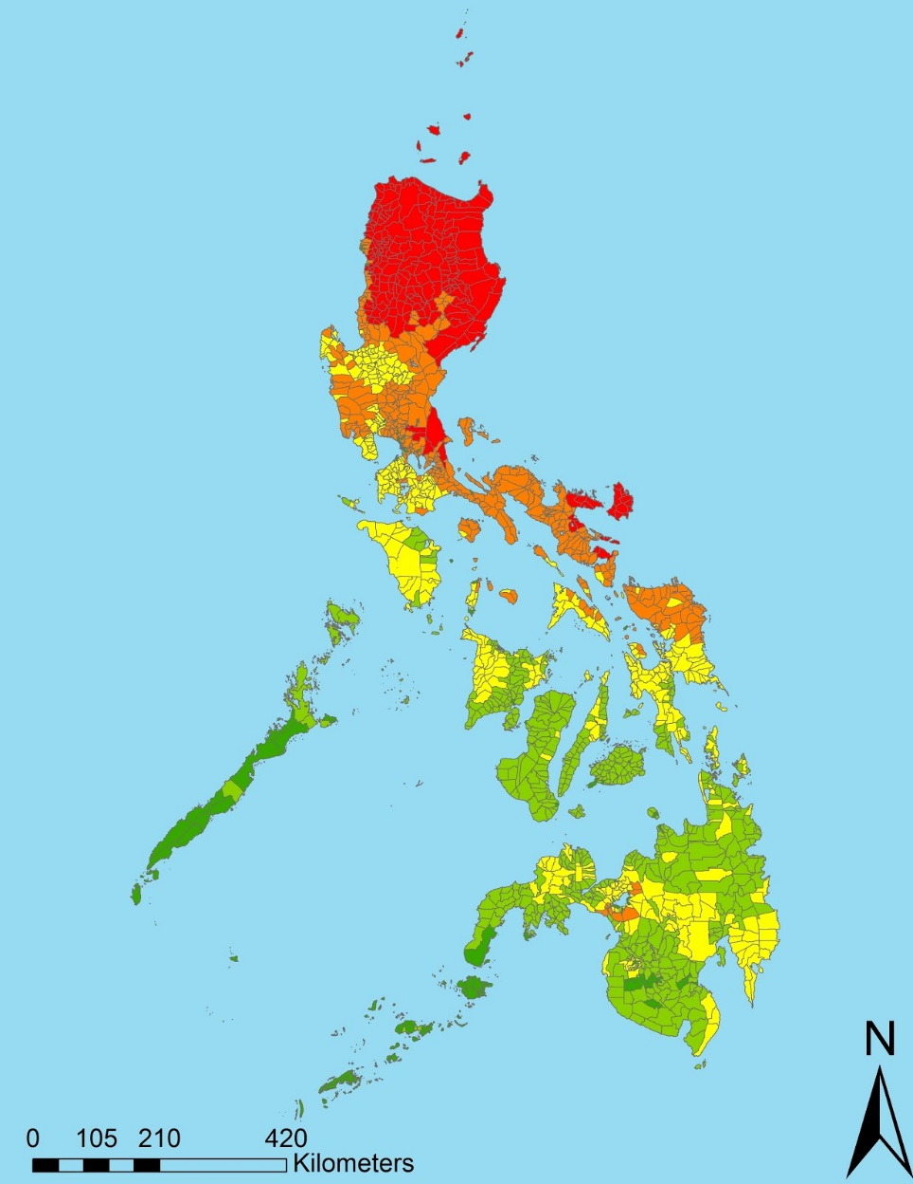




Utilizing NASA and NOAA Earth Observations to Enhance Cyclone Movement and Intensity Measurements to Improve Disaster Relief Planning in the Philippines
Abstract
Objectives
The Philippine islands, located within the northwest Pacific Ocean Basin, are frequently affected by tropical cyclones. During and after tropical cyclones, the number of Gender-Based Violence (GBV) crimes increase. To assist the United Nations Office for the Coordination of Humanitarian Affairs (OCHA), a cyclone vulnerability assessment for each municipality within the Philippines is created and streamlined with demographic data to identify at risk communities. For this effort, hurricane satellite (HURSAT-B1) data were downloaded for each tropical cyclone that affected the Philippines from 1985 to 2009. To include the recent record, data were gathered for tropical cyclones affecting the study area from 2010 to 2015 from the Cooperative Institute for Research in the Atmosphere’s (CIRA) Multiplatform Tropical Cyclone Surface Wind Analysis (MTCSWA). The HURSAT and CIRA products were used to derive estimates of the 18 m/s, 26 m/s, and 33 m/s wind radii for each of the four quadrants (i.e. northwest, northeast, southeast, southwest) of each tropical cyclone at a 6-hour temporal resolution. The wind radii estimates were provided to our team by Dr. John Knaff because the data are not widely available. The wind speed data were then used to estimate the Integrated Kinetic Energy (IKE) of each tropical cyclone in the study period. IKE values were then accumulated over the entire study period for the Philippines and used to generate a climatology of cyclone intensity for each municipality. Additionally, areas susceptible to rainfall-triggered landslides were mapped using slope data from Shuttle Radar Topography Mission.
Enhance vulnerability maps with storm intensity and landslide risk for disaster preparedness and response
Assess gender vulnerability based on improved physical risk analysis
Enable our partners to predict areas of greatest vulnerability during future cyclone events
Study Area
Methodology
Data Acquisition
  International Best Track Archive for Climate Stewardship (IBTRaCS)
  Hurricane Satellite Dataset (HURSAT-B1)
  Multi-Platform Tropical Cyclone Surface Wind Analysis (MTCSWA)
  Satellite Radar Topography Mission (SRTM)
  Philippines Demographic Data
  Calculate the climatological Track Integrated Kinetic Energy (TIKE) of all tropical cyclones that affected the Philippines from 1985 - 2015
Data
Analysis
  Create a comprehensive precipitation initiated nationwide landslide susceptibility index
  Improved natural hazards risk index
End Products
  Interactive ArcMap file for disaster prevention
Earth Observations
GOES
Geostationary Operational Environmental Satellite Suite (e.g. GOES-8), contributes to HURSAT dataset
Philippines Disasters II
Shuttle Radar Topography Mission (SRTM) data used to analyze slope stability in landslide risk assessment.
SRTM
Results
Track Integrated Kinetic Energy (TIKE) was calculated by summing IKE values for the lifetime of a cyclone. Next, TIKE was accumulated annually, and averaged from 1985 - 2015 to create an annual average.
Typhoon Risk was calculated by determining the average annual TIKE impact for each municipality.
Landslide Risk was calculated using SRTM datasets for slope and elevation.
Physical Exposure was calculated by merging Landslide Risk and Typhoon Risk.
Conclusions
Project Partners
The project improved the identification of municipalities with the greatest tropical cyclone exposure by incorporating IKE, which was calculated from HURSAT & IBTRaCS data.
Compared to previous methods, the improved tropical cyclone and landslide risk data more accurately determined which portions of the Philippines are at greatest need for disaster mitigation preparation.
Methods used in this project can be expanded to other vulnerable nations.
United Nations Office for the Coordination of Humanitarian Affairs (OCHA)
United Nations Institute for Training and Research, Operational Satellite Applications Programme (UNOSAT)
The Netherlands Red Cross
NOAA, National Environmental Satellite, Data, and Information Service (NESDIS)
Team Members
Acknowledgements
The Philippines Disaster II team thanks our science advisors for their time and support over the course of this project:
Dr. Carl Schreck, Cooperative Institute for Climate and Satellites – North Carolina
Dr. Ken Knapp, Center for Weather and Climate, National Centers for Environmental
Information
Michael Marston
Team Lead
Aaron Mackey
Brittany Thomas
NOAA National Centers for Environmental Information – 2017 Summer

