Slide 1
Laramie Mountains
Ecological Forecasting
Mapping Fire History in the Laramie Mountain Range, Wyoming with a 31-Year Landsat Time Series
Stephanie Krail (Project Lead)
Alexa Grafton
Aubrey Hilte
Darin Schulte

Slide 2
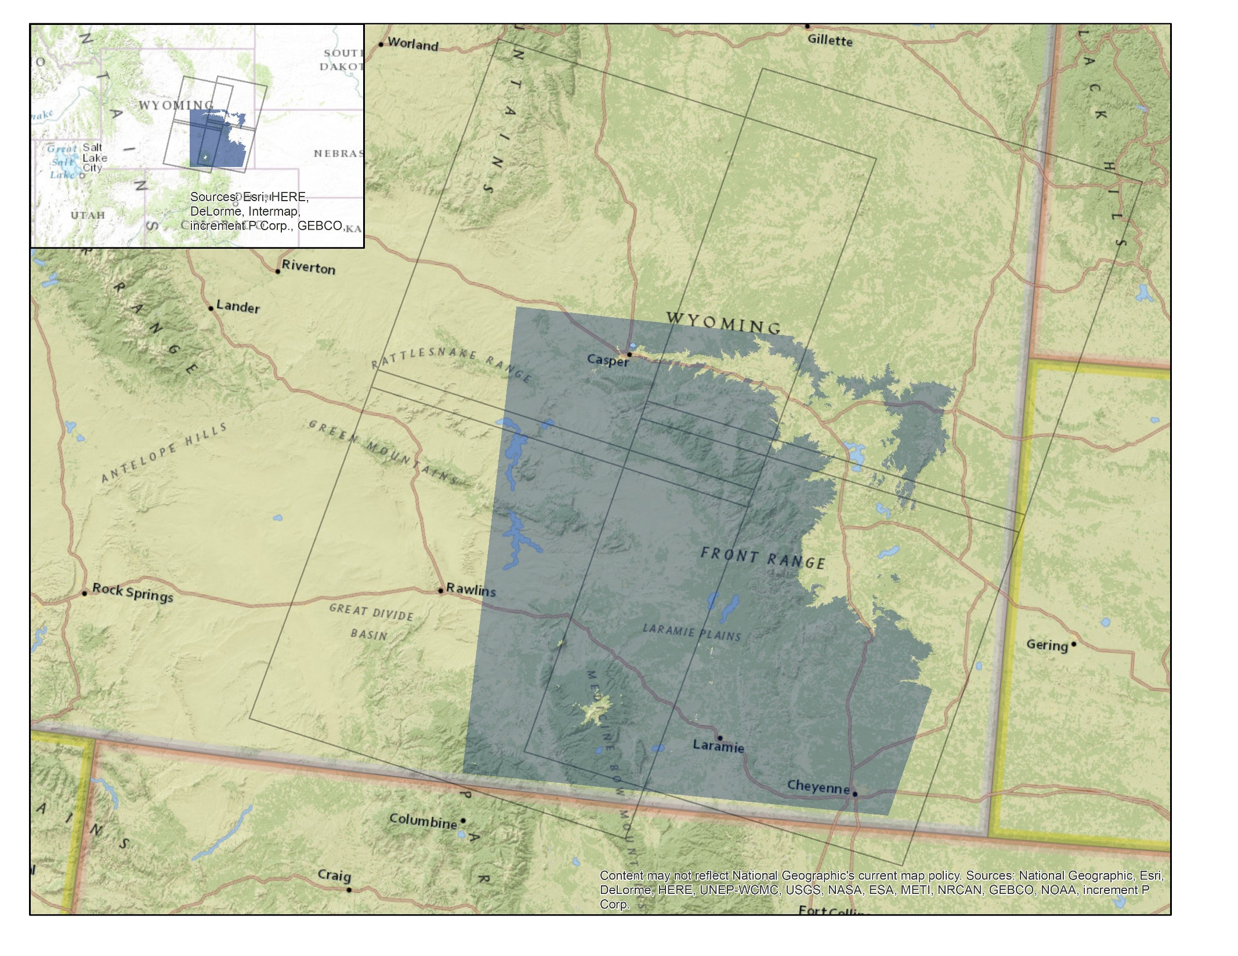
Laramie Mountains Ecological Forecasting Study Area
Study area extent
Path, Row outlines
Notes:
The Laramie Mountain Range consists of two units in southern Wyoming. The Pole Hill Mountain (or Sherman) unit and Laramie Peaks unit of the Laramie Range are managed in conjunction with the Snowy Range unit and Sierra Madre unit. Together, these four units comprise the Medicine Bow National Forest (MBNF) of southern Wyoming, which spans over 1.4 million acres. With such an expansive range, the area provides a multitude of ecosystem services, including year round recreational opportunities, timber harvest, wildlife habitat, and forage for livestock.
The study area is encompassed by WRS2 Path 34/Row 30, Path 34/Row 31, Path 35/Row 30, Path 35/Row 31 and focuses on areas within aspen species range (elevations of 1580 to 3200 m). The study period is between June 1984 and August 2015 during the growing season months (June to August) when fires are the most prevalent.

Slide 3
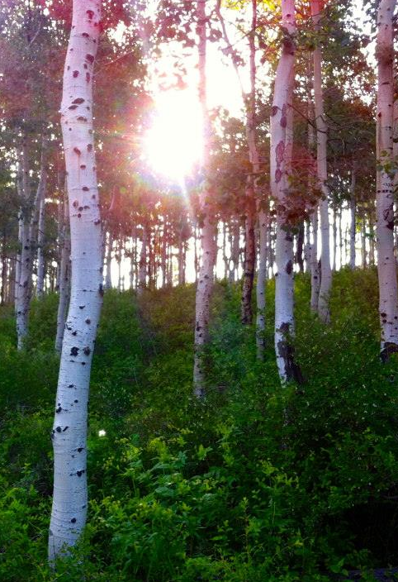
Objectives
Delineate fire history of the Laramie Mountain Range
Classify severity of past fire events
Calculate fire return intervals through a 31-year time series
Analyze locations within study area for future fire risk
Image Credit: Kelsey Corria
Notes:
The Laramie Mountains Ecological Forecasting project focused on four main objectives for the duration of the term.
-The first goal was to delineate fire history of the study area between the years of 1984 and 2015.
-Following this, we classified the severity of the past fire events in the area and compared our results to ancillary data.
-We also calculated fire return intervals throughout the 31-year time series.
-Our last goal was to determine locations at risk for future fires within the study area.
Image Source: Kelsey Correia, Colorado State University

Slide 4
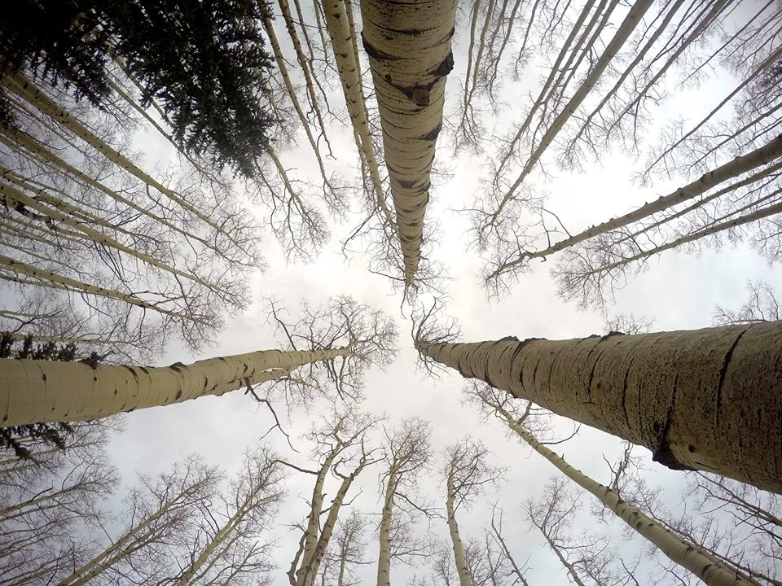
Image Credit: Kelsey Correia
Community Concerns
Population fitness of Mule Deer and Elk
Aesthetic and recreational value of aspen
Increasing extent of Sudden Aspen Decline (SAD)
Aspen regeneration efforts
Notes:
Inspiration for this project stemmed from conversations with our project partners, the Wyoming Game and Fish Department, USDA Forest Service Laramie Ranger District, and Colorado State University, Natural Resource Ecology Laboratory (NREL). Concerns regarding the ecological importance of aspen stands and the decreasing presence of healthy aspen stands within the study area were discussed in-depth.
Mule Deer, Elk, and other ungulate populations’ fitness depends on aspen stands for survival. Aspen are also highly appreciated for their aesthetic and recreational value. The extent of Sudden Aspen Decline (SAD) is increasing throughout the intermountain west and threatens the prosperity of the species. To combat this threat and, ultimately, assist the dependent ecosystems, specific land management plans and prescribed burns are being considered for the area in order to facilitate the regeneration of new, healthy aspen stands.
Image Source: Kelsey Correia, Colorado State University

Slide 5

Methodology
Data Acquisition
Data
Processing
Modeling
Results
Landsat
Data
LandsatLinkr
Tasseled
Cap
Time
Series
Vegetation
Indices
Extent
Severity
Return Interval
Risk Analysis
Ancillary
Data
Normalized
Burn Ratio
Adjust
Thresholds
Notes:
Our general workflow included four main stages: Data Acquisition, Data Processing, Modeling, and Results. We followed two main paths through the workflow, which are depicted left to right in the diagram. The first path results in the fire history time series and the other results in the fire extent, burn severity, frequency, and return interval.
The following slides explain the components of each stage in more detail.

Slide 6
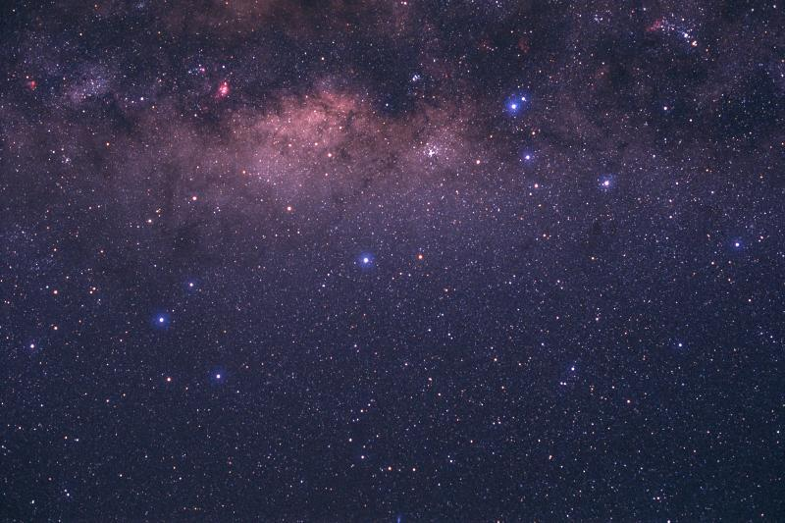

NASA Sensors
Landsat 8 Operational Land Imager & Thermal Infrared Sensor (OLI & TIRS)
Landsat 5 Thematic Mapper (TM)
Landsat 7 Enhanced Thematic Mapper Plus (TM)
Shuttle Radar Topography Mission (SRTM)
Notes:
Through the United States Geological Survey (USGS) EarthExplorer portal, we downloaded six tiles from the Shuttle Radar Topography Mission (SRTM) digital elevation model (DEM) data for the range of our study area. Also, through the EarthExplorer portal, we compiled all available Landsat 5 TM, Landsat 7 ETM+, and Landsat 8 OLI/TIRS imagery with less than 20% cloud cover for the 1984-2015 growing seasons (June through August).
Specific data products included surface reflectance (SR), Normalized Difference Vegetation Index (NDVI), Enhanced Vegetation Index (EVI), Soil-Adjusted Vegetation Index (SAVI), Modified Soil-Adjusted Vegetation Index (MSAVI), Normalized Difference Moisture Index (NDMI), Normalized Burn Ratio (NBR), and Normalized Burn Ratio 2 (NBR2).
Image Source: http://www.devpedia.developexchange.com/dp/index.php?title=List_of_Satellite_Pictures; El Pensieve De Dinorider, http://dinorider.blogspot.com/2005_06_01_dinorider_archive.html, http://creativecommons.org/licenses/by-nc-nd/4.0/legalcode

Slide 7

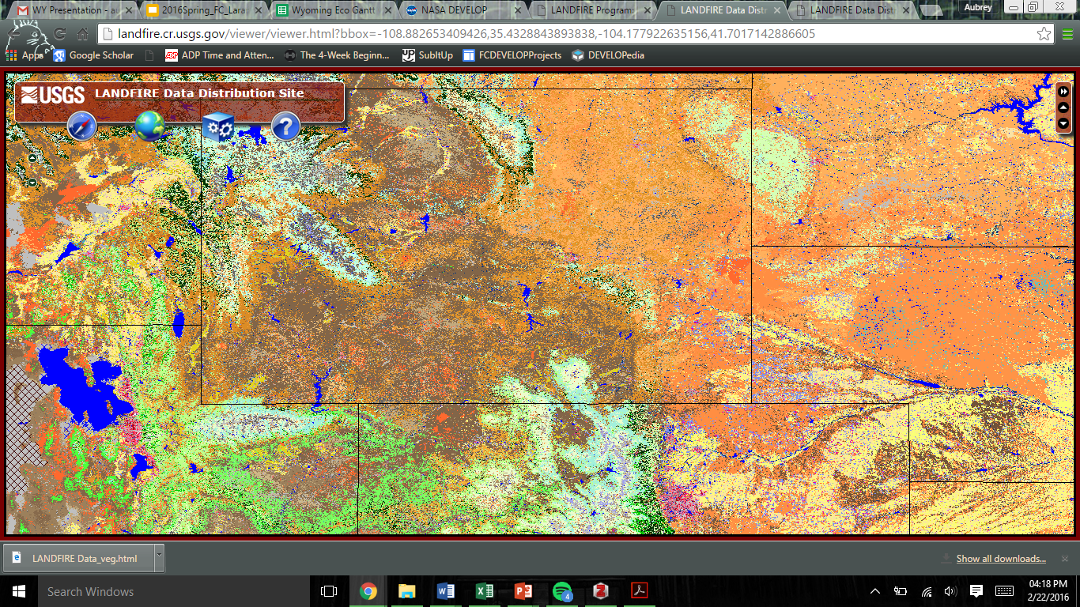
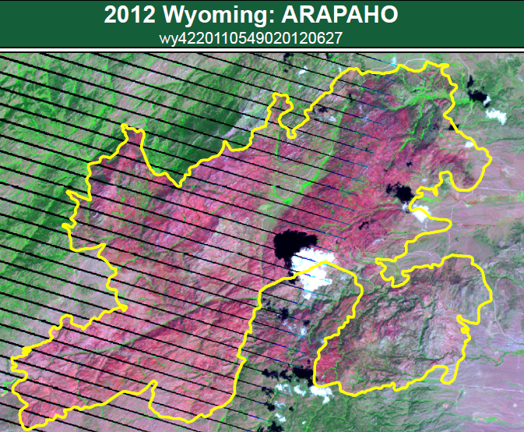
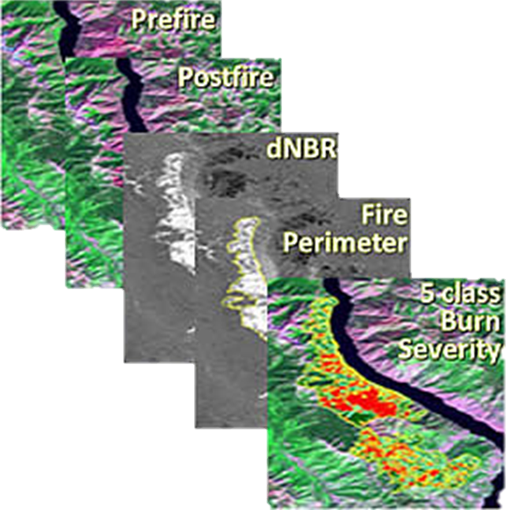
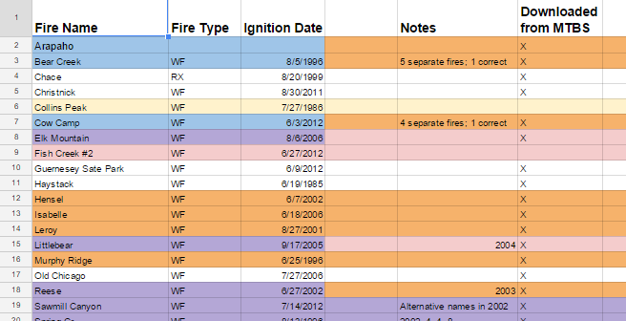
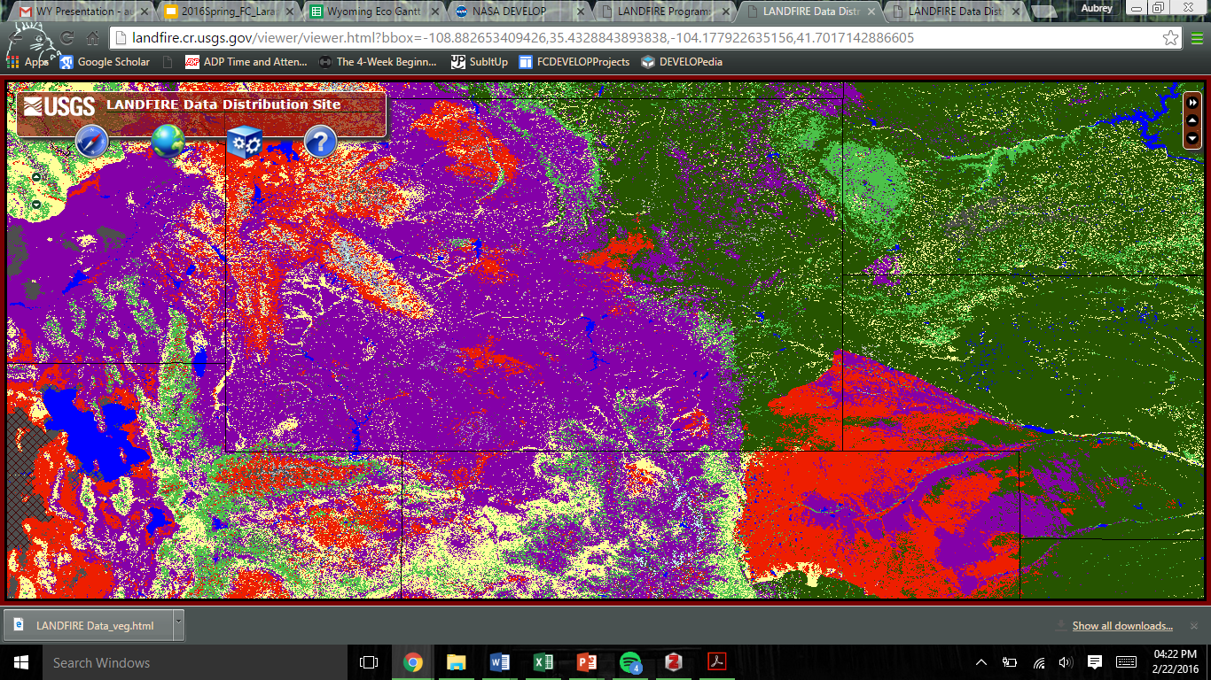
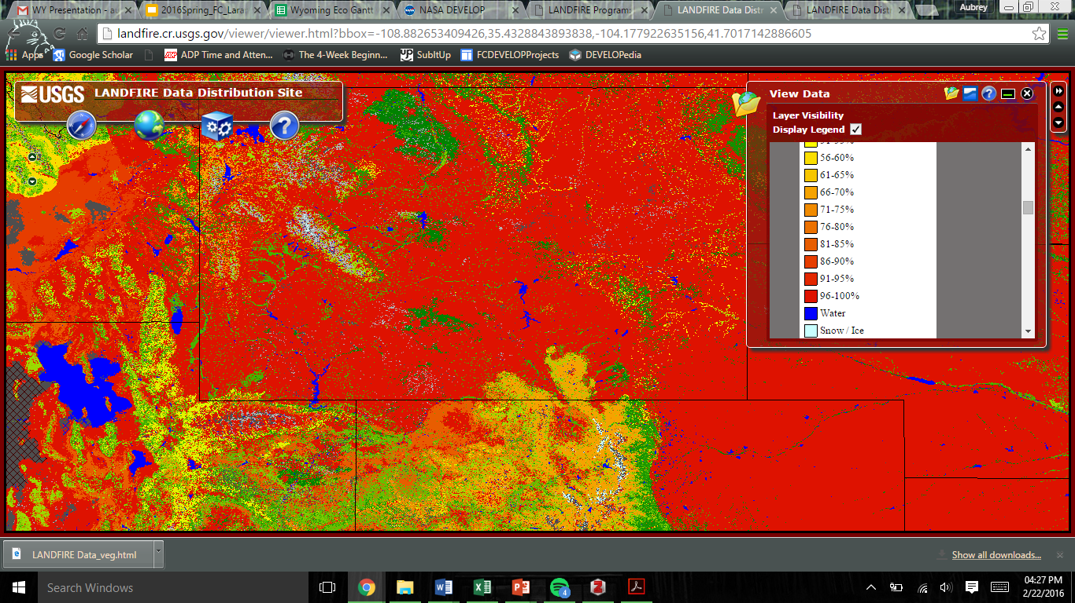
Ancillary Data
LANDFIRE Layers
Field data from USDA Forest Service, Laramie Ranger District
Monitoring Trends in Burn Severity (MTBS)
Notes:
The USDA Forest Service, Laramie Ranger District provided us with shapefiles for Administrative Boundaries, Vegetation Records, and Fire History Records. Additional vegetation and fire history records were acquired from the Landscape Fire and Resource Management Planning Tools Program (LANDFIRE) and Monitoring Trends in Burn Severity (MTBS).
Image sources:
http://www.mtbs.gov/data/individualfiredata.html; http://nrfirescience.org/event/landfire-3-customizing-data; http://www.fs.usda.gov/prc

Slide 8
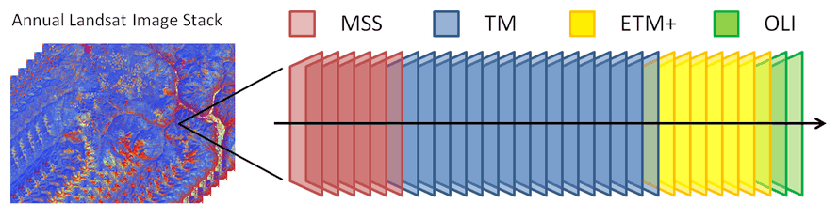
LandsatLinkr
Platform | Data Product | Spatial Resolution | Images
Landsat 5 | TM | 30 m | 110
Landsat 7 | ETM+ (SLC-off) | 30 m | 12
Landsat 8 | OLI & TIRS | 30 m (OLI) & 100 m (TIRS) | 43
SRTM | DEM | 30 m | 6
Notes:
We preprocessed a total of 165 downloaded images (A more specific breakdown can be see in the table through LandsatLinkr, an automated system that creates spectrally consistent Landsat imagery across TM, ETM+, and OLI sensors.
The six tiles of SRTM elevation data were mosaicked together to create a digital elevation map of the area using the LandsatLinkr package in the R statistical computing language and environment. Aspen in the intermountain west typically occur between 1,500 m and 3,200 m in elevation. The study site for this project was determined by excluding locations with elevation values outside of this range. Processing of SRTM data was performed in QGIS Desktop version 2.12.1.
Data downloaded from EarthExplorer were decompressed, stacked, resampled, and reprojected within LandsatLinkr. Tasseled-cap indices were calculated for each TM and ETM+ image. OLI data were spectrally calibrated to ETM+ data, and annual cloud-free composite images were generated as stand-alone outputs, as well as a time series stack consisting of all annual cloud-free image composites.
Annual composites for each of the four Path/Row scenes were mosaicked together for each year. Locations outside of the study area were masked, and the resulting image stack was used for subsequent data analysis.
Image Source: http://landsatlinkr.jdbcode.com/

Slide 9
Modeling
Coming Soon!
Notes:
Coming soon!

Slide 10
Analysis
Coming Soon!
Notes:
Coming soon!

Slide 11
Results
Coming Soon!
Notes:
Coming soon!

Slide 12
Results
Coming Soon!
Notes:
Coming soon!

Slide 13
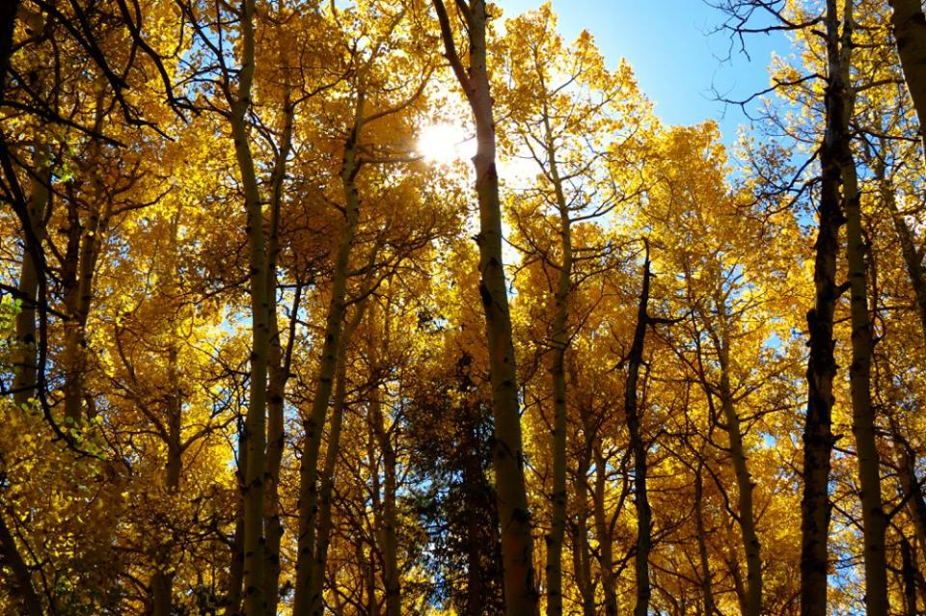
Conclusions
Coming Soon!
Image Credit: Kelsey Correia
Notes:
Coming soon!
Image source: Kelsey Correia, Colorado State University

Slide 14
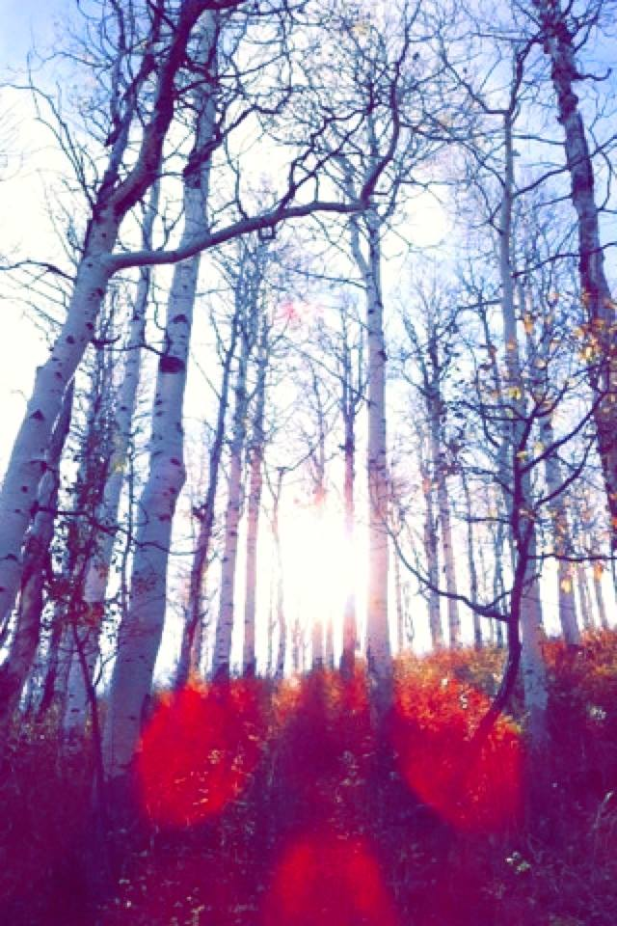
Errors & Uncertainties
Data limitations in image availability and quality
Threshold designations
Extensive cloud cover over study area
Validation of data from prescribed and natural burn locations
Image Credit: Kelsey Correia
Notes:
Limitations in data availability and quality was the largest source of possible errors and uncertainty. We were restricted to using imagery from Landsat 5 TM, Landsat 7 ETM+, and Landsat 8 OLI and TIRS because the resolution of MSS data would not have been sufficient in detecting fires.
Other origins of uncertainty include designating thresholds for fire identification and severity classification (i.e. mild, moderate, and severe), masking out extensive cloud cover in images, and validating the dates and locations of prescribed burns due to the lack of historic records.
More coming soon!
Image source: Kelsey Correia, Colorado State University

Slide 15
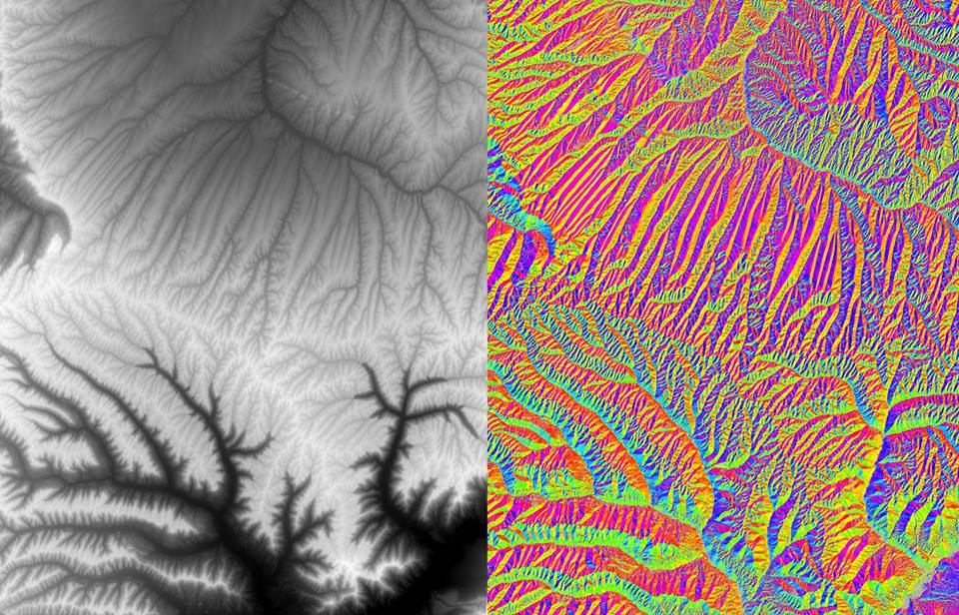
Future Work
DEVELOP Summer 2016 Term
Utilizing aspen as an indicator species for healthy ungulate habitat
Expanding research on fire as a management tool
Conducting field work to supplement satellite imagery
Image Credit: Kelsey Correia
Notes:
The project will be expanded upon during the summer term where a Species Distribution Model (SDM) will be utilized to delineate aspen cover throughout the Pole Hill Mountain (or Sherman) unit, Laramie Peaks unit, Snowy Range unit, and Sierra Madre unit. The identification of aspen will be indicative of local habitat quality and the areas’ carrying capacities for mule deer and elk. Incorporating fire history and severity maps, as well as calculated fire return intervals with the aspen cover maps, will further inform land managers on the relationship between fire and aspen regeneration, which will aid in conservation efforts.
Additional future work includes conducting field work in the area to locate aspen stands and ground truth results. Studying the characteristics of these stands (i.e. stand density, average diameter at breast height (DBH), number of young aspen suckers, etc.) will provide additional information regarding aspen growth and regeneration.
Image source: Kelsey Correia, Colorado State University

Slide 16
Advisors
Dr. Paul Evangelista (Colorado State University, Natural Resource Ecology Laboratory (NREL))
Dr. Amanda West (Colorado State University, NREL)
Partners
Wyoming Game and Fish Department
USDA Forest Service, Laramie Ranger District
Colorado State University, NREL
Others
Dr. Bill Romme (Colorado State University, NREL)
Brian Woodward (NASA DEVELOP Center Lead)

