Slide 1
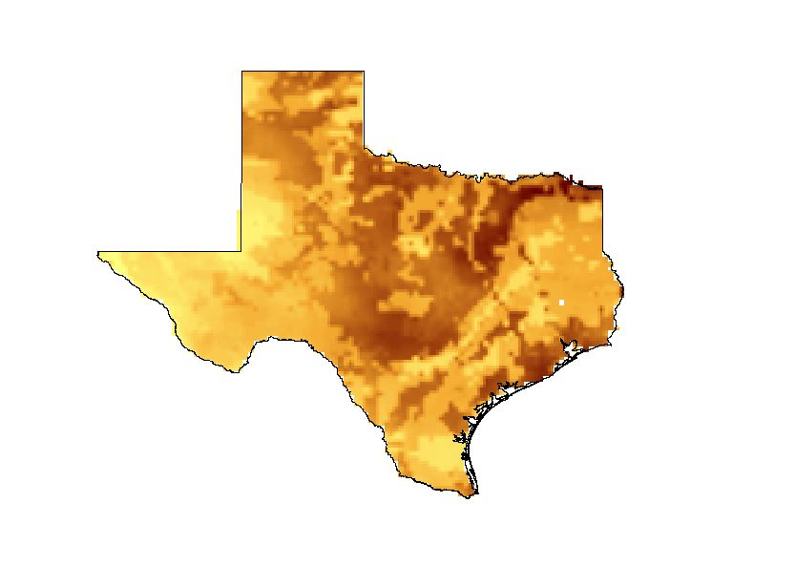
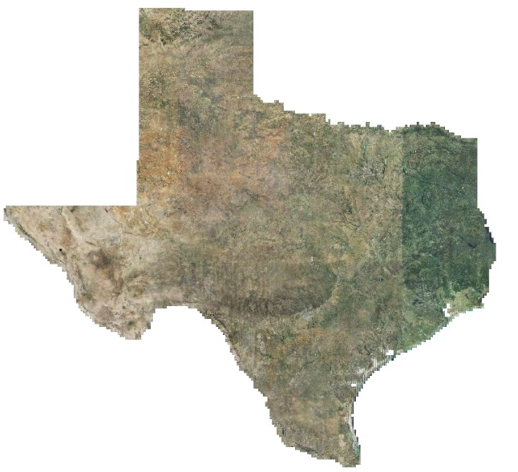

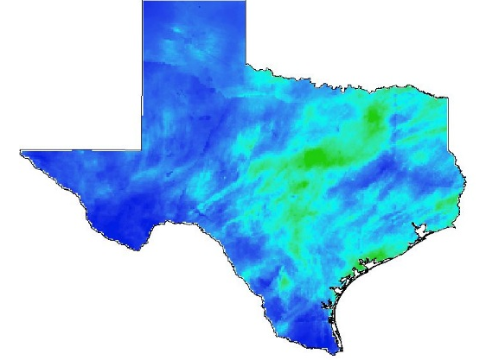
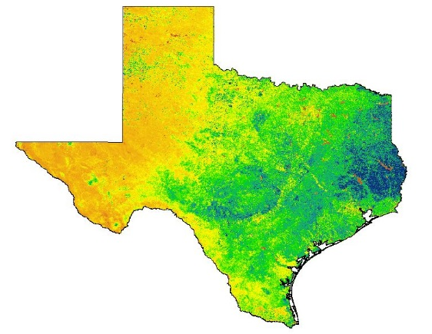


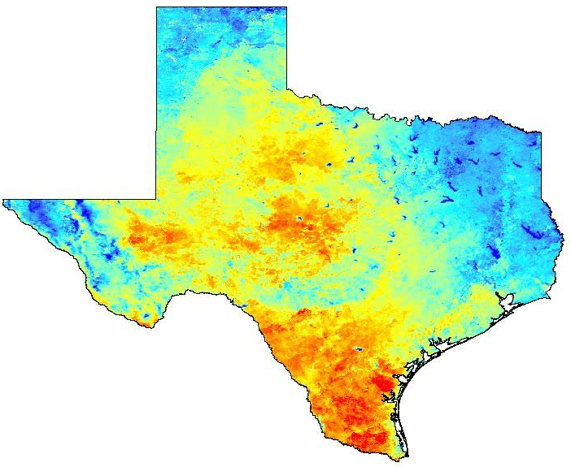
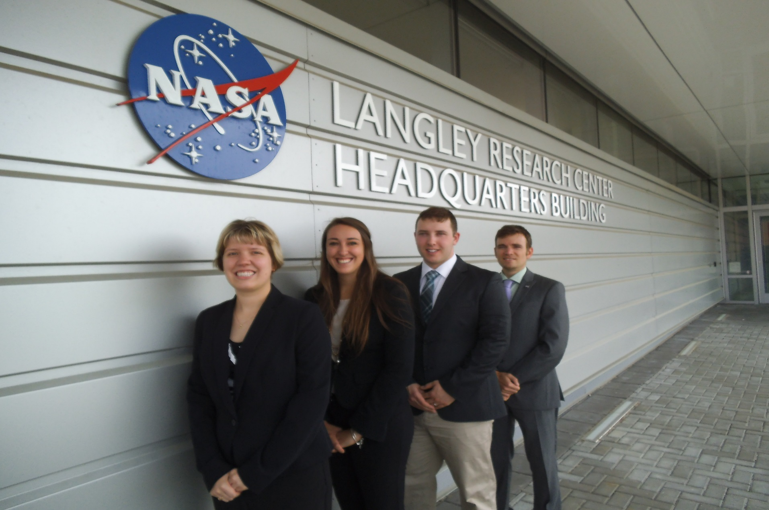
Texas Water Resources
Utilizing NASA Earth Observations to Monitor Drought Severity in Texas for Wildfire Mitigation Support
Megan Buzanowicz (Project Lead), Zacary Richards, Laura Lykens, Jeff Close
Hampton University, Arizona State University, Old Dominion University, US Air Force
Abstract
Objectives
Keep this blank for now.
Body text point size should be at least 24.
Caption text point size should be at least 16.
Feel free to rename, move, and resize sections as needed.
Expand upon the Scaled Drought Condition Index (SDCI) created by Rhee et. al. (2010) by including a soil moisture component.
Design a product for the Texas Forest Service to utilize in order to identify locations within the state most prone to wildfire disasters.
Correlate the Drought Severity Index with the measurements of live fuel moisture content (FMC) obtained from the National Fuel Moisture Database in order to determine its accuracy.
Methodology
Study Area
Data Acquisition
Data Processing
Data Analysis
North American Land Data Assimilation System (NLDAS)
Noah-2.8 Model
Soil Moisture
(NLDAS – NLDAS_{min})
(NLDAS_{max} – NLDAS_{min})
ArcMap
10.3
Texas
Python
2.7
Summer 2010 - Summer 2011
Summer 2014 – Summer 2015
Multi-Sensor Precipitation Data (MPE)
Daily Observed Precipitation
(MPE – MPE_{min})
(MPE_{max} - MPE_{min})
Modified Drought Severity Index
scaled LST
+
scaled NDVI
+
scaled MPE
+
scaled NLDAS
Terra MODIS
MOD13Q1
Normalized Difference Vegetation Index (NDVI)
Earth Observations
(NDVI - NDVI_{min})
(NDVI_{max} – NDVI_{min})
Terra
MODIS
Aqua
MODIS
Aqua MODIS
MYD11A2
Land Surface Temperature (LST)
(LST_{max} – LST)
(LST_{max} – LST_{min})
Results
Conclusions
Use images.
Make sure that it has some sort of flow, that it makes sense. Show your results in a logical order.
No bullets.
Use bullets.
Use complete sentences with periods.
Team Members
Project Partners
Acknowledgements
From L to R: Megan Buzanowicz, Laura Lykens, Jeff Close, and Zacary Richards
Texas Forest Service
Curt Stripling: Geospatial System Coordinator
Tom Spencer: Department Head of Predictive Service
Dr. Kenton Ross: NASA DEVELOP National Program (Science Advisor)
Lance Watkins: NASA DEVELOP National Program, Geoinformatics/Center Lead
Grant Mercer: University of Nevada – Las Vegas
Rocky Garcia: City University of New York
Tiffani Miller: NASA DEVELOP, Project Coordinator Senior Fellow
Summer 2015 Texas Disasters DEVELOP Team: John C. Stennis Space Center (SSC):
Langley Research Center

