Slide 1
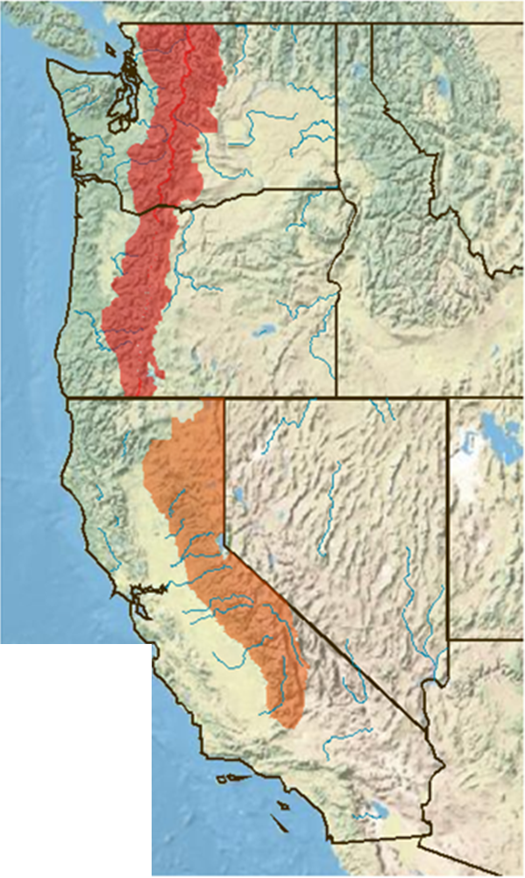
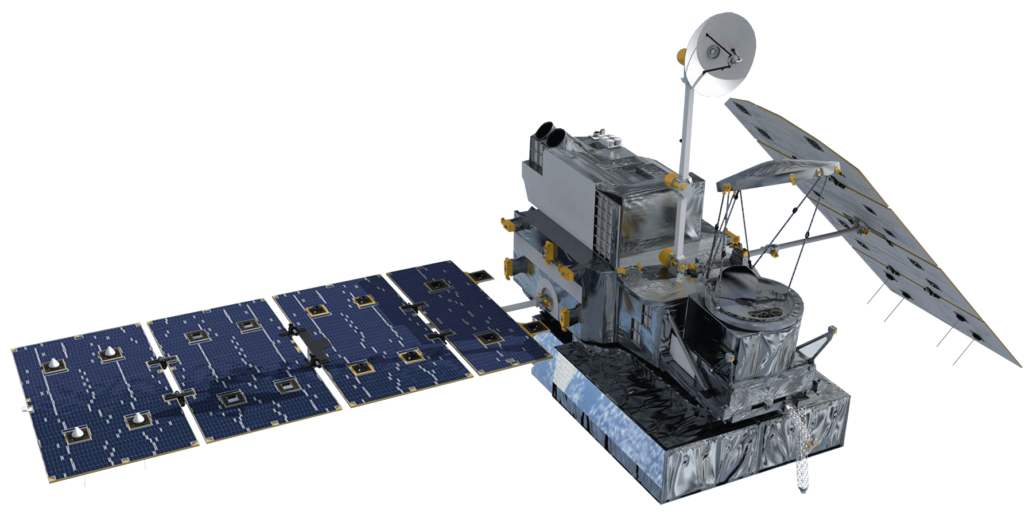


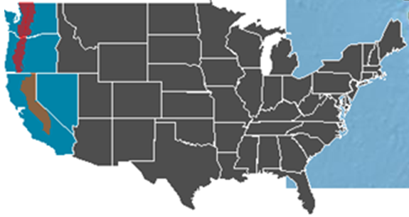



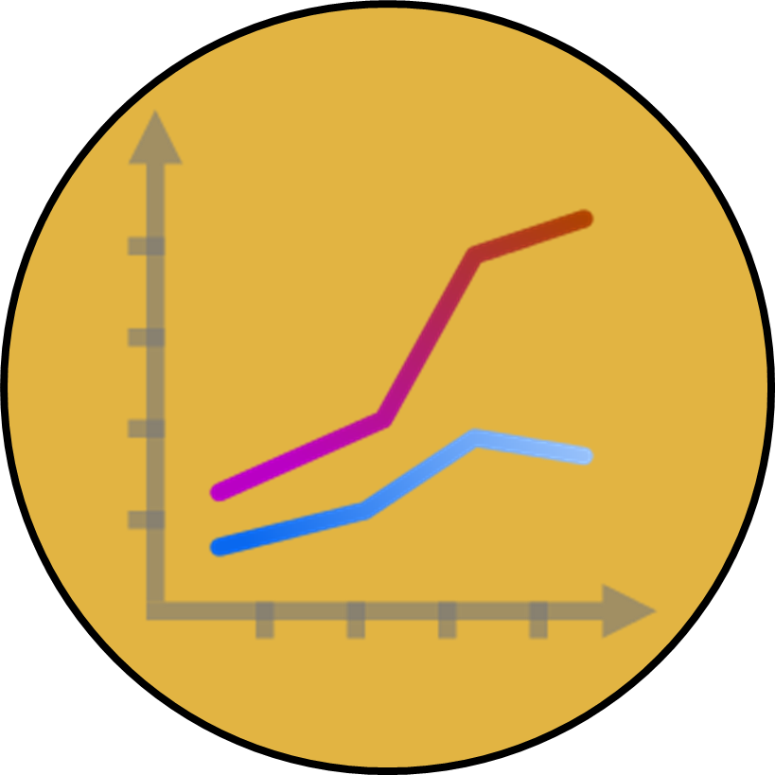

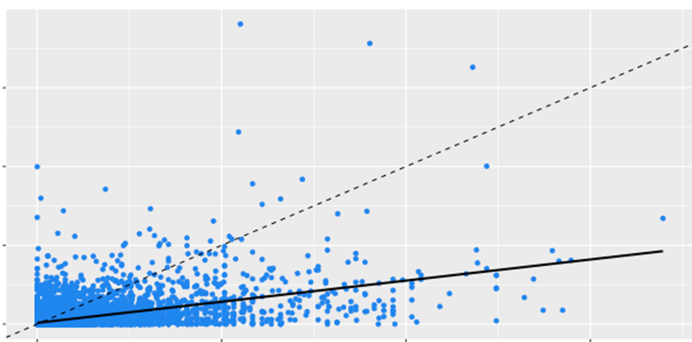

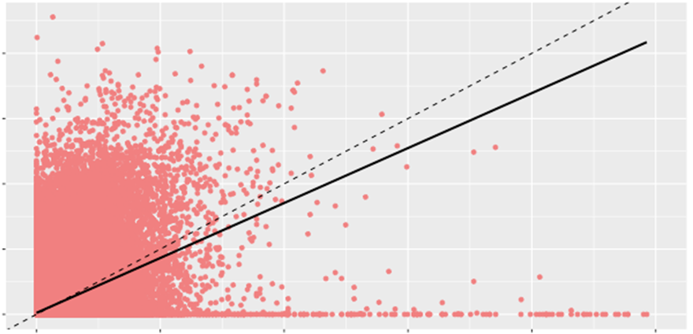
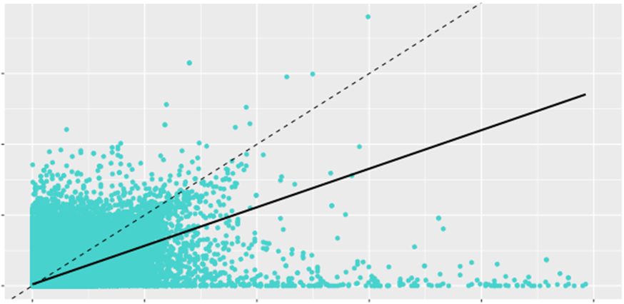
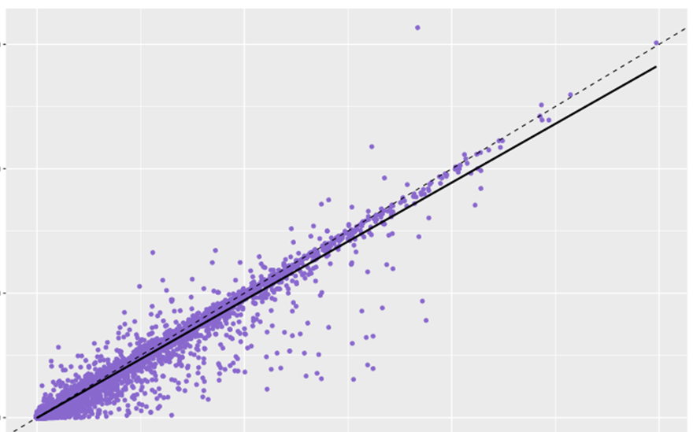

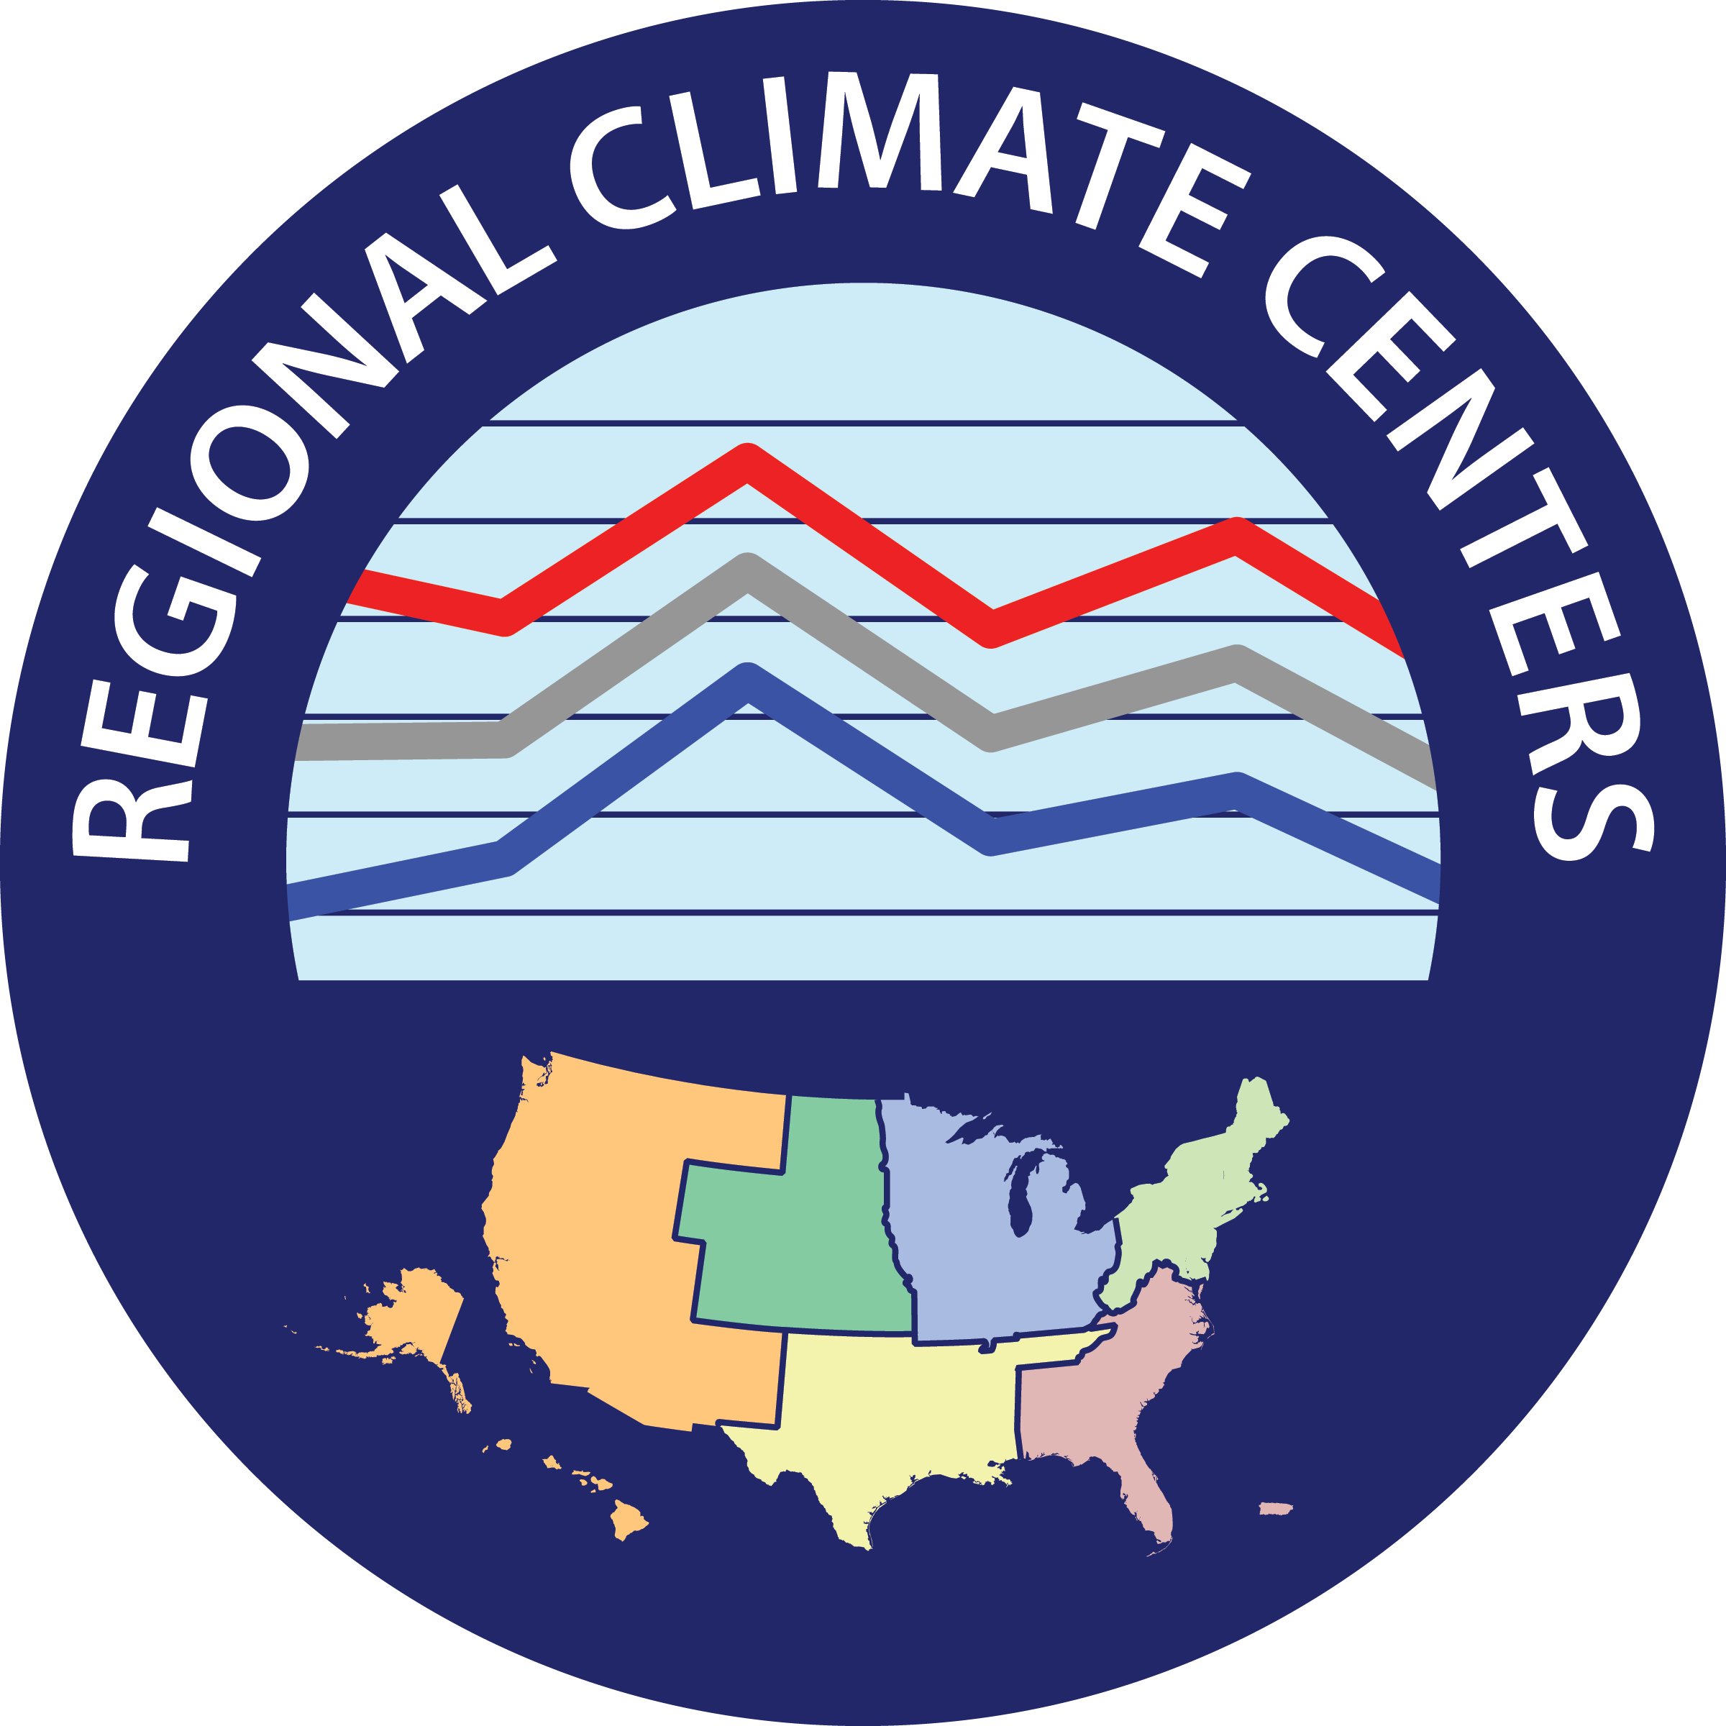


Cascade & Sierra Nevada Mountains
Water Resources
A Comparison of Remotely-Sensed Climate Data Records for Improved Climate Monitoring by the Western Regional Climate Center and National Weather Service River Forecast Centers
Sam Swanson (Team Lead) and Kevin Rapa
DEVELOP National Program at NOAA National Centers for Environmental Information
Abstract
Kilometers
Study Area
Objectives
Shifting hydrologic processes have grown to be a significant problem in California, Oregon, and Washington. In recent years, the average winter temperatures have risen, spring snowmelt has occurred earlier, and a greater portion of precipitation has fallen as rain rather than snow in the Sierra Nevada and Cascade mountain ranges. The natural reservoir of water stored in mountain snowpack has drastically declined, limiting water availability in the summer and forcing water managers to reassess their water management regimes. Current methods of understanding orographic precipitation in the West are limited to ground-station and volunteer-based observations, which are spatially limited in such areas. Considering the needs of the Western Regional Climate Center and the National Weather Service Western Region, this project enhanced the understanding of precipitation in the Sierra Nevada and Cascade mountain ranges, using the NOAA Climate Prediction Center Morphing technique (CMORPH), the Global Precipitation Model (GPM), and the NOAA National Weather Service Snow Data Assimilation System (SNODAS) satellite data records. A comparison between satellite and in- situ datasets revealed information about the usefulness of remotely-sensed data in estimating orographic precipitation. Ultimately, this project created several output products for the end-user: maps comparing in situ and satellite data, maps detailing precipitation variability, and maps identifying regions that lack in situ data while performing well at the remotely-sensed level.
5000
WA
Determine if satellite data are useful in measuring orographic precipitation by comparing satellite climate data records (CDRs) to currently-used ground-station data records.
Create a suite of map products to enhance the Western Regional Climate Center’s and National Weather Service’s understanding of precipitation in the western United States.
Understand snow water equivalent (SWE) in the study area by performing similar analyses on SNODAS satellite data and SNOTEL ground observations.
3750
2500
OR
1250
Legend
0
NV
Earth Observations
Sierra Nevada
CA
Shown: GPM microwave sensor
Spatial resolution:
0.1° (~11 km²)
Temporal resolution:
30 minute
Included in the CPC Morphing Technique:
SSM/I, AMSU-B, AMSR-E, and TMI
0.073° (~8 km²), 30 minute
Cascades
Methodology
Acquisition:
Download data
GHCN, CMORPH,
PRISM, SNODAS, GPM
Subset if possible
Decompress files
Processing:
Satellite-derived
Convert to rasters
Clip to study area
Aggregate to daily
Ground-based
Assign station names
Average by raster pixel
Compilation:
Extract raster values
Append raster values to
GHCN data
Synchronize units
Visualization:
Scatter plots
Difference maps
Benefits maps
SWE scatter plot
Results
Conclusions
Estimated vs Observed measurements
CMORPH / PRISM Differences
CMORPH Benefits
From the graphs, CMORPH appears to estimate precipitation better in the western United States
when compared to GPM.
From the difference maps, CMORPH still underestimates precipitation in the Sierra Nevada and Cascade mountain ranges, despite generally doing a better job than GPM.
Based off of the color gradients in the difference maps, satellite precipitation estimations become more inaccurate as elevation increases.
From the benefits map, CMORPH can provide a viable alternative in certain low elevation areas if station data were unavailable.
Because of SNOTELS’s integration in the SNODAS dataset, their exceptionally close relationship is unsurprising. However, further research on SNODAS’s usefulness independent of SNOTEL is recommended.
150
GPM vs. GHCN
Difference between
CMORPH and PRISM
100
Areas of low GHCN station density where CMORPH measurements are close to PRISM’s. Areas without shading are considered to have a high station density. Darker shades of color
represent areas where CMORPH's
difference from PRISM is the smallest.
mm / day (absolute values)
GPM (mm/day)
0.00 - 0.56
Areas of greatest benefit
50
0.57 - 1.11
0
0
50
100
150
October
November
1.12 - 1.67
GHCN (mm/day)
Difference between
CMORPH and PRISM
1.68 - 2.23
Areas of some benefit
400
CMORPH vs. GHCN
2.24 - 2.79
300
-16.22 to -8.35
-2.79 to -1.66
CMORPH (mm/day)
-8.36 to -7.23
-1.67 to -0.55
200
-7.24 to -6.12
-0.56 to 0.57
100
-6.13 to -5.01
0.58 to 1.68
0
0
100
200
300
400
500
December
January
-5.02 to -3.89
1.69 to 2.80
Acknowledgements
GHCN (mm/day)
-3.90 to -2.78
2.81 to 11.32
We would like to thank our center lead Jessica
Sutton and science advisor Michael Kruk for
their help and guidance in this project.
We also would like to acknowledge:
PRISM vs. GHCN
mm / day
300
CMORPH underestimation
CMORPH overestimation
200
CMORPH is most similar
PRISM (mm/day)
Average differences of CMORPH measurements from PRISM measurements. Each image is a 1998 - 2013 average, where each year
is itself an average of daily sums inside a particular month. The units used
are millimeters per day and classes are
based off of ½ standard deviations.
The NCEI employees | Nina Oakley
Emma Baghel | Andrea Bair
Dr. Olivier Prat | Jonathan Brannock
Mike Squires | Ronald Leeper
100
February
March
0
0
100
200
300
400
500
0
500
1,000
2,000
0
250
500
1,000
GHCN (mm/day)
Kilometers
Kilometers
CMORPH and PRISM raster pixel values were sampled from
each GHCN station coordinate for every day from 1998 to 2013 in
the Northwest River Forecast center from October 1 to March 31,
and then plotted on a graph against a linear regression line. Points
closer to the line represent close relationships between CMORPH
and PRISM measurements.
SNODAS vs SNOTEL Snow Water Equivalents
Team Members
Project Partners
3000
2000
SNODAS raster pixels were sampled from each SNOTEL station
coordinate in the Northwest River Forecast Center for every day
from 2003 to 2012 from October 1 to March 31, and then plotted
on a linear regression line. Points closer to the line represent close
relationships between SNODAS and SNOTEL measurements.
SNODAS (monthly maximums in mm)
1000
0
0
1000
2000
3000
Sam Swanson (lead) and Kevin Rapa
SNOTEL (monthly maximums in mm)
NOAA National Centers for Environmental Information

