Slide 1
Gulf of Mexico Water Resources
Utilizing NASA Earth Observations to detect factors contributing to hypoxic events in the southern Gulf of Mexico
Rebecca Chapman (Project Lead)
Alannah Johansen
Irma Caraballo Álvarez
Mackenzie Taggart
Åse Mitchell
Bridget Smith

Slide 2
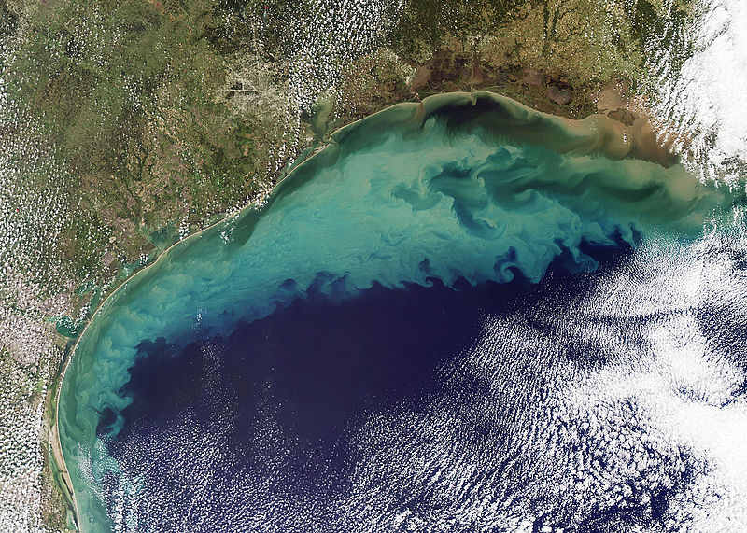
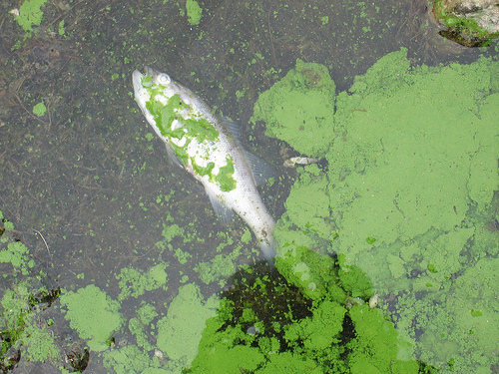
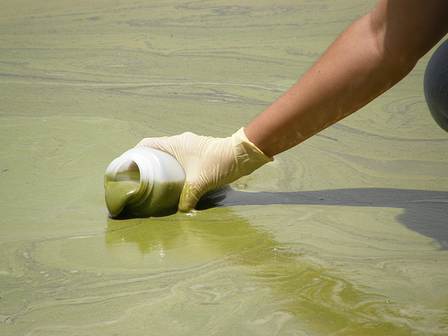
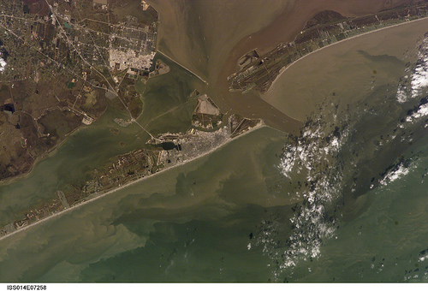
Community Concerns
Photo credit: NASA
Photo Credit: Dr. Jennifer L. Graham
Photo Credit: Nara Souza
Photo credit: NASA
Notes:
Persistent seasonal hypoxia and dead zones occur frequently in the Gulf of Mexico (GoM) and are known to be influenced by runoff from the Mississippi River Basin (Diaz and Rosenberg, 2008). Unfortunately, little is known about the second largest contributor of sediment and runoff into the GoM, the Grijalva-Usumacinta River Basin. This watershed is an important source of drinking water, hydroelectric energy, fisheries, and other natural resources to the 6 million people who live within the region. Since the early 2000s, increasing frequencies of hypoxic events and algal blooms have been observed along the coastal continental shelf surrounding the river delta (Signoret et al., 2006). Additionally, many blooms in the southern GoM have been composed of toxin-producing algal species. These harmful algal blooms (HABs) have been implicated in eutrophication, fish kills, economic loss for fisheries, and human illness (Rabalais et al., 2002).
text sources:
Diaz, R. and R. Rosenberg. (2008). Spreading Dead Zones and Consequences for Marine Ecosystems. Science 321: 926-929.
Signoret, M., Monreal-Gomex, M. A., Aldeco, J. and D.A. Salas-de-Leon. (2006). Hydrography, Oxygen Saturation, Suspended Particulate Matter, and Chlorophyll-a fluorescence in an Oceanic Region Under Freshwater Influence. Estuarine, Coastal, and Shelf Science 69: 153-164
Rabalais, N. N., Turner, R. E., and D. Scavia. (2002). Beyond Science into Policy: Gulf of Mexico Hypoxia and the Mississippi River. BioScience 52(2): 129-142.
photo sources:
https://www.flickr.com/photos/nasa2explore/9402769906/in/photolist-iKCkdu-fgSTKG-fjTDUw
https://www.flickr.com/photos/48722974@N07/4558031458/in/photolist-7WM6Xh-7RC7eF-7WHSvB-7VMhxE-7WxfeH-7RWfqk-7RGiTW-81CcmS-7V3qMG-9Ciz1h-83c1Dx-82TKDq-bN5GKR-7RFmAE-9CfE8X-9CfE8v-7RYuKj-7RWaer-7Scnqj-7RC7ee-7Wxaf6-7WM6FC-8u1nWd-7VHZKp-54wxhr-9kSMVi-9n97dh-9kSQGe
https://www.flickr.com/photos/48722974@N07/5120831376/in/photolist-8NvAL9-7Q6sN7-8L4AeR-cMwprs-cMvP8A-9EhoS5-7XqCye-8ELJzH-7WMZs6-7VuHYb-8ZVK3b-9AeFQt-7T3Co3-7Q3MTV-7RWfqk-7NAzb5-9EeudP-7THaTB-7RJoVy-92bQxW-7ZmkR3-7WxfeH-8L4An2-8X6uuX-bDLdQ1-7T3DCm-92bQtQ-7PLax8-7WAfE5-7Q6sHh-7Q3mFX-8EP9aa-8L7EHb-8X9vmN-bSEWHP-8Ha3p4-8Hdb71-7TLroC-9CfDyF-8EPVE7-7U7yaX-7Q69fC-9CfE34-9AbNsF-818dSr-7WHRVt-7Q4mMX-7T2ka7-7PLavp-9eCaM1
https://www.flickr.com/photos/48722974@N07/5120227735/in/photolist-8Nsvjx-8F4id7-7PJNHv-7PN1L3-7RGoKf-82Wf4w-7RGoNq-8GsUAU-7T2vD5-7YAazg-7NydFE-7YhSbx-7S5PfX-7WLudv-99betE-7WM6Xh-7SZBdk-9ny7MT-8GsVEo-7WJ5xZ-99bewE-9987aH-8ZVJJJ-9sUKvZ-839VPL-7Vux8Y-7PJNKr-8ZVJPb-7V5et1-7PiLq4-95sgSN-7NwNcz-7WYTXp-7XfChA-7PiLDi-7VfHm3-9BA4qt-81r7BE-8L4Aia-819YbA-7Q3msV-cMvDUq-9eyfMT-8N2Qbs-7PJNTt-7VrzDR-cMv575-7Vuvc1-8psf5p-9nAVBU

Slide 3
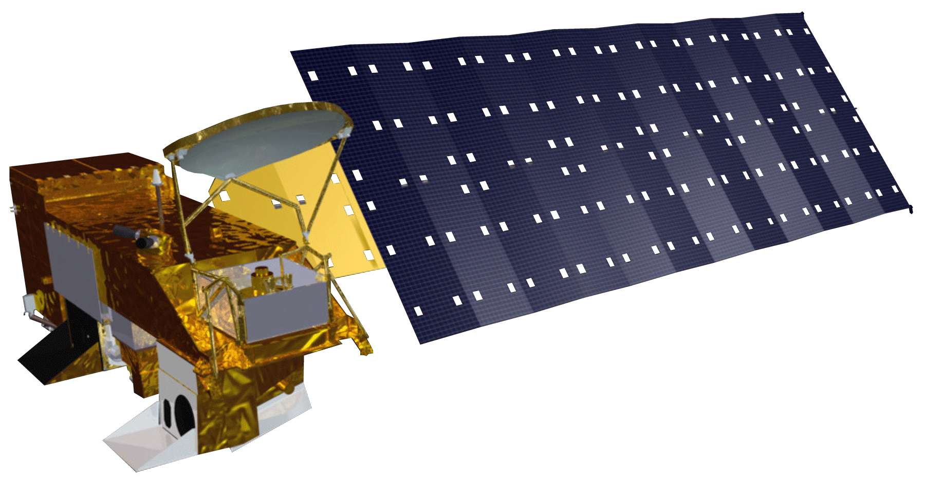
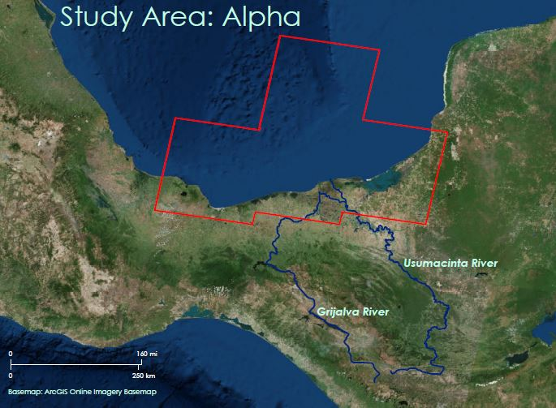
Objectives
- Identify indicators of hypoxic events and harmful algal blooms in the southern Gulf of Mexico
- Understand the impact of nutrient and sediment loading from the Grijalva-Usumacinta River Basin
Photo credit: NASA
Notes:
The main objective of this study was to use NASA Earth observations to identify indicators of hypoxic events and HABs in the southern Gulf of Mexico and connect their occurrences to nutrient and sediment loading from the Grijalva - Usumacinta River Basin.
Photo Sources:
https://www.flickr.com/photos/48722974@N07/4558031458/in/photolist-7WM6Xh-7RC7eF-7WHSvB-7VMhxE-7WxfeH-7RWfqk-7RGiTW-81CcmS-7V3qMG-9Ciz1h-83c1Dx-82TKDq-bN5GKR-7RFmAE-9CfE8X-9CfE8v-7RYuKj-7RWaer-7Scnqj-7RC7ee-7Wxaf6-7WM6FC-8u1nWd-7VHZKp-54wxhr-9kSMVi-9n97dh-9kSQGe

Slide 4
Indicators of Hypoxic Events
Floating algae index (FAI)
Normalized difference turbidity index (NDTI)
Chlorophyll-a (Chl)
Sea Surface Temperature (SST)
Colored Dissolved Organic Matter (CDOM)
Photosynthetically Available Radiation (PAR)
Notes:
Although there are challenges to directly measure dissolved oxygen using remote sensing techniques, several known indicators of hypoxic events and HABs can be detected or derived from Earth Observations. These indicators include floating algal index (FAI), normalized difference turbidity index (NDTI), chlorophyll-a (Chl), colored dissolved organic matter (CDOM), sea surface temperature (SST), and photosynthetically-available radiation (PAR).

Slide 5
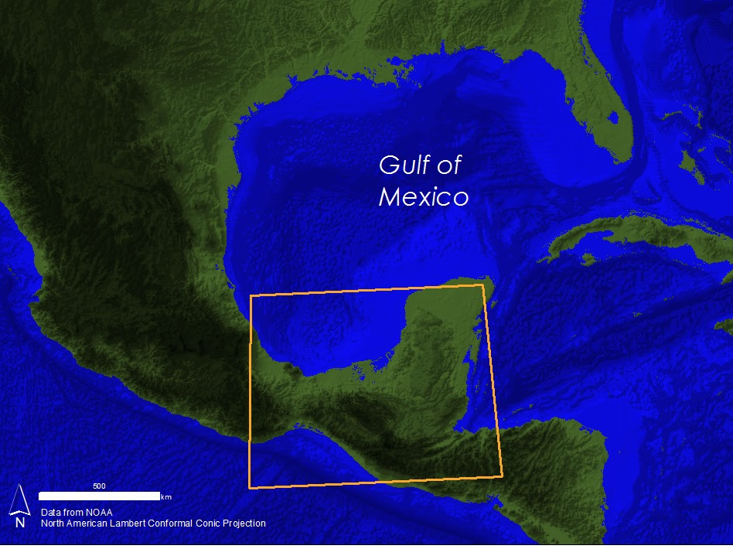
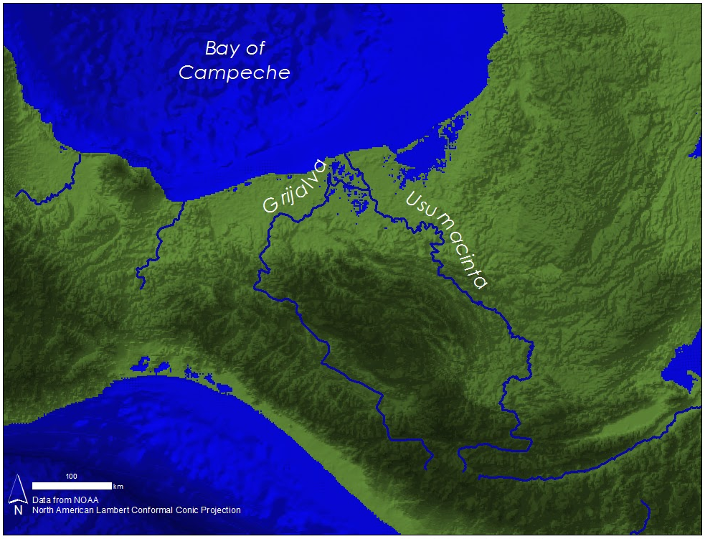
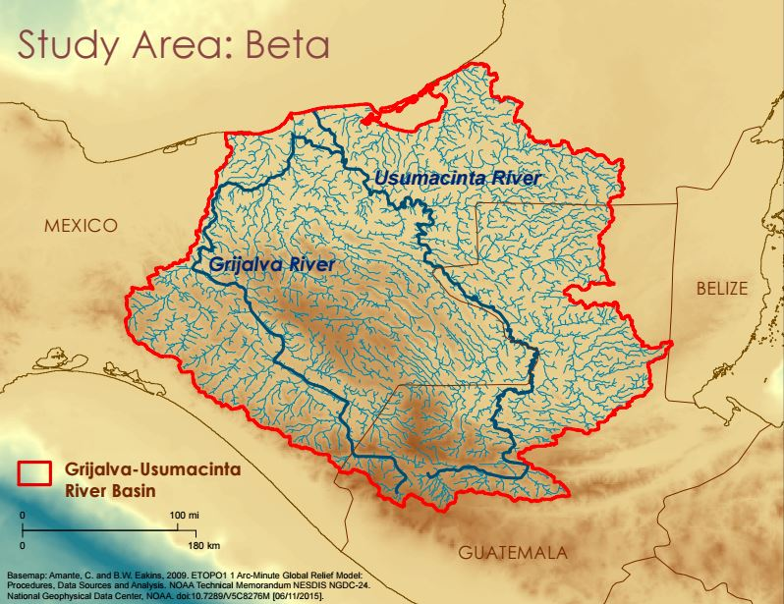
Study Area
Notes:
The Usumacinta-Grijalva River Basin is the second largest freshwater contributor to the Gulf of Mexico. The headwaters for both rivers are in Guatemala, however, the majority of the basin falls within the political boundaries of Mexico, with drainage from the states of Tabasco, Chiapas, and Campeche.
Analyses were performed in the Usumacinta-Grijalva River Basin, the coastal region along the southern end of the Bay of Campeche, and the Gulf of Mexico as a whole.

Slide 6
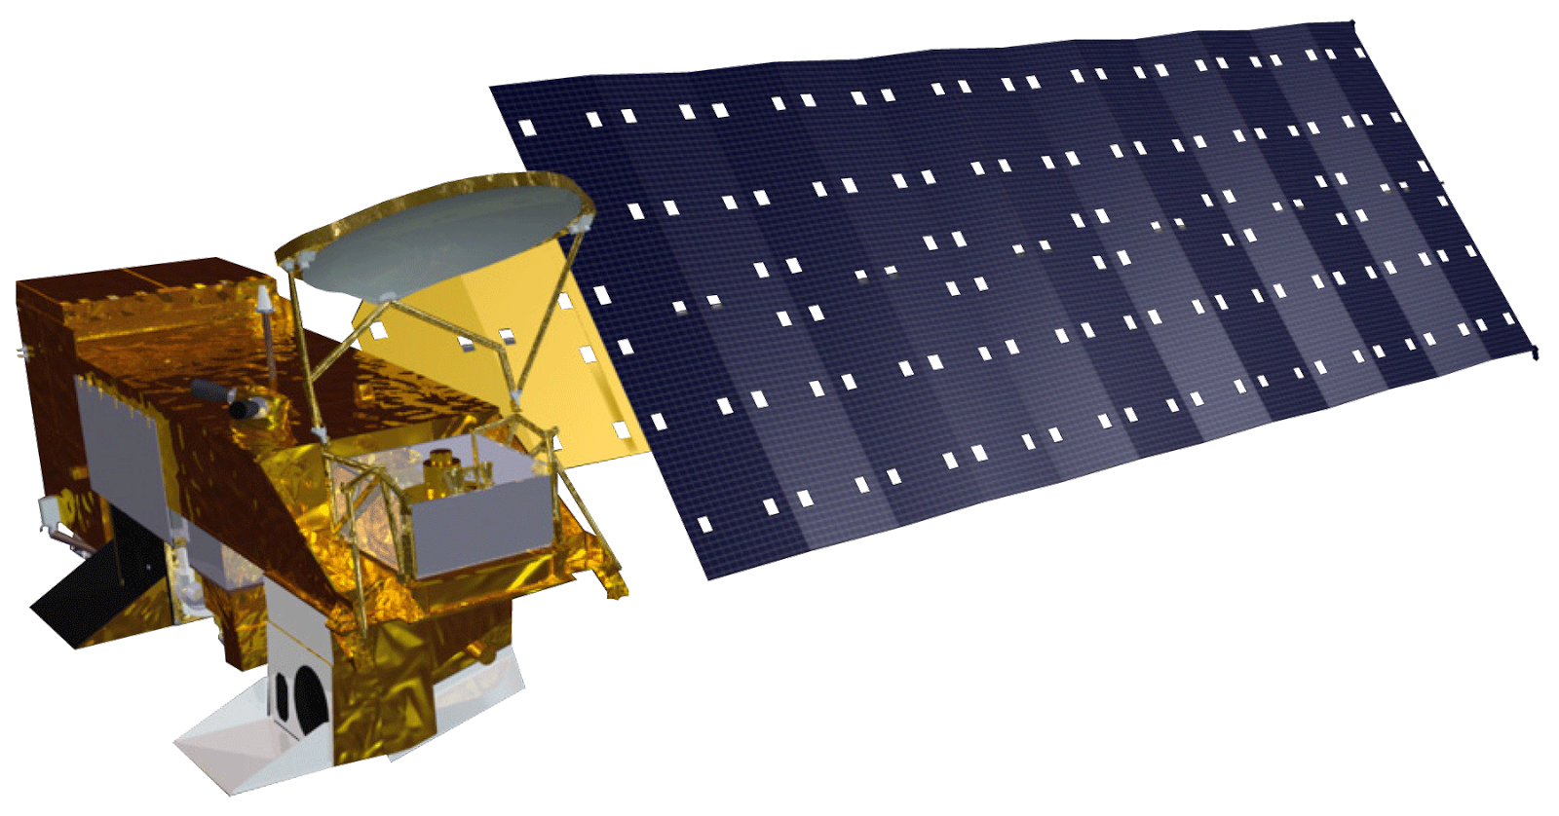
Earth Observations Used
Aqua MODIS
2002 - 2014 data
Landsat 8
2013 - 2014 data
Notes:
Aqua MODIS SMI Level 3, 8-day composites for 2002-2014 were downloaded through the Ocean Color database and used to analyze. These products were used in creating a time series analysis of Chl, SST, PAR, and CDOM.
Landsat 8 OLI climate data records (CDRs) were obtained and accessed through the USGS Earth Explorer database. These data were used for analyzing years 2013 - 2014 to derive FAI and NDTI in study area α. Bands 3, 4, 5, and 6 were used to derive FAI and NDTI.

Slide 7
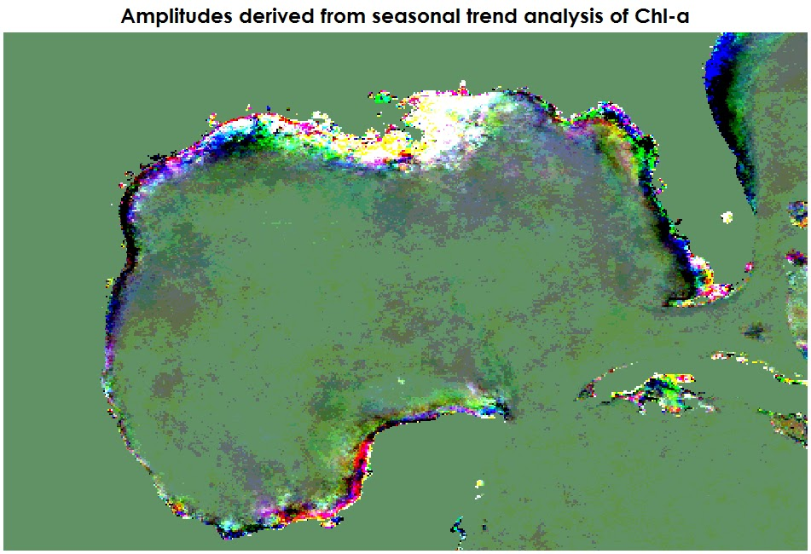
Methods: Earth Trends Modeler (ETM)
- Acquired MODIS L3, 8-day SMI Products:
Chlorophyll a
SST
CDOM index
PAR
- Analyzed trends and dynamic characteristics of these phenomena
- Utilized Harmonic Regression and Extended Principal Component Analysis
Figure 1: Amplitudes derived from seasonal trend analysis of chlorophyll-a.
Notes:
MODIS products were processed using TerrSet’s Geospatial Monitoring and Modeling Software. TerrSet Earth Trends Modeler (ETM) was used to analyze Chl, SST, CDOM, and PAR for patterns consistent with algal blooms or hypoxic events. As determined by Stumpf et al. (2003), anomalies in Chl spectral signatures serve as the first indication timing and occurrence of algal blooms. Additionally, the CDOM to Chl reflectance ratio was developed by Morel and Gentili (2009) as a way of distinguishing live phytoplankton from detritus in the open ocean. We looked at making short and long term trend analyses of these indicators and linear modeling of the lagged relationships between individual series over time.
Sources:
Stumpf, R. P., Tomlinson, M. P., Calkins J. A., Kirkpatrick, B., Fisher, K., Nierenberg K., Currier, R., and T. T. Wynne. (2009). Skill assessment for an operational algal bloom forecast system. Journal of Marine Systems 76: 151-161.
Morel, A. and B. Gentilli. (2009). A simple band ratio technique to quantify the colored dissolved and detrital organic material from ocean color remotely sensed data. Remote Sensing of Environment 113: 998–1011.

Slide 8
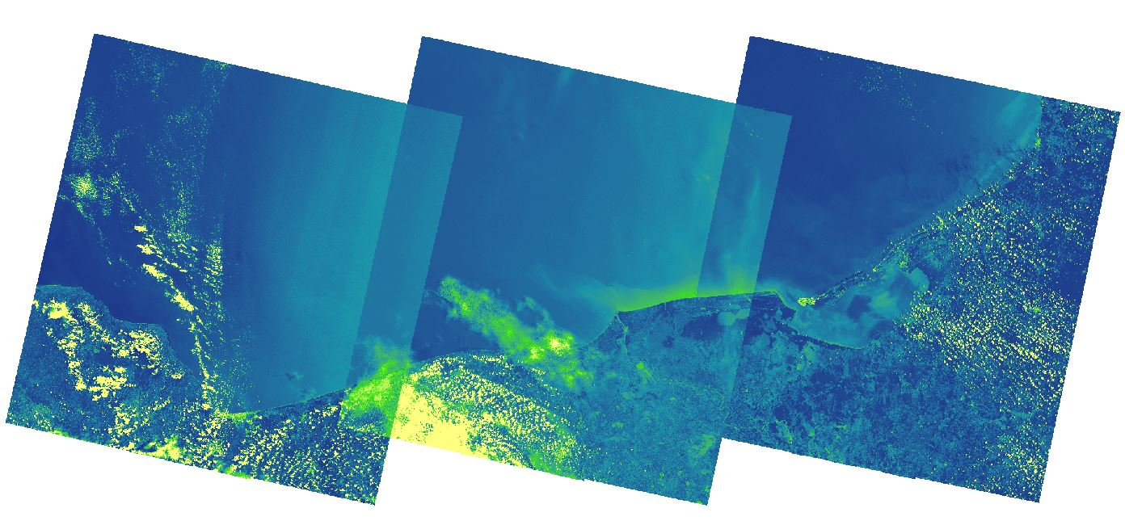
Methods: FAI and NDTI
- Acquired Landsat 8 OLI scenes
- Applied Floating Algal Index (FAI) and Normalized Difference Turbidity Index (NDTI)
- Mosaiced indexed scenes together and analyzed
Figure 2: Floating algal index for the Bay of Campeche.
Notes:
Landsat 8 scenes were processed using an ArcPy reflectance to index script in order to produce FAI and NDTI.
Scientific advisors from the Bay Area Environmental Research Institute (BAERI) provided the script to automate FAI and NDTI. This script iterated through a chosen folder of TIFF files and applied FAI and NDTI to all images, with the resultant output being a new folder of raster files with the indices applied.
Within the script, NDTI requires a customized setting for the minimum and maximum target pixels. There is a default setting to choose from, but for more accurate results in the study region, the invariants were chosen by hand. This was done by selecting and averaging multiple satellite image target pixel values of where the brightest and darkest land pixels were within a 3 x 3 grid. These values were set to 0.1752 maximum and .0289 minimum.

Slide 9
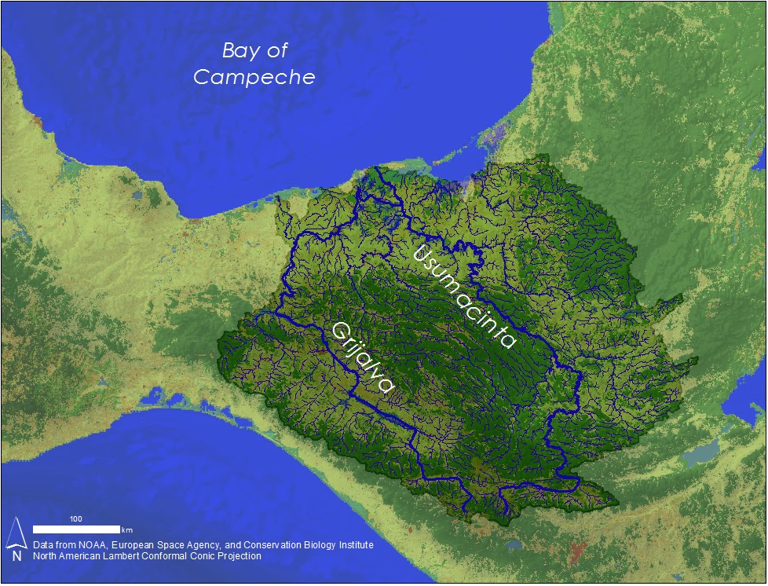
Methods: Soil and Water Assessment Tool (SWAT)
Inputs:
DEM
Weather
Soil Type
Land cover
River discharge
Outputs:
Nitrogen
Phosphorus
Sediment loading
Figure 3: SWAT delineated Grijalva-Usumacinta watershed.
Notes:
ArcMap was utilized for analyzing basin data in study area β using the SWAT tool. The SWAT application delineated a watershed area based on the DEM, which served as a model input, along with weather, soil, and hydrologic data. The river gauge data were used to calibrate the SWAT model for a more accurate look at the nutrient and sediment loading that are contributing to hypoxia in the southern GoM.
Two forms of Digital Elevation Models (DEM) were obtained from the USGS Earth Explorer database. ASTER GLOBAL DEMs provided 10 detailed tiles needed in study region β. These tiles were mosaicked together using ArcGIS, and merged with the larger DEM obtained from the Global 30 Arc-Second Elevation (GTOPO30) DEMs. These tiles provided the additional coverage in study area β that the GTOPO30 DEMs could not provide.
Weather data utilized for this study were obtained from Texas A&M University. These data included temperature, precipitation, wind speed, relative humidity, and solar radiation.
Land cover and soil maps were obtained from ESA Climate Change Initiative - Land Cover (CCI-LC) database and the United Nations University – Institute for Water, Environment, and Health (UNU-INWEH) database (UNU-INWEH, 2015), respectively.
Streamflow data from the Grijalva - Usumacinta watershed were necessary for calibrating the SWAT model. These data were obtained from the Banco Nacional de Datos de Aguas Superficiales (BANDAS).

Slide 10
Results: TerrSet
Results Placeholder

Slide 11
Results: FAI and NDTI
Results Placeholder

Slide 12
Results: SWAT
Results Placeholder

Slide 13
Conclusions
Conclusions Placeholder

Slide 14
Limitations
- Limited spatial resolution of NASA Earth Observations utilized
- In situ data in the Southern Gulf of Mexico is spatially and temporally limited
- Smaller, yet influential, distributaries were not reflected in the delineated watershed while running SWAT
- The algorithm used to derive level III SMI MODIS products were designed for Class 1 open ocean waters and this project’s study area was located in Class 2 waters

Slide 15
Advisors
Dr. Juan L. Torres-Pérez, Bay Area Environmental Research Institute, DEVELOP National Program
Dr. Sherry L. Palacios, Bay Area Environmental Research Institute
Chase Mueller, Bay Area Environmental Research Institute
Partners
Consorcio de Instituciones de Investigación Marina del Golfo de México y del Caribe (CiiMar-GoMC)
Centro del Cambio Global y la Sustentabilidad en el Sureste (CCGSS)
Comisión Nacional para el Conocimiento y Uso de la Biodiversidad (CONABIO)
Centro Nacional de Datos Oceanográficos (CENDO)
Universidad Autónoma de Baja California (UABC)
Universidad Juárez Autónoma De Tabasco (UJAT)
Secretaría de Marina (SEMAR)
The Federal Ministry of Health, through its directorship on Sanitary Risks Protection, is conducting surveys that identify and quantify the toxin-producing algal species that proliferate during HABs and red tide events

