Slide 1
Missouri River Climate
Using NASA and NOAA Satellite Observations and In Situ data to better understand Runoff in the Missouri River Basin for Improved River System Management and Decision Support
Emily Sturdivant, Team Lead
Alec Courtright
Sam Swanson
Nancy Barnhardt
Jessica Sutton (Center Lead)
L. DeWayne Cecil (Science Advisor)

Slide 2
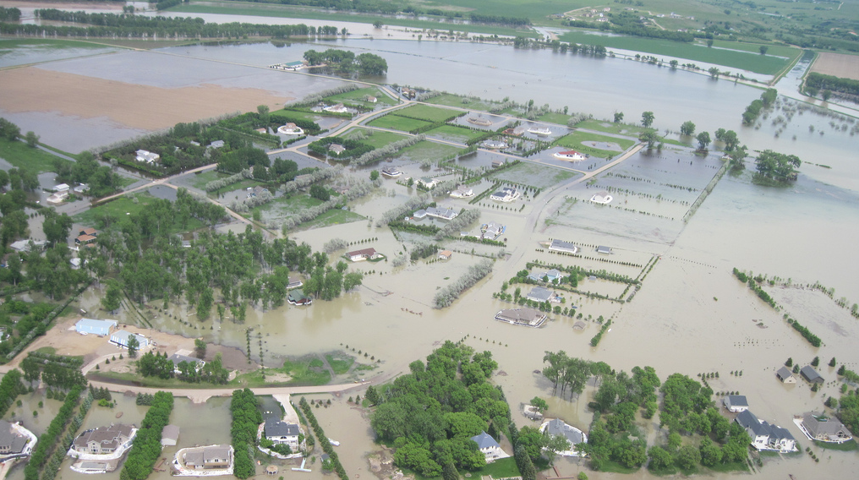
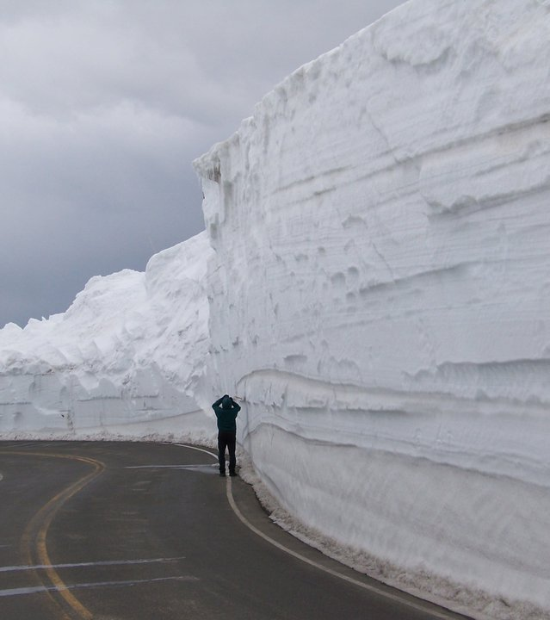
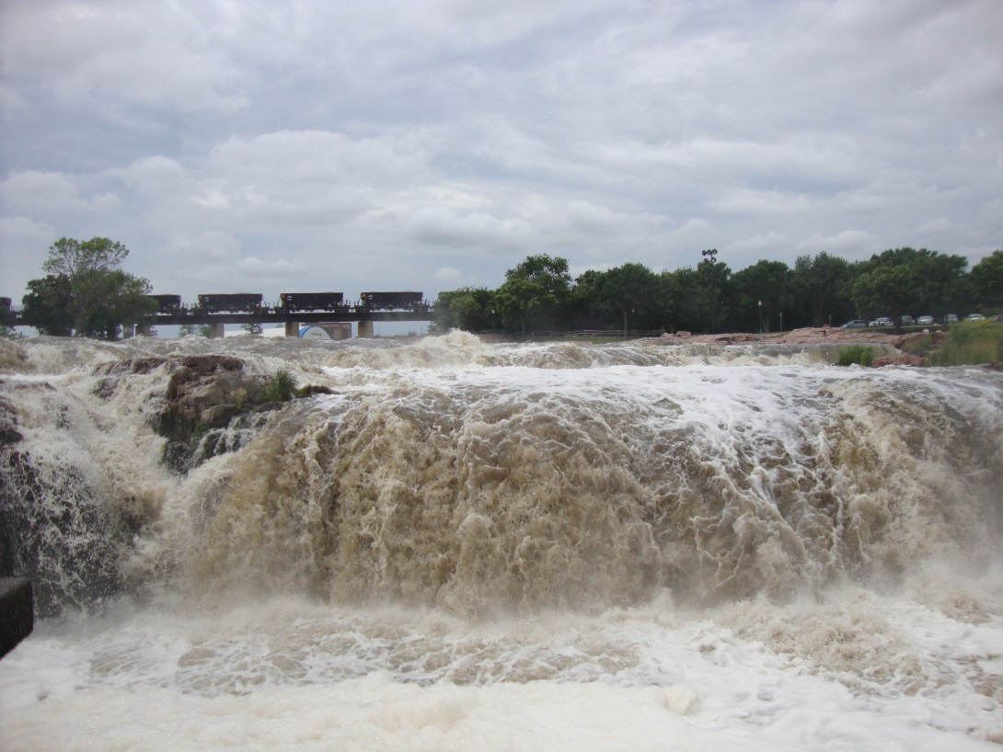
From Deliverables -> Images
U.S. Army Corps of Engineers
Notes:
Image Source: http://news.sciencemag.org/sites/default/files/styles/thumb_article_l/public/sn-floodwarning%20%282%29.jpg?itok=CynBYVDR
The 2011 floods led to increased collaboration to improve understanding of runoff in the Missouri River Basin and communication with the public. Subsequent flooding and damage to communities, businesses, and ecosystems across the entire region cost the agency approximately $1 billion [USGAO 2014]. An official investigation found that although Corps officials could not have predicted such an event, further research should be conducted to better understand the environmental factors that drive run-off in the MRB. This brought together the Corps, state, and federal partners to work towards a common goal. We hoped to use NASA and NOAA Satellite Observations and in situ data to better understand run-off in the Missouri River Basin for improved river system management and decision support, to avoid situations like the 2011 floods.

Slide 3
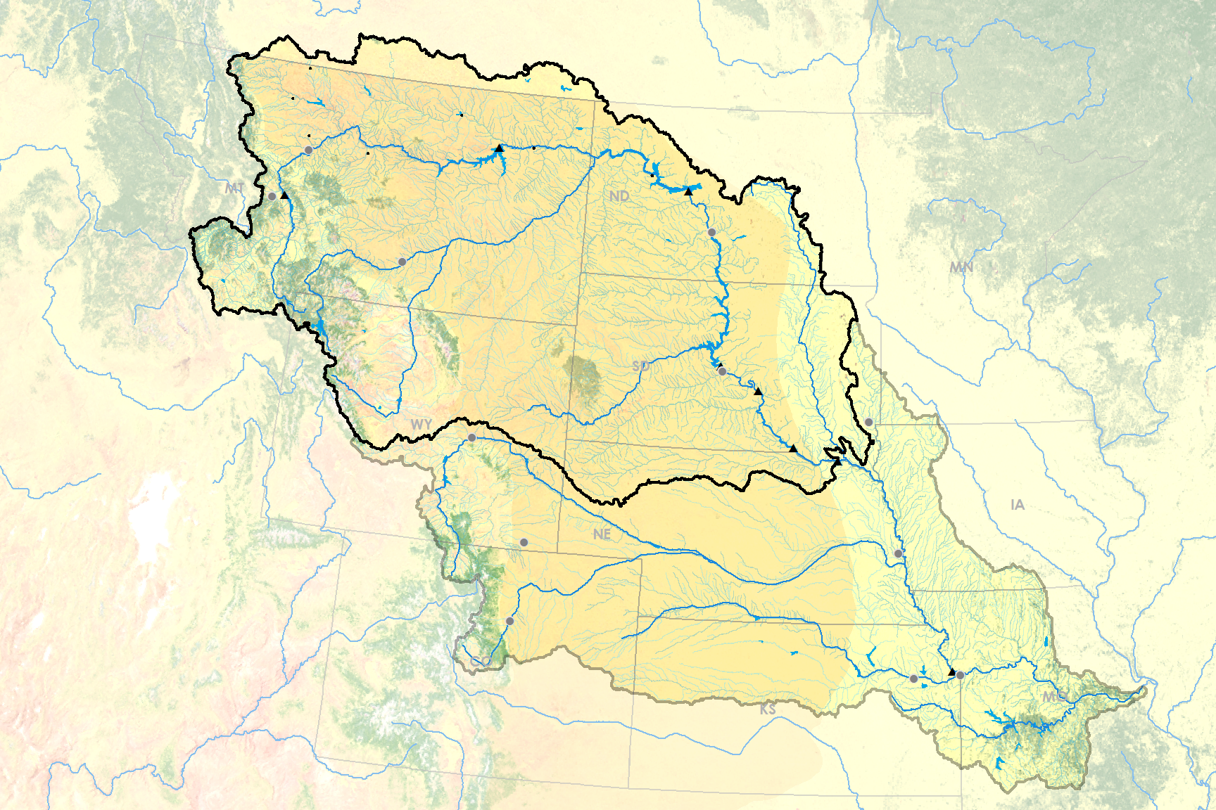
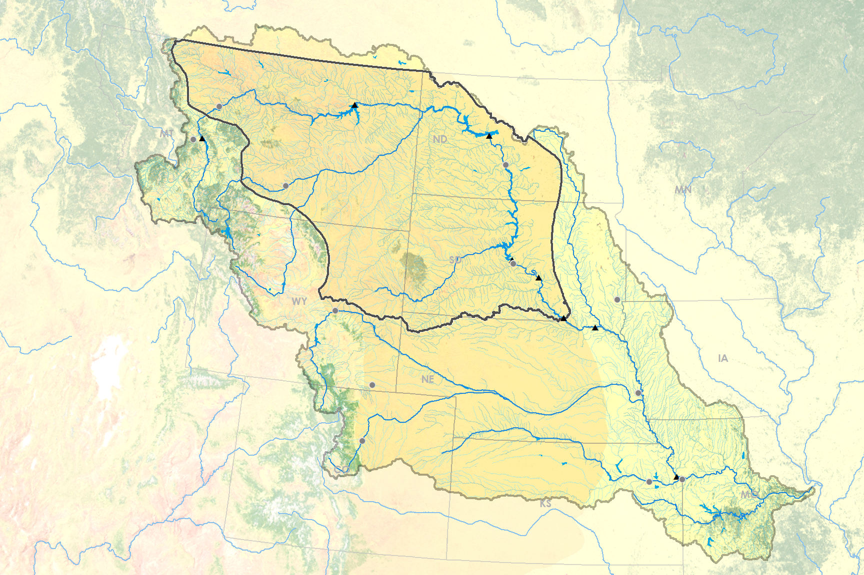
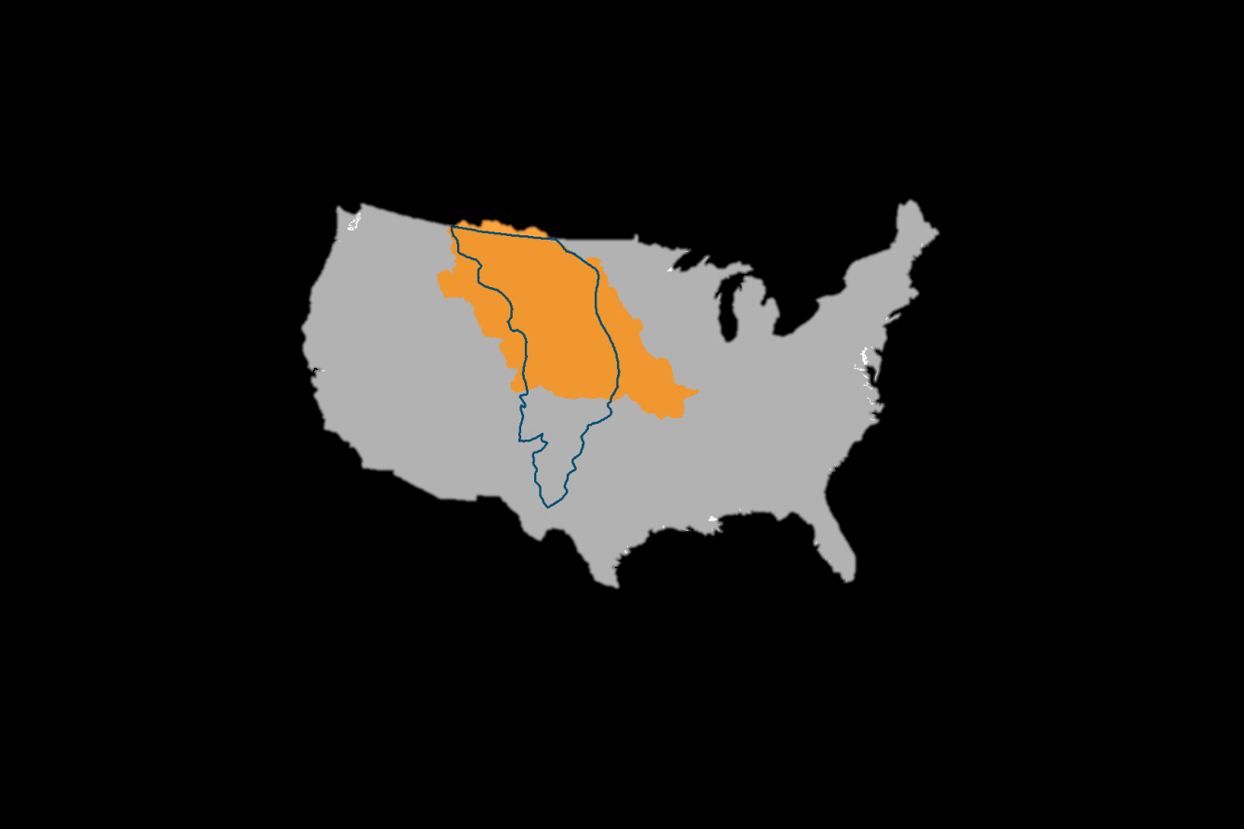
Missouri River Basin (MRB)
Missouri River Basin (MRB)
Great Falls
Fort Peck
Cities
USACE Dams
Rivers
Helena
Canyon Ferry
Garrison
Upper Basin Plains Focus Region
Bismarck
Billings
Northern Great Plains
Oahe
Pierre
Big Bend
Sioux Falls
Casper
Fort Randall
Gavins Point
Soil monitoring: SCAN stations
Cheyenne
Omaha
Denver
MRB
Soil monitoring: SCAN stations
Kansas City
Topeka
Great Plains
Credit: Missouri River Climate team
Notes:
Image Source: Emily Sturdivant (Team Lead)
Upper basin is the source of 90% of river volume
“However, the Corps’ main source of information hydrologic information is from a sparse network of ground stations. For example, the SCAN network…”(animate SCAN sites)
“Data is especially sparse in the plains region of the upper basin, which is an important region for runoff, as seen in the 2011 example” (accumulated late-season plains snowpack is blamed for the sudden runoff event in April).
(Optional Information/Intro)
Missouri River Basin 529,300 square miles
largest reservoir system (by storage) in the US
We focus on the upper Missouri River Basin [see MAP]
90% of water storage is contained in the three uppermost reservoirs: Fort Peck, Garrison, and Oahe [POINT]
Average runoff: 25.2 MAF. Runoff in 2011 was 61 MAF.
Current forecasting protocol:
The Missouri River Basin Water Management Division (MRBWMD) uses a monthly runoff forecast using regional ground station data to anticipate Basin conditions at six dam and reservoir locations. Their model incorporates important environmental variables like snowpack, soil temperature, and soil moisture. There are many measuring stations in the mountainous west (*dot sites here*), but there are few ground stations in the northern plains region (*stark contrast with mountain dots*).
Northern Plains region aka focus area :
The Northern plains region is an area we defined by an overlap of the Upper Missouri River Basin above Fort Randall and the Great Plains. This was the focus area within our study region, because it currently lacks sufficient data despite it’s expansive winter snowpack and large role in basin run-off.

Slide 4
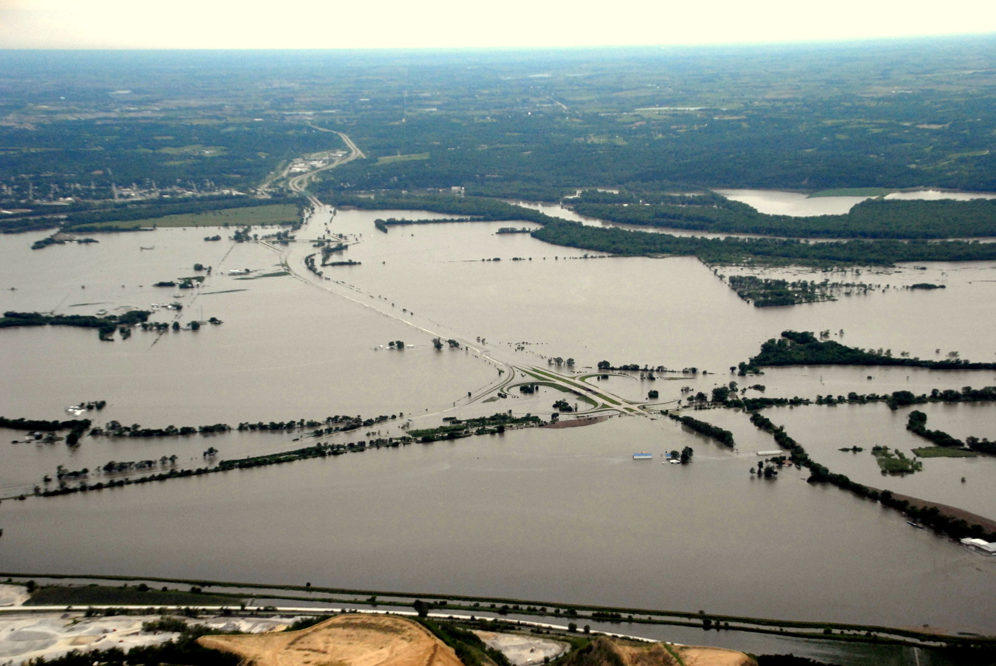
June 16, 2011
Council Bluffs, Iowa
Iowa Army Corps of Engineers
Community Concerns
Water management decisions affect:
Flood control
Navigation
Irrigation
Recreation
Water quality
Water supply
Fish and wildlife
Hydropower generation
Nebraska Radio Network
Notes:
Image Source: Kevin Grode – with the U.S. Army Corps of Engineers
Our partners have a difficult job. Their forecasting and decisions must take into account the river’s many purposes, like flood control, navigation, irrigation, recreation, hydropower, and water quality and supply. They also impact many river users downstream, like stakeholders that make decisions based on reservoir releases, and the fish and wildlife - including endangered species.

Slide 5
Project Partners
Kevin Grode: The Army Corps of Engineers, Missouri River Basin Water Management Division Director
Doug Kluck: Central Regional Climate Services Director, NOAA
Dennis Todey: South Dakota State University, South Dakota State Climatologist
Notes:
The project sought to achieve a relevant and informative product for end-users by involving Kevin Grode, P.E., of the USACE MRBWMD, Dennis Todey, PhD, a State Climatologist and Associate Professor at South Dakota State University, and Doug Kluck, the NOAA Regional Climate Services Director for the Central Region.
Kevin directs the Reservoir Regulation Team, hydraulic engineers and computer specialists who conduct studies and produce short- and long-term forecasts pertaining to the regulation of the Missouri River Mainstem Reservoir System. It was Kevin who told us that soil moisture, frost depth, and snow water equivalent are poorly quantified in the Northern Plains region.
Dennis and Doug help to disseminate information to the public. Improved understanding of trends in these variables and their effect on runoff will aid in their communications with basin organizations and residents.
Dennis: expert on current climate conditions and outlooks across the Northern Plains and Midwest.
Doug works with Regional Climate Centers, state climatologists, federal and state governments… to develop climate data stewardship, build climate change capacity, and assess climate services needs by sector.

Slide 6
Objectives
1
Detect historic and present soil temperature, soil moisture, and snow water equivalents through a combination of NASA and NOAA Earth Observations, modeled data, and in situ data
2
3
Document normal and anomalous conditions for Northern Plains region
Exploratory Analyses of the association between these driver variables and stream discharge
Chad Copess
Notes:
Image Source: http://www.dakotagraph.com/2011/08/lazy-afternoon-on-missouri-river.html
We used remotely sensed and in situ data from the previous 35 years to improve the understanding of water supply and runoff in the Missouri River Basin. With a focus on the Northern Plains region of the basin, we
detected historic and present soil temperature, soil moisture, and snow water equivalent through a combination of NASA Earth Observations, NOAA CDRs, and in situ data,
documented the normal and anomalous conditions for the Northern Plains region,
performed exploratory analyses of the association between these driver variables and stream discharge with a focus on seasonality and anomalous events.

Slide 7
Todd Klassy
Methodology
Climatologies
Exploratory Analysis
Snow Water Equivalent (SWE)
Soil Temperature
Soil Moisture
Streamflow
Notes:
Image source: https://www.flickr.com/photos/latitudes/8389646376
According to our end users, comprehensive in situ data for the plains region on snow water equivalent, soil temperature, and soil moisture can be hard for the Corps to get its hands on. Our team decided to focus on these three variables within the northern plains region to find historical trends that could benefit the Corps management and forecasting methods.
-Snow water equivalent, especially within the plains region, was a key driver in the 2011 floods. Unprecedented plains snowpack in 2011 sparked massive amounts of runoff after a large rain-on-snow event. With a disproportionately low number of Snotell and other snowpack ground measurements in the plains – remote sensing may be the best answer to improved snow water equivalence predictions.
When it comes to soil measurements there seem to be even fewer ground stations – with only
-By soil temperature we’re mostly referring to soil freezing. Once the top soil freezes water infiltration dramatically decreases and often times the soil becomes an impermeable layer. Frozen soil dramatically increases run-off volumes and rates.
-Soil moisture has a similar effect on run-off. The more saturated soil is the lower infiltration rates are which increases the amount of run-off. Soil moisture also influences groundwater movement and soil temperature which affect river streamflows.
For our third objective, the exploratory analysis, we used USGS steamflow data to statistically compare our results with discharge rates. We did this to both check our findings and take the first step at relating these variables to runoff for a future model.
Since the majority of our variables are most important during the winter season we analyzed all of our variables to water years – the USGS equivalent of a winter year that starts in October and goes to September. This can be seen in the monthly climatologies and other analyses that we produced.

Slide 8
NASA/NOAA Satellites and Data Sources
Snow Water Equivalent product
GlobSnow – Aqua with DMSP satellite series
Soil Moisture and Soil Temperature
NLDAS – from GOES satellite
SCAN – NRCS
Streamflow
HCDN – USGS
Notes:
In situ data
Kevin and his team rely almost entirely on ground data, so we wanted to explore the utility of remotely sensed datasets and model products. We drew on these satellites: GlobSnow, ESA product result of collaboration between top-tier space programs
NLDAS, which is involved with the NOAA Climate Prediction Center and uses the GOES
(abbrevations’ real names)
DMSP = from Defense Meteorological Satellite Program
NLDAS = North American Land Data Assimilation System
SCAN = Soil Climate Analysis Network
HCDN = Hydro-Climatic Data Network
Image sources:
http://www.devpedia.developexchange.com/dv/index.php?title=Defense_Meteorological_Satellite_Program_(DMSP)
http://ldas.gsfc.nasa.gov/nldas/

Slide 9
NASA/NOAA Satellites and Data Sources
Snow Water Equivalent product
GlobSnow – Aqua with DMSP satellite series
SMMR, SSM/I, AMSR-E sensors, and ground-based data
Daily, weekly, and monthly
Resolution: 25 km
Time period
NetCDF: 1979 to 2012
HDF: 1979 to 2015
Source: ESA GlobSnow consortium
Other parameters: Snow extent, 15+ years
Notes:
http://www.devpedia.developexchange.com/dv/index.php?title=Defense_Meteorological_Satellite_Program_(DMSP)
For snow water equivalent we pulled data from the GlobSnow product. GlobSnow uses multiple satellite instruments from the Defense Meterological Satellite Program (DMSP) satellite series as well as ground-based data. Temporally the data comes in a temporal resolution of daily, weekly, and monthly – our team used weekly data. The spatial resolution of this data is 25 km and it dates from 1979 to present.

Slide 10
NASA/NOAA Satellites and Data Sources
Soil Moisture and Soil Temperature
NLDAS – from GOES satellite
USGS
Hourly, 3-hourly, and monthly
Look for daily from NCEI next year
Model: Noah
Resolution: ¹/₈ degree
Time period: 1979 to present day
Source: NASA GES-DISC
Other parameters: 52
Notes:
http://ldas.gsfc.nasa.gov/nldas/
For both soil moisture and soil temperature we pulled data from the NOAH model as part of the North America Land Data Assimilation System (NLDAS) satellite series. Temporally this data is only available in hourly, 3-hourly, and monthly. Due to time and processing limitations we used monthly data. However, according to people at NCEI daily NLDAS data should be available some time next year (2016). Spatially this data has a resolution of 1/8th degree and dates from 1979-present.

Slide 11
Snow Water Equivalent (SWE)
GlobSnow consortium dataset
Calculated
Created
Daily satellite observations and ground station data (1979-2012)
Average max SWE for each month of the year, and for each year
A climatology for every month, visually, in a table, and graphically to show anomalous years
Notes:
The European Space Agency’s GlobSnow consortium dataset is an estimated measurement of snow water equivalents from a combination of satellite and ground station data. It incorporates measurements from NASA Earth Observations’ SSM/I and SMMR sensors and from European weather station forecasts. GlobSnow provides daily and weekly estimates of SWE at 25 km grid spacing beginning in 1979, and are publically accessible. However, there were some formatting and processing issues with the data from 2013-present. These estimations are shown to be especially accurate over medium elevation flat plains with seasonal snow cover, which accurately describes the Northern Plains region [Vuyovich et al., 2014].
Using “R”, we drew average maximum SWE by pixel (or area), and then created maps in ArcGIS that describe monthly normals from 33 years of data. Because snow water equivalents accumulate on their own throughout the winter, maximum SWE is a common measurement for the amount of snow in a region. Average maximum, then, is our unit of measurement when creating a climatology.

Slide 12
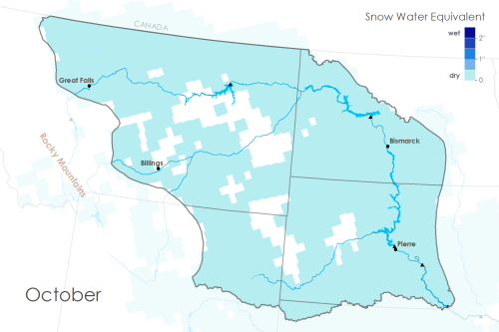
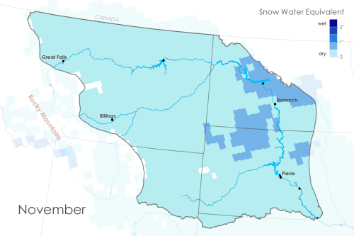
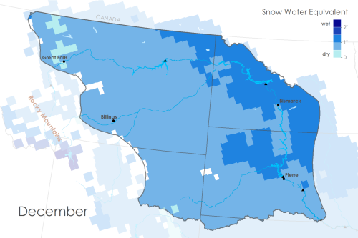
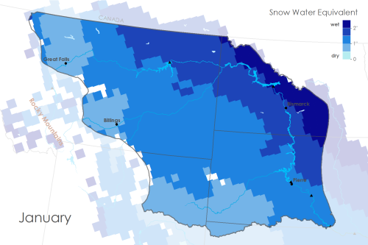
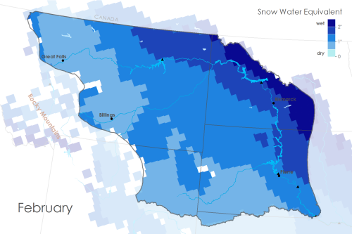
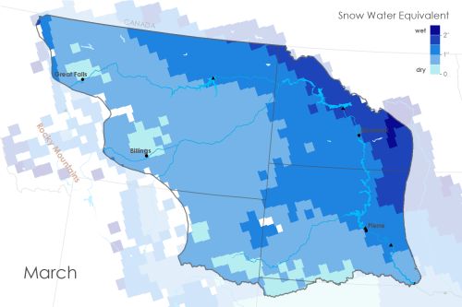
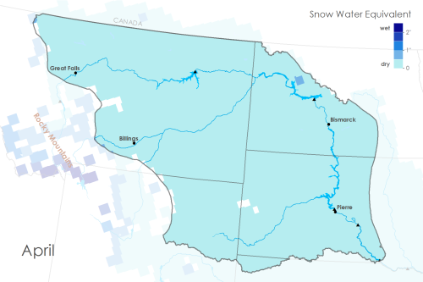
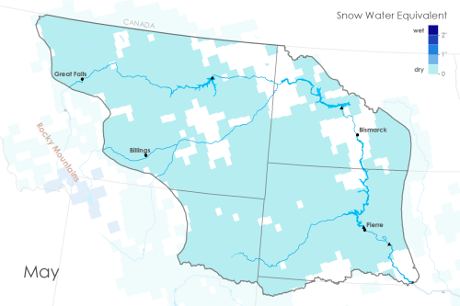
SWE Results: Monthly Climatologies
Oct Nov Dec Jan
Feb Mar Apr May
Dry Wet
0 25 50 (mm)
0 1 2 (inches)
Notes:
Image Source: Maps Made by Team
These maps, created in ArcGIS, show the average maximum SWE over the 33 year period for every month, October through May within our focus area, the Northern Plains as defined by the Upper Missouri River Basin and the Great Plains. They could be used to understand average years compared to the current one, and to make management decisions from their deviations. Each map is created with the same classifications in their color scheme to show change in snowpack throughout the year.

Slide 13
SWE Results:
1.2
1.0
0.8
0.6
0.4
0.2
0
-0.2
-0.4
-0.6
-0.8
-1.0
2 Standard
Deviations
1 Standard
Deviation
(in)
1983
1998
Water Years
Figures 1-9. These figures are derived from the previous table to show the unusualness of certain years. The average SWE was subtracted from maximum SWE, then plotted for each year. Horizontal lines represent one and two standard deviations from normal.
Notes:
Image Source: Figure Made by Sam Swanson
Things to note: description of a water year, 1983 and 1998 as strong El Nino years, similar to 2016 predictions, 1st and 2nd standard deviations are shown to illustrate uncommonly dry or wet years, like 2011. There’s a slightly positive trend in these anomalous years, as can be seen in the next graphic…

Slide 14
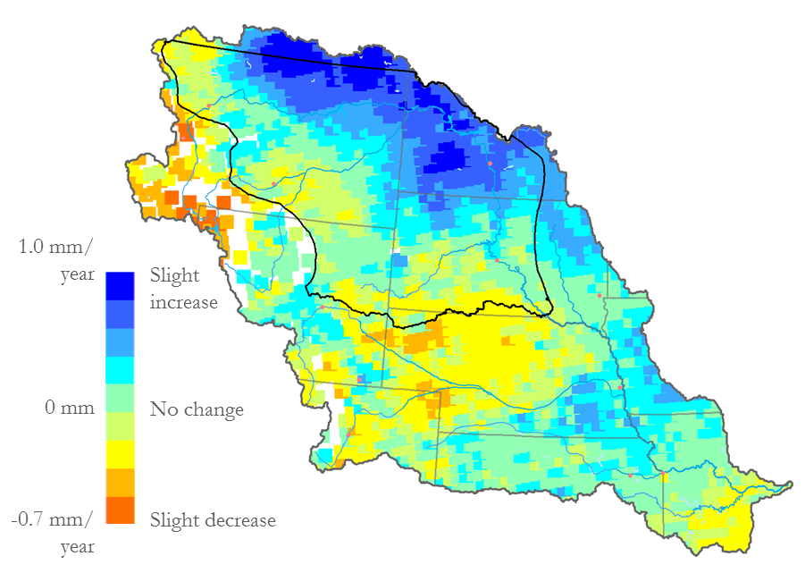
SWE Results: Trends Map
1.0 mm/
year
0 mm/year
-0.7 mm/year
Slight
Increase
No change
Slight Decrease
Notes:
Image Source: Map Made by Team
Some parts of the Northern Plains region saw an increase in average maximum SWE of 1 mm/year for the last 33 years. Overall, our focus area saw no change or a slight increase in SWE, which is consistent with IPCC predictions that high-latitude areas will receive higher amounts of precipitation due to climate change.

Slide 15
Soil Temperature
North American Land Data Assimilation System (NLDAS)
Monthly soil temperature data from NLDAS model (1979-2015)
Calculated
Average 35 year monthly soil temperature per pixel
Analyzed
Monthly Climatology
Compared geographic differences in seasonal soil freezing
Notes:
Our team gathered monthly soil temperature data from NLDAS, or the North American Land Data Assimilation System, with a spatial resolution of 1/8 of a degree from September 1979 to August 2015. The soil temperature model is based on four depth measurements (list here) and is averaged over 1 meter. For each pixel, we averaged over the 35 year period to highlight the months with average soil temperatures below freezing. Next, based on a trend that we noticed, we compared the first month of freezing, last month of freezing, and frozen month durations for each year between two different cities – Bismarck, ND in the lower eastern plains and Billings, MT in the higher western plains.
Lastly, we created a winter climatology of frozen soils on a monthly scale per 1/8 degree pixel.

Slide 16
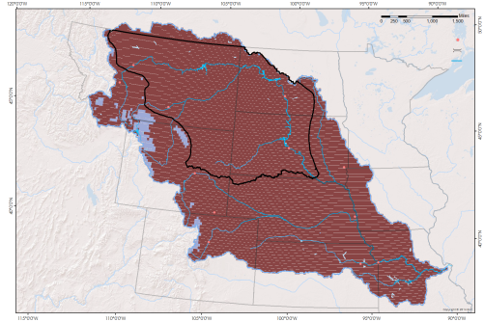
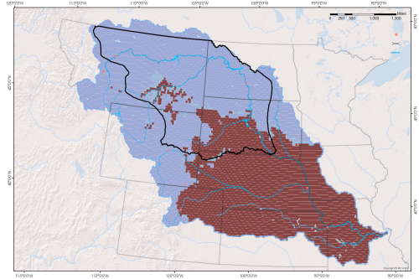
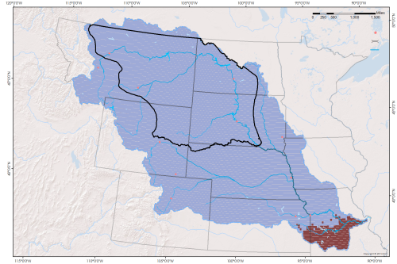
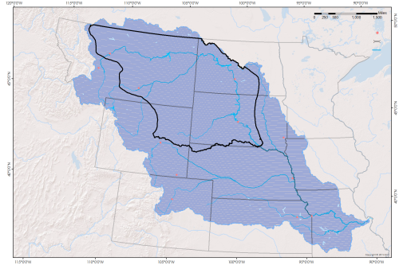
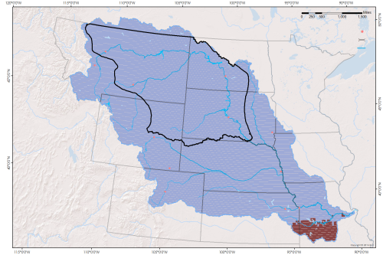
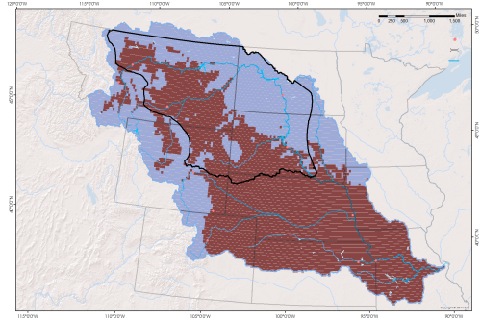
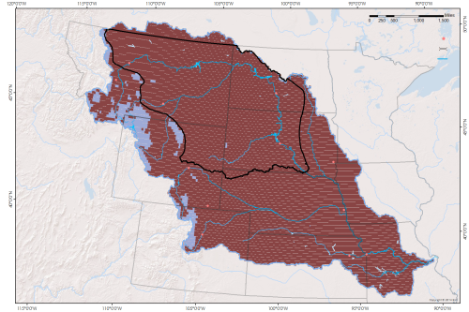
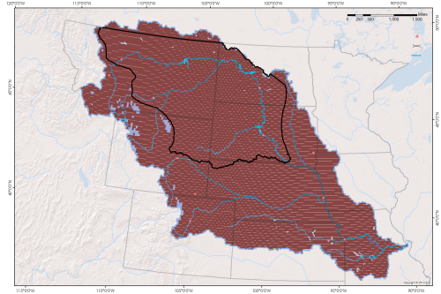
Soil Temperature: Monthly Climatologies
Oct Nov Dec Jan
Feb Mar Apr May
Not Frozen
Frozen
Notes:
Image Source: Maps Made by Team
The monthly climatology is centered around the winter season (also known as the water year) starting in October and ending in May (months between May and October are all unfrozen. These maps show which areas have frozen soil each month on average over the last 35 years. Anything red-brown indicates soil temperatures above freezing and any area blue-grey indicates frozen soil. It is interesting to see similar freezing and warming patterns as the soil temperature drops and rises throughout the winter season. If you’ll notice, October (a cooling month) and April (the counterpart warming month) show very similar maps. The same goes for December and February. Differences arise when comparing the maps for November and March. As you can see within our focus area, the Northern Plains region (outlined in black), there is a difference in seasonal freezing and thawing.

Slide 17
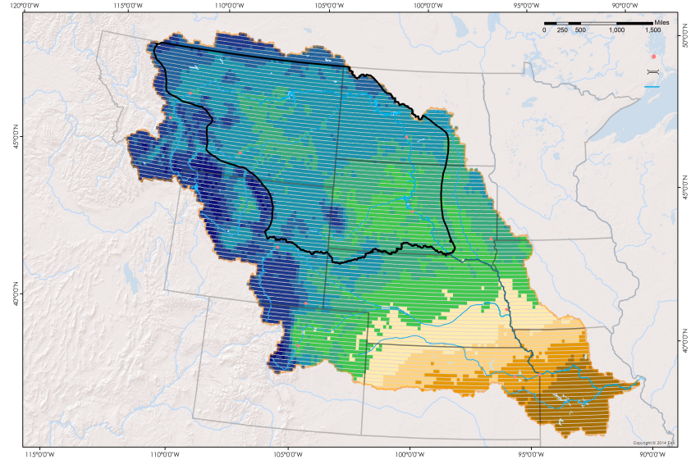
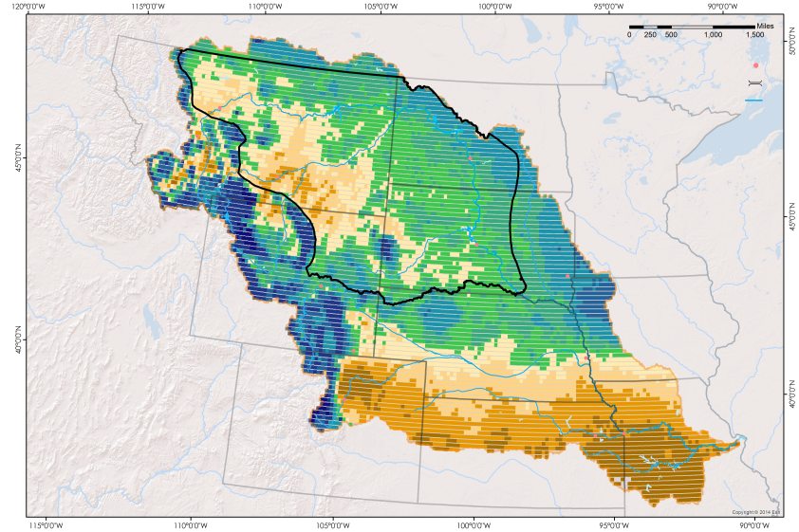
Soil Temperature:
November vs March
November
March
Bismarck, ND
Bismarck, ND
Billings, MT
Billings, MT
-14 °C - -9 °C
0 °C
3 °C - 5 °C
Notes:
Image Source: Maps Made by Team
If we look at November and March in more detail with the actual soil temperatures, you can see within our focus area, the Northern Plains region (outlined in black), there is a difference in seasonal soil freezing and thawing along an east to west gradient. The western portion of the focus area (which consists mostly of the higher elevation western plains) stays slightly warmer than the lower eastern plains in the north and thaws much earlier in the year (as indicated by the March climatology). The lower northeastern plains contain a large area of frozen soil during March. This seasonality makes sense since the northeastern portion of the basin tends to keep its snowpack longer than anywhere else in the basin (aside from the high Rocky Mountains). This area also tends to receive more precipitation than the western plains. With increased soil moisture means deeper and longer lasting frost depths.
We can take the comparison a step further and compare specific two points from the east and the west – {animate cities}
Bismarck, ND and Billings, MT.

Slide 18
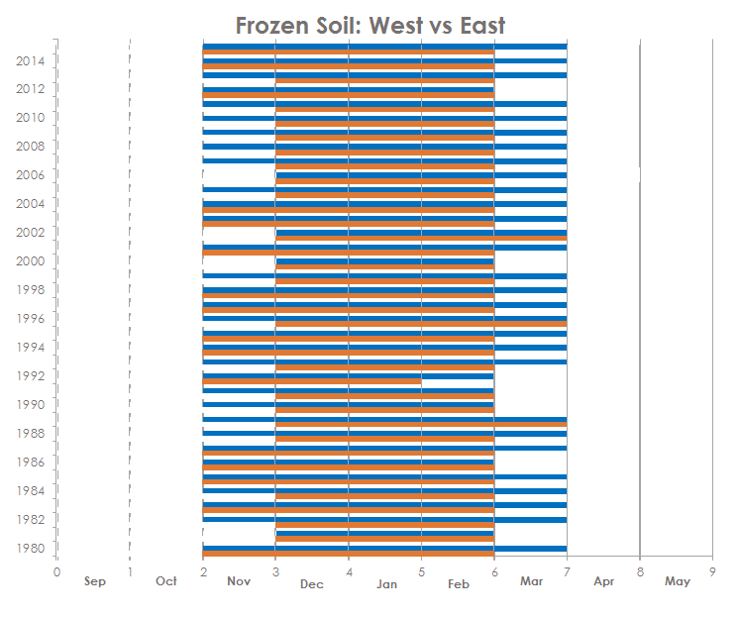
Frozen Month Duration
Billings, MT vs Bismarck, ND
Bismarck, ND
Billings, MT
Notes:
Image Source: Figure Made by Alec Courtright (team)
To compare these two specific points we compiled monthly soil temperatures for each location over the 35 year period. Then, we identified the first months, last months, and durations of months with average soil temperatures below freezing per year. We created two tables as a comparison method and the graphic above for a more visual representation (Explain graphic if necessary). As you can see the eastern plains (represented by Bismarck, ND in blue) consistently has longer durations of frozen soil months and, aside from three years out of the past 35, thaws in March while the western plains (Billings, MT) usually thaws in February. This can have a huge influence on runoff from eastern snowpack and snowmelt.

Slide 19
Soil Moisture
North American Land Data Assimilation System (NLDAS)
Model of soil moisture content produced by data assimilation (1979-2015)
Monthly and yearly averages of soil moisture content present
Validated the utility of NLDAS with SCAN
Calculated
Created
Climatologies of monthly averages and a table that also included yearly averages
Notes:
For soil moisture we used NLDAS . We chose to use the soil moisture content parameter for our analysis, which is measured in kg/m². For our calculations we found the monthly and yearly averages over the 35-year time period and then we made monthly climatology maps with these averages and also made a table to show all of this data to our project partners. The validation was done by using the seven SCAN (Soil Climate Analysis Network) in situ sites that are located in our focus region to visually confirm the usefulness of the NLDAS data.

Slide 20
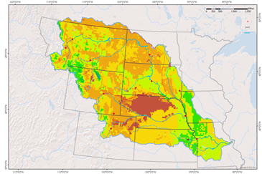
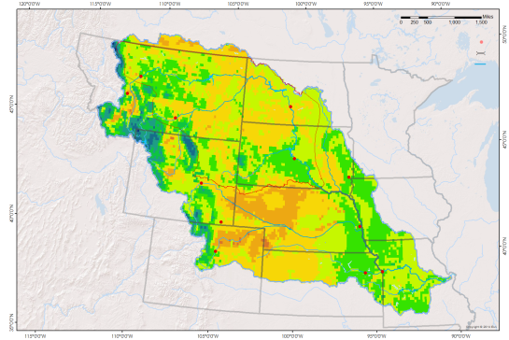
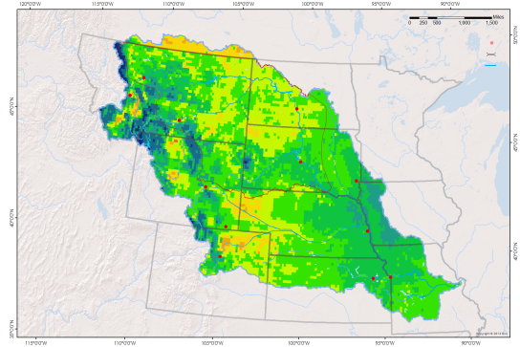
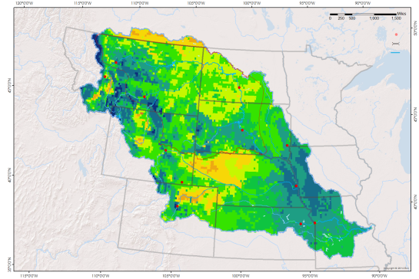
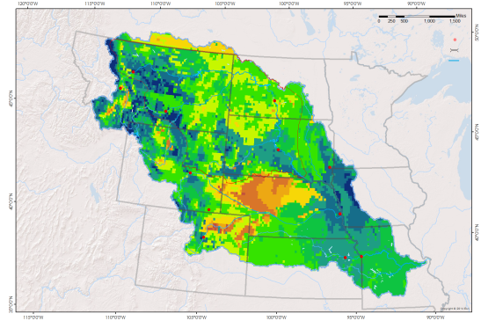
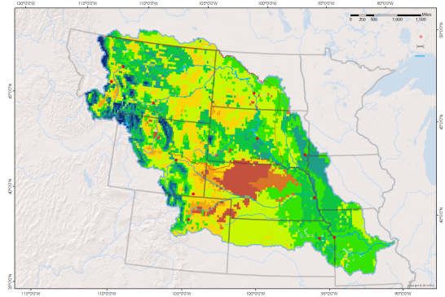
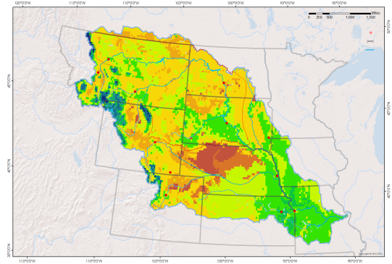
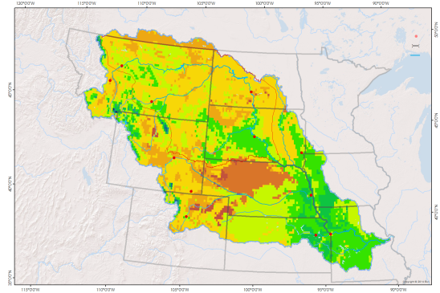
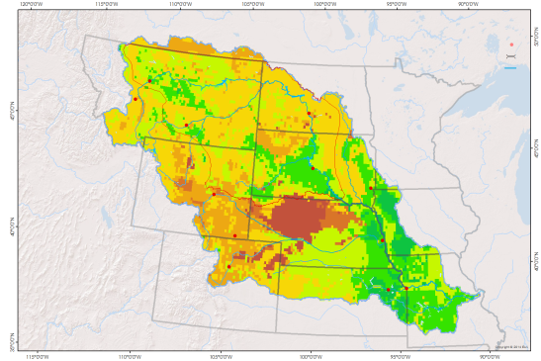
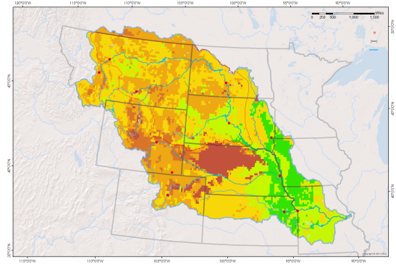
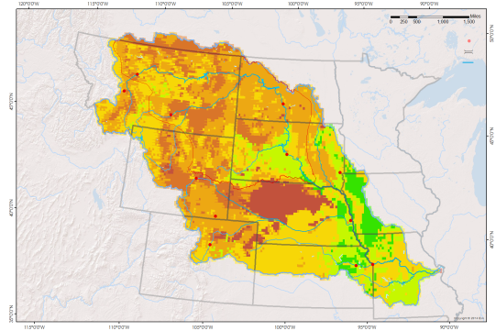
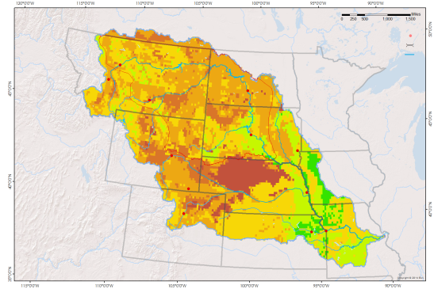
Results: Monthly Climatologies for Soil Moisture Content
Oct
Nov
Dec
Jan
Feb
Mar
Apr
May
Jun
Jun
Jul
Aug
Sep
9 kg/m²
27 kg/m²
46 kg/m²
Notes:
Image Source: Maps Made by Team
These maps show the climatologies for soil moisture content for each month averaged over the 36 years from the NLDAS dataset. For example, the October map shows the average soil moisture content over 35 years per pixel. As with soil temperature, the data in this map is an average of the top 1 meter of soil in these areas. The blue represents wetter conditions while the brownish red represents drier conditions. As you can see, soil moisture content is much higher in the winter than it is in the summer. It starts to decrease in April. The summer months are much warmer and the air is drier and also more people are using the groundwater for irrigation so this trend makes sense.

Slide 21
Soil Moisture Content Deviations by Year
2 Standard
Deviations
1 Standard
Deviation
1983
1998
Figure 1: This graph shows how anomalous each year is from average soil moisture content. The dotted lines represent one or two standard deviations from the normal.
Notes:
Image Source: Figure Made by Nancy Barnhardt
This graphs shows how unusual the average soil moisture content of each year from 1979-2015 was from the overall average soil moisture content. The years in red, 1983 and 1998, are strong El Nino years. The 2015 water year is also supposed to be a relatively strong El Nino year as well. The y-axis shows how much each year varied from the average with the units being in kg/m^2. The x-axis shows each year with the years being water years. [animate trend line]The black line indicates an increasing trend in the amount of soil moisture over the years.

Slide 22
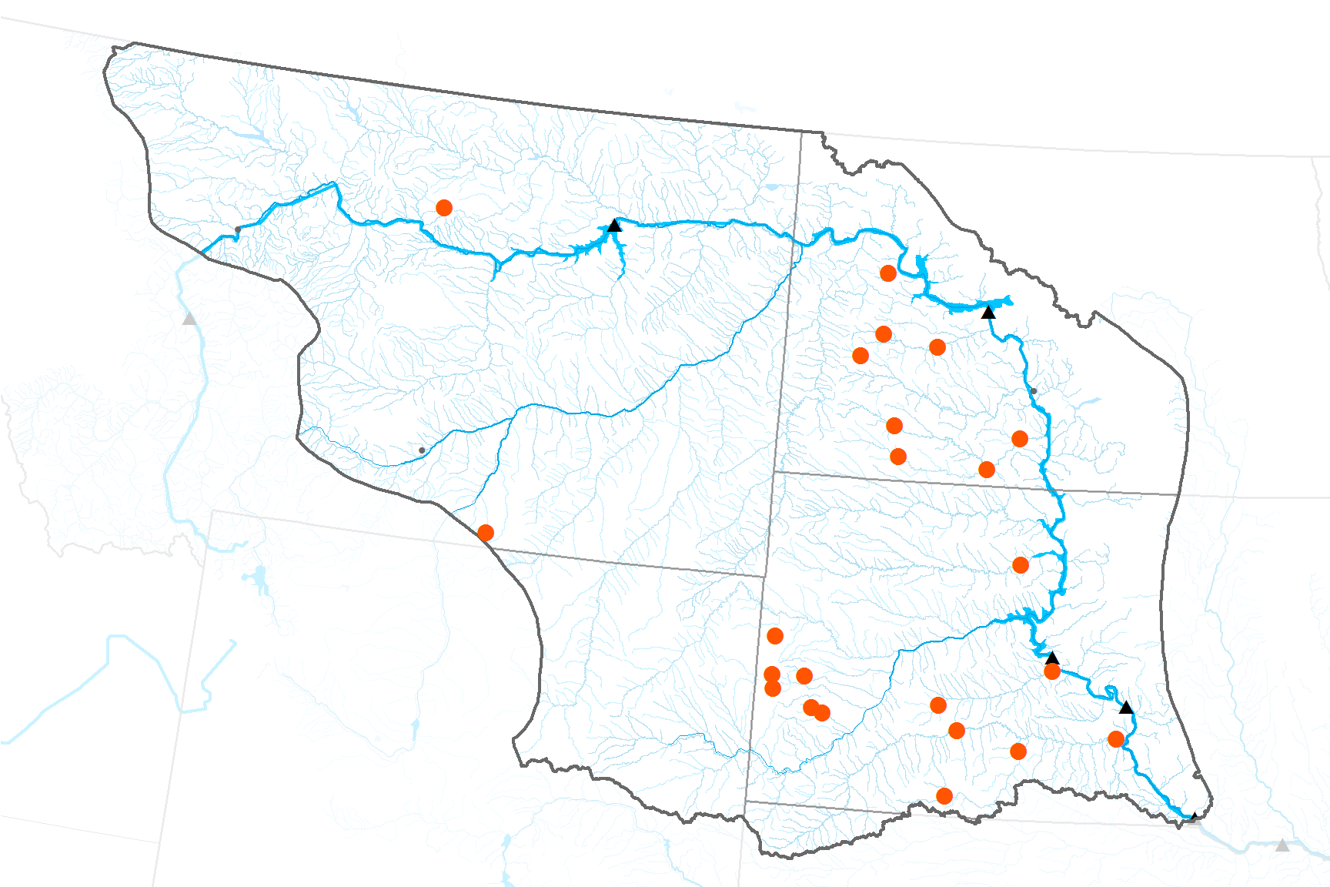
Exploratory Analysis:
Streamflow
USGS HCDN dataset
Found
Created
List of USGS stream gauges with low human impact
Daily stream discharge for 23 sites in our focus region
A linear model comparing stream discharge (MAF) to SWE, soil moisture, and soil temperature for two periods: Feb – Apr and May - Sept
Notes:
Image Source: Map Made by Team
Streamflow:
Used USGS stream gauge stations in the Hydro-Climatic Data Network (HCDN) to
Used discharge data from only those sites on unique unregulated tributaries – 12 stations within the Focus Region.
Found the average discharge per site for each month in the 35-year period. (Found the total monthly discharge at each site and then the average for all 12 stations in the focus region.)
We analyzed the relationship with the three driver variables by checking the explanatory power of each variable on discharge and then running a multiple linear regression. For that, we used standardized values (Z-scores).
*One acre-foot is the amount of water to cover 1 acre of land in water 1 foot deep.

Slide 23
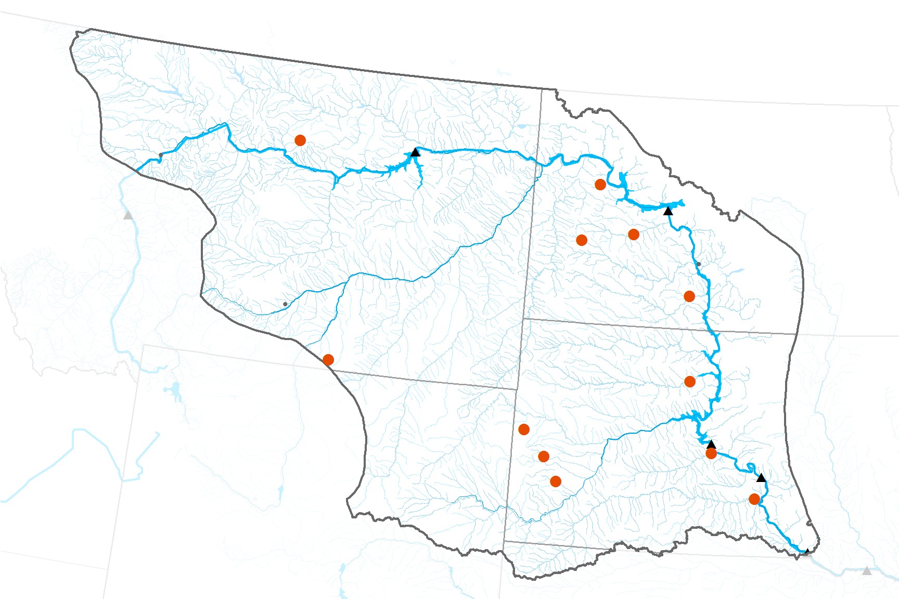
Streamflow Results: Regression Analysis
Melt season February – April
Growing season May – September
Discharge |  | SWE | SMC | ST
SWE | 0.35 | 1 | 0.74 | -0.67
SMC | 0.19 | 0.74 | 1 | -0.84
ST | 0.08 | -0.67 | -0.84 | 1
Discharge |  | SWE | SMC | ST
SWE | 0.35 | 1 | 0.74 | -0.67
SMC | 0.19 | 0.74 | 1 | -0.84
ST | 0.08 | -0.67 | -0.84 | 1
0.35 | 1 | 0.74 | -0.67
0.19 | 0.74 | 1 | -0.84
0.08 | -0.67 | -0.84 | 1
0.01 | 1 | 0.17 | -0.33
0.64 | 0.17 | 1 | -0.38
-0.36 | -0.33 | -0.38 | 1
Discharge =
-0.69 + 0.76*SWE + 0.82*SM + 2.2*ST
Discharge =
1.18 + 0.9*SM - 0.31*ST
Notes:
Image source: Missouri River Climate team
The variables have very different relationships during the melt season and the growing season, as you might expect.
During the melt season: snow and soil moisture follow similar patterns, increasing and decreasing together. Soil temperature has an inverse relationship with both: high soil temperatures often occur with low soil moisture and vice versa (during melt season when soil is typically cold and wet).
The linear model for melt season: all coefficients are positive and soil temperature has the highest coefficient.
For the growing season, we remove snow from the relationship.
We see a strong positive relationship between discharge and soil moisture: high soil moisture <-> high discharge and vice versa
However, soil temperature has an inverse relationship with discharge: high temperatures <-> low discharge/ low temperatures <-> high discharge
These differences are reflected in the model: soil temperature has a negative effect on discharge and soil moisture has a stronger (positive) influence.
Z-scores were used in regression
Results of multiple linear regressions to understand the combined effect of the variables on discharge.
P-values of 0.05 or less are considered “significant”, and the resulting degree of significance is shown with *’s. A p-values verify the random character of a sampling, like the one our satellites took when sensing SWE, SM, and soil temperature in our study region. A p-value of 0.05 implies that if our study sample was repeated 100 times, 95% of results would reach similar conclusions to ours. A p-value of 0.01, then, implies 99% of results would reach similar conclusions to those shown. Thus, p-values give a measure of certainty to our results.
Estimates describe the relationship of a variable to stream discharge. From Feb-April, for example, for every millimeter of SWE, average discharge rises by 0.39 MAF. Soil temperature shows the strongest influence of discharge during runoff – for every degree Celcius the soil temperature rises, discharge also rises by 2.18 MAF. Two seasons, that of spring run-off and that of growing period, were analyzed by recommendation of our partners. Snow water equivalent wasn’t included in the summer analysis because most snow has melted in our focus area by the end of April, generally.
Melt season
Residual standard error: 11.81 on 95 degrees of freedom
Multiple R-squared: 0.3677, Adjusted R-squared: 0.3477
F-statistic: 18.41 on 3 and 95 DF, p-value: 1.697e-09
Growing season
Residual standard error: 7.27 on 102 degrees of freedom
Multiple R-squared: 0.4204, Adjusted R-squared: 0.4091
F-statistic: 37 on 2 and 102 DF, p-value: 8.287e-13

Slide 24
Conclusions
Trends in snow and soil moisture
Slight increase in SWE
Slight increase in soil moisture
Continued El Niño patterns
West-east freeze-thaw patterns
Positive correlations during runoff
(+) Soil moisture and (-) soil temperature during growing season
Soil temperature seasonal change
Streamflow correlation
Notes:
To sum it up:
We present you with these long-term monthly averages and our observations of patterns:
Since 1979, we observed
Increasing trend in SWE, especially in the NE.
Slight increasing trend in soil moisture.
Given that NOAA anticipates one of the strongest El Ninos in recorded history this year (water year 2016), our observations of conditions in the Northern Plains in ‘83 and ‘98 suggest that we will see below normal snow accumulation, normal levels of soil moisture, and normal duration of frozen soil.
Across the Northern Plains, the east is decidedly colder: longer duration of frozen ground and thaws later in the spring.
We confirm a relationship between the variables and discharge, although this could be explored with much more depth. We preliminarily find positive correlations during the melt season which becomes an inverse relationship with soil temperature during the growing season.
Refining the analysis could lead to a longer-term forecasting ability.

Slide 25
Future Work
Probabilistic Runoff Model
Incorporate Current Model
Utilize Earth Observations
Yield Probability of Runoff Events
Interactive ArcGIS Online Map
Public Access
Forecast predictions displayed
Each Variable + Runoff outcome
Notes:
There are a few ways to continue the work we have done this term. One extension would be continue involving earth observations data and the historical trends that we found in a comprehensive runoff model. The US Army Corps of Engineers have a pretty steady runoff model. A new model would be helpful only if it could help improve the Corps current methods. A probabilistic model could be very beneficial to the Corps and MRBWM team by showing the probability of runoff events as opposed to coming up with a set level of runoff.
OR
Another secondary step could be to create an interactive map through ArcGIS Online. This map could be used to help our end-users communicate with the public and help basin residents understand how different drivers will affect them personally.

Slide 26
Advisors
L. DeWayne Cecil, Global Science & Technology
Jessica Sutton, NASA DEVELOP at NOAA NCEI: Center Lead
Emma Baghel, NASA DEVELOP at NOAA NCEI: Assistant Center Lead
Partners
Kevin Grode, U.S. Army Corps of Engineers
Doug Kluck, NOAA Central Region Climate Services Director
Dennis Todey, South Dakota State University and State Climatologist
Others
Rocky Bilotta, Anthony Arguez, Ethan Shepherd, Jesse E. Bell NOAA NCEI
Deke Arndt, Climate Monitoring Branch
Ned Gardner, NOAA NCEI
Michael Kruk, NOAA NCEI
Carrie Vuyovich, U.S. Army Corps of Engineers

Slide 27
Appendix
Notes:
More in depth figures for questions.

Slide 28
Data
Data Source | Spatial Resolution | Temporal Resolution | Run-off Driver/Product
DMSP: Defense Meteorological Satellite Program ESA | 25 km | Daily aggregated to monthly 1979-2012 | Snow water equivalent from GlobSnow product
HCDN: Hydro-Climatic Data Network USGS | 23 stations in focus area | Daily 1979-2014 | Streamflow
NLDAS: North American Land Data Assimilation System NASA | 1/8 degree | Monthly Sep.1979-Aug. 2015 | Soil Moisture and Soil Temperature from NOAH model
GHCN: Global Historical Climatological Network NOAA | 864 stations within MRB | Daily 1981-2010 | Temperature
Notes:
Data in more detail.

Slide 29
SWE Results: Focus area table
Year | (mm) Oct | Nov | Dec | Jan | Feb | Mar | Apr | May | Annual average (mm) | (in)
1980 | 0.03 | 1.56 | 1.64 | 8.78 | 12.11 | 11.35 | 1.27 | 0.01 | 4.59 | 0.18
1981 | 0.18 | 0.92 | 3.74 | 1.79 | 4.47 | 0.87 | 0.17 | 0.09 | 1.53 | 0.06
1982 | 0.23 | 0.00 | NA | 62.62 | 61.74 | 39.79 | 7.18 | 0.02 | 24.51 | 0.97
1983 | 0 | 1.82 | 17.95 | 18.71 | 7.44 | 1.73 | 0.24 | 0.17 | 6.01 | 0.24
1984 | 0 | 5.10 | 58.49 | 55.12 | 9.32 | 8.25 | 0.61 | 0.35 | 17.16 | 0.68
1985 | 0.21 | 0.48 | 23.88 | 40.96 | 29.69 | 31.98 | 1.62 | 0 | 16.10 | 0.63
1986 | 0.12 | 45.38 | 80.82 | 63.93 | 68.75 | 27.63 | 3.13 | 0.10 | 36.23 | 1.43
1987 | 0.01 | 12.05 | 7.78 | 5.68 | 10.82 | 23.29 | 4.45 | 0 | 8.01 | 0.32
1988 | 0 | 0.27 | 0.26 | 19.17 | 28.50 | 13.67 | 1.73 | 0.40 | 8.00 | 0.31
1989 | 0.25 | 2.71 | 9.77 | 50.23 | 33.40 | 41.37 | 2.52 | 1.49 | 17.72 | 0.70
1990 | 0.13 | 3.08 | 34.51 | 23.01 | 15.85 | 9.25 | 2.54 | 2.23 | 11.32 | 0.45
1991 | 0 | 0.41 | 22.34 | 37.07 | 20.40 | 9.53 | 8.97 | 0.32 | 12.38 | 0.49
1992 | 7.19 | 23.08 | 9.61 | 10.08 | 4.85 | 1.99 | 0.54 | 0.02 | 7.17 | 0.28
1993 | 0 | 6.66 | 24.22 | 61.36 | 52.07 | 46.61 | 0.23 | 0.01 | 23.90 | 0.94
1994 | 0.68 | 12.47 | 31.99 | 43.44 | 44.76 | 41.18 | 2.70 | 1.95 | 22.40 | 0.88
1995 | 0.12 | 3.59 | 14.87 | 22.23 | 18.26 | 22.64 | 3.08 | 0.35 | 10.64 | 0.42
1996 | 1.09 | 8.87 | 14.75 | 44.08 | 49.76 | 15.56 | 2.04 | 0.02 | 17.02 | 0.67
1997 | 0.98 | 31.83 | 85.23 | 86.38 | 67.54 | 43.86 | 3.60 | 0.02 | 39.93 | 1.57
1998 | 0.64 | 3.83 | 4.35 | 20.08 | 14.65 | 27.57 | 1.30 | 0.05 | 9.06 | 0.36
1999 | 0.04 | 13.68 | 11.58 | 40.39 | 27.51 | 13.66 | 9.01 | 0.44 | 14.54 | 0.57
2000 | 0 | 0.34 | 4.75 | 8.49 | 21.06 | 5.80 | 1.07 | 0.02 | 5.19 | 0.20
2001 | 0.04 | 30.27 | 37.49 | 34.14 | 46.76 | 41.37 | 2.16 | 0 | 24.03 | 0.95
2002 | 0.28 | 0.63 | 6.19 | 8.22 | 10.01 | 26.37 | 6.10 | 1.68 | 7.44 | 0.29
2003 | 2.37 | 2.80 | 7.20 | 16.97 | 19.55 | 29.65 | 0.38 | 0.02 | 9.87 | 0.39
2004 | 0.25 | 23.61 | 24.88 | 54.95 | 61.25 | 31.96 | 0.32 | 0.11 | 24.67 | 0.97
2005 | 0 | 0.11 | 1.99 | 28.40 | 6.17 | 5.24 | 1.63 | 0.32 | 5.48 | 0.22
2006 | 0 | 1.35 | 20.40 | 10.03 | 9.36 | 15.00 | 1.86 | 0.03 | 7.25 | 0.29
2007 | 0.02 | 1.29 | 5.55 | 11.34 | 28.58 | 23.27 | 1.68 | 0.01 | 8.97 | 0.35
2008 | 0 | 1.59 | 8.66 | 20.08 | 25.07 | 6.95 | 2.13 | 1.01 | 8.19 | 0.32
2009 | 0 | 7.46 | 34.77 | 58.40 | 40.37 | 40.29 | 16.93 | 0.02 | 24.78 | 0.98
2010 | 0.15 | 0.17 | 42.76 | 69.49 | 77.14 | 59.14 | 0.29 | 0.04 | 31.15 | 1.23
2011 | 0 | 8.80 | 42.80 | 68.49 | 80.13 | 73.57 | 22.40 | 0.13 | 37.04 | 1.46
2012 | 0 | 1.23 | 3.77 | 14.40 | 15.22 | 16.02 | 0.29 | 0.14 | 6.38 | 0.25
2013 | 0.33 | 11.08 | 14.83 |  |  |  |  |  | 8.75 | 0.34
Monthly average (mm) | 0.45 | 7.90 | 21.63 | 33.89 | 30.99 | 24.44 | 3.46 | 0.35 | 15.22 | 0.60
Monthly StDev (mm) | 1.28 | 10.90 | 21.35 | 23.01 | 22.71 | 17.64 | 4.84 | 0.61 | 10.24 | 0.40
Dry Wet
Table 1. This table shows maximum SWE in millimeters by month and year for the Northern Plains region, then averaged maximums in the last row and column, also shown in inches. Colors coordinate with the maps on the previous slide.
0 25 50 (mm)
0 1 2 (inches)
Notes:
Image Source: Figure Made by Team
Focus area table depicting maximum snow water equivalents for every month since 1979. Color schemes match climatologies for the same variable. The years 1983 and 1998 signify El Nino years.

Slide 30
Results: West vs East
Billings, MT (West)
Bismarck, ND (East)
Water Year | First Frozen Month | Last Frozen Month | Duration | Duration
1980 | November | February | Nov-Feb | 4
1981 | December | February | Dec-Feb | 3
1982 | December | February | Dec-Feb | 3
1983 | November | February | Nov-Feb | 4
1984 | December | February | Dec-Feb | 3
1985 | November | February | Nov-Feb | 4
1986 | November | February | Nov-Feb | 4
1987 | November | February | Nov-Feb | 4
1988 | December | February | Dec-Feb | 3
1989 | December | March | Dec-March | 4
1990 | December | February | Dec-Feb | 3
1991 | December | February | Dec-Feb | 3
1992 | November | January | Nov-Jan | 3
1993 | December | February | Dec-Feb | 3
1994 | November | February | Nov-Feb | 4
1995 | November | February | Nov-Feb | 4
1996 | December | March | Dec-March | 4
1997 | November | February | Nov-Feb | 4
1998 | November | February | Nov-Feb | 4
1999 | December | February | Dec-Feb | 3
2000 | December | February | Dec-Feb | 3
2001 | November | February | Nov-Feb | 4
2002 | December | March | Dec-March | 4
2003 | November | February | Nov-Feb | 4
2004 | November | February | Nov-Feb | 4
2005 | December | February | Dec-Feb | 3
2006 | December | February | Dec-Feb | 3
2007 | December | February | Dec-Feb | 3
2008 | December | February | Dec-Feb | 3
2009 | December | February | Dec-Feb | 3
2010 | December | February | Dec-Feb | 3
2011 | December | February | Dec-Feb | 3
2012 | November | February | Nov-Feb | 4
2013 | December | February | Dec-Feb | 3
2014 | November | February | Nov-Feb | 4
2015 | November | February | Nov-Feb | 4
Water Year | First Frozen Month | Last Frozen Month | Duration | Duration
1980 | November | March | Nov-March | 5
1981 | December | February | Dec-Feb | 3
1982 | November | March | Nov-March | 5
1983 | November | March | Nov-March | 5
1984 | November | March | Nov-March | 5
1985 | November | March | Nov-March | 5
1986 | November | February | Nov-feb | 4
1987 | November | March | Nov-March | 5
1988 | November | March | Nov-March | 5
1989 | November | March | Nov-March | 5
1990 | November | February | Nov-Feb | 4
1991 | November | February | Nov-Feb | 4
1992 | November | February | Nov-Feb | 4
1993 | November | March | Nov-March | 5
1994 | November | March | Nov-March | 5
1995 | November | March | Nov-March | 5
1996 | November | March | Nov-March | 5
1997 | November | March | Nov-March | 5
1998 | November | March | Nov-March | 5
1999 | November | March | Nov-March | 5
2000 | December | February | Dec-Feb | 3
2001 | November | March | Nov-March | 5
2002 | December | March | Dec-March | 4
2003 | November | March | Nov-March | 5
2004 | November | March | Nov-March | 5
2005 | November | March | Nov-March | 5
2006 | December | March | Dec-March | 5
2007 | November | March | Nov-March | 5
2008 | November | March | Nov-March | 5
2009 | November | March | Nov-March | 5
2010 | November | March | Nov-March | 5
2011 | November | March | Nov-March | 5
2012 | November | February | Nov-Feb | 4
2013 | November | March | Nov-March | 5
2014 | November | March | Nov-March | 5
2015 | November | March | Nov-March | 5
Table 2: This table compares the first and last month of freezing as well as freezing month durations between Bismarck, ND (eastern plains) and Billings, MT (western plains).
Water Year | First Frozen Month | Last Frozen Month | Duration | Duration
1980 | November | March | Nov-March | 5
1981 | December | February | Dec-Feb | 3
1982 | November | March | Nov-March | 5
1983 | November | March | Nov-March | 5
1984 | November | March | Nov-March | 5
1985 | November | March | Nov-March | 5
1986 | November | February | Nov-feb | 4
1987 | November | March | Nov-March | 5
1988 | November | March | Nov-March | 5
1989 | November | March | Nov-March | 5
1990 | November | February | Nov-Feb | 4
1991 | November | February | Nov-Feb | 4
1992 | November | February | Nov-Feb | 4
1993 | November | March | Nov-March | 5
1994 | November | March | Nov-March | 5
1995 | November | March | Nov-March | 5
1996 | November | March | Nov-March | 5
1997 | November | March | Nov-March | 5
1998 | November | March | Nov-March | 5
1999 | November | March | Nov-March | 5
2000 | December | February | Dec-Feb | 3
2001 | November | March | Nov-March | 5
2002 | December | March | Dec-March | 4
2003 | November | March | Nov-March | 5
2004 | November | March | Nov-March | 5
2005 | November | March | Nov-March | 5
2006 | December | March | Dec-March | 5
2007 | November | March | Nov-March | 5
2008 | November | March | Nov-March | 5
2009 | November | March | Nov-March | 5
2010 | November | March | Nov-March | 5
2011 | November | March | Nov-March | 5
2012 | November | February | Nov-Feb | 4
2013 | November | March | Nov-March | 5
2014 | November | March | Nov-March | 5
2015 | November | March | Nov-March | 5
Water Year | First Frozen Month | Last Frozen Month | Duration | Duration
1980 | November | February | Nov-Feb | 4
1981 | December | February | Dec-Feb | 3
1982 | December | February | Dec-Feb | 3
1983 | November | February | Nov-Feb | 4
1984 | December | February | Dec-Feb | 3
1985 | November | February | Nov-Feb | 4
1986 | November | February | Nov-Feb | 4
1987 | November | February | Nov-Feb | 4
1988 | December | February | Dec-Feb | 3
1989 | December | March | Dec-March | 4
1990 | December | February | Dec-Feb | 3
1991 | December | February | Dec-Feb | 3
1992 | November | January | Nov-Jan | 3
1993 | December | February | Dec-Feb | 3
1994 | November | February | Nov-Feb | 4
1995 | November | February | Nov-Feb | 4
1996 | December | March | Dec-March | 4
1997 | November | February | Nov-Feb | 4
1998 | November | February | Nov-Feb | 4
1999 | December | February | Dec-Feb | 3
2000 | December | February | Dec-Feb | 3
2001 | November | February | Nov-Feb | 4
2002 | December | March | Dec-March | 4
2003 | November | February | Nov-Feb | 4
2004 | November | February | Nov-Feb | 4
2005 | December | February | Dec-Feb | 3
2006 | December | February | Dec-Feb | 3
2007 | December | February | Dec-Feb | 3
2008 | December | February | Dec-Feb | 3
2009 | December | February | Dec-Feb | 3
2010 | December | February | Dec-Feb | 3
2011 | December | February | Dec-Feb | 3
2012 | November | February | Nov-Feb | 4
2013 | December | February | Dec-Feb | 3
2014 | November | February | Nov-Feb | 4
2015 | November | February | Nov-Feb | 4
Notes:
Image Source: Figure Made by Team
Both tables utilize the same color scheme with darker colors representing either earlier first months, later last months, or longer frozen soil month durations. The eastern plains city, Bismarck, generally has its first month of frozen soil in November and last month of frozen soil in March. In comparison, the western plains city, Billings, experiences its first month December a majority of the time and its last month in February. The actual duration of frozen soil months supports the result we saw in the monthly climatology. The eastern city has generally experienced 5 months of frozen soil while the western city has never broken four months in the last 35 years.

Slide 31
Results: Focus Area Table
Water Years | October (kg/m²) | November | December | January | February | March | April | May | June | July | August | September | Average Yearly Soil Moisture Content (kg/m²)
1979 |  |  |  | 30.09 | 31.40 | 29.93 | 25.41 | 22.95 | 22.10 | 21.13 | 19.74 | 18.14 | 24.54
1980 | 17.38 | 21.94 | 24.57 | 26.04 | 28.01 | 25.59 | 21.54 | 18.45 | 22.37 | 18.07 | 20.02 | 20.06 | 22.00
1981 | 21.19 | 24.61 | 28.76 | 30.50 | 29.34 | 23.26 | 20.42 | 23.60 | 23.92 | 21.73 | 20.64 | 17.37 | 23.78
1982 | 22.09 | 23.01 | 28.68 | 29.65 | 32.69 | 32.05 | 25.61 | 25.64 | 25.71 | 22.57 | 20.39 | 20.62 | 25.73
1983 | 25.79 | 28.67 | 33.98 | 35.57 | 33.42 | 27.75 | 23.48 | 24.21 | 22.44 | 21.86 | 19.39 | 19.15 | 26.31
1984 | 22.53 | 24.48 | 28.55 | 33.17 | 32.57 | 27.52 | 24.22 | 22.86 | 24.75 | 18.37 | 18.02 | 18.94 | 24.66
1985 | 21.35 | 25.17 | 28.89 | 29.60 | 30.55 | 27.36 | 22.68 | 21.06 | 21.88 | 17.51 | 21.80 | 22.23 | 24.17
1986 | 23.63 | 25.99 | 31.17 | 35.66 | 37.04 | 27.97 | 25.15 | 25.53 | 23.58 | 22.27 | 18.74 | 24.86 | 26.80
1987 | 24.73 | 29.91 | 34.42 | 33.77 | 32.19 | 29.98 | 22.81 | 24.07 | 22.71 | 22.41 | 22.18 | 20.96 | 26.68
1988 | 18.96 | 21.19 | 23.95 | 25.66 | 28.91 | 24.71 | 20.54 | 22.26 | 19.36 | 18.32 | 15.97 | 17.33 | 21.43
1989 | 19.29 | 21.46 | 24.63 | 27.40 | 30.70 | 29.89 | 24.55 | 24.15 | 22.56 | 20.09 | 18.88 | 20.55 | 23.68
1990 | 20.11 | 24.44 | 30.78 | 33.81 | 33.74 | 26.98 | 22.69 | 24.17 | 23.40 | 20.54 | 18.98 | 17.71 | 24.78
1991 | 18.24 | 20.37 | 22.81 | 24.74 | 25.91 | 23.98 | 24.26 | 25.47 | 25.68 | 21.03 | 18.63 | 19.28 | 22.53
1992 | 19.36 | 29.00 | 31.28 | 30.74 | 30.24 | 24.94 | 22.45 | 20.69 | 22.74 | 24.56 | 20.71 | 20.04 | 24.73
1993 | 19.83 | 25.87 | 28.57 | 29.65 | 33.28 | 28.88 | 24.61 | 23.05 | 25.68 | 27.55 | 23.50 | 22.59 | 26.09
1994 | 22.93 | 26.82 | 34.22 | 36.41 | 37.68 | 29.52 | 23.84 | 23.62 | 23.84 | 20.71 | 16.63 | 18.12 | 26.20
1995 | 24.35 | 26.78 | 32.45 | 33.51 | 31.49 | 27.41 | 25.21 | 26.44 | 25.69 | 24.39 | 20.38 | 20.80 | 26.58
1996 | 24.04 | 30.25 | 33.02 | 34.48 | 35.70 | 30.63 | 24.92 | 26.22 | 24.27 | 20.64 | 18.03 | 20.97 | 26.93
1997 | 22.95 | 29.50 | 35.57 | 39.50 | 39.34 | 34.21 | 27.82 | 23.35 | 24.06 | 24.61 | 21.57 | 19.99 | 28.54
1998 | 22.12 | 25.27 | 28.32 | 29.94 | 30.78 | 30.06 | 23.85 | 21.99 | 25.51 | 22.19 | 21.78 | 19.67 | 25.12
1999 | 25.16 | 30.67 | 33.85 | 35.31 | 35.76 | 28.59 | 25.54 | 25.63 | 25.49 | 22.08 | 20.61 | 22.90 | 27.63
2000 | 21.60 | 22.47 | 27.85 | 29.76 | 31.50 | 25.12 | 23.21 | 23.52 | 23.93 | 21.76 | 16.72 | 18.03 | 23.79
2001 | 20.94 | 27.55 | 30.14 | 30.87 | 31.67 | 28.15 | 24.13 | 20.84 | 24.56 | 23.10 | 18.39 | 18.52 | 24.91
2002 | 19.62 | 20.83 | 25.51 | 26.58 | 27.14 | 27.43 | 23.79 | 23.29 | 22.81 | 20.14 | 21.06 | 21.39 | 23.30
2003 | 21.96 | 24.37 | 26.45 | 27.68 | 30.81 | 28.30 | 23.69 | 25.31 | 24.27 | 18.81 | 16.53 | 18.83 | 23.92
2004 | 18.89 | 26.78 | 29.43 | 30.65 | 30.83 | 27.05 | 21.20 | 22.41 | 22.35 | 20.97 | 19.45 | 21.06 | 24.26
2005 | 21.83 | 24.90 | 27.11 | 28.63 | 28.79 | 25.16 | 23.40 | 24.61 | 26.38 | 21.22 | 20.43 | 18.64 | 24.26
2006 | 22.53 | 24.84 | 30.10 | 33.87 | 32.61 | 29.86 | 25.51 | 22.55 | 22.30 | 17.08 | 18.18 | 20.84 | 25.02
2007 | 23.11 | 25.20 | 27.31 | 29.89 | 31.35 | 27.96 | 26.84 | 25.35 | 25.06 | 19.60 | 19.31 | 20.24 | 25.10
2008 | 22.33 | 22.53 | 26.44 | 27.55 | 28.78 | 24.26 | 21.62 | 24.45 | 25.50 | 20.85 | 20.05 | 22.52 | 23.91
2009 | 23.65 | 27.63 | 31.98 | 33.63 | 35.75 | 31.42 | 26.74 | 23.61 | 24.23 | 22.49 | 22.04 | 18.60 | 26.81
2010 | 25.11 | 26.35 | 28.62 | 30.90 | 32.11 | 27.98 | 23.79 | 26.23 | 26.12 | 22.69 | 21.29 | 23.44 | 26.22
2011 | 22.00 | 25.50 | 31.32 | 33.32 | 37.37 | 34.35 | 26.90 | 26.86 | 26.75 | 23.36 | 21.08 | 19.57 | 27.37
2012 | 22.40 | 26.42 | 30.38 | 32.43 | 33.24 | 26.93 | 23.31 | 24.10 | 22.78 | 18.86 | 17.40 | 13.51 | 24.31
2013 | 19.02 | 23.60 | 26.88 | 27.69 | 29.49 | 27.46 | 25.49 | 23.55 | 25.76 | 21.27 | 21.06 | 21.77 | 24.42
2014 | 25.33 | 27.89 | 32.42 | 35.20 | 35.76 | 29.55 | 23.53 | 24.84 | 25.94 | 20.93 | 22.59 | 23.53 | 27.29
2015 | 23.32 | 26.41 | 31.71 | 33.48 | 32.46 | 26.04 | 21.62 | 25.23 | 25.34 | 21.02 | 20.38 |  | 26.09
Average Monthly Soil Moisture Content (kg/m²) | 21.94 | 25.52 | 29.50 | 31.28 | 32.17 | 28.06 | 23.96 | 23.84 | 24.10 | 21.27 | 19.80 | 20.08 | 25.13
Standard Deviation (kg/m²) | 2.18 | 2.72 | 3.20 | 3.46 | 3.10 | 2.61 | 1.79 | 1.82 | 1.62 | 2.18 | 1.85 | 2.16 | 1.63
Table 1: This table shows the average soil moisture content for each month of each year in the Northern Plains. It also shows the average yearly and average monthly soil moisture content.
Notes:
Image Source: Figure Made by Team
This chart shows the average soil moisture content for our focus region, The Northern Plains Region, from 1979-2015. The red boxes indicate drier years while the blue indicates wetter years. The yellow boxes are average soil moisture content. The highlighted boxes indicate strong El Nino years. During El Nino years, the soil moisture content usually remains relatively average even though the area that we are studying is usually drier. This was deduced by looking at the table and not seeing any noticeable trends but there are only two examples so we aren’t positive that this trend will continue this year since 2015 is an El Nino year. This table also shows the average monthly and average yearly soil moisture content in kg/m² on the columns to the far right and at the bottom. The standard deviation at the very bottom was used to help obtain the graphs on the next two slides to show anomalies over the years.

Slide 32
Streamflow: Focus area table
Water year | Oct | Nov | Dec | Jan | Feb | Mar | Apr | May | Jun | Jul | Aug | Sep | Average
1980 | 1.13 | 1.56 | 1.07 | 0.73 | 0.81 | 3.71 | 4.11 | 1.80 | 5.20 | 0.82 | 1.72 | 0.70 | 1.95
1981 | 3.14 | 0.96 | 0.81 | 0.90 | 1.24 | 1.54 | 0.99 | 1.72 | 1.78 | 4.35 | 8.19 | 1.08 | 2.23
1982 | 1.09 | 0.78 | 0.57 | 0.44 | 13.27 | 21.68 | 28.13 | 48.68 | 19.62 | 6.70 | 2.97 | 1.68 | 12.13
1983 | 10.28 | 2.93 | 1.65 | 1.98 | 3.66 | 8.66 | 6.23 | 26.35 | 6.95 | 3.48 | 3.22 | 1.17 | 6.38
1984 | 1.37 | 1.60 | 0.98 | 1.39 | 5.20 | 6.01 | 7.64 | 11.66 | 19.97 | 3.06 | 2.57 | 0.72 | 5.18
1985 | 0.97 | 1.04 | 0.75 | 0.68 | 1.07 | 13.76 | 2.94 | 1.89 | 1.88 | 0.95 | 1.41 | 1.03 | 2.36
1985 | 1.11 | 0.72 | 0.71 | 0.89 | 5.09 | 40.21 | 27.26 | 25.13 | 14.54 | 4.75 | 1.43 | 4.11 | 10.50
1987 | 3.99 | 1.81 | 1.67 | 1.55 | 2.84 | 41.71 | 28.40 | 9.92 | 4.20 | 2.36 | 1.83 | 0.87 | 8.43
1988 | 0.85 | 1.05 | 0.96 | 0.48 | 1.59 | 7.63 | 3.13 | 8.79 | 3.06 | 4.15 | 0.67 | 0.55 | 2.74
1989 | 0.88 | 0.75 | 0.76 | 0.53 | 0.52 | 7.84 | 3.72 | 5.54 | 0.99 | 1.17 | 0.50 | 2.86 | 2.17
1990 | 0.68 | 0.99 | 0.74 | 1.17 | 1.75 | 3.78 | 1.75 | 4.42 | 6.42 | 2.81 | 1.30 | 0.84 | 2.22
1991 | 0.61 | 0.68 | 0.43 | 0.39 | 0.84 | 2.58 | 2.84 | 13.19 | 23.51 | 3.19 | 1.63 | 1.25 | 4.26
1992 | 1.07 | 1.96 | 1.25 | 1.20 | 4.35 | 4.44 | 1.32 | 1.54 | 3.43 | 5.25 | 1.76 | 0.89 | 2.37
1993 | 0.66 | 0.97 | 0.67 | 0.50 | 0.68 | 25.35 | 6.86 | 9.00 | 12.29 | 19.55 | 6.35 | 2.93 | 7.15
1994 | 1.68 | 1.44 | 2.33 | 1.43 | 7.10 | 26.87 | 5.80 | 5.90 | 7.24 | 3.19 | 1.62 | 0.99 | 5.47
1995 | 4.09 | 1.34 | 1.12 | 1.23 | 6.03 | 12.65 | 18.81 | 43.61 | 26.04 | 5.15 | 2.20 | 2.08 | 10.36
1996 | 3.48 | 2.78 | 1.86 | 1.65 | 17.93 | 16.55 | 10.00 | 28.62 | 10.71 | 2.97 | 1.60 | 3.93 | 8.51
1997 | 4.27 | 3.38 | 1.91 | 4.89 | 23.26 | 69.67 | 42.30 | 25.57 | 30.32 | 11.85 | 10.69 | 2.79 | 19.24
1998 | 3.16 | 3.04 | 2.81 | 2.30 | 4.11 | 8.75 | 9.43 | 6.09 | 16.56 | 11.34 | 6.36 | 2.22 | 6.35
1999 | 8.82 | 8.22 | 3.57 | 2.29 | 8.27 | 13.30 | 12.89 | 23.60 | 16.42 | 5.15 | 5.26 | 7.77 | 9.63
2000 | 1.82 | 2.20 | 2.22 | 1.77 | 2.94 | 8.69 | 14.67 | 11.17 | 3.61 | 2.67 | 1.37 | 0.78 | 4.49
2001 | 1.05 | 2.11 | 1.42 | 1.09 | 2.12 | 31.32 | 16.26 | 5.89 | 8.02 | 6.34 | 2.34 | 0.94 | 6.58
2002 | 1.19 | 1.31 | 1.67 | 1.22 | 1.95 | 3.74 | 4.57 | 4.30 | 1.91 | 0.83 | 0.85 | 2.59 | 2.18
2003 | 0.86 | 1.17 | 1.09 | 1.08 | 2.33 | 8.94 | 2.87 | 7.19 | 2.44 | 1.85 | 0.55 | 0.65 | 2.58
2004 | 0.71 | 0.88 | 1.21 | 0.92 | 1.45 | 11.90 | 1.86 | 1.67 | 3.15 | 1.59 | 0.85 | 4.19 | 2.53
2005 | 1.63 | 1.90 | 1.10 | 1.36 | 2.21 | 2.13 | 5.70 | 10.14 | 9.84 | 2.46 | 2.10 | 0.62 | 3.43
2006 | 0.82 | 0.90 | 0.85 | 1.86 | 1.36 | 3.52 | 8.14 | 2.93 | 1.50 | 0.50 | 0.91 | 2.36 | 2.14
2007 | 0.82 | 1.06 | 0.77 | 0.63 | 1.03 | 4.58 | 3.17 | 5.21 | 8.38 | 1.16 | 4.80 | 0.89 | 2.71
2008 | 2.06 | 0.79 | 0.69 | 0.68 | 1.35 | 4.08 | 2.69 | 10.13 | 27.58 | 4.75 | 2.00 | 0.90 | 4.81
2009 | 1.54 | 3.48 | 1.10 | 0.82 | 16.46 | 46.47 | 63.87 | 6.66 | 5.65 | 6.10 | 3.28 | 1.16 | 13.05
2010 | 3.63 | 2.85 | 1.37 | 1.37 | 1.38 | 54.34 | 23.05 | 16.94 | 18.51 | 4.12 | 3.41 | 1.59 | 11.05
2011 | 2.49 | 1.48 | 1.46 | 1.49 | 19.67 | 56.78 | 33.63 | 33.28 | 34.13 | 13.48 | 6.32 | 2.52 | 17.23
2012 | 2.50 | 2.38 | 2.43 | 2.43 | 2.48 | 5.30 | 4.14 | 5.77 | 2.51 | 1.12 | 0.61 | 0.56 | 2.69
2013 | 0.80 | 1.06 | 0.94 | 1.00 | 1.52 | 2.57 | 6.54 | 9.70 | 16.07 | 2.50 | 4.77 | 2.68 | 4.18
2014 | 33.71 | 4.10 | 1.91 | 2.79 | 2.79 | 21.88 | 15.78 | 19.52 | 23.16 | 9.04 | 12.88 | 5.92 | 12.79
2015 | 4.08 | 1.04 | 1.18 | 2.15 | 2.70 | 2.84 | 3.87 | 33.06 | 40.82 | 10.25 | 4.89 | 2.55 | 9.12
Average | 3.14 | 1.85 | 1.33 | 1.37 | 4.82 | 16.83 | 12.09 | 13.52 | 12.18 | 4.75 | 3.20 | 1.98 | 6.42
Average monthly discharge (MAF) at the 23 HCDN stations in the Northern Plains region of the upper basin.
Notes:
Image Source: Figure Made by Team
This table shows average stream discharge for every month over a 36 year period, 1979-2015. El Nino years, 1983 and 1998, are highlighted. Average discharge for the year is shown in the far right column, and average discharge for every month is shown in the bottom row. These data were used in a linear model to explore the relationship between average discharge and our environmental variables.

