Slide 1
Coastal Texas Water Resources II
Using NASA Earth Observations to Assess Laguna Madre Water Conditions through Land Cover Mapping and Thermal Analysis
Elaina Gonsoroski (Project Lead)
Vishal Arya
Jennifer Boyd
Notes:
Hello! We are the Coastal Texas Water Resources II team.

Slide 2
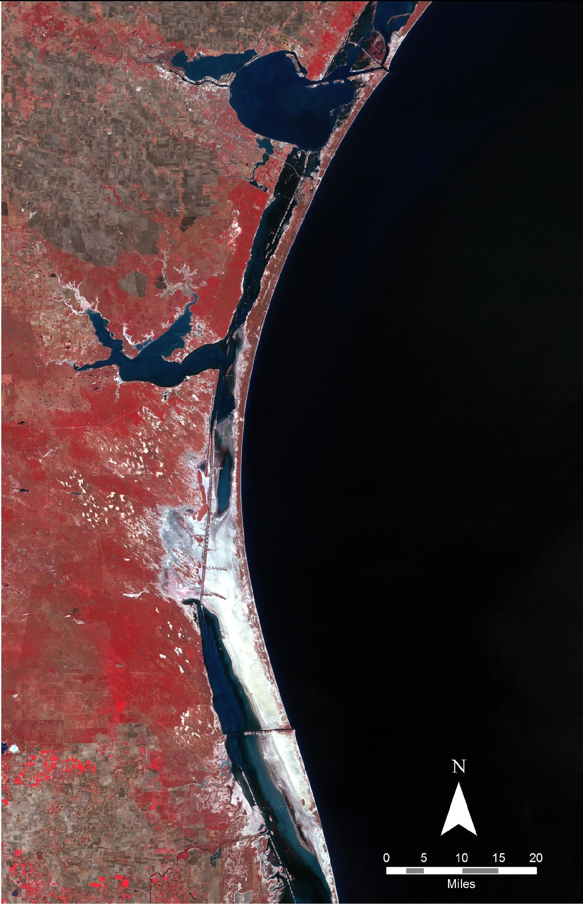
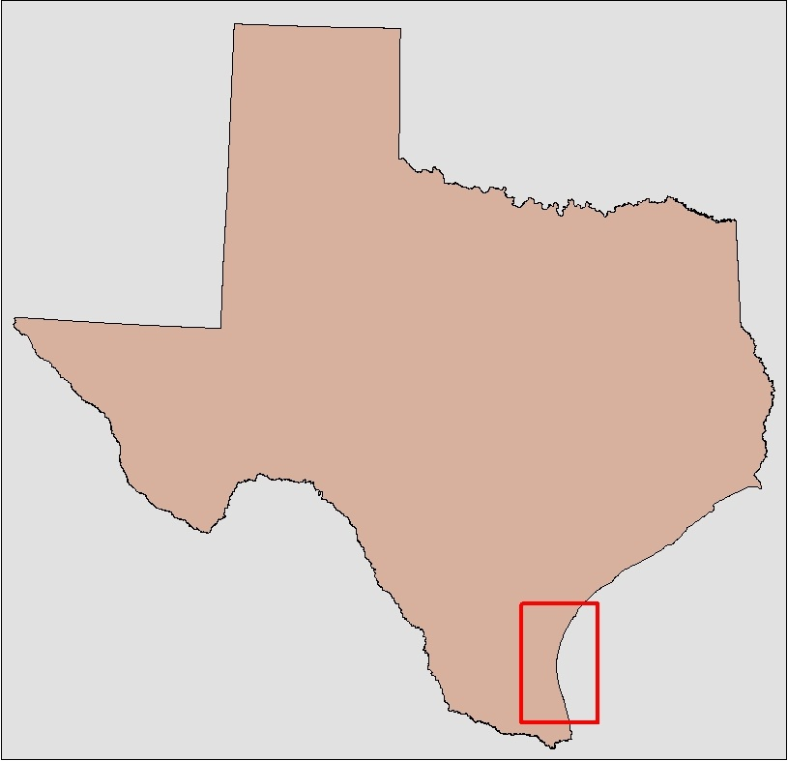
The Laguna Madre
Hypersaline estuary within Padre Island National Seashore
Habitat for numerous protected species
Study period: 1984-2000
Notes:
The Laguna Madre is located on the Gulf Coast of Texas. It is the only hypersaline estuary in North America and therefore is home to a unique ecosystem. It serves as a habitat for numerour protected species and it is an important stop for migrating birds. Our study period spanned from 1984-2000. We conducted land cover analyses during the late summer months and thermal analyses during the winter and late summer.
Image: Landsat 5 data bands stacked 4,3,2

Slide 3
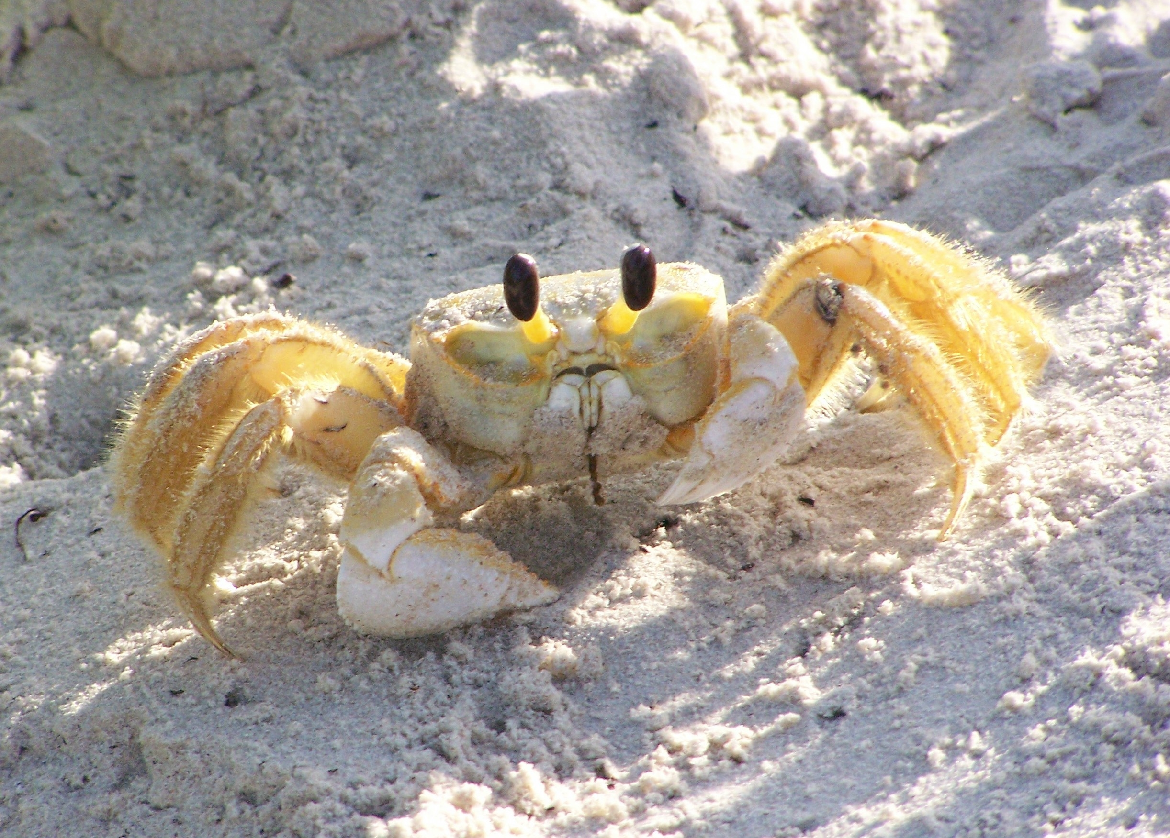
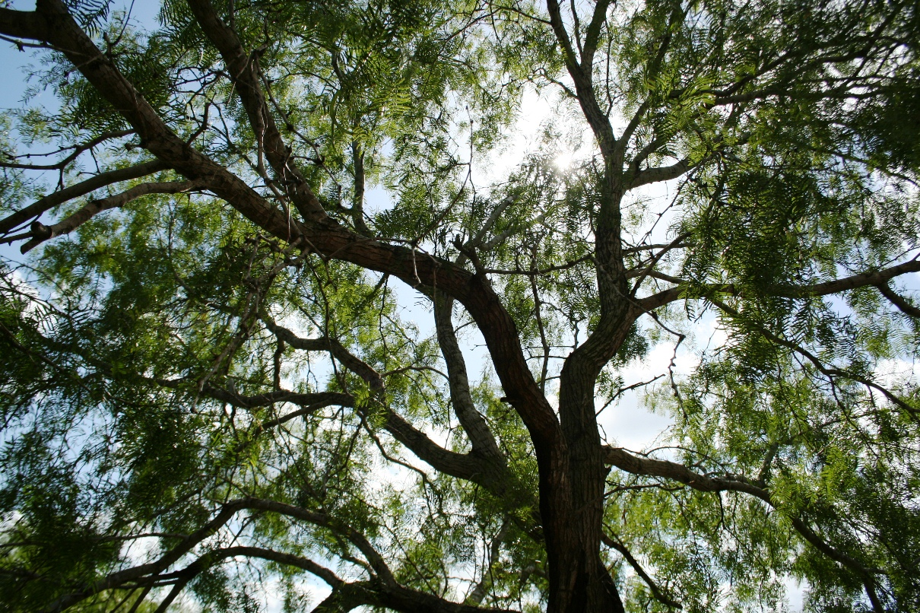
Community Concerns
Increasing salinity of Laguna Madre
Surrounding lands privately owned
Proliferation in spatial extent of honey mesquite tree
Ghost Crab (Image Credit: National Park Service)
Honey Mesquite Tree( Image credit: National Park Service)
Notes:
The the monitoring of the salinity of the lagoon is an important concern to ensure the health of the estuary. However, most of the land surrounding the lagoon is privately owned complicating managment and monitoring of the lagoon. Additionally, the proliferation of honey mesquite trees is hypothesized to be affecting the flow of groundwater to the lagoon and thus to be increasing the salinity of the lagoon.

Slide 4
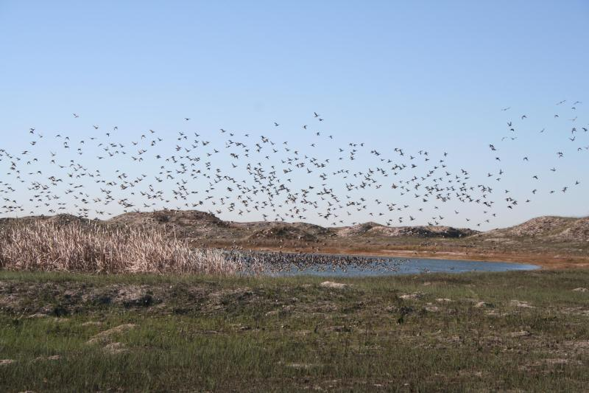
Objectives
Investigate relationship between Laguna Madre salinity and honey mesquite trees
Identify potential areas of fresh groundwater inflow to the lagoon
Compare mesquite trees expansion across time
Assist NPS in studying Laguna Madre hydrology
Redhead ducks over Padre Island (Image credit: National Park Service)
Notes:
There were several main objectives in conducting this research. The first was to investigate the relationship between the Laguna Madre and honey mesquite trees. The second was identify areas of freshwater inflow to the lagoon through thermal analyses. The third was to analyze the expansion of mesquite trees. Lastly, our team worked to develop a systematic method to study the relationship between these environmental factors.

Slide 5
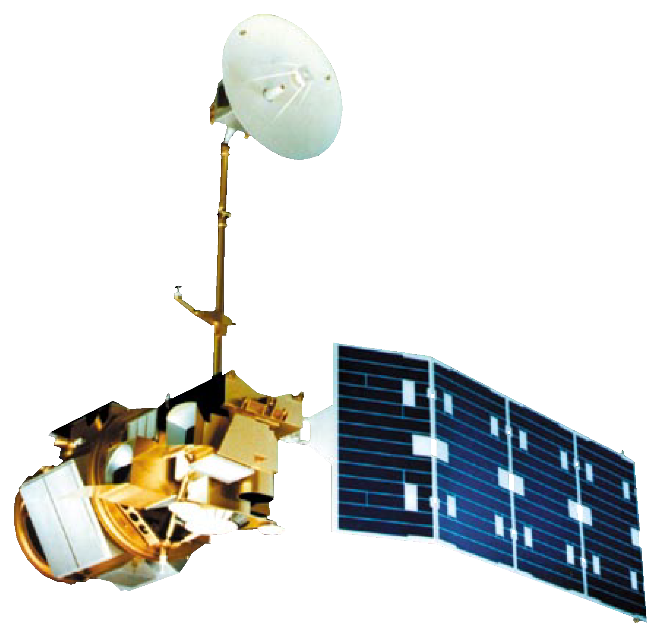
NASA Earth Observations Data
Landsat 5 (TM)
Notes:
Our team used NASA Earth Observation data from the Landsat 5 (TM) satellite to conduct thermal analyses and landcover classification.

Slide 6


Precipitation Data
Ancillary Datasets
In situ precipitation Data
Image Credit: National Oceanic and Atmospheric Administration, National Weather Service
Notes:
Additionally, the team utilized precipation data provided by the PRISM climate group and in situ data provided by weather station in the area surrounding the lagoon.
Image Credit: National Oceanic and Atmospheric Administration, National Weather Service

Slide 7
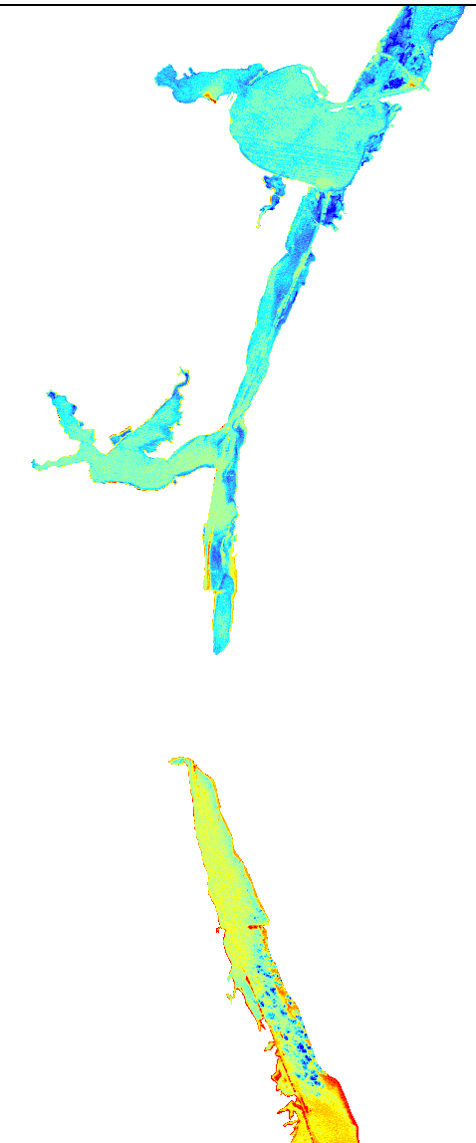
Methodology Workflow
Acquire Landsat and Precipitation Data
Thermal Analysis
Land Use/Land Cover
DN to TOA Radiance to Celsius
TOA Reflectance
Thermal Map
LULC Map
Notes:
Following data acquisition the team went through several steps to reach the results of the thermal analyses and the land cover classification which are outlined here. We will detail the methodology for each of the analyses.

Slide 8
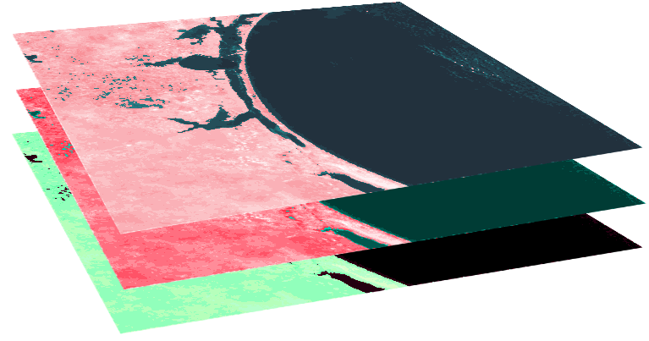
Land Use/ Land Cover (LULC) Methodology
Acquire Landsat Data
Accuracy Assessment
Landsat 5 Bands 2,3,4
Converted to TOA reflectance, and stacked for infrared visualization
Training Regions and Supervised classifications
Notes:
Path 26 row 41 and 42 Landsat 5 (TM) provided data for our land cover scenes. These rows were mosaicked together and clipped to our study area. Bands 2 (green), 3 (red), and 4 (infrared) were converted to TOA reflectance using python script and stacked for infrared visualization using ArcGIS software. Then each raster was converted from a 32-bit float to an 8-bit unsigned raster to be used in ERDAS IMAGINE. Training regions for eight different land cover types were created in ERDAS IMAGINE software to conduct a land cover classification. Then supervised classification was done. Lastly, an accuracy assessment was done using 25 points per class.

Slide 9
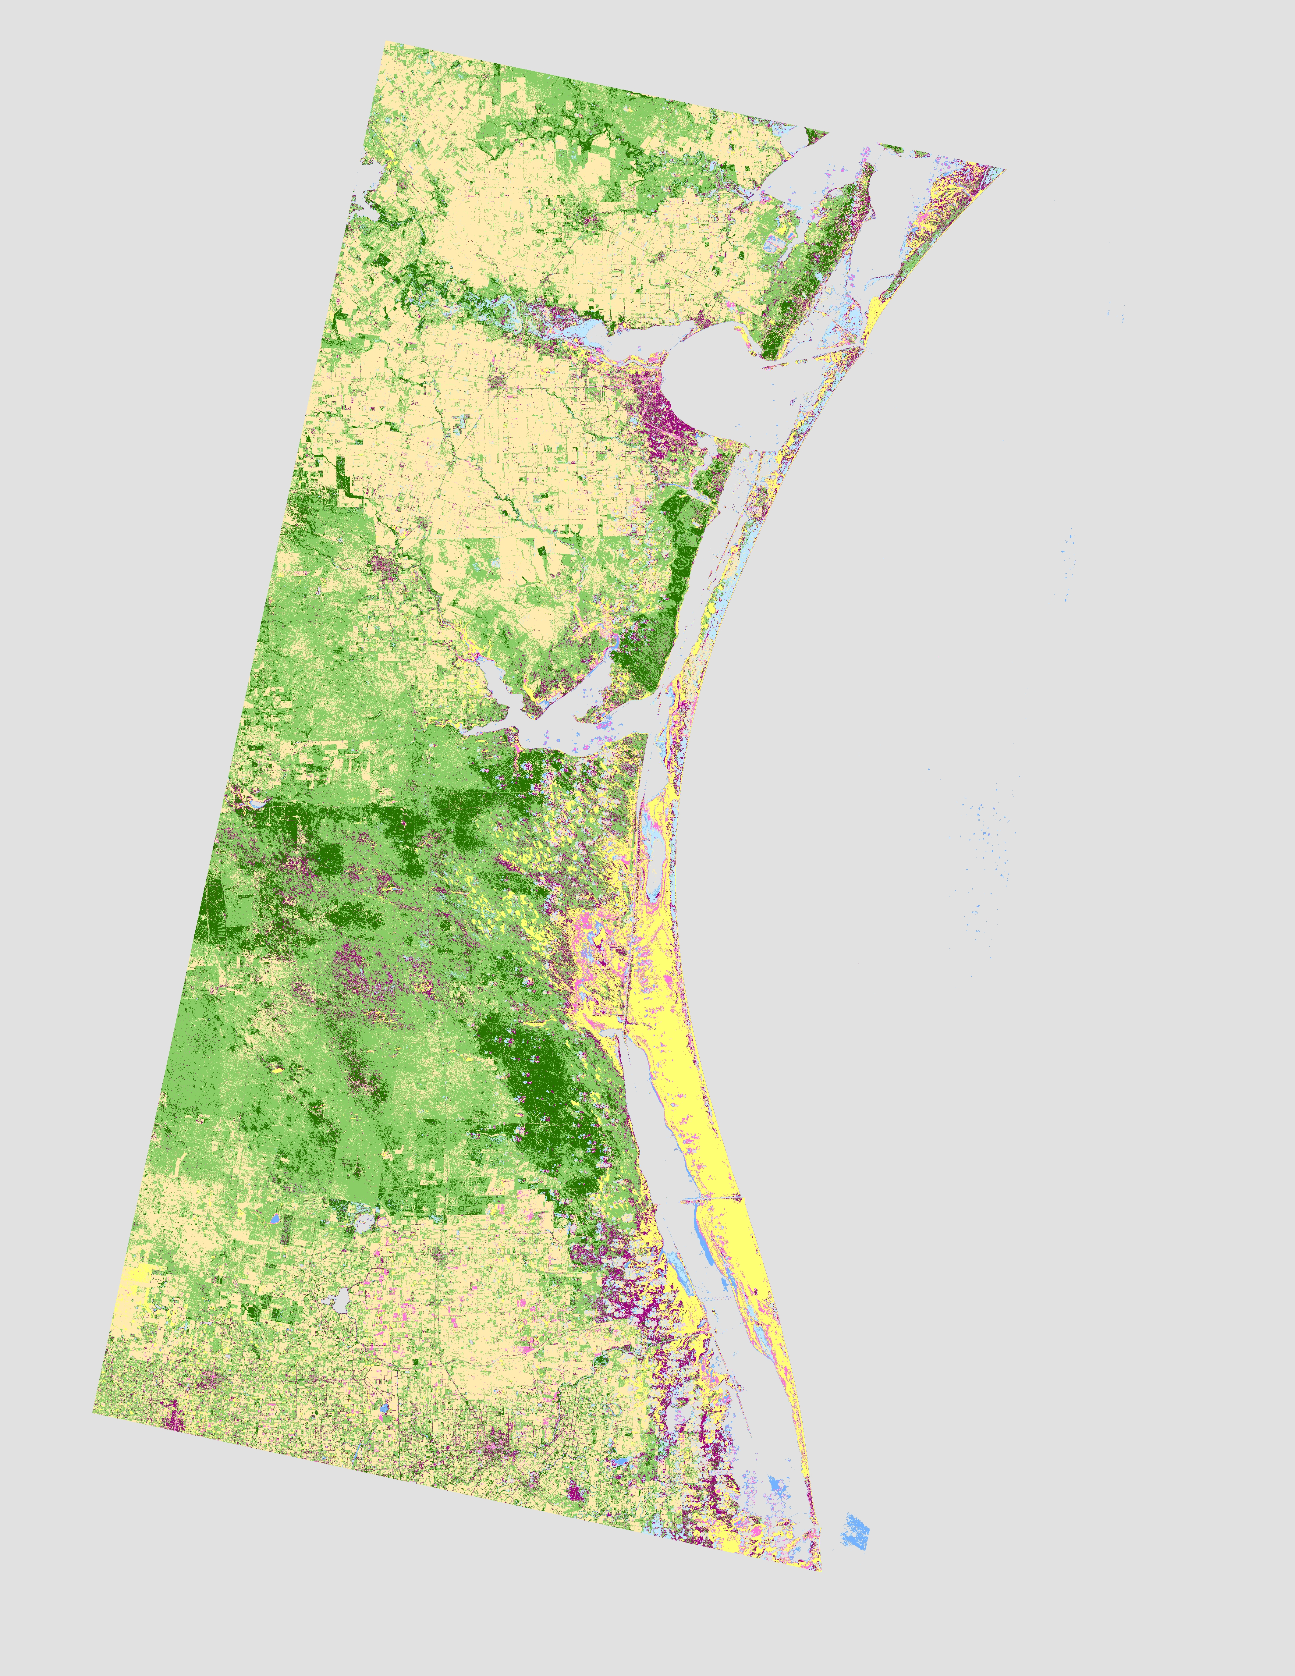
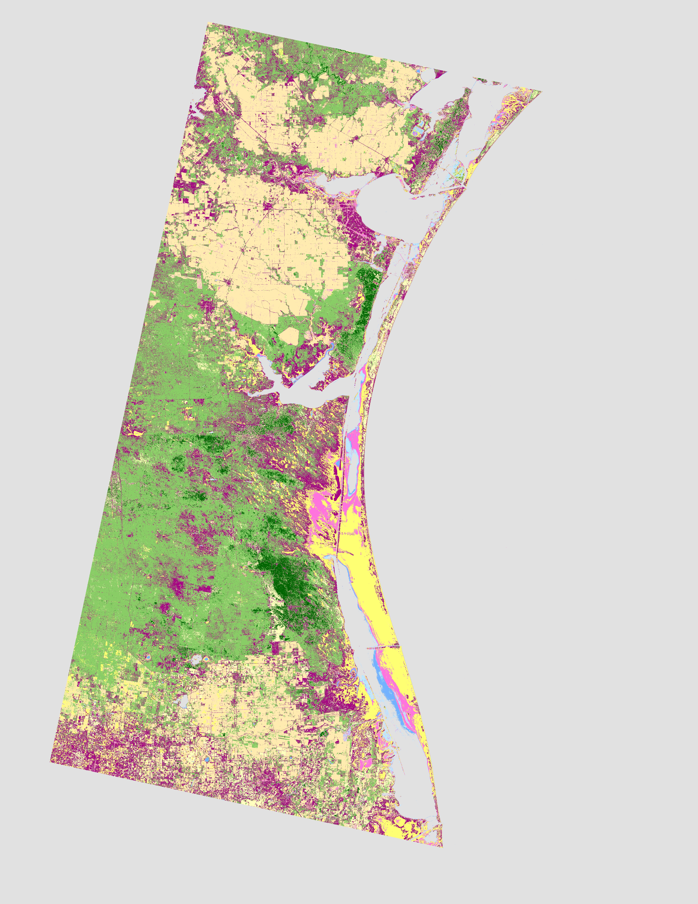
LULC Results
July 1986 LULC
September 2000 LULC
Notes:
The study area was classified into 8 different land cover types. The mesquite trees are shown in dark green. The mesquite tree coverage decreased from 1986 (641 km²) to 2000 (1,443 km²).

Slide 10
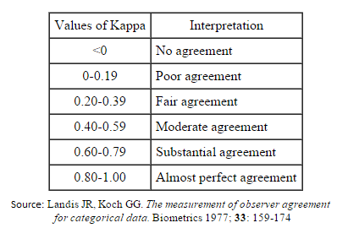
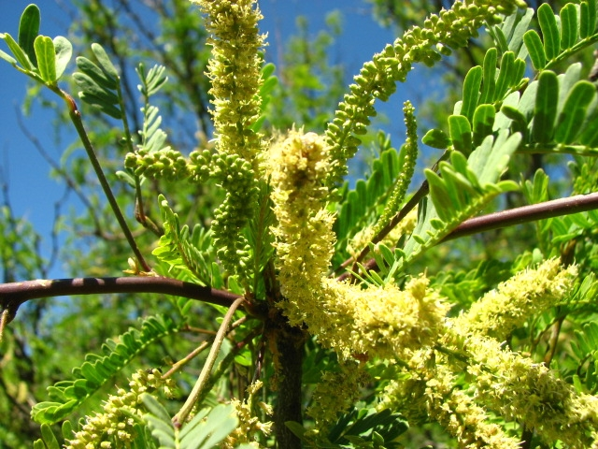
Accuracy Assessments
LULC - Accuracy Totals - Equalized Random
25 Points per Class
 | Overall Classification Accuracy | Overall Kappa Statistics | Mesquite Tree Class – Producer’s Accuracy | Mesquite Tree Class – User’s Accuracy | Mesquite Tree Class – Kappa Statistics
Jul 29, 1986 | 63.1 % | 0.59 | 80.8% | 84.0% | 0.82
Sep 5, 2000 | 58.9% | 0.53 | 48.7% | 86.4% | 0.84
Honey Mesquite Tree( Image credit: National Park Service)
Notes:
An accuracy assessment was run for each year of the land cover classification. The overall accuracy assessment for 1986 was 63% and the overall accuracy assessment for 2000 was 58.9%. Both overall Kappa statistics fell within the moderate agreement category. The Kappa statistics for the mesquite tree class, our class of interest, both fell with in the almost perfect agreement category.

Slide 11


Normalized Difference Vegetation Index (NDVI) Methodology
The NDVI indicates the photosynthetic activity of vegetation
Landsat 5 Bands 3 and 4
Band | Wavelength
Band 3 - Red | 0.63 µm – 0.69 µm
Band 4 – Near Infrared (NIR) | 0.77 µm – 0.90 µm
Notes:
The normalized difference vegetation index (NDVI) was calculated for each year corresponding to a land cover classification. The NDVI is the ration of the difference between bands 3 and 4 of the Landsat 5 satellite over the sum of these values. The resulting index indicates the photosynthetic activity of vegetation.

Slide 12
NDVI Results
July 1986 NDVI
July 1986 LULC
Notes:
Here we have the NDVI map from July 29, 1986 on the left. Areas of higher photosynthetic activity are shown in dark green. On the right we have the July 29, 1986 Land cover classification. The mesquite trees are shown in dark green. The areas of higher photosynthetic activity and mesquite tree coverage approximately correlate which suggests the mesquite trees are more photosynthetically active.
Notes:
The Landsat 5 data used to calculate the NDVI were from the same date as the data used for the LULC.
The first map shows the NDVI results for July 29, 1986
The second map shows the Land cover classification for July 29, 1986

Slide 13
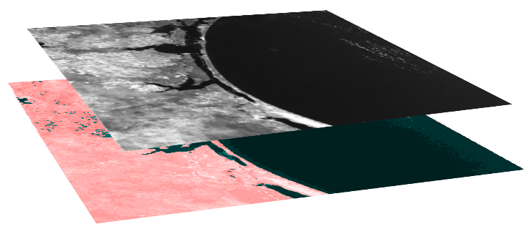

Normalized Difference Infrared Index (NDII) Methodology
The NDII indicates the water content in vegetation
Landsat 5 Bands 4 and 7
Band | Wavelength
Band 4 – Near Infrared (NIR) | 0.77 µm – 0.90 µm
Band 7 – Short Wave Infrared (SWIR) | 2.08 µm – 2.35 µm
Notes:
The normalized difference infrared index (NDII) was also done for years corresponding to the landcover classification. Landsat 5 bands 4 and 7 were used. The NDII is the ratio of the difference between the Near Infrared Band (band 4) and the Short Wave Infrared (band 7) over the sum of these values. The NDII indicates the water content of vegetation.

Slide 14
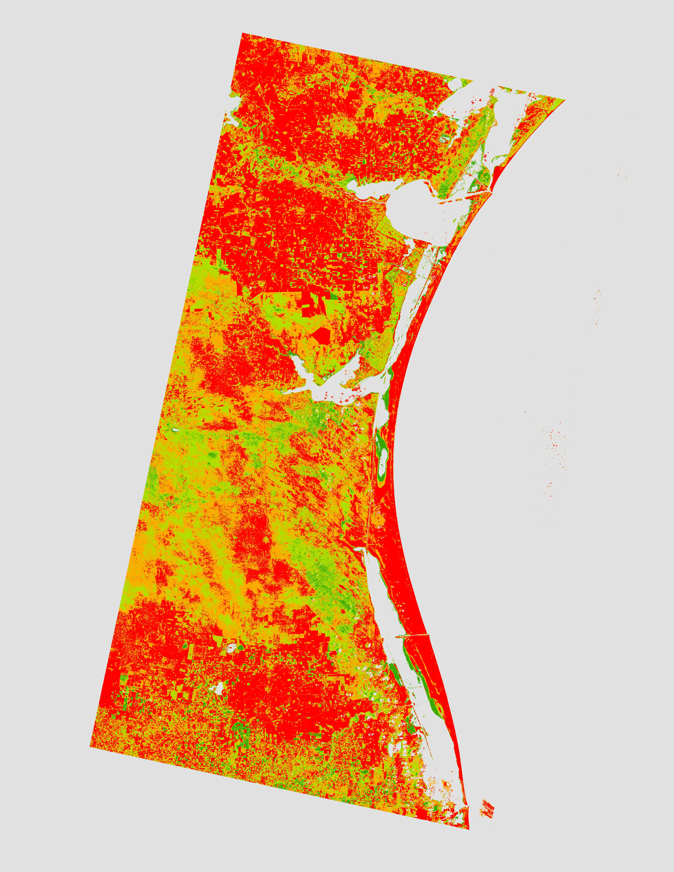
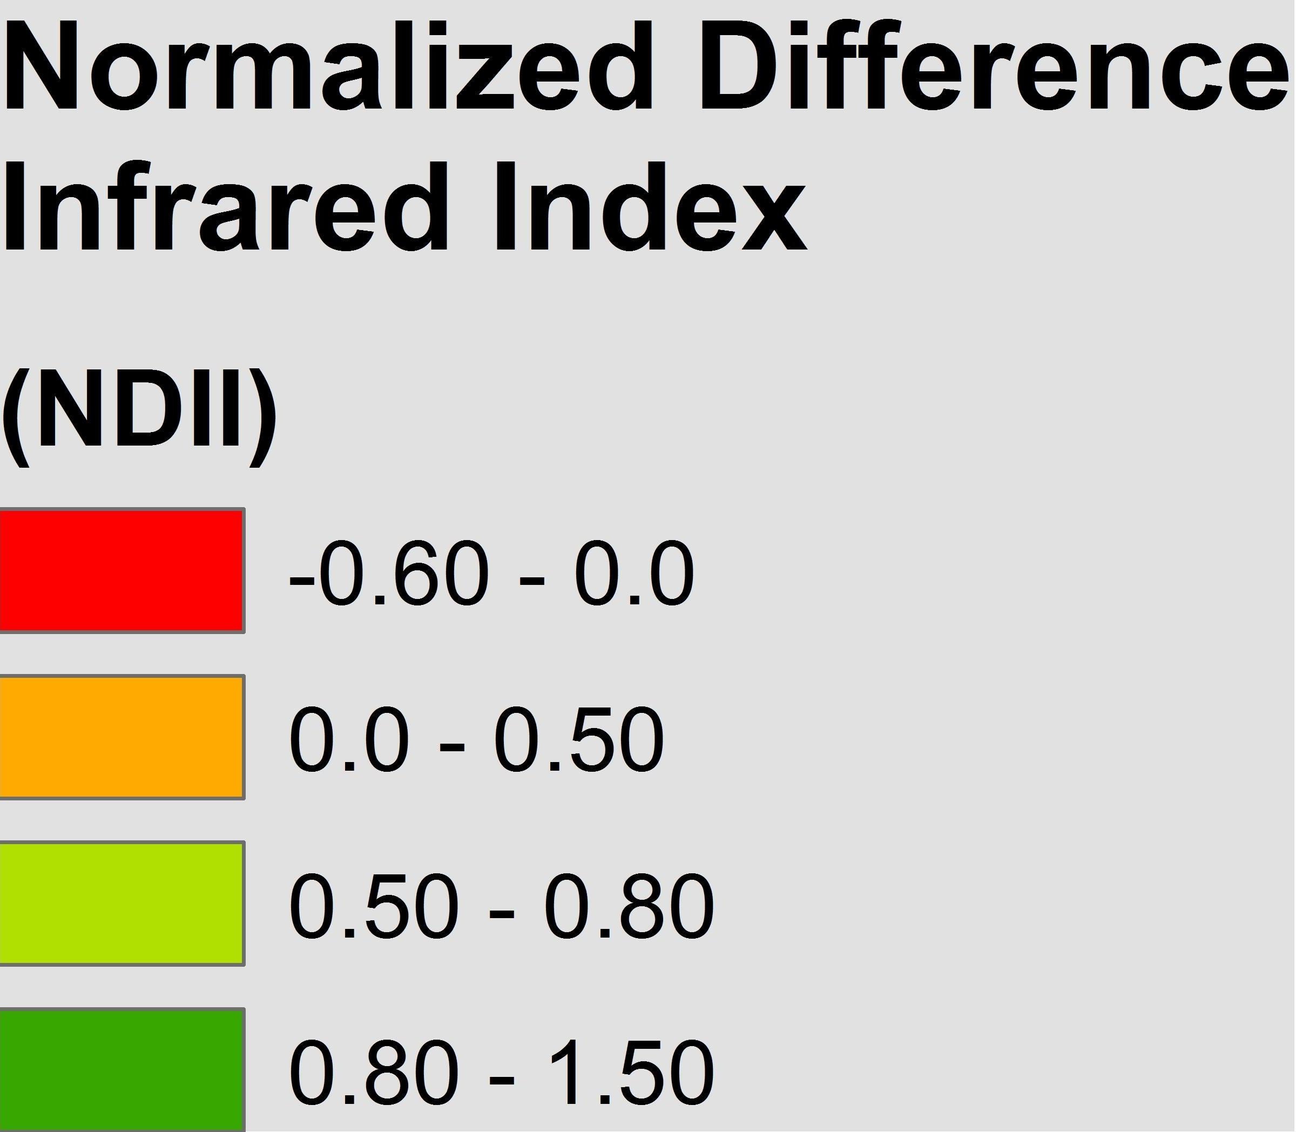
NDII Results
July 1986 NDII
July 1986 LULC
Notes:
Here we have the NDII map for July 29, 1986 and the land classification for the same data. The areas of low vegetation stress or high water content are shown in green. These areas approximately align with the mesquite tree coverage shown in dark green indicating the mesquite trees are able to access water while nearby vegetation cannot.

Slide 15
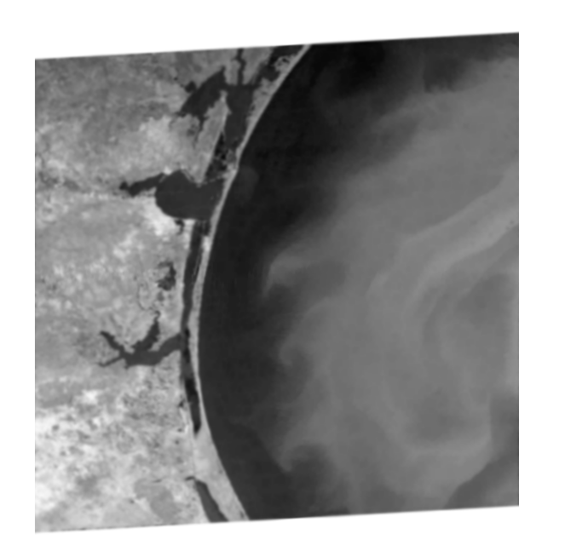
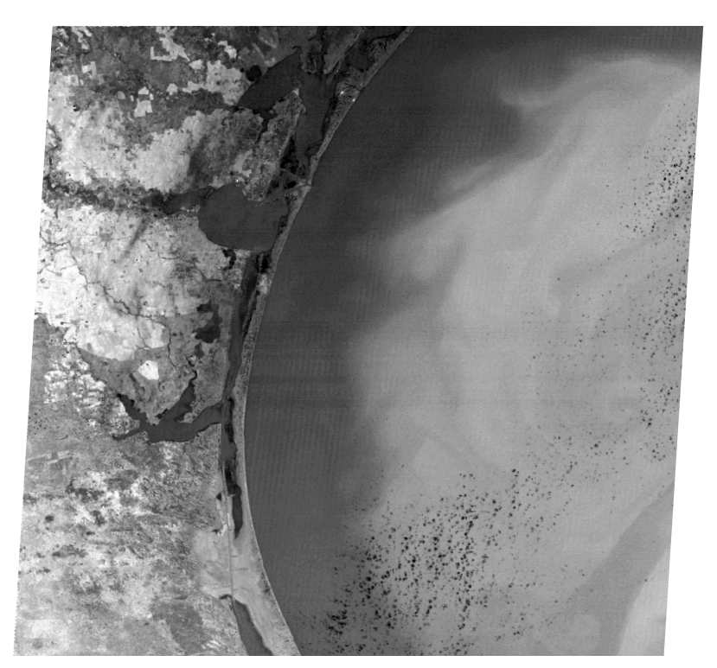
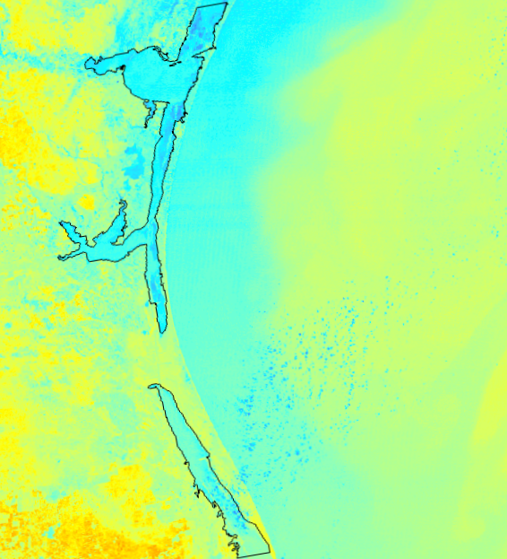
Thermal Analysis Methodology
Landsat 5 Band 6
Convert DN to TOA Radiance
Extract the Laguna Madre and convert temperature to Celsius
Mask out clouds and land
Notes:
Thermal analyses were done to determine the location of freshwater inflow to the lagoon. Landsat 5 (TM) band 6 was converted from the digital number to TOA radiance using a python script. Then, the clouds were masked out using another script. Next, an unsupervised classification was run using stacked bands 4,3,2 of Landsat 5 (TM) in ERDAS IMAGINE. Next a land mask was created using a supervised classification and all land was masked out. Following this step, just the lagoon was extracted to exclude water temperatures from the Gulf of Mexico and lastly, the surface temperature of the lagoon was converted to Celsius. These steps were performed on five pairs of dates that were chosen based on in situ precipitation data. The first date was chosen during the mesquite tree’s growing season, the other when the trees are dormant.

Slide 16
Thermal Analysis Results
Dormant
Season
Growing
Season
Using visual analysis, some anomalies were found
In ArcMap, a “hot spot” analysis tool that uses the Getis-Ord (Gi*) statistic was applied
Some anomalies were found, but were inconclusive
Notes:
Each thermal raster was uploaded into ArcMap for analysis. First the team did a visualization analysis of the thermal images to locate anomalies. Some were found, but the source was inconclusive and the hotspot regions were not consistent throughout the study period. The team resampled the pixel size from 30 m to 90 m in order to change the raster into a point layer. After changing it to a point layer we ran the hotpot analysis tool using the Getis-Ord (Gi*) statistic. However, no significant anomalies were found.

Slide 17
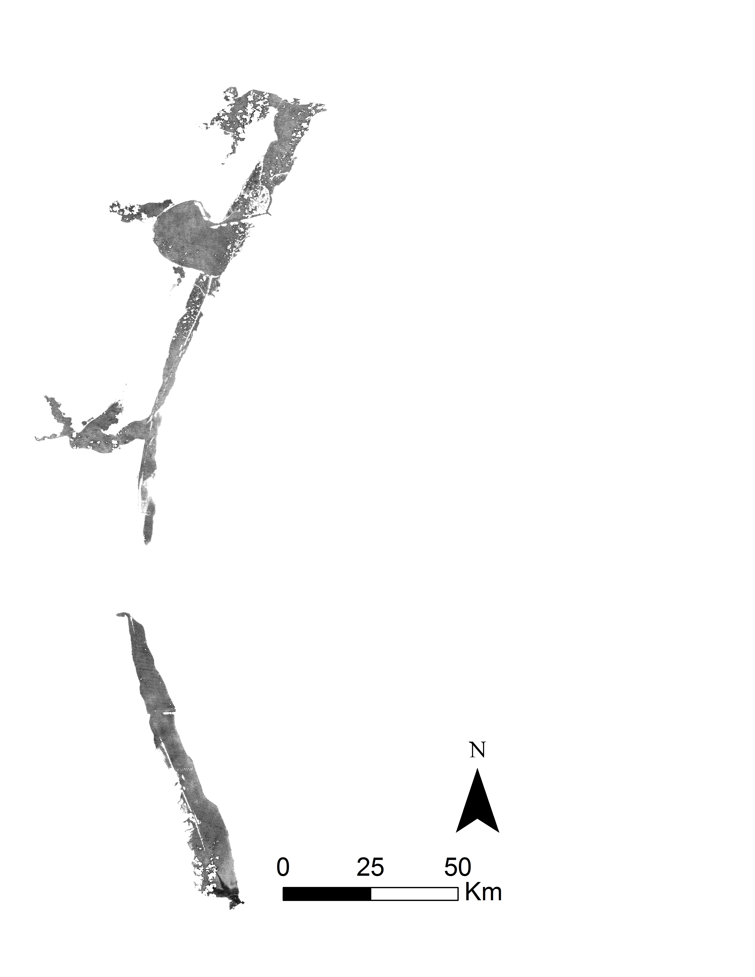
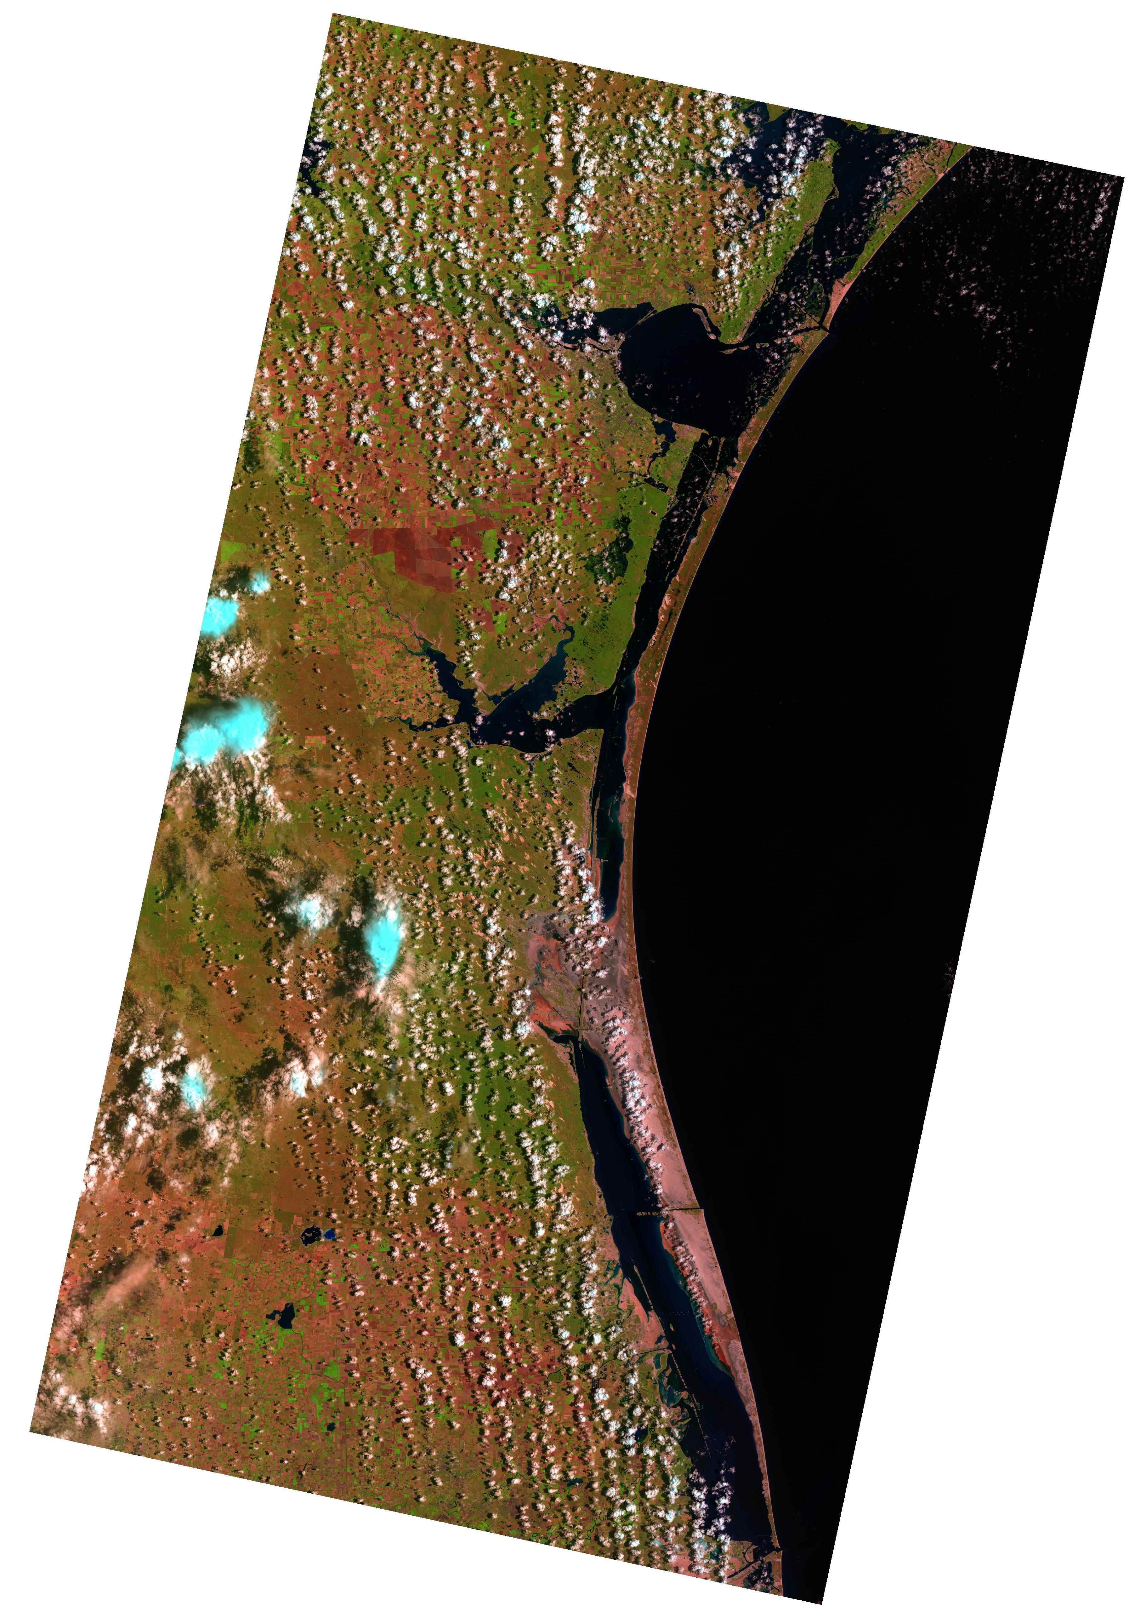
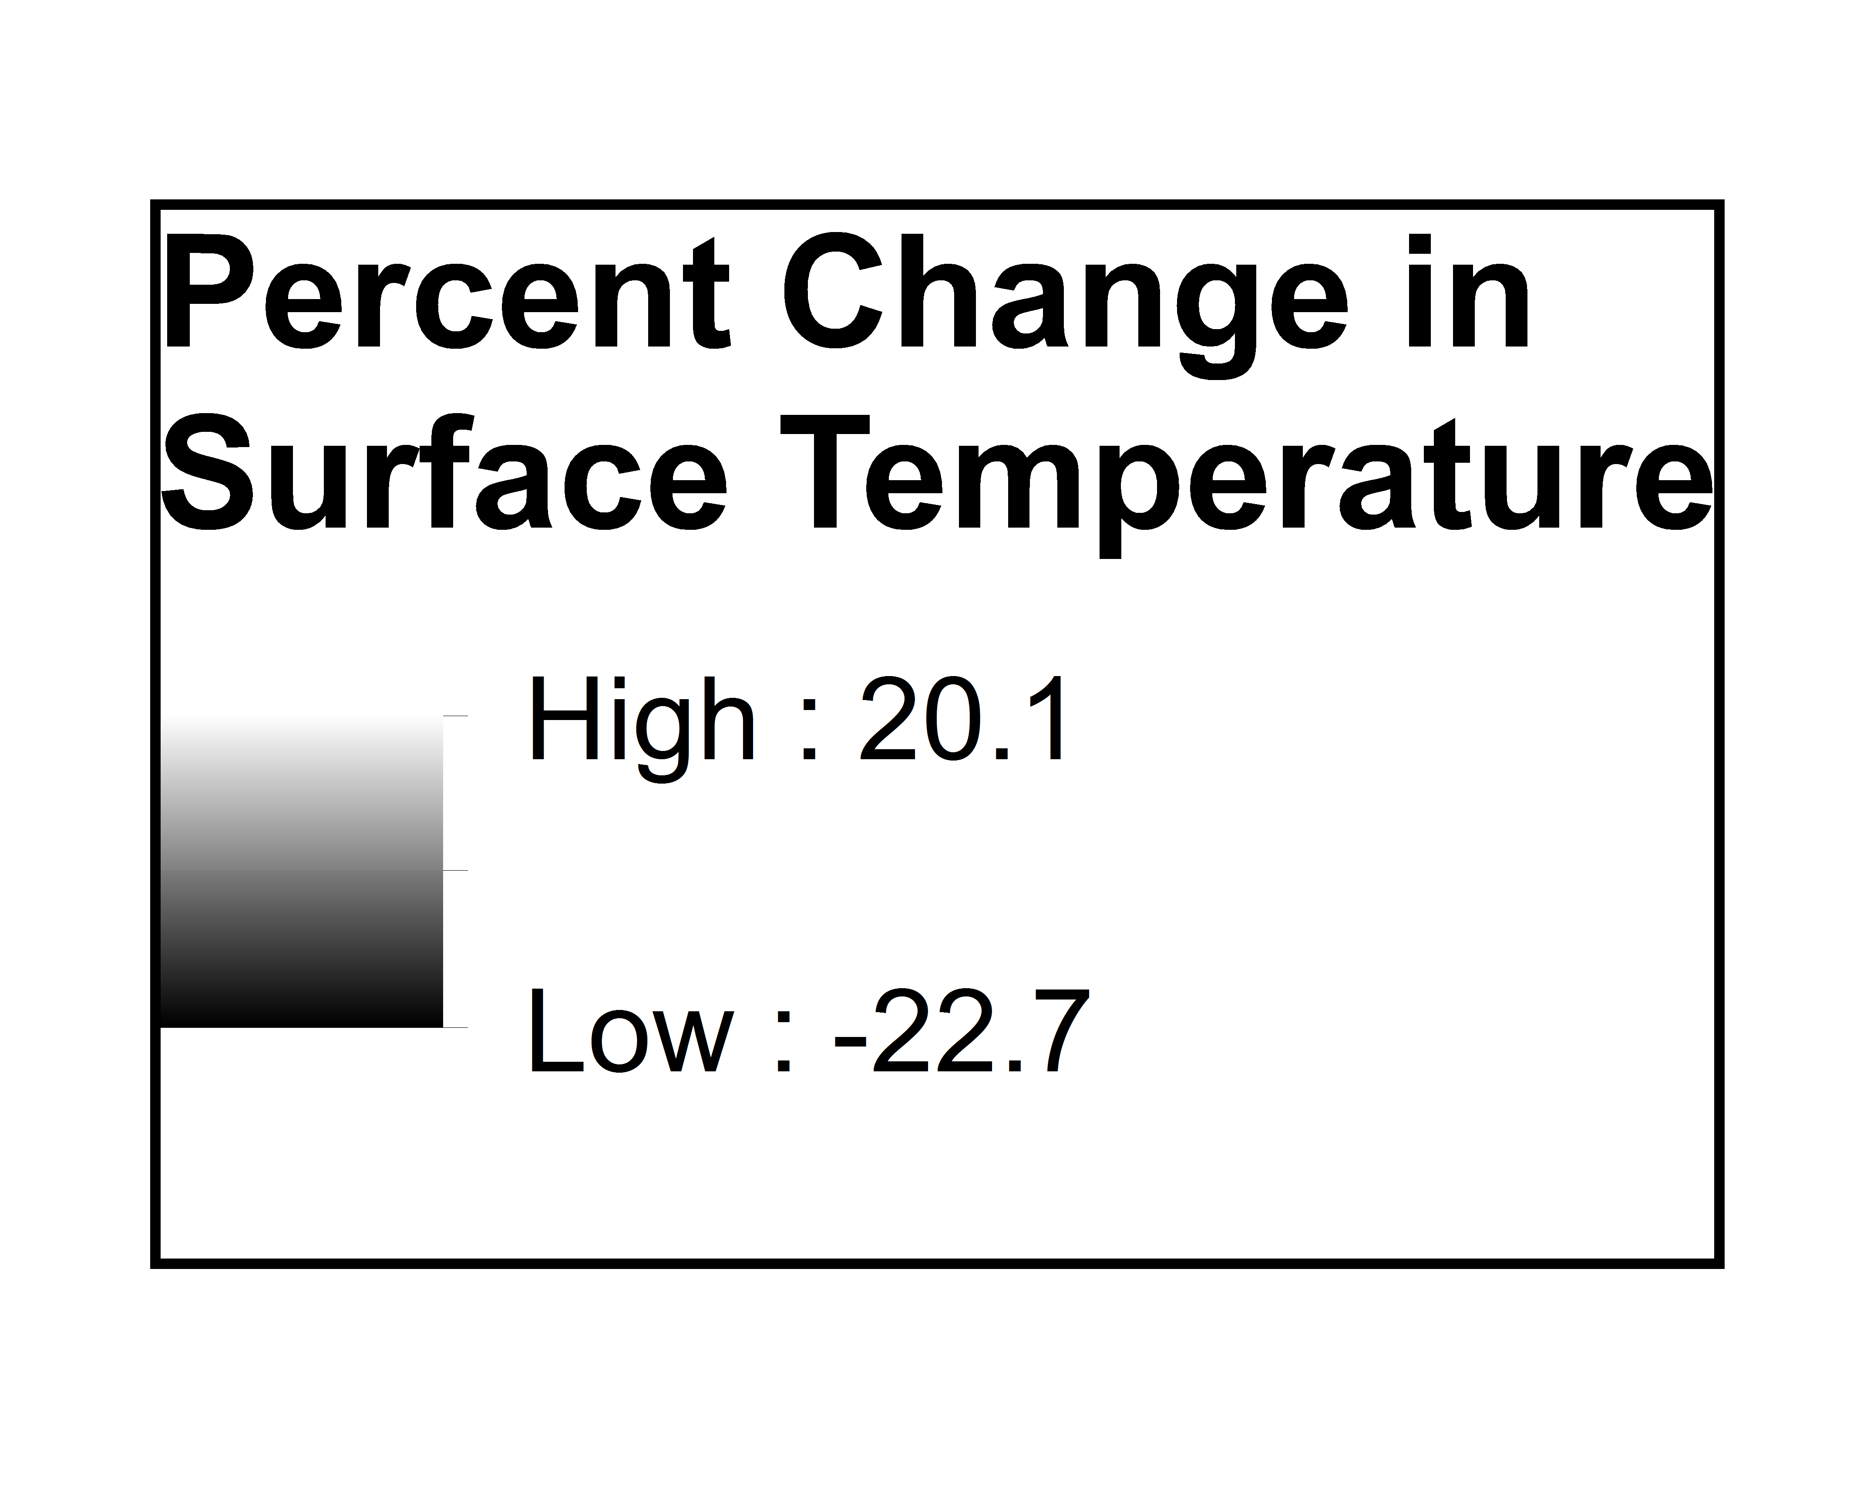
Thermal Analysis Results
Finally, a change detection using “Spatial Modeler” in ERDAS Imagine
A percent change in the surface temperature was calculated using the global mean temperature
The data was then normalized using the global mean
July 1992
Notes:
A third method to analyze thermal data was done through a change detection which was done by using the “Spatial Modeler” in ERDAS IMAGINE. The background data was removed by a conditional statement that only kept data points ranging in value from 0 to 100 degrees Celsius. These values were chosen based on knowledge of the climate in Texas. It was assumed that the temperature of the water would not go below 0°C or above 100°C. The percent change in the surface temperature of the lagoon was calculated by taking ambient temperature, or global mean temperature, and subtracting it from the raster data for each date of thermal data. Then the result was divided by the global mean temperature and multiplied by 100 to calculate the percent change. This equation normalized the data using the global mean temperature.

Slide 18
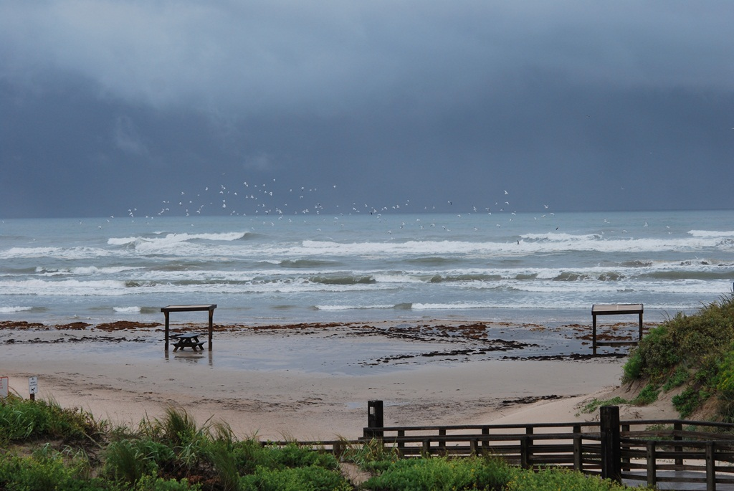
Errors, and Uncertainties
LULC mapping errors were related to the data resolution
Some LULC mapping errors occurred due to misclassification
The coarse thermal data reduced ability to view patches
The shallowness of the lagoon may affect thermal data quality
Padre Island National Seashore (Image Credit: National Park Service)
Notes:
Due to limitations of the data there are several errors and uncertainties. There were errors in land cover classification due to the resolution of the data. Mixed pixels may have resulted in inaccurate classification of some land cover types. Additionally, class confusion occurred between classes with similar spectral responses. Uncertainties in the thermal analyses occurred due to resampling the data to a coarser resolution. This may have affected the team’s ability to detect thermal anomalies. Lastly, due to the shallowness of the lagoon, it is easily affected by climatic conditions including precipitation, cloud cover and air temperature.

Slide 19
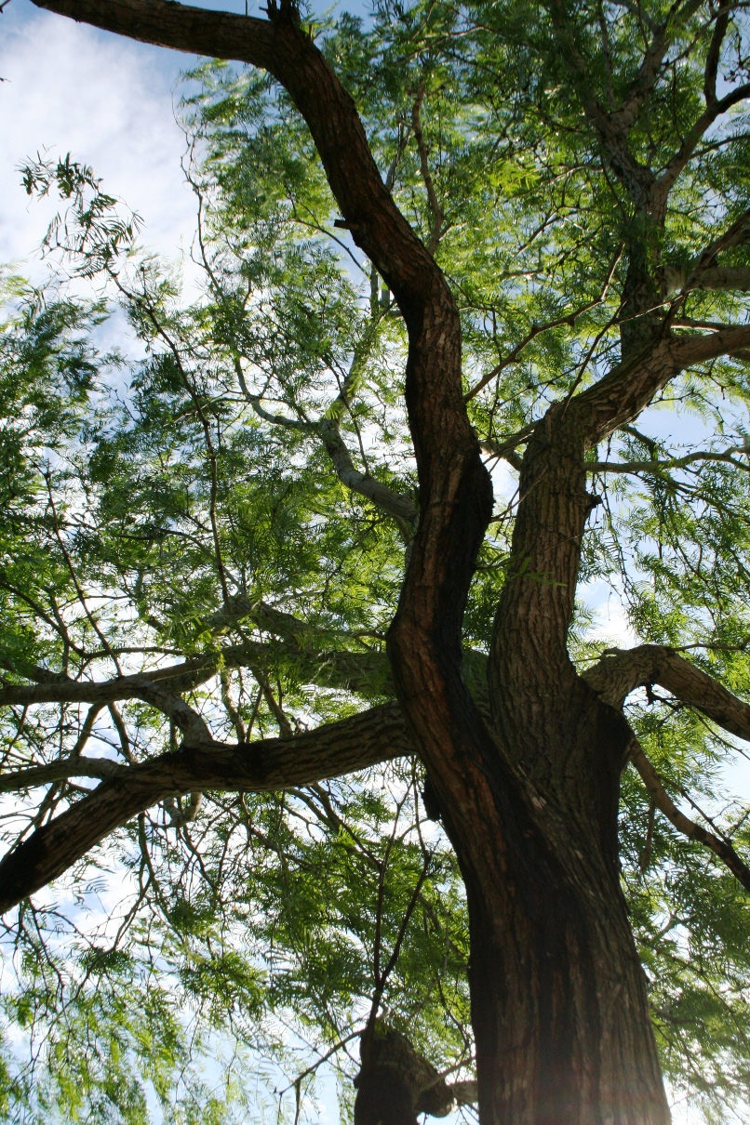
Conclusions
Mesquite tree areas decreased from 1986-2000
Areas of high photosynthetic activity (NDVI) and low water stress (NDII) correlated with areas of mesquite
Lagoon thermal anomalies were not identified
Honey Mesquite Tree( Image credit: National Park Service)
Notes:
From 1986 to 2000 the area of mesquite tree coverage increased. These areas of coverage identified in the land cover classification correlated with areas of high photosynthetic activity shown in the NDVI, and areas of low stress or higher water content identified by the NDII. No thermal anomalies were identified in the surface temperature of the Laguna Madre but analyses will continue.

Slide 20
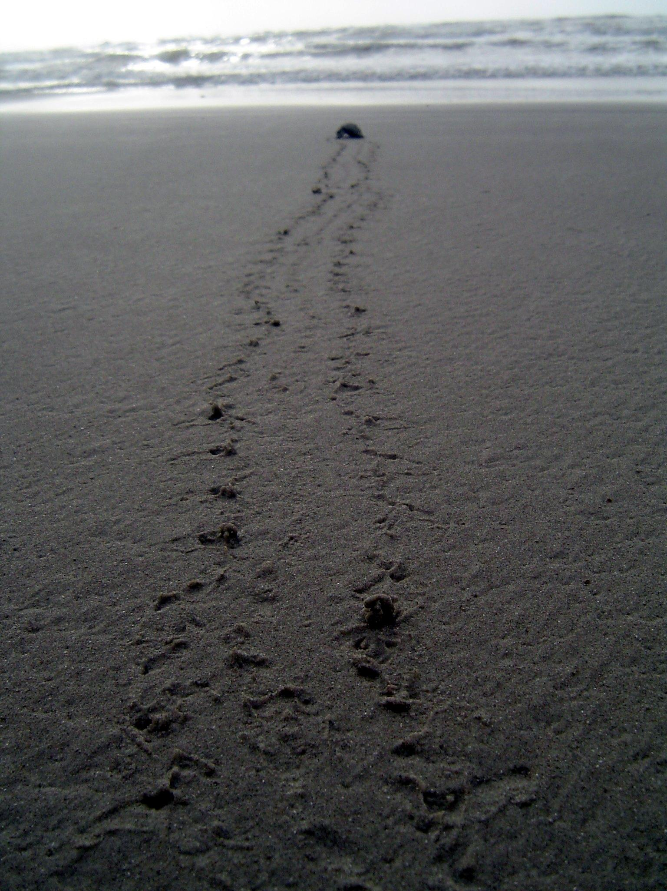
Future Work
Analyze the effects of precipitation and evapotranspiration rates on the lagoon’s salinity
Research the direction of groundwater flow in the region
Investigate the effects of different climatic conditions
Sea Turtle on Beach (Image Credit: National Park Service)
Notes:
The Laguna Madre is a very shallow body of water and is therefore very susceptible to changes due to environmental factors. Future work will be done to analyze the effects of precipitation and evapotranspiration rates on the salinity of the Laguna Madre. Additional research on the direction of groundwater flow in the area will be done focusing on the effects of precipitation on the hydraulic gradient. Lastly, as before mentioned, the lagoon is easily altered because of the shallowness so more investigation in to the effects of changing climatic conditions will need to be done.

Slide 21
Advisors
Joe Spruce (NASA Stennis Space Center)
Dr. Kenton Ross (NASA Langley Research Center)
Partners
Joe Meiman (National Park Service)
Dr. Dorina Murgulet (Texas A&M University, Corpus Christi)
Others
Dr. Bernard Eichold, M.D., Dr. PH – Mentor (Mobile County Health Department)
Summer 2015 Coastal Texas Water Resources Team: Georgina Crepps, Tyler Lynn, Rodrigo Pereira da Silva, Ryan Schick
Notes:
We would like to thank our advisors Joe Spruce and Dr. Kenton Ross, our partners Joe Meiman (NPS) and Dr. Dorina Murgulet (Texas A&M University - Corpus Christi) as well as our mentor Dr. Bernard Eichold and the DEVELOP National program summer 2015 Coastal Texas Water Resources Team.

