Slide 1
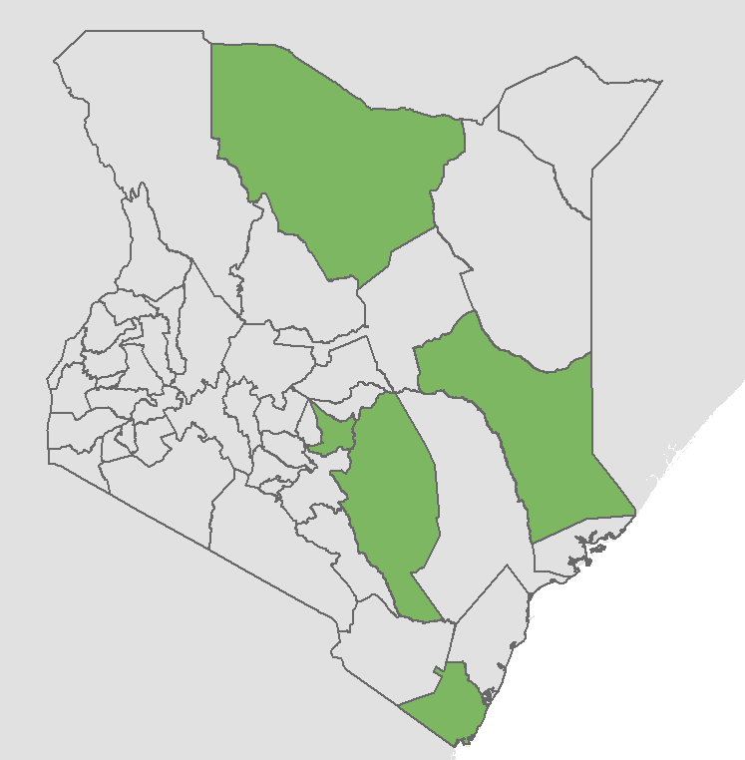
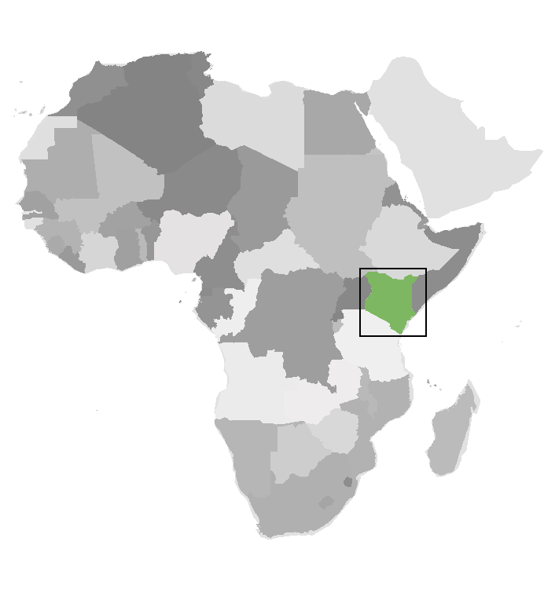
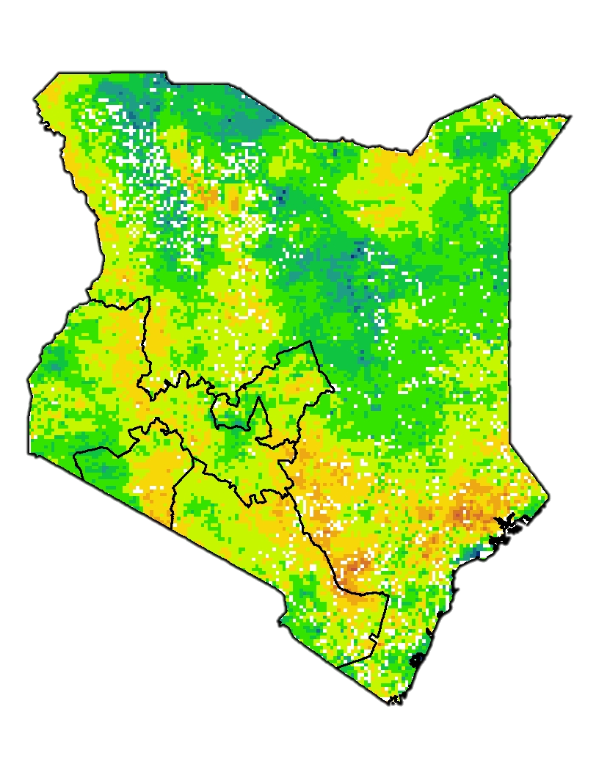
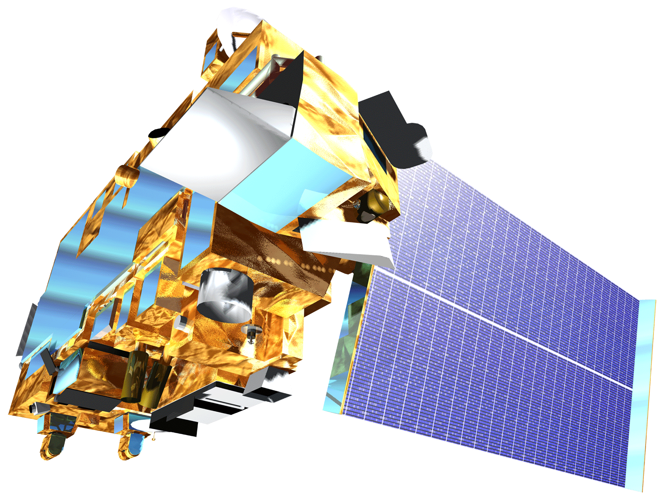
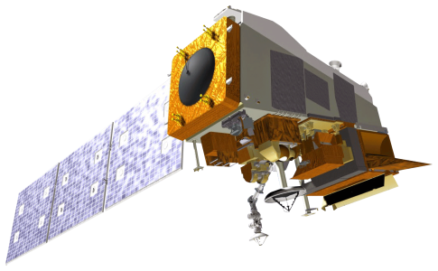
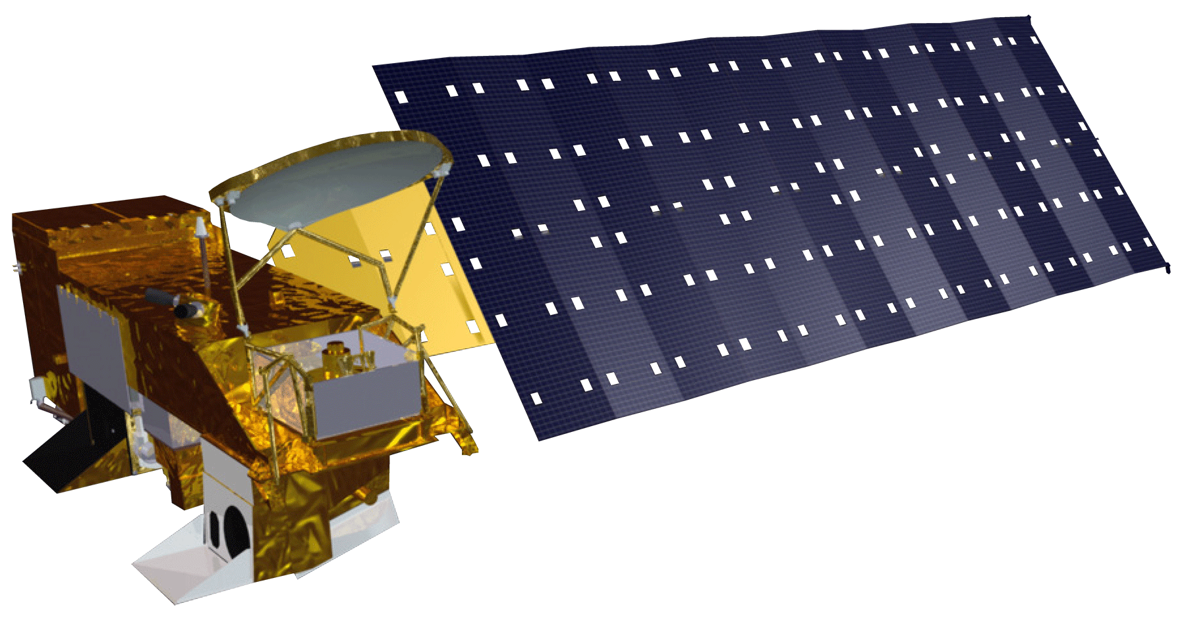
Using NASA Earth Observations to Enhance Drought Warning Systems and Develop Capacity to Use the RHEAS Model in Kenya
Abstract
Study Area
Kenya Food Security & Agriculture II
Twenty-three counties in Kenya experience frequent drought, which damages agricultural productivity and threatens the health and wellbeing of millions. NASA DEVELOP partnered with NASA SERVIR, the Regional Centre for Mapping of Resources for Development (RCMRD) and Kenya’s National Drought Management Authority (NDMA) to enhance drought-detection capacity using NASA Earth observations. Currently, the NDMA publishes monthly Early Warning Bulletins with drought conditions for each arid or semi-arid county in Kenya. These bulletins utilize the Vegetation Condition Index (VCI) from the Moderate Resolution Imaging Spectroradiometer (MODIS) as well as a variety of biophysical, social and economic drought indicators, but do not allow for advanced forecasting. To improve drought-monitoring capabilities, the team created a Combined Drought Indicator (CDI) using the Regional Hydrologic Extremes Assessment System (RHEAS) model, Aqua and Terra MODIS and the National Centers for Environmental Prediction (NCEP). The CDI combined precipitation anomalies, soil moisture anomalies, evaporative stress and VCI according to weights determined by principal component analysis. To evaluate the performance of the CDI across Kenya, the team compiled a dataset of drought events from historical reports and the NDMA’s records. Results suggested that the CDI detected drought earlier than VCI alone. However, more validation is needed to ensure that the CDI accurately and consistently detects drought earlier than current warning systems. In order to better understand the behavior of individual indices and the potential for earlier drought detection, the team also conducted a time-lag analysis. The team found that VCI responds to drought, on average, one month later than most other indices included in the CDI, suggesting that incorporating additional indices could improve early drought warning systems in Kenya.
Marsabit
Garissa
Kitui
Embu
N
0 125 250 500 km
Kwale
Objectives
Results
Study Area: Five case study counties in Kenya
Develop a Combined Drought Indicator for the NDMA
Utilize outputs from the RHEAS model and NASA earth observations to develop drought indices
Analyze the time lag between the different drought indices and create a time lag assessment
Produce a story map that can be used for outreach
Combined Drought Indicator
March 2017
Time Lag Assessment
Comparison | Time Lag | Average Pearson’s Correlation Coefficient
 |  | Arid | Semi-Arid
SPI vs SMA-1 | SMA-1 +0 months | 0.9 | 0.81
SPI vs SMA-2 | SMA-2 +1 months | 0.18 | 0.52
SPI vs SMA-3 | SMA-3 +2 months | 0.37 | 0.46
SPI vs ESI | ESI +1 month | 0.63 | 0.62
SPI vs VCI | VCI +1 month | 0.58 | 0.52
SMA-1 vs VCI | VCI +2 months | 0.61 | 0.49
SMA-2 vs VCI | VCI +0 months | 0.58 | 0.63
SMA-3 vs VCI | VCI -1 month | 0.6 | 0.61
ESI vs VCI | VCI +0 months | 0.78 | 0.77
Alarm
Earth Observations & Methodology
Aqua MODIS
Terra MODIS
Suomi NPP VIIRS
Alert
Alarm
Alert
Drought Severity
RHEAS Model
AppEEARS
ClimateSERV
Dry Wet
CDI and Rainy Seasons Time-Series
NDVI
SPI
SMA
VCI
ESI
monthly
monthly
monthly
monthly
PCA Analysis
CDI
Project Partners
monthly
Conclusions
National Drought Management Authority (Kenya)
NASA SERVIR Science Coordination Office
Regional Centre for Mapping of Resources for Development (RCMRD)
The time lag assessment suggests potential to detect drought much earlier than current systems based on VCI alone.
Our CDI’s performance suggests that some drought indices function better in semi-arid counties than arid counties.
While there is room to improve current drought warning systems, the current CDI did not appear to detect drought significantly earlier than VCI.
Team Members
Acknowledgements
We would like to thank our advisors Dr. Jeffrey Luvall and Dr. Robert Griffin for mentorship and our DEVELOP Fellow A. R. Williams for her guidance. We also would like to thank our collaborator at RCMRD Lilian Ndungu and our partner at NDMA Nelson Mutanda for their continued support throughout the project. We would also like to thank our collaborators at NASA SERVIR Dr. Lee Ellenburg, Emily Adams, Dr. Vikalp Mishra, and Sara Miller for their advice throughout the project. We would also like to thank our mentors Helen Baldwin, Christine Evans, and Madison Murphy for their advice and mentorship. We would also like to thank the team members Ryan Good, Ryan Marshman, Amanda Tomlinson, Chiara Phillips from first term of this project for their work.
Samuel Tatum
Project Lead
Caley Feemster
Jennifer Heeth
Sabine Nix
Alabama – Marshall⁠
From

