Slide 1
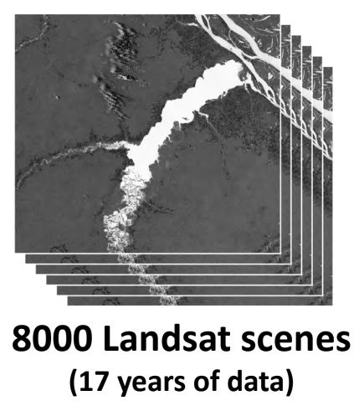


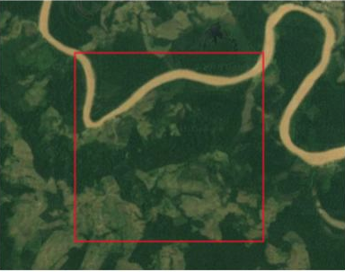
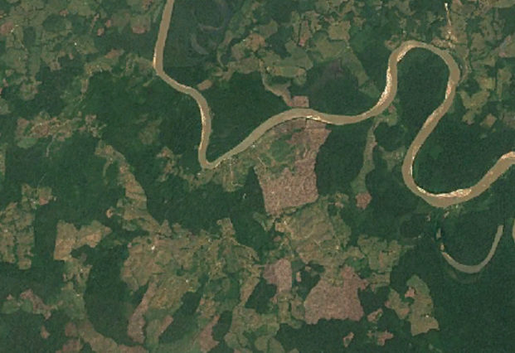
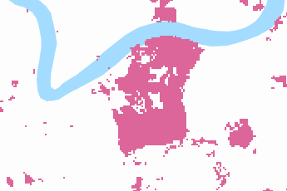
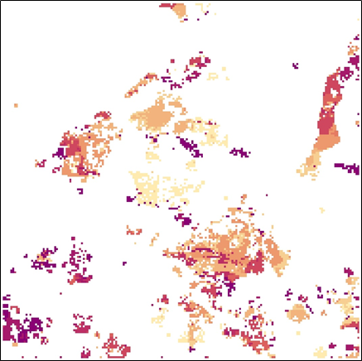
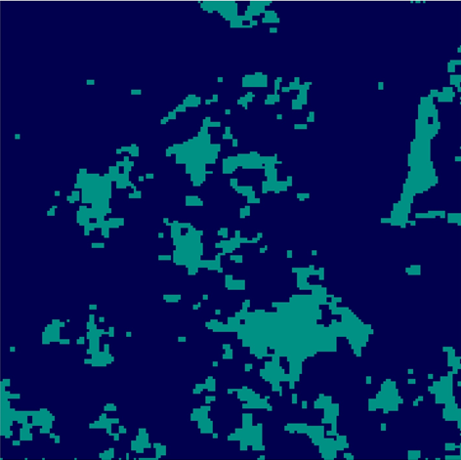

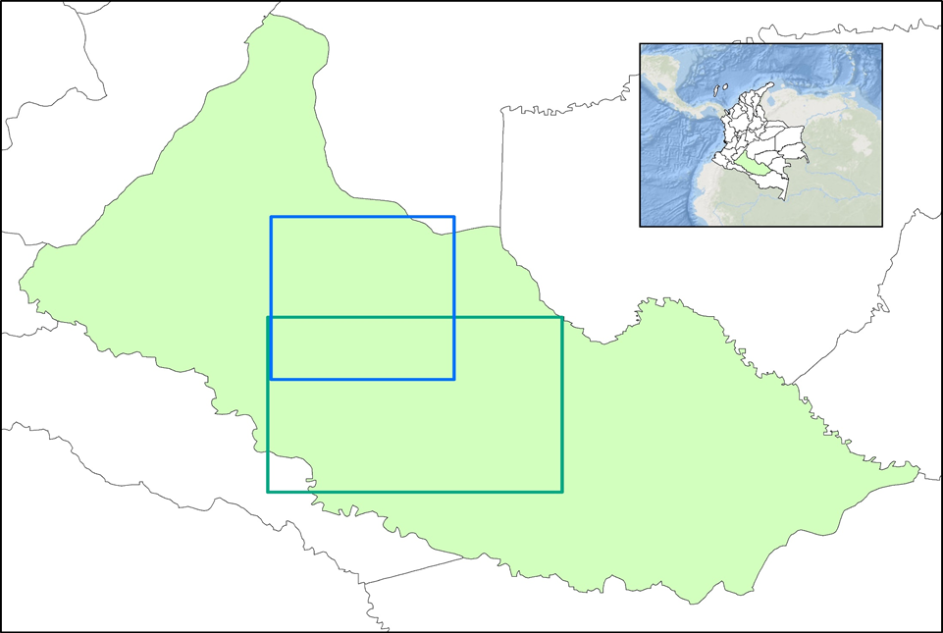
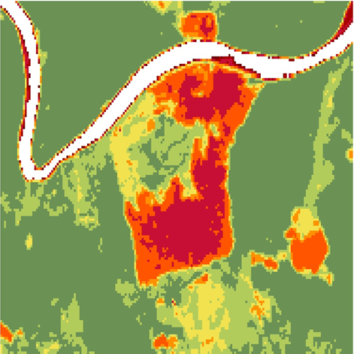
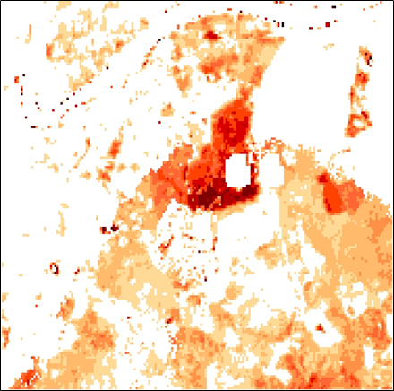
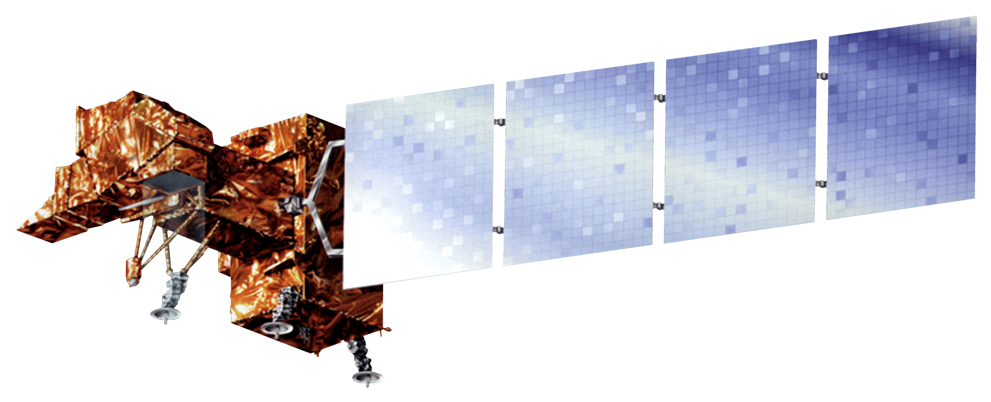
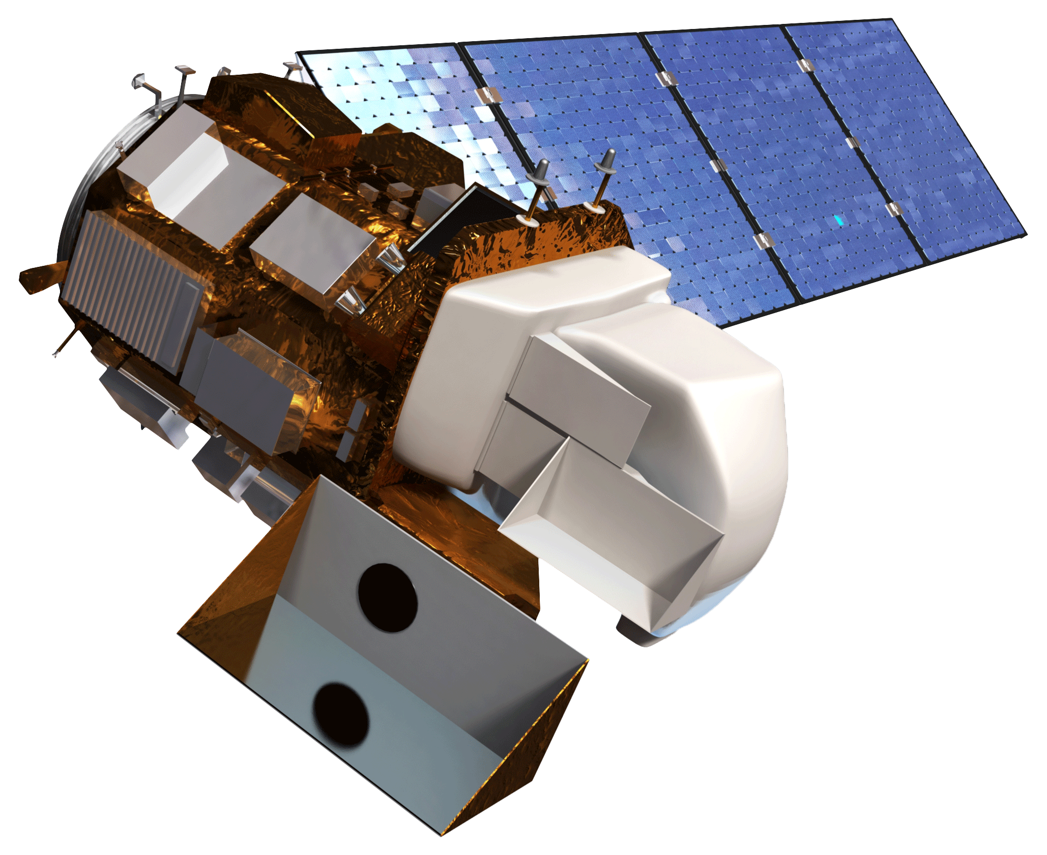
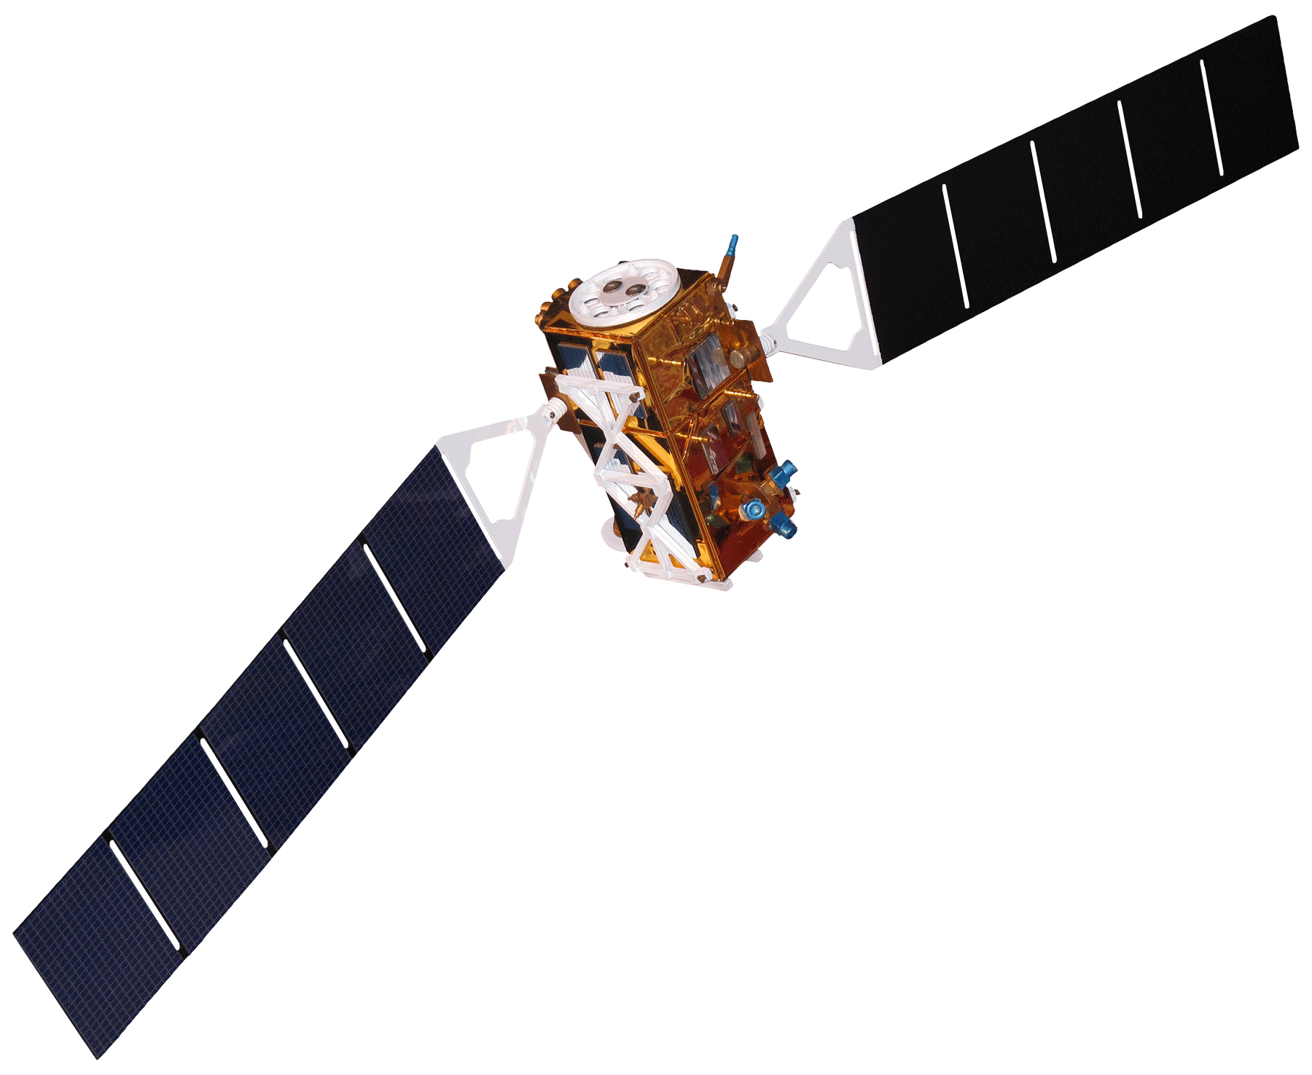






Testing the Effectiveness of the Open Data Cube on Augmenting Deforestation Analysis in Caquetá, Colombia
Abstract
Methodology
Colombia contains a variety of endemic species, making it one of the most biodiverse regions in the world. Due to a recent peace treaty between the Revolutionary Armed Forces of Colombia (FARC) and the Colombian government, Colombia’s rainforest has become more vulnerable to illegal deforestation. This is especially true within the department of Caquetá, located in the southwestern portion of the country. With satellite data becoming more widely available, the Committee on Earth Observation Satellites (CEOS), working directly with the Colombian Institute of Hydrology, Meteorology, and Environmental Studies (IDEAM), has developed the Colombian Data Cube. Using compiled images from Landsat 7 Enhanced Thematic Mapper (ETM+), Landsat 8 Operational Land Imager (OLI), Advanced Land Observing Satellite (ALOS), and Sentinel-1 Synthetic Aperture Radar (SAR) the Colombian Data Cube allows for access to analysis ready satellite imagery without large downloads or processing requirements. The NASA DEVELOP team, working alongside with the University of Andes and IDEAM, aimed to utilize the Colombia Data Cube by refining land change algorithms and vegetation indices to validate field data provided by IDEAM, as well as optimizing their respective interfaces. The results of this project will be useful to IDEAM’s mission to help monitor deforestation hotspots and assist their government with developing strategies to combat deforestation. Additionally, the University of Andes can use this project as an educational tool to teach students about the Colombian Data Cube and its many applications, including deforestation. This project will also be valuable as a case study for other countries looking to develop the Open Data Cube and apply important NASA data to local issues.
Earth
Observation
Acquisition
Landsat 7 ETM+
Landsat 8 OLI
Sentinel 1 C-SAR
Open Data Cube
Colombian Data Cube
NDVI Anomaly
NDVI STD
PyCCD
z
PCA
End Products
Project Partners
8x Data Compression
The Committee on Earth Observation Satellites (CEOS)
The Colombian Institute of Hydrology, Meteorology, and Environmental Studies (IDEAM)
University of Andes
8000 Landsat Scenes
(17 Years of Data)
1000 Data Cube Storage Units (1° x 1° x 1yr)
1000 Data Cube storage units (1°x 1° x 1° yr)
Results
Objectives
Analysis Area-Google Earth 2015
Analysis Area-Google Earth 2016
Global Forest Watch for Analysis Area 2015-2016
Support IDEAM in its desire to increase their capacity for using satellite data to assess deforestation within the region of Caquetá
Assess the Colombian Open Data Cube’s land change detection algorithms and their potential for detecting deforestation
Validate the results with documented deforestation locations provided by IDEAM
Deliver a technical and analytical report that will assist IDEAM in effectively utilizing their Open Data Cube to detect deforestation
PyCCD Time of Change
PyCCD Land Change
Study Area
No Change
Change
Data Cube Extents in Caquetá
Caquetá
Colombia
NDVI Standard Deviation
NDVI Anomaly
Sentinel Extent
Landsat Extent
Earth Observations Used
Landsat-7 ETM+ Landsat-8 OLI Sentinel-1 C-SAR
Algorithm | PyCCD | NDVI STD | NDVI Anomaly
Accuracy Score (F-Score) | 0.16 | 0.81 | 0.85
Team Members
Conclusions
The Colombian Data Cube allowed for faster and more efficient analyses of satellite imagery.
The NDVI STD, NDVI anomaly, and PyCCD were all able to detect areas of deforestation in Caquetá.
NDVI STD had the highest accuracy of the algorithms tested and was the most efficient algorithm in terms of processing time and results generated.
High percentages of cloud cover within the study region of Caquetá created issues with region wide analysis and results.
Ryan Theurer
Project Lead
William Crowley
Project Member
Megan Link
Project Member
Shaifali Prajapati
Project Member
Thomas Richards
Project Member
Acknowledgements
Dr. Kenton Ross (NASA Langley Research Center)
Dr. Brian Killough (NASA Langley Research Center)
Colombia Ecological Forecasting
Virginia-Langley | Summer 2018

