Slide 1
CALIPSO Cross-Cutting III
Interacting with CALIPSO Data Through a
Graphical User Interface
Kathleen Moore (Project Lead)
Jordan Vaa
Notes:
BOTH: Introductions (include brief background info.)

Slide 2
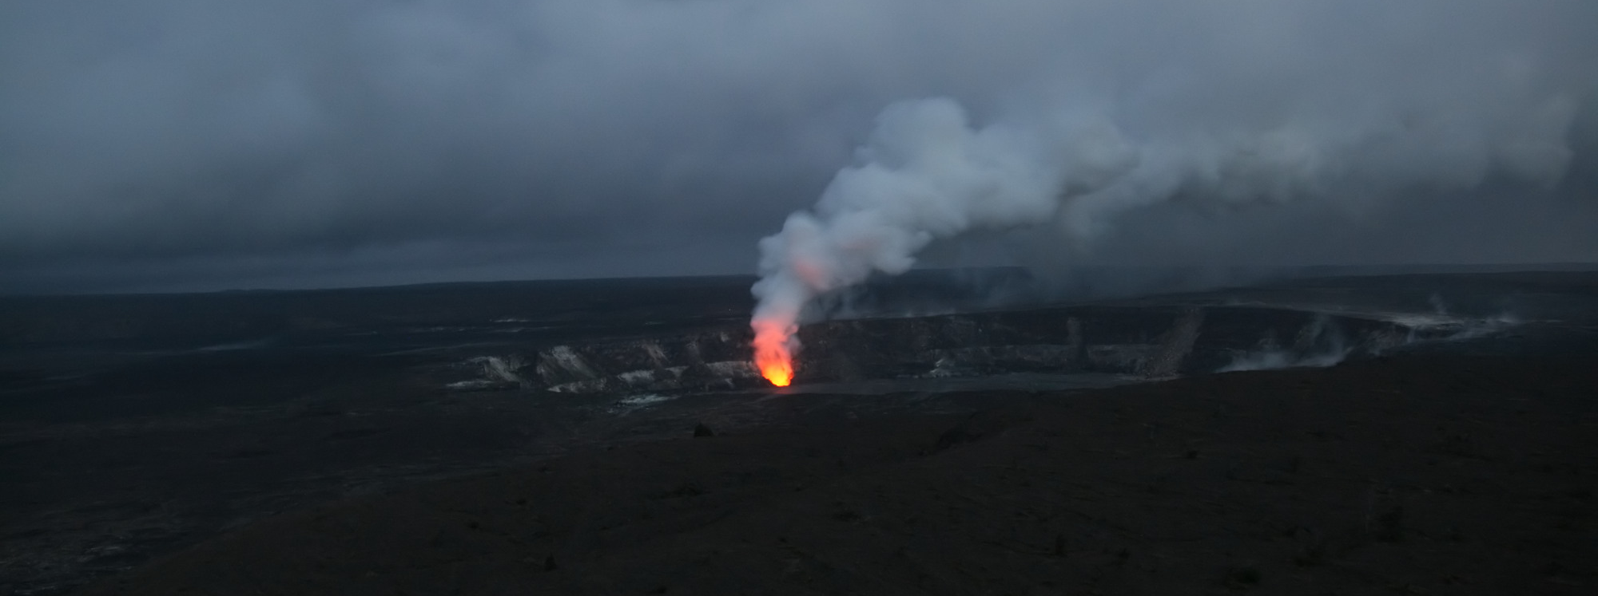
Community Concerns - Aerosols
Natural/synthetic
Warming or cooling
Air quality
Image Credit: Brocken Inaglory
Notes:
J: Though aerosols occur naturally from sources like dust storms and volcanic eruptions, human industrialization has contributed significantly to the production of these particles that can so adversely harm our health.
Image Source: https://commons.wikimedia.org/wiki/File:Sulfur_dioxide_emissions_from_the_Halema%60uma%60u_vent,_glows_at_night.jpg

Slide 3
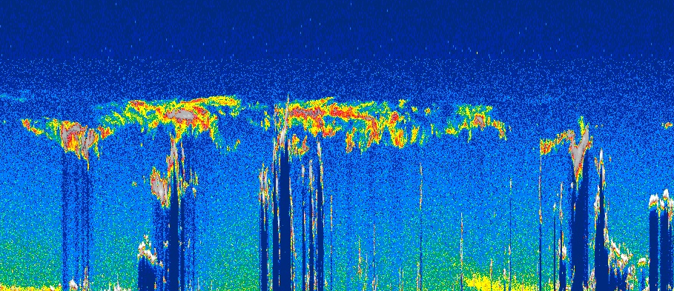
Image Credit: NASA
Motivation – track aerosols
CALIPSO: tracks atmospheric aerosols
Wavelength dependence → can isolate by type
Direct human involvement
Notes:
J: The CALIPSO science team at LaRC studies the vertical profiles of backscattering data output by the CALIPSO satellite. These images reveal aerosols in the atmosphere and are used for analysis of atmospheric health. Depending on the wavelength of light used, different aerosols become visible. These can be smoke, dust, sulfates, and other potential pollutants, as well as clouds and harmless dust particles. Until now, the team has been using an outdated visualizer with virtually no ability to interact with the data. Our task was to ameliorate this problem by producing a new one.
Image Source: https://commons.wikimedia.org/wiki/File:Profiles_from_Australia_and_New_Zealand_with_model_trajectories.jpeg

Slide 4
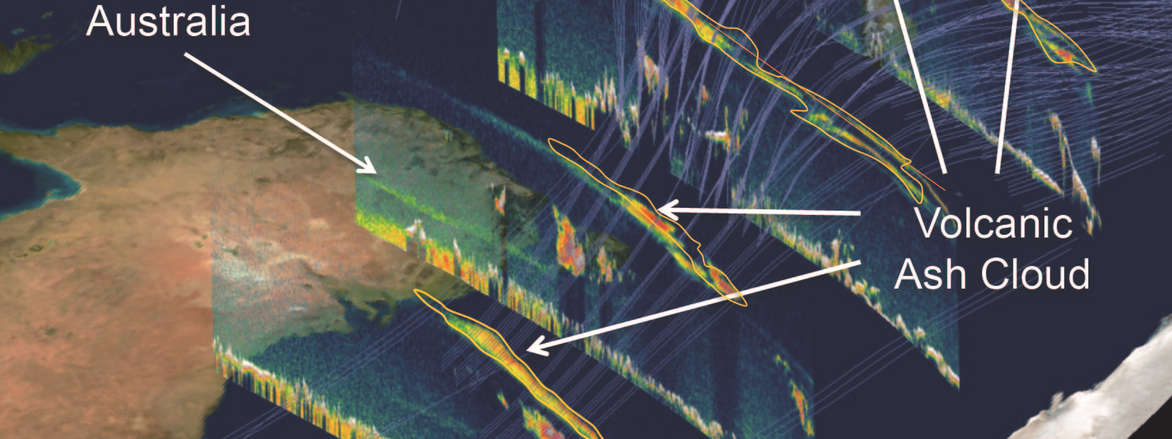
Image Credit: NASA
Motivation – track aerosols
CALIPSO satellite: backscattering profile, curtain data
CALIPSO science team: integrated analysis tool
PDF Harvester: outdated IDL visualizer
Notes:
J: The CALIPSO science team at LaRC studies the vertical profiles of backscattering data output by the CALIPSO satellite. These images reveal aerosols in the atmosphere and are used for analysis of atmospheric health. Depending on the wavelength of light used, different aerosols become visible. These can be smoke, dust, sulfates, and other potential pollutants, as well as clouds and harmless dust particles. Until now, the team has been using an outdated visualizer with virtually no ability to interact with the data. Our task was to ameliorate this problem by producing a new one.
Image Source: https://commons.wikimedia.org/wiki/File:Profiles_from_Australia_and_New_Zealand_with_model_trajectories.jpeg

Slide 5
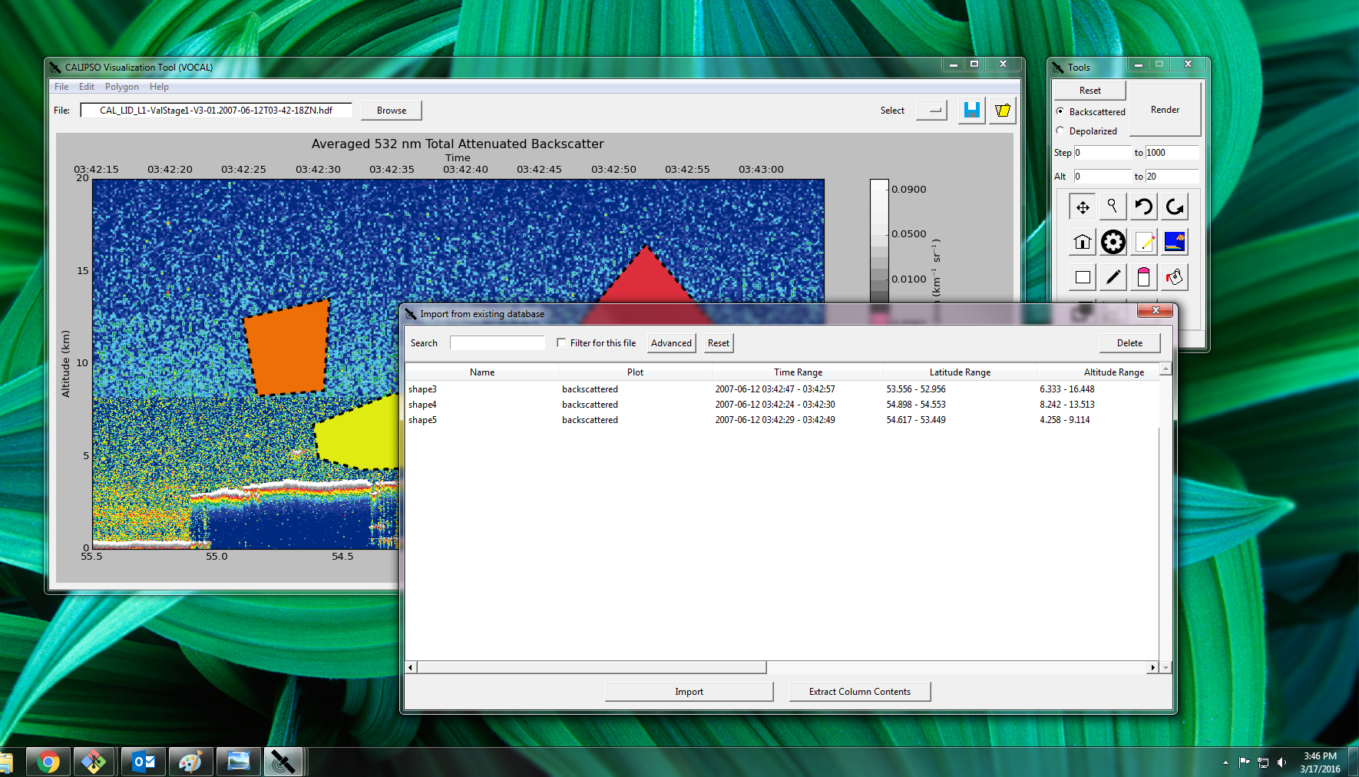
Visualization of CALIPSO (VOCAL)
VOCAL Platform:
Python based data visualizer,
annotator, importer/exporter
Open-Source Release (pending):
developer collaboration
Notes:
K: The Visualization Of CALIPSO (VOCAL) platform was developed in the Summer of 2015 using the Python computer programming language. This language offered many benefits over IDL, the language the previous visualizer was written, namely its open source nature. VOCAL was designed to perform all tasks the old IDL platform was capable of, as well as adding new functionality. The new functionality focuses on collaboration and sharing between developers and researchers. Because it is written in python, it is much easier for developers to work on improving and updating VOCAL for future needs and uses. Additionally, VOCAL has been designed to integrate OPeNDAP functionality to allow easier access to the data as well as allow users to share data and results much easier.
Image Source: https://i.ytimg.com/vi/jcf6Nf4LlbE/maxresdefault.jpg

Slide 6
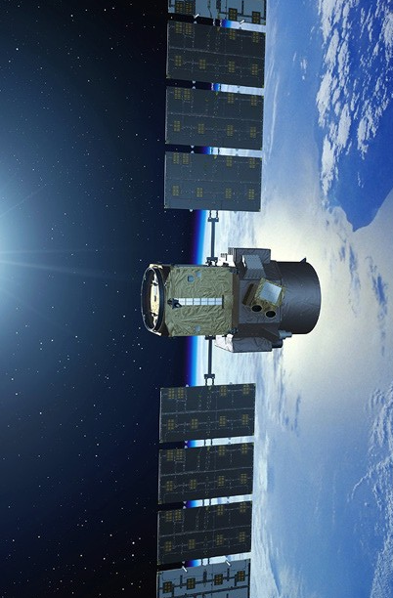
Objectives
Clean Installation:
Stand-alone Windows Installer
Enhanced Attributes: Incorporate useful information
Robust error-handling: Facilitate fixes
Image Credit: NASA
Notes:
K: The major goals of this terms project were to simplify the installation process of VOCAL by creating a stand-alone Windows installer, make shapes easier to work with and load from the appropriate files, and handle errors more robustly. A secondary goal was to create a Mac OS X stand-alone installer, though this is unfinished as of now and will continue in the next term.
Image Source: http://science-edu.larc.nasa.gov/images/spotlight/1-CALIPSO_cropped448W-336H.jpg

Slide 7
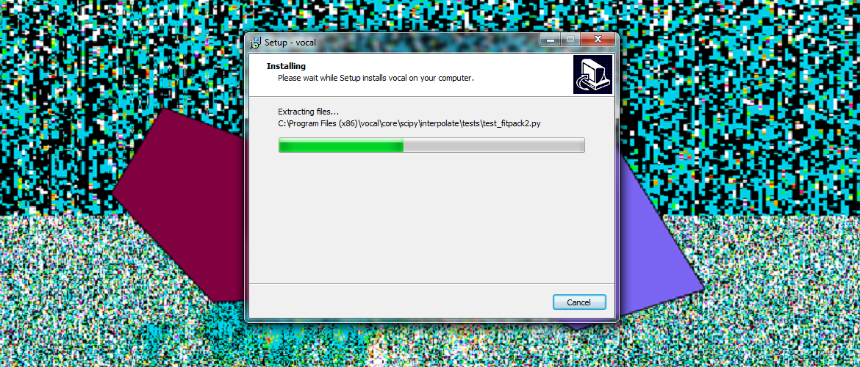
Stand-Alone Windows Installer
One-click setup package
Backwards-compatible (32 bit)
Release-based
Notes:
K: For ease of distribution, we have created a stand-alone Windows installer. With essentially one click, the user can install the software and immediately start looking at the data. Right now, the software is built to utilize 32-bit compatible Python libraries, so the software is largely backwards-compatible with machines. Going forward, for each official release of subsequent versions of VOCAL, a new Windows installer will also be released.

Slide 8
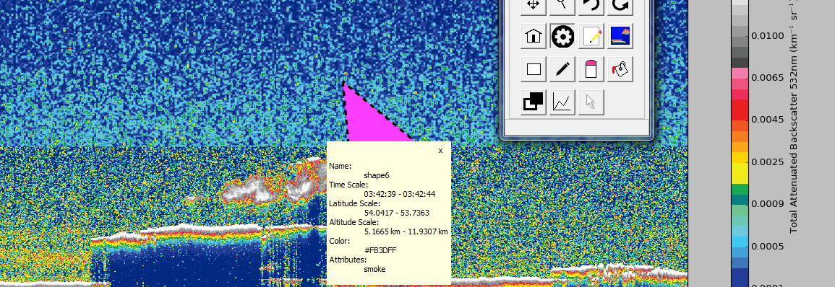
Enhanced Attributes
Unique identifier per polygon
Soon: user-editable, meaningful
Notes:
K: Depending on the plot, shapes (user-drawn polygons) can become numerous. We have improved shape identification that persists into the database. In the future, we want to let the user establish a nomenclature that can be automatically applied to a set of shapes.

Slide 9
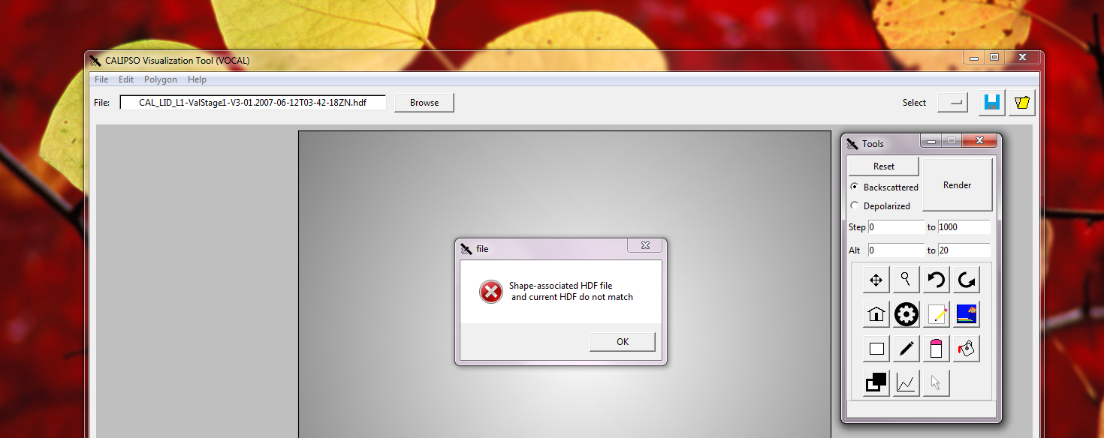
Enhanced Attributes
Sanity-checking within code
Improve user-interaction with system
Notes:
K: Continuing with our attention to shapes, we wanted to incorporate stricter sanity-checking within the program, preventing the user from loading saved shapes from one HDF file (or particular view of that file) to another view or completely different file. You can imagine the ambiguity that could easily arise from a loose association between our database of polygons and the satellite data to which they are attributed.

Slide 10
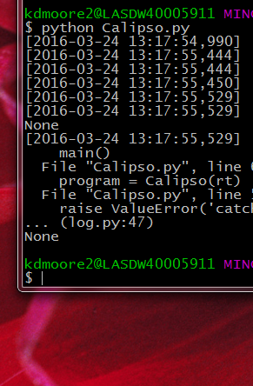
Error-logging
Catching exceptions:
More thorough handling of errors
Notes:
J: Additionally we improved the usefulness of the logging function of the VOCAL program. Previously the log only captured developer generated log items, giving a description of the program running, but little information about errors. It was upgraded to capture a stack trace should a fault occur, allowing a future developer to figure out when and how an error occurred. This should prove to be a major boon in debugging the program in the future.

Slide 11
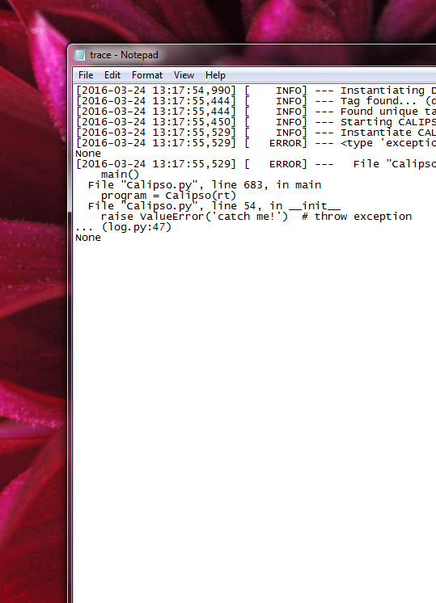
Error-logging
Catching exceptions:
More thorough handling of errors
Sending to log file:
Reproducing, tracing, repairing
Improvements!
Notes:
J: Also added was a redundant logging file, which copied the original log in the event that an error is captured. The original log is overwritten each time the program is instantiated, so this new log allows errors to be permanently captured rather than being lost each time the program is opened.

Slide 12
Lifecycle
Finalize installation
Done!
Deploy to partner
Feedback collection
Functionality
creation
Notes:
J: After finalizing the builds for the Windows and Mac OS installations, we were poised to hand over the software for a “beta” release. Since then, we have been in a feedback cycle wherein we add additional functionality/improve the GUI and simultaneously incorporate feedback from our partners.

Slide 13
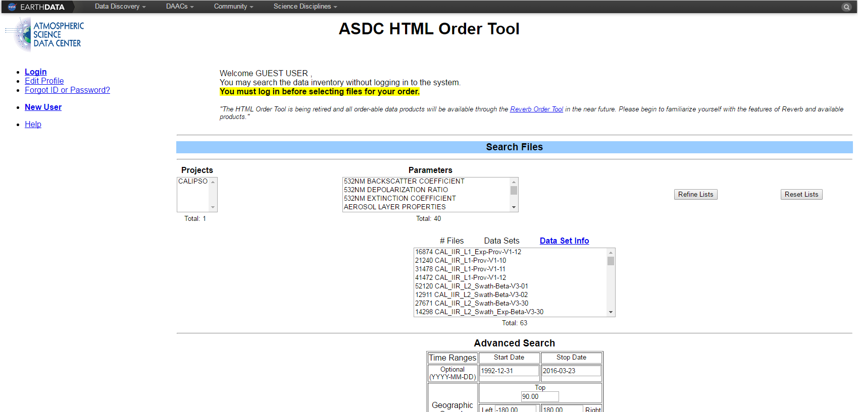
Future Work
Integrate NASA’s OPeNDAP service
Notes:
K: A major revision that we hope to explore in future terms is direct interfacing with our convenient NASA OPeNDAP service through the use of the PyDAP library. Currently, the user requests data from the Atmospheric Science Data Center (ASDC) which is eventually made available for download by the user. This is time- and storage-inefficient. By incorporating live data retrieval, we will move the data sorting and storage offline and instantly download just the window of data that we need.

Slide 14
Future Work
Integrate NASA’s OPeNDAP service
Offsite server:
Less cumbersome dataset
Ad-hoc data requests
Automatically up-to-date data
Notes:
K: As aforementioned, we hope to interface with OPeNDAP.

Slide 15
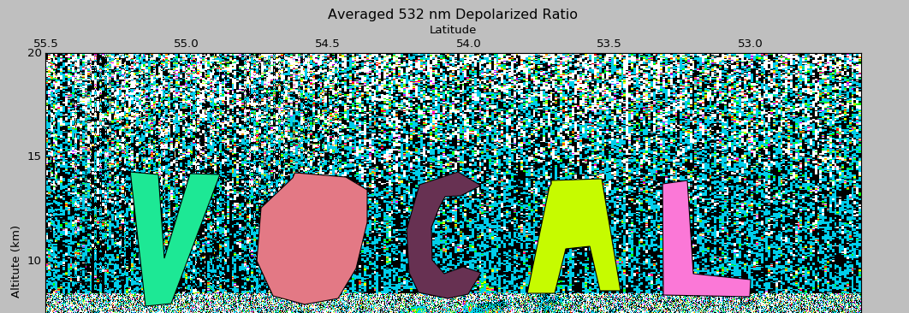
Future Work
Notes:
J: We also plan to continue with the construction of the Mac OS X stand-alone installation package, as Mac systems are ubiquitous these days. Lastly, VOCAL’s designation as open-source software is pending. We want to see this through and open up thoughtful and creative development to this visualizer to technologically savvy scientists all over the world.

Slide 16
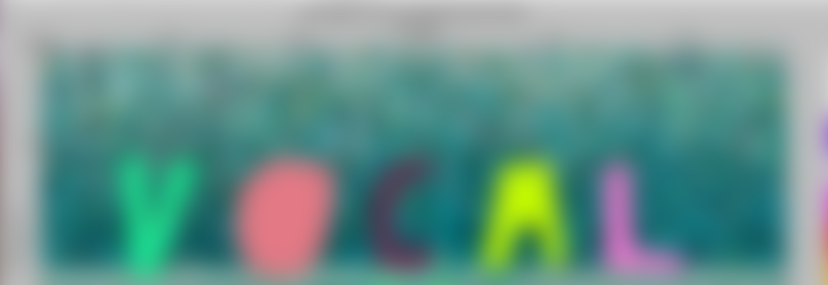
Future Work
Mac OS X stand-alone installer
(platform-independence)
Open-source license (pending)
Notes:
J: We also plan to continue with the construction of the Mac OS X stand-alone installation package, as Mac systems are ubiquitous these days. Lastly, VOCAL’s designation as open-source software is pending. We want to see this through and open up thoughtful and creative development to this visualizer to technologically savvy scientists all over the world.

Slide 17
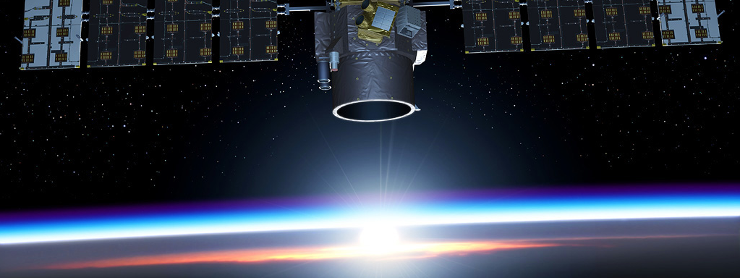
Image Credit: CNES
Acknowledgements
Advisors
Grant Mercer, UNLV
Dr. Kenton Ross, NASA DEVELOP
Partner
Dr. Chip Trepte,
NASA CALIPSO Science Team
Notes:
Image Source: http://calipsooutreach.hamptonu.edu/images/img_gallery/Satellite/images/Calipso-03-1024.jpg

Slide 18
Image Credit: CNES
Acknowledgements
CALIPSO Health
& Air Quality, Spring 2015
Jordan Vaa (project lead)
Ashna Aggarwal
Courtney Duquette
CALIPSO Cross-Cutting II, Summer 2015
Grant Mercer (project lead)
Nathan Qian
Notes:
Image Source: http://calipsooutreach.hamptonu.edu/images/img_gallery/Satellite/images/Calipso-03-1024.jpg

