Slide 1
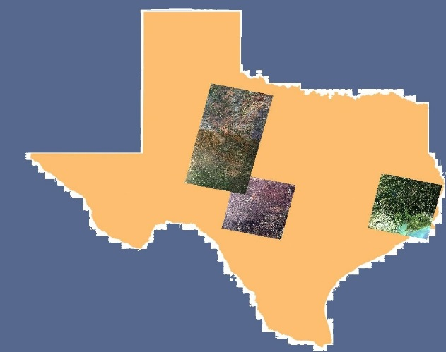
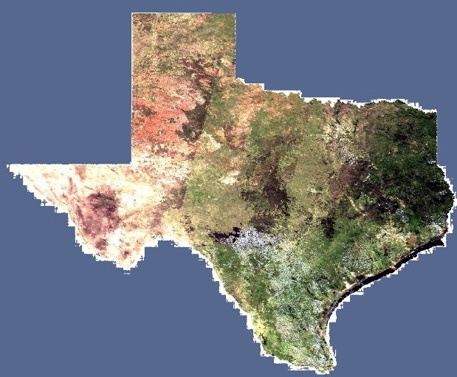
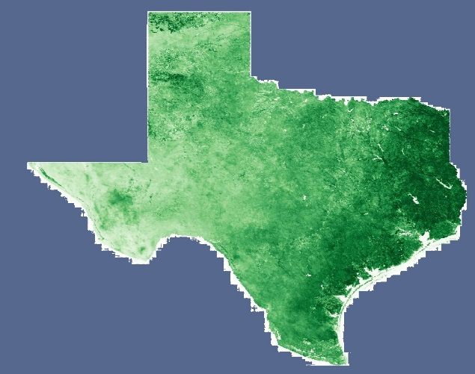
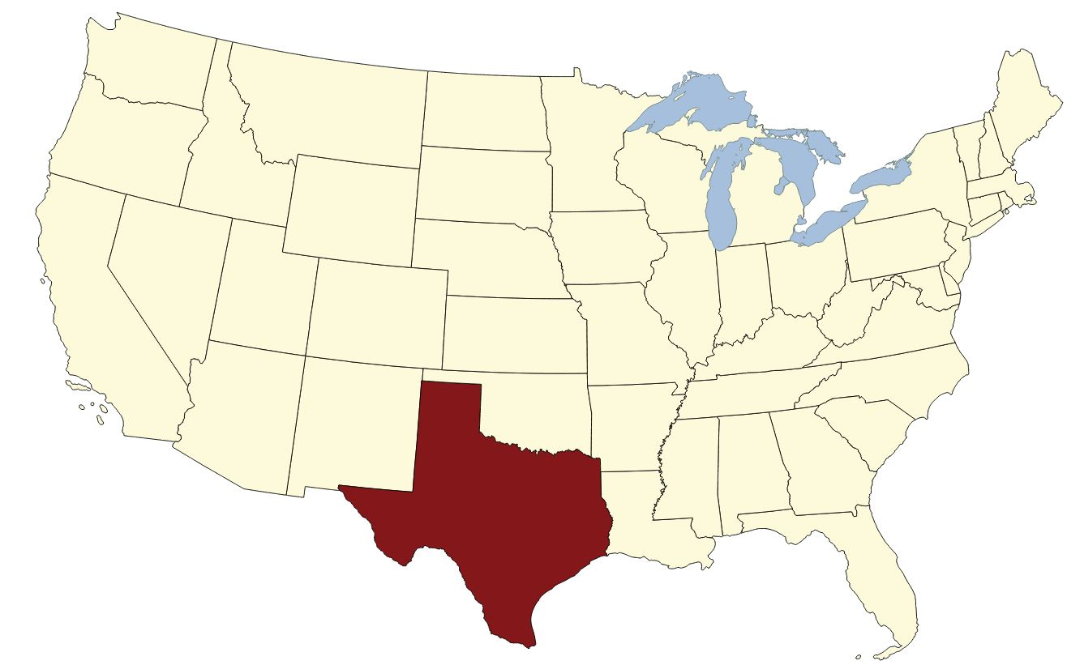
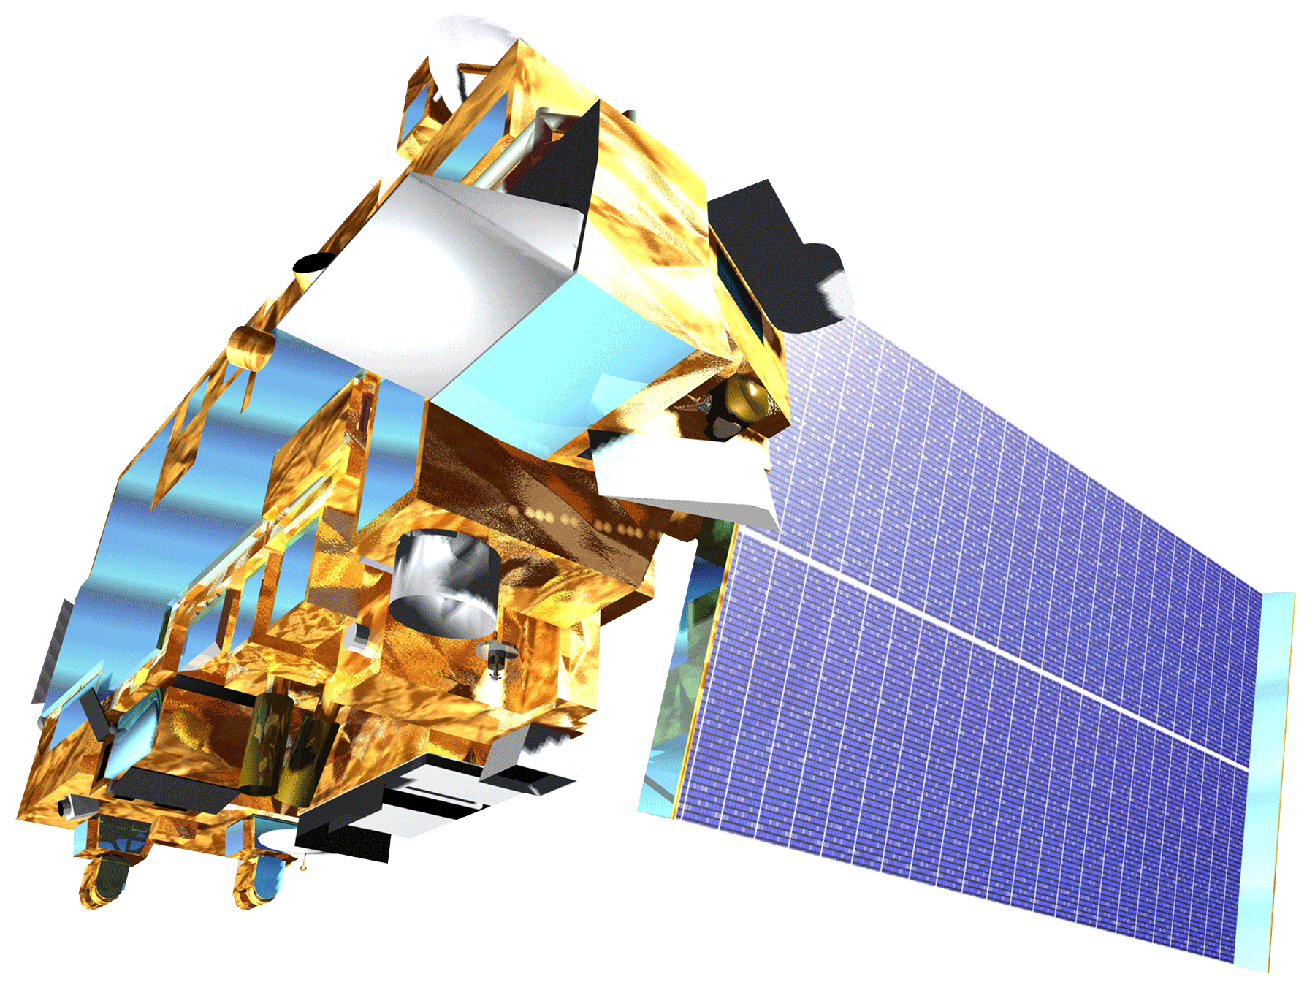
Texas Disasters
Mapping and Analyzing Fuel Loads and Phenology in the Texas Grasslands
Ben S. Beasley (Project Lead), Alex Holland, Kristen Kelehan
Abstract
Objectives
Keep this blank for now.
Body text point size should be at least 24.
Caption text point size should be at least 16.
Feel free to rename, move, and resize sections as needed.
Create up to date fuel type maps using Landsat 8 and MODIS data
Create up to date fuel load data based upon the fuel type map and MODIS data
Provide the ability to update the fuel load maps based upon new MODIS inputs
Methodology
Study Area
Texas consists of 254 counties covering 696,200 sq km
Landsat – 30m Surface Reflectance
MODIS – 500m Surface Reflectance from target date
MODIS – 250m NDVI from target date
Earth Observations
Fuel Types – 30m Classification
Fuel Types – 500m, derived from most recent MODIS date and Landsat classification
Fuel Loads – 500m Statewide map
StarFM
Model
Fusion Model – combines Landsat and MODIS data
Fuel Types – 30m Classification based on MODIS
Fuel Loads – 30m regional map
Landsat 8 OLI (Operational Land Imager)
Terra MODIS
(Moderate Resolution
Imaging Spectroradiometer)
Results
Conclusions
Use bullets.
Use complete sentences with periods.
Fuel Types derived from current MODIS data trained from classified Landsat scene
Fuel Loads derived form fusion of MODIS and Landsat
Relative NDVI (Normalized Difference Vegetation Index)
Team Members
Project Partners
Acknowledgements
Use a professional-looking photo.
Individual headshots are ok, if they aren’t pixelated and are all the same size.
Include a caption that states the team members’ names.
Texas Forest Service; Tom Spencer and Curt Stripling- Predictive Services
USDA Forest Service; William “Bill” Hargrove- ForWarn
Joseph Spruce [Senior Scientist and Lead Science Advisor at NASA SSC]
James “Doc” Smoot [Senior Scientist and Assistant Science Advisor at NASA SSC]
Dr. Kenton Ross [NASA DEVELOP National Science Advisor, LaRC]
NASA Stennis Space Center

