Slide 1
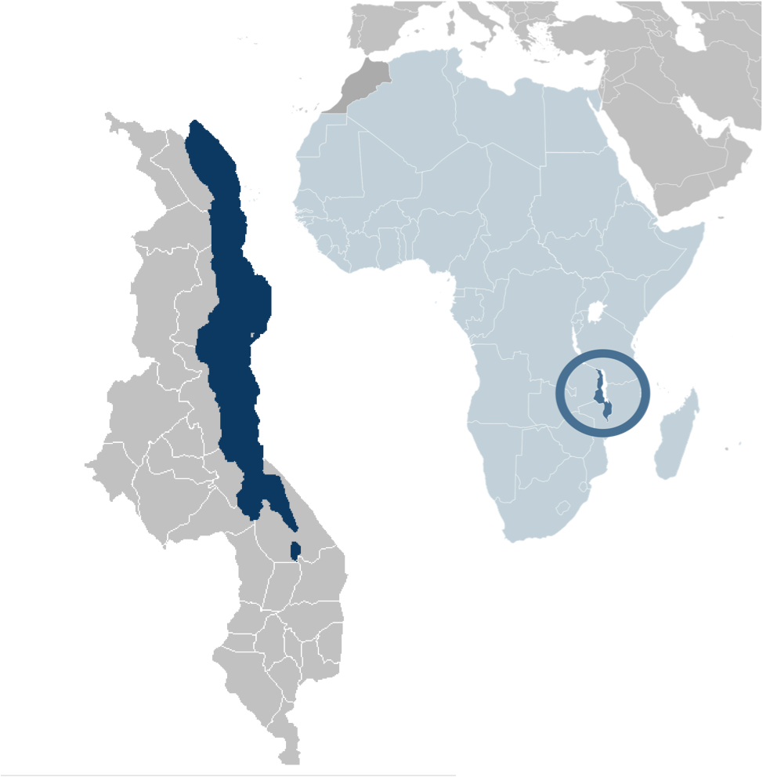
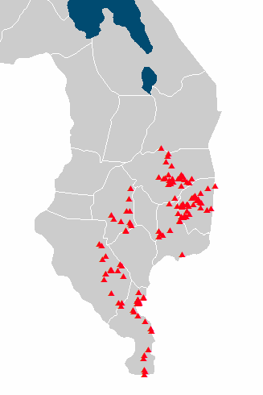
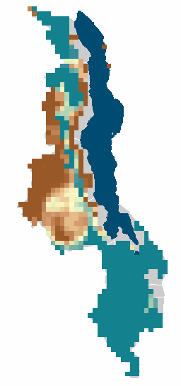
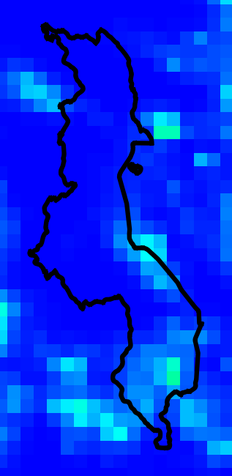
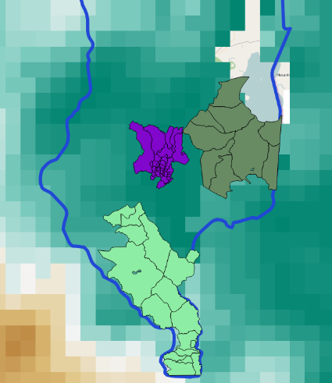
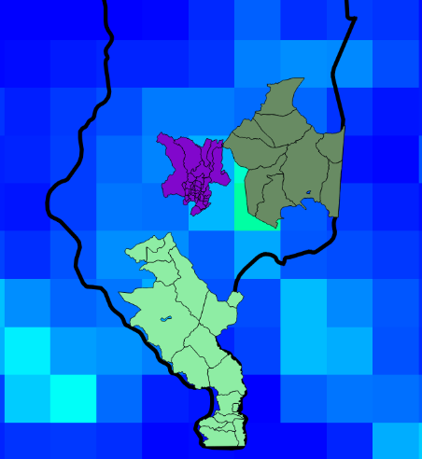
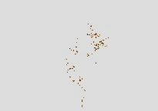
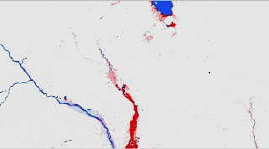
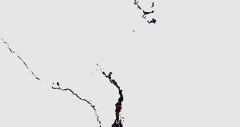
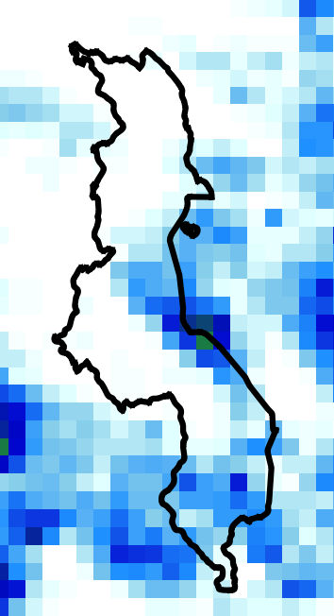
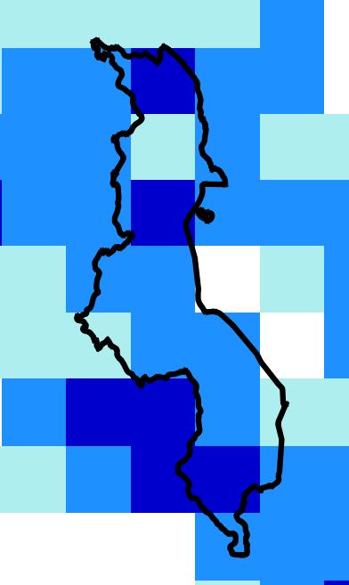
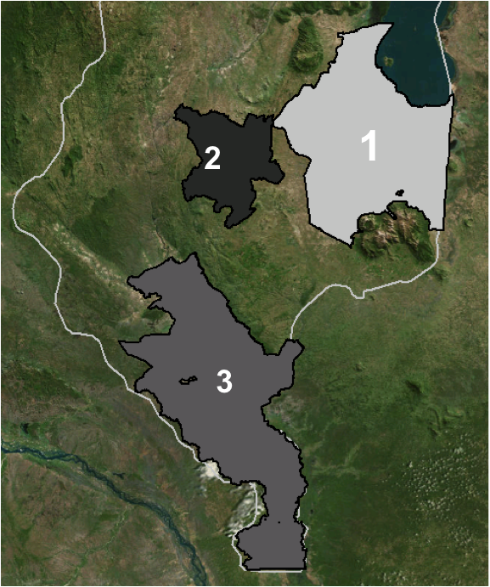
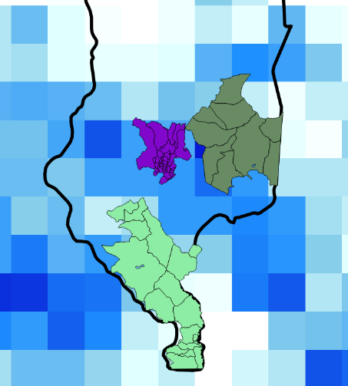
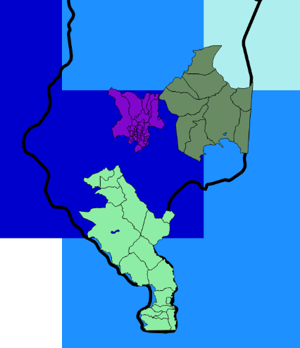
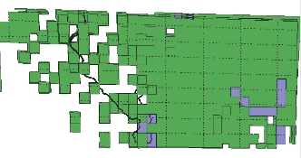
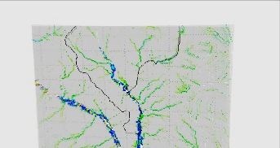
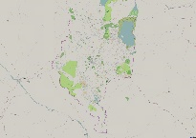
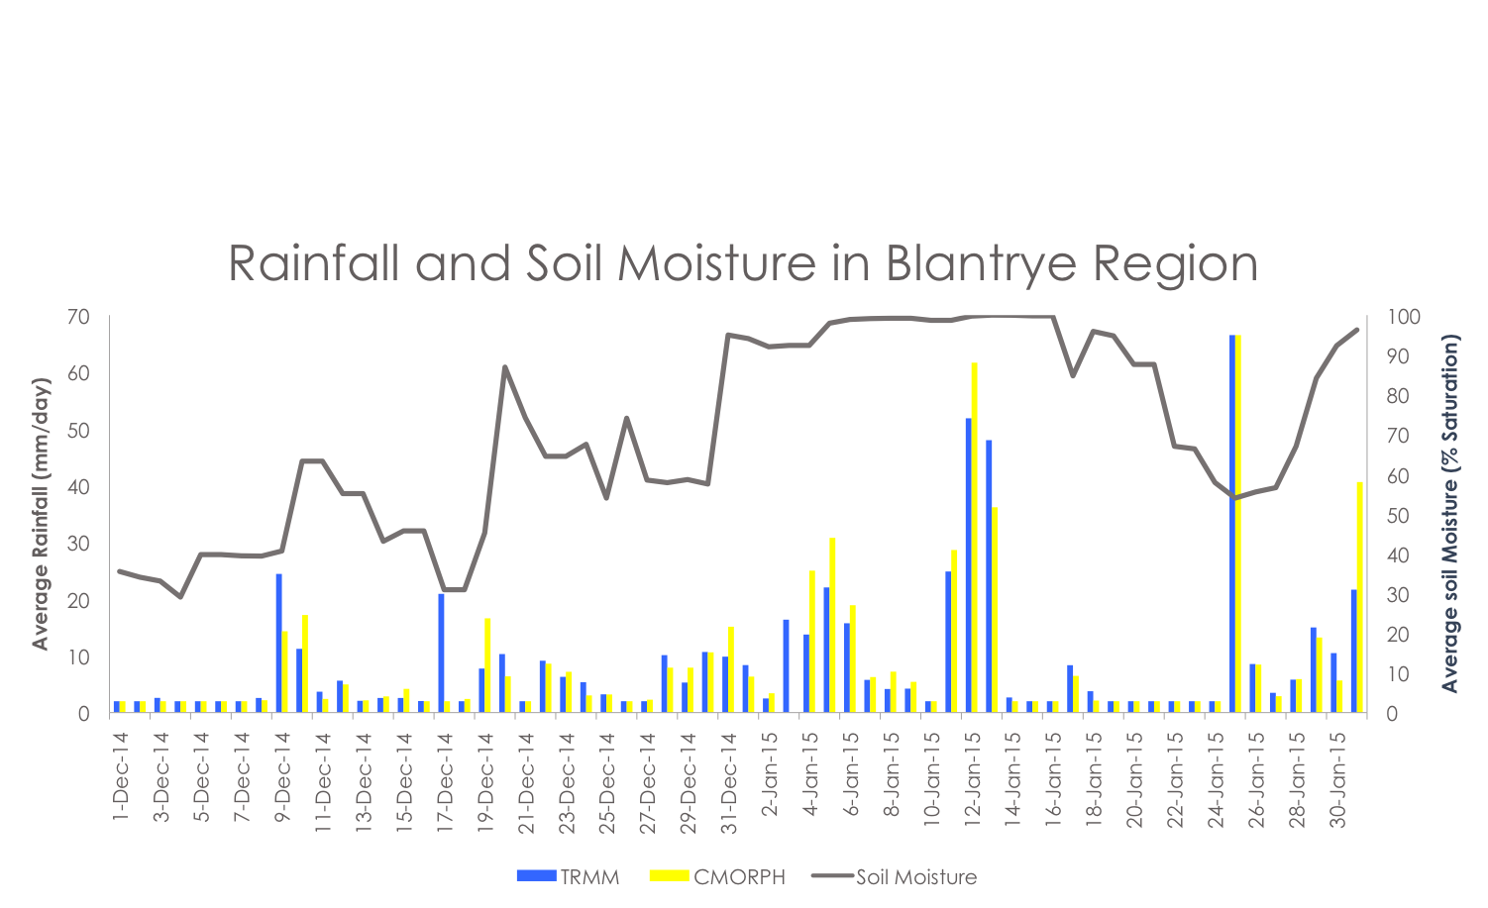
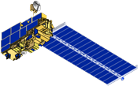
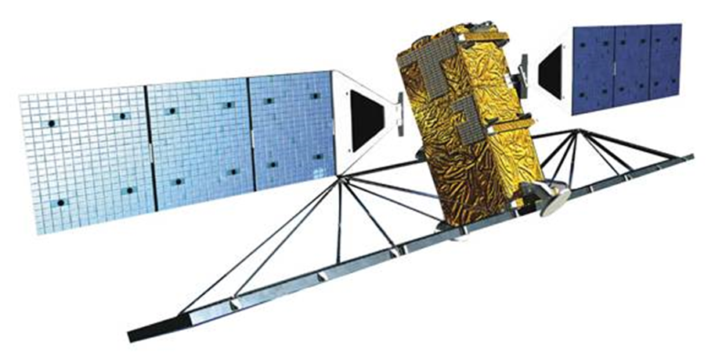
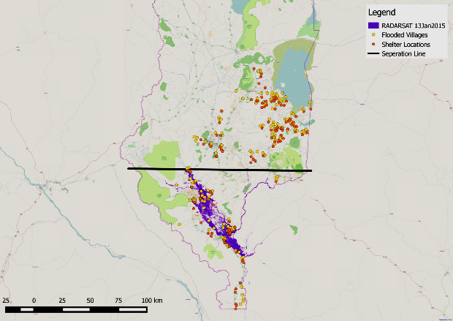
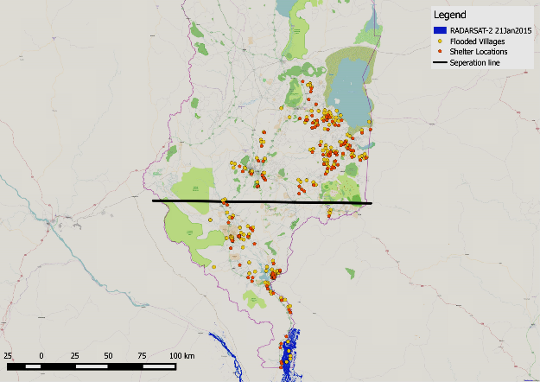
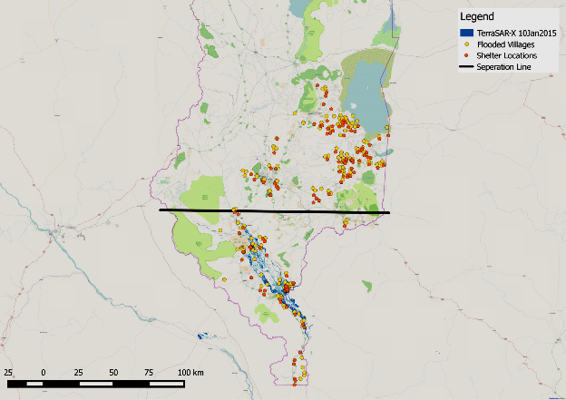
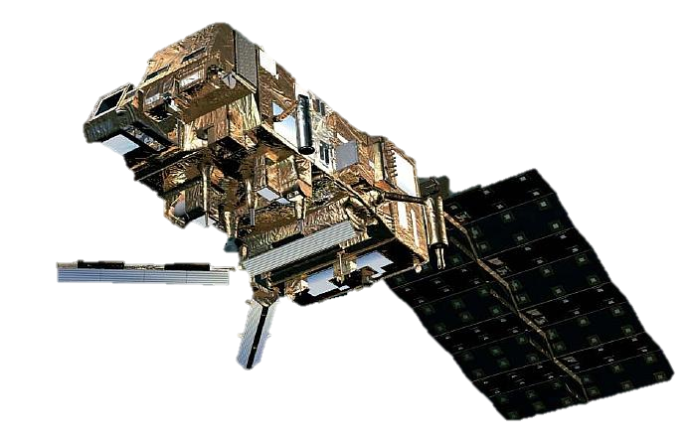
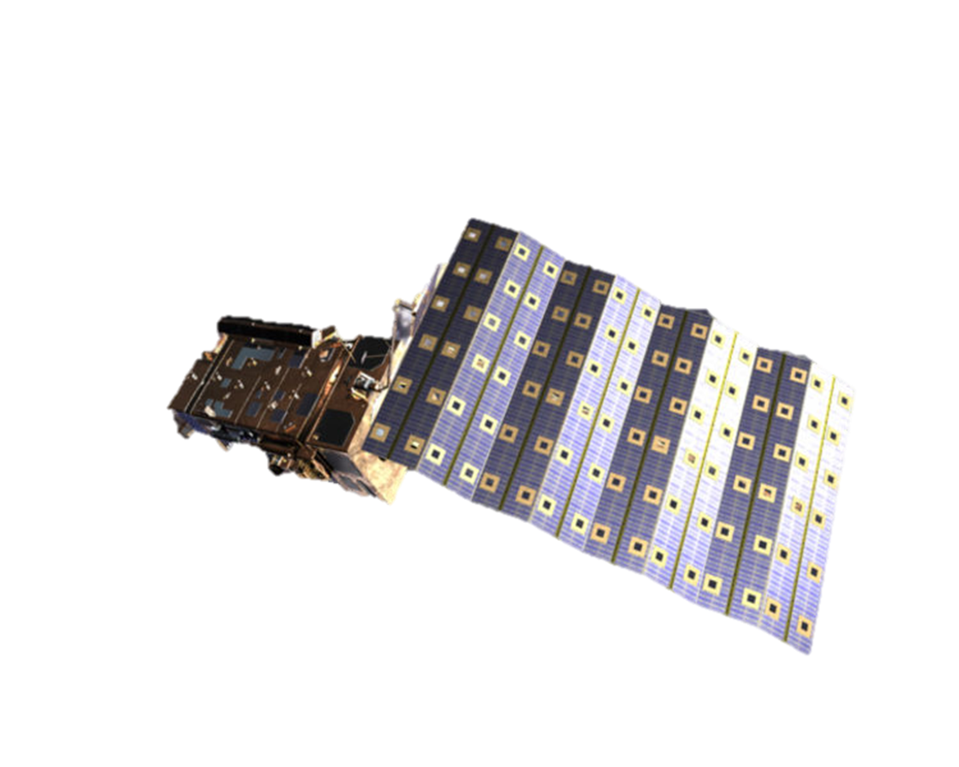
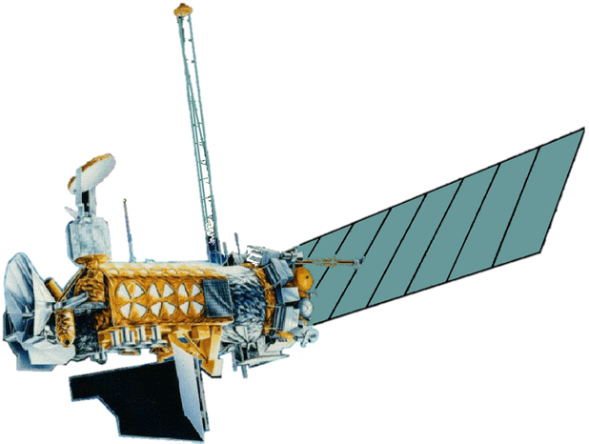
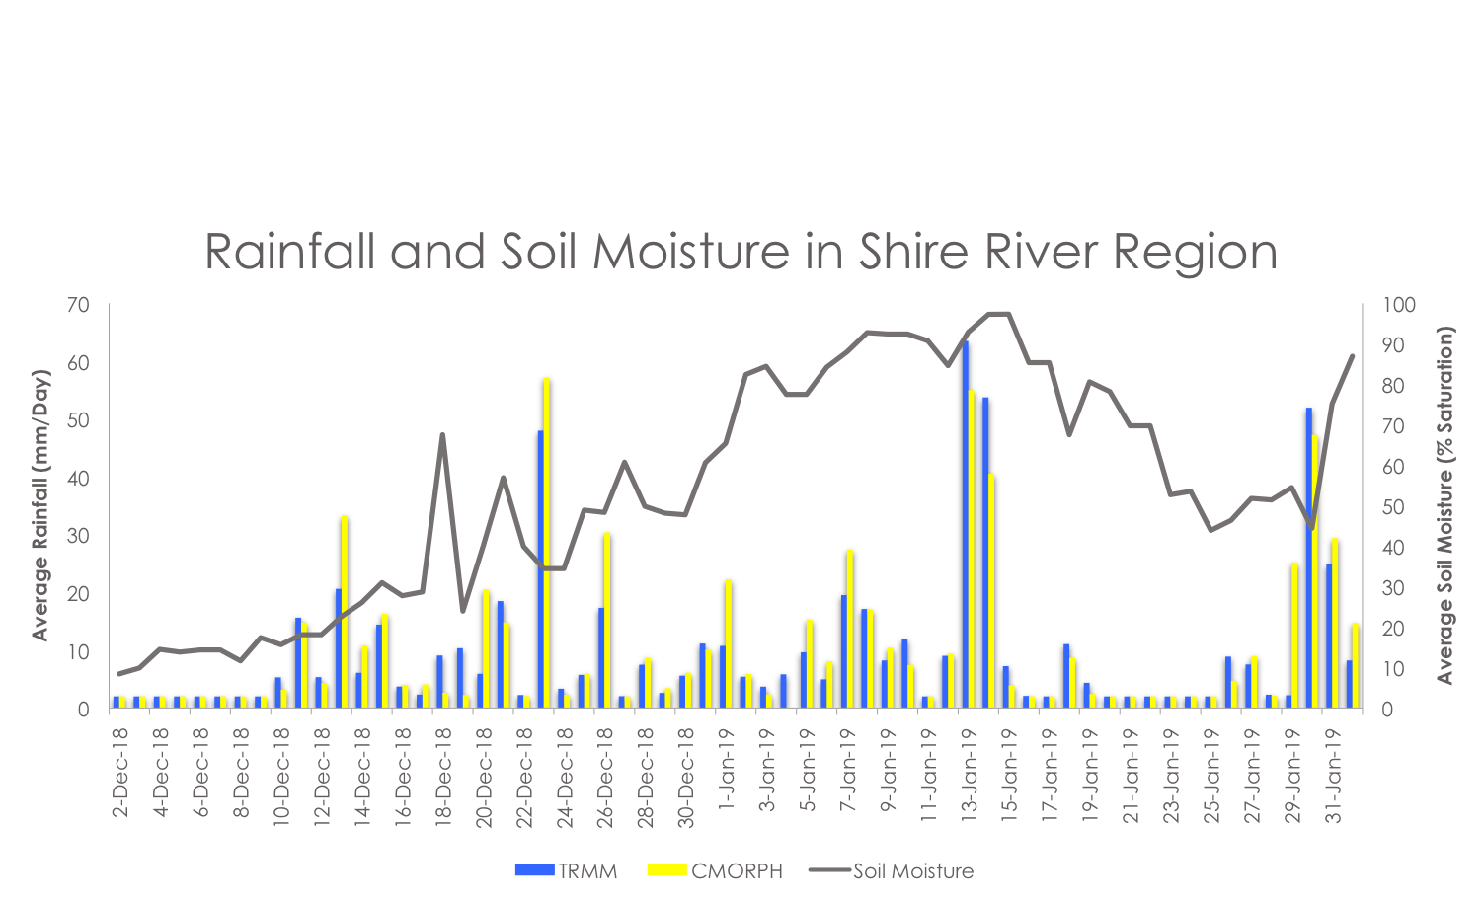
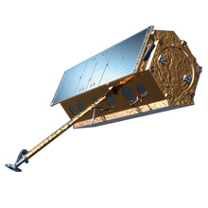
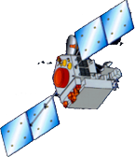
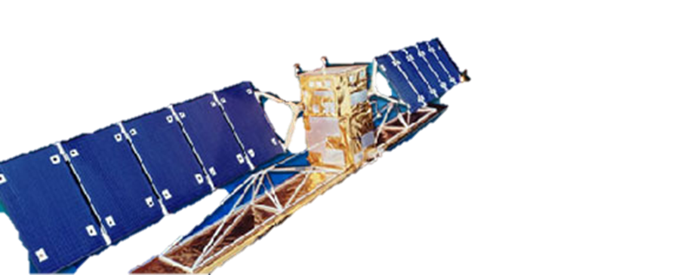
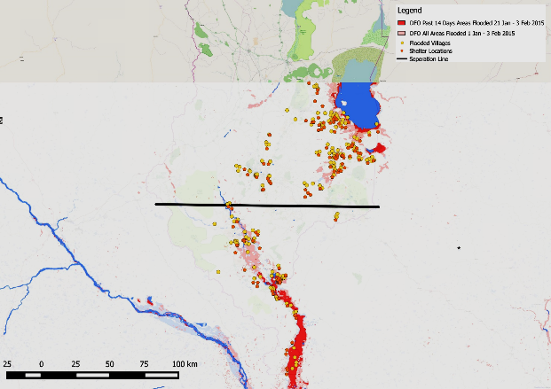
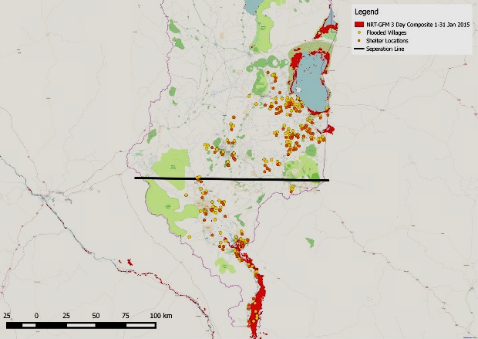
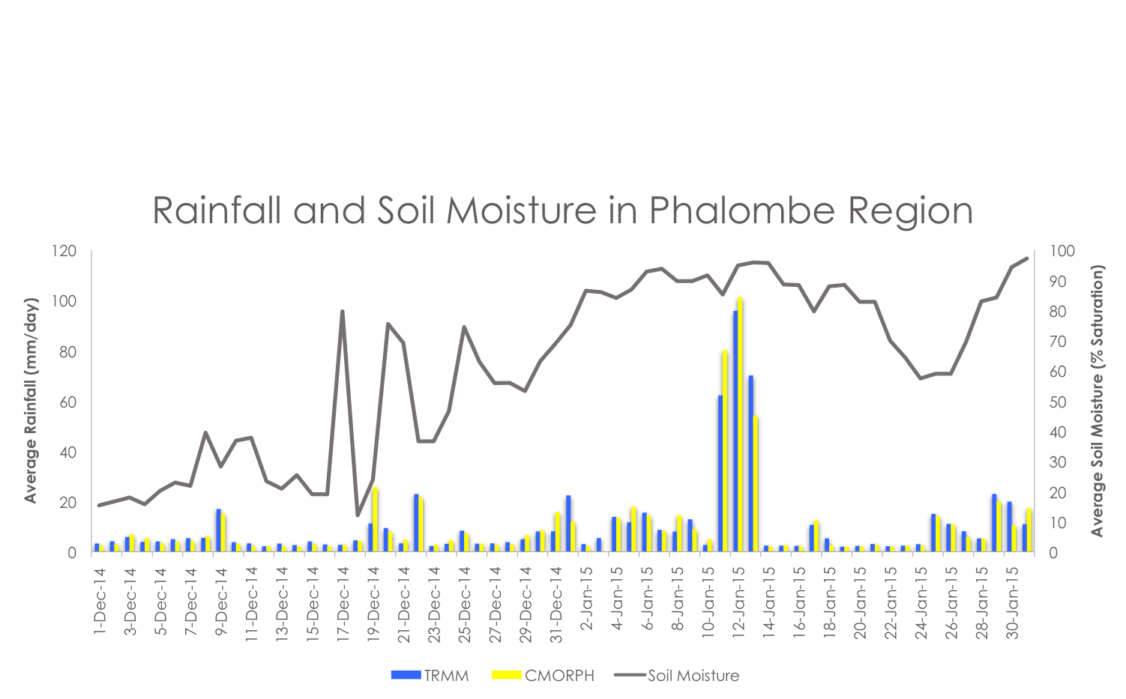
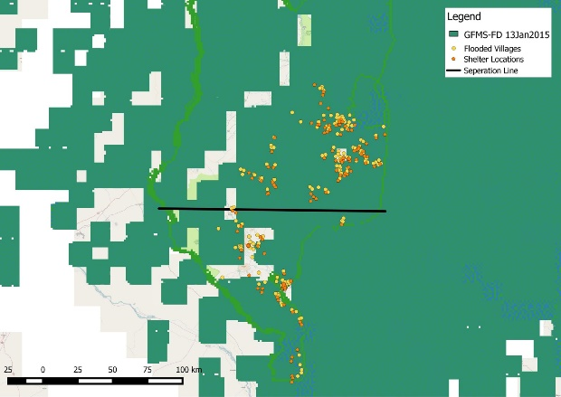
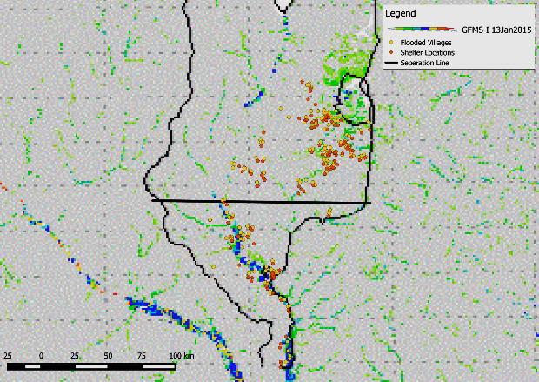
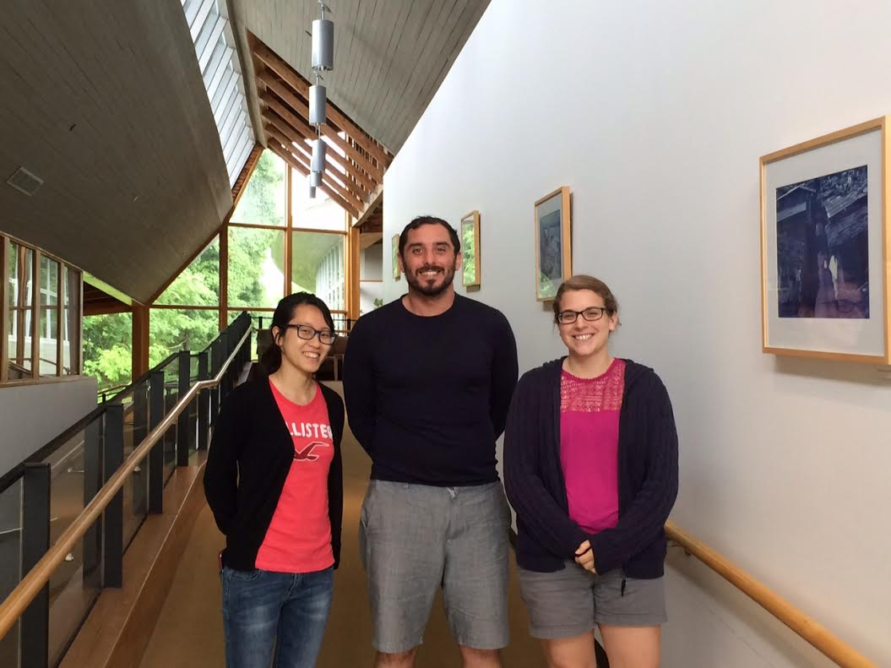
Malawi Disasters II
Applications of flood definitions and NASA Earth Observations to create a flood forecasting methodology
Andrew Kruczkiewicz (Project Lead), Helen Cen, Brigitte Moneymaker
NASA DEVELOP National Program at International Research Institute for Climate and Society
Abstract
Objectives
The African country of Malawi experiences a strong seasonal rainy season stretching from October to April, which provides approximately 95% of annual precipitation. In addition, approximately 20% of Malawi’s land cover is comprised of surface water from Lake Malawi, one of the Great African Lakes. These unique features contribute to the country’s increased vulnerability to riverine floods and flash floods. In January 2015, extended periods of extreme rainfall caused a series of flood events throughout Malawi, which resulted in the displacement of over 230,000 residents and caused 276 fatalities. In order for local authorities and humanitarian agencies to provide post-disaster relief, these organizations often rely on remotely-sensed satellite data to evaluate initial disaster impact and design response programs. In partnership with the Malawi Red Cross, this project aimed to expand on the findings from previous research in Spring 2015 by first comparing ground-truth data (locations of shelter site of internally displaced people (IDPs) and origins of IDPs) with previous term data and second, by integrating European Space Agency (ESA) remotely sensed data to explore the potential predictive capabilities of soil moisture for flash flood detection. In addition to data from NASA sensors (MODIS, TRMM, SSM-I and AMSU-A data), this project incorporated ASCAT data from ESA. The results of this study will increase the ability to forecast and monitor flood events, benefiting organizations involved with disaster preparedness and relief efforts in Malawi and potentially allowing for more efficient action, including prepositioning of pre-flood resources, response operations and allocation of emergency flood relief efforts.
Use the January 2015 floods in Malawi to compare various inundation detection tools
Validate flood maps with ground truth data provided by the Malawi Red Cross
Explore soil moister detection products in relation to flooding
Study Area
Malawi
Study Period
Methodology
January 2015
Flood Product
Soil Moisture Product
Acquire & Process Ground Truth Data
Group Flood Products
Comparison & Validation
Acquire Data
Selecting Areas of Interest
Zonal Statistical Analysis
Group 1: SAR Products
Flooded Villages Layer
Flood Detection Products
Shelter Sites Layer
Base Layer (Open Street Map)
Iso Cluster Unsupervised Classification
RADARSAT
RADARSAT-2
TerraSAR-X
Indicates clusters of similar soil moisture characteristics
Group 2: Near Real Time Products
Soil Water Index
CMORPH
Soil Water Index
CMORPH
DFO
NRT-GFM
Phalombe Region
Blantyre Region
Shire Region
Group 3: University of Maryland Global Flood Monitoring System Products
GFMS-FD
GFMS-I
TRMM
IFRC 6 Day Extreme Rainfall Forecast
TRMM
IFRC 6 Day Extreme Rainfall Forecast
Results
Soil Moisture Product Analysis
Earth Observations
Flood Product Spatial Analysis
Group 1
Aqua
Terra
RADARSAT-2
RADARSAT
RADARSAT-2
TerraSAR-X
MetOp-A
MetOp-B
DMSP
Group 2
TerraSAR-X
TRMM
RADARSAT
Conclusions
DFO in Group 2 is better at detecting riverine floods and possibly flash floods as well.
NRT-GFM in Group 2, TerraSAR-X and RADARSAT in Group 1 are good at detecting riverine floods only.
Within the region where flash floods were the only type (Phalombe), soil moisture was elevated at an earlier date and for a longer period of time. Potentially indicating heightened levels of soil moisture and persistence of said heightened levels may drive flash flood risk
DFO
Group 3
NRT-GFM
GFMS-FD
GFMS-I
Team Members
Acknowledgements
Andrew Kruczkiewicz, Helen Cen, & Brigitte Moneymaker
Project Partners
Dr. Pietro Ceccato
Lead Environmental Monitoring Program, IRI
(Science Advisor)
Red Cross/Red Crescent Climate Centre: Erin Coughlan
Malawi Red Cross Society: Hastings Kandaya
International Research Institute for Climate and Society

