Slide 1
Georgia Disasters and Water Resources
Utilizing NASA Earth Observations to Monitor Sinkhole Development and Identify Risk Areas in Dougherty County, GA
Matthew Cahalan (Project Lead)
Wenjing Xu
Dr. Adam Milewski (Science Advisor)
Tunan Hu
Kimberly Berry
Mohamed Amin

Slide 2
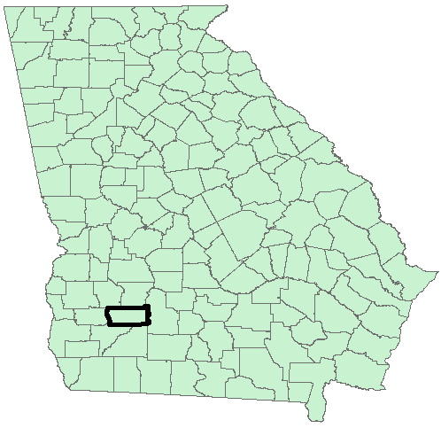
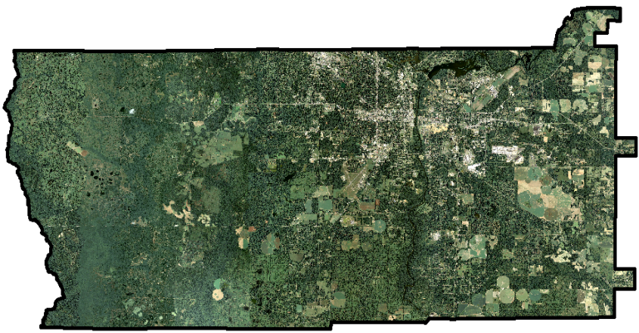
Study Area
Geology- Ocala Limestone and varying
amounts of overburden thickness (0 – 40m)
Hydrology- Flint River and tributaries; Lake
Chewaw; ponds created from sinkhole
depressions
Hydrogeology- Upper Floridan Aquifer
Climate- humid subtropical; 50 inches of annual rainfall
Geomorphology- flat karst terrain characterized by sinkholes, disappearing streams, springs, and cave systems
Human Element- growing populace in agricultural region with increasing demands on groundwater resources for municipalities, agriculture, and industry
Notes:
Dougherty County, Georgia, is located within the Dougherty Plain of Southwest Georgia, an extensive karst region that experiences active sinkhole development—a problem that creates significant environmental and engineering hazards. Dougherty County has a growing populace that relies on groundwater resources from the Upper Floridan Aquifer, the Flint River, and tributaries for agriculture, industry, and municipal purposes. Despite being in a humid subtropical climate with 50 inches of annual rainfall, restrictions on water supply/usage have been implemented. Albany is the county’s largest metropolitan area with a population of approximately 80,000 residents. The land surface is generally flat and underlain by the Ocala Limestone. This area is considered a covered karst region, as it is normally mantled by 0 -40 meters of unconsolidated sediment. Large-scale cover-subsidence and small-scale cover-collapse sinkholes form in this covered karst region.

Slide 3
Background
Sinkhole types:
Cover-collapse- small area and abrupt formation
Cover-subsidence- large area and gradual formation
Sinkhole formation factors:
Geologic- fractures and overburden thickness
Hydrologic- distance to surface water features
Anthropogenic- land use and infrastructure development
Hydrogeologic- aquifer levels / fluctuations
Geomorphologic- elevation, slope, and aspect
Climatic- precipitation
Sinkhole formation mechanisms:
Flooding- liquefaction
Drought and/or groundwater over extraction - loss of hydrostatic support
Notes:
This research strives to understand the formation and spatial distribution of two sinkhole types: cover-collapse and cover-subsidence. Cover-collapse sinkholes are smaller in scale and tend to form over short time periods measured in minutes and days. Cover-subsidence sinkholes are larger in scale and form over longer time periods measured in months to years. Sinkholes are formed from interactions on the surface and in the subsurface between geologic, hydrologic, anthropogenic, geomorphologic, climatic, hydrogeologic, and other minor factors. Flooding can initiate sinkhole formation through liquefaction and mass addition processes. With increased mass, the unconsolidated overburden material overcomes the support forces from hydrostatic pressure (i.e., aquifer levels) and cohesiveness of material directly above the subsurface cavity the unconsolidated material gets transported into during sinkhole development. Drought and/or over extraction of groundwater results in the lowering of aquifer levels that provide hydrostatic support of overlying materials. Because sinkholes are initiated underground and develop over long periods of time, the processes are difficult to observe and quantify for useful purposes. Therefore, surface characteristics of sinkholes, which include spatial distribution, dimensions, and morphology, are useful in assessing sinkhole development and subsequent growth. By taking these variables into account, spatial and statistical analytical approaches are used to model sinkhole susceptibility in this research.

Slide 4
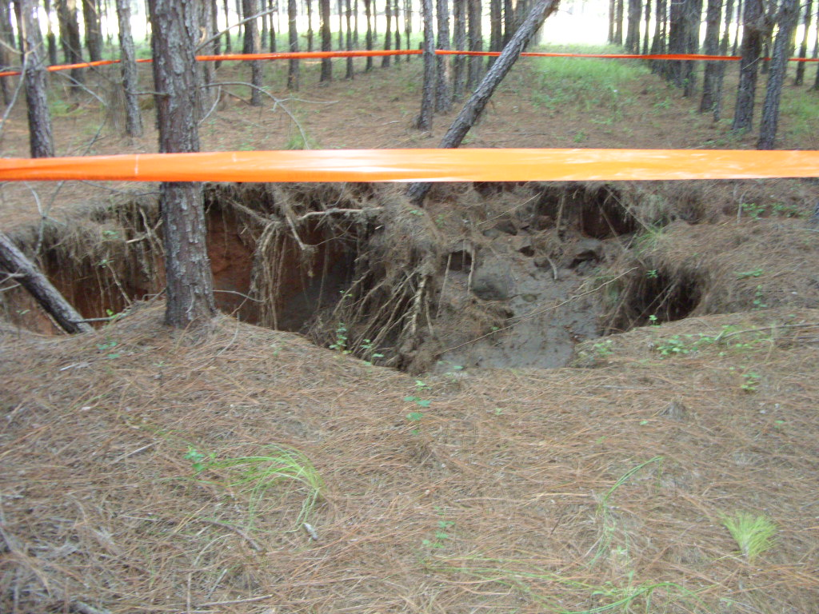
Community Concerns
Sinkholes are a risk to human safety, environmental health, and infrastructure (i.e., roads and buildings) in Dougherty County and other areas within the coastal plain of the southeastern United States.
Sinkholes pose a threat to groundwater pollution, as they quickly introduce contaminants into karst aquifer systems with high transmissivities, or ability to disperse contaminants through advection processes. The susceptibility to groundwater contamination is largely a function of land use type.
Notes:
Sinkholes present difficulties for land use management, groundwater contamination, and infrastructure damage to roads and buildings. Thus, assessing the spatiotemporal distribution of sinkhole formation is an important step in addressing these problems within Dougherty County, Georgia, and other karst areas. Improving the understanding of sinkhole formation is a critical step towards alleviating concerns that many groups of people have related to land use, infrastructure, and water resource management in Dougherty County, Georgia. Farmers, city planners, water resource managers, and other organized groups can use this research to benefit their own respective projects and help reduce risks associated with sinkholes. Additionally, this research can be applicable to other urban and rural areas underlain by karst aquifer systems that exhibit active sinkhole formation.
*The team was given permission to use the image in this slide from a project partner.*

Slide 5
Objectives
Develop sinkhole inventory maps for years ranging from 1999 – 2011 utilizing a time-series of digital elevation models (DEMs) and an automated algorithm developed by the team
Improve the understanding of and predictive capabilities for sinkhole development by analyzing the factors influencing the development of newly formed sinkholes
Produce a sinkhole susceptibility map for Dougherty County, Georgia
Notes:
Sinkholes are a risk to human safety, environmental health, and infrastructure in the coastal plain of the Southeastern United States. The overall objective of this research was to develop sinkhole inventories between 1999 and 2011 using a time-series of digital elevation models (DEM’s) to determine environmental risk to human health, infrastructure, and water supply. Additionally, this research improved the understanding of and predictive capabilities for sinkhole development. Specifically, this research identified and mapped sinkholes, analyzed the factors influencing the development of newly formed sinkholes, and produced a sinkhole susceptibility map for Dougherty County, Georgia.
**Will insert result imagery (most likely sinkhole inventory map(s)) into this slide**

Slide 6
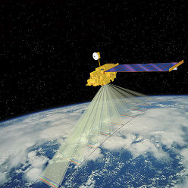
NASA Earth Observations
NASA SRTM DEM
Acquired in 2000
30m resolution
NASA Terra (ASTER) Global DEM Version 2
Acquired in 2011
30m resolution
Notes:
The Georgia Disasters and Water Resources project utilized a time-series of digital elevation models (DEM’s) to complete the first objective of compiling sinkhole inventory maps for the study period (1999– 2011). A high density of DEM’s for our study period were acquired for a thorough analysis of the spatiotemporal distribution of cover-subsidence (large-scale) and cover-collapse (small-scale) sinkhole development. DEM data from NASA’s Flagship Earth Observing Satellite, Terra (ASTER sensor), and the SRTM were utilized to detect cover-subsidence sinkhole development due to their spatial and temporal resolutions.

Slide 7
Other Observations
European Space Agency’s (ESA) European Remote Sensing (ERS) satellites.
ERS-1
ERS-2
ERS-1 and 2 satellite aperture radar (SAR) data were inputs for the ENVI SARscape program’s DEM Extraction tool to produce high resolution (5m) DEMs for cover-collapse sinkhole detection purposes.
Notes:
To complement and extend NASA Earth observations, DEM’s were generated using satellite data from the European Space Agency’s two ERS satellites, ERS-1 and ERS-2. The DEM extraction tool in ENVI’s SARscape program was used to generate high-resolution (5 meter) DEM’s from ERS-1 and 2 data ranging from 1999 – 2011 for cover-collapse (small scale) sinkhole detection.

Slide 8
Methodology
Sinkhole Formation Factor Analysis
Independent Variables:
Overburden thickness
Land use type
Land use change
Distance to fractures
Distance to streams
Distance to wetlands
Distance to ponds
Distance to roads
Elevation
Slope
Aspect
Aquifer fluctuations
Precipitation
Data download
Sinkhole Mapping
Geographically Weighted Regression
ArcGIS ModelBuilder Algorithm
Sinkhole Susceptibility Map
Validation
Temporal Difference Maps
Sinkhole Density Maps
Notes:
Data download: NASA’s SRTM global 30 meter resolution DEM from the year 2000 and the 2011 ASTER global DEM Version 2, also 30 meter resolution, were purposed for cover-subsidence sinkhole mapping. Cover-subsidence sinkholes form gradually and over large areas. Thus, these two DEM’s were chosen for their spatial and temporal resolution suitable to fulfill that objective. Cover-collapse sinkholes tend to form abruptly over small areas. Thus, they can be difficult to detect without high-resolution data. ENVI’s SARscape program has the capability to extract DEM’s of high resolution from SAR data. ERS-1 and 2 SAR archived products were used to generate 5 meter resolution DEM’s for cover-collapse sinkhole detection for the years 1999, 2002, 2004, 2005, and 2009. The combination of two 30 meter NASA Earth observation DEM’s and five 5 meter SAR generated DEM’s allow for a thorough analysis of the spatiotemporal distribution of past and newly formed sinkholes between 1999 and 2011 by increasing the team’s capabilities to fulfill the first objective of mapping sinkholes.
Sinkhole mapping: After sinkhole inventories were produced and validated using the ArcGIS ModelBuilder algorithm the project team developed, temporal difference and sinkhole density maps were generated, which are primary inputs for the project’s second objective of producing a sinkhole susceptibility map. To produce the temporal difference maps, the finalized sinkhole polygon maps from the various years were converted into point files. Then, newly formed sinkholes between the years were identified through comparisons of the maps. The 30 meter and 5 meter derived sinkhole maps were compared separately. Two temporal difference maps were created: one that showed the newly formed or expanded cover-subsidence sinkholes between 2000 and 2011 from NASA 30 meter data, and one that showed the newly formed or expanded cover-collapse sinkholes between 1999 and 2011. The latter is a compilation of temporal difference maps from 1999 – 2002, 2002 – 2004, 2004 – 2005, and 2005 – 2009- each color coded to show the newly formed sinkholes between the respective periods.
From the point files, sinkhole density maps could be created. First, however, a cluster analysis was completed to examine the spatial distribution of sinkholes. The cluster analysis showed the distance at which sinkholes, which are clustered at some maximum distance, exhibit a statistically significant dispersed pattern. This distance was the search radius input for the sinkhole density maps.
Ordinary least squares (OLS) and geographically weighted regression (GWR) geostatistical techniques were utilized to improve the understanding of and predictive capabilities for sinkhole development, as well as building a more robust sinkhole susceptibility map. The dependent variable for both of these geostatistical models was sinkhole density. Independent variables included precipitation from PRISM datasets, Upper Floridan Aquifer fluctuation levels, distance to roads, distance to streams, distance to lakes and ponds, distance to fractures/lineaments, land use type, land use change, slope, aspect, distance to wetlands, and overburden thickness. The dependent variable and independent variables were spatially assigned to each sinkhole point generated from the temporal distance maps.
The results of the regression analysis and the sinkhole density maps were combined to generate the sinkhole susceptibility map, which represents

Slide 9
Results
Will insert result table(s) and/or imagery for final draft.

Slide 10
Conclusions
Will insert results table(s) and/or imagery for final draft.

Slide 11
Errors and Uncertainties
Will describe elevation data uncertainty (i.e., vertical accuracy)
Will describe Dougherty County land use practice of filling in sinkholes.
Will describe methodology uncertainties.

Slide 12
Future Work
The Georgia Water Resources Fall 2015 term project, which has been tentatively accepted, will further the results and analyses from this project to produce a groundwater contamination susceptibility map and groundwater storage change maps.

Slide 13
Advisors
Dr. Adam Milewski (Science Advisor), Water Resources and Remote Sensing Laboratory, Department of Geology, University of Georgia
Partners
City of Albany and Dougherty County Planning and Development Services, Paul Forgey
Southwest Georgia Water Resources Task Force, Randy Weathersby
Others
Jim Stolze, Albany Utilities
Notes:
The Georgia Disasters and Water Resources team would like to thank the NASA DEVELOP National Program Office and community for supporting this project. This work could not have been completed without the knowledge, direction, and resources provided by our science advisor, Dr. Adam Milewski. We would also like to thank our partner organizations, the City of Albany and Dougherty County Planning and Development Services and the Southwest Georgia Water Resources Task Force, for working with us in building capacity for future decision making. Our points-of-contact for the organizations, Paul Forgey and Randy Weathersby, were instrumental in dissemination of results. Lastly, we would like to acknowledge Jim Stolze of Albany Utilities for allowing us access to the Albany Utility well-field for sinkhole mapping validation purposes and gathering VPS footage.

