Slide 1
Alto Orinoco Health and Air Quality
Utilizing NASA Earth Observations to Locate Remote Yanomami Villages in the Alto Orinoco Municipality for Targeted Eradication of River Blindness Disease
Sara Amirazodi
Rajkishan Rajappan (Project Lead)
Amanda Rumsey (Project Lead)
Annabel White
Kyle Sowder
Zachary Tate
Timothy Larson

Slide 2
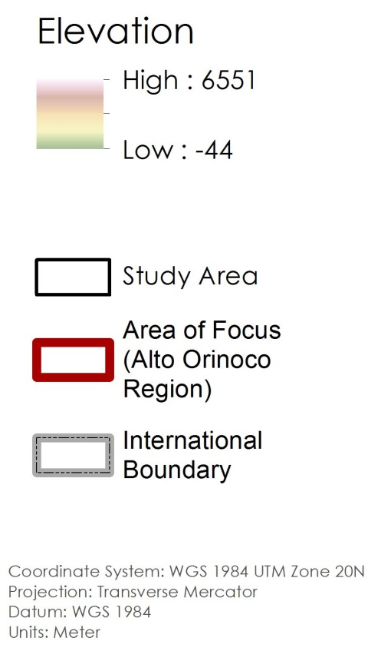
Study Area

Slide 3
Project Objectives
Create a village location map with coordinates
Develop a suitability model to assist The Carter Center in identification of Yanomami settlements

Slide 4
Community Concerns
Onchocerciasis classified as a Neglected Tropical Disease (NTD) to be eradicated by the World Health Organization (WHO) and The Carter Center
Approximately 20,500 people in need of treatment for Onchocerciasis
Majority of cases located in developing countries among the world’s poorest communities
Cycle of poverty reinforced by the crippling effects of this disease

Slide 5
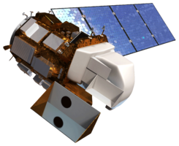
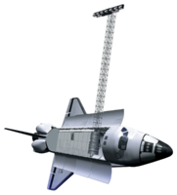
Earth Observations
Landsat 7 Enhanced Thematic Mapper Plus (ETM+)
Landsat 8 Operational Land Imager/Thermal Infrared Sensor (OLI/TIRS)
Shuttle Radar Topography Mission (SRTM)
All data collected from the USGS Earth Resource Observations and Science (EROS) Center and Land Process Distributed Active Archive Center (LPDAAC)
Landsat 7
Landsat 8
SRTM

Slide 6
Methodology
Data Processing Flow All data processed with Spatial Analyst toolbox in ArcGIS.
Elevation
Processing flow
Slope
Image coming soon
NDVI
dNBR
Distance to Streams
Fuzzy Membership
Suitability Model

Slide 7
Data Analysis

Slide 8
Results

Slide 9
Advisors
Dr. Jim Tucker (NASA Goddard Space Flight Center)
Kel Markert, Mentor & Science Advisor
Dr. Kenton Ross (NASA DEVELOP)
Dan Irwin (SERVIR Collaborator)
Dr. John D. Bolten (NASA Goddard Space Flight Center)
Dr. Jeff Luvall (NASA at National Space Science and Technology Center)
Dr. Robert Griffin (University of Alabama in Huntsville)
Katie Melocik (NASA Goddard Space Flight Center)
Dr. Thomas Unnasch (University of South Florida)
Melanie Salyer, Mentor (Wise County)
Leigh Sinclair, Center Lead (Marshall Space Flight Center)
Amberle Keith, Assistant Center Lead (Marshall Space Flight Center)
Jordan Bates, Center Lead (Wise County)
Kiersten Newtoff, Center Lead (NASA Goddard Space Flight Center)

