Slide 1
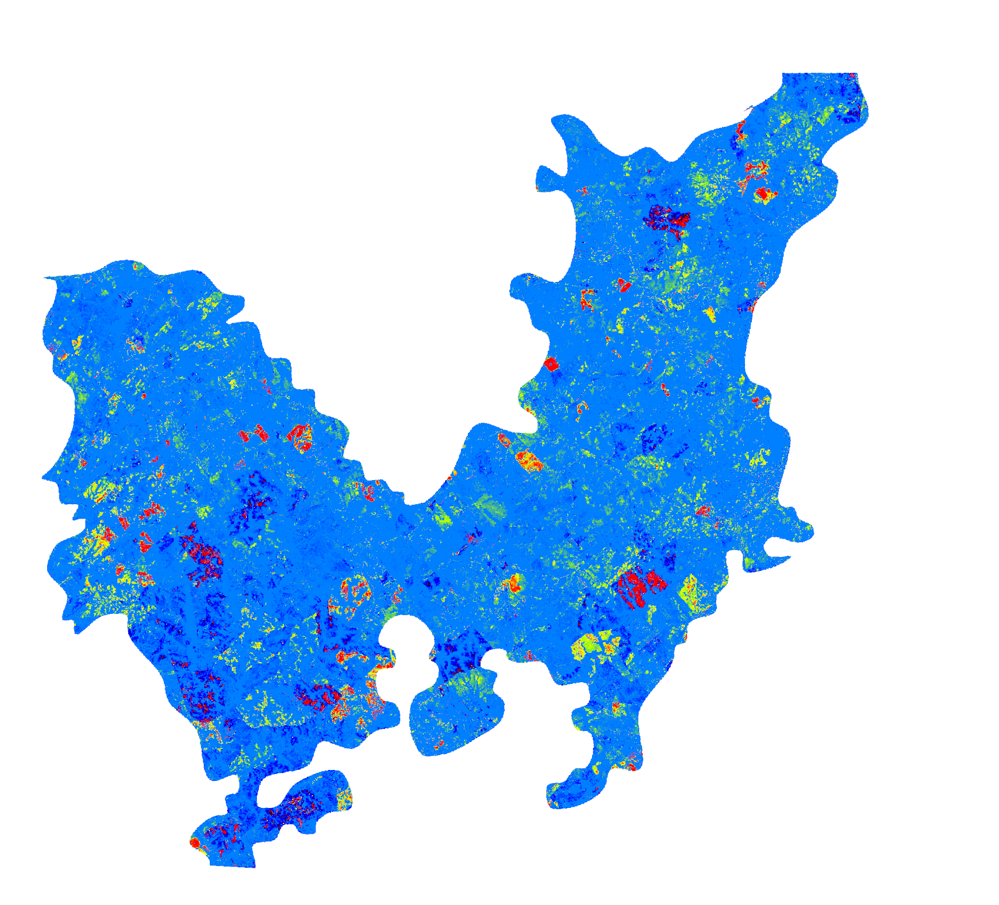
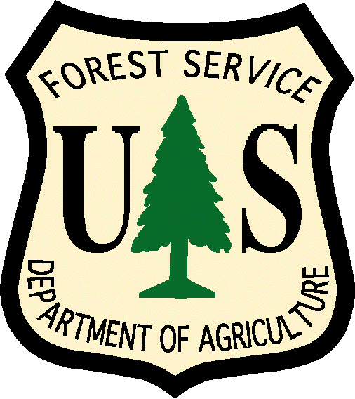
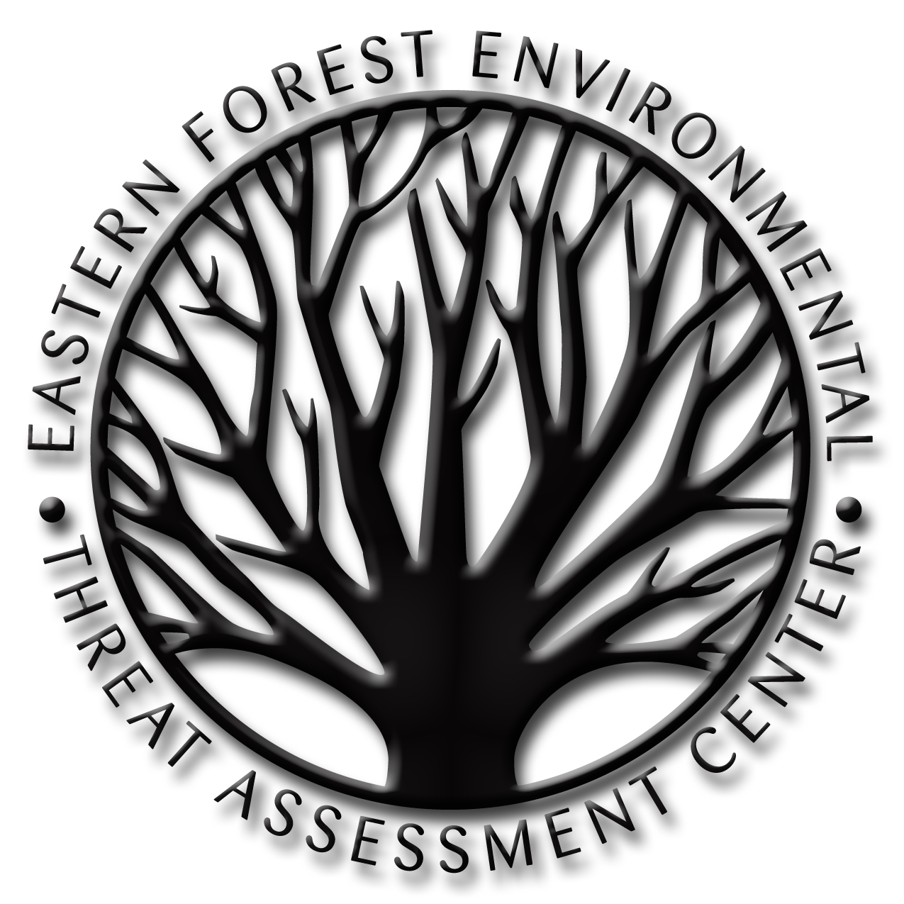
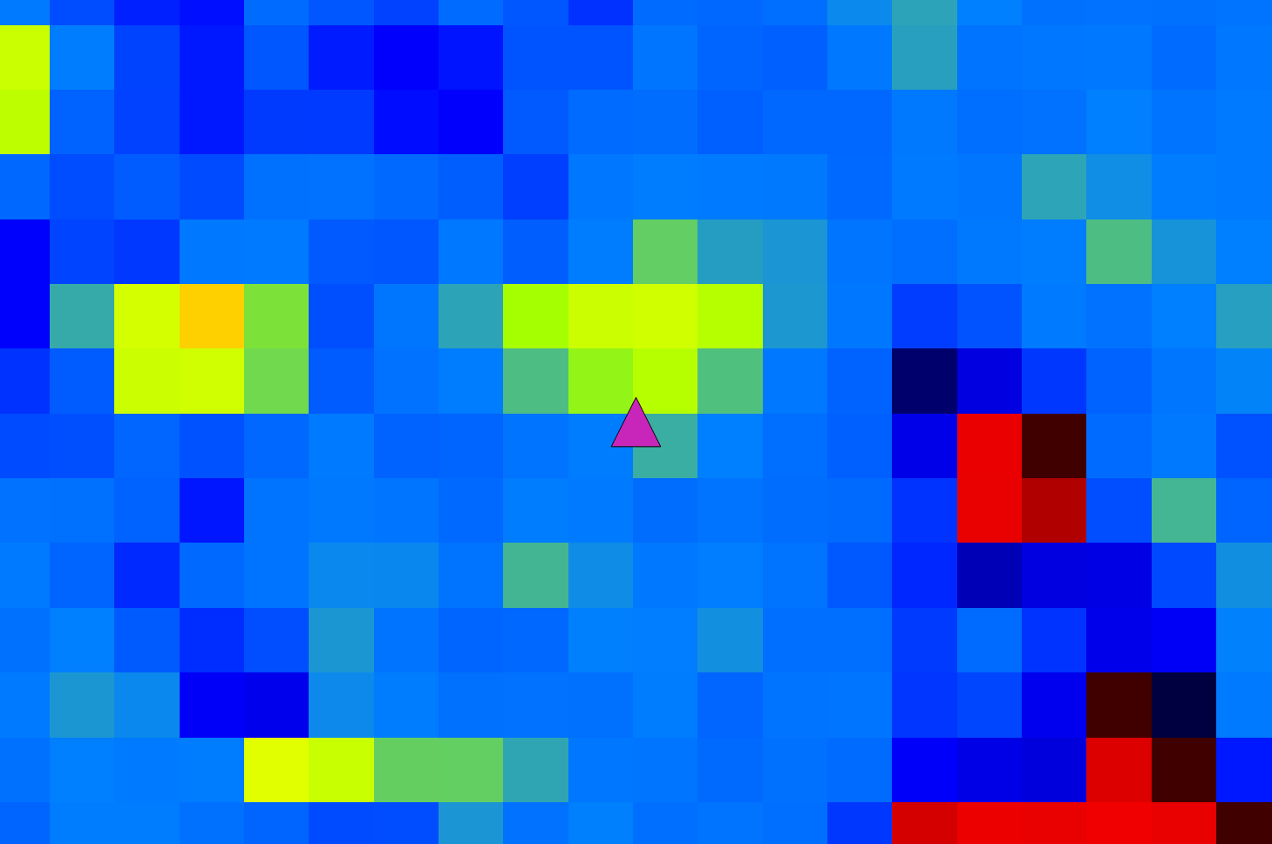
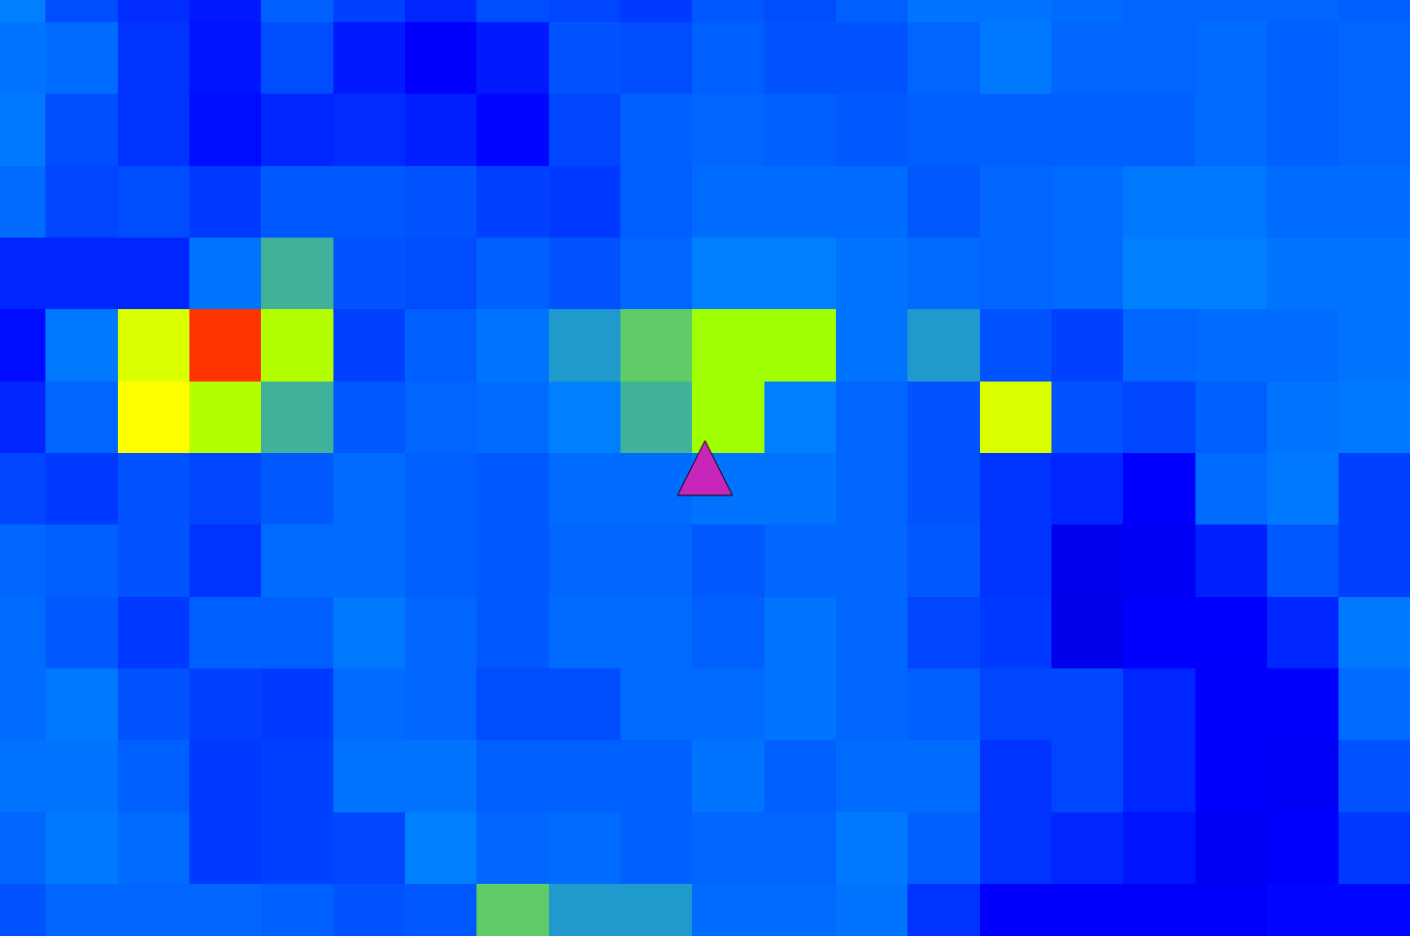
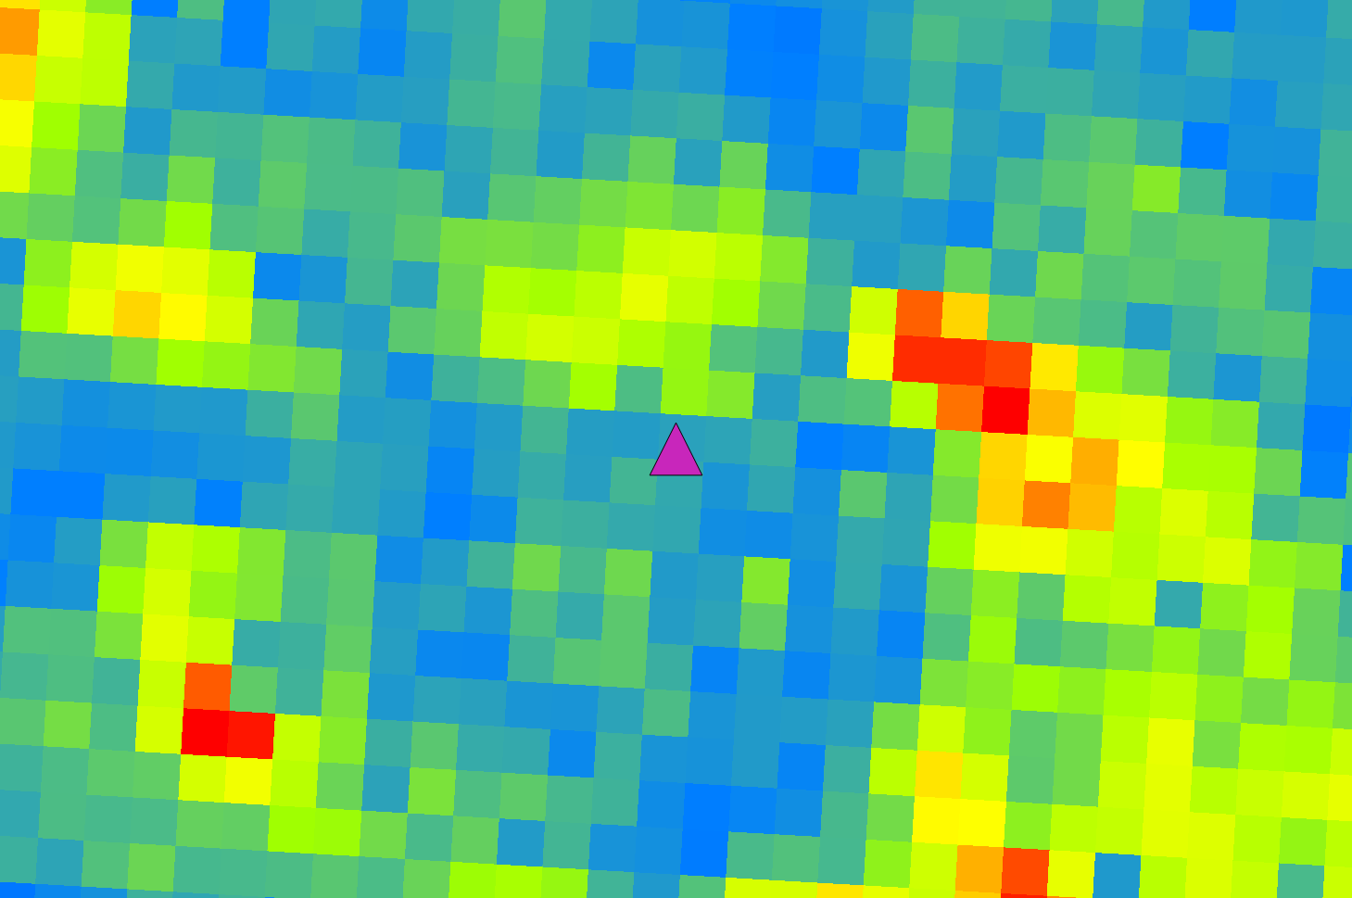
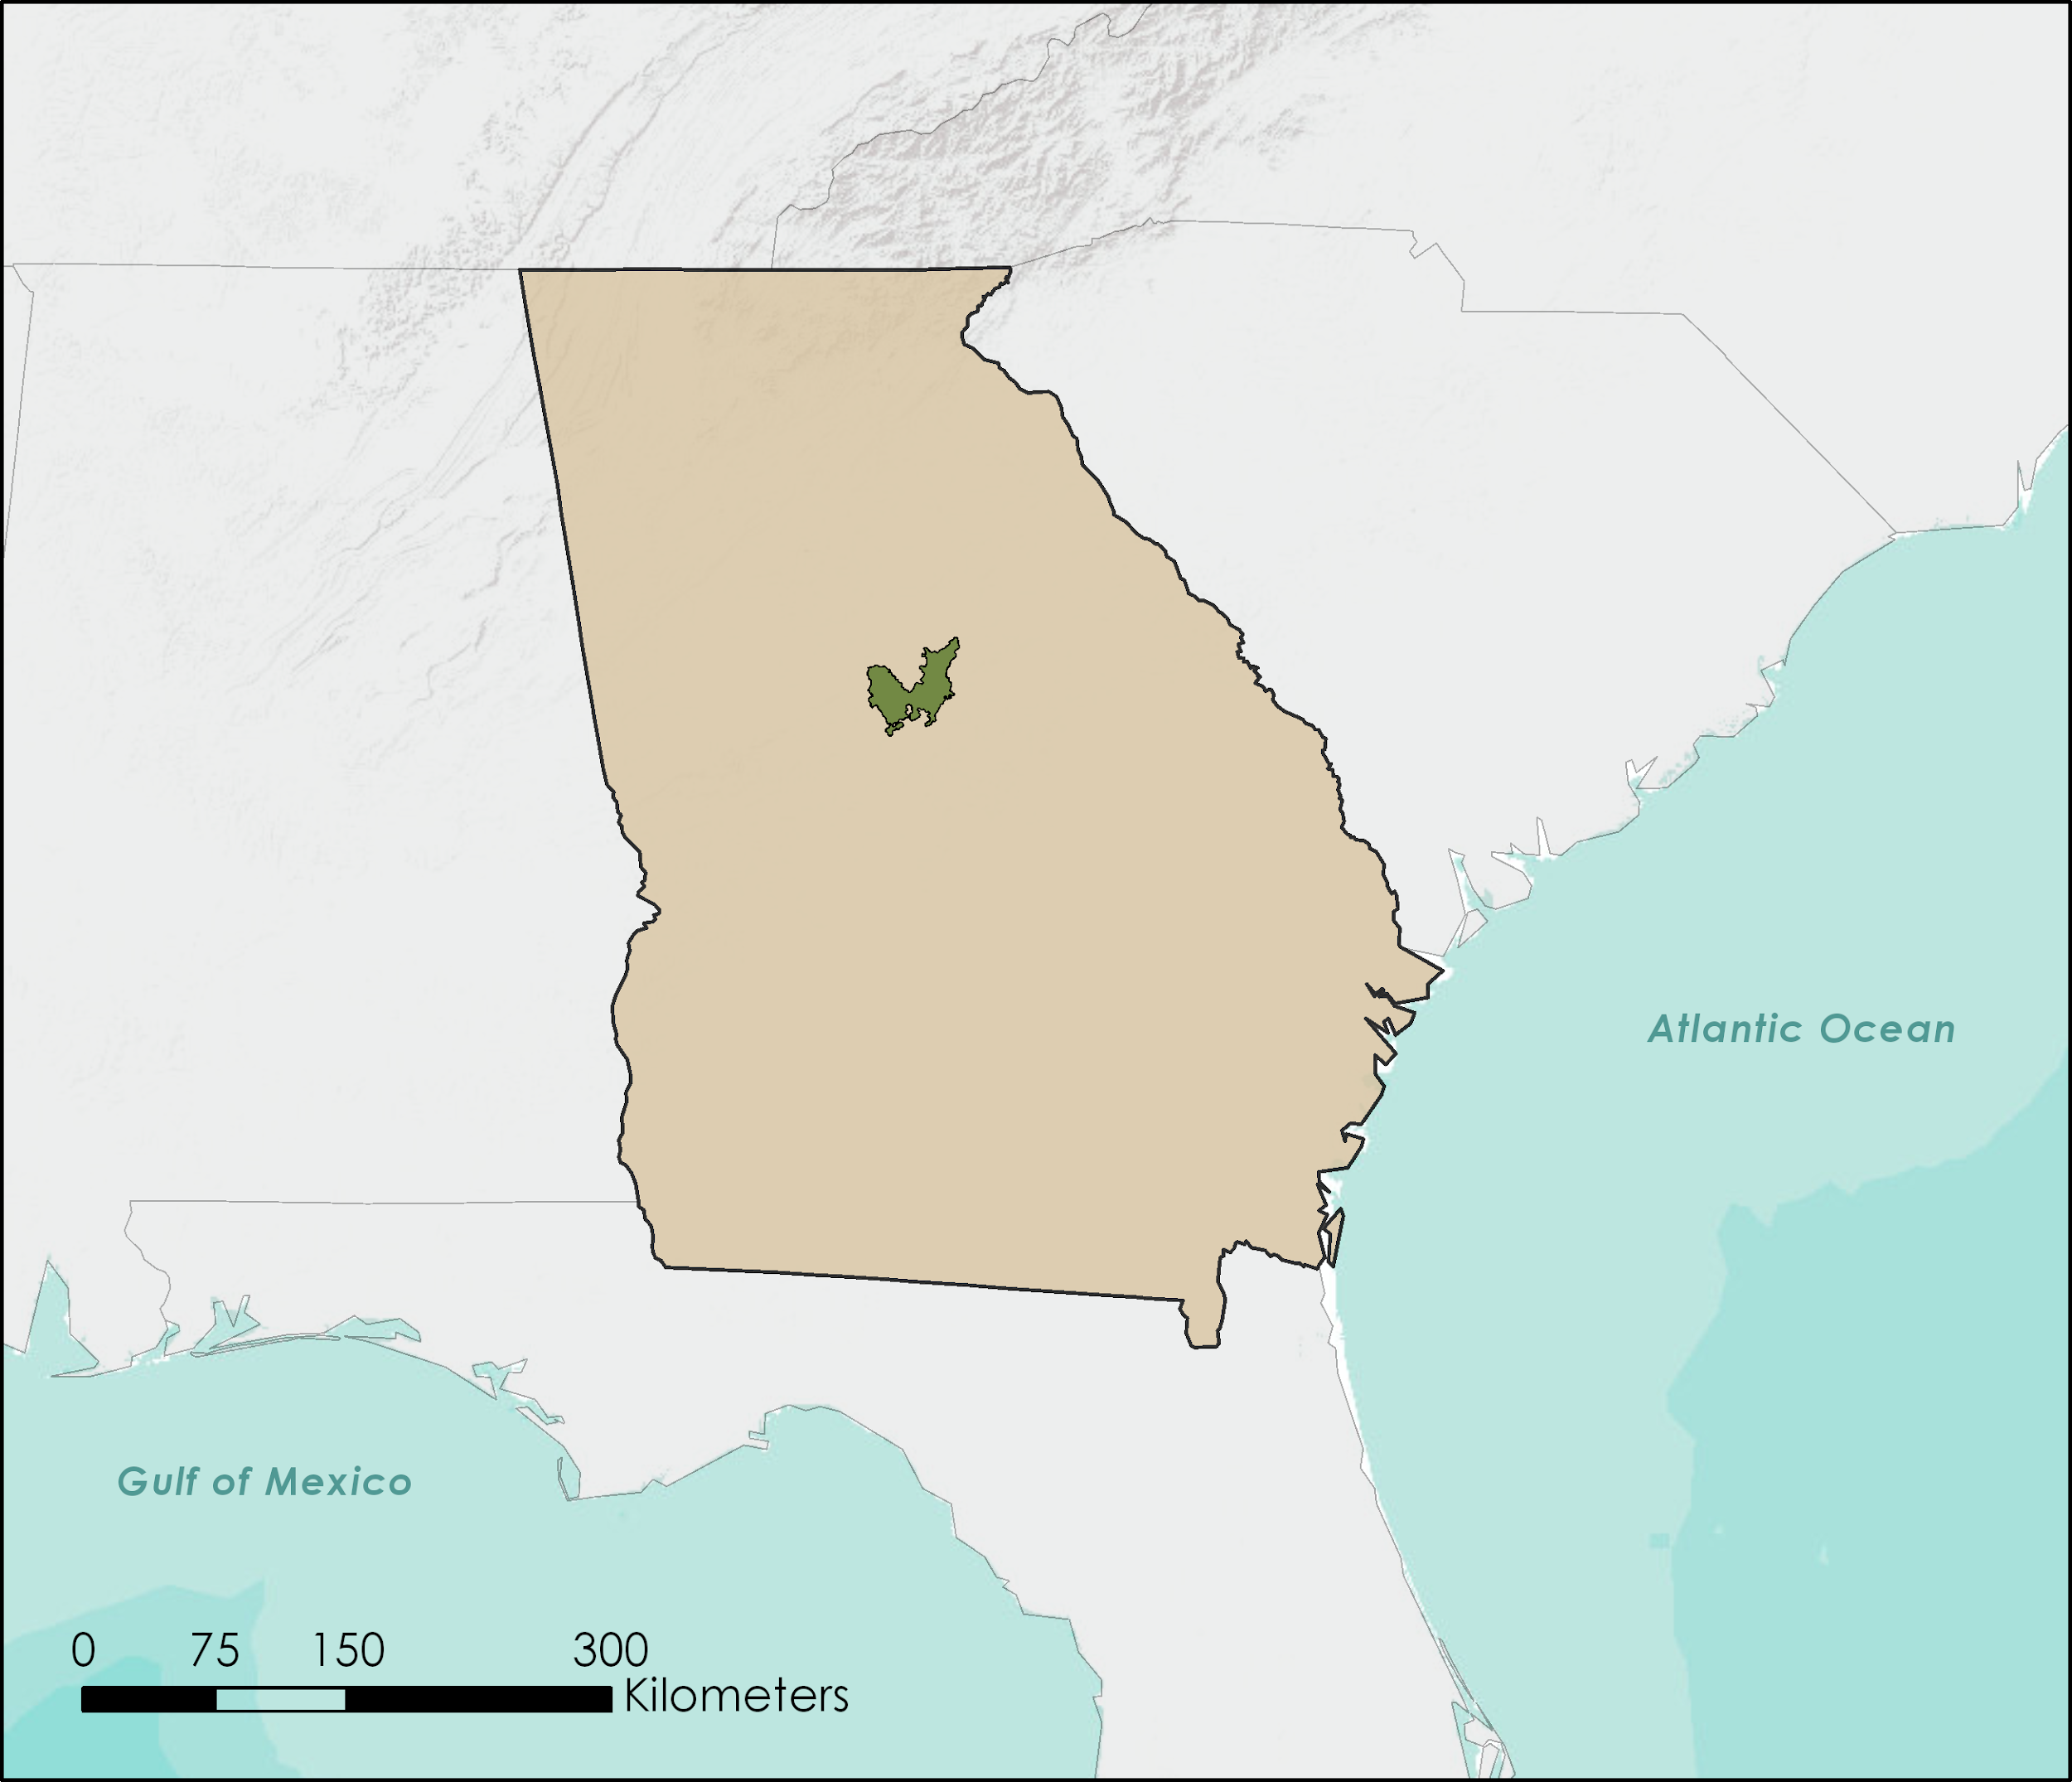
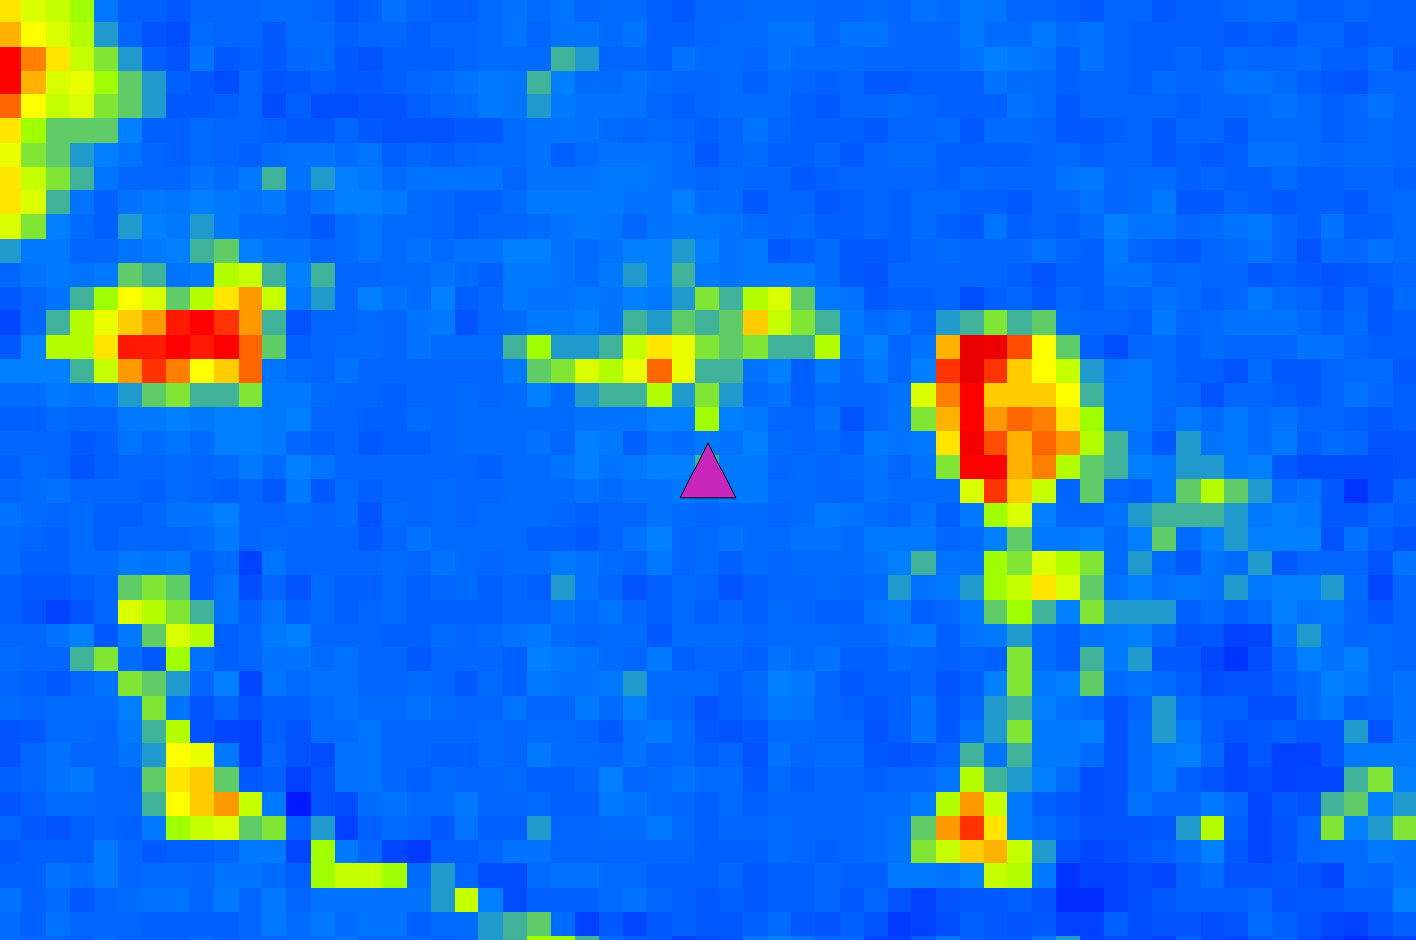
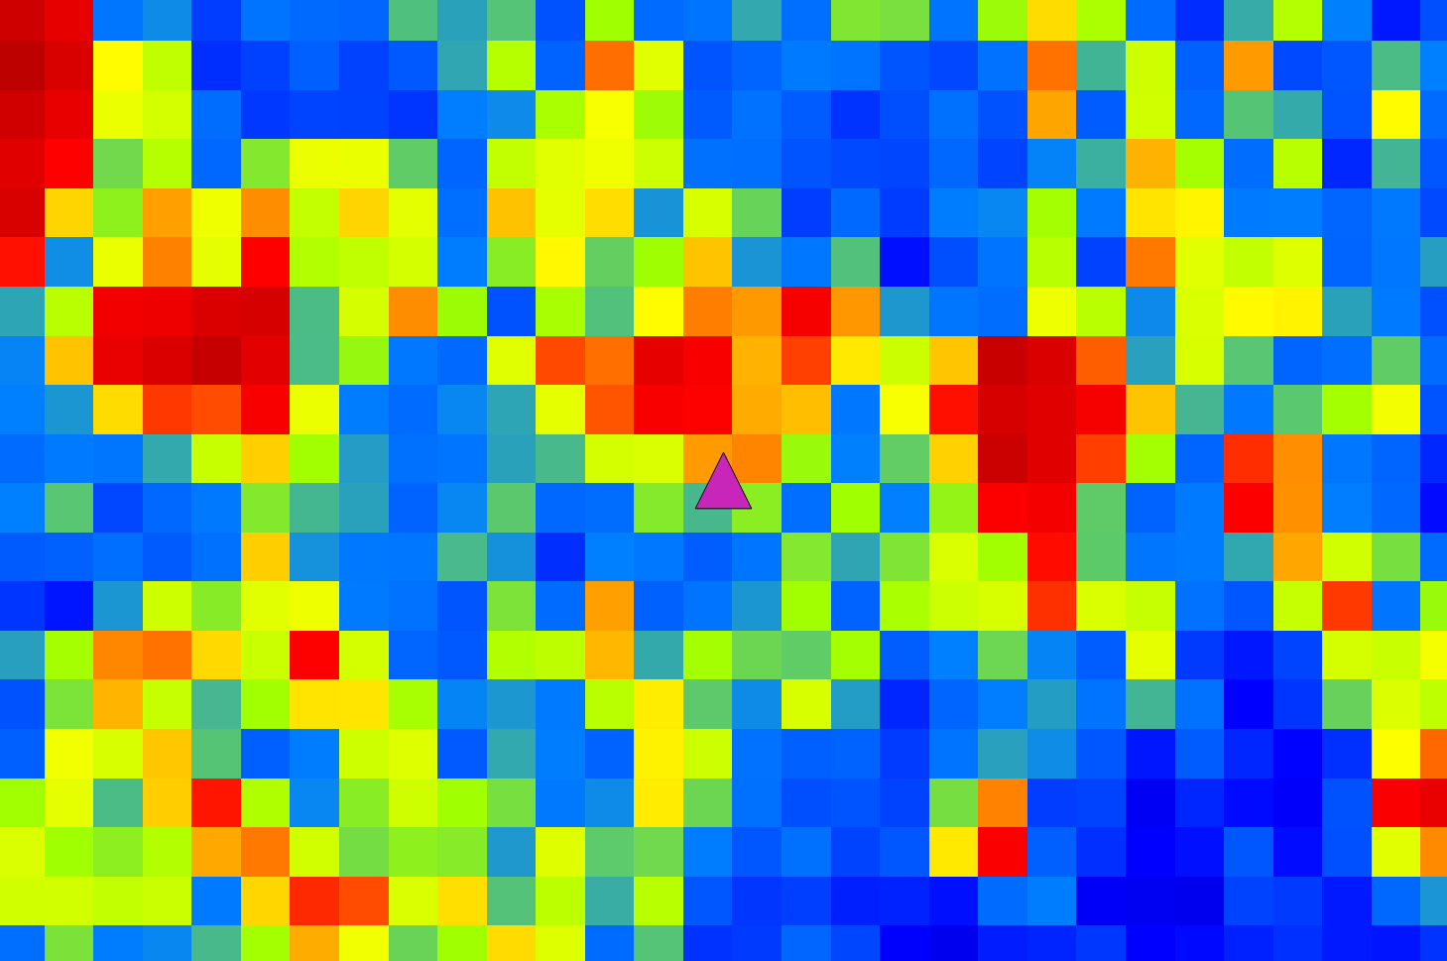
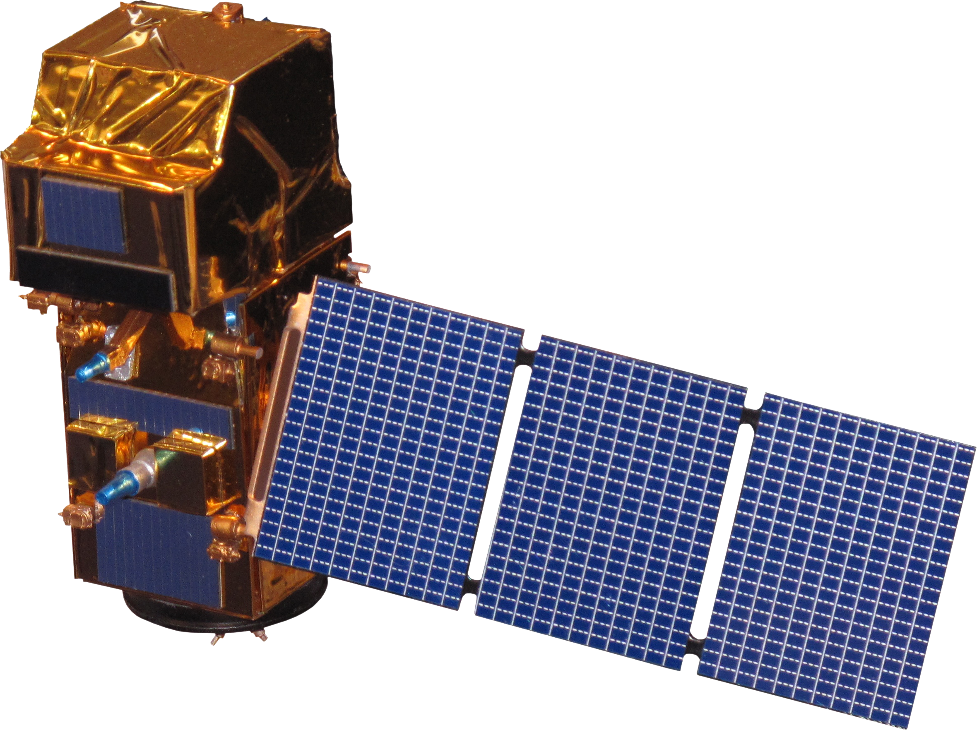
Early Detection of Bark Beetle Outbreaks in the Southeastern United States Using Earth Observations
Abstract
Methodology
Since 2015, bark beetle infestations have increased in the southeastern United States, increasing the potential for devastating wildfires. Bark beetle infestations begin in small spots, usually by attacking a weakened or stressed focal tree. Beetles then use aggregation pheromones to increase the breeding population in the area, boring into the trees and disrupting the flow of water and nutrients to reproduce and develop under the bark. This disrupting activity causes detectable canopy color changes, with needles fading and eventually turning red before falling off. The USDA US Forest Service currently uses ForWarn Moderate Resolution Imaging Spectroradiometer (MODIS) Normalized Difference Vegetation Index (NDVI) to identify locations of bark beetle outbreaks; however, the spatial resolution of MODIS can only detect infestation once a sufficiently large swath of trees have dying foliage, lost needles, or have been harvested via sanitation logging. This detection of widespread disturbance can be too late for effective intervention to reduce beetle populations using forest management practices. In response, the NASA DEVELOP team assessed the potential of higher resolution remotely sensed imagery from Landsat 8 Operational Land Imager (OLI) and Sentinel-2 MultiSpectral Instrument (MSI) to detect early stages of bark beetle outbreaks occurring in the Oconee National Forest from January 2015 – July 2017. The project assessed the possibility of enhanced early detection of bark beetle activity via remote sensing, which could improve the US Forest Service’s ability to mitigate beetle damage in forests of the southeastern United States. Project results suggest that Sentinel-2 MSI and Landsat 8 OLI data were useful for assessing co-occurring bark beetle outbreaks and drought impacts to pine forests.
Landsat 8 OLI
2015 to 2017
<10% cloud cover
Sentinel-2 MSI
2016 to 2017
<10% cloud cover
Acquire data
Classify evergreen forest to create beetle host map
Compile vegetation index change maps
Identify outbreak areas on maps
Assess accuracy using validation datasets
Compare utility of map products
Compare Landsat 8 OLI and Sentinel-2 MSI Results
Compare both Landsat 8 OLI and Sentinel-2 MSI results with ForWarn
Results
Normalized Difference Vegetation Index Change:
May 2016 to May 2017
Normalized Difference Moisture Index Change:
May 2016 to May 2017
Project Partners
The NASA DEVELOP team partnered with the USDA Forest Service’s Eastern Forest Environmental Threat Assessment Center.
-100%
-2000%
-20%
-100%
-10%
-50%
-5%
-25%
0%
0%
20%
100%
ForWarn
Landsat 8 OLI
100%
Landsat 8 OLI
Sentinel-2 MSI
2000%
Objectives
Inverted Red Edge Chlorophyll Change:
May 2016 to May 2017
Sentinel-2 MSI
Comparing Utility of Derived Change Map Products for Identifying Bark Beetle Spots
Assess satellite data processing algorithms to detect early Ips and southern pine beetle outbreaks in the Southeastern United States using remotely sensed data from Landsat 8 OLI and Sentinel-2 MSI
Compare Landsat 8 OLI and Sentinel-2 MSI data for improving detection of forest damage from bark beetles
Validate our methodology with available aerial, satellite, and in situ survey data
ForWarn ΔNDVI
Landsat 8 OLI ΔNDMI
Negative Change
Landsat 8 OLI ΔNDVI
Sentinel-2 MSI ΔNDMI
Positive Change
Bark beetle spot
Study Area
-100%
-20%
Oconee National Forest
-10%
Sentinel-2 MSI ΔNDVI
Sentinel-2 MSI ΔIREC
Maps show the change in indices from May 2016 to May 2017 in the vicinity of a known bark beetle outbreak detected in a September 2017 aerial survey.
Mixed oak-pine-hickory forest surrounded by pine plantations
Pine forests vulnerable to bark beetle attacks include:
Loblolly pine (Pinus taeda)
Shortleaf pine (Pinus echinata)
Study period: 2016-2017
Georgia
-5%
0%
20%
Sentinel-2 MSI
100%
Conclusions
Negative NDVI, NDMI, and IREC changes are correlated with known bark beetle activity and drought impacts.
Landsat 8 OLI and Sentinel-2 MSI data products offer a higher spatial resolution view of bark beetle activity than ForWarn.
Sentinel-2 IREC index change maps showed greater potential for identifying early indications of disturbance by bark beetles compared to non-red edge NDVI and NDMI change maps.
Earth Observations
Landsat 8 OLI
NASA/USGS Mission
16 day temporal resolution
30 m spatial resolution
Sentinel-2 MSI
European Space Agency Mission
5 day temporal resolution
10 m spatial resolution
Team Members
Acknowledgments
Haley Ritger
Project Lead
Jacob Armistead
Dionne Blanks
Bernard H. Eichold II, M.D., Dr.P.H., NASA DEVELOP Mentor, Mobile County Health Department
Joe Spruce, NASA DEVELOP Science Advisor, Science Systems & Applications, Inc.
Dr. Kenton Ross, NASA Langley Research Center
Dr. William “Bill” Hargrove, USDA Forest Service
Dr. Steven P. Norman, USDA Forest Service
William “Bill” Christie, USDA Forest Service
Farnaz Bayat, Center Lead, NASA DEVELOP National Program - Wise County
Danielle Quick, Assistant Center Lead, Impact Analysis Fellow, NASA DEVELOP National Program - Wise County
Michael Torbett, Georgia Forestry Commission
Paul Merten, USDA Forest Service
Kenny Frick, USDA Forest Service
Madison Murphy
Danielle Quick
Larissa Robinov
Southeastern US Disasters
Alabama – Mobile | Spring 2018

