Slide 1
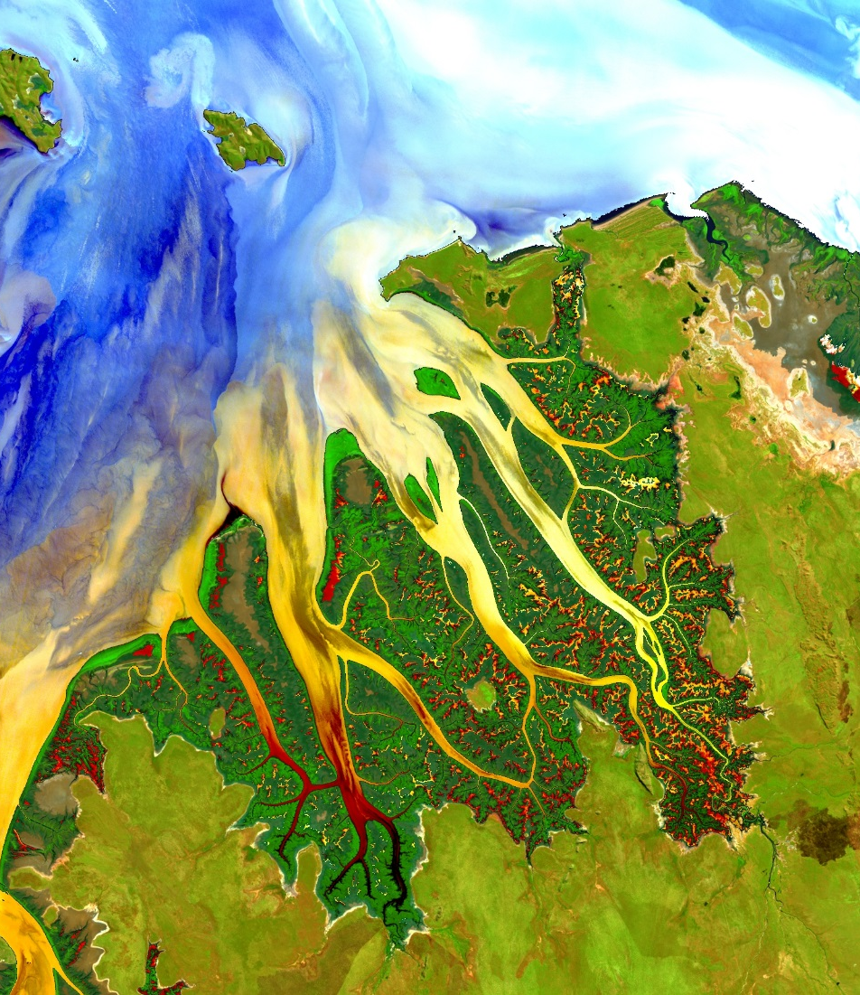


Your project Website Image should be placed behind the hexagons. An example image has been placed in this position for your reference. Delete the example image, insert your image, then right click your image and select the “Send to Back” option. Position and adjust the size of your image so that it lines up with the provided margin rulers.
Insert team member names in the boxes provided. Delete unused text boxes. Do not delete or move the 20th anniversary logo or other page components, including name boxes.
Body text should default to “Black, Text 1, Lighter 25%”
Align body text to slide titles, NOT the hexagon elements (as shown in example slides)
Delete this text box.
2018 Fall | Node Name
PROJECT SHORT TITLE (ALL CAPS)
Long Title Goes Here (Title Case) – Adjust text box width if needed so title takes up a maximum of 4 lines of text without covering the website image
Team Member 1
Team Member 2
Team Member 3
Team Member 4
Team Member 5
Notes:
Your project Website Image should be placed behind the hexagon grid. An example image has been placed in this position for your reference. Delete the example image, insert your image, right click your image and select the “Send to Back” option. Position and adjust the size of your image so that it lines up with the provided margin rulers.

Slide 2

Presentation Tips
Font is always Century Gothic
Font color is Black, Text 1, lighter 25%
NOT black
This is the standard DEVELOP bullet style
Generally, headers are 32-48 point
Body copy should be at least 20 point, depending on slide formatting
Do not go below 14 point type
Here’s why
Maximize the size of any images, figures, and graphs to fill up the slide
*Hint - it’s a symbol under the Wingdings 3 font
Not this
or this
or this

Slide 3
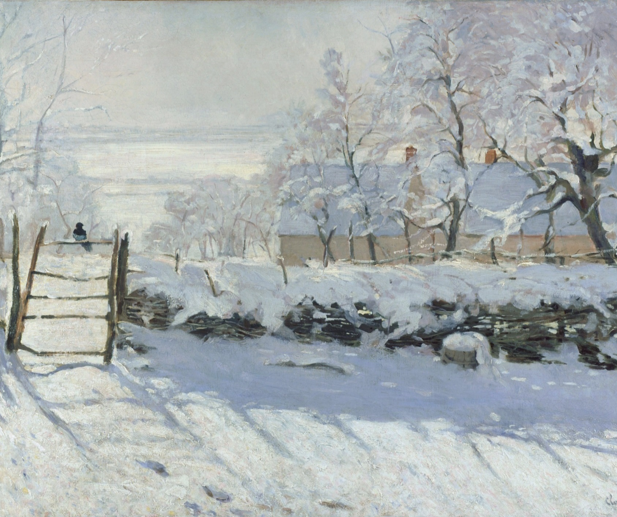
Components
Study area
Study period
Objectives
Partners
Community concerns
NASA satellites/sensors used
Methodology
Results
Conclusions
Errors & uncertainties
Future work
Acknowledgements
Backup slides
Required Statement
Feel free to vary slide templates – you don’t have to use only one!
See HOME Tab -> Layout drop-down menu for layout options.
Delete this text box.
The slides provided in the template are just a starting point for teams. Feel free to expand upon these topics, alter the headings, and change the order of the slides to fit your needs. An outline slide is NOT required.
Image Credit: Monet
Notes:
These notes should be thorough enough for someone not familiar with the project to clearly present the material.
NOTE: For every image on the slide include an image source in the speaker notes (ex. URL; Name, Affiliation, etc.)
Image Source: http://commons.wikimedia.org/wiki/File:Claude_Monet_-_The_Magpie_-_Google_Art_Project.jpg

Slide 4
Components II
Header text point size should be between 32 and 48 on most slides.
Body text point size should be at least 20.
All other text (captions, legend, image credits, etc) should be at least 12.
Use Century Gothic.
Keep text to a minimum.
Try to use a consistent font size between slides.
Image Credit: Monet
Notes:
These notes should be thorough enough for someone not familiar with the project to clearly present the material.
NOTE: For every image on the slide include an image source in the speaker notes (ex. URL; Name, Affiliation, etc.); ALL images need to be created by a DEVELOPer, in the public domain (federal agency), or published under a creative commons license (if attributed correctly)
Image Source: http://commons.wikimedia.org/wiki/File:Claude_Monet_-_The_Magpie_-_Google_Art_Project.jpg

Slide 5

General Guidelines
Image Credit: Monet
Include speaker notes for each slide (see below).
Include a visual on each slide, if possible.
Arrange content to minimize white space.
Notes:
These notes should be thorough enough for someone not familiar with the project to clearly present the material.
NOTE: For every image on the slide include an image source in the speaker notes (ex. URL; Name, Affiliation, etc.)
Image Source: http://commons.wikimedia.org/wiki/File:Claude_Monet_-_The_Magpie_-_Google_Art_Project.jpg

Slide 6
Maps & Logos
Maps
A scale bar is required for reference on all maps.
A North arrow is suggested. Otherwise all maps should be oriented such that North is the top of the slide.
Make sure all text is legible and add legends separately (so they can be moved or resized).
Cite base layer source in speaker notes.
Logos
US Federal logos only.
No state, NGO, local and or international government logos, or software logos.
Notes:
These notes should be thorough enough for someone not familiar with the project to clearly present the material.

Slide 7
Backup Slides
This slide can be used as a section transition, if needed for your presentation.

Slide 8

Maps, Figures, & Graphs
Keep all images and text boxes editable, including individual elements of flowcharts.
Do not copy/paste graphs or flowcharts as images.
Separate and editable legends and text makes resizing images quick and easy!
See the examples on the following slides ☺
Average Annual Mississippi Oyster Landings 2002 - 2015
4,500,000
4,000,000
3,500,000
3,000,000
2,500,000
Landings (Lbs)
2,000,000
1,500,000
1,000,000
500,000
Hurricane Katrina
DWH Spill
Bonnet Carré
0
2002 2003 2004 2005 2006 2007 2008 2009 2010 2011 2012 2013 2014 2015
Notes:
These notes should be thorough enough for someone not familiar with the project to clearly present the material.

Slide 9
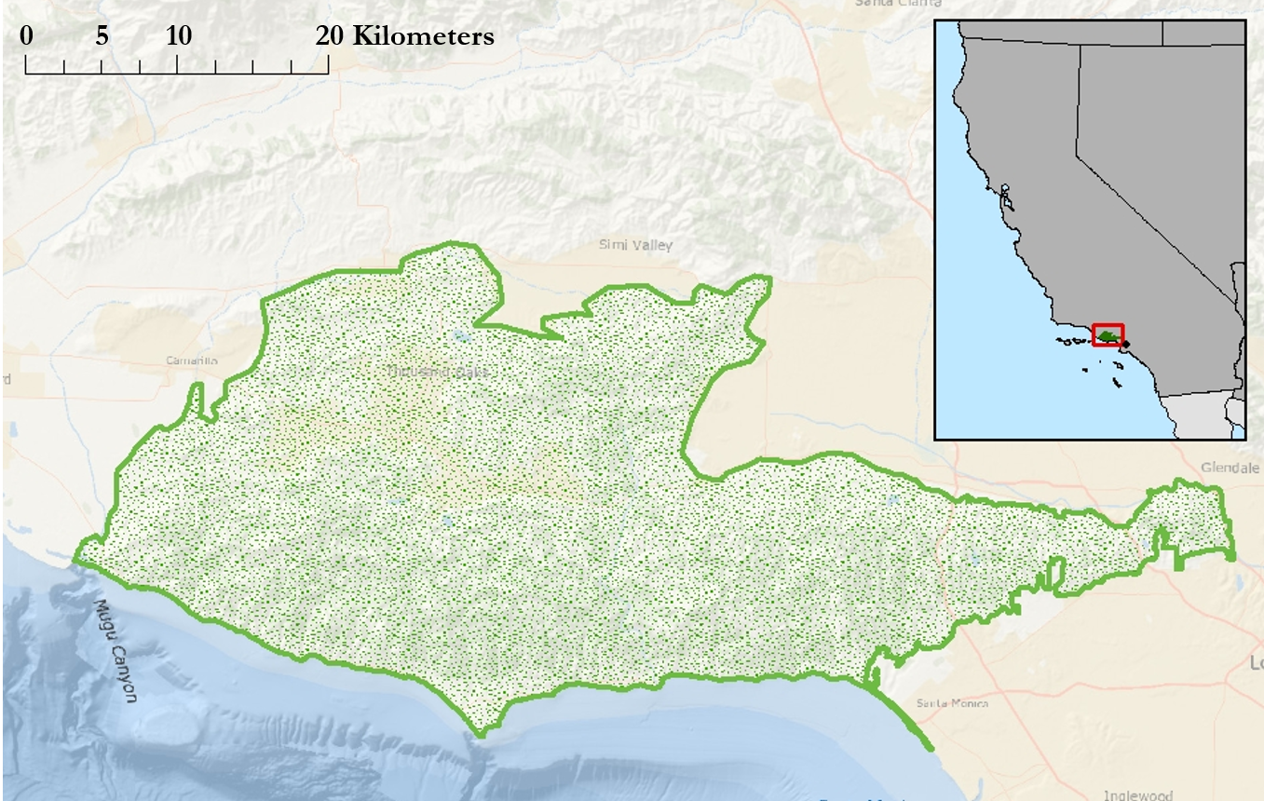
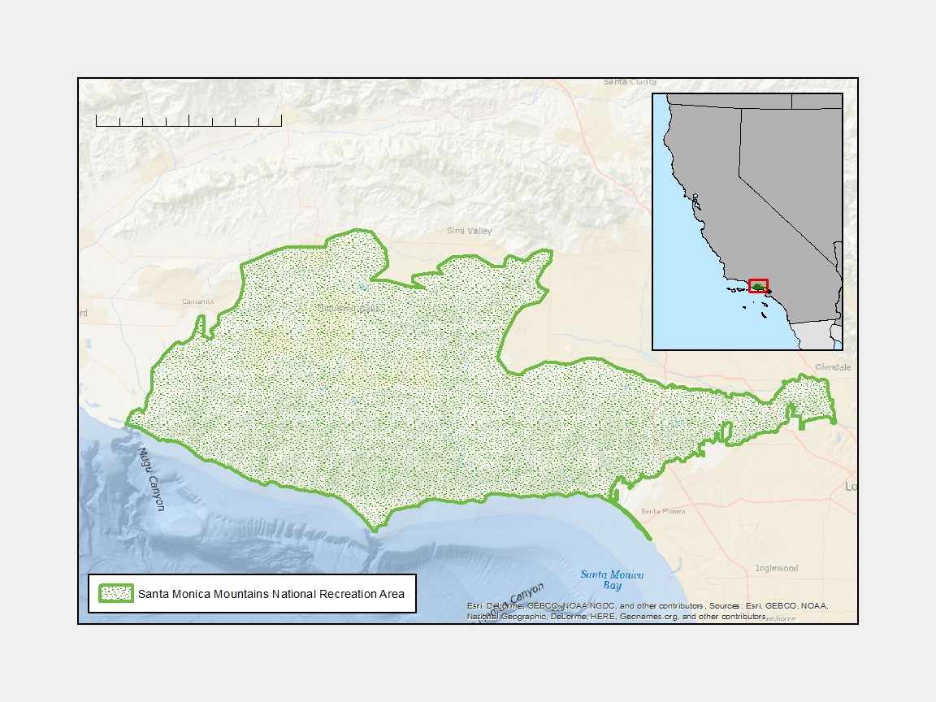
Separate & Editable – The Good
NV
CA
Good Example:
All text is separate and editable
North arrow separate
Scale bar is NOT separate
Los Angeles
MEXICO
Santa Monica Mountains National Recreation Area
Notes:
These notes should be thorough enough for someone not familiar with the project to clearly present the material.
NOTE: For every image on the slide include an image source in the speaker notes (ex. URL; Name, Affiliation, etc.); ALL images need to be created by a DEVELOPer, in the public domain (federal agency), or published under a creative commons license (if attributed correctly)
Image Source: http://commons.wikimedia.org/wiki/File:Claude_Monet_-_The_Magpie_-_Google_Art_Project.jpg

Slide 10



Separate & Editable – The Bad
Bad Example:
Legend is not separate or editable
  Barely legible
North arrow not separate and hard to see
Scale bar is the only thing that is separate
If you can’t read a legend at 100% on your computer screen, your audience won’t be able to read it during a presentation.
Notes:
These notes should be thorough enough for someone not familiar with the project to clearly present the material.
NOTE: For every image on the slide include an image source in the speaker notes (ex. URL; Name, Affiliation, etc.); ALL images need to be created by a DEVELOPer, in the public domain (federal agency), or published under a creative commons license (if attributed correctly)
Image Source: http://commons.wikimedia.org/wiki/File:Claude_Monet_-_The_Magpie_-_Google_Art_Project.jpg

Slide 11

Separate & Editable – The Bad
Bad Example:
Legend is not separate or editable
  Barely legible
  Never label your legend, “Legend”
North arrow not separate and hard to see
Scale bar is the only thing that is separate

Slide 12
Photos & Figures
Please do not include the image URL in the source text box but rather place it in the notes section below.
If you use a border for your images include it on all photographs to keep your presentation consistent.
Background images are discouraged. If you use one, make sure that your text remains clear and legible.
Obtain a media release form from all people in photos that your team has taken!
All image sources should be cited using a consistent format and should be visible on the slide (see slides 3, 4, and 5).
You may only use images taken by your team, provided by your partners (as long as you have permission from them), from a Federal Agency, from the new DEVELOP stock imagery collection on DEVELOP’s Flickr page, or Creative Commons images.
Notes:
These notes should be thorough enough for someone not familiar with the project to clearly present the material.

Slide 13
Acknowledgements
List advisors, partners, and others who have contributed in any way to the project.
If your project is a multi-term one, acknowledge past contributors.
Choose one of the two following slides as an acknowledgements page. Feel free to modify them as needed to fit your content.

Slide 14
Acknowledgements

