Slide 1
Southwest US Disasters
Incorporating CDRs and MODIS to Create a Predictive Model of Post-Burnout Vegetation Regrowth in Relation to Flood Risk
Jason Zylberman (Project Lead)
Jennifer Holder
Lance Watkins

Slide 2
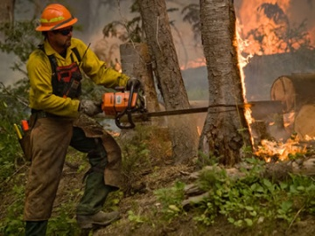
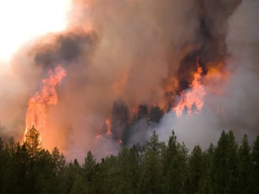
Community Concerns
Wildfires and flooding are two major disasters which cause economic damage and loss of life in the Southwest.
Flood events that occur after periods of wildfires can lead to an increase in soil erosion and larger debris in flood waters
Credit: US Forest Services
Notes:
Image Source: http://www.fs.fed.us/managing-land/fire

Slide 3
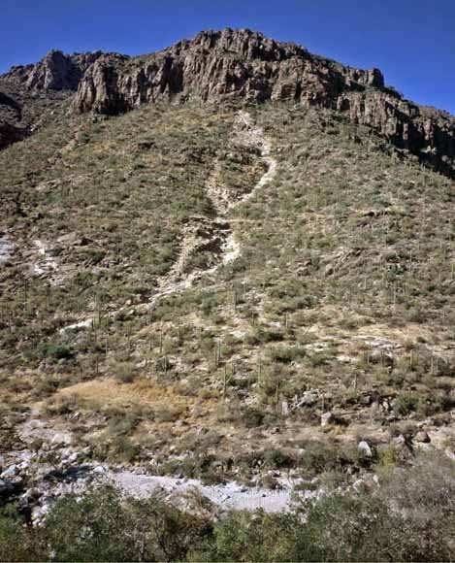
Objectives
Establish a spatio-temporal relationship between vegetation regrowth as a function of NDVI and post-fire runoff hazard, over a 10-year period, for greater Tuscon, Arizona area within the Lower Colorado River Basin
Generate a raster surface indicating vegetation regrowth rate after historical wildfires on a per-pixel basis
Identify precipitation rates associated with increased post-wildfire flooding risk based on historical runoff events
Credit: USGS
Notes:
Image Source: http://pubs.usgs.gov/of/2008/1274/images/coverphoto.jpg

Slide 4
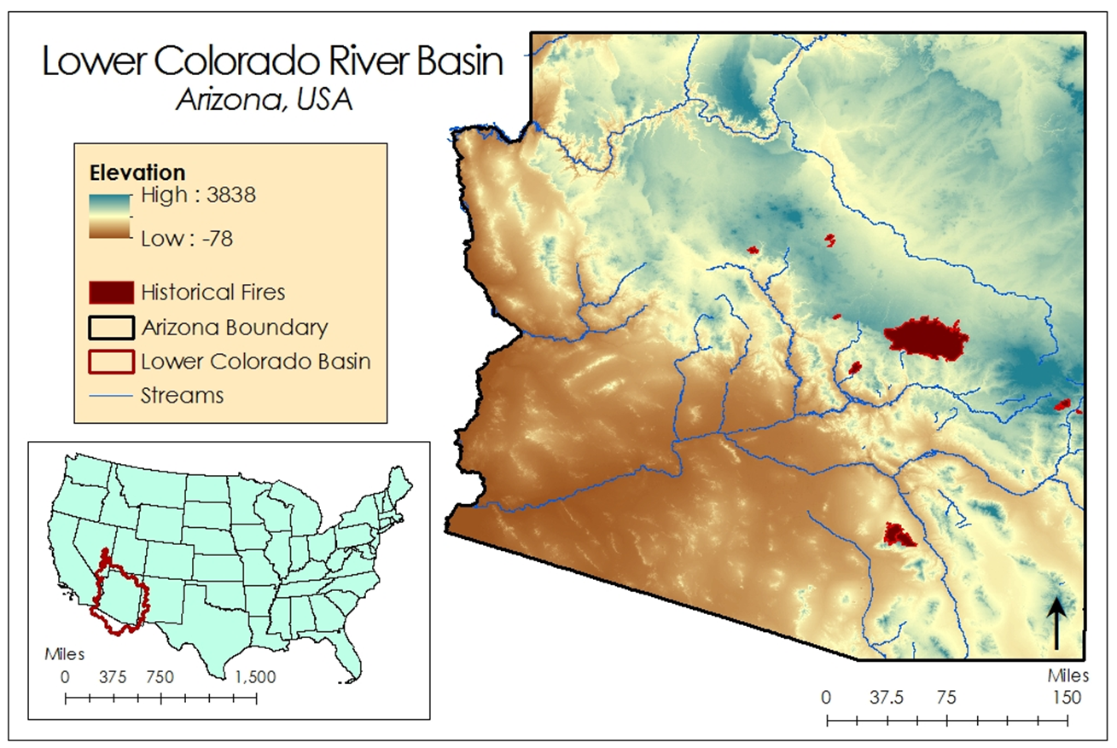
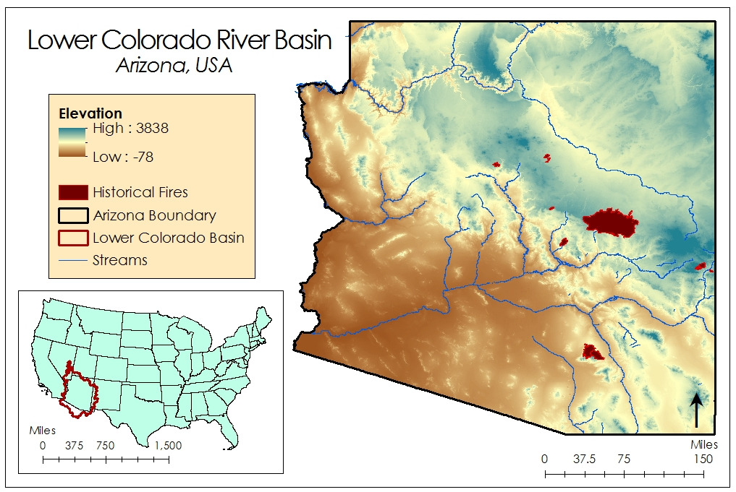
Study Area

Slide 5
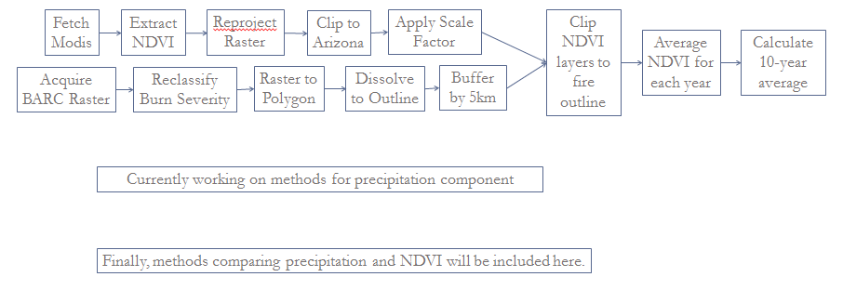
Methodology
This slide will be edited as processing continues.

Slide 6
NOAA Climate Data Records
Precipitation Estimation From Remote Sensing Information Using Artificial Neural Network (PERSIANN) – Climate Data Records (CDR)
PERSIANN CDR Specifications:
0.25 – deg * 0.25 deg
Daily Product
1983 – present
Updated Quarterly
Inputs to the PERSIANN CDR:
GridSat – B1 CDR (IRWIN)
GPCP 2.5 deg Monthly Data
Notes:
Image Source: Derived from PERSIANN data in ArcMap

Slide 7
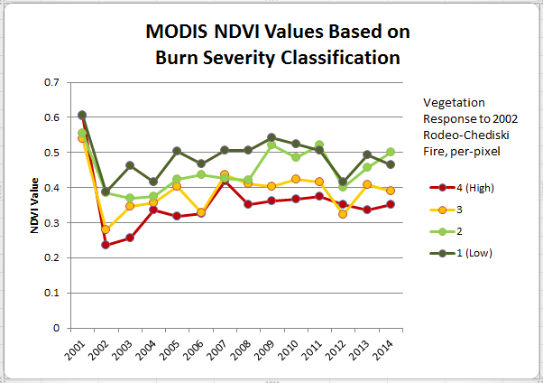
Results
Animation of NDVI Regrowth for Rodeo-Chediski Fire, 2001-2014
created in GRASS GIS

Slide 8
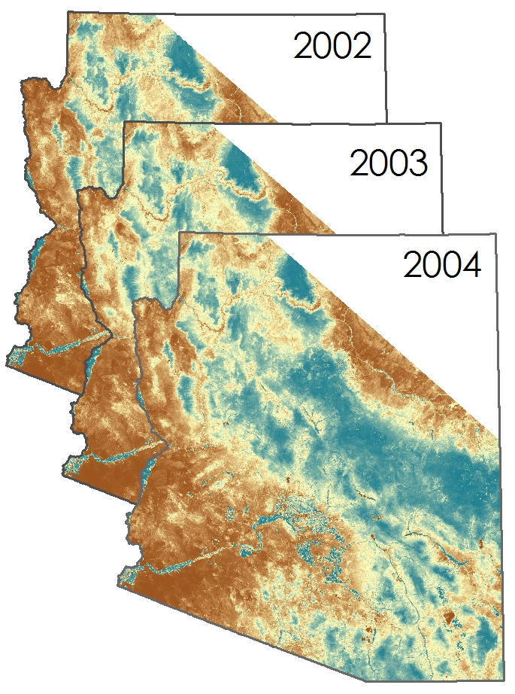
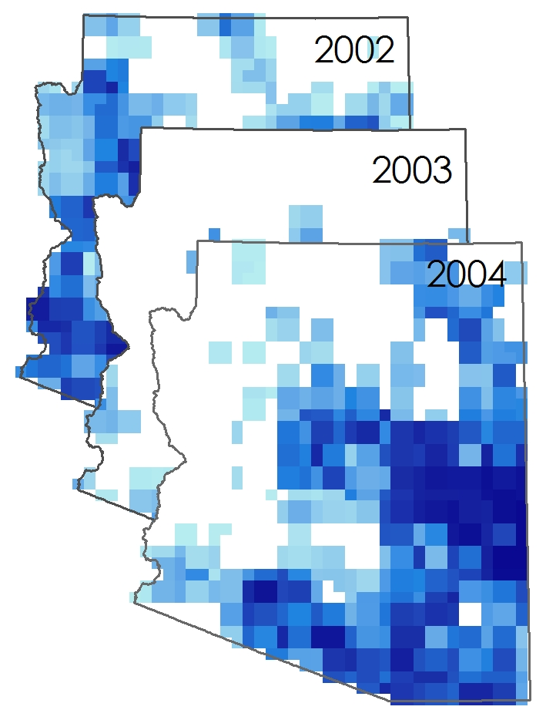
Results
NDVI and PERSIANN precipitation data from July 12 (2002, 2003, and 2004)

Slide 9
Conclusions
Conclusions will be placed here

Slide 10
Advisors
Dr. DeWayne Cecil, NOAA National Centers for Environmental Information
Partners
Dr. Gregg Garfin, Climate Assessment for the Southwest
Tim Brown, Western Regional Climate Center
Dennis Staley, USGS Landslides Hazards Team
Jason Kean, USGS Landslides Hazards Team
Others
Michael Schaffner, NWS
Christopher Smith, USGS

