Slide 1
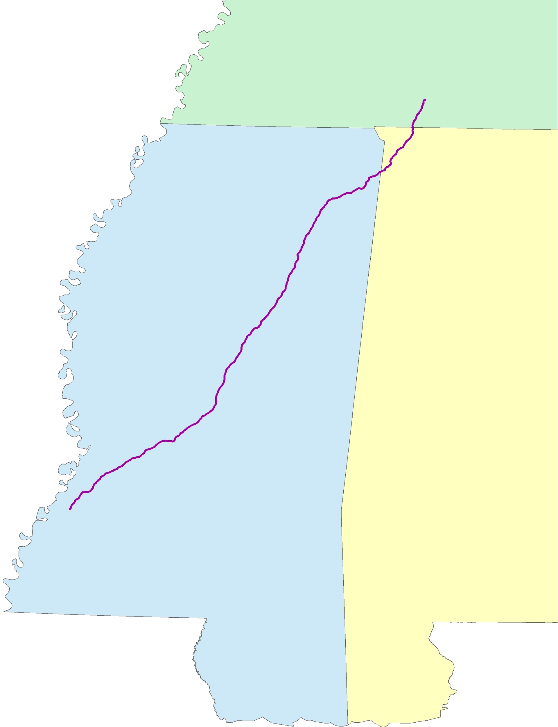
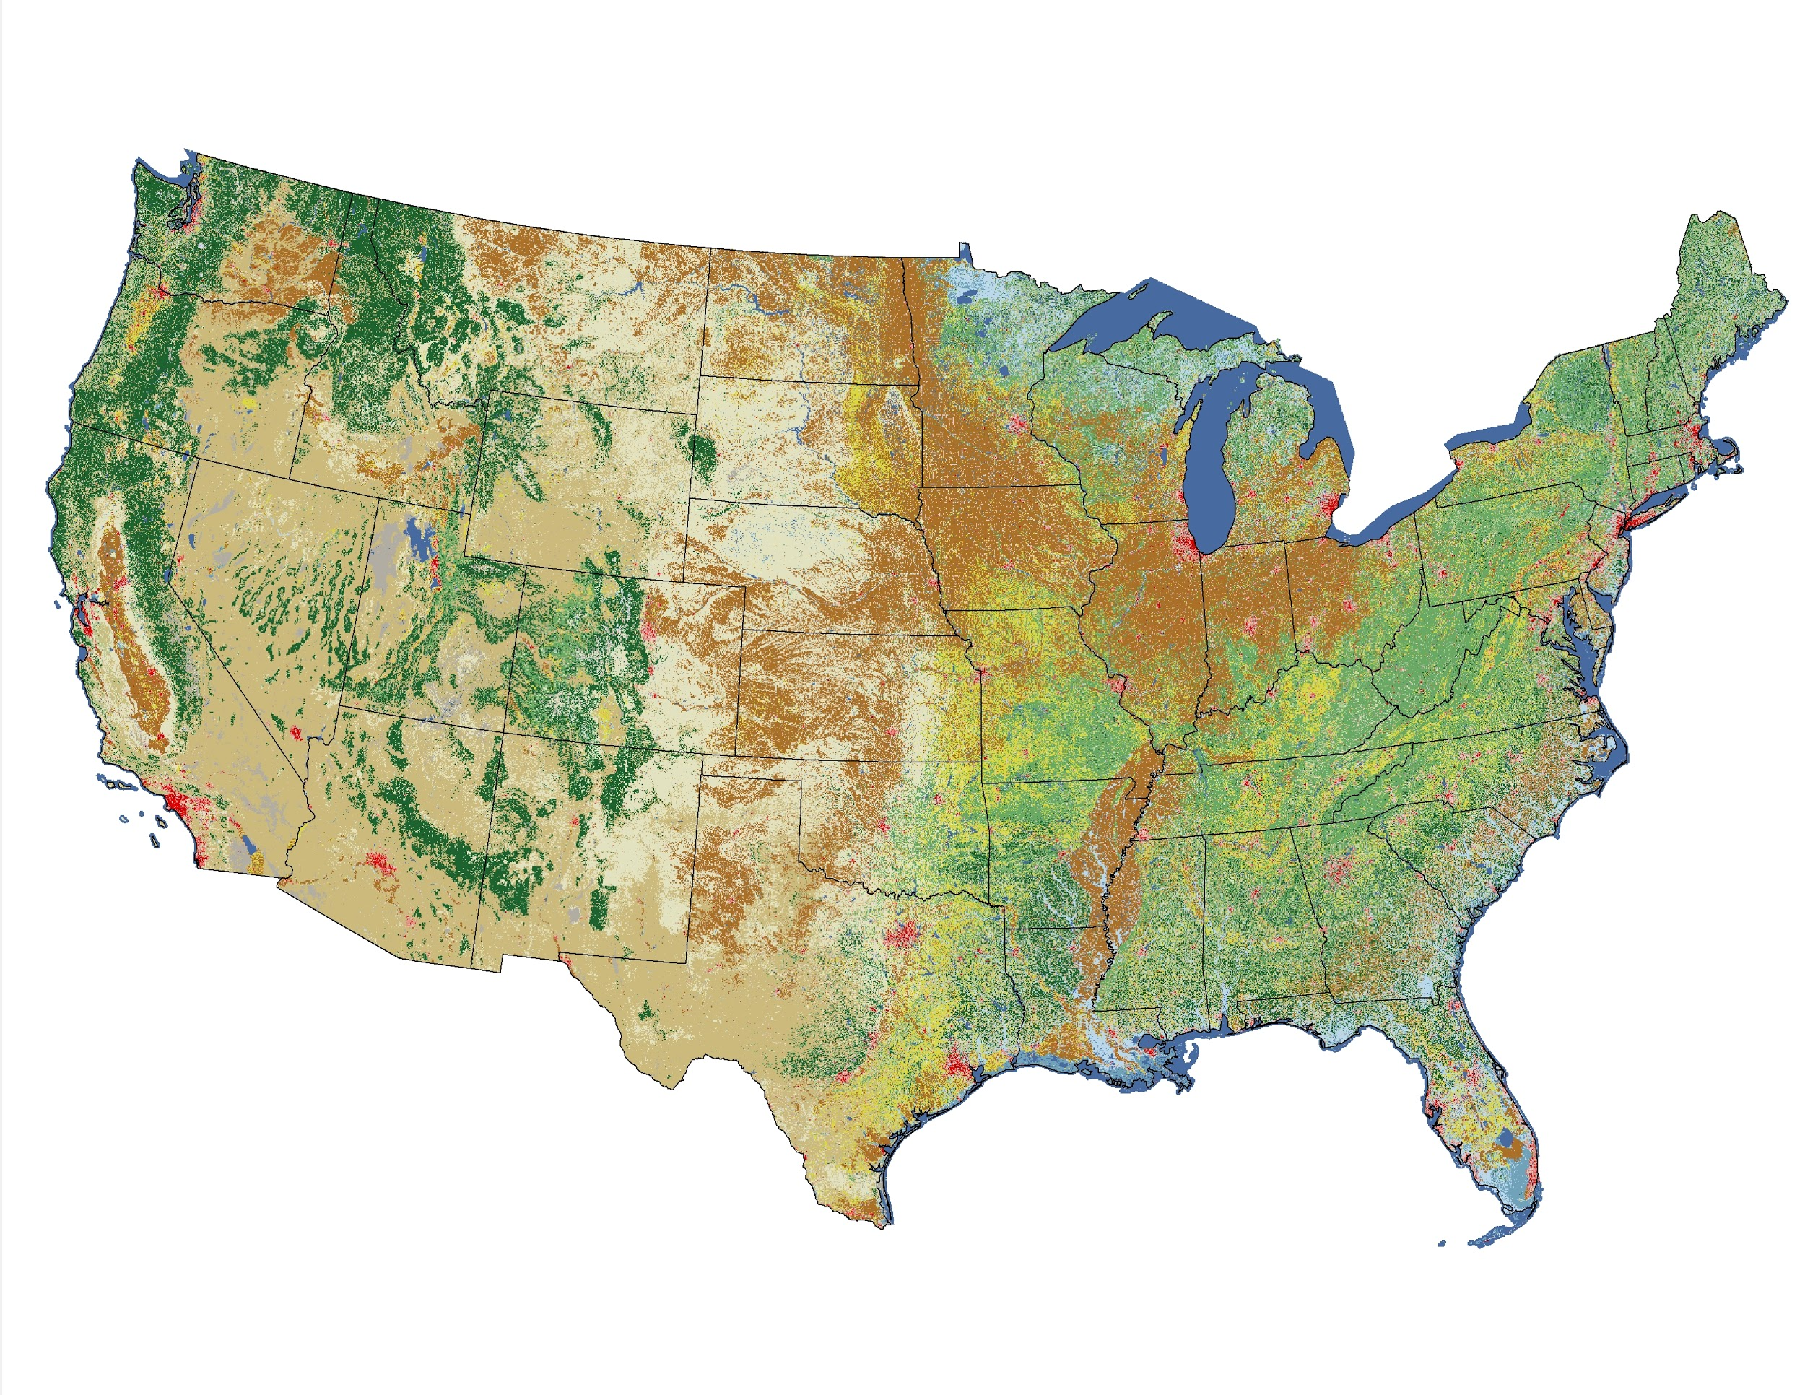
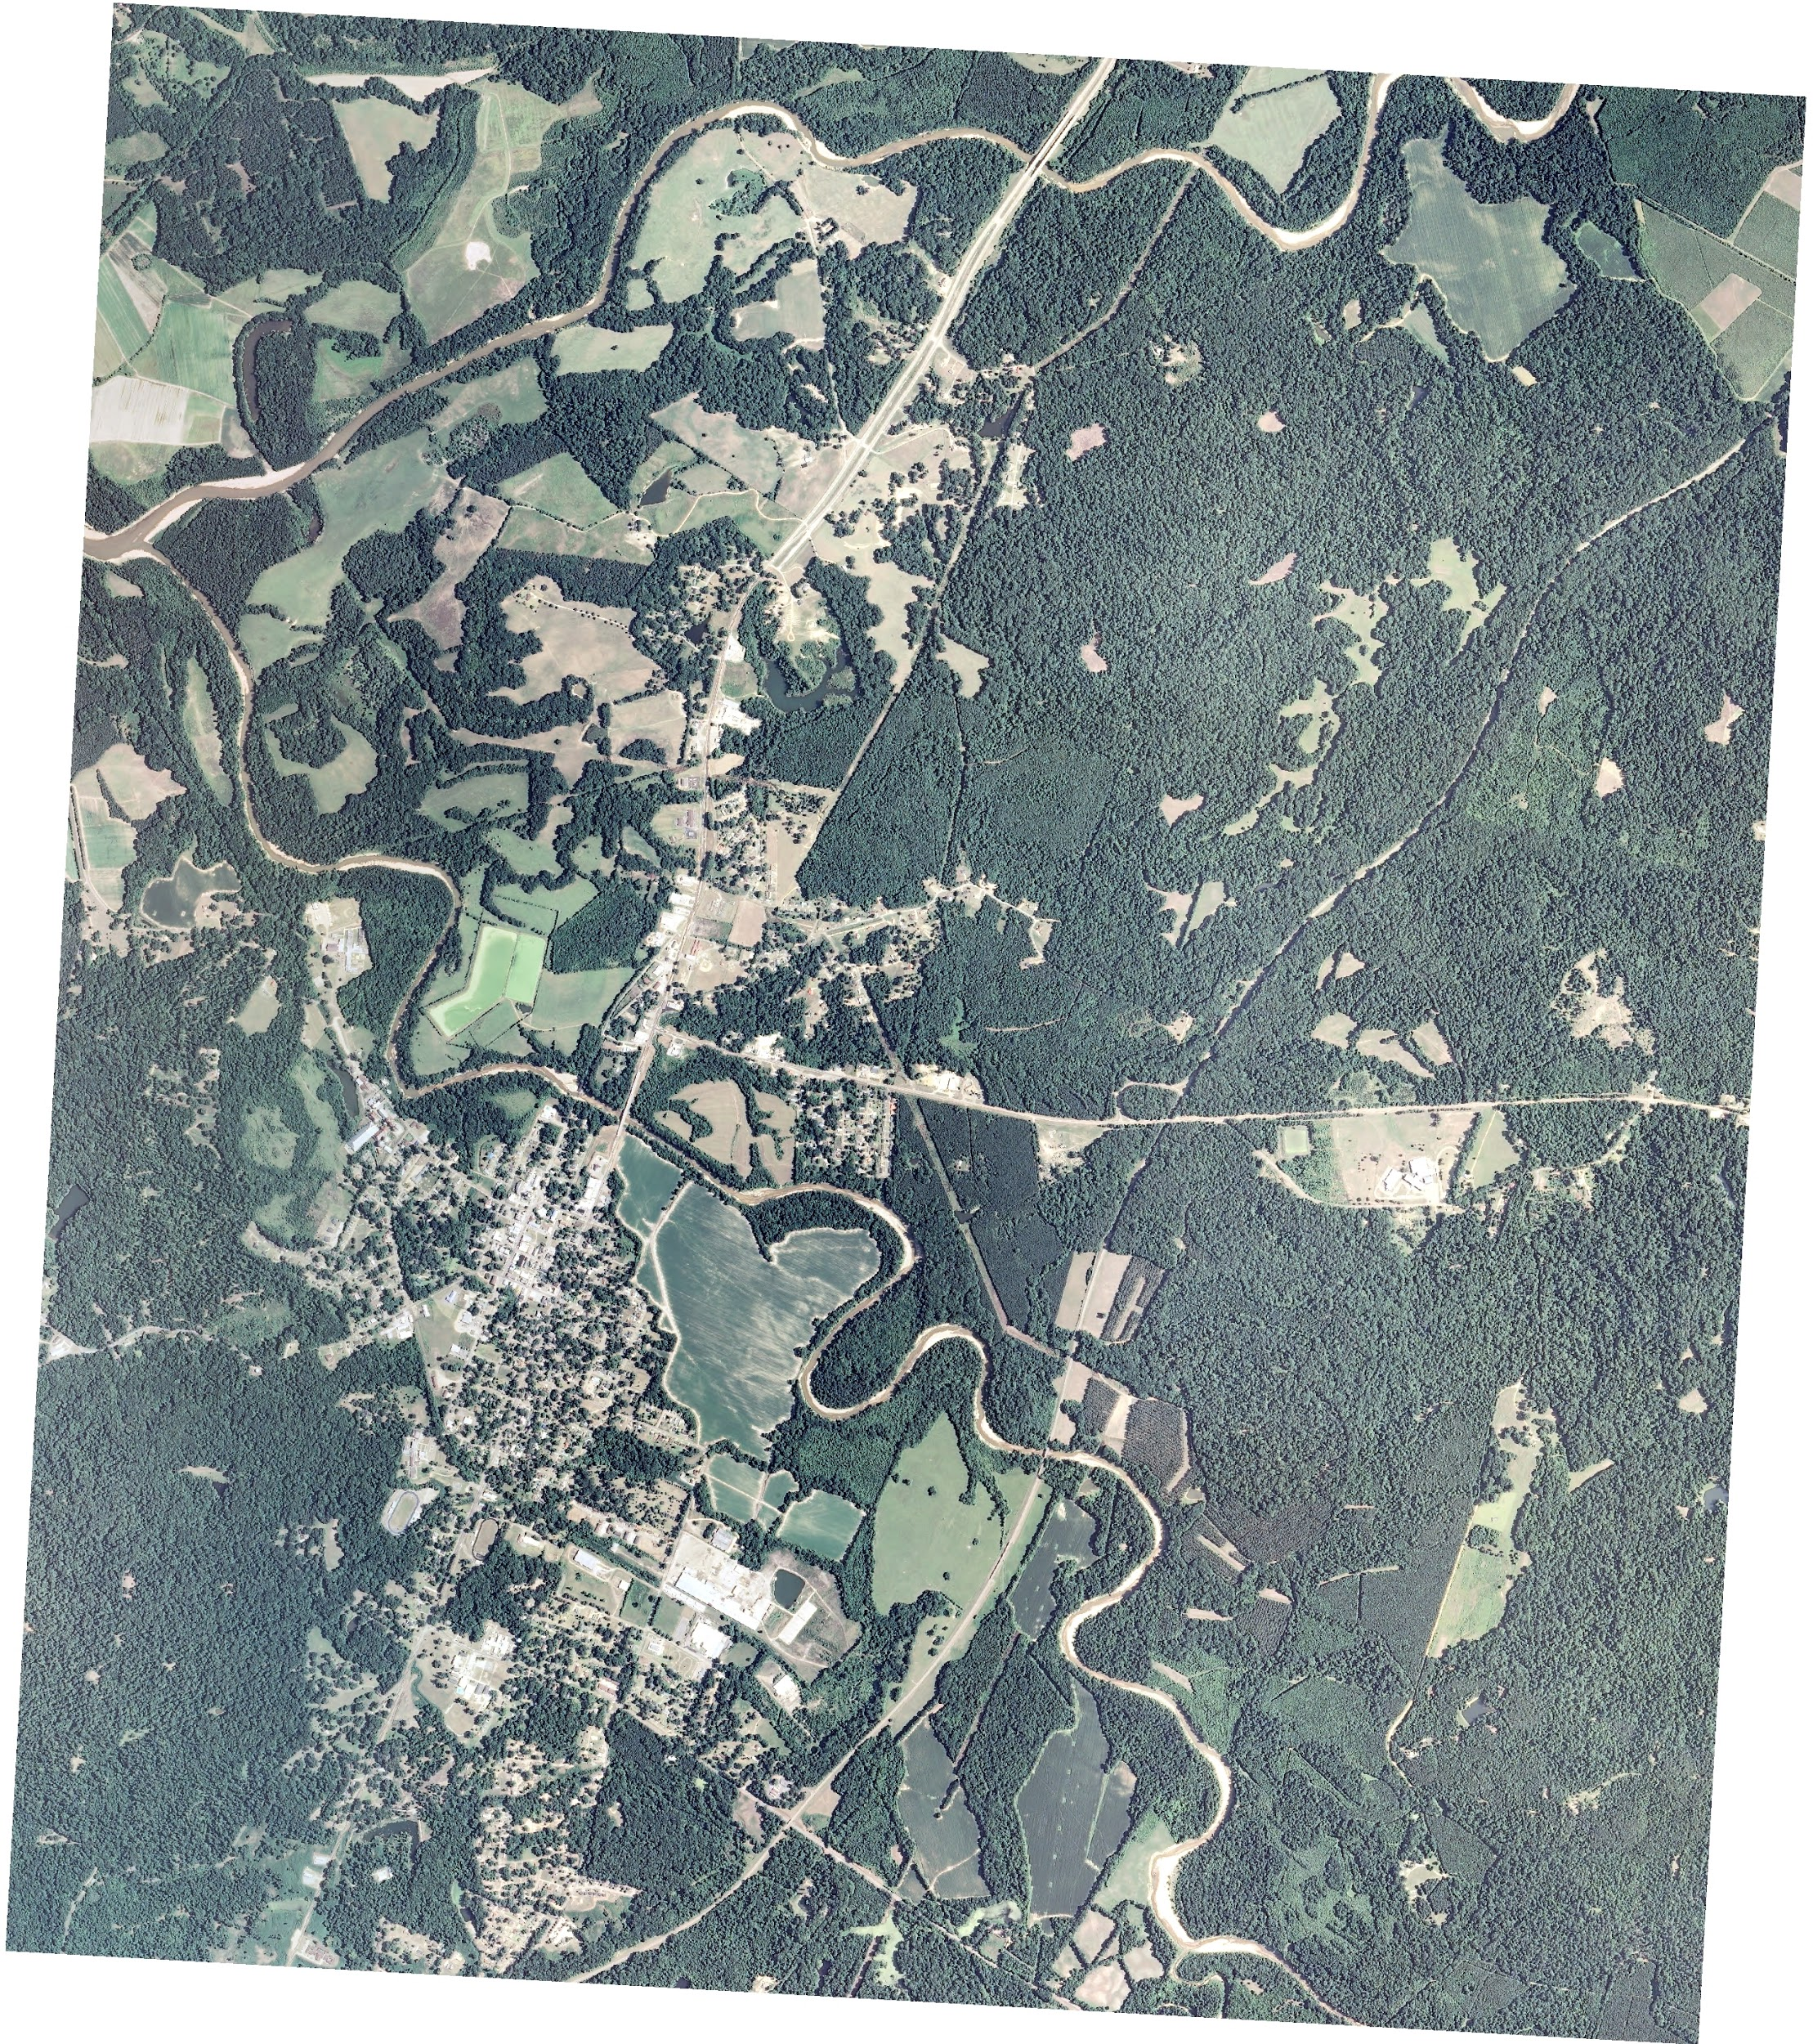
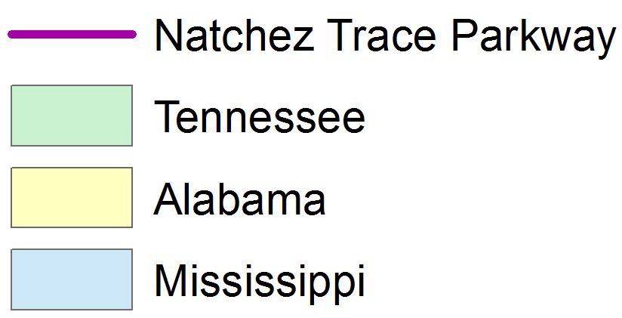



Natchez Trace Eco Forecasting
Utilizing NASA Earth observations to assess current and historic wetland extent along the Natchez Trace Parkway
Jennifer Rackley (Project Lead), Ashley Gideon, Tyler Lynn
NASA DEVELOP National Program
Abstract
Objectives
Keep this blank for now. Body text point size should be at least 24. Caption text point size should be at least 16. Feel free to rename, move, and resize sections as needed.
Establish historic wetland extents for the Natchez Trace Parkway
Provide information for past and future wetland extents to aid the National Park Service in conservation management and maintenance strategies
Address community concerns resulting from beaver damming activity, which has caused damage to roads, property, and private lands
Methodology
Study Area
Data
The study area extended the length of the Natchez Trace Parkway, spanning across Mississippi, Alabama, and Tennessee. The study period ranged from 1992 to 2015.
Landsat 5 Thematic Mapper (TM)
Landsat 8 Operational Land Imager (OLI)
USGS National Land Cover Database (NLCD)
USDA National Agriculture Imagery Program (NAIP)
Stacked (?) Landsat 5 and 8 imagery
Processing
Earth Observations
Land Cover Classification (ERDAS Imagine 2015)
Unsupervised classification
Supervised classification
Wetlands Extent Prediction (TerrSet Land Change Modeler)
Landsat 5
Thematic Mapper (TM)
Preprocessing (ArcMap 10.3)
Atmospheric corrections
Mosaicked scenes
Accuracy Assessment (ERDAS Imagine 2015)
Landsat 8
Operational Land Imager (OLI)
Results
Conclusions
Use images. Make sure that it has some sort of flow, that it makes sense. Show your results in a logical order. No bullets.
Work in progress.
Time Series Land Cover Classification
Wetland Extent Prediction
Land cover classification for 1992
Land cover classification for 2001
Land cover classification for 2006
Predicted wetland extent for future year
Land cover classification for 2011
Land cover classification for 2015
Team Members
Project Partners
Acknowledgements
Team Picture!
National Park Service (NPS)
Dr. Bert Eichold, M.D., Dr. PH
Public Health Officer, Mobile County Health Department
Joe Spruce
Science Advisor, NASA Stennis Space Center
James “Doc” Smoot
Science Advisor, NASA Stennis Space Center
Dr. Kenton Ross
DEVELOP National Science Advisor, NASA Langley Research Center
Picture of Natchez Trace collected by Deanna Boensch
Mobile County Health Department

