Slide 1
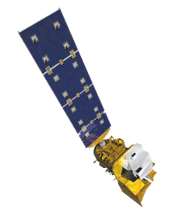
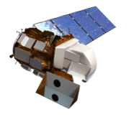
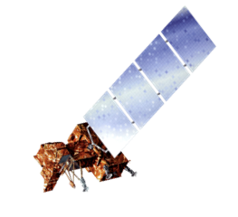
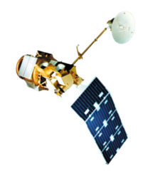
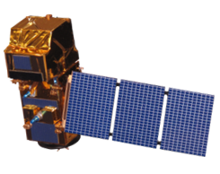
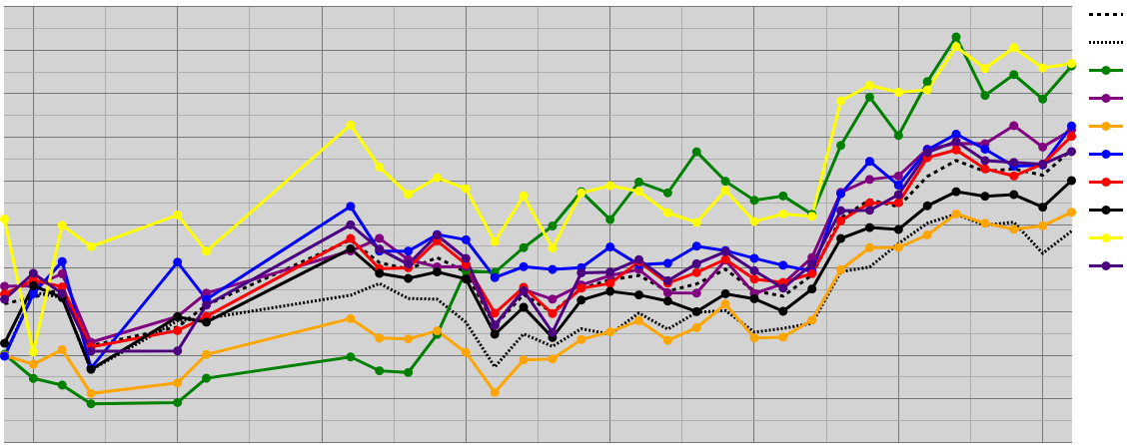
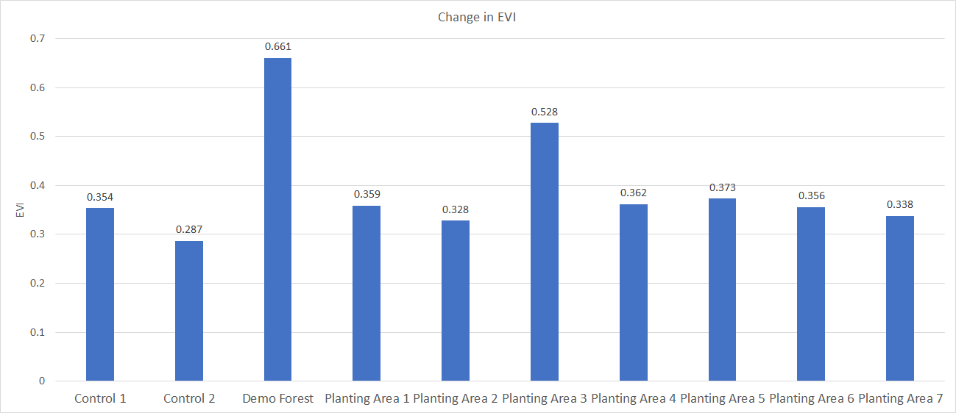
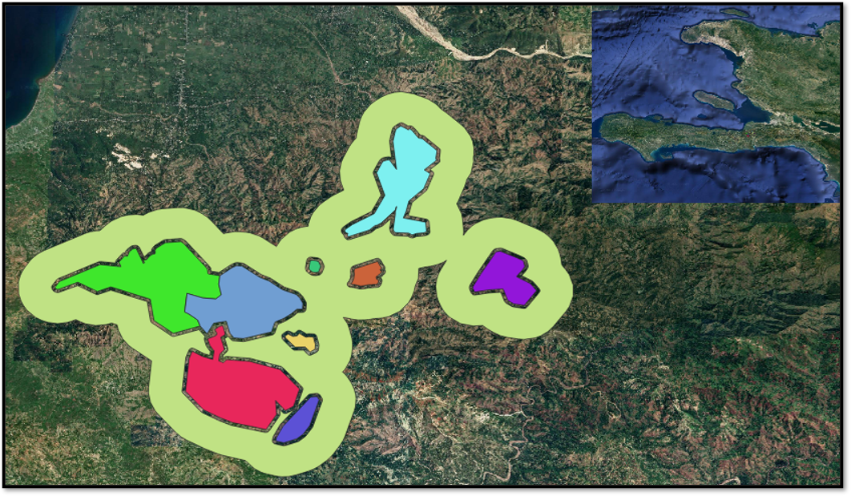
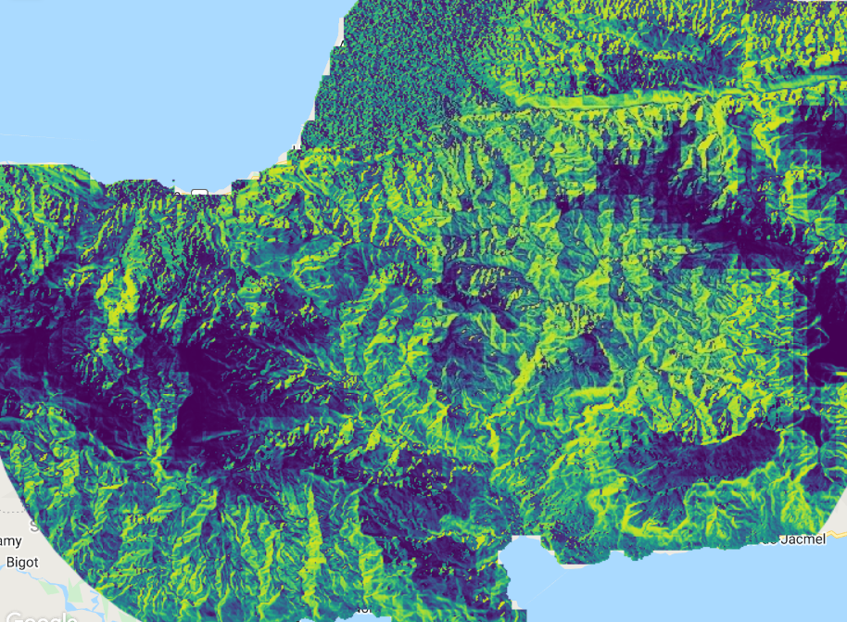
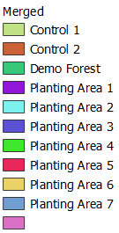
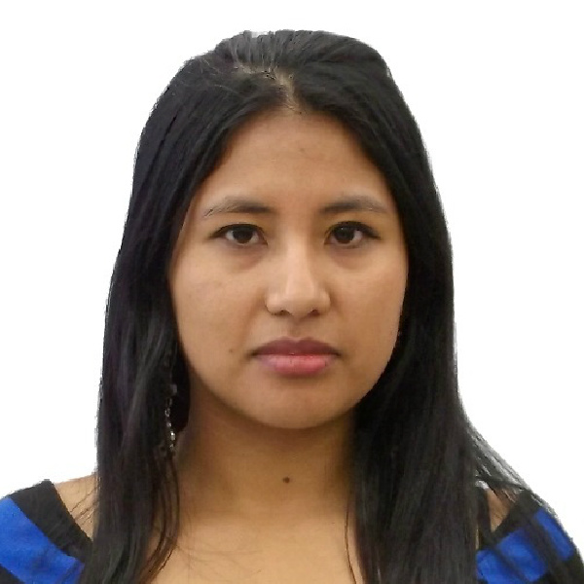
Utilizing NASA Earth Observations to Evaluate the Success of Reforestation Practices in Haiti
Abstract
Objectives
Haiti Agriculture
Haiti is one of the world’s most deforested and environmentally degraded countries. Over the past 30 years, the Haiti Reforestation Partnership (HRP) has provided resources, education, and expertise to support reforestation work in Haiti. The HRP has planted over 15 million trees through their partnership with Comprehensive Development Program (CODEP). However, they have yet to conduct a comprehensive analysis of forest stand survival. The NASA DEVELOP team partnered with the HRP to aid their future silvicultural decisions using satellite imagery. Through the creation of the Monitoring of Vegetation Presence (MVP) tool in Google Earth Engine, the team produced a time series showing trends in enhanced vegetation index (EVI) from 1984 to 2021, as well as a habitat suitability map using a general model for all tree species. These provided the partner with visuals to communicate their reforestation efforts and guidance on where to apply their future efforts. The team utilized Landsat 5 Thematic Mapper (TM), Landsat 7 Enhanced Thematic Mapper Plus (ETM+), Landsat 8 Operational Land Imager (OLI), Landsat 9 OLI-2 and Sentinel-2 Multispectral Instrument (MSI) vegetation indices as indicators of stand success over time. The team also incorporated WorldClim bioclimatic variables such as precipitation and temperature, Centre National de L’Information Geo-Spatiale (CNIGS) Airborne Lidar elevation, and ancillary datasets areas suitable for future reforestation efforts. Overall, the time series showed that the demonstration forest increased in EVI at a greater rate than the surrounding area and the habitat model suggested there are 49,000 hectares of suitable habitat for planting using slope, aspect and temperature as predictor variables.
Analyze past and present-day patterns of stand success in the form of vegetation indices by creating a tool in Google Earth Engine
Produce a 37-year time series chart from vegetation indices to visually display the impact of reforestation efforts in charts
Create an animation that shows the recovery of the demonstration forest over time
Construct a habitat suitability model correlating environmental parameters with stand success to inform potential future planting locations
Earth Observations
Landsat 9 OLI-2
Landsat 8 OLI
Landsat 7 ETM+
Landsat 5 TM
Sentinel-2 MSI
Methodology
Results
Trends in EVI from 1984 to 2021
Landsat 5, 7, 8, 9
Harmonization
Sentinel-2
Cloud masking
Cloud masking
EVI + NDVI Time Series
EVI + NDVI Time Series
Median Composite Images
Fig 1. Annual EVI trend per planting area from 1984 to 2021.
1.2
Control 1
Control 2
Demo Forest
1.0
Planting Area 1
Planting Area 2
Planting Area 3
0.8
Planting Area 4
EVI
Planting Area 5
Planting Area 6
EVI vs NDVI Comparison
Landsat
Sentinel-2
EVI chosen for Monitoring of Vegetation Prescence (MVP) Tool
0.6
Planting Area 7
WorldClim BIO
Precipitation
CNIGS DEM
Elevation
Slope
Aspect
Temperature
EVI success Points
Low stand success
High stand success
Habitat Suitability Model
0.4
0.2
1985
1990
1995
2000
Year
2005
2010
2015
2020
0.7
0.661
Change in EVI
Fig 2. Overall change in EVI per zone from 1984 to 2021.
0.6
0.528
0.5
0.373
0.4
0.354
0.287
0.359
0.328
0.362
0.356
0.338
0.3
Study Area
0.2
Fondwa, a small village to the southwest of Port-au-Prince
Planting zones broken up by land ownership
Study period: January 1984 – April 2022
0.1
Demo Forest
Planting Area 1
Planting Area 2
Planting Area 3
Planting Area 4
Planting Area 5
Planting Area 6
Planting Area 7
0
Control 1
Control 2
Fig 3. Habitat Suitability model displayed over the study area. Darker blues correspond with low habitat suitability while light greens and yellows symbolize high habitat suitability.
0
25
50km
Control 1
Control 1
Control 2
Control 2
Demo Forest
Demo Forest
Planting Area 1
Planting Area 2
Planting Area 3
Planting Area 4
Planting Area 5
Planting Area 6
Low
Medium
High
0
5
10km
Planting Area 7
Conclusions
0
2.5
5km
The HRP's planting efforts have resulted in a general EVI increase over time
The Demonstration Forest and Planting Area 6 show the strongest increase in EVI
Our habitat suitability model suggests that there are 49,000 hectares of land suitable for future planting efforts
Aspect, slope, and temperature are significant predictors for habitat suitability in the study area
Team Members
Acknowledgements
Jamie Rhoads, Haiti Reforestation Partnership
Michael Anello, Haiti Reforestation Partnership
Hunter Bowman, Haiti Reforestation Partnership
Dr. Marguerite Madden, NASA DEVELOP Science Advisor, Georgia Node
Sarah Payne, NASA DEVELOP Fellow, Georgia Node
Dr. Kenton Ross, NASA Langley Research Center
Taylor Simkins
Project Co-Lead
Kelli Roberts
Project Co-Lead
Ilan Bubb
Nohemi Huanca-Nunez
Georgia – Athens
This material contains modified Copernicus Sentinel data (2016 - 2022), processed by ESA.

