Slide 1
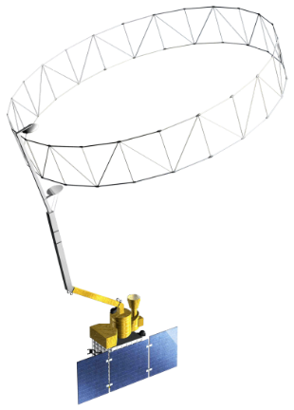
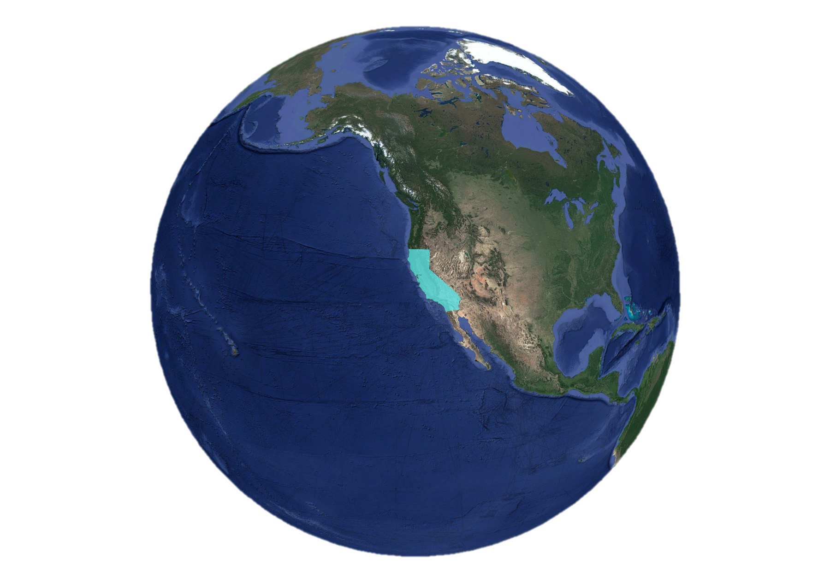
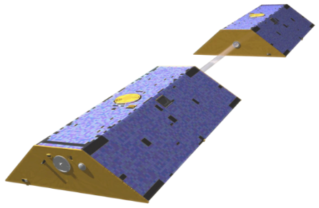
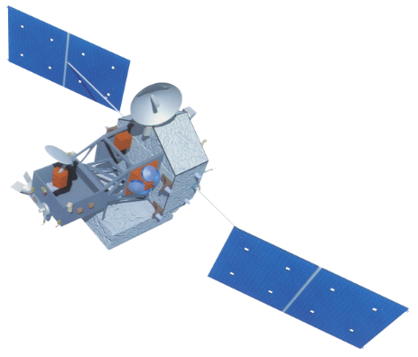
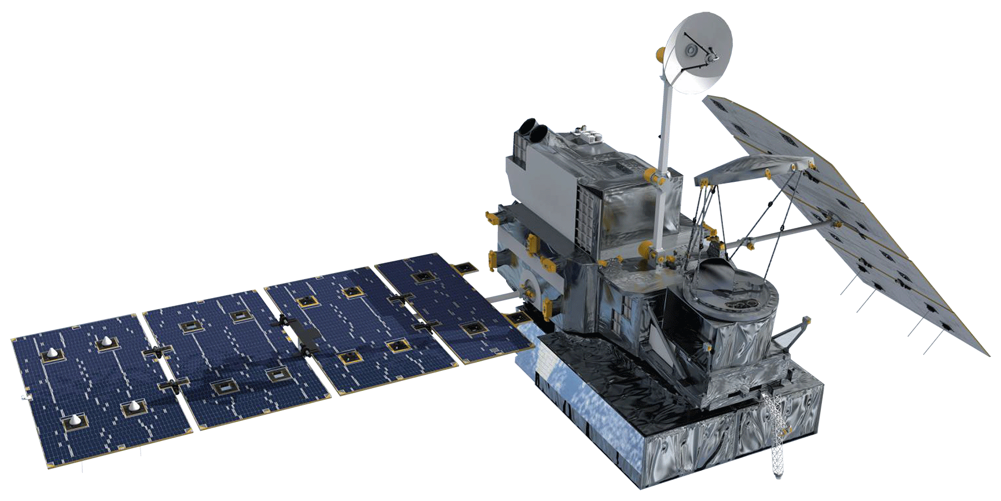
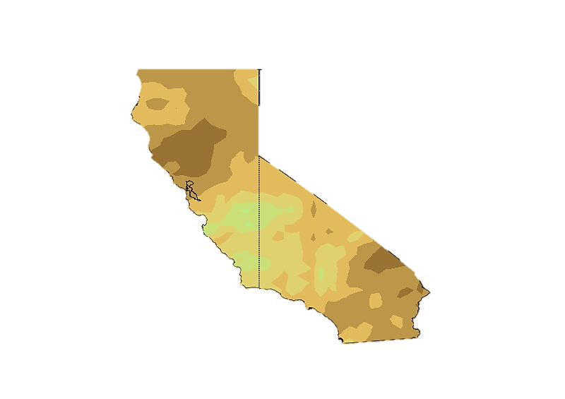
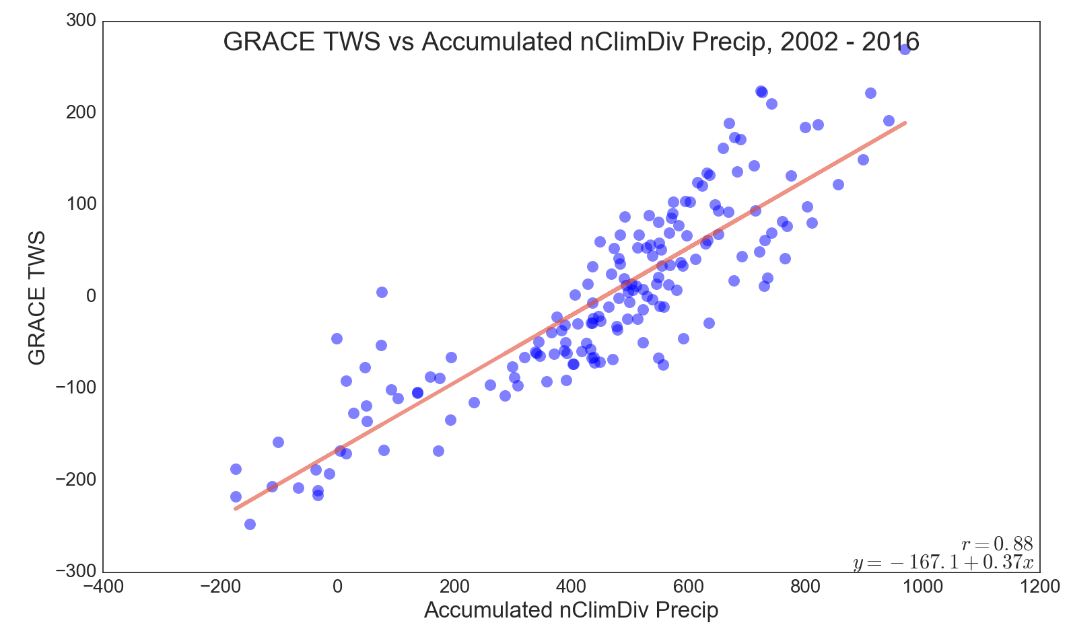
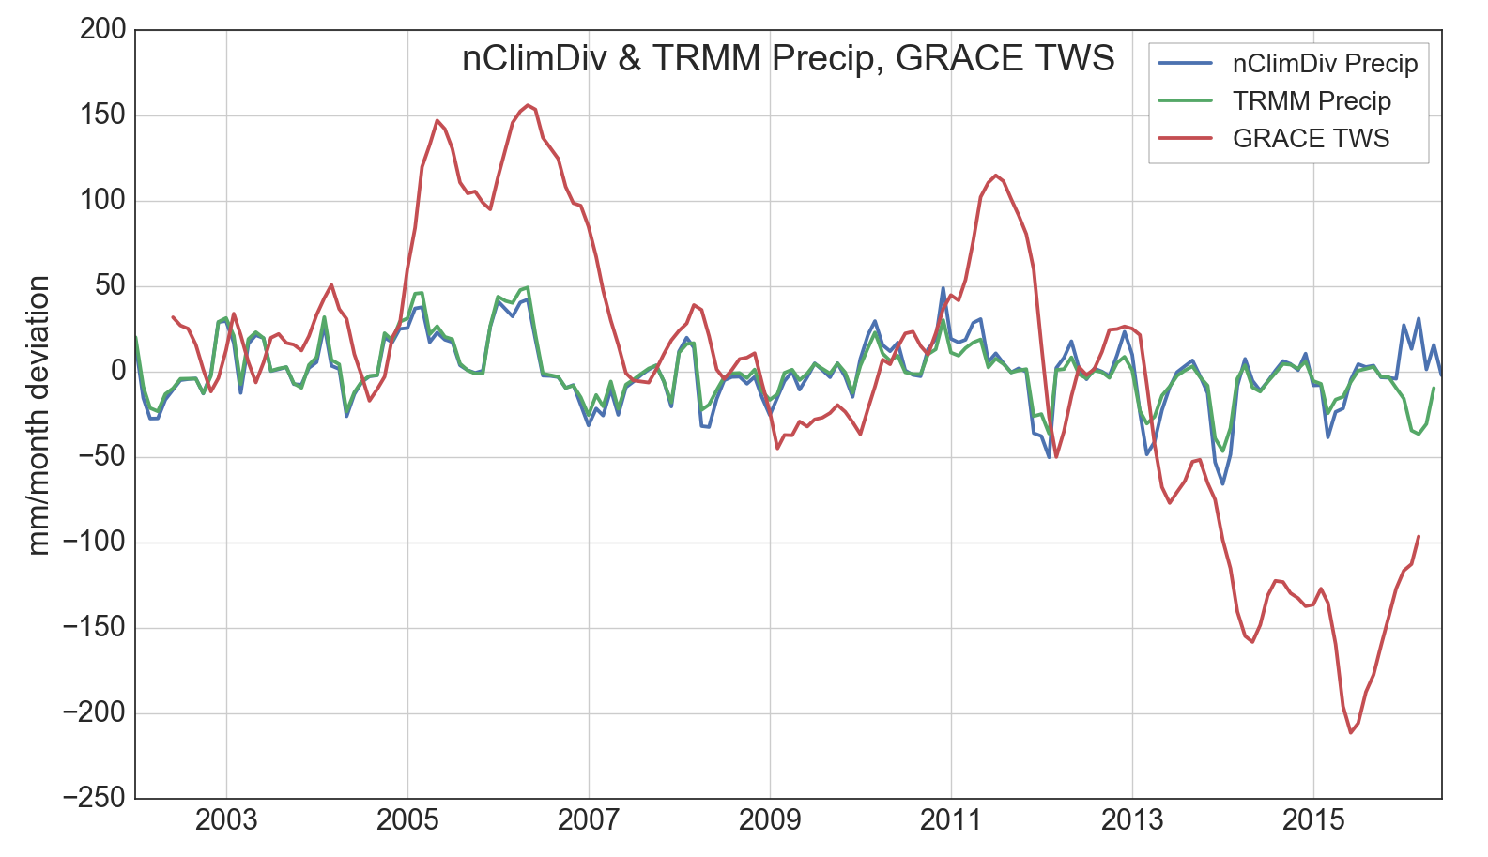
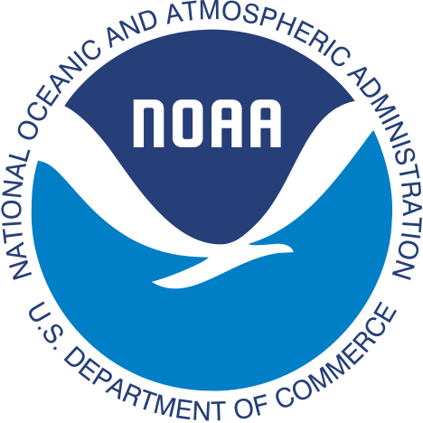
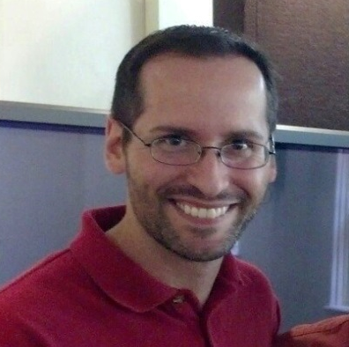
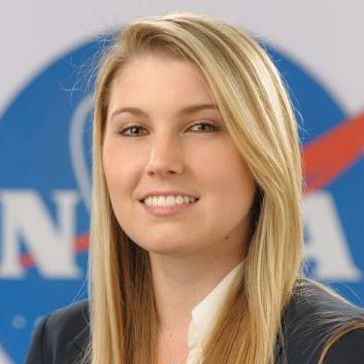
Quantifying the Impact of the 2015-2016 El Niño Event on California’s Historic Drought With NASA Earth Observations
Abstract
Objectives
2015 marked the arrival of the strongest El Niño ever recorded. As sea surface temperatures in the Central Pacific increased, it was forecasted that similar to past events, the ensuing wet season could bring excess precipitation to California and alleviate what the U.S. Drought Monitor classifies as “exceptional” drought nearly statewide. However, the drought, now in its fifth year, continues to strain municipal and agricultural water supplies. To gain a more complete understanding of the water budget, our team utilized data from NASA’s Gravity Recovery and Climate Experiment (GRACE), Global Precipitation Measurement (GPM), Tropical Rainfall Measuring Mission (TRMM), and Soil Moisture Active Passive (SMAP) Earth Observations. In addition to satellite data, meteorological ground observations from the National Oceanic and Atmospheric Administration (NOAA), historical reservoir levels from the California Department of Water Resources, and the Oceanic Niño Index were also included. Together with our partners at the NOAA/National Weather Service (NWS) Los Angeles/Oxnard regional office, our study employs NASA Earth observations to better quantify impacts of the 2015-16 El Niño event and determine how much drought recovery occurred throughout the state over the course of the wet season. Specifically, monthly GRACE measurements of terrestrial water storage (TWS) allow for a more complete understanding of aggregate resources, including parameters often omitted from drought assessments. Further, we analyzed monthly precipitation and temperature trends in relation to droughts and ENSO patterns with climatological history from NOAA dating back to 1895.
Analyze the effects of the 2015-2016 El Niño event in California
Determine how much drought recovery occurred
Research historical climate trends from the past century
Understand ENSO’s impact on California’s water balance
Study Area & Earth Observations
GRACE
SMAP
California
Methodology
TRMM
GPM
Conclusions
Data Acquisition
Processing
(Python, ArcGIS)
Analysis
Results
There is a high correlation (r = 0.94) between historic NOAA precipitation ground data (nClimDiv) and TRMM TMPA Earth Observation data during the 14 year study period within the state of California.
High correlation values between GRACE TWS and accumulated nClimDiv precipitation data (r = 0.88) demonstrate how GRACE is beneficial for water resource management.
Quantified deficient water storage within California via GRACE TWS
NASA Earth Observations provide valuable insight for current and forecasted drought analysis.
GRACE (TWS)
Resampled to Monthly
Time Series Analysis
Visualization & Assessment Maps
GPM
Masked to Study Area
Multivariate Analysis
Established relationship with TWS and Precipitation
California Water Resources
TRMM TMPA
NOAA nClimDiv
Removed Climatology & Normalized
Linear Regression and Correlation Coefficient Relationships
SMAP
Quantified TWS Recharge Estimates
Oceanic Niño Index
Aggregated Datasets
Reservoir Levels
Results
Figure 2: The correlation between GRACE TWS and monthly accumulated nClimDiv precipitation. This relationship provides a more robust estimate of California’s water budget across a range of potential precipitation scenarios.
Figure 1: 3 month rolling averages with climatology removed of nClimDiv and TRMM precipitation with GRACE TWS. nClimDiv (ground based) and TRMM (remotely sensed) are highly correlated (r = 0.94). The five year drought signal is evident in TWS as a result of consecutive below average wet seasons.
Project Partner
NOAA, National Weather Service, Los Angeles/Oxnard Weather Forecast Office
Team Members
Acknowledgements
Dr. John T. Reager, NASA Jet Propulsion Laboratory (Science Advisor)
Mark Jackson, Jayme Laber, and John Dumas from the National Weather Service, Los Angeles/Oxnard
Aaron Trefler and Jinny Lee (NASA Jet Propulsion Laboratory) for their advice and suggestions.
Any opinions, findings, and conclusions or recommendations expressed in this material are those of the author(s) and do not necessarily reflect the views of the National Aeronautics and Space Administration. This material is based upon work supported by NASA through contract NNL11AA00B and cooperative agreement NNX14AB60A.
Justin Lawrence
Project Lead
Lauryn Gutowski
Nick Rousseau
Brittany Zajic
NASA Jet Propulsion Laboratory – Summer 2016

