Slide 1
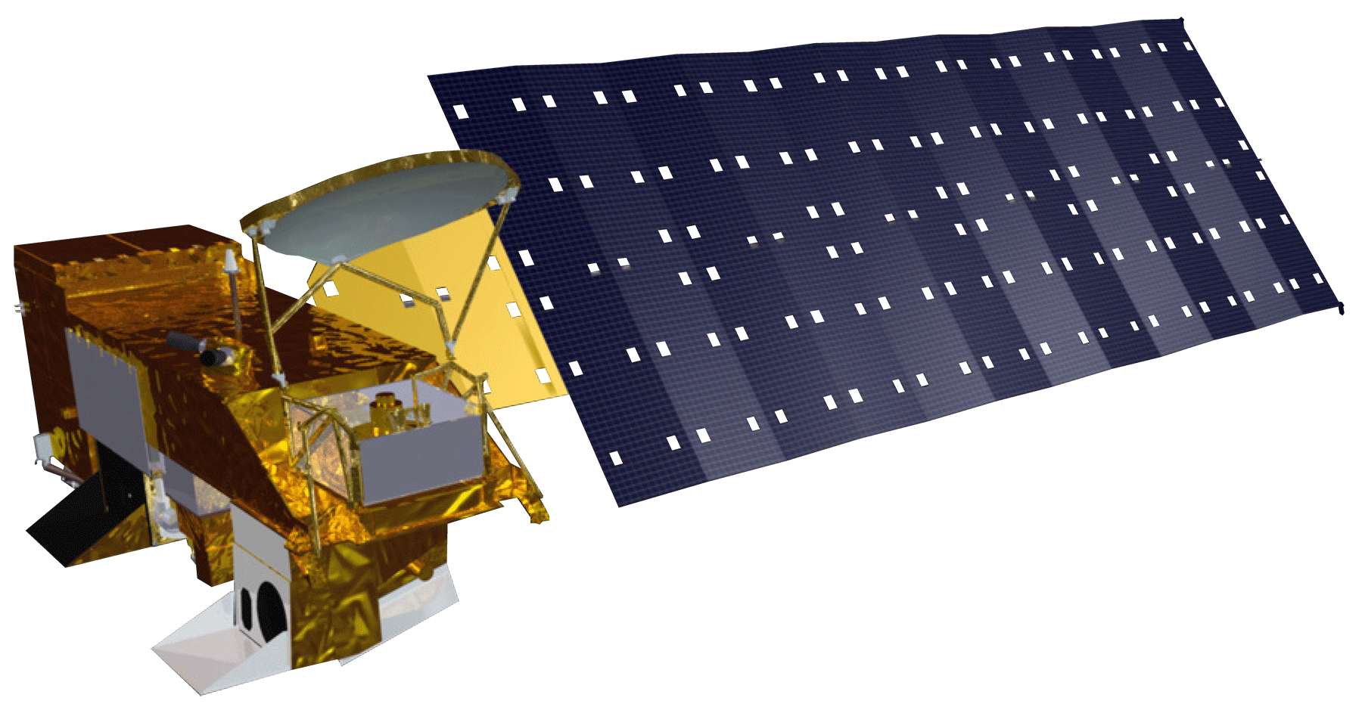
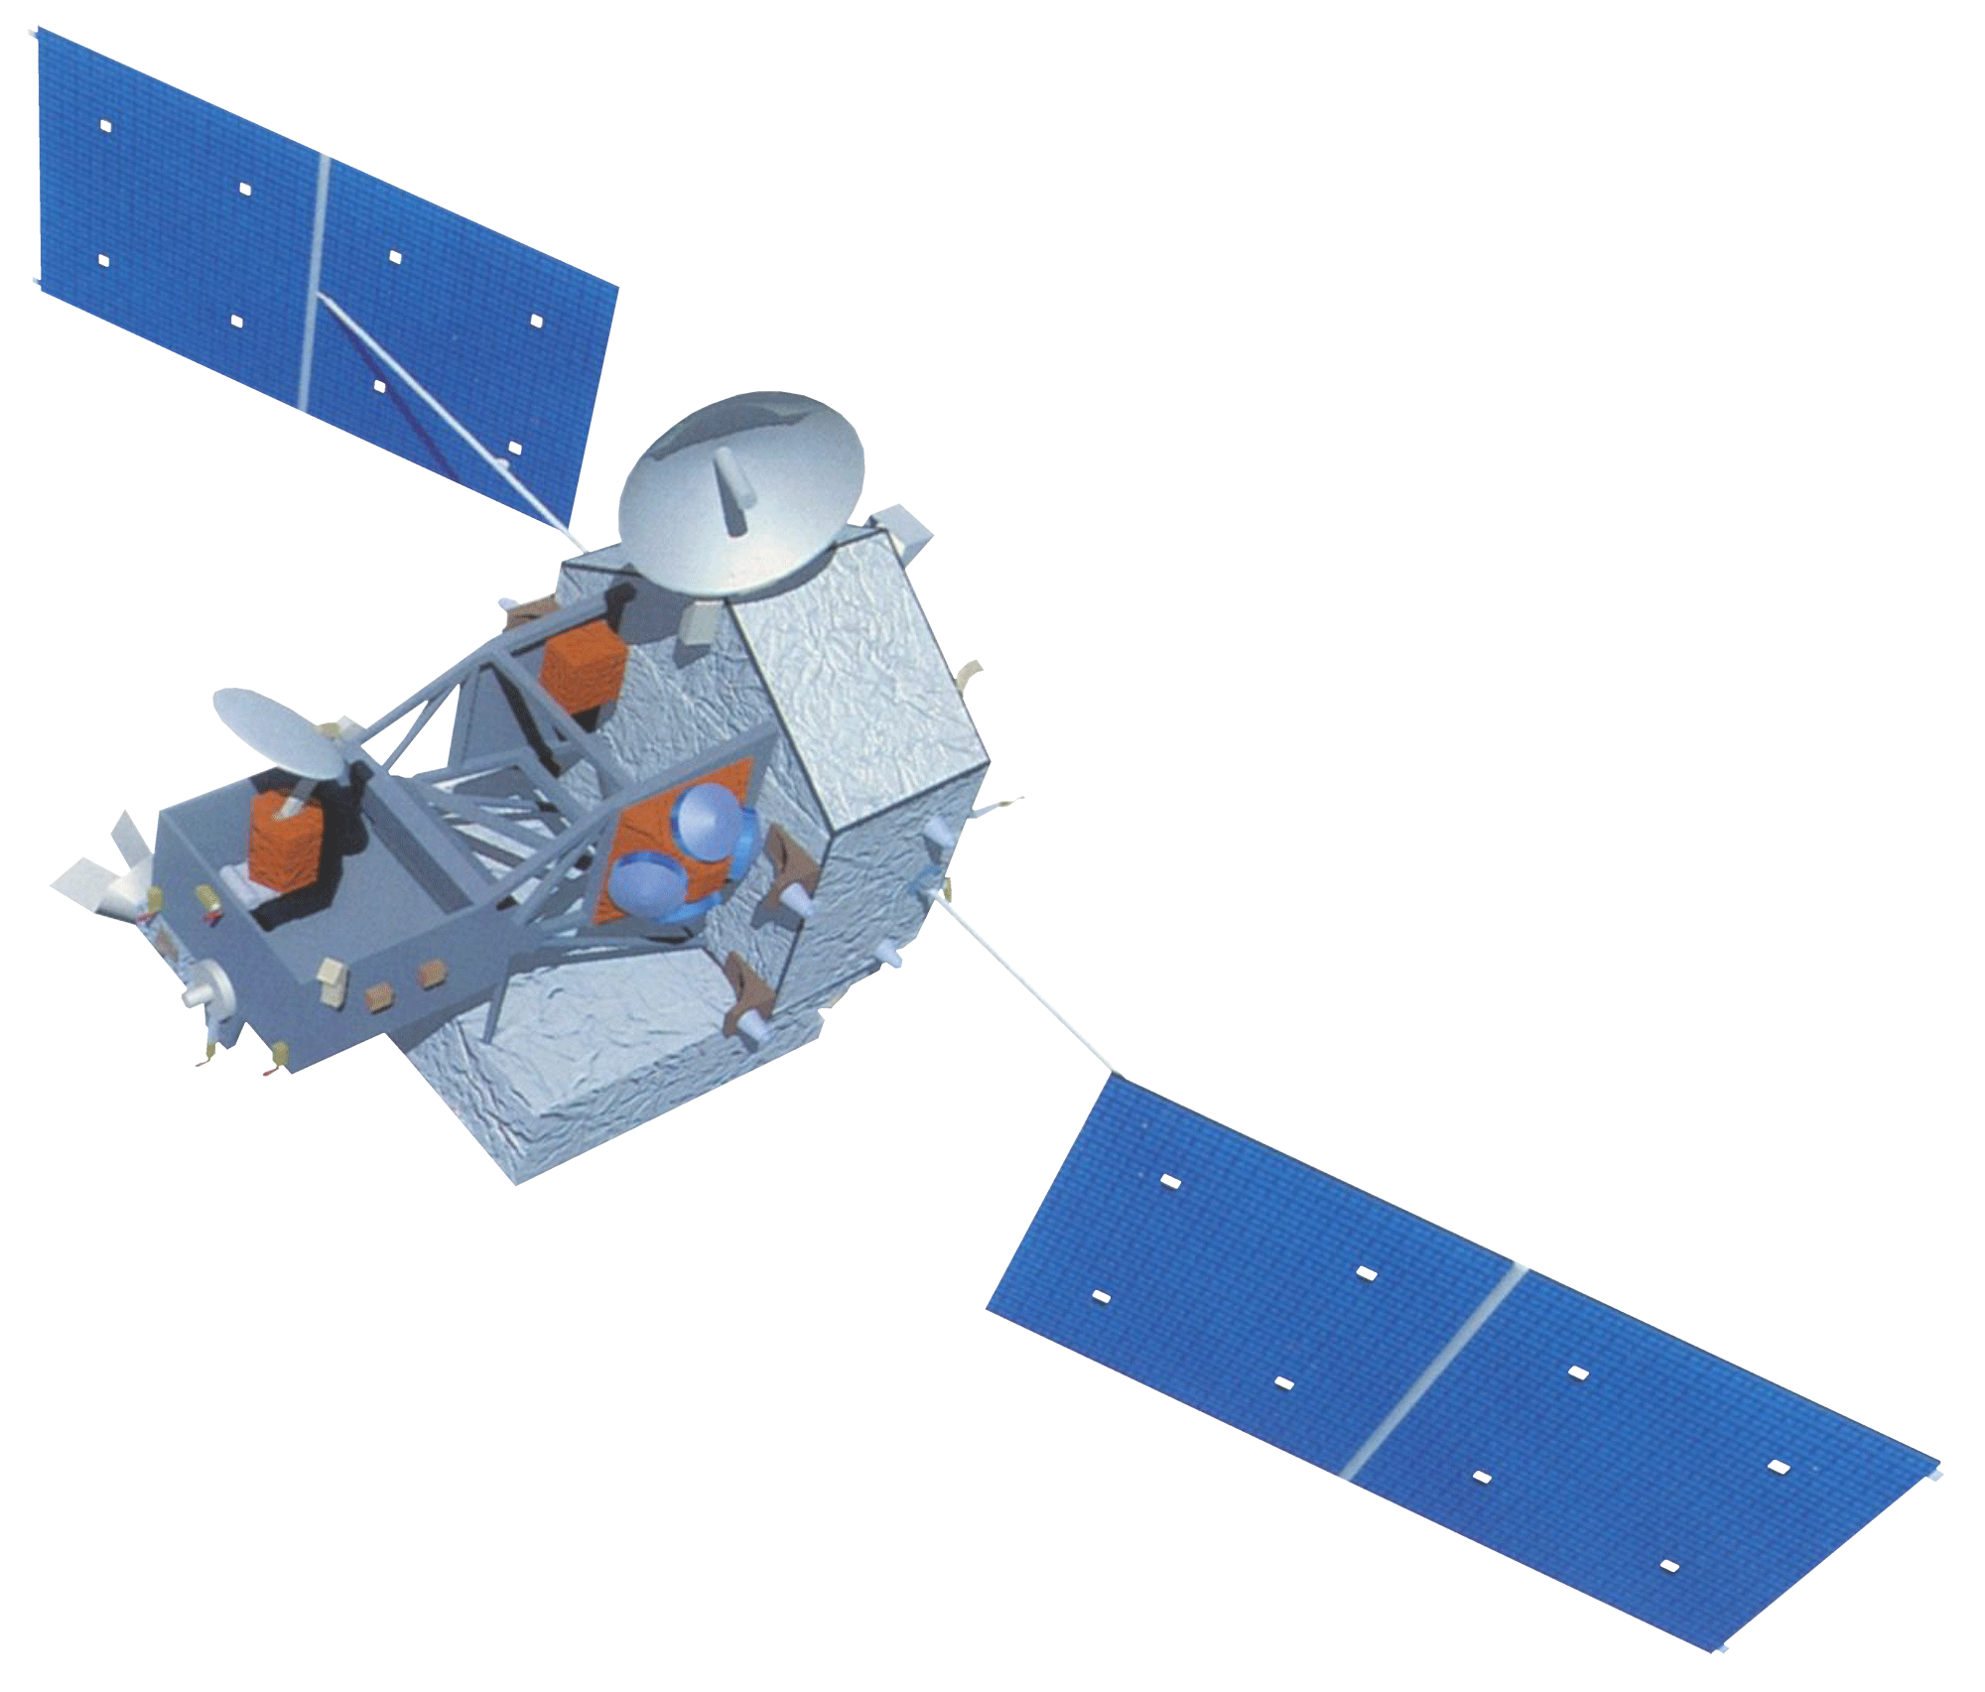
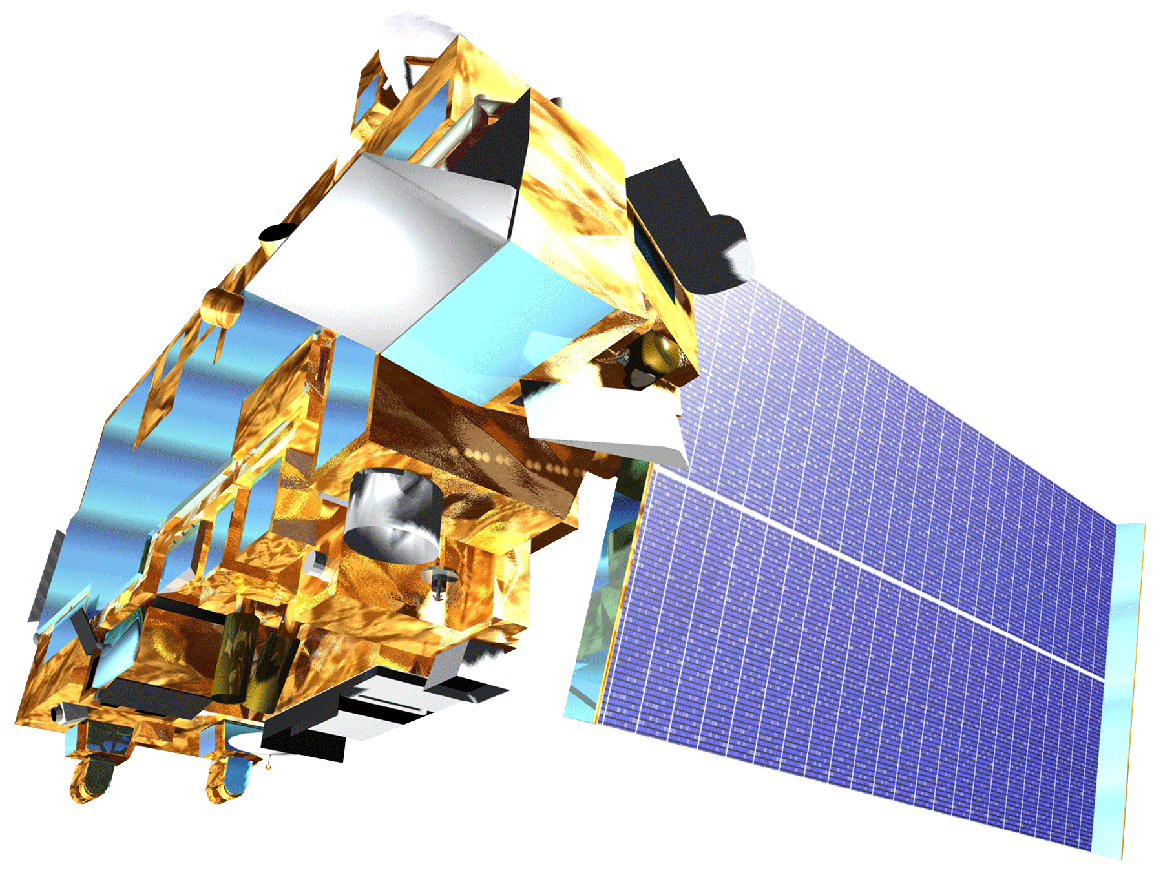
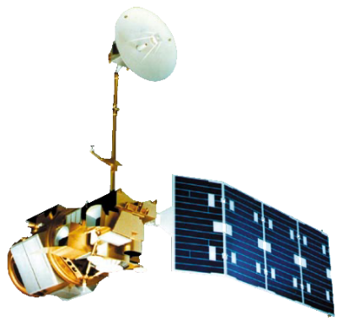
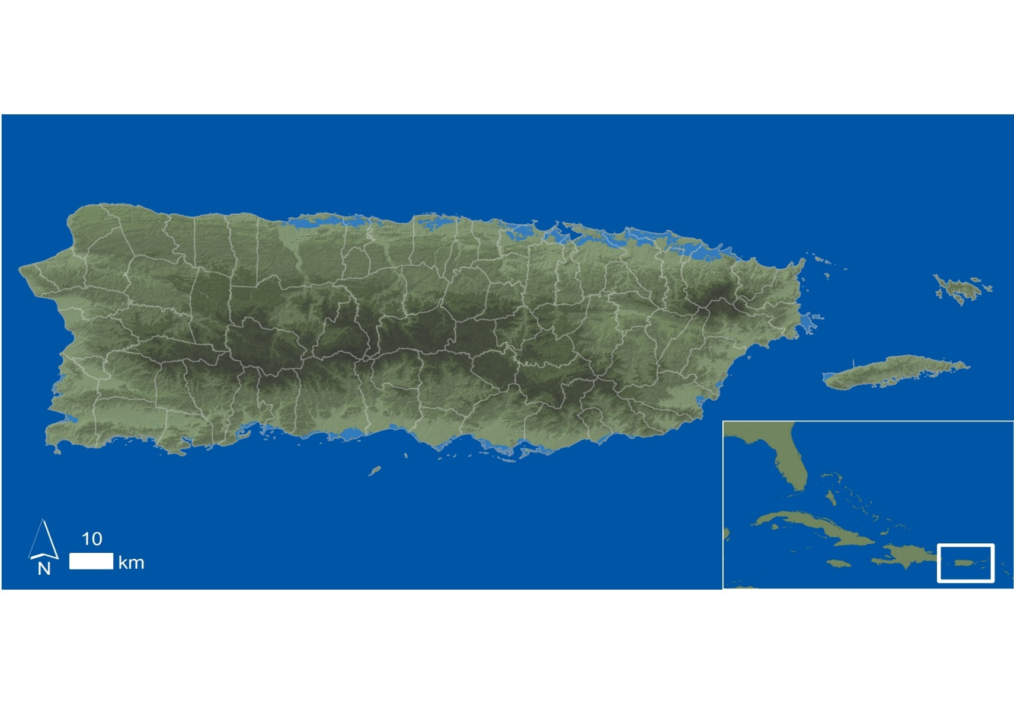
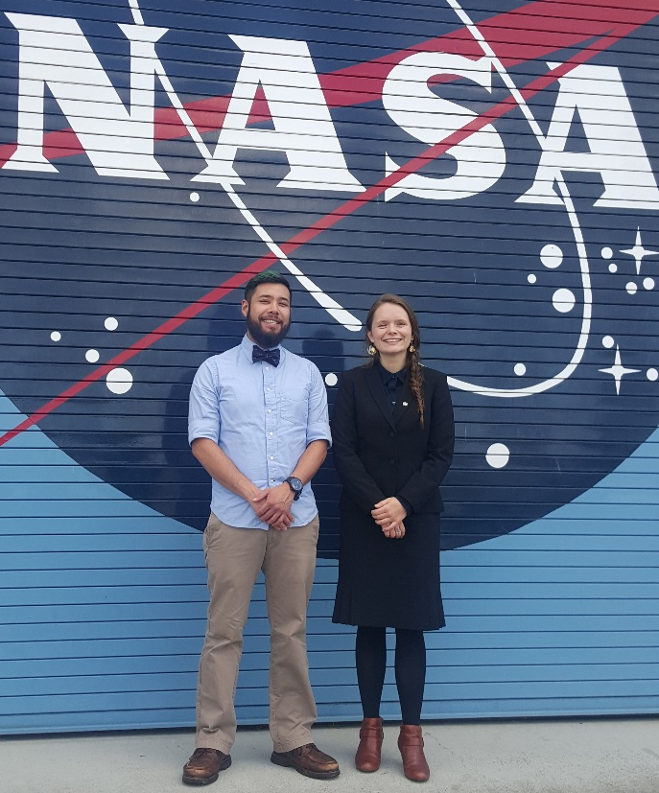
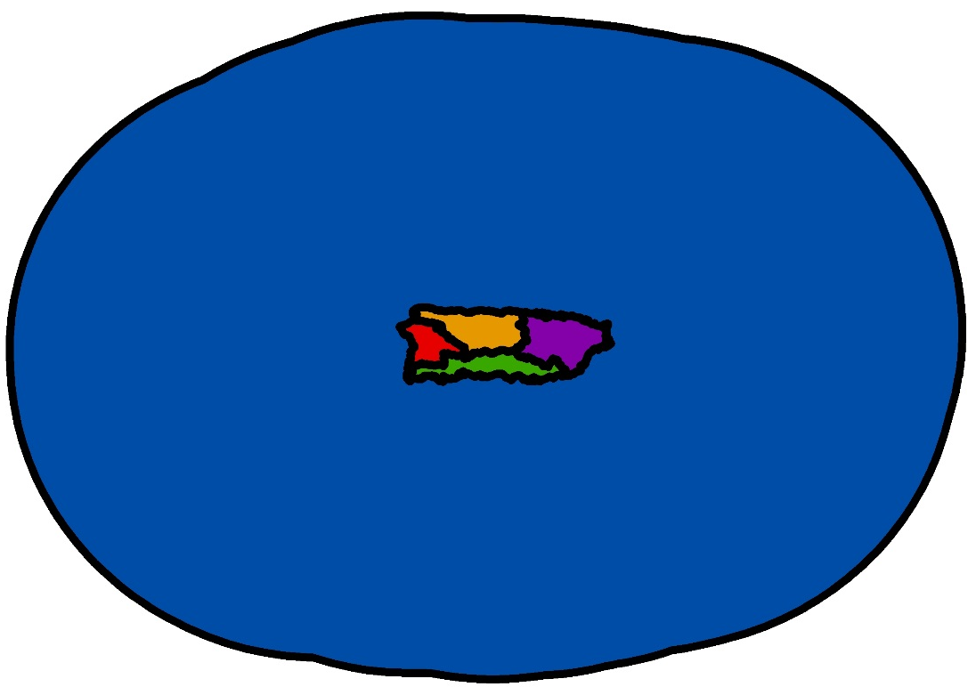
Puerto Rico Health II
A Geospatial Assessment of Environmental Variability in Puerto Rico and its Relation to Confirmed Dengue Fever Cases
Andrew Nguyen (Project Lead^{)1,}, Martha Sayre¹, Dr. Pablo Méndez-Lázaro², Dr. Roberto Barrera³, Dr. Juan Torres-Pérez^{1, 4}
¹NASA DEVELOP National Program, ²Medical Sciences Campus of the University of Puerto Rico, ³U.S. Centers for Disease Control and Prevention Dengue Branch, ⁴Bay Area Environmental Research Institute
Abstract
Earth Observations
Vector-borne diseases such as dengue fever, chikungunya, and Zika pose a major threat to the health of Caribbean communities. Aedes aegypti (Ae. aegypti), the primary vector of these viruses, is dependent on humans for reproduction, and has been detected in populated areas within Puerto Rico. The vector’s lifecycle and its transmission of dengue in Puerto Rico have been connected to specific environmental conditions. This study examined environmental conditions related to Confirmed Dengue Fever Cases (CDFC) for Puerto Rico from January 2009 - December 2013 to model the distribution of dengue-infected Ae. aegypti and its relationship to these conditions. This project used monthly NASA Terra/ Aqua MODIS Normalized Difference Water Index, along with day and night land surface temperature (DLST / NLST) products, Geostationary Operational Environmental Satellite system Puerto Rico Water Energy Balance humidity products, and Climate Hazards Group InfraRed Precipitation and Satellite total precipitation (TP) modeled data. A Maximum Entropy Species Distribution Model and Earth Trends Modeler within Clark Labs’ TerrSet were used to spatially delineate monthly Ae. aegypti habitat suitability, determine the permutation importance of the environmental conditions, and quantify island-wide environmental trends. TP and DLST had the highest mean relative importance of the dynamic environmental variables, agreeing with several studies that climatic environmental conditions play a significant role in disease transmission.
Aqua-MODIS
TRMM-PR
Objectives
Study Area
Terra-MODIS
Landsat 5-TM
Develop methods to examine the relationship between environmental conditions and Ae. aegypti proliferation throughout the island.
Use the Maximum Entropy Species Distribution Model to determine the contribution of environmental conditions to CDFC epidemics and produce Ae. aegypti habitat suitability maps.
To analyze seasonal and inter annual changes regarding environmental conditions to better understand the relationship between CDFC and environmental seasonality.
Project Partners
Team Members
University of Puerto Rico, Medical Sciences Department
Center for Disease Control (CDC) – Dengue Branch
Puerto Rico Department of Health
Figure 1. The Commonwealth of Puerto Rico has an area of appx. 9,104 km². It is divided into 78 municipalities. The climate is tropical with annual average temperatures between 21°C and 27°C, and a rainy season from April to November. Climate varies along the length of the island, with the drier regions occurring in the south.
Relative Importance of variables
to CDFC
Andrew Nguyen (Project Lead, left), Martha Sayre (right)
Methodology
Maximum Entropy Habitat Suitability Model
Habitat Assessment Map
7) Land Cover (NLDC)
8) Elevation (NED)
Geospatial Assessment of Ae. aegypt Suitability
Monthly Jan 2009- Dec 2013
1) CDFC (CDC, In-Situ)
2) NDWI (MODIS)
3) TP (CHIRPS)
4) Population Density (WorldPop)
5) LST- Day (MODIS)
6) LST- Night (MODIS)
7) RH (GOES-PRWEB)
&
Figure 2. The data project workflow. Two approaches were taken (upper and lower sections). The upper section outlines the environmental conditions and the Habitat Assessment Map as inputs into the Maximum Entropy model along with potential model results. The lower section outlines the use of Hydrological Unit Code 8 (HUC-8) and a 256km² buffer around the island as study regions for Earth Trends Modeler to delineate seasonal and inter annual trends.
ETM Study Regions
Seasonal Trend Analysis
Inter Annual Trend Analysis
1) HUC-8 (Watershed Boundary Dataset)
2) 256km² Buffer
Results
Conclusions
Acknowledgements
We would like to thank Emily “Chippie” Kislik and Victoria Ly from Ames DEVELOP for their input and guidance throughout this project, along with Nirav Nikunji Patel from World Pop for processing and providing gridded population density data for Puerto Rico. We would also like to thank Alannah Johansen for her vast contributions to the project during the previous term.
We would like to acknowledge Dr. Pablo Méndez-Lázaro from Medical Sciences Campus of the University of Puerto Rico, and Dr. Roberto Barrera from the U.S. Centers for Disease Control and Prevention (CDC) Dengue Branch for project advisement and data sources. We would also like to thank Jessica Cabrera from the Puerto Rico Department of Health for her overall support of the project.
NASA Ames Research Center

